Slide 1
LBNF Neutrino Beam
Jim Strait, Fermilab
For the LBNF/DUNE Team
NuFact 2015
Rio de Janeiro, Brazil
14 August 2015

Slide 2
Outline
Overview of LBNF/DUNE
Current and expected capabilities of the Main Injector complex
Reference design of the LBNF Neutrino Beam
Optimizing the focusing system for greater physics reach
Summary

Slide 3
Long-Baseline Neutrino Facility
A facility to enable a world-leading experimental program in neutrino physics, nucleon decay, and astroparticle physics.
LBNF comprises:
Underground and surface facilities at the Sanford Underground Research Facility capable of hosting a modular LAr TPC of fiducial mass ≥ 40 kt (~70 kt liquid mass)
Cryostats, refrigeration and purification systems to operate the detectors
A high-power, wide-band, tunable, ν beam at Fermilab
Underground and surface facilities to host a highly-capable near detector at Fermilab … and potentially other non-oscillation neutrino experiments

Slide 4
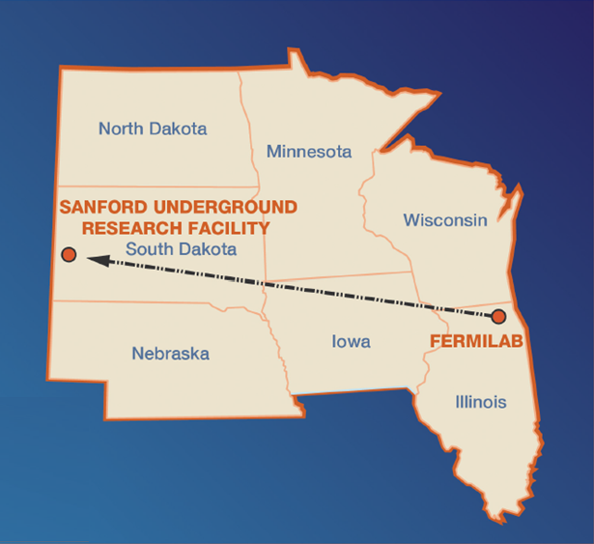
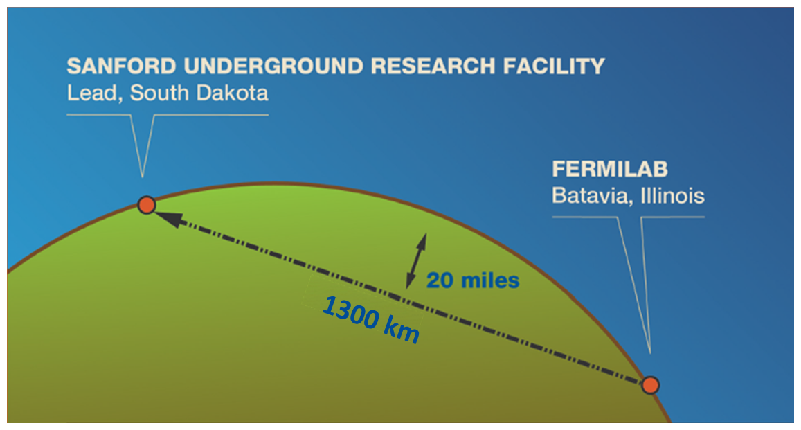
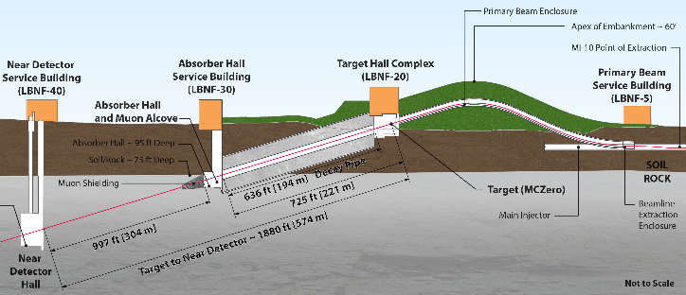

LBNF/DUNE
LBNF is a DOE/Fermilab hosted project with international participation.
Major partners include CERN and SURF.
DUNE Collaboration will build and operate the experiment* in LBNF.
*See DUNE talks:
DUNE Physics
(WG1 Monday)
DUNE Near Detector
(WG1-2 Tuesday)
DUNE Systematics
(WG1-2-3 Thursday)
32 km

Slide 5
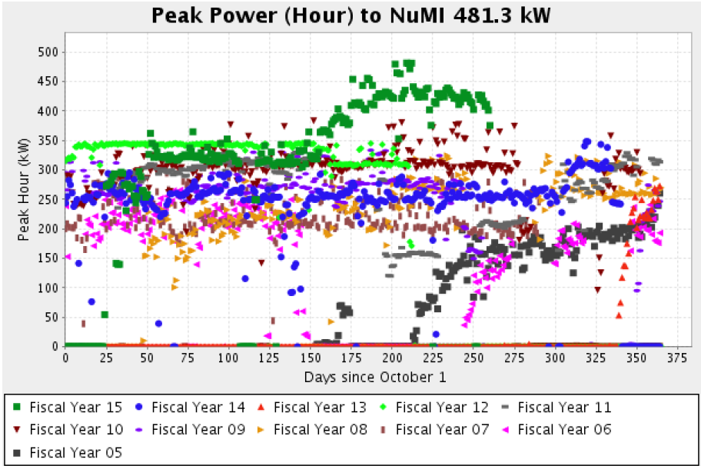
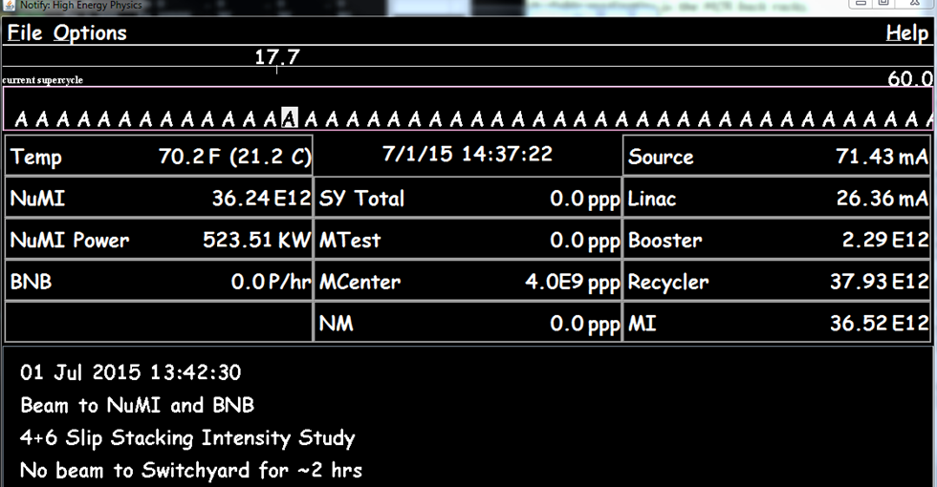
Fermilab Main Injector Capabilities
Routine operation >400 kW since March
Dedicated Neutrino Operations
With Fixed Target Beam Operations
Record beam power 520 kW just before summer shutdown.
Goal is 700 kW for NOvA by next Spring

Slide 6
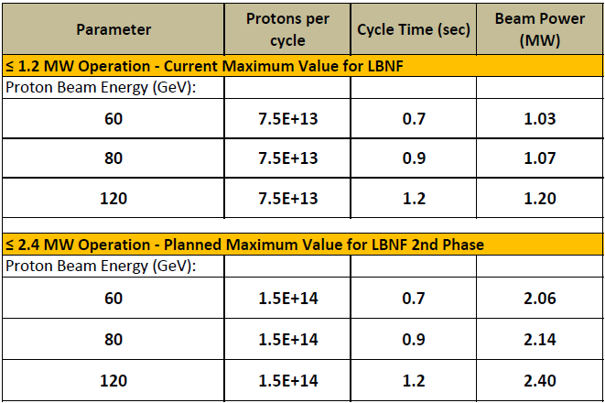
LBNF Beam Operating Parameters:
Main Injector Complex with PIP-II and PIP-III upgrades
Summary of key Beamline design parameters for ≤1.2 MW and ≤2.4 MW operation
PIP-II
(1.1 – 1.9)x10²¹ POT/yr
PIP-III
Pulse duration: 10 μs
Beam size at target: tunable 1.0-4.0 mm

Slide 7
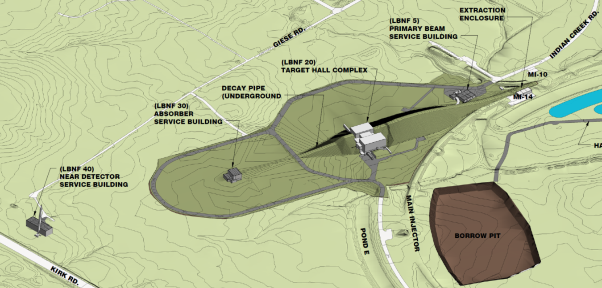
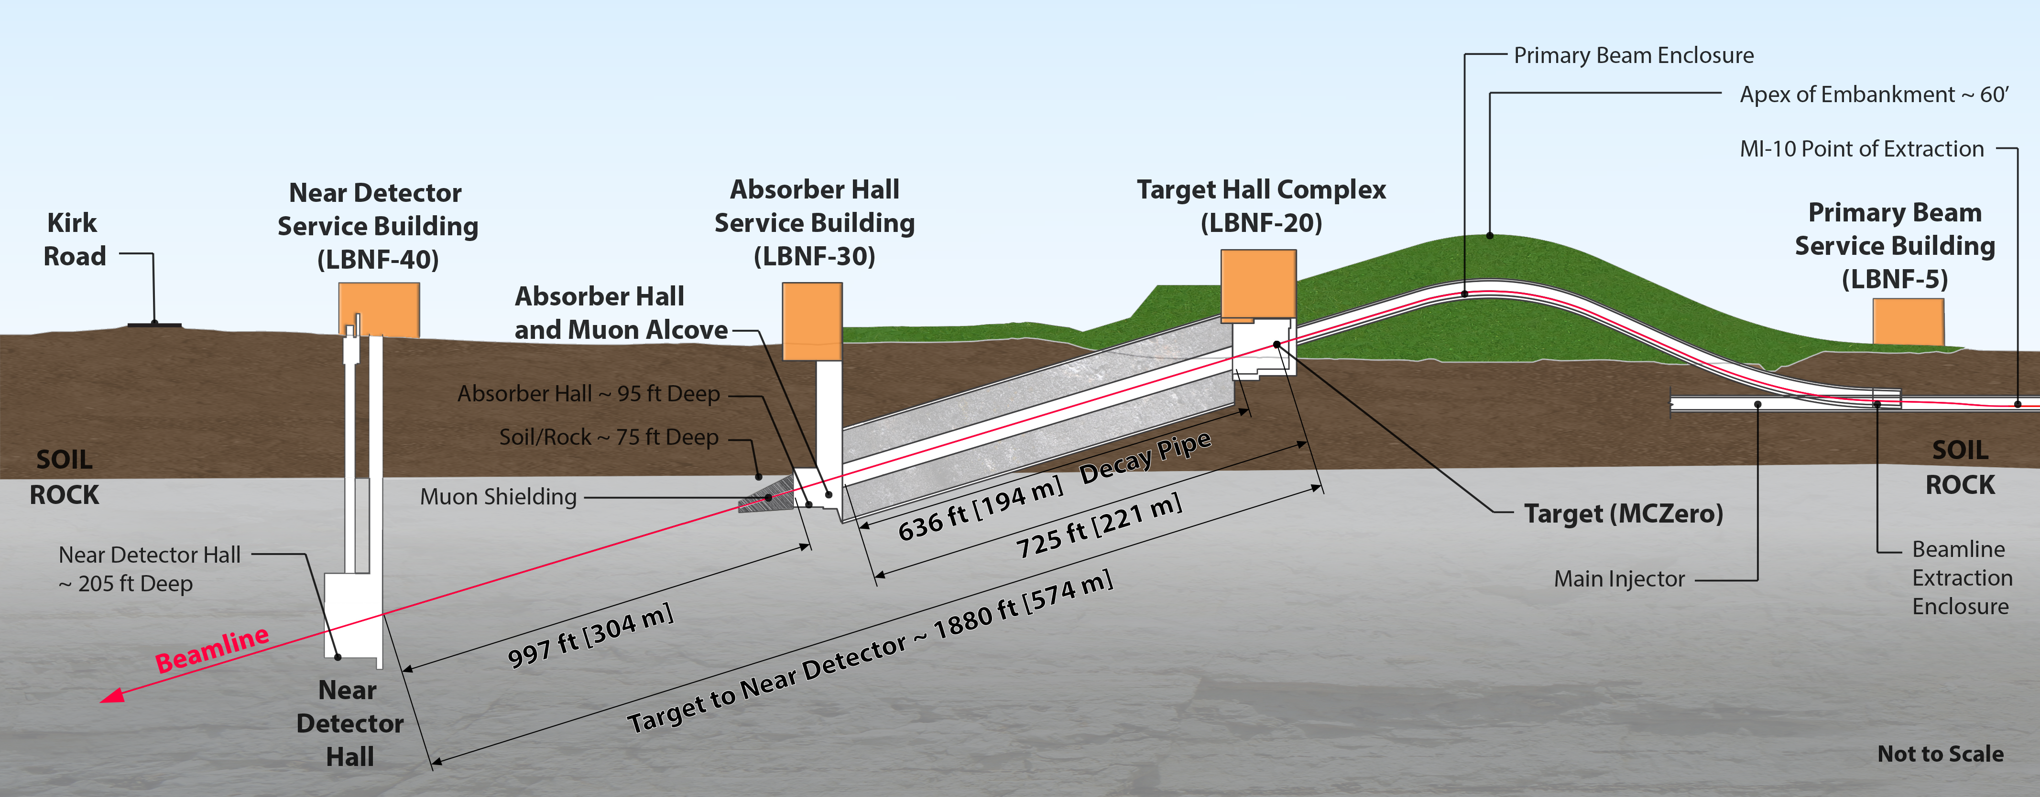
LBNF Neutrino Beam
To SURF

Slide 8
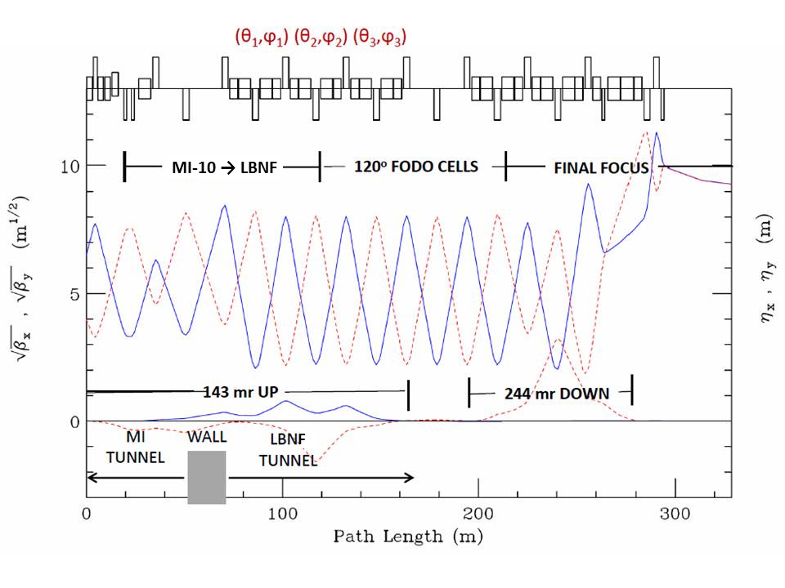
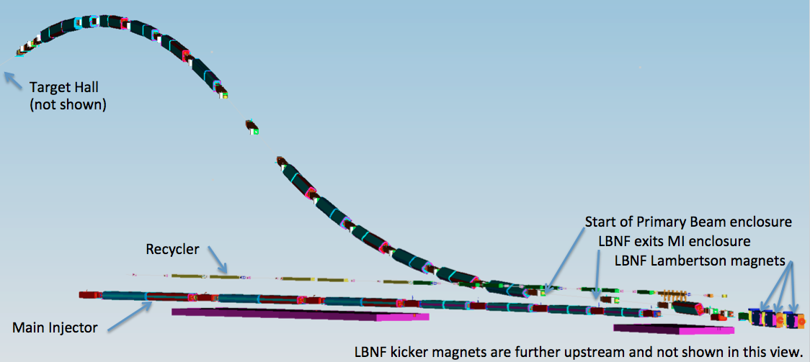
Primary Beam and Lattice Functions
The LBNF Primary Beam will transport 60 - 120 GeV protons from MI-10 to the LBNF target to create a neutrino beam. The beam lattice points to 79 conventional magnets (25 dipoles, 21 quadrupoles, 23 correctors, 6 kickers, 3 Lambertsons and 1 C magnet).
Beam size at target tunable between 1.0-4.0 mm
Horizontal (solid) and vertical (dashed) lattice functions of the LBNF transfer line

Slide 9
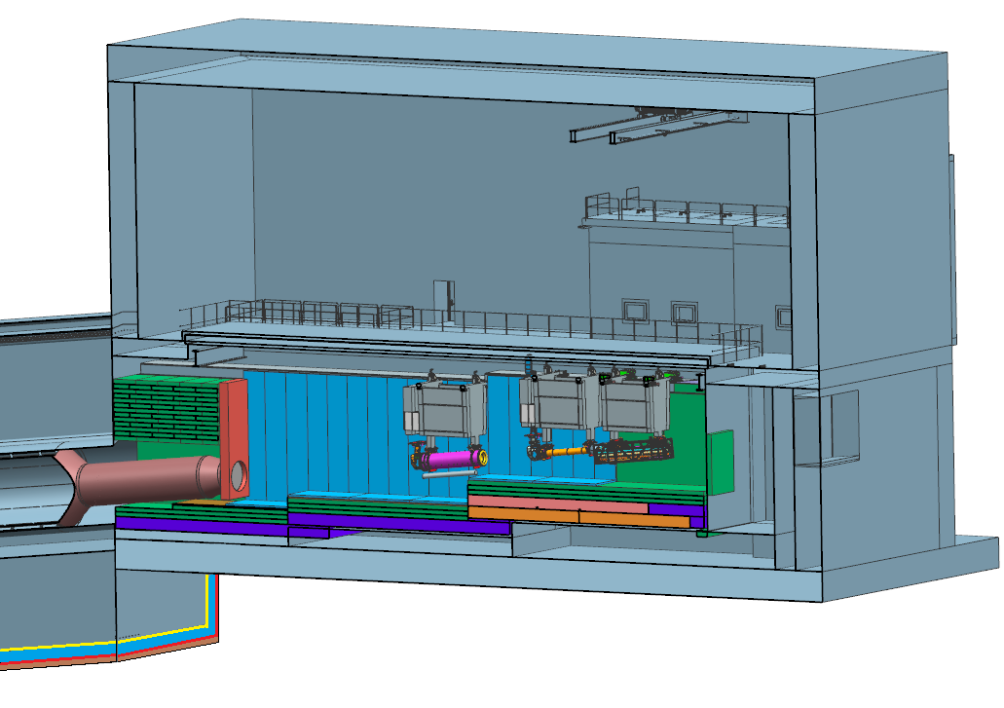
Neutrino Beam Configuration
Work cell
Support modules for target/baffle carrier and horns
Decay Pipe
snout and window
Water cooled
panels
Decay
Pipe
Beam slopes down at 101 mrad towards the Far Detector 1300 km away
Space reserved for more
optimized horn system
multi-­ply geosynthetic barriers, separated by a drainage layer

Slide 10
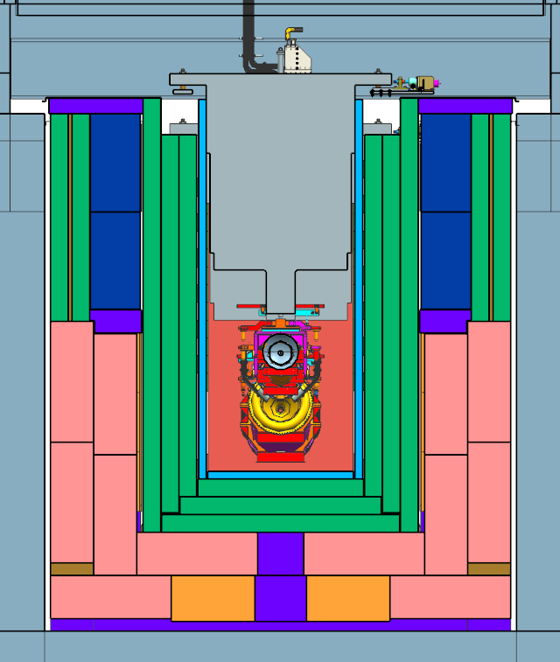
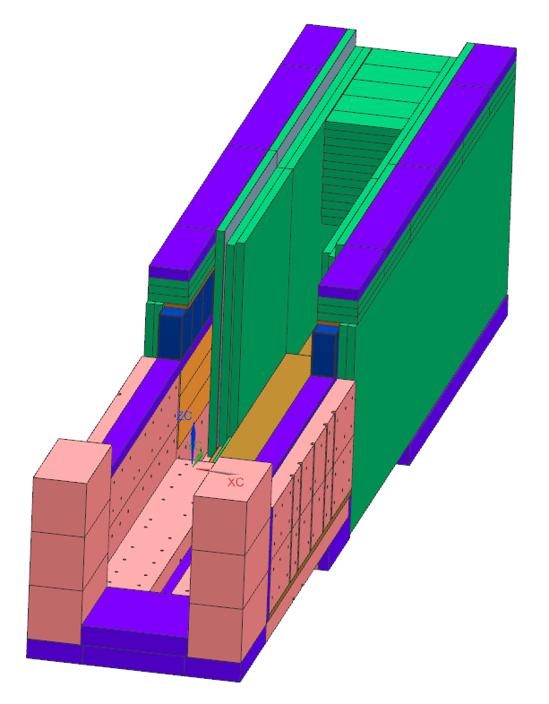
Target Shield Pile
steel shielding surrounds the beamline components (baffle, target, Horn 1, Horn 2, and the decay pipe upstream window) installed in the target chase
Water-cooled chase panels
~40% of the beam energy deposited in the target chase
Cooling: combination of forced air & water-cooled panels

Slide 11
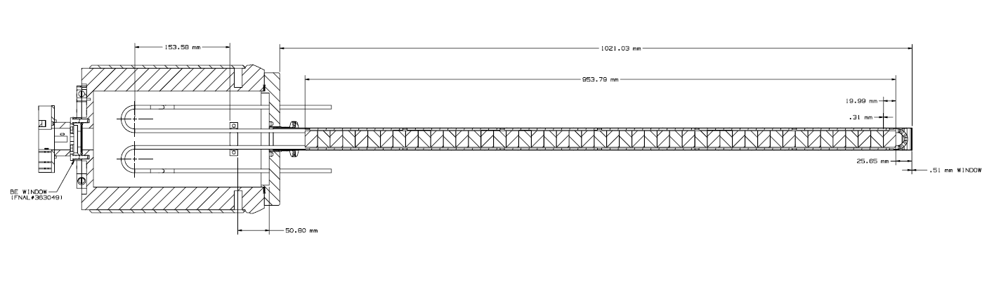
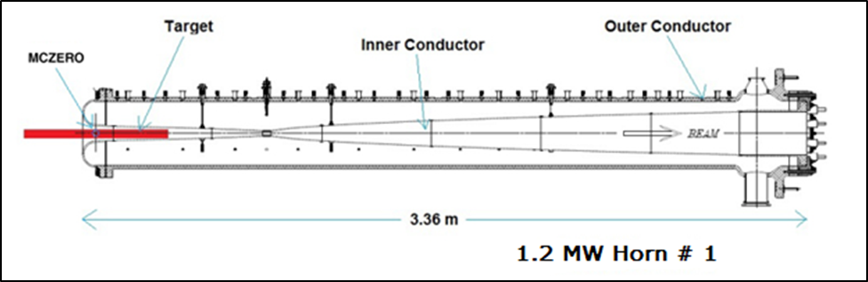
Target and Focusing System – Reference Design
Protection Baffle
150 cm
Ten graphite cores, 17 mm Ø hole, enclosed by an aluminum tube
Target
NuMI-style target: 47 graphite segments, each 2 cm long and spaced 0.2 mm apart, for a total target core length of 95 cm, 2 λ_{I}.
Viable for 1.2 MW beam power.
Horns: identical to NuMI, but operated at 230 kA current and subjected to a maximum beam power of 1.2 MW
new Horn Power Supply necessary to reduce pulse width to 0.8 ms
Target starting 45 cm upstream of MCZERO

Slide 12
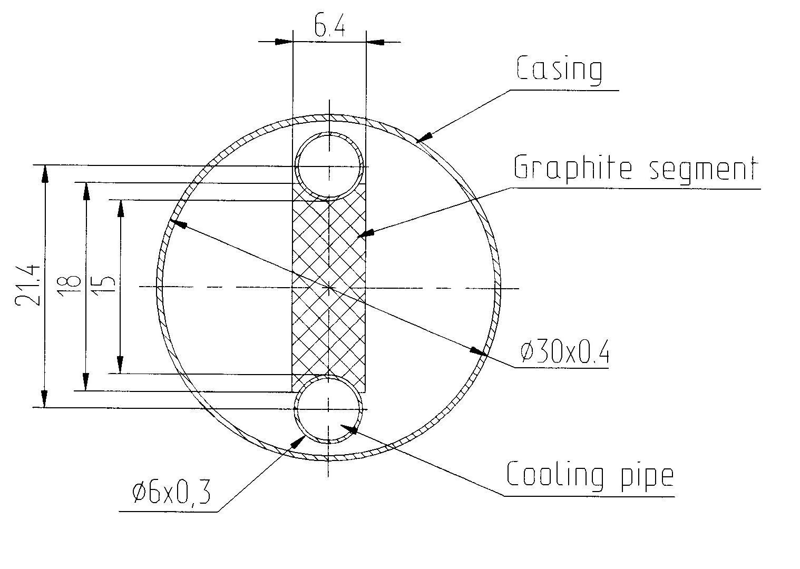
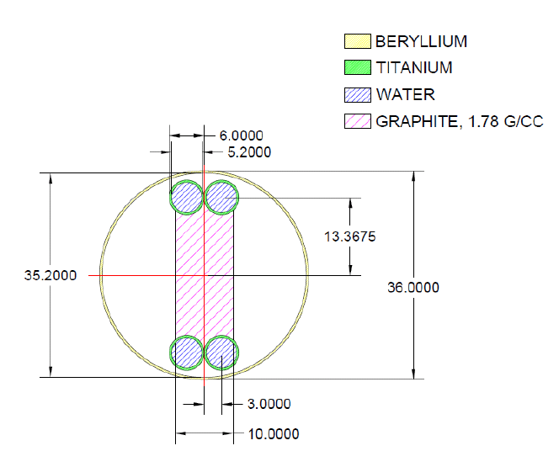
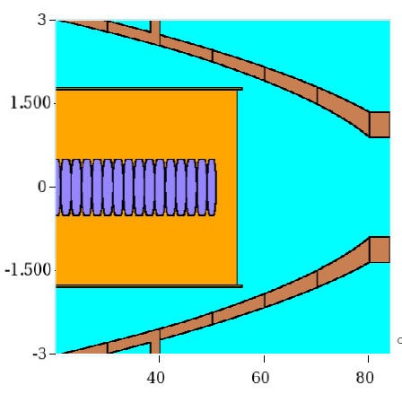
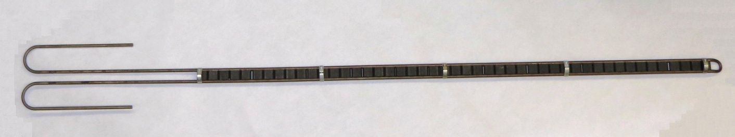
Initial Modifications for 1.2 MW
700 kW design
7.4 mm
Proton
Beam
Wider target material (still graphite): 7.4 10.0 mm
Dual cooling pipes – greater surface area
Slightly larger outer vessel diameter: 30 36 mm
(Move target upstream 10 cm from horn)
cm
47 graphite segments, each 2 cm long
mm

Slide 13
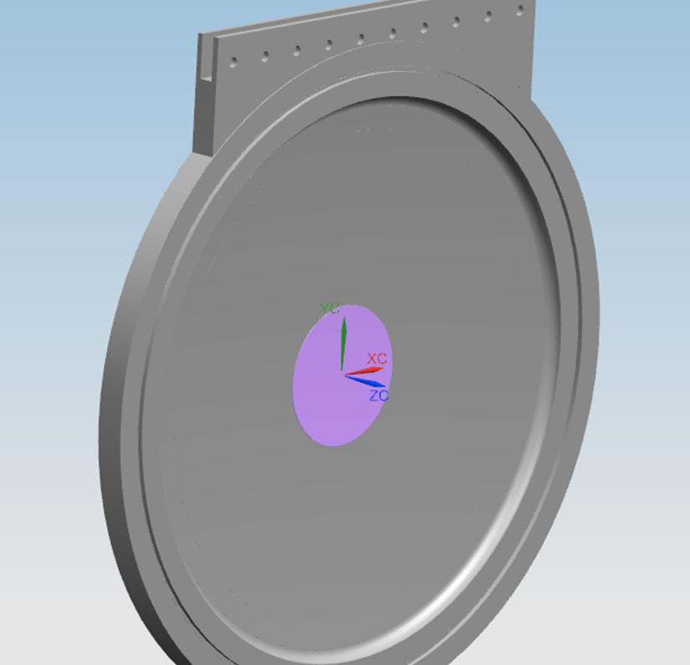
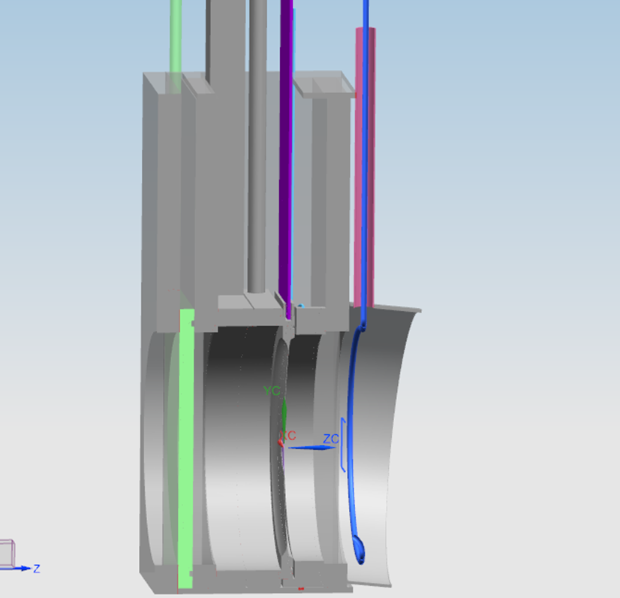
Upstream Decay Pipe Window
1.5 m
~ 20 cm
He cooling supply
temporary blind
thin replaceable window
1.25 mm beryllium or beryllium-aluminum alloy foil welded to a heavier aluminum ring
heavier ring includes a seal groove for an all metal seal
viable design for 60-120 GeV/c protons, 1.03-1.20 MW beam power

Slide 14
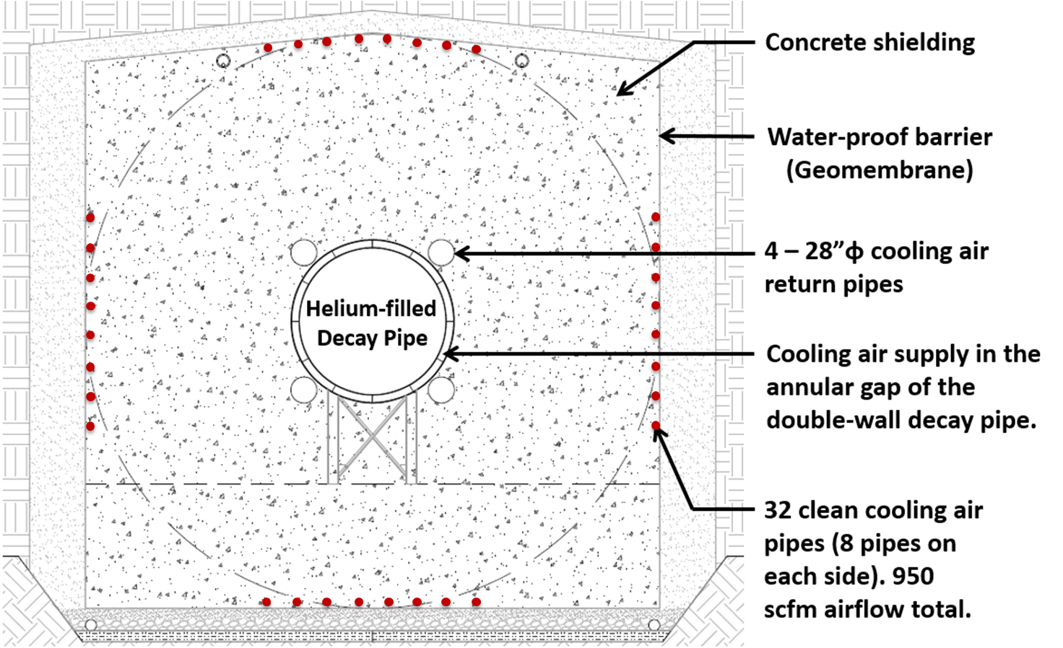
Decay Pipe
194 m long, 4 m inside diameter
Helium filled
double-wall decay pipe, 20 cm annular gap
5.6 m thick concrete shielding
It collects ~30% of the beam power, removed by an air cooling system
Porous cellular
concrete drainage
layer

Slide 15
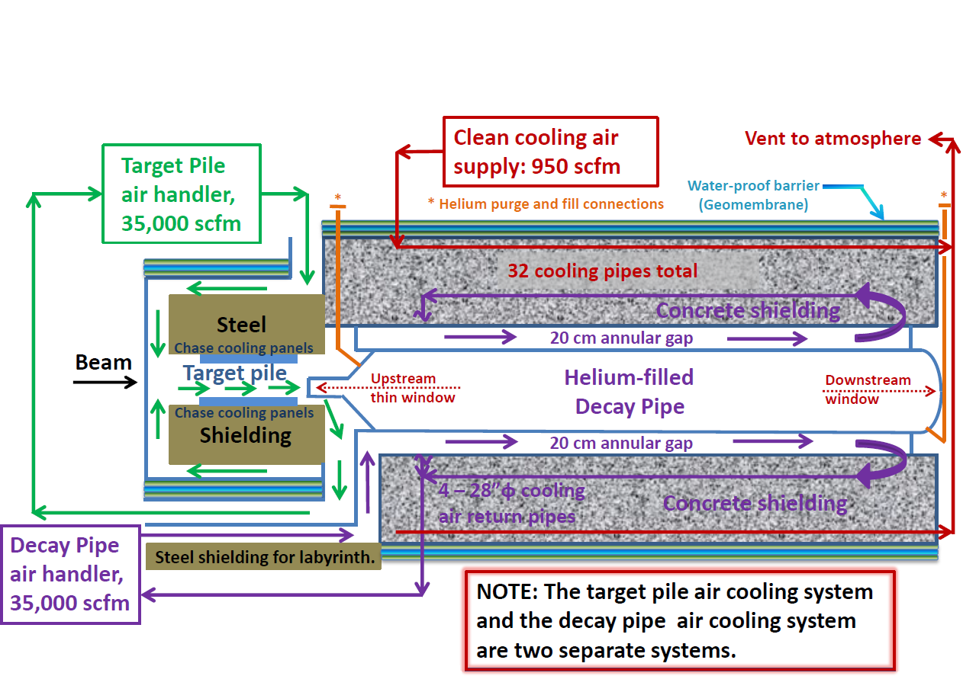
Target Chase & Decay Pipe Cooling
Combination of forced air & water cooling panels for Target Shield Pile
Air-cooled Decay pipe
2 separate air systems for target Chase and Decay Pipe
Possible need to replace air in the target chase with N2 or He under study

Slide 16
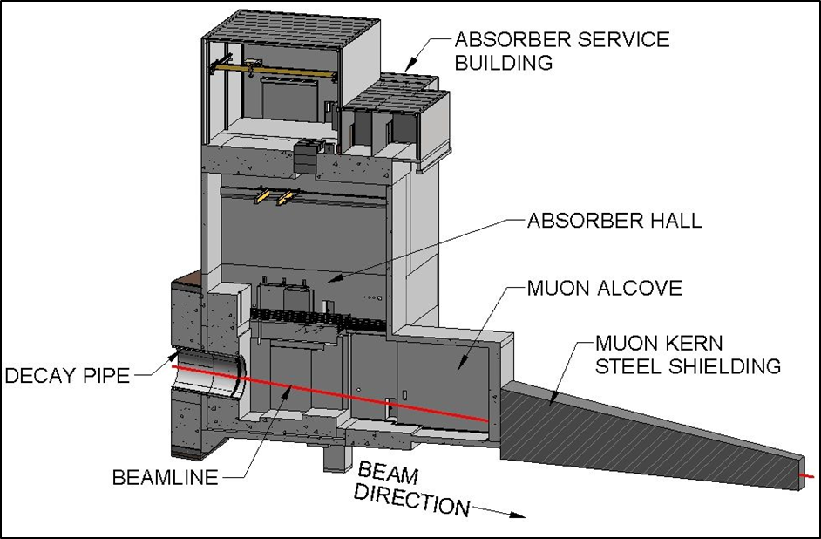
Absorber building
Absorber goes here

Slide 17
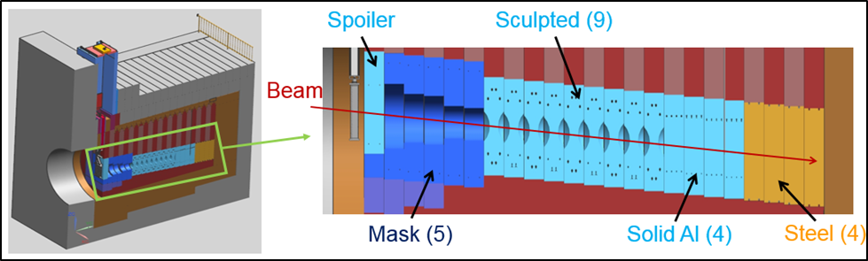
Beam Absorber Configuration
~30% of the beam energy deposited in the Absorber
Core: replaceable water-cooled blocks, each 1 foot thick
Outside of the core is forced-air cooled steel and concrete shielding
Viable for 60-120 GeV/c protons, 2.06-2.4 MW beam power, including both steady-state operations and accident conditions

Slide 18
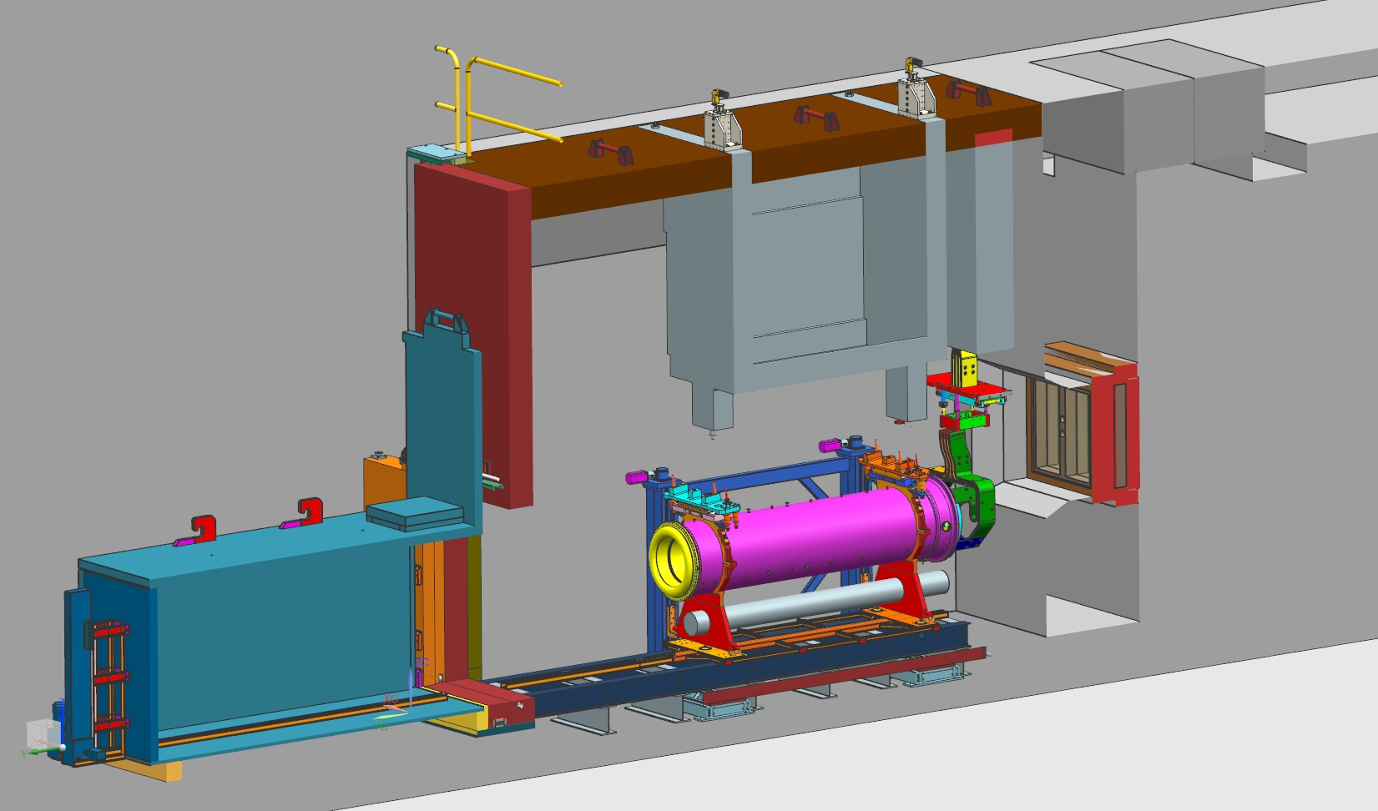
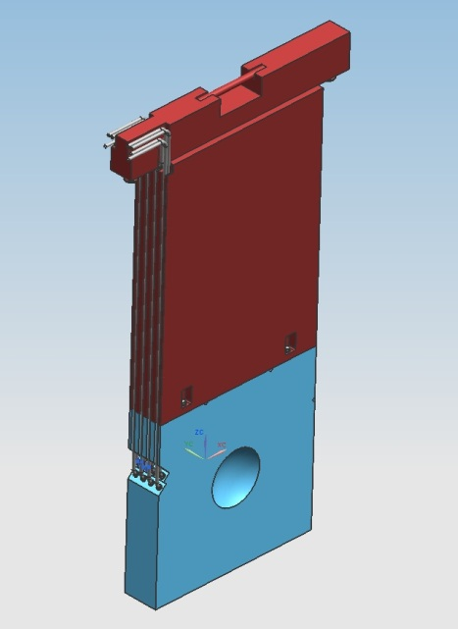
Remote Handling
Remote Handling systems are integrated into the infrastructure of the Target complex, they must be designed to be sufficient for 2.4-MW beam power
  Shield doors (will incorporate air seals)
  Lifting fixtures, vision system
  Morgue/Maintenance areas, Rail System
  Hot Storage Rack and Work Cell
Absorber Hall components and shielding allow future replacement
  Low probability of complete failure, final design and construction
  of remote handling equipment not included in the LBNF project
  No Work Cell needed in Absorber Hall
Work Cell
Cask
Transfer cart
Replaceable
core blocks
Beam

Slide 19
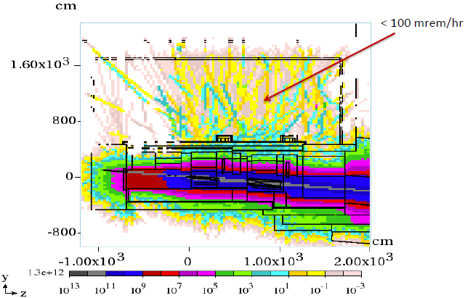
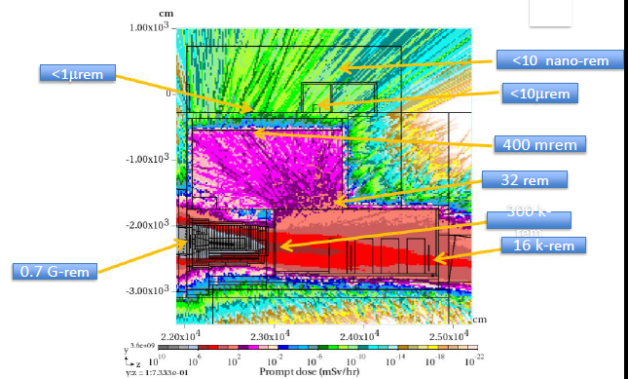
Beam Simulation
Extensive MARS simulations for energy deposition and radiological studies as well as for Beamline configuration optimization studies.
  ~40% of the beam power is deposited to the Target Hall Complex, 30% to the Decay Pipe region and 30% to the Absorber Hall complex.
GEANT simulations for Beamline configuration optimization studies, neutrino fluxes, sensitivity and systematic studies.
Target Complex (mSv/hr)
Absorber Complex (mSv/hr)

Slide 20
What is being designed for 2.4 MW
Designed for 2.4 MW, since upgrading later would be prohibitively expensive and inconsistent with ALARA:
  Size of enclosures (primary proton beamline, target chase, target hall, decay pipe, absorber hall)
  Radiological shielding of enclosures (except from the roof of the target hall, that can be easily upgraded for 2.4 MW when needed)
  Primary Beamline components
  The water cooled target chase cooling panels
  The decay pipe and its cooling and the decay pipe downstream window
  beam absorber
  remote handling equipment
  radioactive water system piping
  horn support structures are designed to last for the lifetime of the Facility

Slide 21
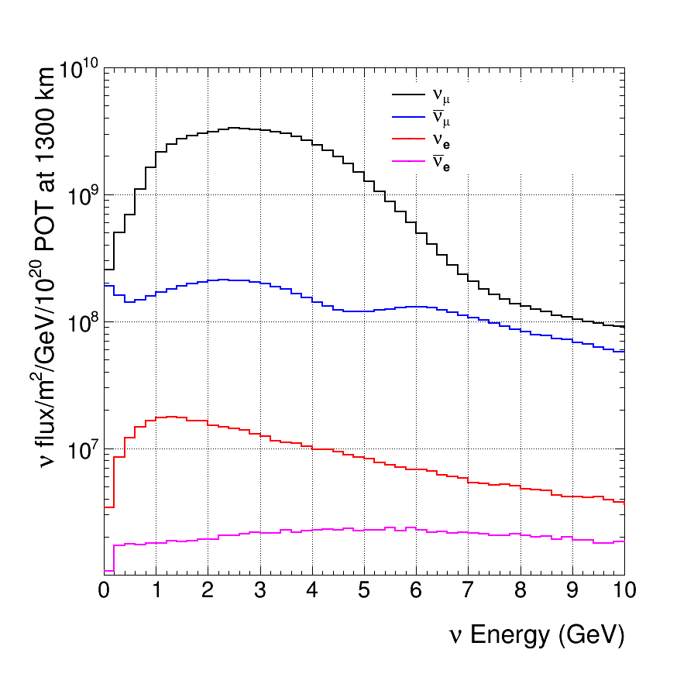
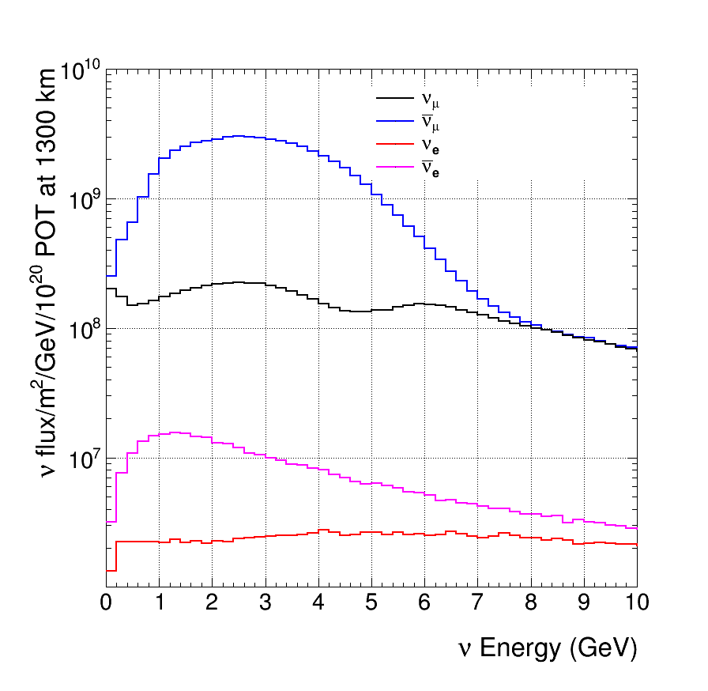
Neutrino Flux – Reference Configuration
Focusing positive particles (ν_{μ} beam)
120 GeV protons
230 kA horn current
Focusing negative particles (ν̅_{μ} beam)
2nd 1st osc max
2nd 1st osc max

Slide 22
Studies for an optimal beam design - Physics
Proton energy choice in the range 60-120 GeV (some programmatic consequences).
Horns
  Shape/size
  current (power supply up to 300 kA, just completed new conceptual design)
Target (currently two interaction lengths)
  Size/shape/position with respect to Horn 1
  Material(s) (higher longevity can increase up time - ongoing R&D)
Studied Decay Pipe length and diameter. Current length 194 m (studied 170 m - 250 m). Current diameter 4 m (studied 2-6 m).
Recently fixed at 194 m long x 4 m diameter.

Slide 23
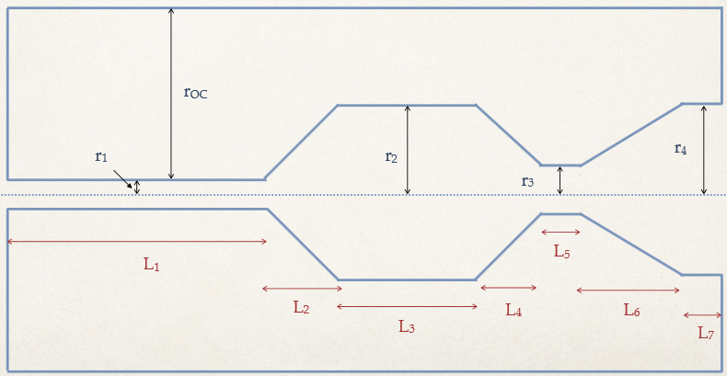
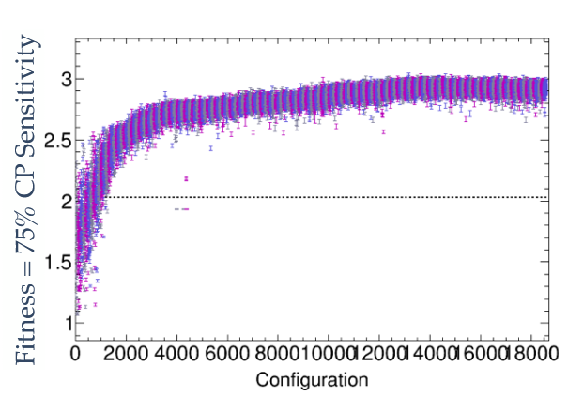
Optimizing the focusing system for greater physics reach
Genetic algorithm, inspired by work done by LBNO Collaboration
to optimize for CP Violation sensitivity
Genetic algorithm and new shape of Horn 1
Horn 2 is NuMI shape in this case but rescaled radially and longitudinally

Slide 24
Target chase allows for optimized focusing systems
Reference Design Target Chase indicating the positions of the reference design horns (in red) and the optimized horns (in blue)

Slide 25
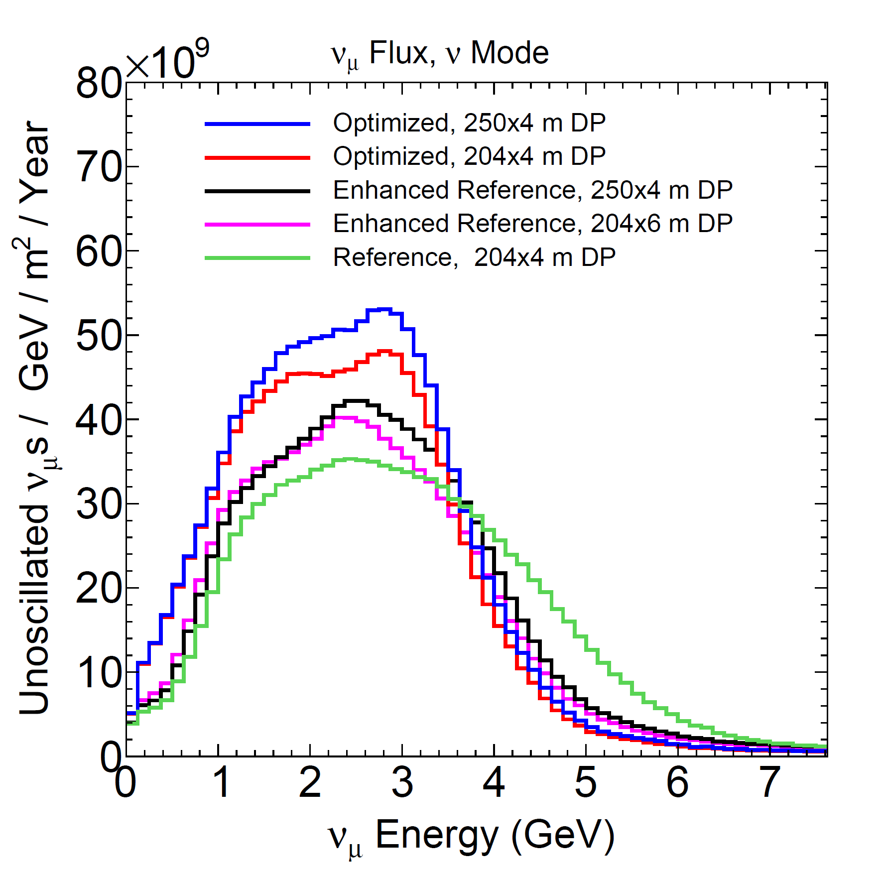
Neutrino Flux of best configurations compared with Reference Design
80 GeV protons
Enhanced: thinner and shorter cylindrical Be target, 25 cm upstream of 1st horn

Slide 26
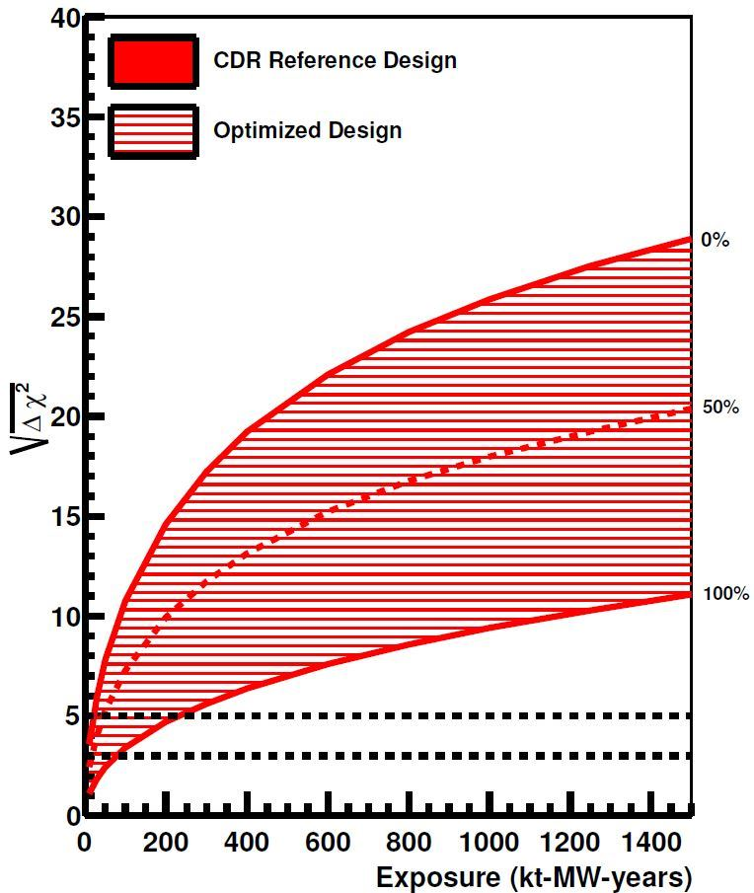
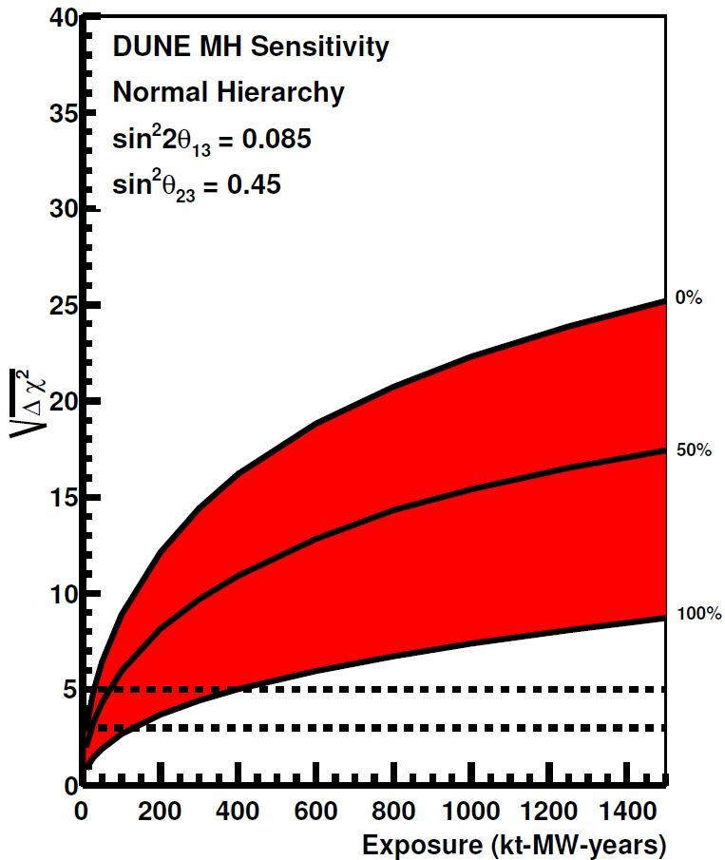
CPV and MH sensitivity improvement with optimized beam
50 % CP Violation Sensitivity
5 % ⊕ 1 %
5 % ⊕ 2 %
5 % ⊕ 3 %
30% less exposure req’d
40% less exposure req’d

Slide 27
Further work required on optimized target-horn system
Engineering needed to determine feasibility of horn designs selected by genetic algorithm
Study effect of 2 -> 3 horn system
Search phase-space of horn design more broadly, and consider other optimization criteria, e.g. for ν_{τ} appearance.
Alternate target designs and materials
Target and horn R&D towards 2.4 MW operation
Alternate ideas to “classical” horn focusing?
=> Ideas from new collaborators are needed!

Slide 28
Summary
The Fermilab Main Injector is delivering the world’s highest beam power for neutrinos ... 0.5 MW now, 0.7 MW next year, 1.2 MW -> 2.4 MW with PIP-II and eventually PIP-III
The LBNF beamline design is well developed, based on NuMI experience
  All systems designed for 1.2 MW
  All elements that cannot be replaced later are designed
  for 2.4 MW
Further optimization can have a big impact on the physics reach of DUNE … new ideas and new collaborators are needed now to realize this potential.

