Slide 1
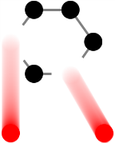
RaDIATE Collaboration
K. Ammigan, R.B. Jones et al.
Proton Accelerators for Science and Innovation
2nd Annual Meeting
RAL, UK
19 May 2013

Slide 2
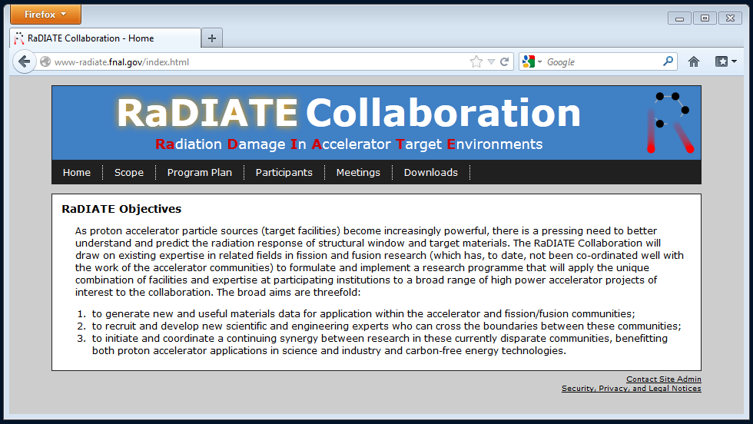

RaDIATE Website
Web address: : http://www-radiate.fnal.gov/index.html
Listserv address: radiate@listserv.fnal.gov
Scope and plan of the collaboration
Presentations and minutes from monthly meetings (5)
Documents and reports on radiation damage studies
Irradiated materials table and target parameter space
RaDIATE Collaboration – PASI 2013 Meeting - RAL, UK

Slide 3
Stage 1 progress: Exploratory/Development
Stage 1 objective: develop specific research activities to meet program goal!
Literature review of material radiation damage studies
Graphite, Beryllium and Tungsten
Post-doc material of study choice
Post-doc recruitment
Irradiated specimens and target parameter space
Identify existing facilities testing capabilities
RaDIATE Collaboration – PASI 2013 Meeting - RAL, UK

Slide 4
Radiation damage literature review
Graphite
Barry Mardsen and Graham Hall (University of Manchester)
Radiation damage in nuclear graphite
Analyzed potential concerns for target environments
Beryllium
Barry Jones (Oxford University team) to provide an update on Be work
Lack of radiation damage data on fatigue or irradiation creep
Tungsten
Barry Jones (Oxford University team) starting to look at Tungsten data in more detail
RaDIATE Collaboration – PASI 2013 Meeting - RAL, UK

Slide 5
Material of choice for post-doc studies
Beryllium
If RaDIATE does not undertake Be radiation damage study, it will not happen anytime soon!
Research programs on graphite and tungsten already ongoing for nuclear applications
Broad application as windows in all high intensity machines
Some experience with Be from fusion research at Culham Center for Fusion Energy (CCFE)
LBNE funding significant portion of post-doc cost – low Z neutrino target material suitable for LBNE is desired
RaDIATE Collaboration – PASI 2013 Meeting - RAL, UK

Slide 6
Post-doc recruitment
Post-doc to be based at the Materials for Fusion and Fission Power (MFFP) group at Oxford University under Steve Roberts
  anticipated work at RaDIATE US participating institutions
Job description for post-doc Be studies finalized
PO for post-doc costs in process
Advertising very soon!
RaDIATE Collaboration – PASI 2013 Meeting - RAL, UK

Slide 7
Irradiated specimens and parameter space
Updated list of available irradiated specimens
  Be, W, C
  Irradiation environment and proton fluence
    0.16 – 400 GeV, 60 - 900 °C, 5e20 – 5e22 p/cm²
  Estimated DPA damage and gas production
    0.1 – 9 DPA, ~ 300 appm/DPA He, ~ 1000 appm/DPA H
Parameter s pace for RaDIATE program
  Targets/windows of future accelerator facilities
  Expected operating conditions and beam parameters
    0.8 – 120 GeV, 300 - 1600 °C, 0.1-20 DPA/yr
  Potential tests/studies required
http://www-radiate.fnal.gov/downloads.html
RaDIATE Collaboration – PASI 2013 Meeting - RAL, UK

Slide 8
Potential new collaborators
FRIB/MSU MatX initiative – Georg Bollen, Frederique Pellemoine
  - Radiation damage from ‘swift ions’ on
    Graphite target
    Titanium beam dump vessel
    Diamond detectors
LANL – Stuart Maloy has expressed interest and is on the RaDIATE mailing list
ESS Target Facility
  Tungsten target
  Beam window
RaDIATE Collaboration – PASI 2013 Meeting - RAL, UK

Slide 9
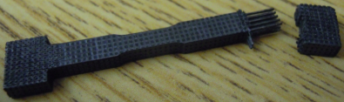
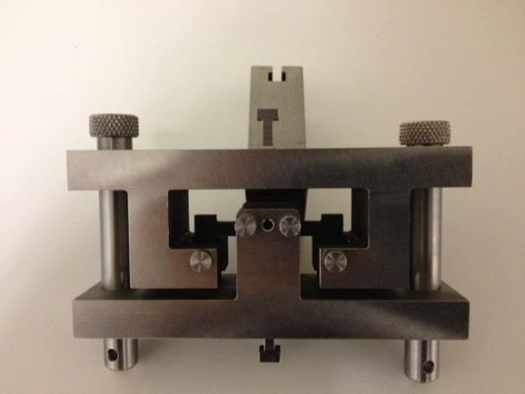
Other news…
MOU status
  Approved!
  Current collaborators: FNAL, STFC, PNNL, BNL, Oxford
NNUF update from Steve Roberts
  Currently purchasing equipment
  Potentially accept activated materials for tests in about 2 years
BNL BLIP graphite studies
  HEPA filters and hot cell ready
  Flexural tests on irradiated 3D C/C composites
Interim report for Stage 1 complete
RaDIATE Collaboration – PASI 2013 Meeting - RAL, UK

Slide 10
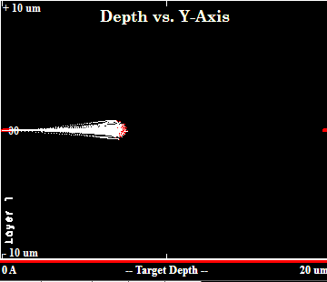
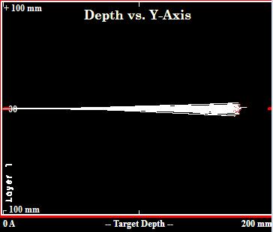
Next steps…
Final report for Stage 1 – Summer 2013
Recruit post-doc by Fall 2013
Evaluate available irradiated specimens and new irradiation testing needs – HE protons vs. LE ions
2 MeV He ions into Be
~ 7 µm penetration
200 MeV protons into Be
~ 180 mm penetration
RaDIATE Collaboration – PASI 2013 Meeting - RAL, UK

Slide 11
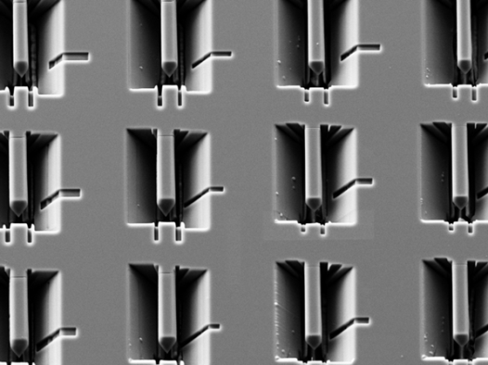
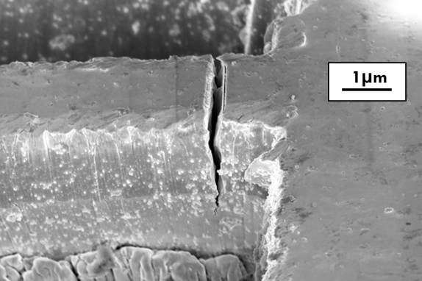
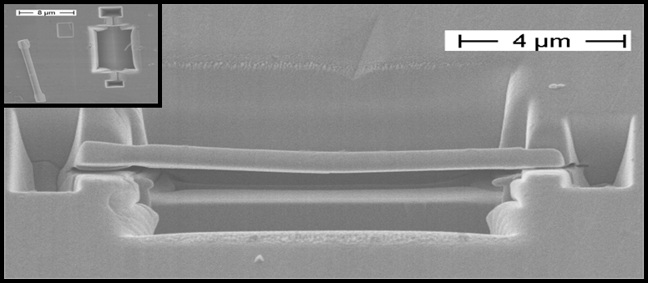
Next steps…
Evaluate Post Irradiation Examination (PIE) techniques to start initial tests on irradiated Be specimens
  Micromechanics on Be (MFFP group – Oxford)
    Micro-properties to bulk properties
RaDIATE Collaboration – PASI 2013 Meeting - RAL, UK

Slide 12
Opportunities for future collaboration
Coordinate with FRIB/MSU on MatX initiative
Graphite: BNL BLIP
Tungsten: ISIS/RAL
Open to other collaborators
  Contact: P. Hurh, C. Densham

Slide 13
Beryllium for proton accelerator windows and targets
By
R B Jones

Slide 14
Irradiation experience on Be
Design conditions proposed for Be proton accelerator windows and targets.
Accelerator operating experience with Be.
Survey of neutron irradiation experience with Be.
Other factors of importance for Be usage.

Slide 15
Proposed window/target designs
LBNE 700kW, 120GeV, 1Hz, σ_{rms} = 1.3mm Window/target
Cyclic T ºC Dose dpa Gas
200/300 0.15/year total He 1330 appm/year
Av/peak @7e-4 to 7e-9dpa.s⁻¹ He/dpa = 8867
Maximum/average H data not available
LBNE 2.3MW 120GeV, 1Hz, σ_{rms} = 1.3mm Target only
Cyclic T ºC Dose dpa Gas
350/550 0.5/year total He data not available
Av/peak @2.5e-3 to 2.5e-8 dpa.s⁻¹ H data not available
Maximum/average
H (Tritium) generation and release needs consideration
Be windows operate in air/vacuum conditions

Slide 16
Accelerator irradiation experience
Various Be windows, targets & test pieces are available.
Average operating temps 40º to 200ºC, max peak 250ºC.
Windows in air/vacuum, targets in air, test pieces in water.
Pulsed operation 0.5 - 7.5Hz (or a more complex cycle).
Beams 0.2 - 400 GeV, 0.19 - 1mm spot sizes.
Peak proton fluences mostly 1.4e21 to 3.7e24 p/cm².
Peak dose (when quoted) 0.1 - 8.5 dpa.
No gas production values available.
Two CERN CNGS windows failed after 0.49 - 1.4e20 POT.
Maximum life 9 and 30 years for another window and target respectively.
S65, PF-60 and S200F Be grades represented.
Post-irradiation examination needed for causes of failure.

Slide 17
Data from neutron irradiations
Irradiations cover 43 - 600ºC, doses from <1 - 52 dpa (Be) at dose rates of 0.2 - 9.9 x10⁻⁷ dpa/s with He contents up to 22,500appm at He/dpa ratios of 50 - 420. Extent of data not equally populated for all phenomena investigated.
Relative to accelerators neutron exposures are at much lower He/dpa ratios and constant dose rates and temperatures. Accelerators have cyclic dose rates and temperatures
Topics investigated ( * more details given below)
*Helium and hydrogen production; bubble swelling
Irradiation growth
Irradiation hardening, irradiation embrittlement
*Fracture toughness
*Thermal creep, irradiation creep and stress relaxation
Cyclic stressing
*Thermal conductivity
Irradiation induced changes to other physical properties
Oxidation
Corrosion

Slide 18
Helium gas and swelling
Helium arises from ⁹Be(n, 2n)2⁴He.
Large amounts are generated.
He bubbles give swelling after irradiation at ≥ 200ºC.
No bubbles ≤200ºC; He accommodated in the Be lattice (solid swelling).
Figure shows %swelling vs He appm (C) for both regimes.
%V/V₀ = 1.15e-4 C[1 + 9.49e-5 C^{0.5} T^{1.5} exp(-3940/T)], (T in ºK, Billone’s equ’n).
However – only a few data are from density
measurements; length changes often used.
He content often calculated, not measured.
Older grades of Be show more swelling.
For He level in LBNE (1330appm/year) swelling is ≤0.5%/year.
Tritium generated by neutrons but in small amounts (~1% of He). This may diffuse to bubbles or escape at surfaces.

Slide 19
Thermal and irradiation creep of Be
Thermal creep important >0.5T_{m} (>504ºC) i.e. at the hot end of Be accelerator usage.
Wide variations found due to impurities (Al, Mg, Si, Fe), porosity and %BeO.
Recent data shows steady creep rate (sec⁻¹) έ = A (1 – p^{2/3})^{-2.43} σ^{2.43} exp(-19470/T)
with A = 7.21x10⁻³ and σ in MPa. This relation incorporates post-irradiation creep for swollen Be (porosity p).
Concurrent irradiation enhances creep. The lower figure shows a loaded Be helical spring deforming at 43ºC in a MTR (only one test).
Derived steady state irradiation creep is
έ_{i} = 3.2 x 10⁻⁶ (1 – p^{2/3})⁻¹ (Ф) σ
with Φ in dpa/s and σ in MPa. No primary creep or any later creep from irradiation-induced void or bubble swelling is included
Stress relaxation can be estimated from the primary and steady creep data.

Slide 20
Fracture toughness of Be
Differing grades of Be (CIP-HIP, VHP and HIP) with 0.5% to1.6% BeO content were tested.
All unirradiated Be grades had the same toughness of 11 MPa.m^{1/2} at temperatures <200ºC. Toughness increased above ~200ºC.
Irradiations in BR-2 at 200, 230 & 350°C to 0.94 to 1.78 x 10²¹n/cm² (E>1MeV & He/dpa ratio of 290) degraded toughness (Moons et al).
Be exposed in ATR at 66°C to 3.4 - 5.0 x 10²¹n/cm²(E>1MeV) also reduced toughness (Beeston).
Higher temperature-aged or 600ºC-irradiated Be exhibited better toughness levels before and after irradiation.
No toughness data at high He levels.

Slide 21
Irradiation and Be thermal conductivity (κ)
Irradiation effects on κ examined in Be of differing textures, grain sizes and impurity levels (mainly the level of BeO).
Irradiations were at 343K and 473K, doses of 2 – 58 dpa and He 840 – 20,600 appm (1dpa ~ 0.25 x 10²² n/cm² (E>0.1MeV).
κ varies with test temperature and axial orientation (texture). After irradiation at 473K (see top diagram) κ is much reduced, the test temp dependence is lost but texture effects remain.
The dose-induced reduction in κ after 673K irradiation is much smaller (only 10-20%).
The most rapid irradiation-induced reduction in κ occurs at the lower doses and irradiation temperatures (lower diagram).
Prismatic interstitial loops (20-80nm), basal vacancy loops (40-500nm) and He bubbles (4nm) occur (no bubbles below 473K). All loops absent at 673K, only flat plate-like pores seen.
The reduction in κ at low irradiation temps is mainly due to radiation-induced dislocation loop formation with a contribution from He generation and small He clusters.
No quantitative analysis has been fully developed relating the type and morphology of the defects present to the observed reductions in κ.
Need further work at low doses at 473K and on the relative κ effectiveness of transmutation gas.

Slide 22
Other issues
Irradiation growth in Be has been measured but its magnitude has not been satisfactorily separated from the effects of gas swelling.
Evidence is available on the release of He and H (T) from Be during heating. He release is not significant below 600ºC.
Many data exist on irradiation hardening and embrittlement in Be. These effects have their maximum effect at 400ºC.
No information has been found on the cyclic stressing or creep/fatigue response of irradiated Be.
Predictive equations are available for the physical properties of Be and the influences of temperature and porosity (e.g. density, Young’s modulus, coefficient of thermal expansion).
Evidence exists for enhanced oxidation of Be under He ion irradiation at ambient temperature. However the significance of this is tempered by the good practical performance of proton-irradiated Be windows in air.
Long term neutron irradiation increases the corrosion of Be in cooling water.
Be is not easy to fabricate using conventional techniques which yield textured products. Powder metallurgical methods (HIP) are favoured and can produce products with randomised grain orientations.
Be is toxic and requires specialised handling (glove boxes, adequate ventilation etc).

Slide 23
Conclusions
Post-irradiation examination of both failed and unfailed Be windows/targets is required to determine what factors affect longevity under proton irradiation.
More data required on He and H generation by protons in Be window/targets.
Determinations of thermal conductivity effects are needed at low irradiation doses and window/target temperatures. Obtain better definition of the κ-effectiveness of He bubbles.
More Be irradiation creep data needed for estimating stress relaxation of thermal and mechanical stresses.
Investigation required of pulsed irradiation doses on irradiation creep.
Experiments needed on cyclic stressing and creep/fatigue of Be both after and under irradiation.
Need to explore the fracture toughness response of Be at irradiation temperatures between 250 and 600ºC. Determine whether toughness is affected by differing distributions of He bubbles.

