Slide 1
Neutrinos from Stored Muons νSTORM Target Station Conceptual Design 15-April-2013 Kris Anderson Fermilab/Accelerator Division/Mechanical Support Department Target Facilities Group Leader

Slide 2
• Goal is to utilize prior and existing target station designs and components from successfully operated FNAL target stations (NuMI/NOvA, AP0 Antiproton Source, MiniBoone) • Existing design costs and operational characteristics are well understood • SWF is a significant cost driver for new projects and impact is minimized by utilizing or slightly modifying existing design concepts
νSTORM Target Station Conceptual Design

Slide 3
• Target station beamline chase with adequate shielding • Active beamline elements include: - Production target - Focusing horn, stripline bus, and power supply - Pair of quadrupole magnets and related power supplies/utilities - Water cooled collimators for quad protection • Support modules for beamline alignment of the above devices • Air handling and radioactive water (RAW) systems • Work cell for hot handling and failed component repair/replacement • Remote handling fixtures and camera system • Hot component storage morgue for device cool-down • Functional civil construction enclosure consistent with providing the means of maintaining Target Station equipment and facilitating adequate operational up-time
Key Elements of vStorm Target Station

Slide 4
Utilize NuMI /NOvA style horn 1 for focusing pions produced in a NuMI low energy style graphite fin target - NuMI LE style graphite fin target (95cm length x 6.4mm wide) has been successfully operated at beam power of 350kW to 400kW - NuMI horn 1 baseline design for 200kA peak current pulse, 400kW incident beam, and 10M pulse fatigue life (plus an additinal fatigue life safety factor) - Work ongoing to define quadrupole magnet design and requirements
νSTORM Target Station Beamline Elements

Slide 5
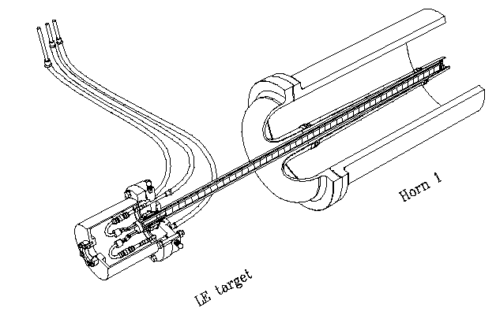
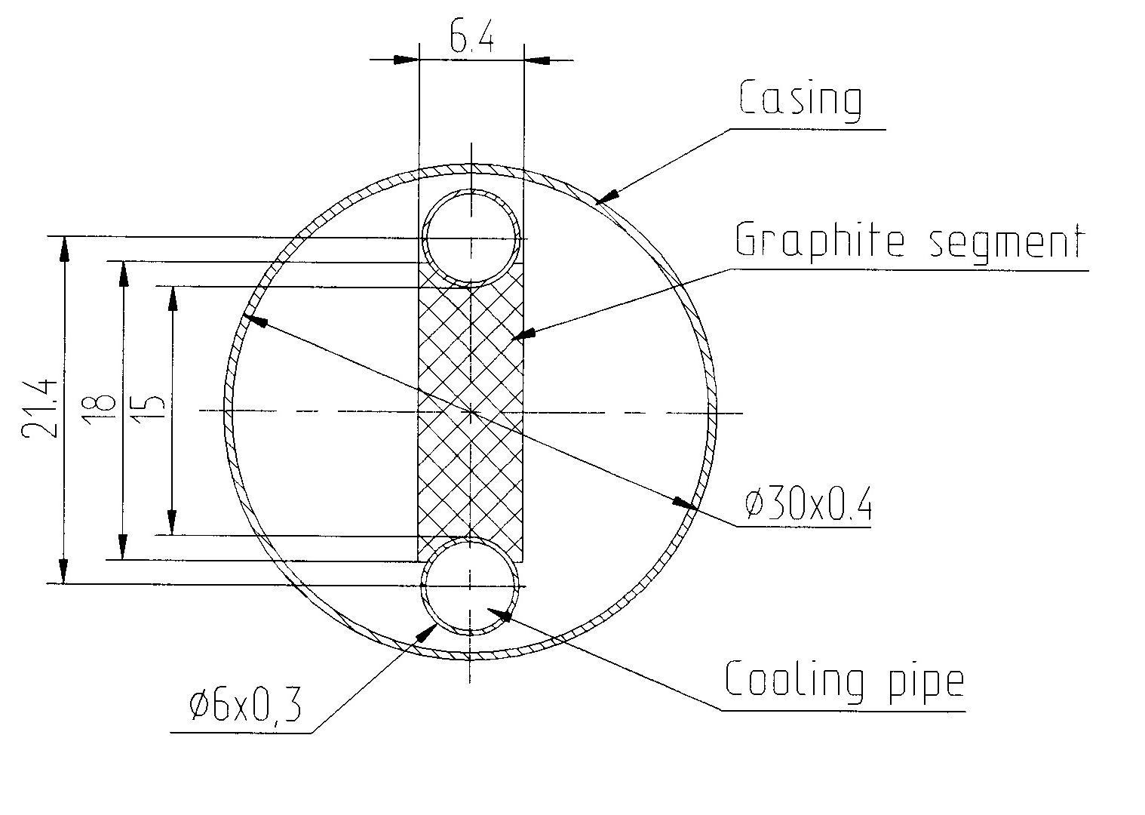
Target for Low Energy Neutrino Spectrum
Graphite Fin Core
6.4 mm wide
Water cooling tube
Backing target out of horn produces neutrinos at higher energies
Fits within the horn.

Slide 6
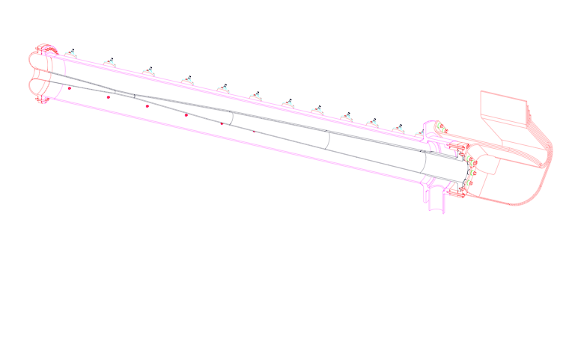
Magnetic Horn General Design Features
Outer Conductor
Stripline
Β
Inner Conductor
π⁺
Ι
Spray Nozzle
Depending on Polarity Horn Can
Focus π⁺ or π⁻
Large toroidal magnetic field
Requires large current - 200 kAmp
Thin inner conductor, to minimize π⁺ absorption
Water spray cooling on inner conductor
Insulating Ring
Drain

Slide 7
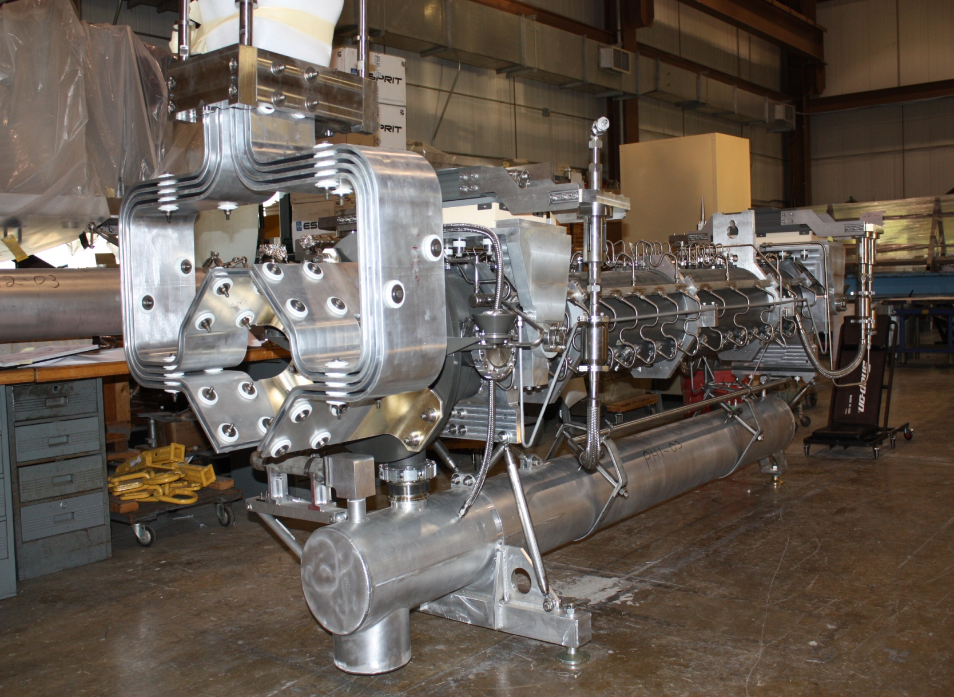
νSTORM Target Station Beamline Elements: NuMI Horn 1
Stripline
Conductors
Spray Nozzles and
Water Supply Lines
Outer
Conductor
Water Scavenge
Tank

Slide 8
• Utilize NuMI style target chase and positioning modules • Utilize NuMI style hot handling techniques • Target chase shielding steel would be mostly comprise of relatively inexpensive “Duratek” shielding blocks • Target station facility would likely be a variation between NuMI and the AP0 Antiproton Source Target Hall • Need to have an effective plan for handling airborne activation products and tritium control
νSTORM Target Station Conceptual Design Approach

Slide 9
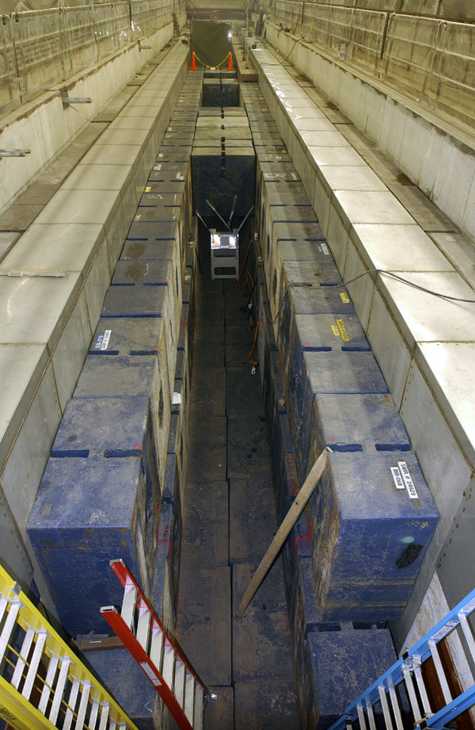
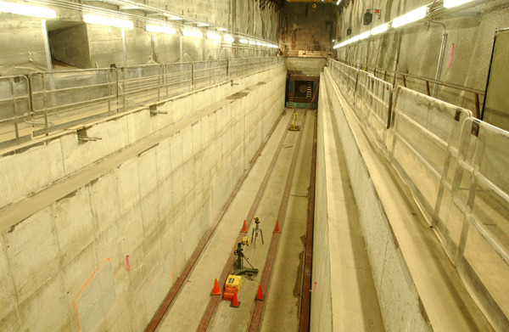
Target Chase Configuration-
Proposal to Use NuMI Style
Concrete Lined Beamline Chase Walls and Base Provided by Civil
Construction
Beamline Chase Steel Constructed
Using Duratek Steel Blocks

Slide 10
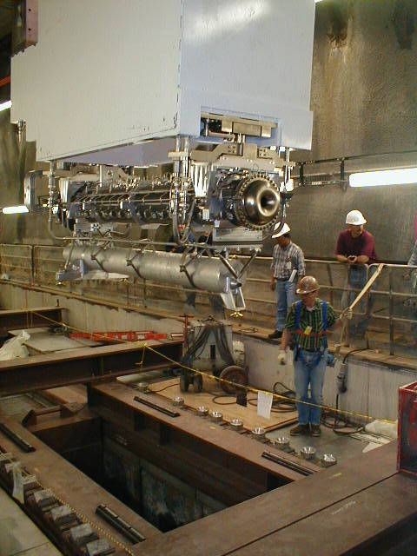
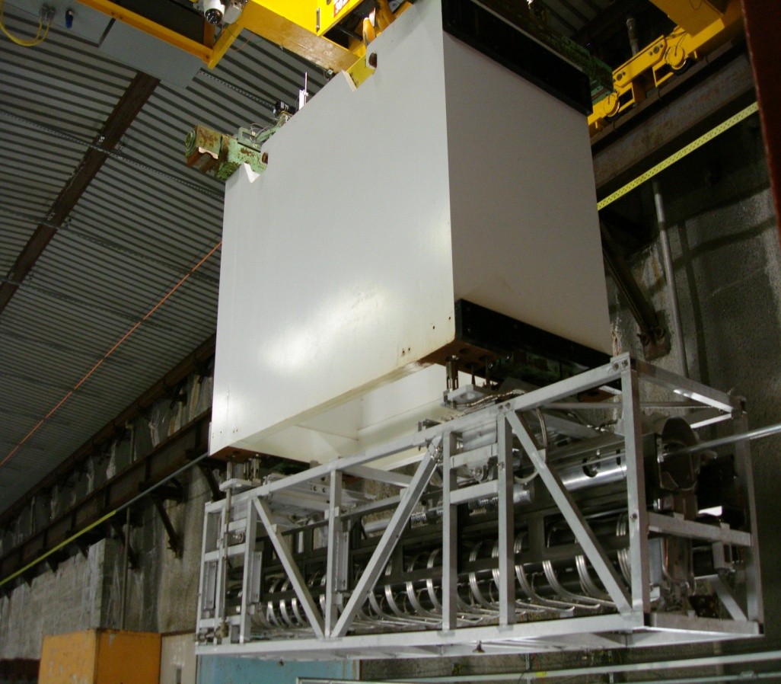
Target Chase Configuration-
Proposal to Use NuMI Style Components
NuMI Low Energy Target and Associated Beamline Positioning
Module
New NuMI Horn 1 and Beamline Positioning Module Chase Installation

Slide 11
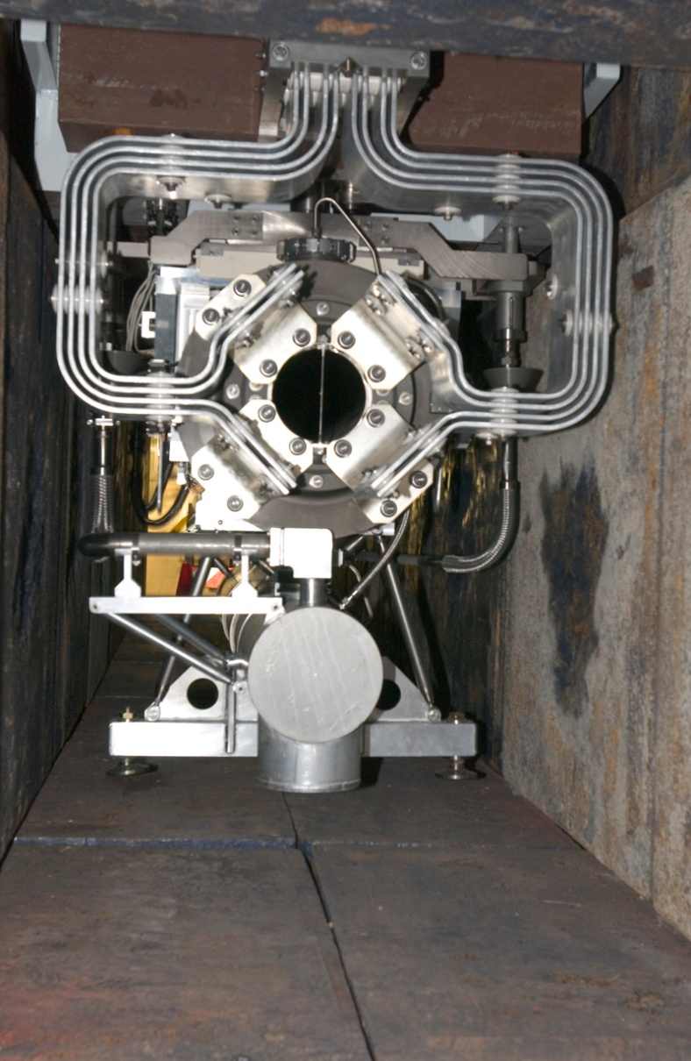
Target Chase Configuration-
Proposal to Use NuMI Style Components
Downstream end of horn 1 suspended in NuMI target chase by module showing stripline conductors and water scavenge tank surrounded by Duratek steel shield block pile

Slide 12
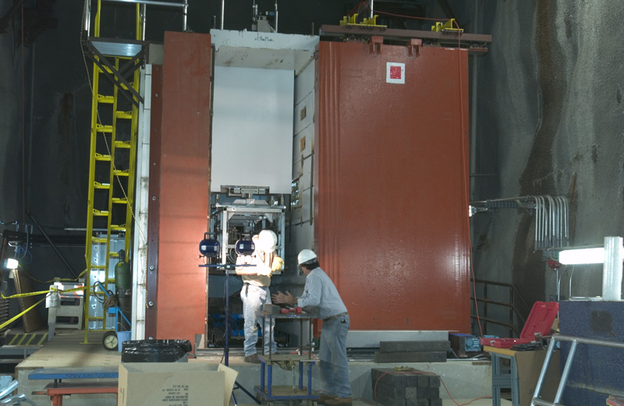
Target Chase Configuration-
Proposal to Use NuMI Style Components
NuMI Workcell for Failed Component Replacement
(Image shown is that of new components during installation)

Slide 13
vStorm Beamline Chase Conceptual Design
Cross-Section: Horn, Module, and Shielding
Horn Module
Support Carriage
Cross-Beam
Poured
Concrete
3ft. Nominal
Thickness
Duratek
Steel Shielding
Blocks
Air Gap Perimeter
For Air Cooling of
Steel Shield Pile

Slide 14
vStorm Beamline Target Station Plan View
Work is ongoing to provide cost estimates associated with this
proposed facility
Work
Cell
Target
Module
Horn
Module
Utilities &
Power Supply
Room
Quads
Temporary
Storage
Morgue

