Slide 1
Target challenges for
the next generation of Neutrino Facilities
Ottone Caretta, Tristan Davenne, Peter Loveridge,
Andrew Atherton, Mike Fitton,
Joe O’Dell, Dan Wilcox, and Chris Densham
(RAL)
Ilias Efthymiopoulos, Nikolaos Charitonidis, Adrian Fabich
(CERN)
2015-05-20 High Power Target workshop at FermiLab

Slide 2

Inputs to High Power Target design envelope
Cyclic stresses (fatigue)
Heat load removal
Creep
Quasi-static stresses
Stress endurance
Dynamic inertial stresses
High power proton beam
HP Target
Disposal
Operational safety
Material props
Rad. Damage
Toxicological
Radiological
Physics performance
Remote handling
Operational reliability

Slide 3
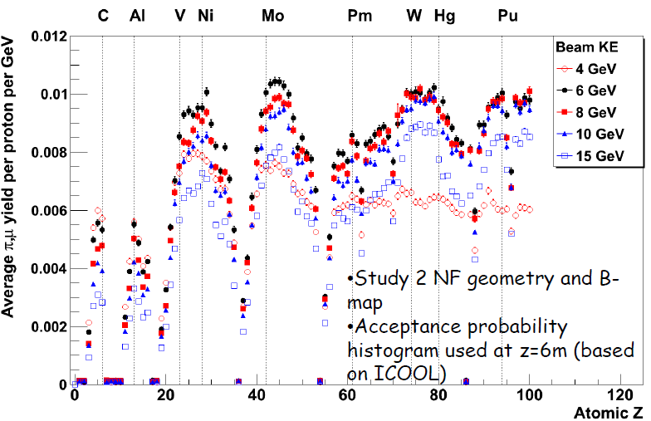
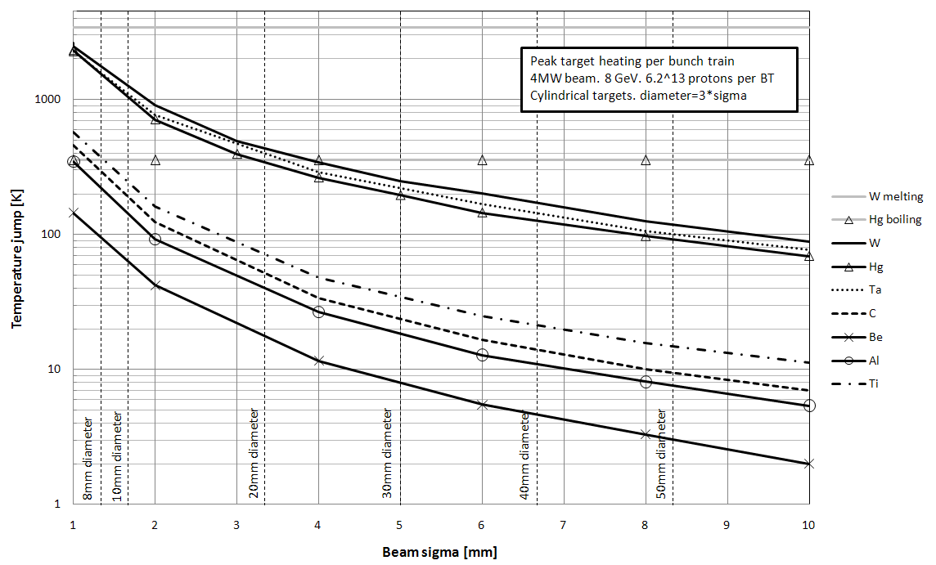
Yield or Productivity?!
J.Back
See NF yield in W with that in C (left) and see respective peak temperature jump (below)
Reliability in engineering
Rf= r1*r2*r3*...rn
Where rn<=1 is the reliability of a given component

Slide 4
Heat Removal and Thermal stresses
Target | Power Deposited [kW] | Peak Temperature Jump [K] | Existing or proposed solution
Mu2e | 2 | 0.0014 | Peripherally cooled cylinder
T2K | 15 | 100
Numi | 4 | 364 | Peripherally cooled segmented
Nova | 8 | 253
LBNE | 23 | 75+
ISIS | 100 | 3.8 | Segmented with cooling through core
EuroNu | 200 | 62
Neutrino Factory | 500 | 1000? | Flowing or rotating target
ESS | 3000 | 100 | Rotating target with cooling through core of target
segmentation
T. Davenne
Segmentation is a powerful tool to improve cooling and reduce stresses although there’s no such thing as a free ride..

Slide 5
Heat Removal and Thermal Stress Summary
Flowing or rotating targets
Segmented
Peripherally cooled monolith
T.Davenne

Slide 6
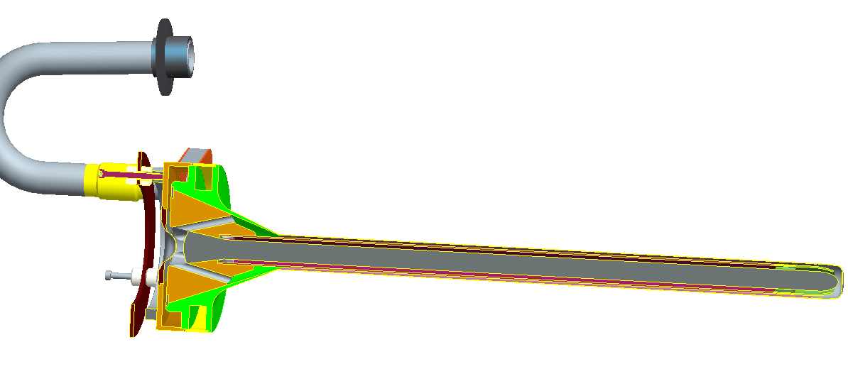
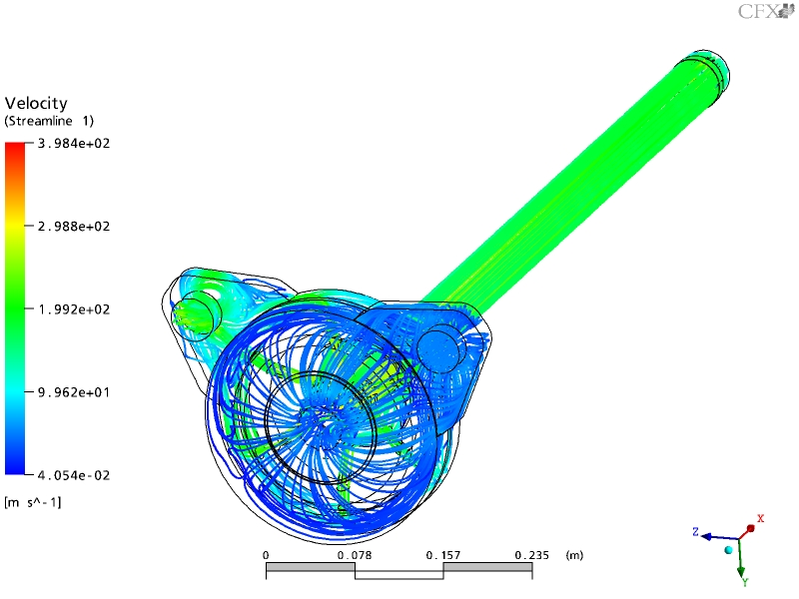
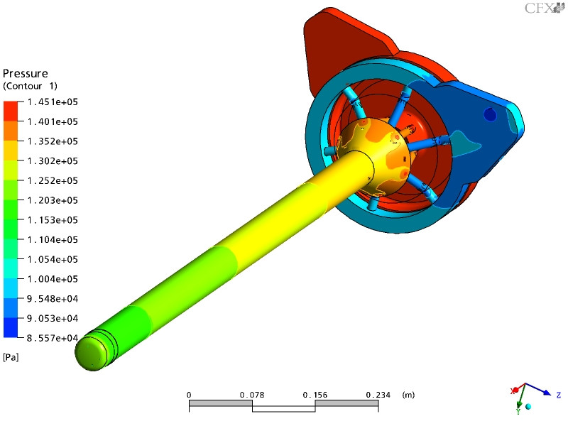
Monolithic (peripherally cooled) target: T2K
T2K
Beam 30GeV, 750kW
Target 23kW, 7MPa
Graphite core
Ti-6Al-4V shell
M.Fitton
C.Densham
Helium cooling velocity streamlines
Maximum velocity = 398 m/s
Pressures (gauge)
Pressure drop = 0.792 bar

Slide 7
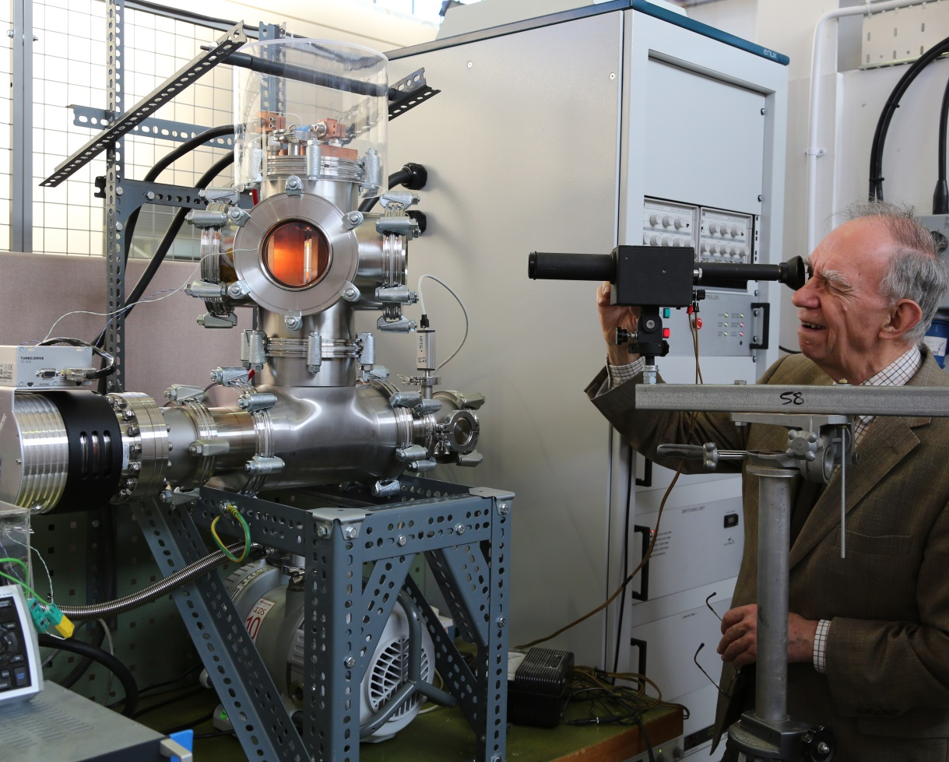
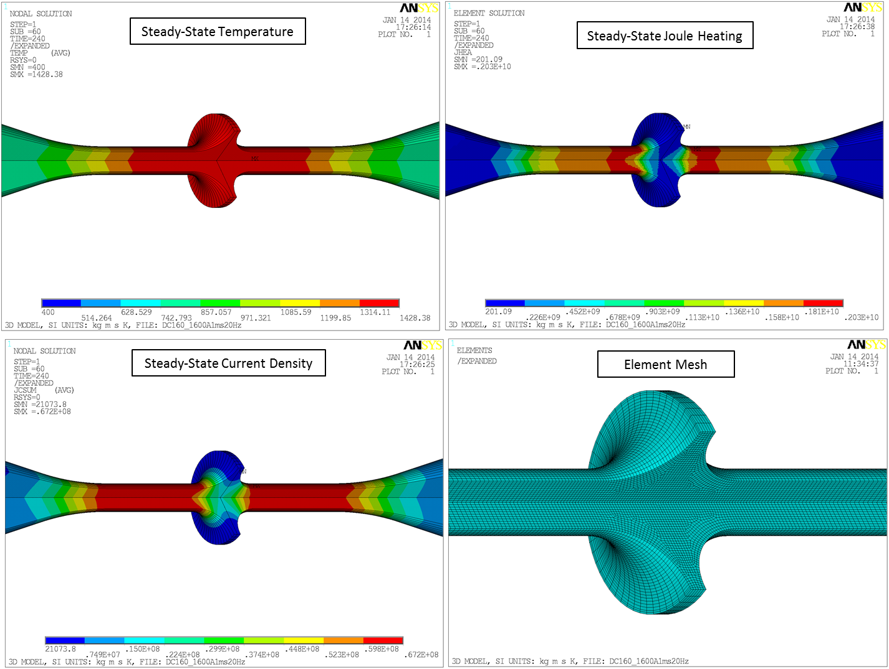
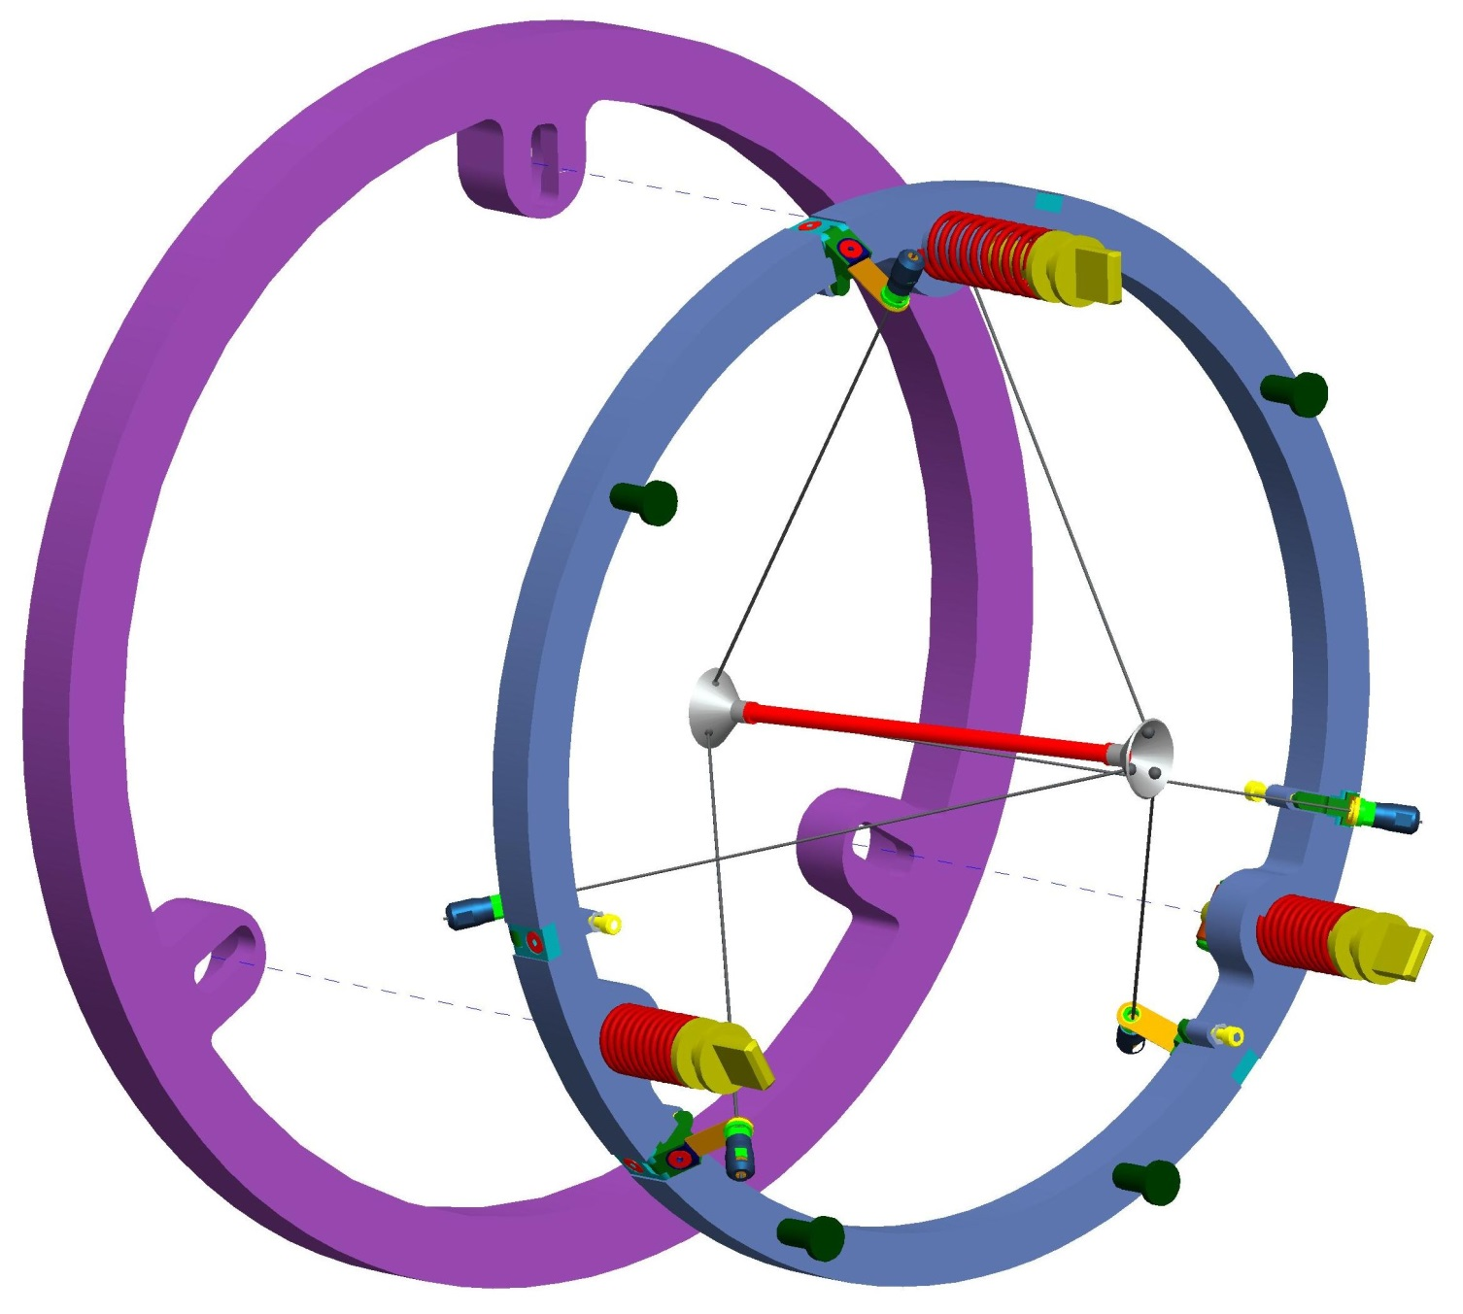
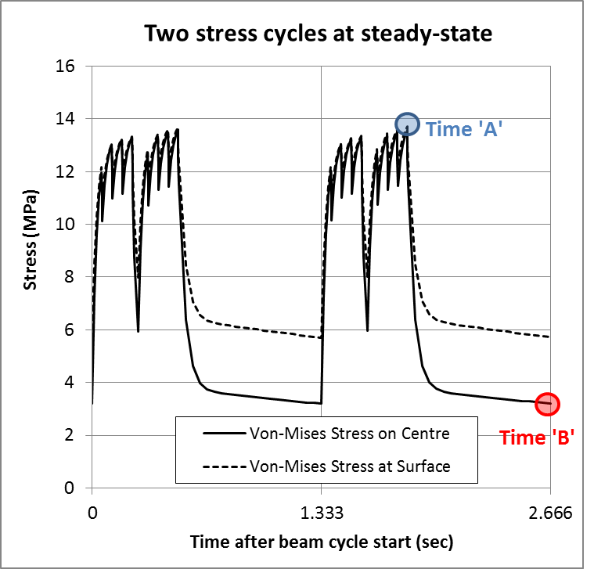
Monolithic radiation cooled target: Mu2e
P.Loveridge

Slide 8

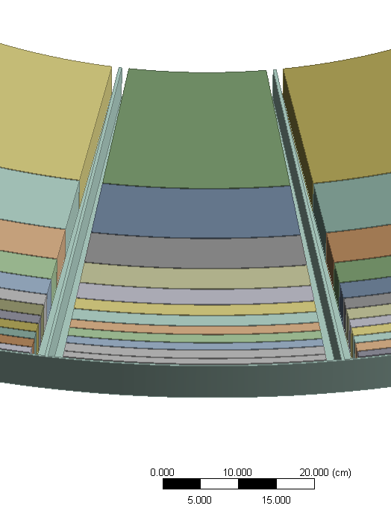
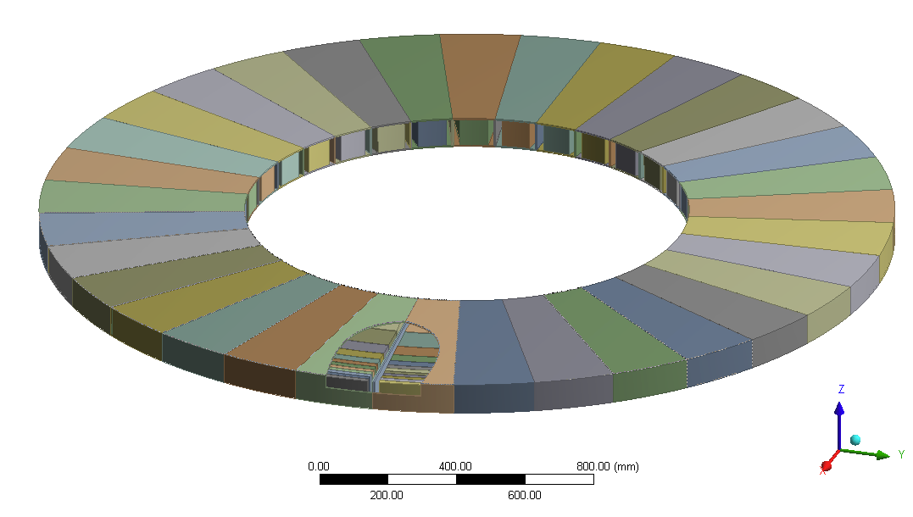
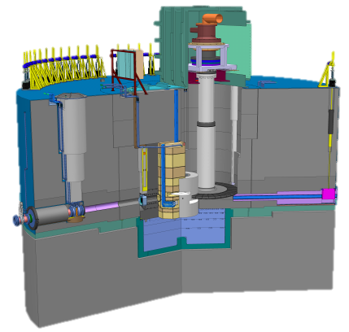
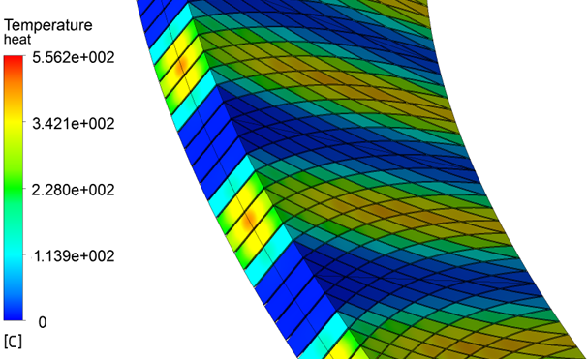
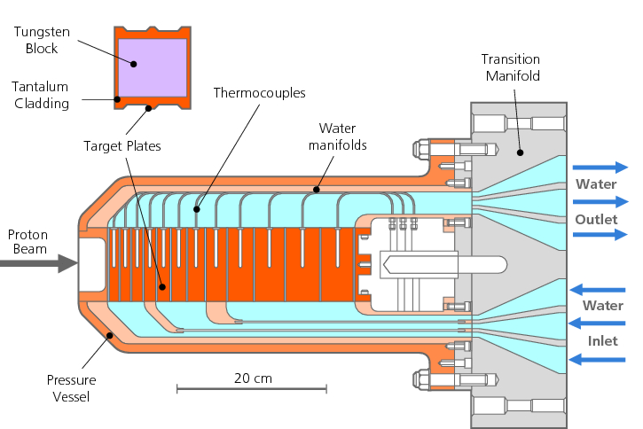
Segmented target: ESS wheel
5 MW target: helium cooled tungsten wheel
Gap of 2mm
Segmentation is necessary to remove the heat and a higher degree of segmentation may be required to reduce the peak stresses
ISIS
p

Slide 9
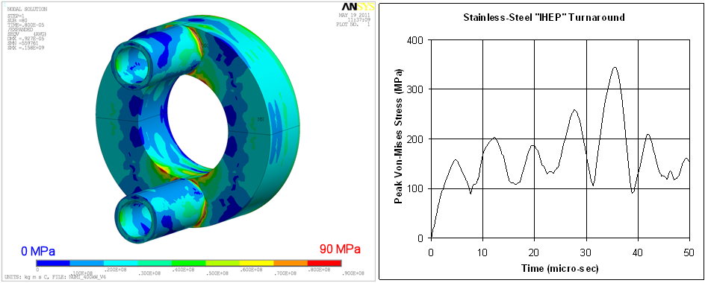
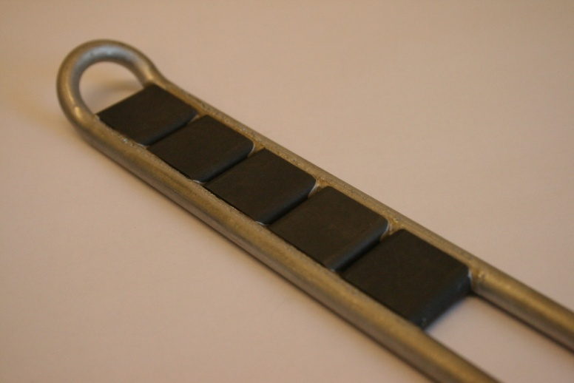
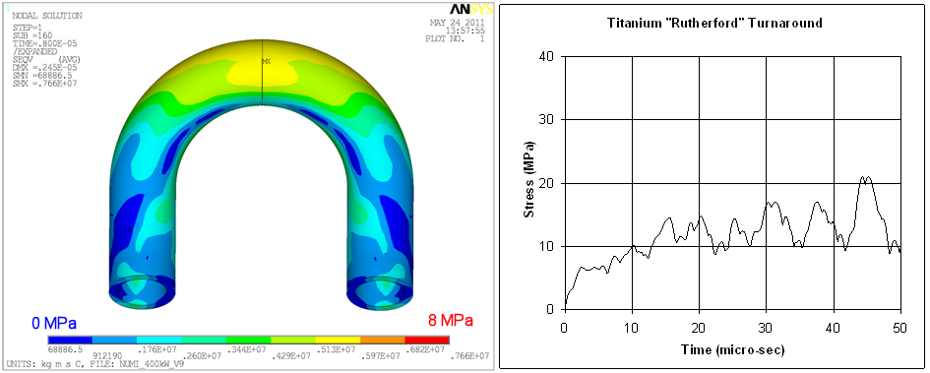
Segmented Target: NuMi
P.Loveridge
M.Fitton.
G.Burton
5K temperature jump in water
40K temperature jump in Steel cooling tubes

Slide 10
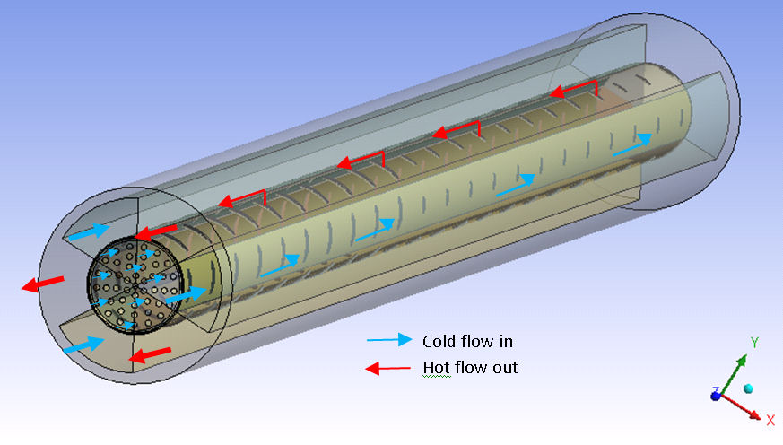
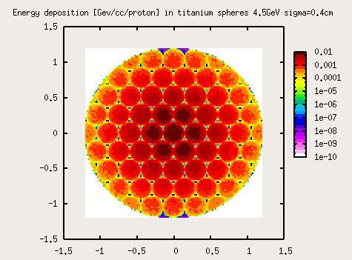
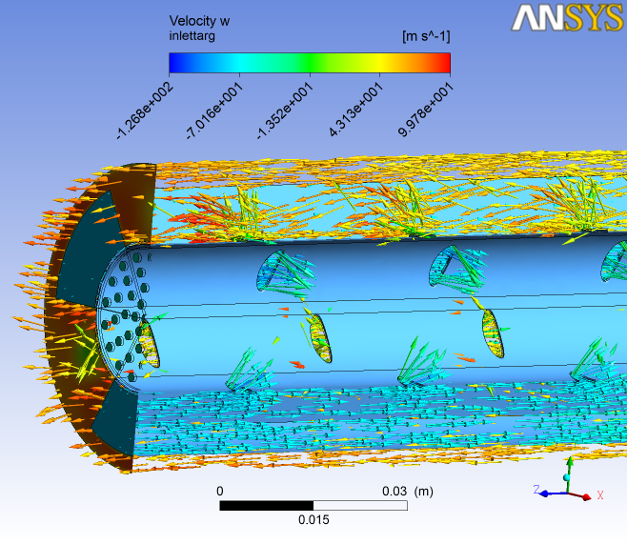
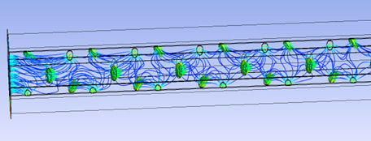

Segmented Target: EURONu
Increased surface area. Coolant reaching
maximum energy deposition region
Stress limit reached for solid
peripherally cooled target
100 m/s helium
Packed bed target concept for 4 MW Neutrino Superbeam study (EUROnu)
T.Davenne

Slide 11
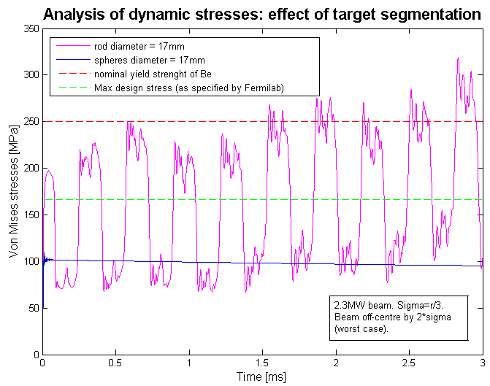
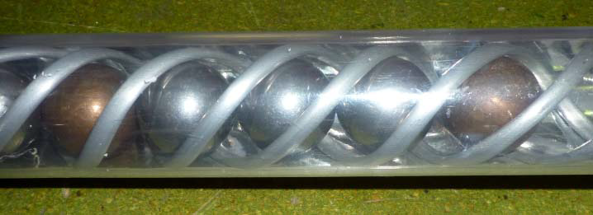
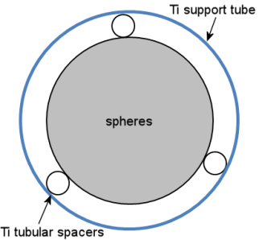
Segmented target: LBNE
Dynamic stresses in beryllium cylinder compared to beryllium spheres as a result of LBNE 2.3MW beam
Relationship between peak dynamic stress and energy deposition time for a sphere
Expansion time α target size
T.Davenne

Slide 12
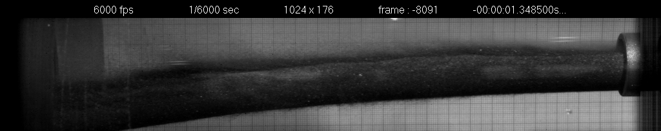
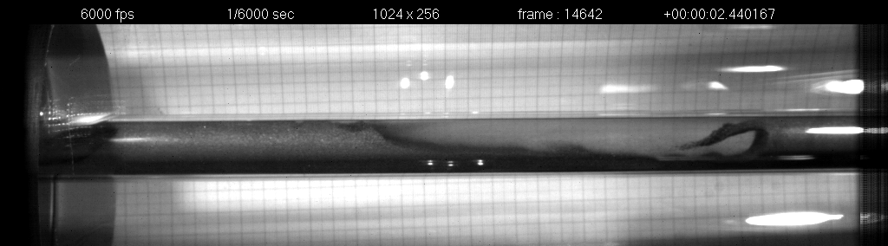
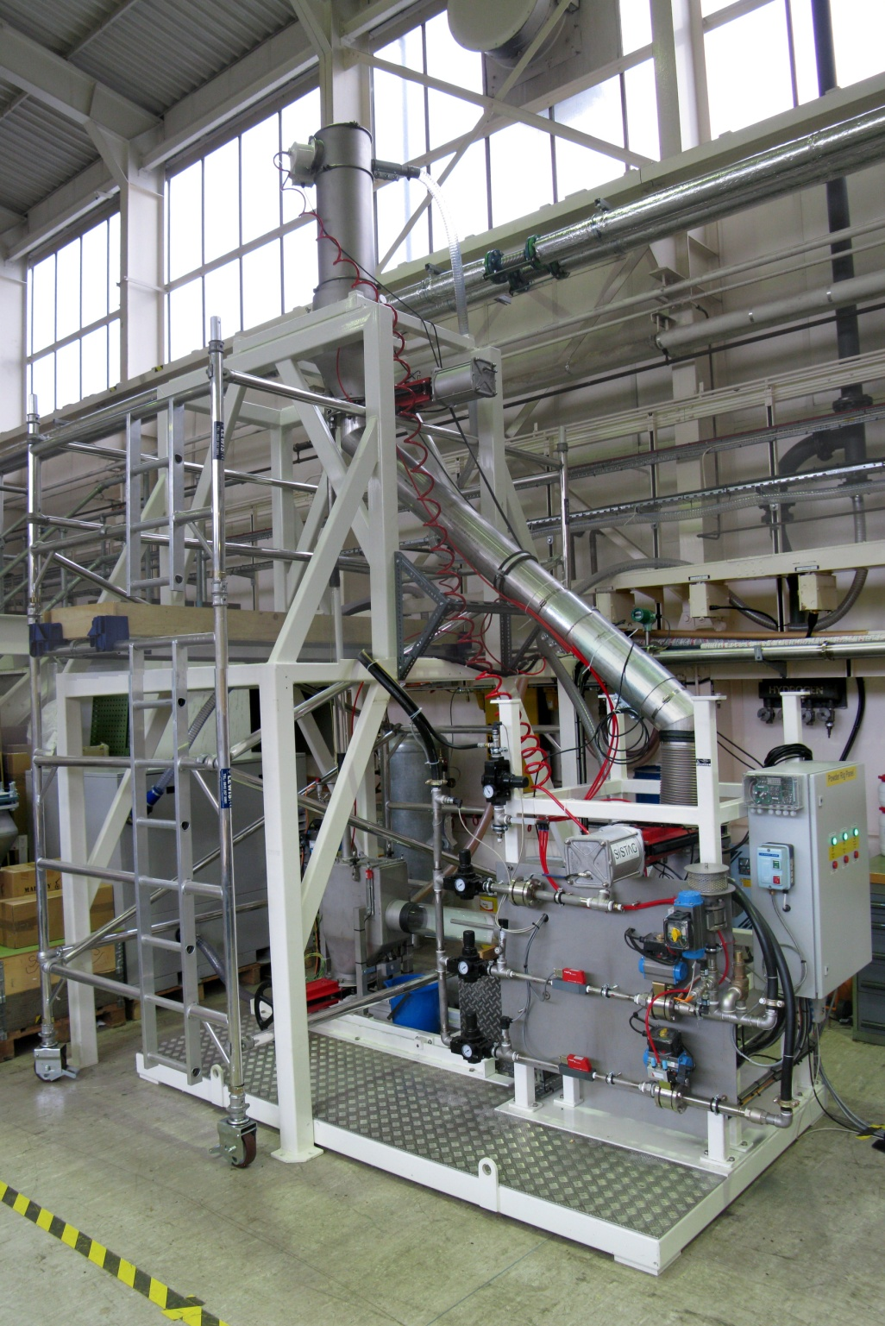
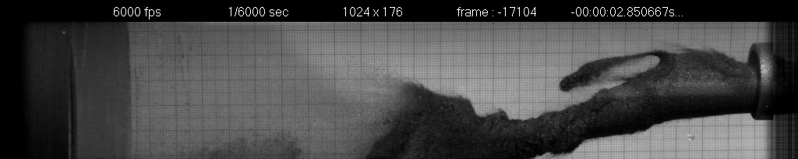
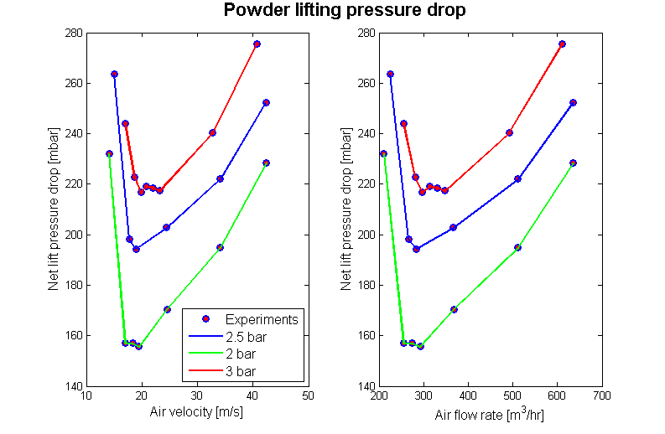
Fragmented high Z flowing target: W powder rig
Dense-phase delivery
Offline testing
  Pneumatic conveying
  (dense-phase and lean-phase)
  Containment / erosion
  Heat transfer and cooling of powder
High speed image: tungsten powder jet
High speed image: tungsten powder flow in a pipe
Unstable tungsten powder jet
2
Lean-phase lift
1
3
4

Slide 13
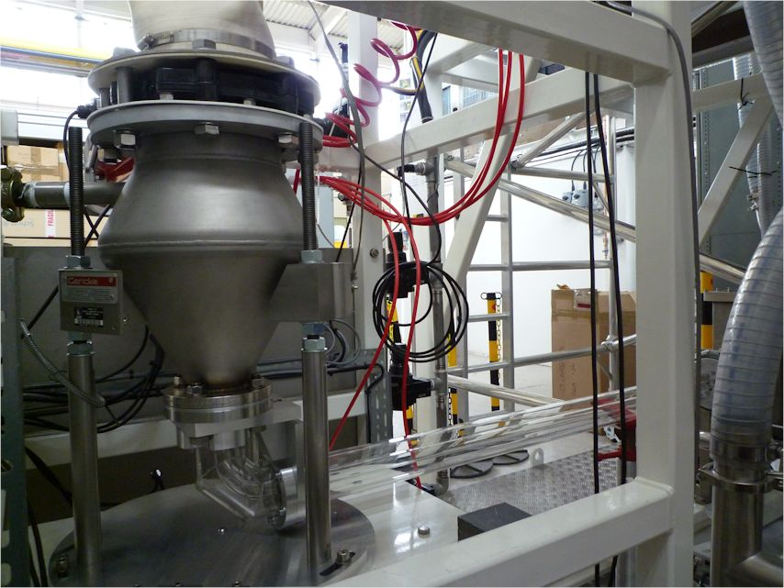
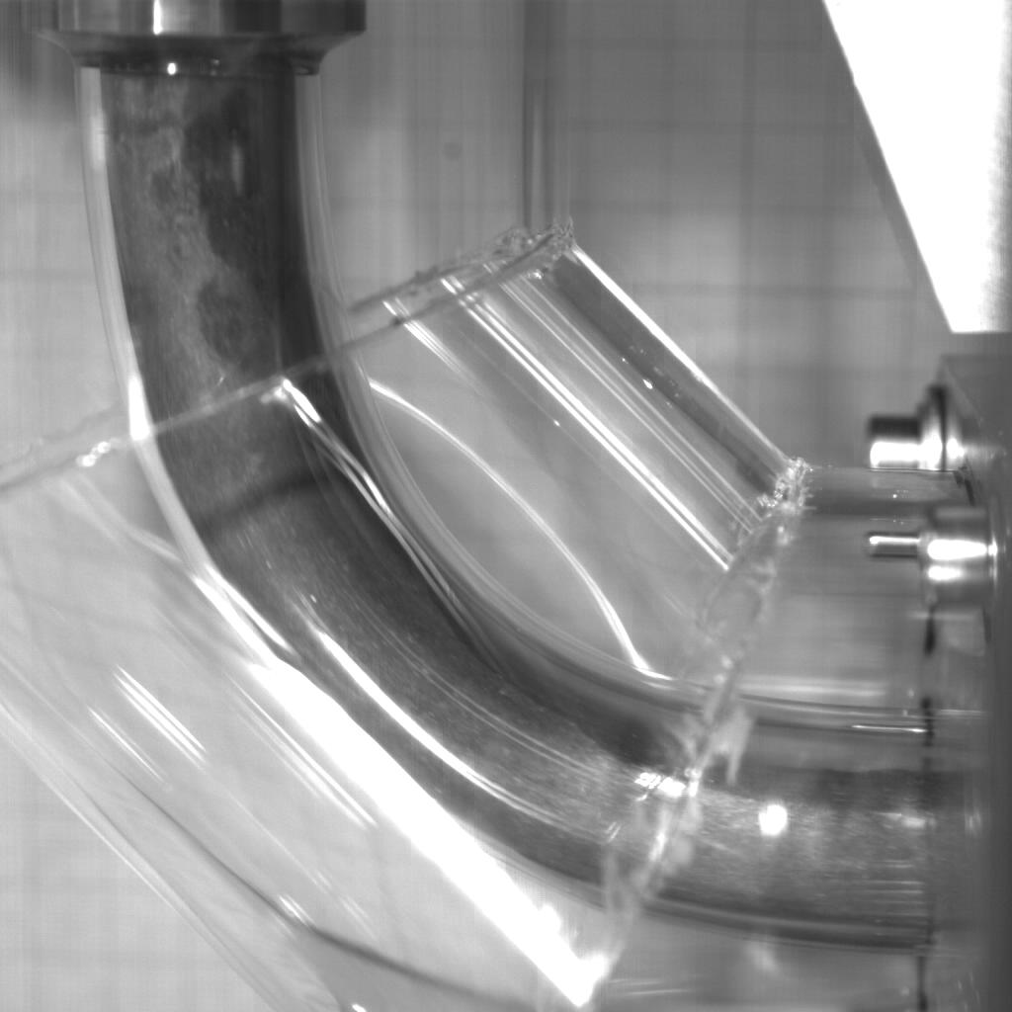
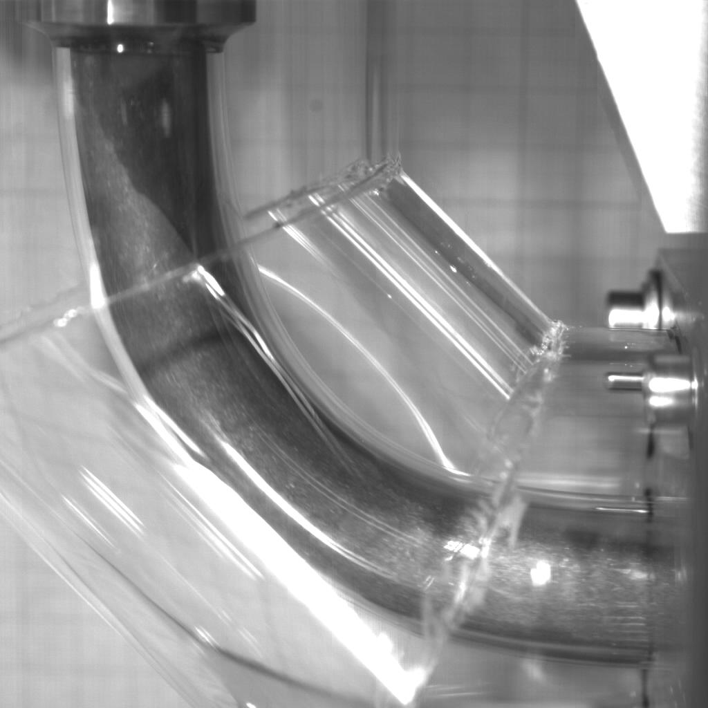
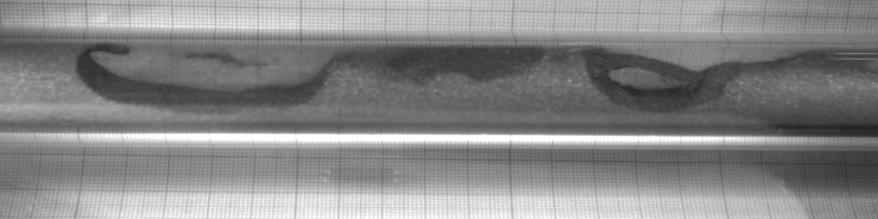
Improving diagnostics to increase the solid fraction
glass parts tube show early stages of phase separation
O’Dell - Loveridge

Slide 14
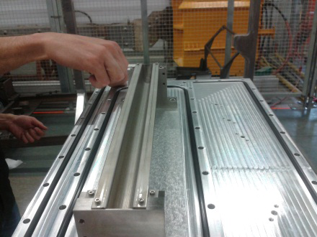
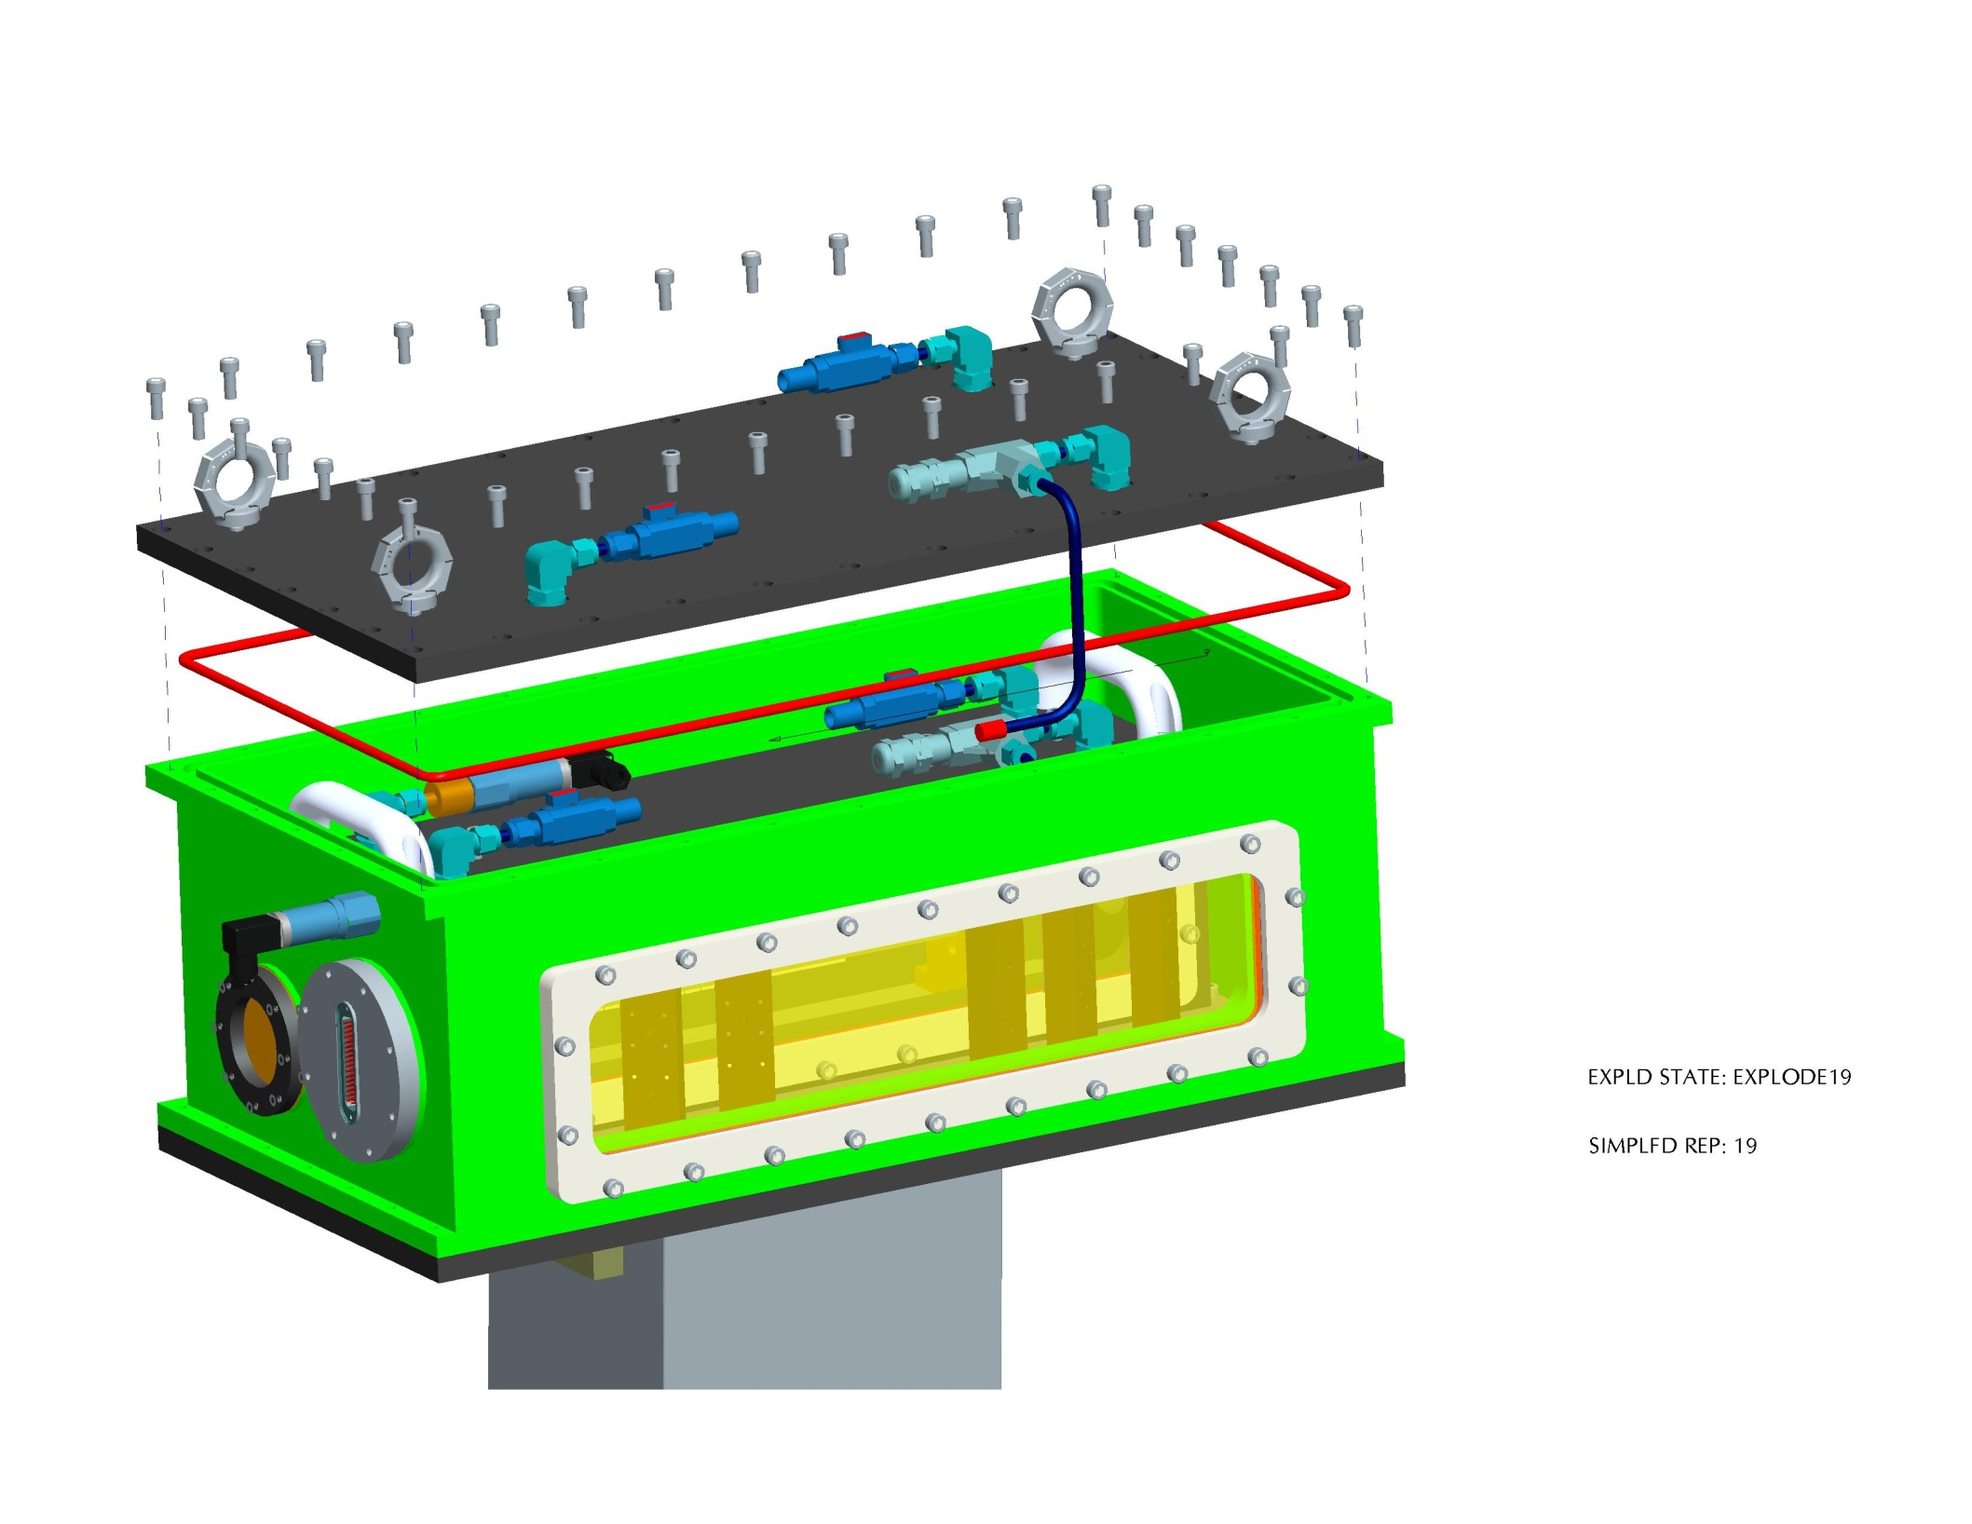
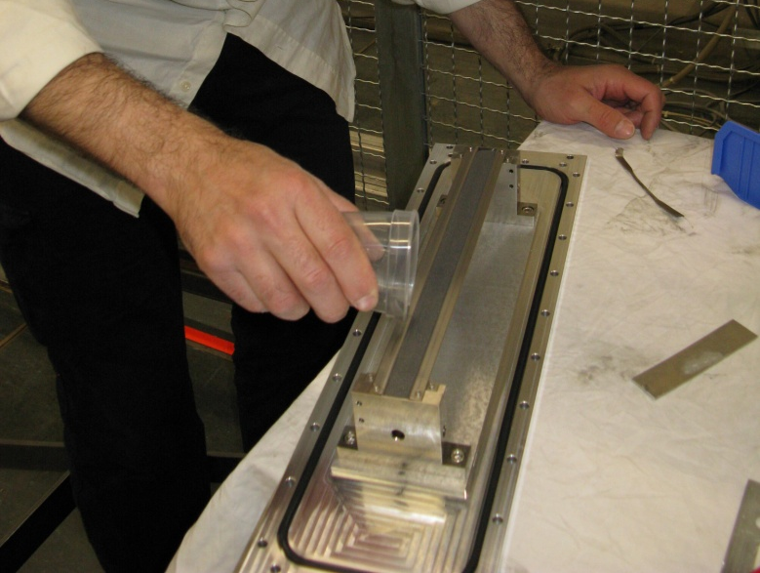
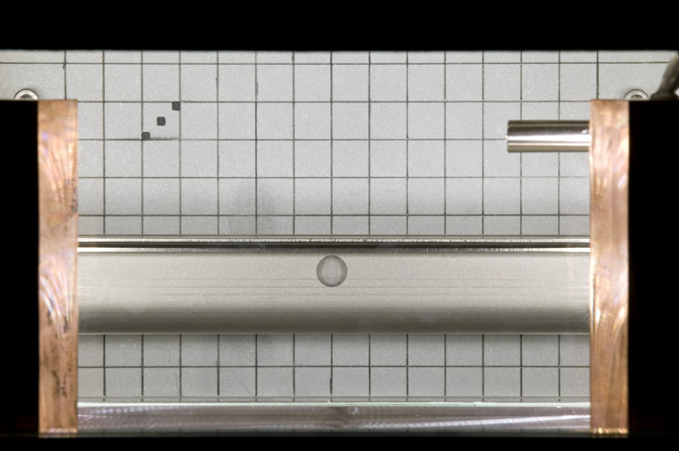
In beam tests at CERN
Beam
LDV/camera
Open trough Assembly
Beam
LDV/camera
Filling with Tungsten Powder
Lift Table
Tungsten powder sample in an open trough configuration
Helium environment
Two layers of containment with optical windows to view the sample
Remote diagnostics via LDV and high-speed camera
View from high speed camera

Slide 15
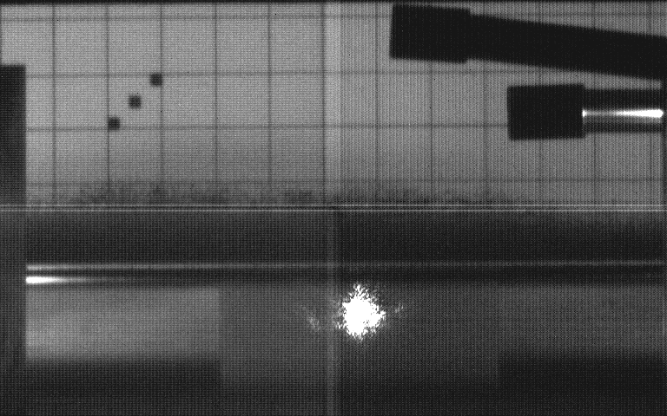
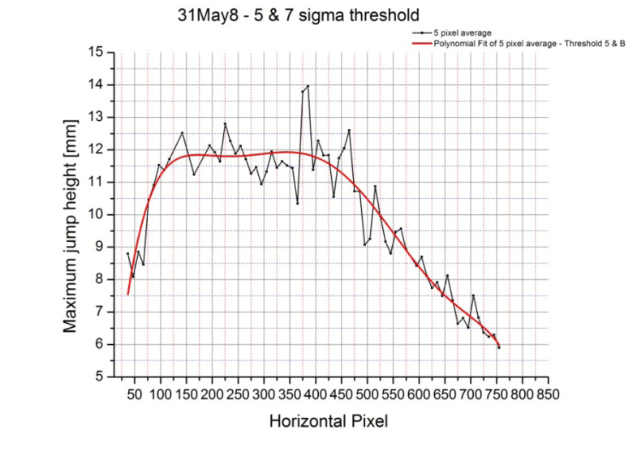
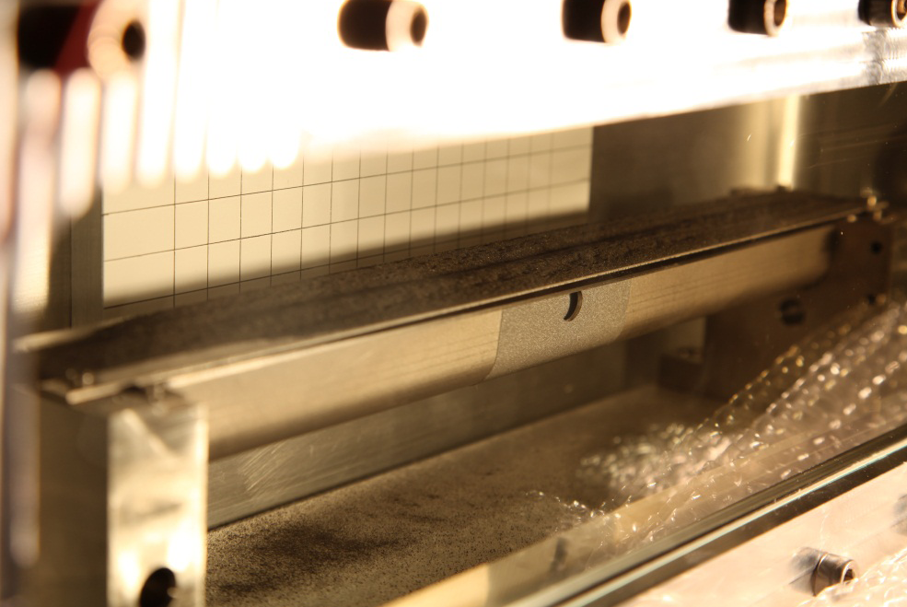
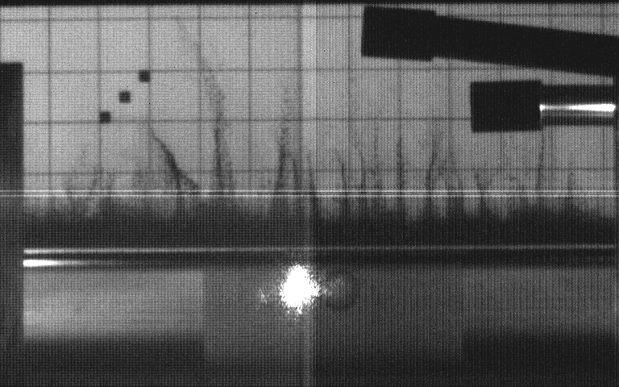
Charitonidis
Lift height correlates with deposited energy
HSV
Shot #8, 1.75e11 protons
Note: nice uniform lift
LDV
Shot #9, 1.85e11 protons
Note: filaments!
Trough photographed after the experiment.
Note: powder disruption

Slide 16
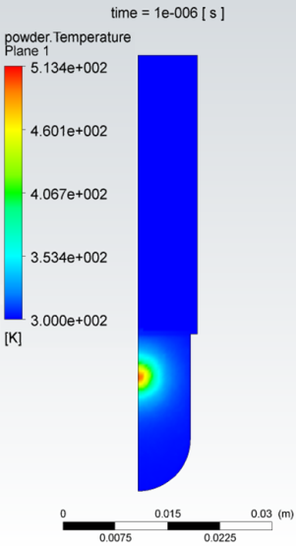
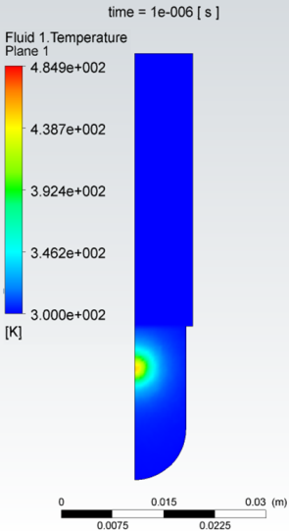
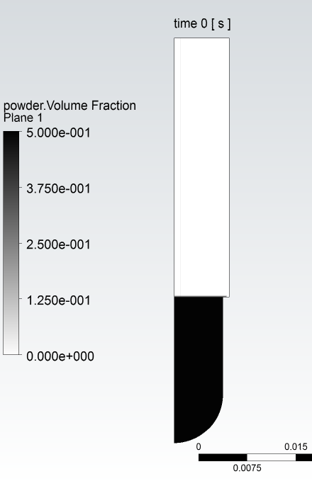
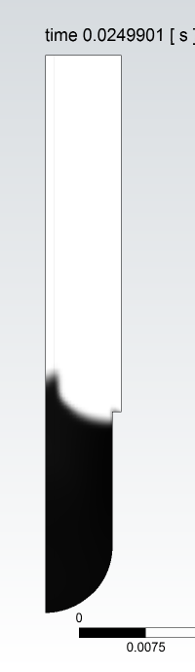
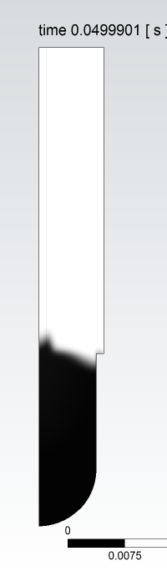
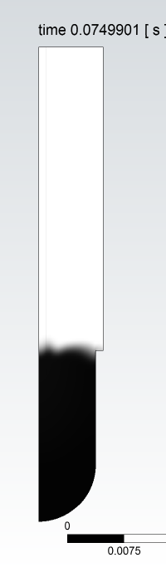

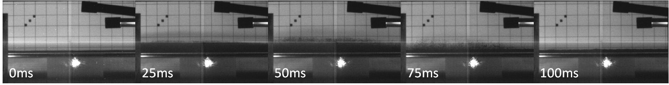
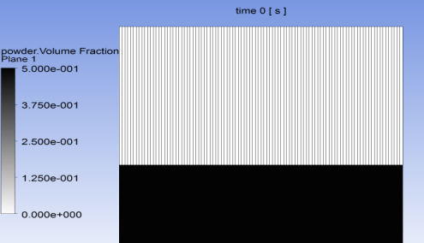
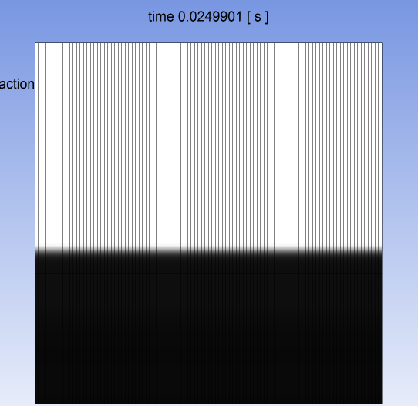



Davenne: CFD predictions/post fits
Beam heating
Powder lift was predicted by CFD
However the energy to lift the powder was found in the experiment to be an order of magnitude smaller than predicted
So is the lift:
aerodynamic?
stress propagation?
electrostatic?
Test Results from Shot #8, 1.75e11 protons, beam sigma 0.75 mm x 1.1 mm
CFD simulation of Shot #8, assuming 1 micron particle size
(n.b. no lift with 25 micron particles at this intensity)

Slide 17

Tungsten powder puff experiment:
understanding the powder lift
piston
Puff cell

Slide 18


Tungsten powder puff experiment
Aim: To compare behaviour of Tungsten powder after a short pressure spike against the behaviour in the HiRadMat experiment
Method: Use a short pressure pulse to lift the powder
Notes:
All experimental data and videos can be found in: \\te9files.te.rl.ac.uk\HPTshr\rachel\Powder puff experiment
in the various Powder Puff # folders
\\te9files.te.rl.ac.uk\HPTshr\rachel\Powder puff experiment\Powder puff test setup photos contains images of the test setup

Slide 19



Tungsten powder puff experiment
The maximum height reached by the powder is proportional to the energy put in by the compression of the piston
The powder sample containing smaller particles was lifted higher than the sample containing only larger particles
The acceleration is faster that can be captured with 1kHz HSV
0 to 300 um
150 to 212 um
There is a threshold energy which has to be reached before the powder begins to lift. The threshold depends on the depth of the powder
Notes:
Analysis has been carried out on data for Powder Puffs 2, 3, 4 and 8 with the excel spreadsheets in the relevant folder

Slide 20




Tungsten powder puff experiment
Powder depth = 13.5mm
Powder depth = 15.5mm
Powder depth = 22.5mm
The smaller the depth of powder, the larger the maximum powder height reached

Slide 21



Understanding powder lift
Pressure drop for air flowing through a bed of powder
Atherton, Davenne
Notes:
\\te9files.te.rl.ac.uk\HPTshr\rachel\Fluidised bed experiment\Videos (106 to 150 microns)

Slide 22




Packed bed experiment
Experimental pressure drop measured across a packed bed of W powder is in line with the analytical pressure drop given by Ergun (employed by CFX)
Notes:
Measured data for fluidised bed experiment is here: \\te9files.te.rl.ac.uk\HPTshr\rachel\Fluidised bed experiment
called Pressure drop data v3.xlsx
Calculations for expected pressure drop can be found here: \\te9files.te.rl.ac.uk\HPTshr\rachel\Fluidised bed experiment
1. Pressure drop calculations v2.xlsx
2. Tungsten_FLuidization v2.xlsx (Andrew’s document)
These calculations are based on equations from: http://www.umich.edu/~elements/12chap/html/12prof2a.htm

Slide 23
Tungsten Powder programme live areas of work
  Rig improvement
    Increasing the solid fraction
    CW upgrade
    Calorimetry
  In beam tests HiRadMat
    Understanding factor/factors for beam powder lift
      aerodynamic
      stress propagation
      Electrostatic
      a combination of all the above

Slide 24
Peripherally cooled cylindrical monolith targets have limited heat dissipation capability and experience high steady state and dynamic stresses.
Segmented internally cooled stationary targets can accommodate much higher heat loads and higher power densities.
A pebble bed target such as that proposed for EURONu is probably the ultimate segmented target and may be relevant for other facilities where a solid cylindrical target is not viable. R & D in pebble bed and other segmented targets would be beneficialfor future neutrino facilities and neutron sources alike.
At higher beam powers it may become necessary to employ flowing (powder and liquid metals) or rotating targets and that is why research in this area is required.
Physics performance is a function of reliability as well as optimum particle yield so the simplest target design possible is often the best choice.
Conclusions

