Slide 1
High flux heat transfer in a target environment
T. Davenne
High Power Targets Group
Rutherford Appleton Laboratory
Science and Technology Facilities Council
2nd PASI meeting
5th April 2013

Slide 2
Contents
Radiation Cooling
Forced Convection
Nucleate Boiling
Critical Heat Flux
Other ideas
Summary

Slide 3

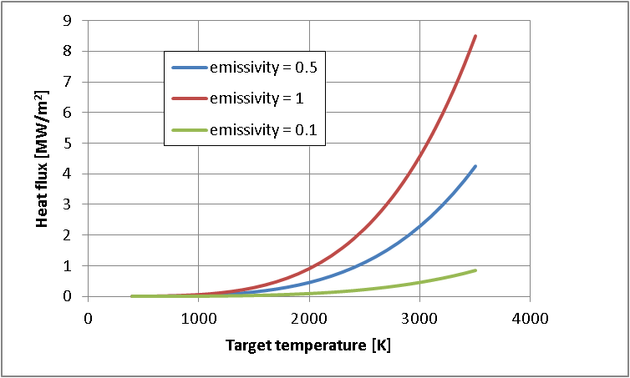
Radiation cooling
High temperatures require refractory metals and also good vacuum
quality to avoid target loss through oxidation and evaporation cycles

Slide 4

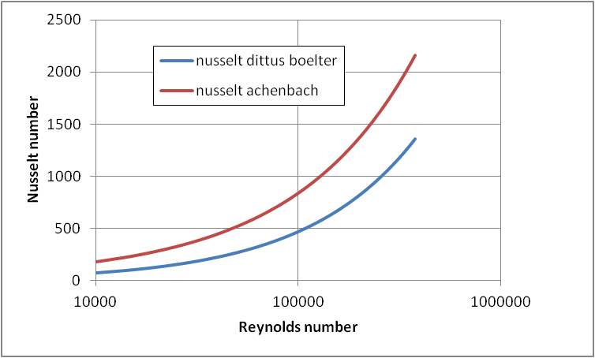



Forced Convection
Consider turbulent heat transfer in a 1.5mm diameter pipe –
Dittus Boelter correlation
N = 0.4 for fluid being heated
Valid for:
Achenbach correlation for heat transfer in a packed bed of spheres
Max power density for a sphere

Slide 5
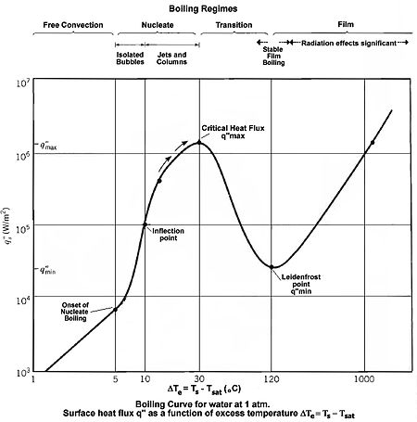
Nucleate Boiling
Vapour bubbles forming at nucleation sites and separating from the heated surface thus enhances mixing and heat transfer
Critical heat flux >1MW/m²
Heat transfer driven by temperature difference alone, i.e. Plate above boiling temperature of water and no forced convection

Slide 6
Critical heat flux forced convection water flow (original graph Wimblett)
Water temp = 40PSI
Temp = 30 to 50°C
10MW/m²
Burn out curve
Nucleate boiling
Forced convection no boiling
2MW/m²
ISIS TS2
ISIS TS1
Burnout flux sensitive to channel thickness
5m/s
10m/s
15m/s

Slide 7
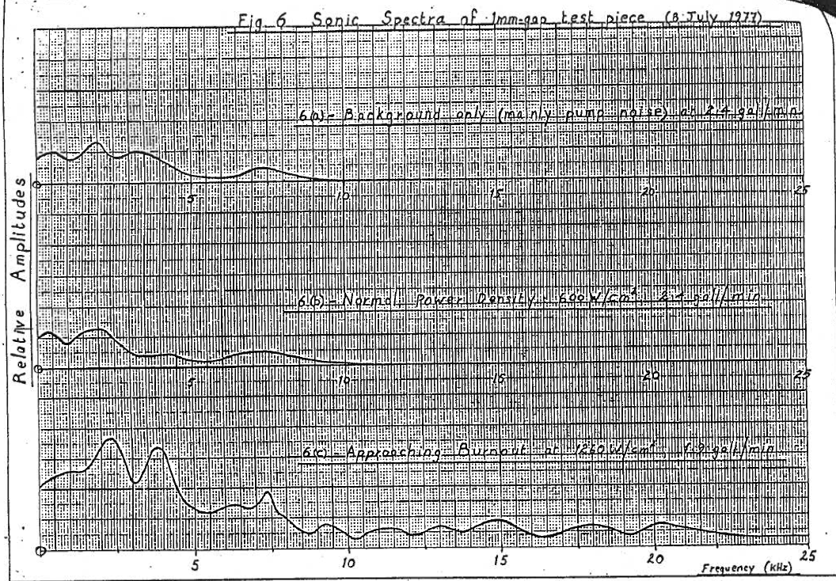
Acoustic transducer used to detect burnout
Wimblett & Coates 1978
Maximum heat flux could be achieved by monitoring for burnout
Heat flux may be limited by erosion due to high water velocities

Slide 8
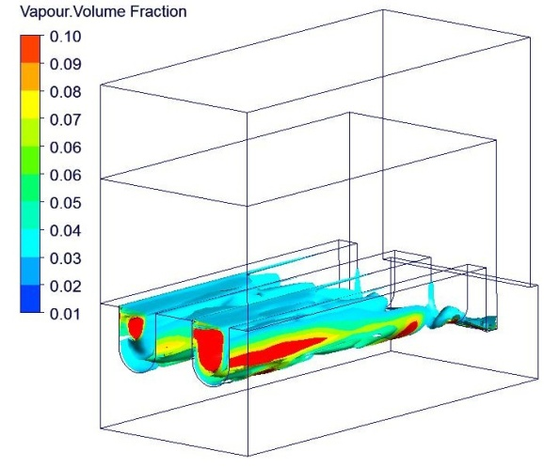
Other ideas
Hypervapotrons
Water cooled finned heat exchangers developed to cope with the high heat fluxes present in experimental fusion devices and ancillary systems.
Water flow, heat load and channel width tuned to generate a repetitive cycle that moves steam out into the sub cooled bulk flow.
Typically, these can sustain power densities of up to 20-30 megawatts/m² in steady-state, using water at flow velocities < 10 m/s and operating pressures < 10 bar.
Nanofluids
Water-based nanofluids (suspensions of 0.001-10% nanoparticles, <100nm) have the potential to deliver much improved cooling while retaining the advantages of water.
10-14% increase in convective/conductive heat transfer and 100-200% increase in critical heat flux have been reported.
Long-term stability of nanofluids, the deposition of particles, and their effect on erosion are not well understood.
Falter and Thompson
Jet
S. K. Das et al., Nanofluids, First ed., John Wiley & Sons, 2007

Slide 9
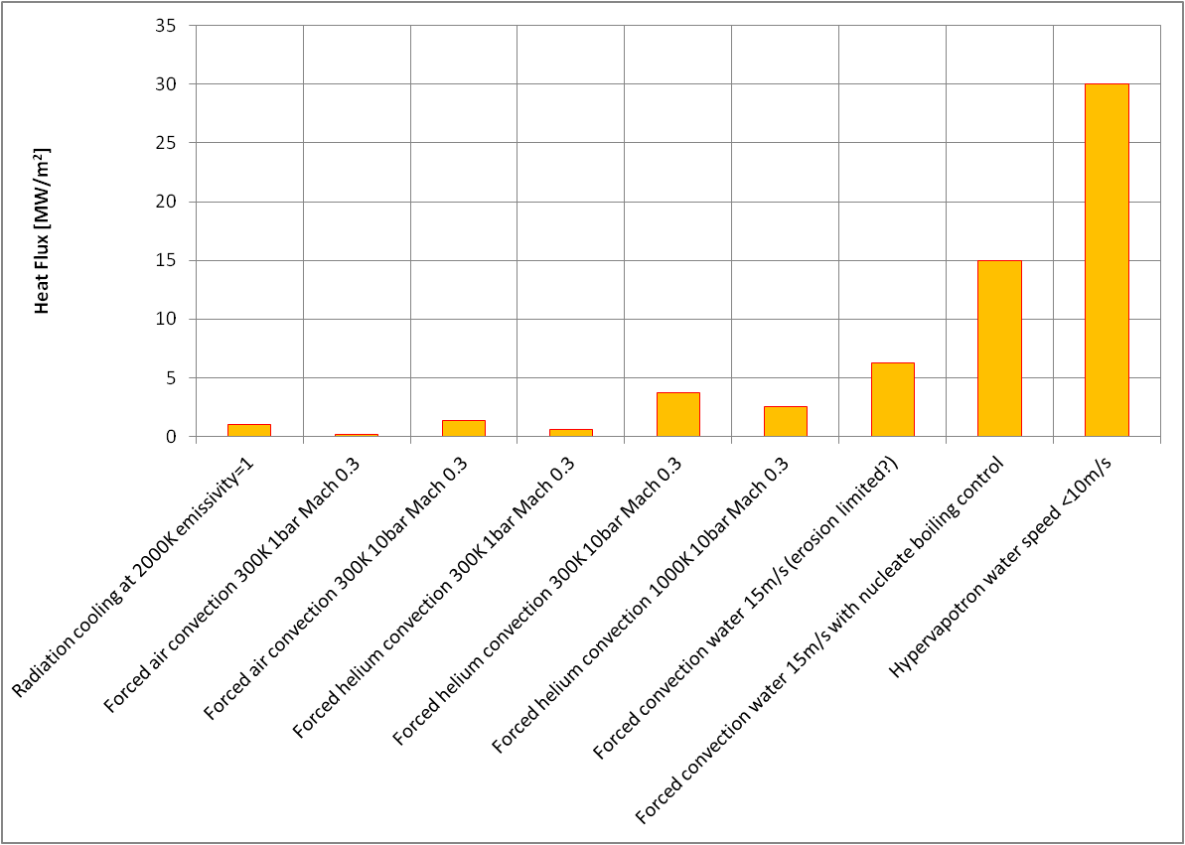
Summary

Slide 10

The Calculation of Critical Heat Flux in Forced Convection Boiling
P. B. Whalley, G. F. Hewitt, P. Hutchinson
0 Reviews
Atomic Energy Research Establishment, 1973 - 17 pages
International Journal of Heat and Mass Transfer
Volume 30, Issue 11, November 1987, Pages 2261–2269
Critical heat flux of forced convective boiling in uniformly heated vertical tubes with special reference to very large length-to-diameter ratios
Journals > Heat Transfer Research > Volume 33, 2002 Issue 5&6 > Calculation of Critical Heat Flux in Natural and Forced Convection Boiling

