Slide 1
Static & dynamic stresses from beam heating in targets & windows
T. Davenne
High Power Targets Group
Rutherford Appleton Laboratory
Science and Technology Facilities Council
2nd PASI meeting
5th April 2013

Slide 2
Contents
Steady state and transient stress (non inertial)
Elastic stress
Plastic stress -
shakedown
ratcheting
Inertial Stress
Elastic waves
Plastic Waves
Shock Waves

Slide 3
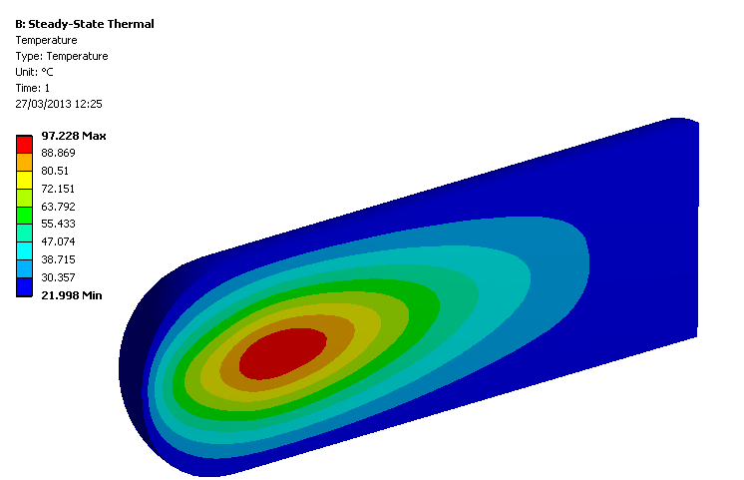
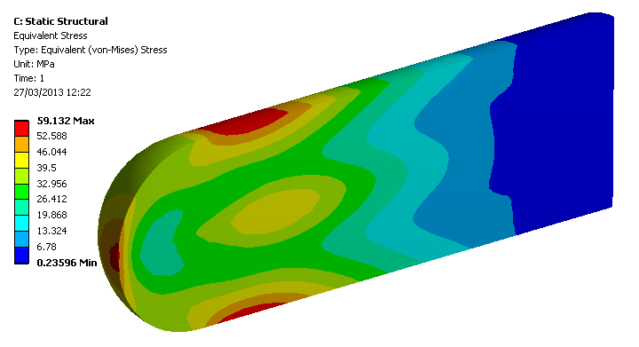
Elastic stress (non inertial)
(reversible, small strain deformations)
Typical temperature contour in a cylindrical target
A ‘continuous’ beam results in constant heat power deposited within a target
The target is cooled resulting in a temperature gradient (which primarily depends on power deposition, thermal conductivity and geometry)
BEAM
As a result of thermal expansion and the temperature gradient a stress field is setup within the target
Von-Mises Stress as a result of temperature contour

Slide 4
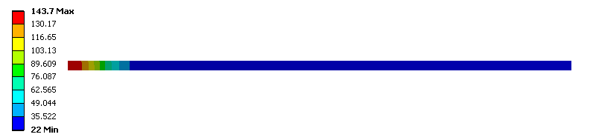
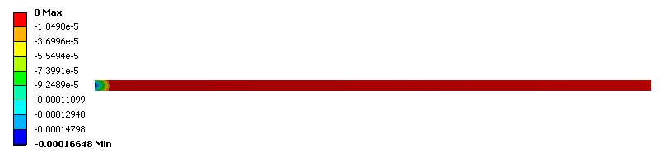
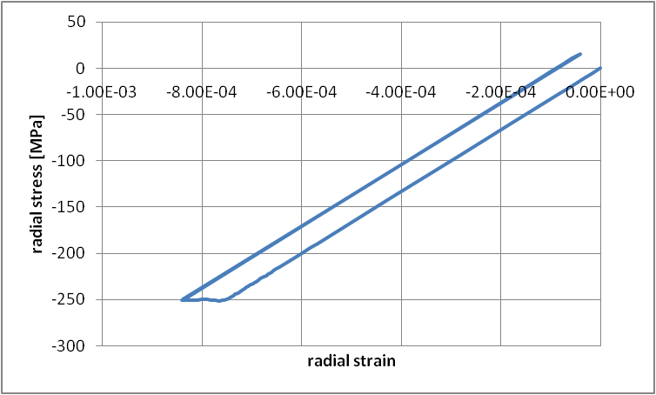
Plastic stress (non inertial) stress exceeds yield point and plastic deformation occurs
Consider the stress and strain near the centre of a window heated by a ‘large’ beam pulse
Plastic deformation starts to occur at point A until the point of maximum compressive stress occurs at point B.
If the window is then cooled back to ambient temperature the stress unloads along the line B-C.
Point C has a small amount of tension resulting from the plastic deformation.
If the window is heated again by the same amount the stress will reach point B without any further plastic deformation.
Beam window temperature profile [°C]
Plastic strain occurring at centre of window
C
σ_{yield}
B
A
D
Point D represents stress prediction with
a simple linear model

Slide 5
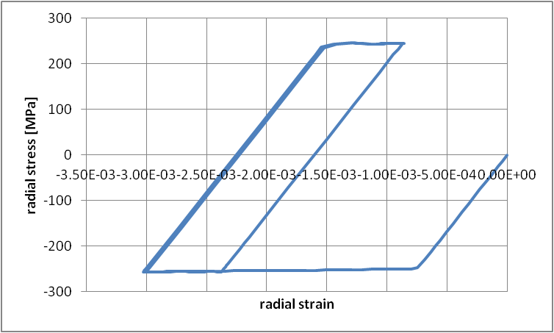
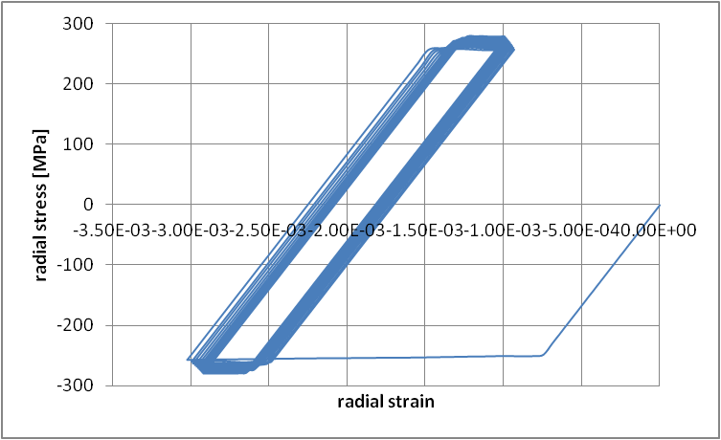
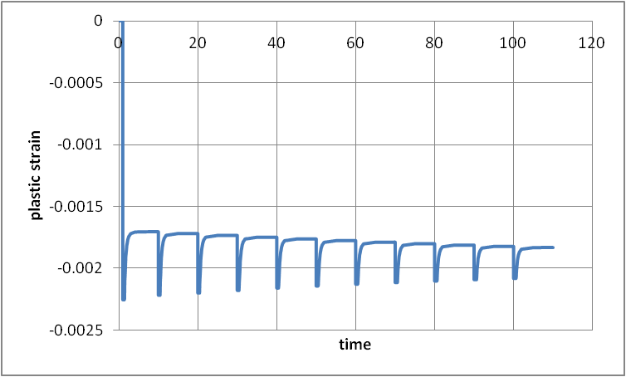
Plastic stress – shake down
Plastic shakedown behavior is one in which the steady state is a closed elastic-plastic loop, with no net accumulation of plastic deformation
Consider more significant heating to the window resulting in significantly more plastic deformation between A and B.
Unloading now follows line B-C thus setting up a loop of repetitive cycles of plastic deformation
C
2σ_{yield}
Kinematic hardening model
B
A
If the yield stress increases following plastic work then the magnitude of the cyclic plastic deformation reduces until return to the elastic regime.
Isotropic hardening model

Slide 6
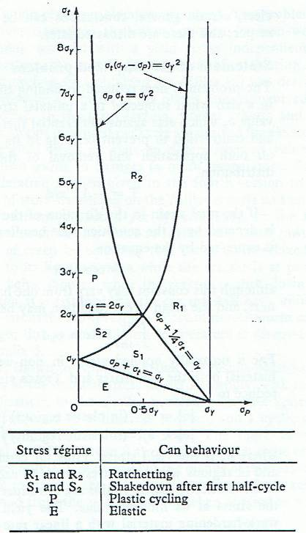
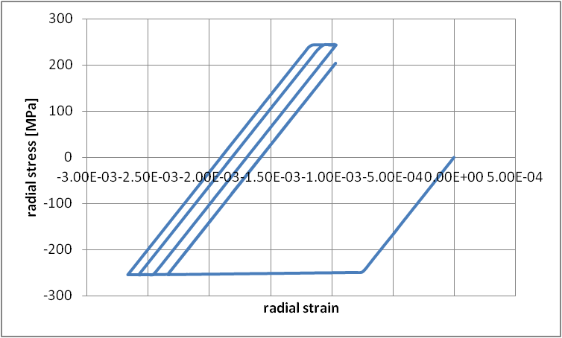
Plastic stress – ratcheting
Ratcheting behavior is one in which the steady state is an open elastic-plastic loop, with the material accumulating a net strain during each cycle
UNSTABLE Ratcheting behaviour observed by increasing window thickness
G E C
Bree diagram shows regions where ratcheting can occur
F D B
A

Slide 7
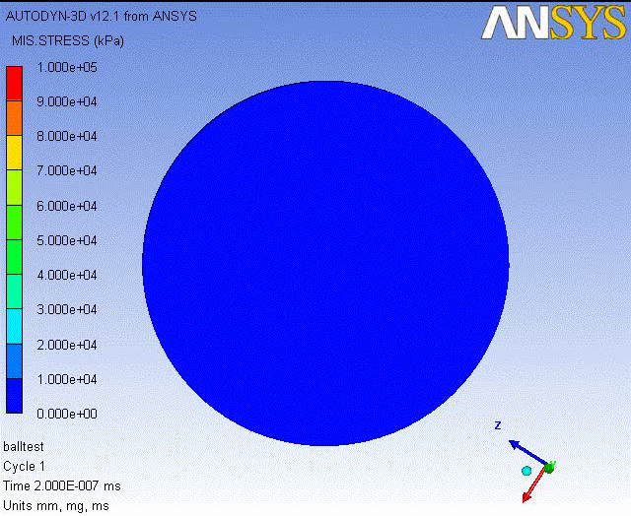
Inertial Stress - Elastic Waves
Stress waves with a magnitude below the yield stress propagating with small reversible deflections
Consider a spherical target being rapidly and uniformly heated by a beam pulse.
If it is heated before it has had time to expand a pressure/stress occurs. This results in oscillating stress waves propagating through the target as it expands, overshoots and contracts again.
The waves travel at the speed of sound in the material. (longitudinal or shear sound speeds)
Stress depends on heating time

Slide 8
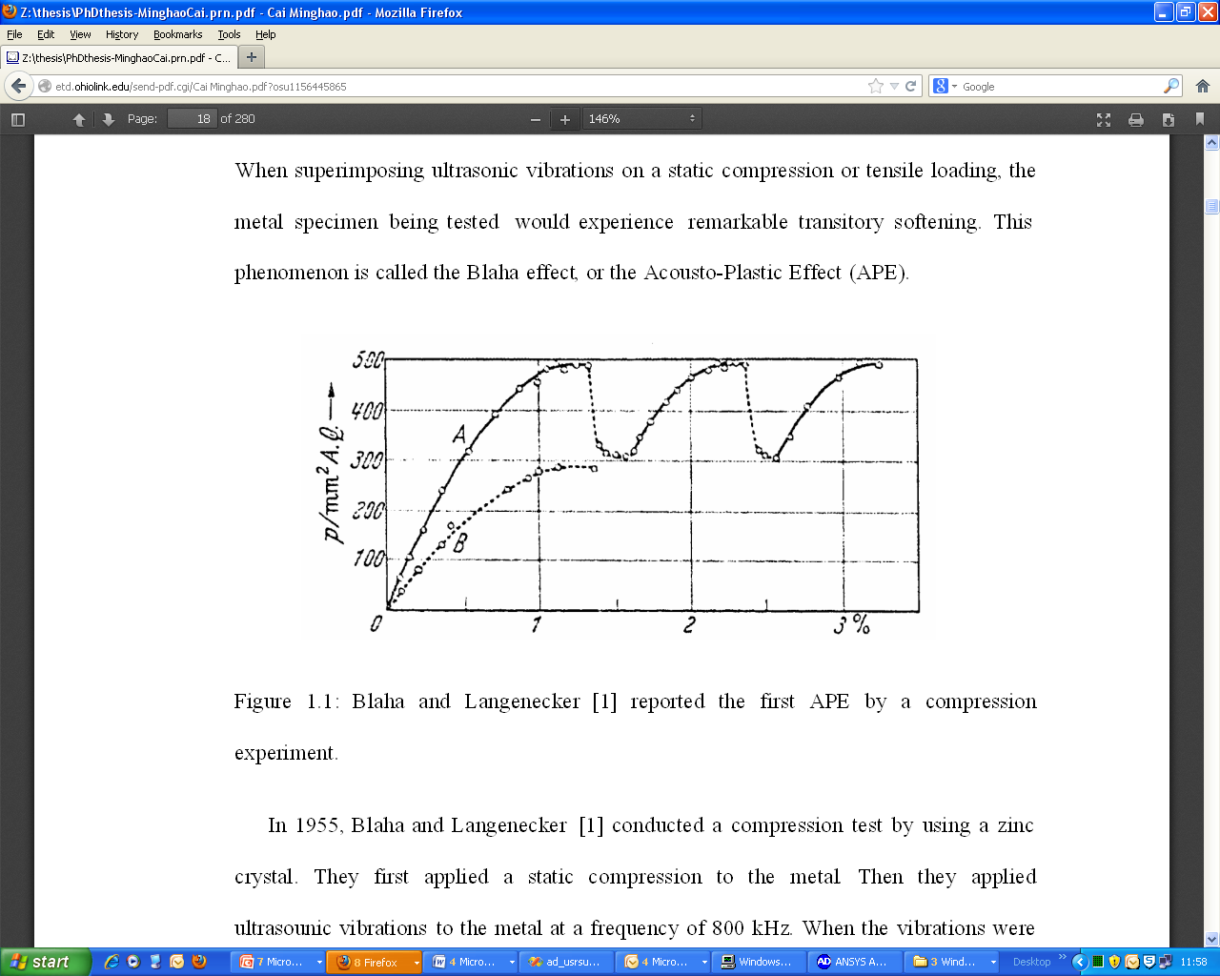
Inertial Stress - Plastic Waves
If a pulse is transmitted to a material that has an amplitude exceeding the elastic limit the pulse will decompose into an elastic and a plastic wave
Plastic waves travel slower than acoustic elastic waves due to the dissipative effect of plastic work
But what is the dynamic yield point?
Material | Hugoniot Elastic Limit [GPa] Meyers | Typical static yield point [Gpa]
2024 Al | 0.6 | 0.25
Ti | 1.9 | 0.225
Ni | 1 | 0.035
Fe | 1-1.5 | 0.1
Sapphire | 12-21
Fused Quartz | 9.8
Strain rate dependance of mild steel Campbell and Ferguson
Do we induce vibratory stress relief by bouncing inertial waves through a target?
Applied ultrasonic vibrations can result in reduced yield stress
Acousto-plastic-effect
Research required in this area

Slide 9




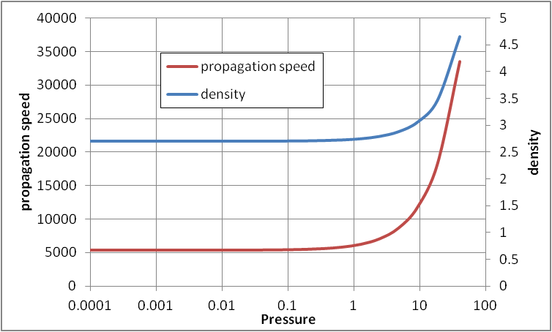
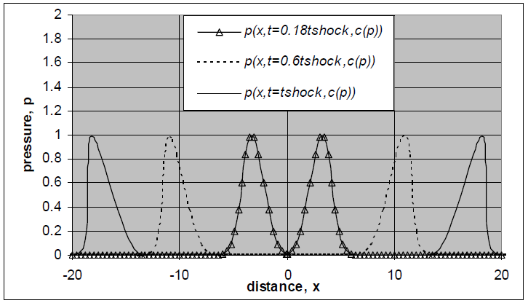
Shock Waves – Inertial
A discontinuity in pressure, temperature and density
Shock waves in solids normally studied using impacts and involve multiple Gpa pressures
Requirement for formation of a shock wave (in a target or window)
Higher amplitude regions of a disturbance front travel faster than lower amplitude regions
Isothermal compression shock compression
plastic
Solution of wave equation with c(p) non linear steepening
elastic
shock
GPa
High pressures required for non-linear wave
steepening
Geometric spreading of waves in targets results
in a reduction in wave amplitude
Acoustic attenuation of wave energy opposes
Non-linear steepening (ref Goldberg number)
Formation of a shock wave from a beam induced
pressure wave is unlikely

Slide 10
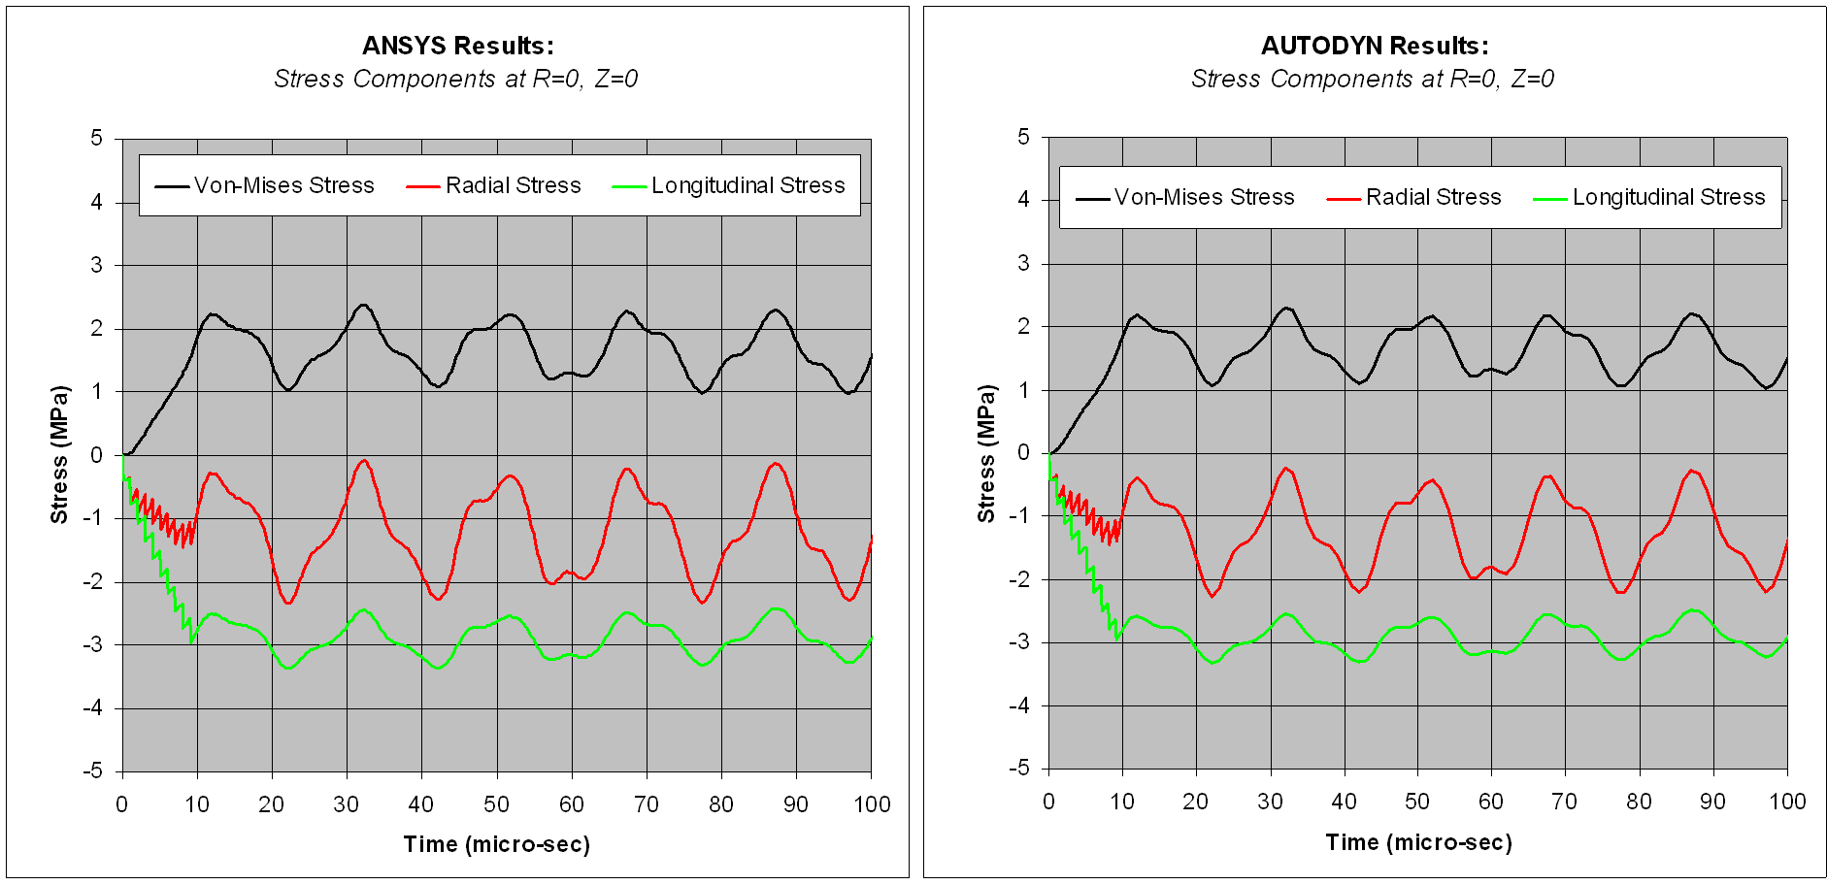
ANSYS Classic vs AUTODYN for inertial stress modelling
Comparison of implicit and explicit finite element codes in the elastic regime
P.Loveridge
Autodyn time step limited by Courant number stability criteria, sometimes may be able to get away with slightly longer timesteps using implicit method, still needs to be short enough to capture physics
ANSYS classic has advantages for temperature dependant material modelling in the elastic and plastic regions
Autodyn shock equations of state are for high compressions – shock EOS data not employed in this calculation as compression is small
No option to enter tangent modulus – inertial plastic wave simulations as yet not attempted
Explicit method does offer stability for highly non linear phenomena if you have them
Before employing Autodyn or LS-dyna be certain you are in a regime where you need it, are the equations of state and material strength models relevant to your problem?

Slide 11
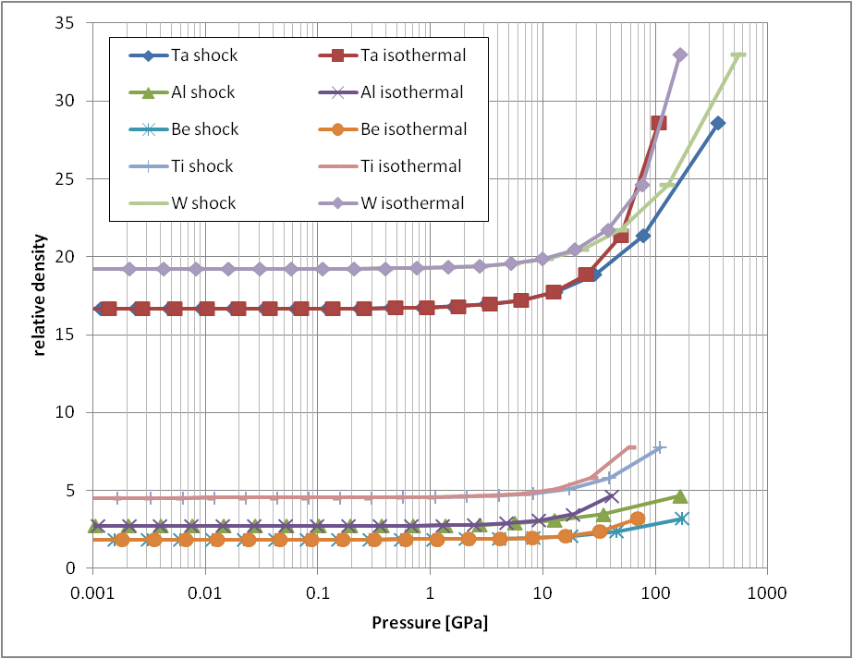
Asay & shahinpoor

