Slide 1
Tungsten Status
Chris Densham (RAL)
Yongjoong Lee (ESS)
19 May 2014

Slide 2
Talk outline
Review of current knowledge of irradiated tungsten
PIE possibilities
(Call for) interested parties and potential collaborators
ESS Tungsten status report (Yongjoong Lee)

Slide 3
(UK) National Nuclear Laboratory Literature Review
On The Irradiation Response Of Be, W And Graphite for Proton Accelerator Applications
R.B. Jones (BazNutec), G. Hall (Manchester), B. Marsden (Manchester) and C. A. English (NNL), November 2013
Report not publicly available until copyright issues on all materials data resolved

Slide 4
NNL Literature review
Topic | Comments on data reviewed
Information on irradiation induced microstructure | Quantitative TEM information on loops, voids and matrix dislocation density at 600°C and 800°C for low doses ~ 0.15 dpa. TEM of W and He ion-irradiated W 300°C-800°C up to 10s of dpa [recent additional news from Oxford]
Void swelling | W is resistant to void swelling (as bcc) Fission neutron data available from 500-1500°C at < 10dpa. Peak swelling is ~1.5% at 800-1000°C.
Gas generation | Greater He and H generation expected for protons cf neutrons H<He for fission neutrons H>He for protons

Slide 5
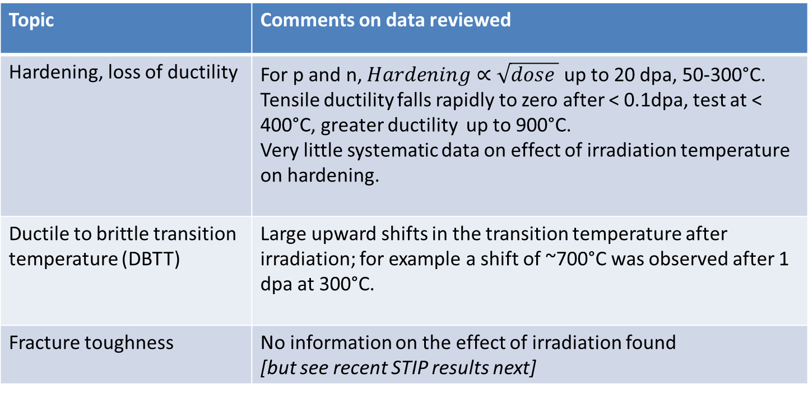
NNL Literature review (II)
Topic | Comments on data reviewed
Hardening, loss of ductility | For p and n, $Hardening∝\sqrt{dose }$ up to 20 dpa, 50-300°C. Tensile ductility falls rapidly to zero after < 0.1dpa, test at < 400°C, greater ductility up to 900°C. Very little systematic data on effect of irradiation temperature on hardening.
Ductile to brittle transition temperature (DBTT) | Large upward shifts in the transition temperature after irradiation; for example a shift of ~700°C was observed after 1 dpa at 300°C.
Fracture toughness | No information on the effect of irradiation found [but see recent STIP results next]

Slide 6
NNL Literature review (III)
Topic | Comments on data reviewed
Irradiation and thermal creep | One datum on irradiation creep, one on stress relaxation. No general conclusions on irradiation creep sensitivity to applied stress and irradiation parameters could be formulated.
Corrosion | Enhanced corrosion rates in de-ionised water occurred due to radiolysis under the proton beam. Cladding of the W target with Ta has been successfully adopted as a remedy.
Physical properties | No data found on the effect of irradiation on physical properties of W [KIT reported to have data on effects of neutron irradiation on thermal conductivity]

Slide 7
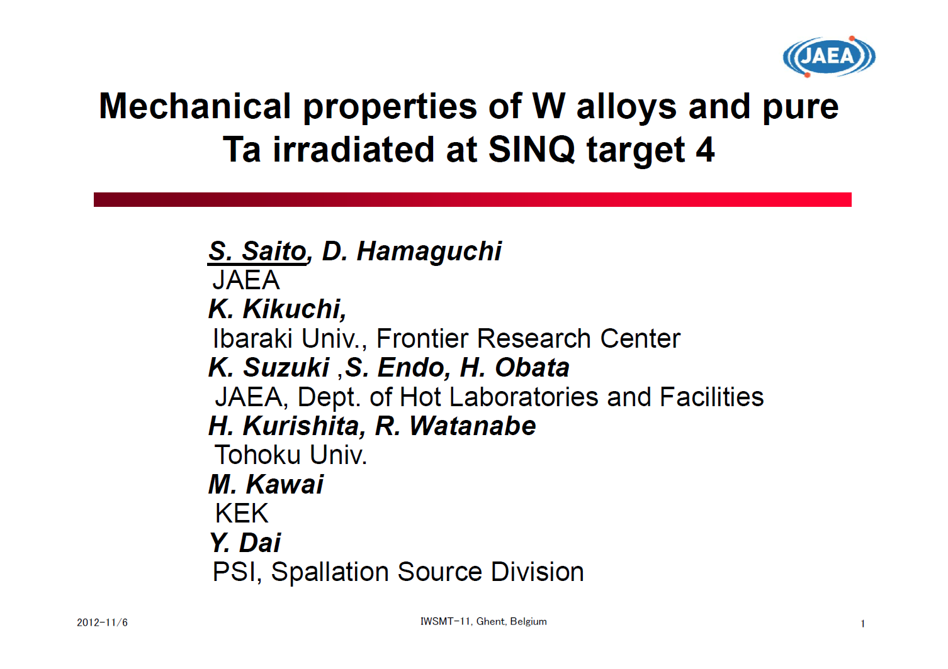

Slide 8
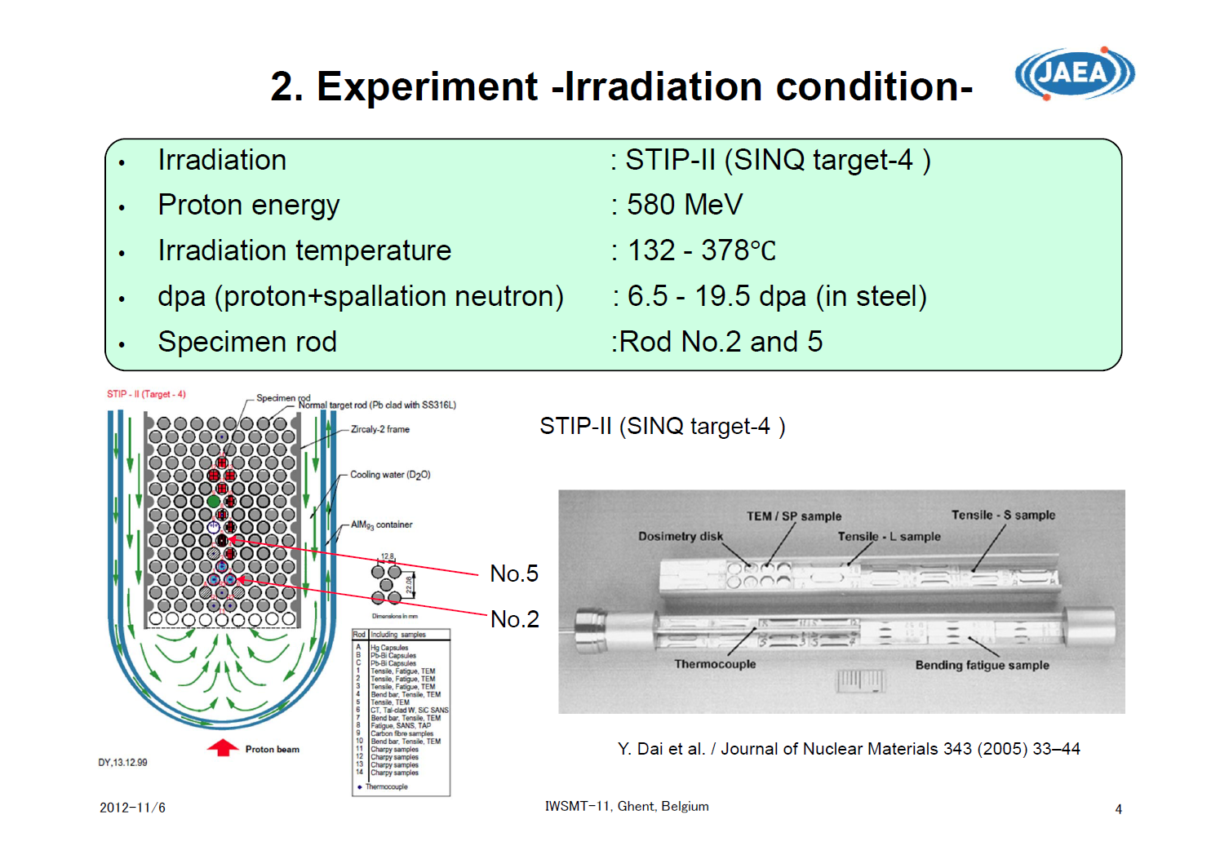

Slide 9
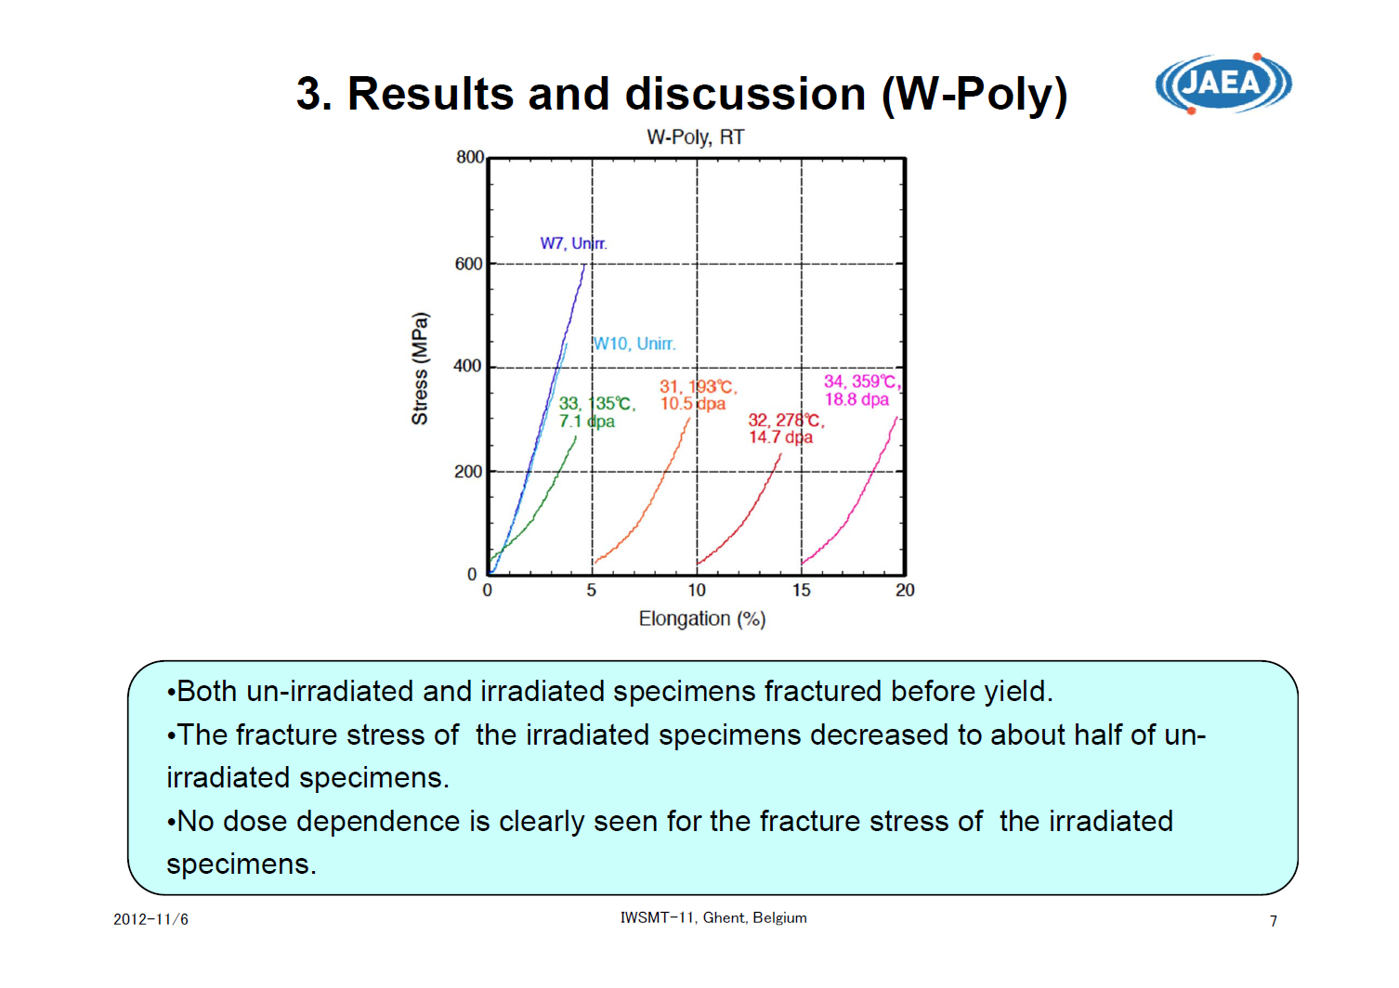

Slide 10
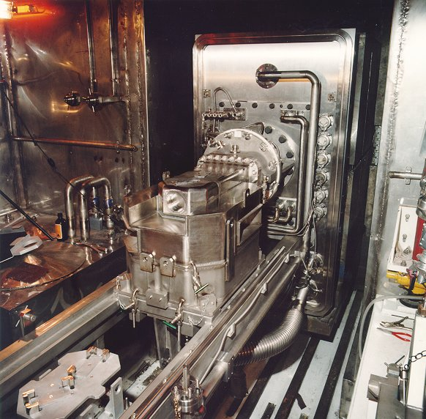
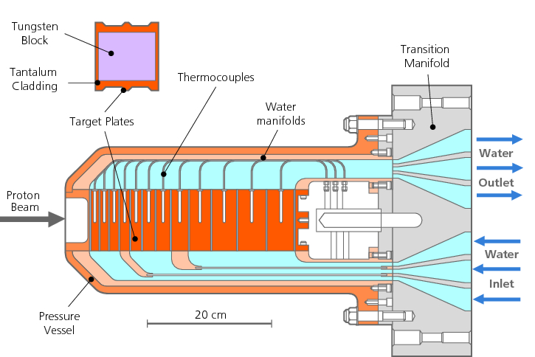
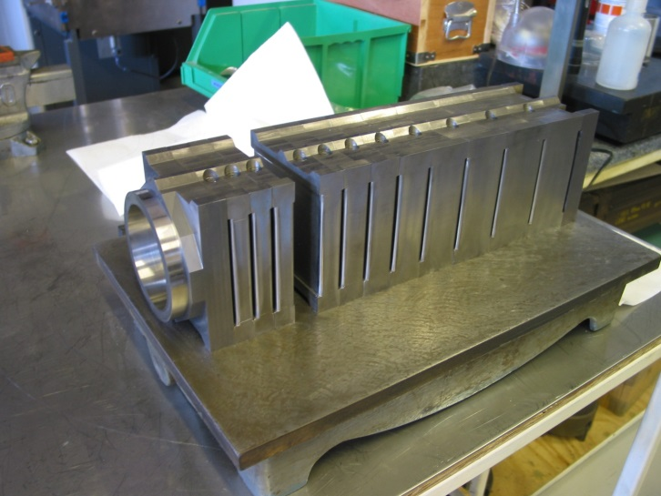
ISIS target (TS1) at RAL

Slide 11
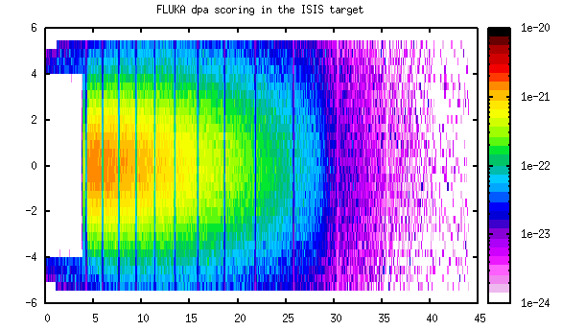
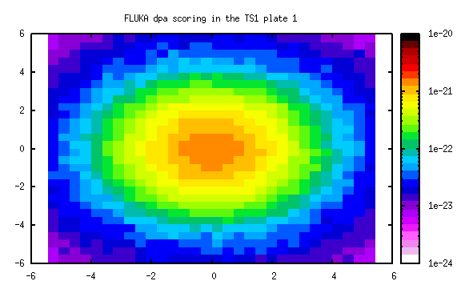
ISIS TS1 summary of FLUKA results (T.Davenne)
Variation of dpa across a target plate
Variation of dpa through out target

Slide 12
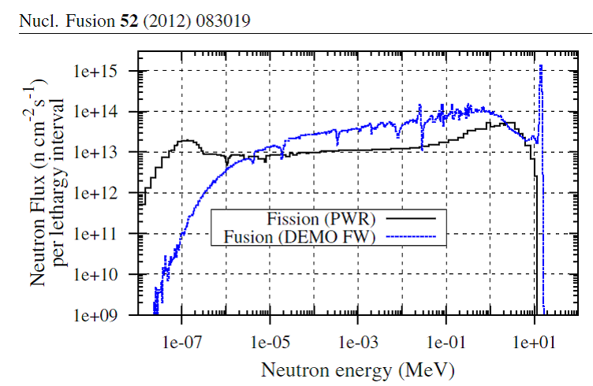
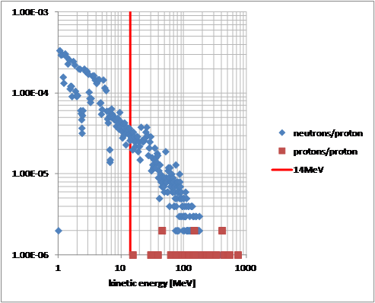
Applicability to fusion materials research? (T.Davenne)
Typical fusion neutron spectrum
Fluka calculation indicates ≈1dpa per fpy in sample corner and the following neutron and proton flux
Consider a sample corner of a TS1 target plate
Tungsten sample corner
Beam

Slide 13
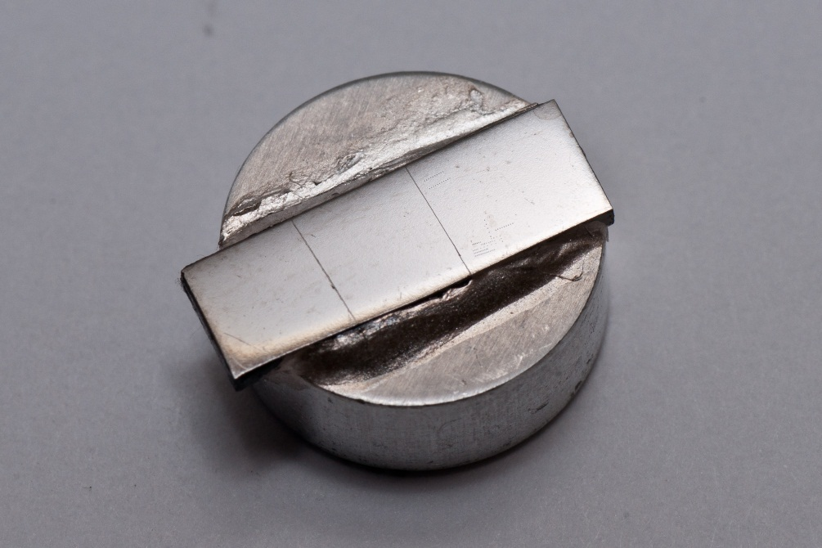
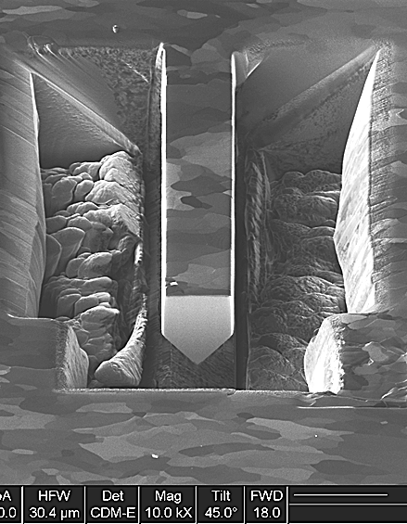

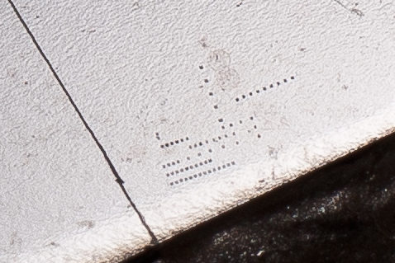
W5Ta micro-cantilever sample (D. Armstrong)
5mm
13

Slide 14
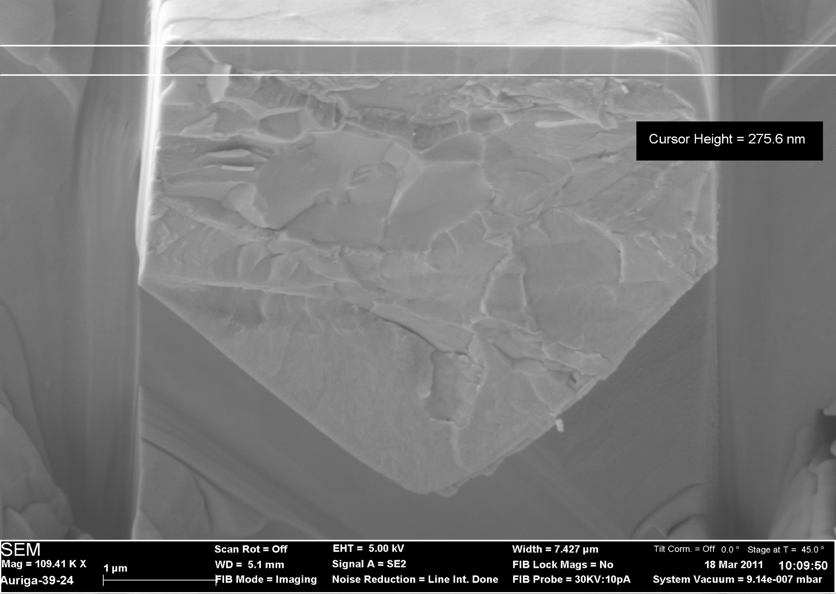
Tested micro-cantilever (D. Armstrong)

Slide 15
Elevated Temperature Results (D. Armstrong)

Slide 16
Updated RaDIATE table of proton irradiated tungsten
Physical Description |  |  | Beam Parameters |  |  | Irradiation Parameters |  |  |  |  |  |  | Status |  | Comments
Name | Quantity | Size and Form | Energy (GeV) | Spot Size (sigma - mm) | Pulse Structure | Average Temp (˚C) | Peak Temp (˚C) | Environment | Peak Proton Fluence (p/cm²) | Peak Damage (DPA) | Gas Production (appm/DPA) |  | Current Location | Activity (Bq)
 |  |  |  |  |  |  |  |  |  |  | He | H
ISIS TS1 | 12 plates | 80 mm height, 105 mm width | 0.8 | 16 | 0.1 µs pulse of 2.5e13 at 50 Hz, 27 years operation | Min: 30, Max: 250 | ΔT/pulse: 10 | water (D₂O) around tantalum clad | 4.96E+22 | ~250 dpa |  |  | RAL | ~10¹³ | 5 years operation, 5 years cooling
ISIS TS2 | 1 | 56 mm diameter, 300 mm length | 0.8 | 6 | 0.1 µs pulse of 2.5e13 at 50 Hz, 4 years operation | Min: 36, Max: 400 | ΔT/pulse: 39 | water (H₂O) around tantalum clad | 5.23E+22 |  |  |  | RAL |  | ~ 1 year target lifetime
BLIP CTE Sample | 5 |  | 0.2 | σx = 9.4, σy = 6.4 | 525 µs pulse of 7.5e13 at 7.5 Hz | 900 | --- | water | 2e13 p/cm².s | 2 |  |  | BLIP-BNL |  | lost mass due to water
BLIP Tensile Sample | 7 |  | 0.2 | σx = 9.4, σy = 6.4 | 525 µs pulse of 7.5e13 at 7.5 Hz | 900 | --- | water | 2e13 p/cm².s | 2 |  |  | BLIP-BNL |  | lost mass due to water
STIP (SINQ) | 2 | rods | 0.58 |  |  | Min: 132, Max: 378 | --- |  |  | 6.5 - 19.5 |  |  | PSI |  | PIE carried out on: W-Poly (Tokyo tungsten, 99.99% purity), W-Sin (Tokyo tungsten), W-TiC (Tohoku Univ., W(4N) + TiC(3N), TiC : 0.25 wt.%),W-SUS (Tohoku Univ., W : 93 wt.%, 304L : 7 wt.%)

Slide 17
ISIS target PIE: Potential collaborators
ISIS/RAL
  MD Fletcher, DM Jenkins, JRJ Bennett, TR Edgecock
  CJ Densham, T Davenne, O Caretta, P Loveridge
UK National Nuclear Users Facility (NNUF)
  M O’Brien, C Hardie (Culham Centre for Fusion Energy)
  Sellafield to cut up (£££ quote expected)
  Culham to test (ready Sept 2015)
Oxford (Materials for Fission & Fusion Power)
  SG Roberts, D Armstrong, J Gibson (Micro-fracture tests)
SCK-CEN, Belgium
  I. Uytdenhouwen
JAEA?
KIT?
PNNL?
ESS
  Yongjoong Lee

Slide 18
Tungsten Status Report: ESS
Yongjoong Lee
Materials, Target Division
RaDIATE Collaboration Meeting
May 19, 2014

Slide 19
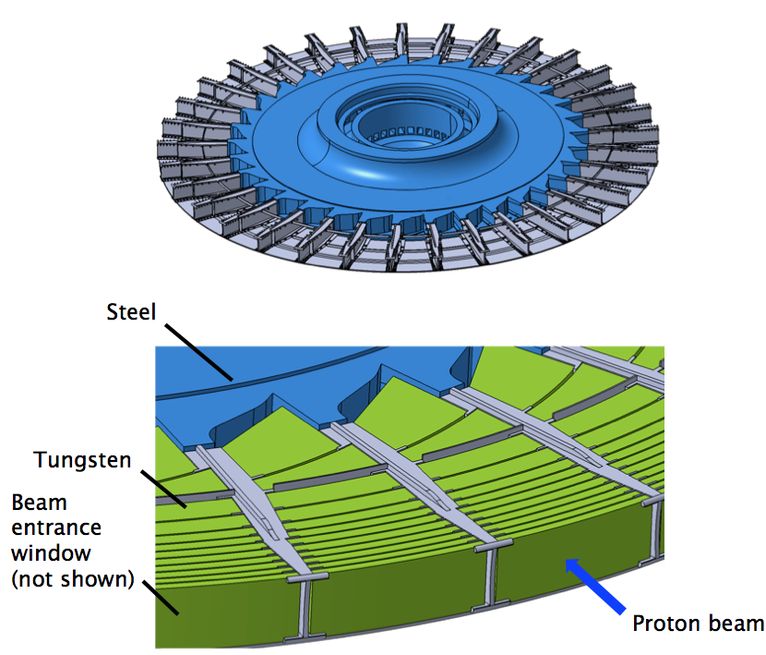
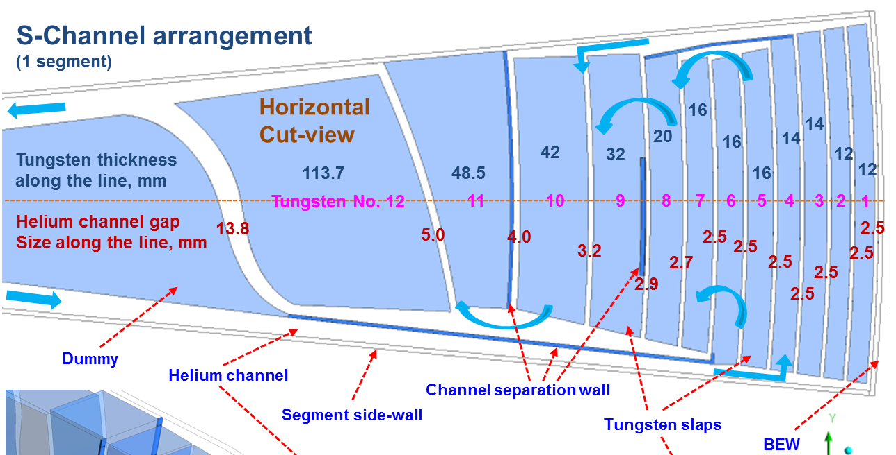
Tungsten at ESS
5 MW spallation source
  5 MW (2.0 GeV/2.5 mA) proton beam
  2.86 ms long beam pulse with 14 Hz repetition rate
Rotating tungsten target:
  Helium cooled target with water cooled backup
Structural integrity of tungsten is important for reliable target operation

Slide 20
Target Material Study Plan
Tungsten
Non-Irradiated
Irradiated
Mechanical Properties
Oxidation in inert gas
Mechanical properties
Thermal properties
DBTT
Tensile strength
Microstructure
DBTT
Fatigue endurance
Tensile strength
Tungsten with coating/cladding

Slide 21



Target Material Study Partners
Partners
  Yongjoong Lee (ESS)
  Jemila Habainy (ESS, LTH)
  Srinivasan Iyengar (LTH)
  Yong Dai (PSI)

Slide 22
Status Report: Mechanical Strength
Tensile and fatigue properties of tungsten at different temperatures are being examined (Lund University)
  Three different vendors were chosen for the tests.
  The mechanical properties of hot rolled and hot forged tungsten specimen are being studied, for different surface smoothness and grain orientations.
Mechanical strength of tungsten at different temperatures are being studied with mini-samples (PSI)
  Small punch test, three point bending tests and tensile tests are being performed.
  The DBTT for the tested specimen are being identified.

Slide 23
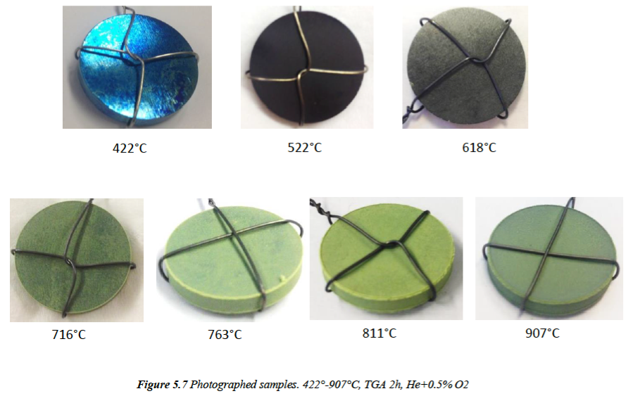
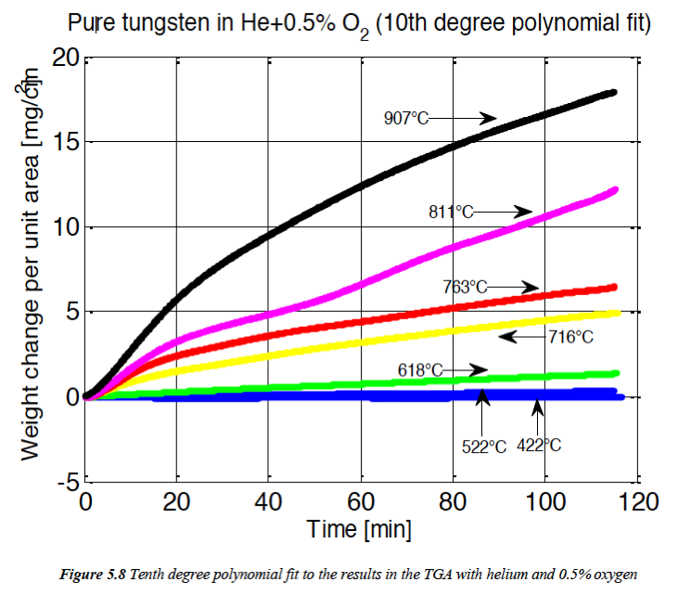
Status Report: Tungsten Oxidation
Tungsten oxidation at different temperatures are being examined (Lund University)
  The tests are being performed in inert gas (Ar, He) with different O2 or H2O impurities
  ”Pure” is not pure enough – Tiny impurity of oxygen ≤ 5·10⁻⁶ atm led to oxidation at 500°C.
  Oxidation was observed from 400°C.
Using WO3 specimen, the threshold temperature for WO3 evaporation in air is being investigated (Lund University)

Slide 24
Status Report: Tungsten PIE at PSI
STIP | Tungsten Type | Dimension | Qty | Irradiation Condition
STIP-V (2007-2008) | HR-W for CSNS | 60 x 8 x 1 [mm3] | 2 | 5-28 dpa at 100-800 C
STIP-VI (2011-2012) | HR-W from Goodfellow | 27 x 5(6) x 0.5 [mm3] | 52 | 5-25 dpa at 100-600 C
STIP-VII (2013-2014) | HR-W from a Chinese vendor | Bend bar | 10 | 5-35 dpa at 100-600 C
STIP-VII (2013-2014) | HR-W from a Chinese vendor | Rods with HIP’ed Ta cladding/canning | 11 | 5-35 dpa at 100-600 C
STIP-VII (2013-2014) | HIP’ed PIM-W from KIT | Bend bar | 5 | 5-35 dpa at 100-600 C
STIP-VIII (2015-2018) | TBD | TBD | TBD | TBD

Slide 25
PIE Plan for STIP-V Tungsten Specimen
PIE | Anticipated Results
Bend tests at high temperatures | Flexure and yield strength
Small punch tests | Tensile strength and ductility
Hardness tests at RT | Irradiation hardening
Thermal diffusion tests at different temperatures | Thermal conductivity and specific heat capacity at different temperatures
Scanning electron microscopy (SEM) | Fracture mode at different doses and temperatures
Transmission electron microscopy (TEM) | Microstructure change at different doses and temperatures
Thermal desorption spectroscopy (TDS) | H, D, T retention

Slide 26
Time Plan: STIP-V Tungsten Specimen
 | Start | Finish
Project Preparation | 2014.01.01 | 2014.03.31
Mechanical tests with cold samples | 2014.04.01 | 2014.09.30
Transport of STIP-V rods to PSI-East | 2014.04.01 | 2014.06.30
Sample preparation for PIE | 2014.07.01 | 2014.09.30
Mechanical and thermal tests | 2014.10.01 | 2015.03.31
Microstructure analyses | 2015.04.01 | 2015.06.30
Thermal desorption spectroscopy | 2015.07.01 | 2015.09.30
Synthesis analysis and report | 2015.07.01 | 2015.09.30
Data analyses and publication of the results | 2015.07.01 | 2015.12.31

Slide 27
PIE of STIP-VI/VII Tungsten Specimen
PIE of each STIP specimen set roughly costs 0.5 MEUR.
STIP-VI are for general material properties of tungsten after irradiation
STIP-VII specimen are for investigating the properties of cladding and canning.
STIP-VIII will include a number of chosen tungsten specimen.
Collaboration can be set up for STIP-VI/VII tungsten PIE.

