Slide 1
EUROnu Beam Window Studies
Stress and Cooling Analysis
Matt Rooney, Tristan Davenne, Chris Densham
Strasbourg June 2010

Slide 2
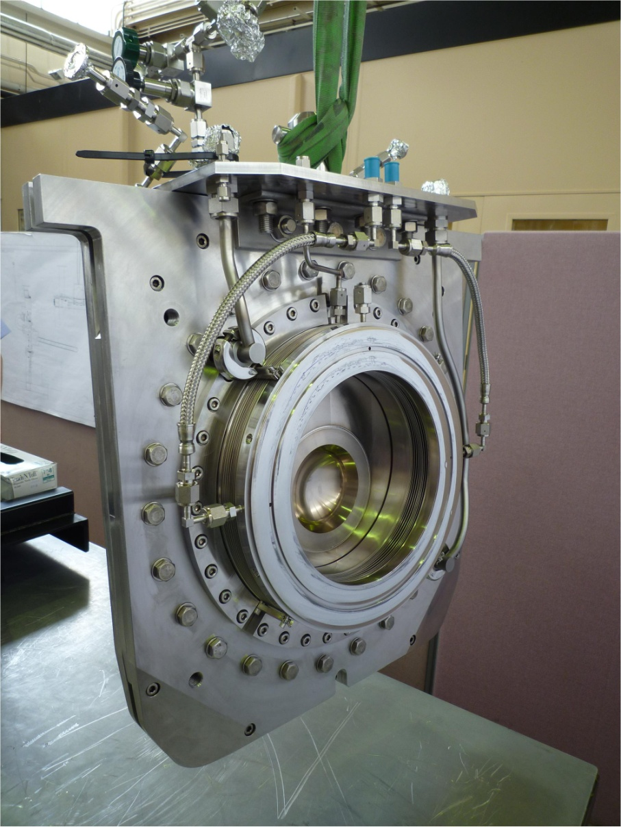
T2K beam window
Double-skinned titanium alloy window, cooled by helium gas.
LBNE plan to use a similar design for their beam window. But perhaps beryllium instead of titanium.
Cost ~ $100k

Slide 3
T2K Target Station
Window
Proton beam
Focusing horns
Target

Slide 4
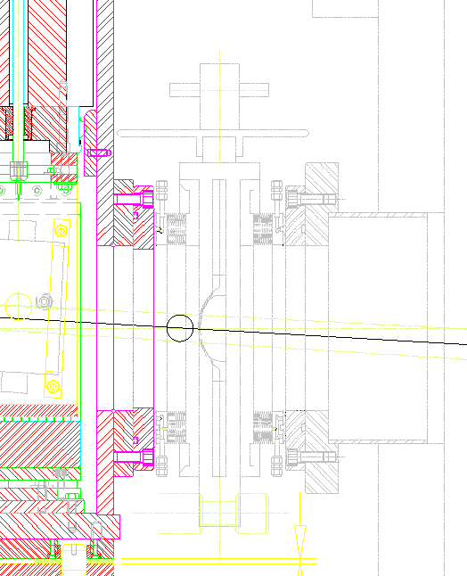
Section view

Slide 5
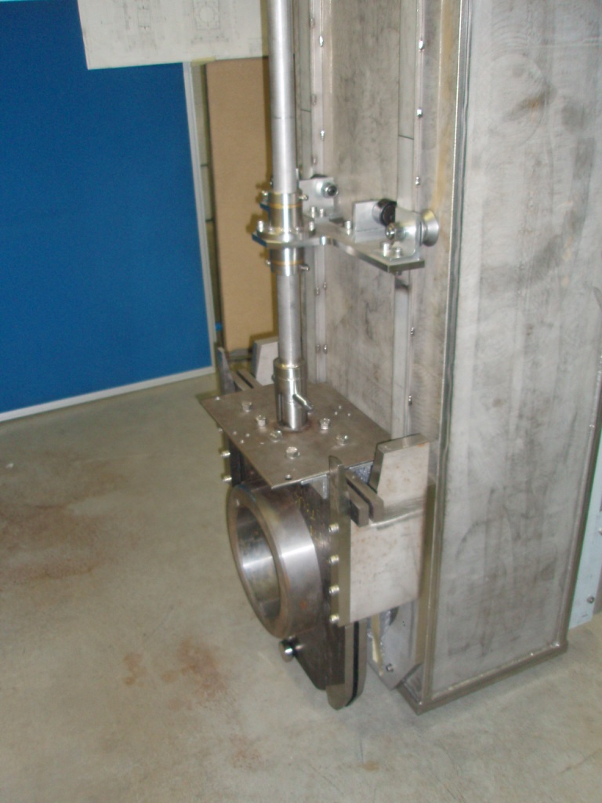
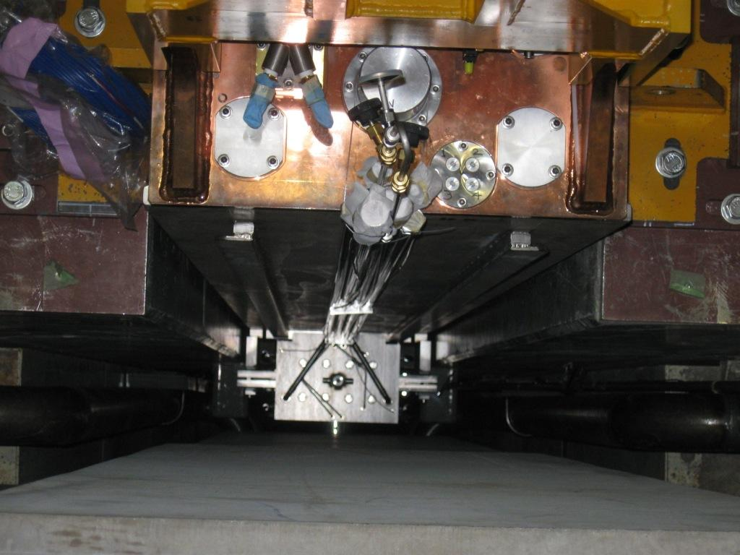

Slide 6
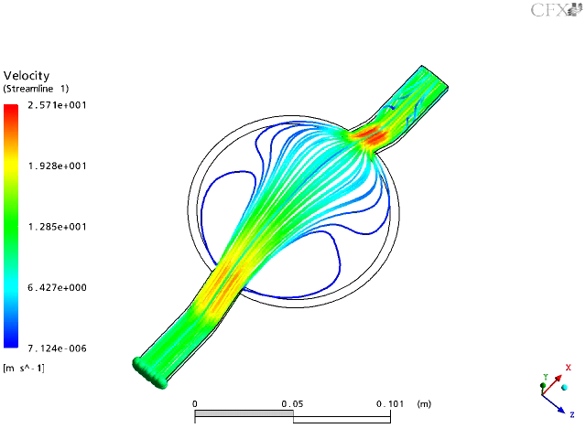
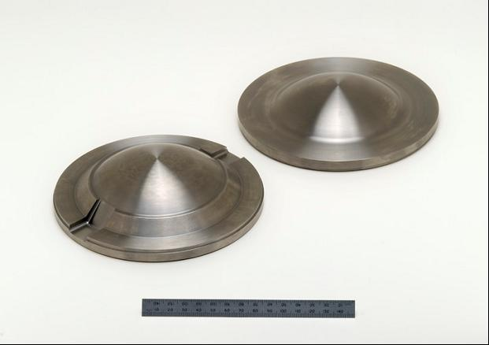
Double skinned window with helium cooling

Slide 7
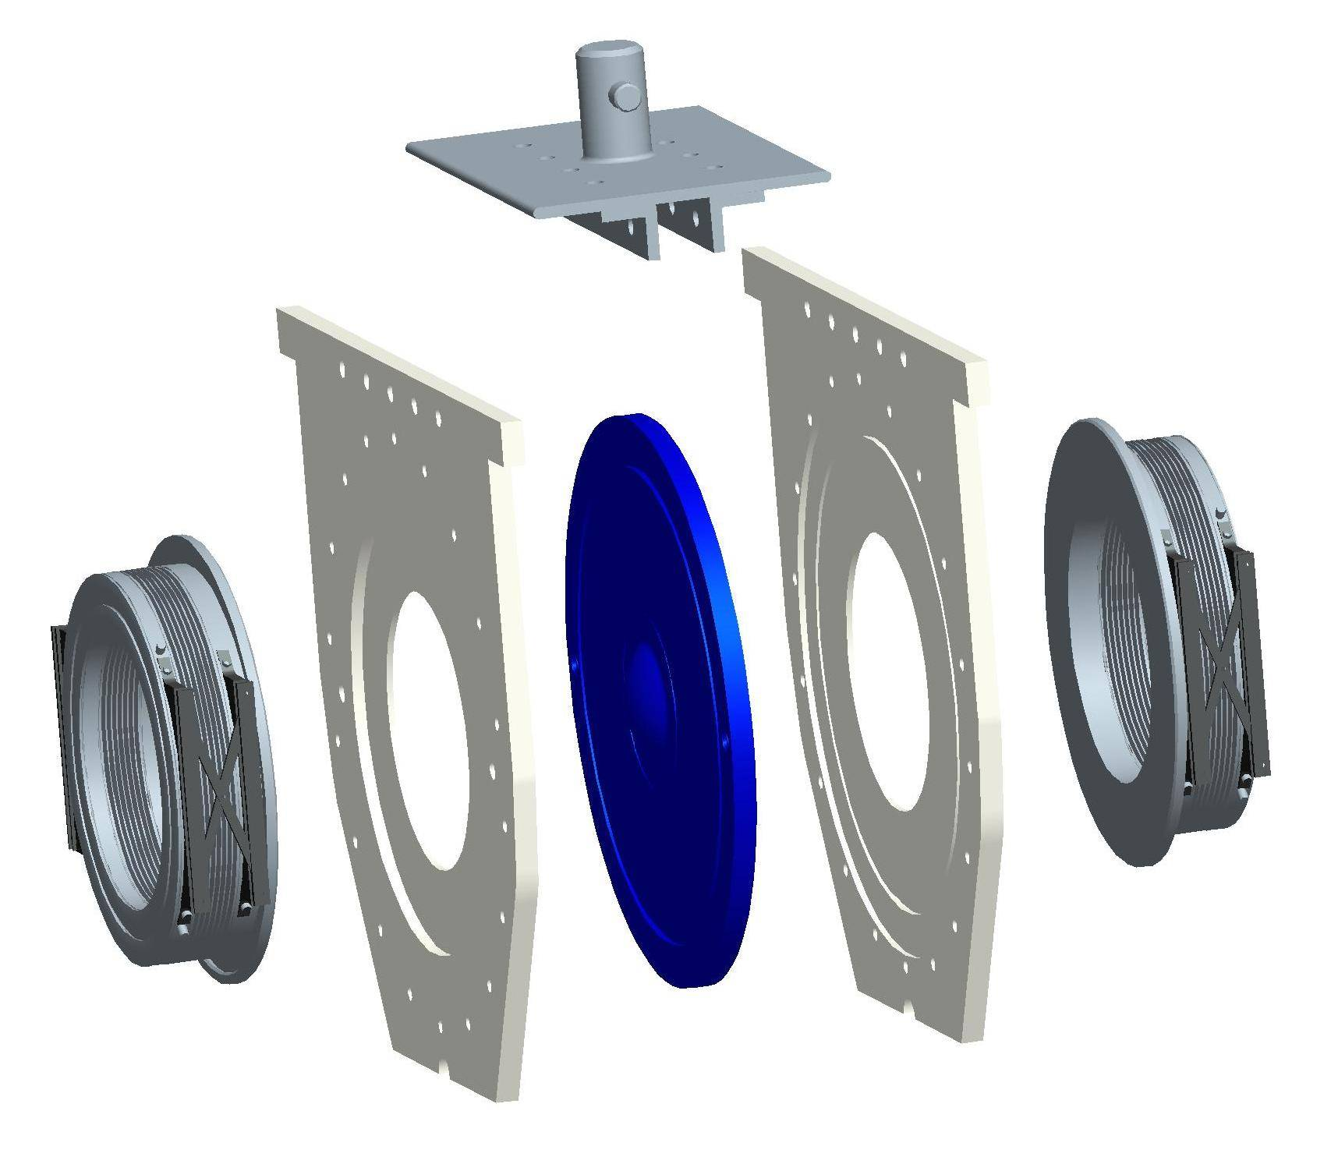
Main components
Top plate
Used for inserting and removing window
Protects pillow seals and mating flanges
Provides a connection point for services
Pillow seals
Seal helium vessel and beam line
(leak rate spec, 1 x 10⁻⁷ Pam³/s)
Side plates
Provide a firm support for the beam window to hold it in position
Ti-6Al-4V beam window

Slide 8
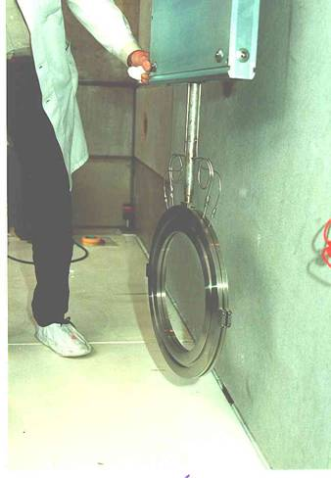
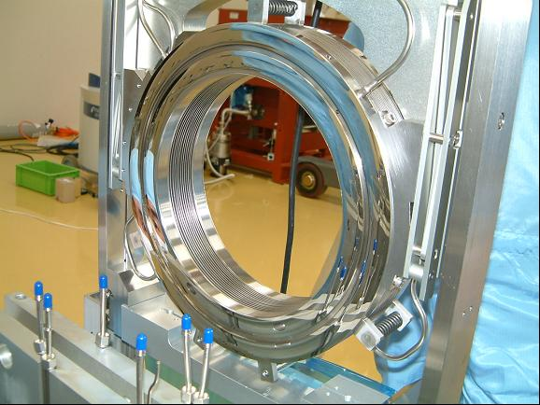
Inflatable seals
PSI
KEK Muon Group
Picture courtesy of Y. Miyake and
S. Makimura (KEK)
Picture courtesy of PSI

Slide 9
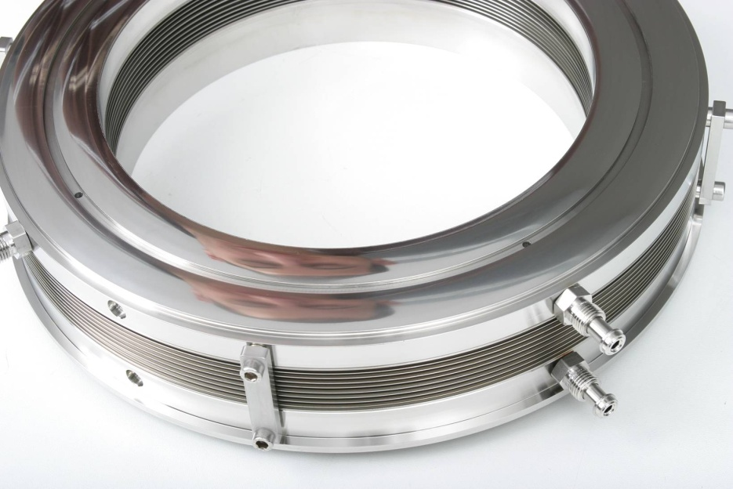
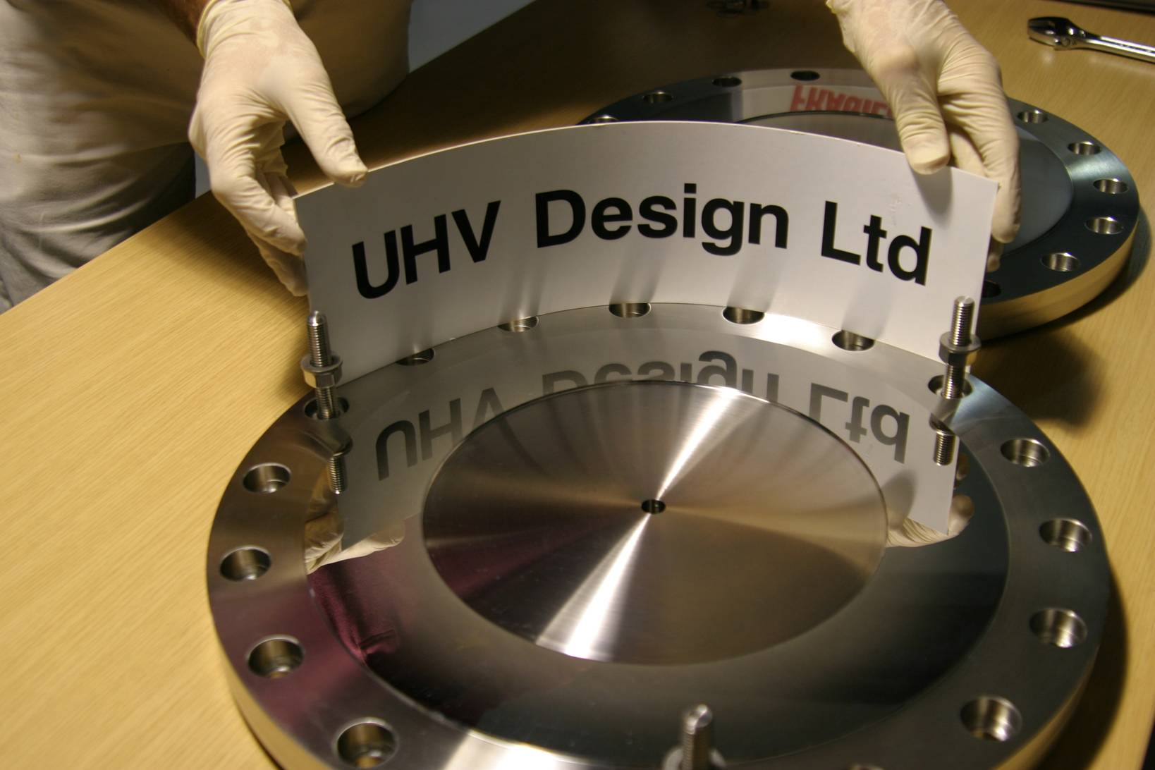
Seal and mating flange
Seal foils (surface roughness, Ra = 0.004 µm, Rt = 0.030 µm)
Polished flange (surface roughness, Ra = 0.020 µm)
Leak performance ~ 1 x 10⁻⁹ Pa.m³/s
Cost: ~ $30,000 each

Slide 10
EUROnu window candidate materials
Others candidates: AlBeMet, GUM, INVAR…

Slide 11
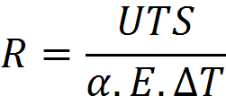
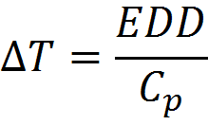
Simple stress comparison
‘Thermal stress resistance’,
where
UTS – ultimate tensile strength
α – coefficient of thermal expansion
E – Young’s modulus
ΔT – temperature jump
EDD – energy deposition density
Cp – specific heat capacity

Slide 12
Superbeam comparison
 | EUROnu | LBNE (700 kW) | LBNE (2 MW) | T2K
Beam power | 1 | 0.7 | 2 | 0.75 | MW
Beam energy | 5 | 60 | 60 | 30 | GeV
Protons per pulse | 1.50e14 | 5.60e13 | 1.6e14 | 3.30e14
Beam sigma | 4 | 1.5 | 3.5 | 4.24 | mm
Peak energy dep. | ~ 80 | ~ 200 | ~ 128 | ~ 160 | J/cc/spill
Pulse length | 5 | 10 | 5 | 5 | μs
Frequency | 12 | 1.32 | 1.32 | 0.47 | Hz
NOTE: Energy deposition is for beryllium.

Slide 13
Euronu stress analysis – variables studied
Beam parameters:
Power: 1 MW (4 MW divided between four targets/windows)
Energy: 5 GeV
1.5 x 10¹⁴ protons per pulse
Frequency: 12.5 Hz
Pulse length: 5 microseconds
Beam sigma: 4 mm
Design considerations:
Materials: Beryllium (S65C), Titanium alloy (Ti-6Al-4V)
Cooling methods: direct forced convection helium and circumferential water
Beam parameters taken from EUROnu WP2 Note 09-11

Slide 14
Typical ANSYS model showing cooling options
ANSYS Multiphysics v11 used with coupled field elements (axisymmetric model)

Slide 15
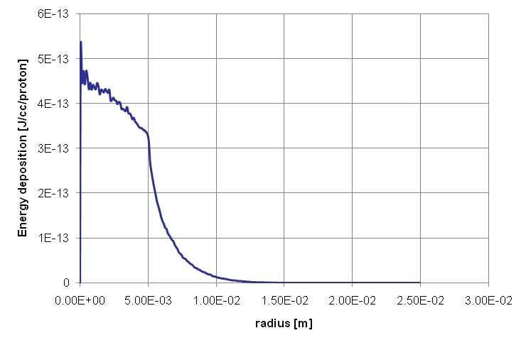
Energy deposition profile
NOTE: Data produced by Tristan Davenne (RAL) using Fluka.
A Gaussian approximation of this data has been used in ANSYS for simplicity.
Peak is around 80 J/cc/spill for beryllium window

Slide 16
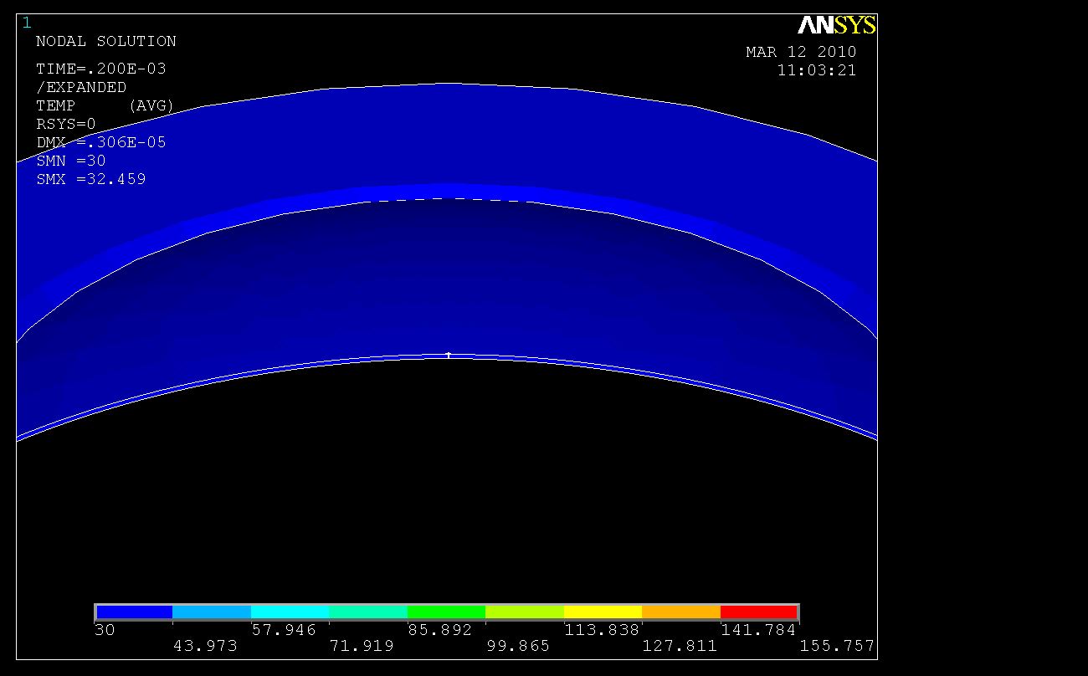
Transient animation

Slide 17
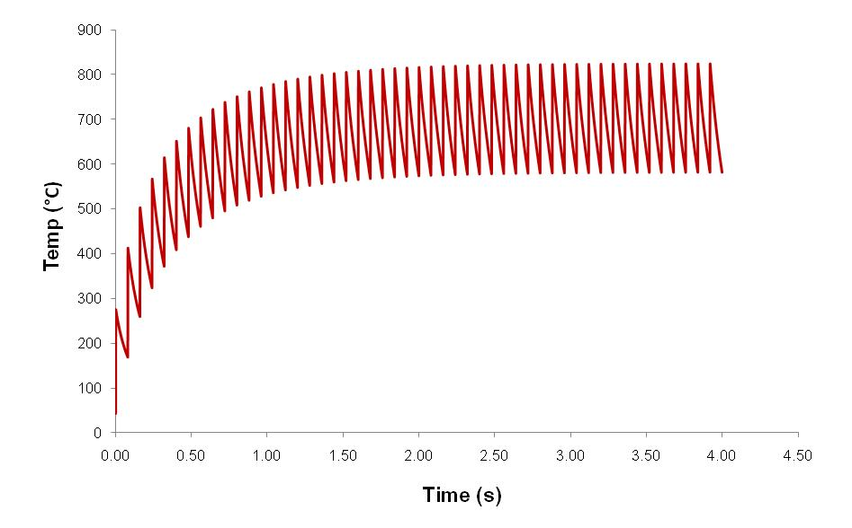
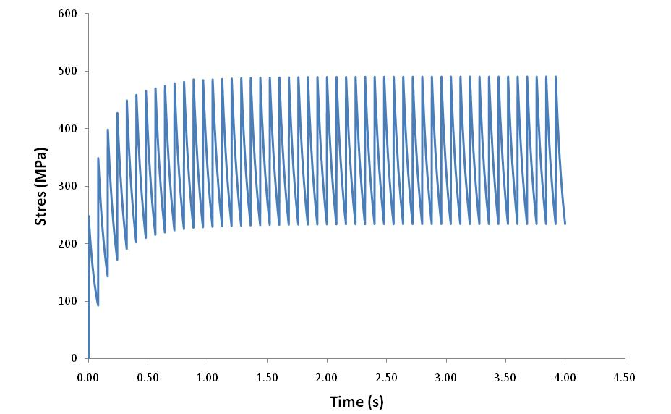
Helium cooled Ti-6Al-4V window (like T2K) is not an option
50 pulses (4 seconds)
0.25 mm thick titanium alloy window
Direct helium cooling
(assumes 1000 W/m²K)
Peak stress of 500 MPa is above yield stress for titanium at 800°C.

Slide 18
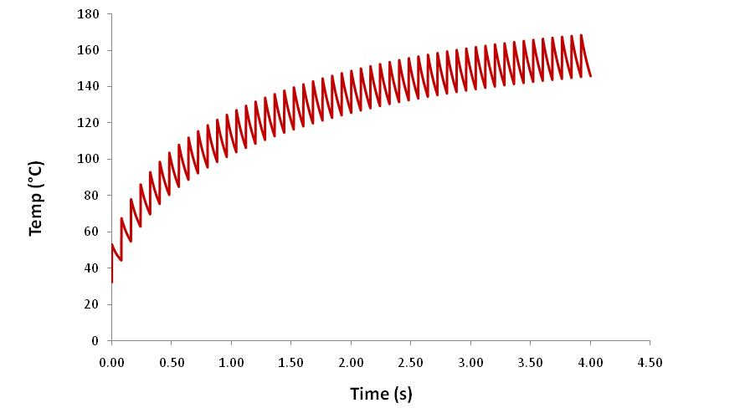
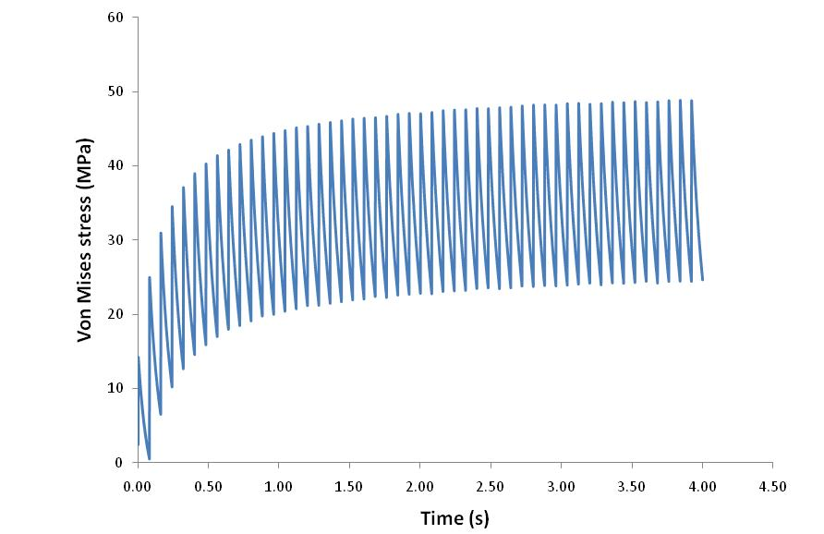
Circumferentially water cooled beryllium window
0.25 mm thick beryllium window
Circumferentially water cooled
(assumes 2000 W/m²K)
Max temp ~ 180 °C
Max stress ~ 50 MPa (yield ~ 270 MPa)
Acceptable!

Slide 19
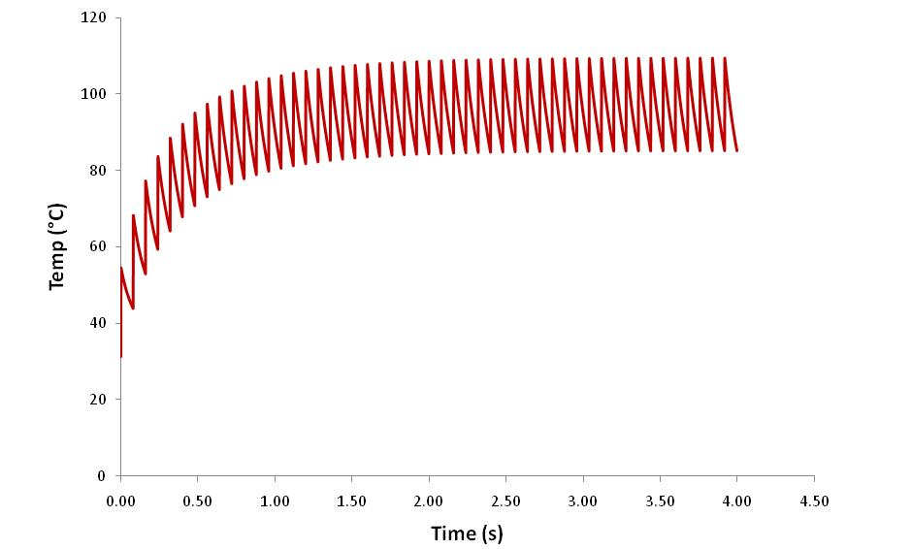
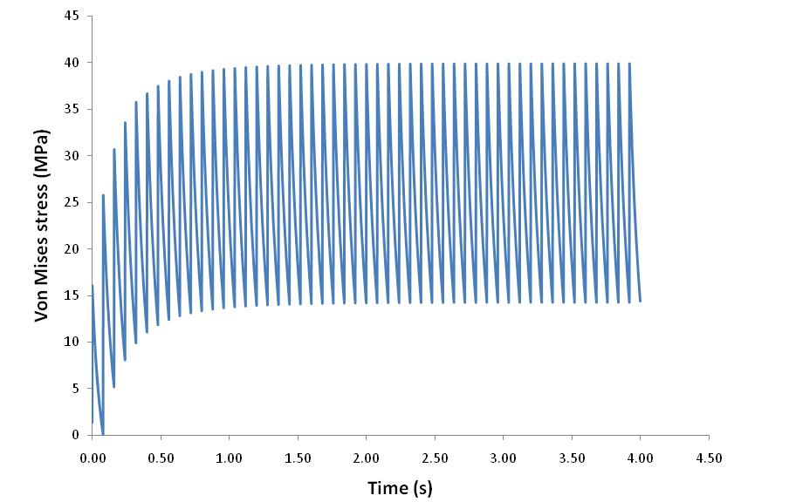
High velocity helium cooled beryllium window
0.25 mm thick beryllium window
Direct helium cooling
(assumes 1000 W/m²K)
Max temp 109 °C
Max stress 39 Mpa
Better!

Slide 20
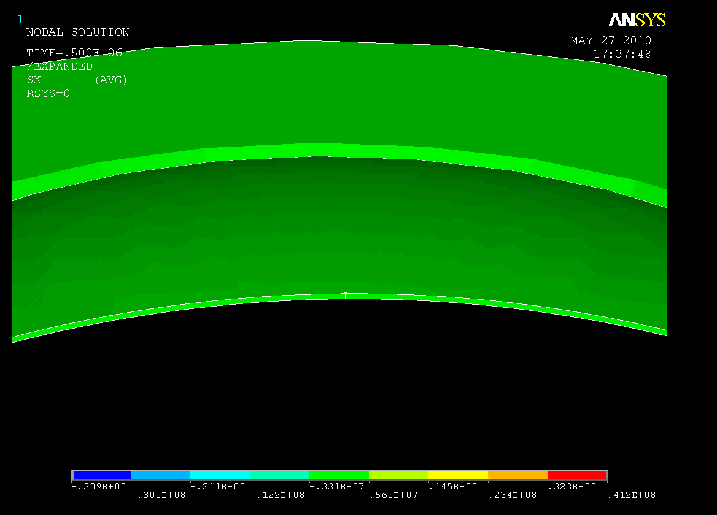
Shock animation

Slide 21
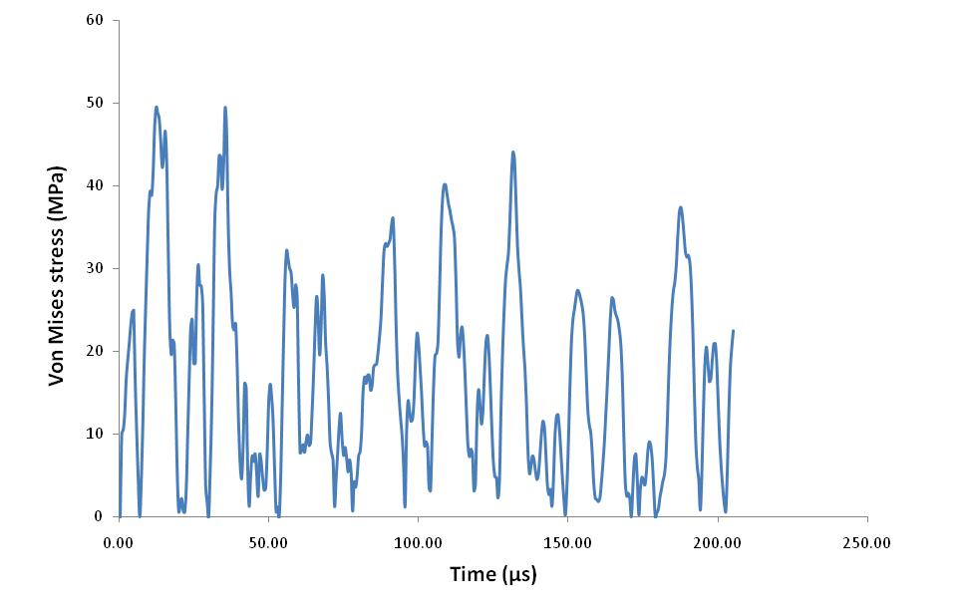
‘Shock’ stress due to single pulse in beryllium window
Temp jump of 22°C results in 50 MPa peak stress. When superimposed with other stresses the peak may be around 70 MPa, giving a SF of around 4 on the UTS.

Slide 22
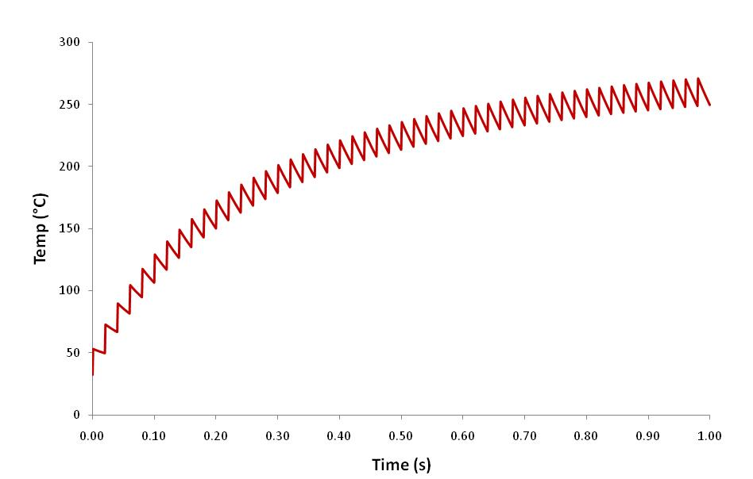
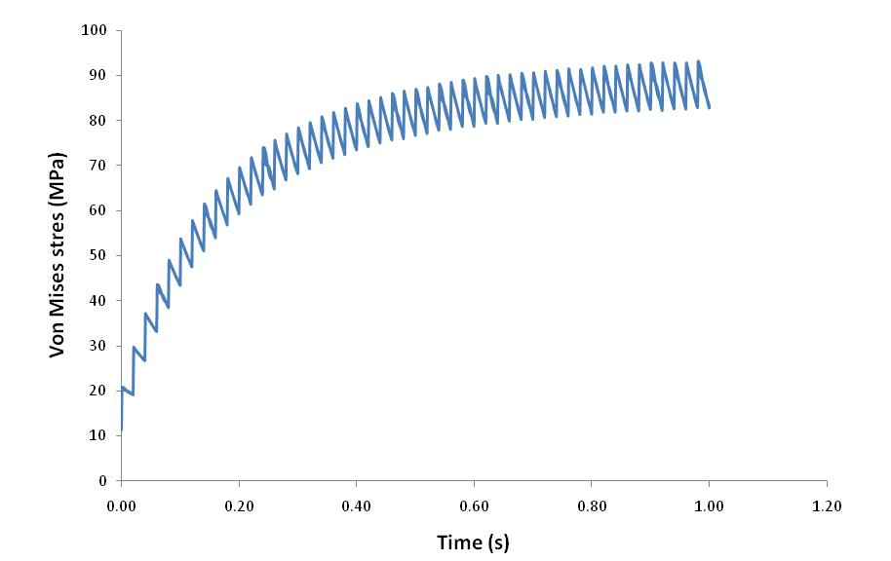
4 MW window for neutrino factory?
50 pulses (1 second)
Yield strength of beryllium @ 260°C
is around 200 MPa. This leaves a safety factor of about 2 for a beryllium neutrino factory window with these beam parameters.

Slide 23
Conclusions
High frequency beam makes cooling the main challenge for any window. Actual thermal stress due to each pulse is within acceptable limits.
Difficulty in cooling a titanium window makes this a bad choice for EUROnu beam parameters.
High frequency beam with low protons per pulse makes beryllium window a possibility due to its high thermal conductivity. Either direct helium cooling on the beam spot or circumferential water cooling may be feasible.
Neutrino factory window may be possible with this beam parameters, though safety factor is small and radiation damage would quickly become an issue.

