Slide 1



Meson Productions for Target System with GA/HG Jet and IDS120h Configuration
X. Ding (Presenter), D. Cline, UCLA
H. Kirk, J.S. Berg, BNL
Muon Accelerator Program Collaboration Meeting
SLAC, March 5, 2012

Slide 2
Outline
Motivation of optimization of GA target
Introduction of IDS120h Configuration
(Target/Collection system, fieldmap and target geometry)
Optimization methods
Optimized target parameters and meson productions at proton KE of 8 GeV
Optimized target parameters and meson productions at different proton KE (Comparison between HG/GA Jet, between IDS120h/Study2a with HG jet)
Focused Incident Proton Beam
Summary

Slide 3
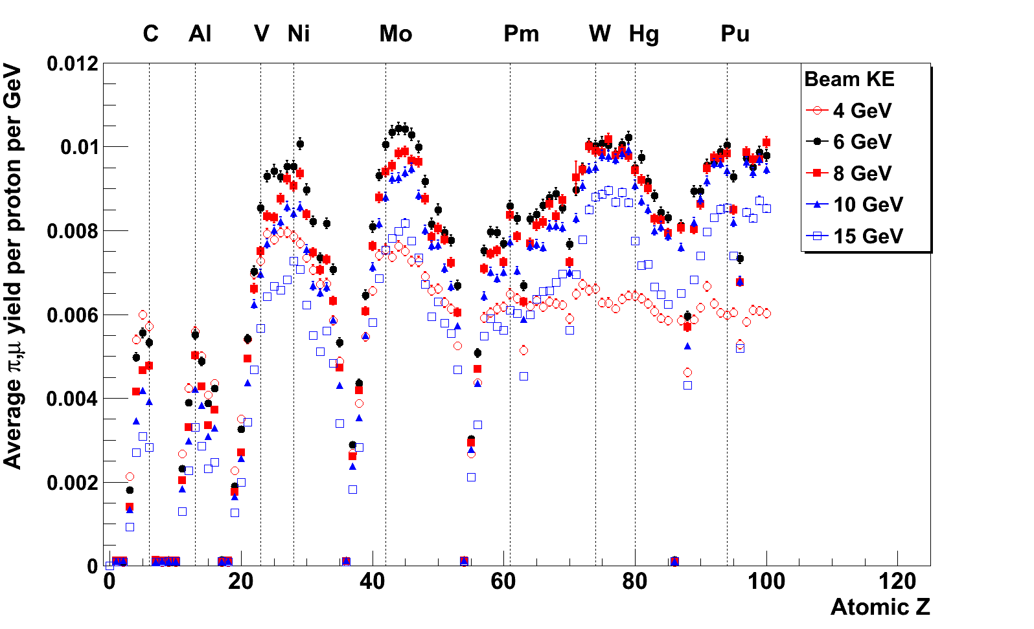
Motivation to Optimize GA Target
(Possible target alternative of HG)
Study 2 NF geometry and B-map
Acceptance probability histogram used at z=6m (based on ICOOL)
Pion/muon yields for different atomic Z’s and beam energies (J. Back/X. Ding);
Advantages of Gallium: relative efficient meson production (near the NI Peak), liquid state at relatively low temperature (Melting Point = 29.8⁰ C) and potential for easier handling (H. Kirk).

Slide 4
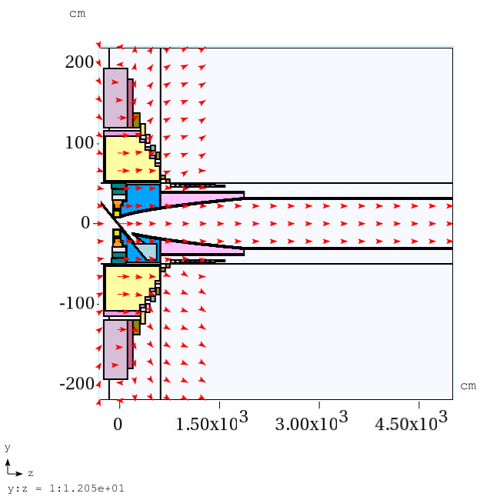
Target/Collection System of IDS120h
Count all the pions and muons that cross the transverse plane at z=50m.
For this analysis we select all pions and muons with 40 < KE < 180 MeV.

Slide 5
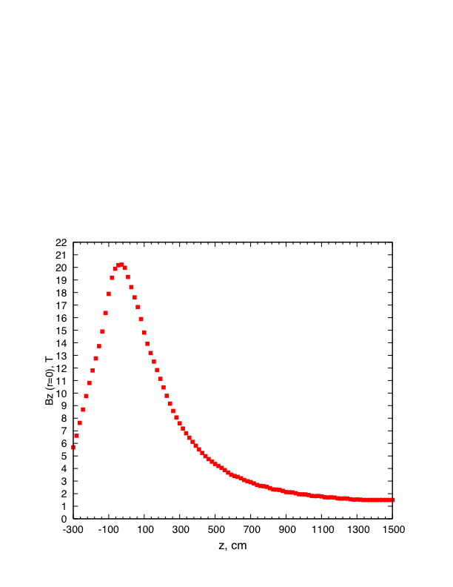
Axis Field (Bz at r=0) with IDS120h

Slide 6
HG/GA Target Geometry
(New Setting Procedure)
The mercury jet target geometry. The proton beam and mercury jet cross at z=-37.5 cm.
Put beam exactly below the HG/GA jet at z=-37.5 cm (see above y-z plot), fix beam/jet intersection point at (0, 0, -37.5 cm) and project beam back to z=-200cm. (Difference: In previous simulation for study 2a, beam launching point is at z=-75 cm.)
Initial target parameters at proton KE of 8 GeV: target radius of 5 mm, beam angle of 67 mrad at z=-37.5 cm, beam/jet crossing angle of 33 mrad at z=-37.5 cm.
The SC coils, resistive Cu and Shielding are deleted in MARS code for speeding up simulation (Difference: not so in simulation for study2a).

Slide 7
Optimization Method
Take 3 runs in each cycle:
1) Vary jet radius with initial beam angle and beam/jet crossing angle;
2) Vary beam/jet crossing angle with new target radius while keeping jet fixed - always project beam back to z=-200 cm;
3) Vary jet angle with new target radius and beam/jet crossing angle-always keep crossing angle constant-both jet and beam must be rotated about intersection point together and always project beam back to z=-200 cm.
Repeat above cycle until convergence.

Slide 8
Optimized Target Parameters at 8 GeV at z = -37.5 cm
 | HG |  |  | GA
 | Target radius, mm | Crossing angle, mrad | Beam angle, mrad | Target radius, mm | Crossing angle, mrad | Beam angle, mrad
Initial | (5mm, 33mrad, 67mrad) |  |  | (5mm, 33mrad, 67mrad)
1st Cycle | 4.6 | 23 | 120 | 6.7 | 21 | 112
2nd Cycle | 4.15 | 23 | 117 | 5.5 | 17 | 94
3rd Cycle | 4.15 | 21.6 | 120 | 4.9 | 13.2 | 92
4th Cycle | 4.04 | 20.6 | 117 | 4.5 | 13 | 90
5th Cycle |  |  |  | 4.4 | 12.8 | 86
6th Cycle |  |  |  | 4.4 | 13 | 88
Nuclear interaction length: HG/14.58 cm, GA/23.92 cm.

Slide 9
Meson Productions at 8 GeV
(400,000 events)
 | HG | GA | [N(GA)-N(HG)]/N(HG)
Before optimization (Target radius/beam angle/crossing angle) | 108528 (5mm/67mrad/33mrad, Initial) | 96586 (5mm/67mrad/33mrad, Initial) | -11% (w/t opt)
After optimization (Target radius/beam angle/crossing angle) | 131362 (4.04mm/117mrad/20.6mrad, end of 4th Cycle) | 114401 (4.5mm/90mrad/13mrad, end of 4th Cycle) | -12.9% (opt)
[N(opt)-N(w/t opt)]/N(w/t opt) | +21% | +18.4%

Slide 10
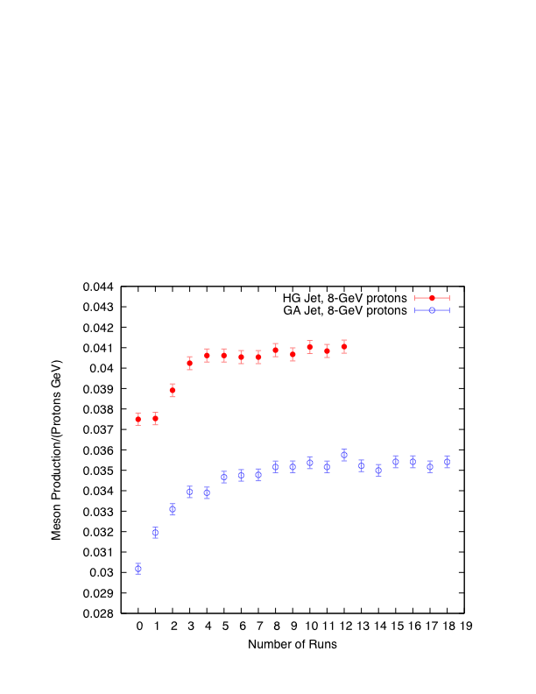
Meson Productions Vs. Run No. at 8 GeV
(Number of runs: 0-Initial, 1,4,7,10,13,16-optimized target radius, 2,5,8,11,14,17- optimized crossing angle, 3,6,9,12,15,18-optimized beam angle )

Slide 11
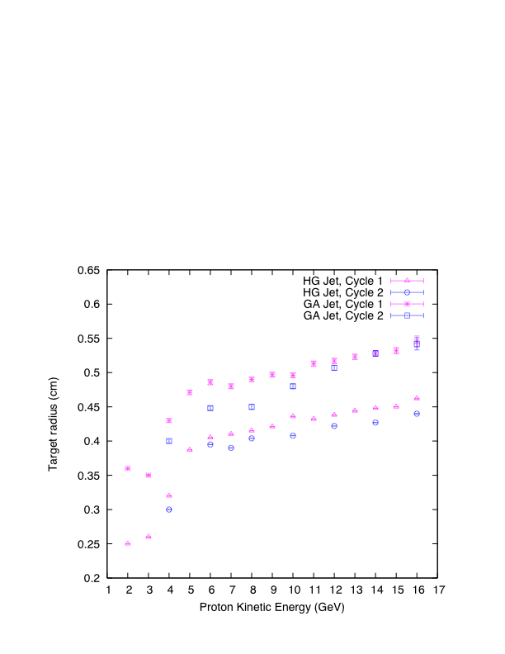
Target Radius vs. KE
(HG/GA Jet)

Slide 12
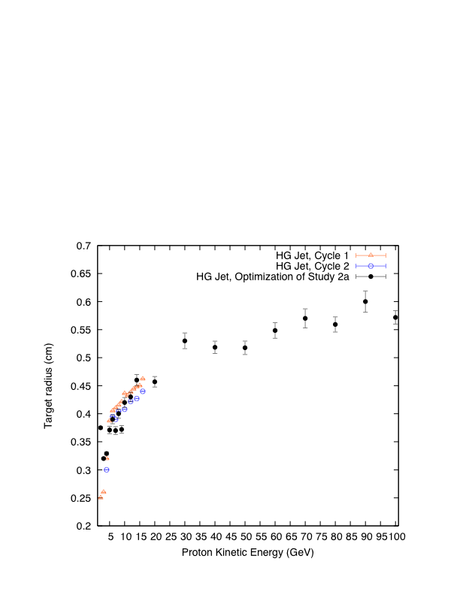
Target Radius vs. KE
(IDS120h/Study2a, HG Jet)

Slide 13
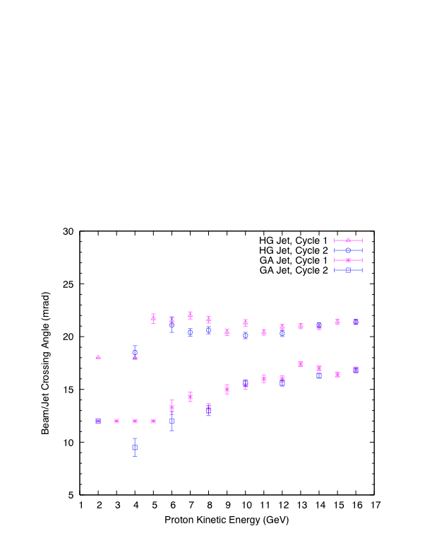
Beam/Jet Crossing Angle vs. KE
(HG/GA Jet)

Slide 14
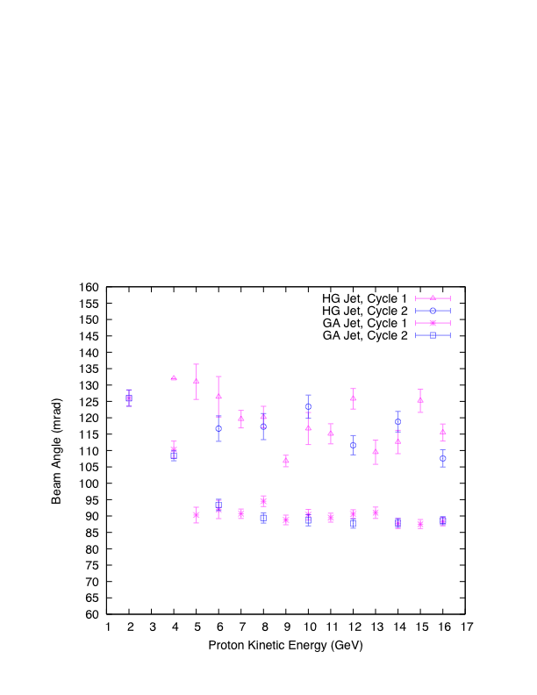
Beam Angle vs. KE
(HG/GA Jet)

Slide 15
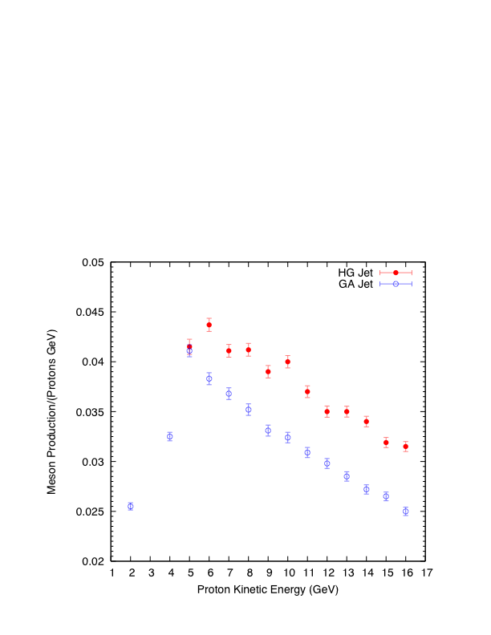
Meson Production vs. KE
(HG/GA Jet)

Slide 16
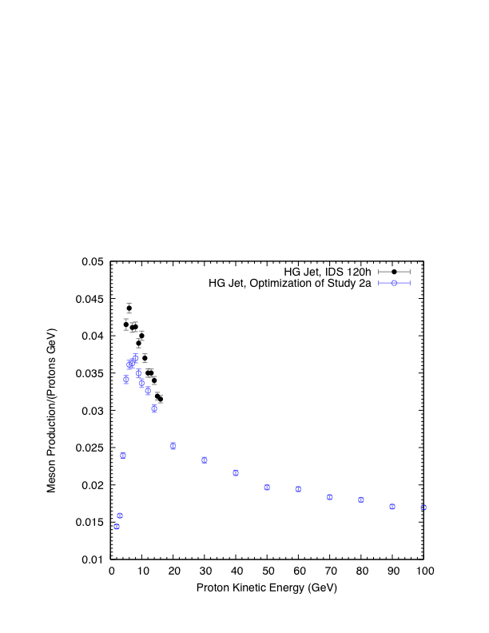
Meson Production vs. KE
(IDS120h/Study2a, HG Jet)

Slide 17
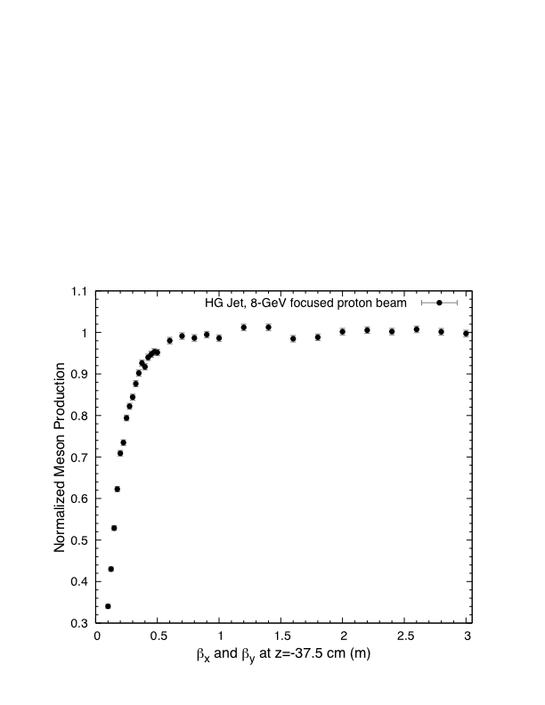
Focused Incident Proton Beam at 8 GeV

Slide 18
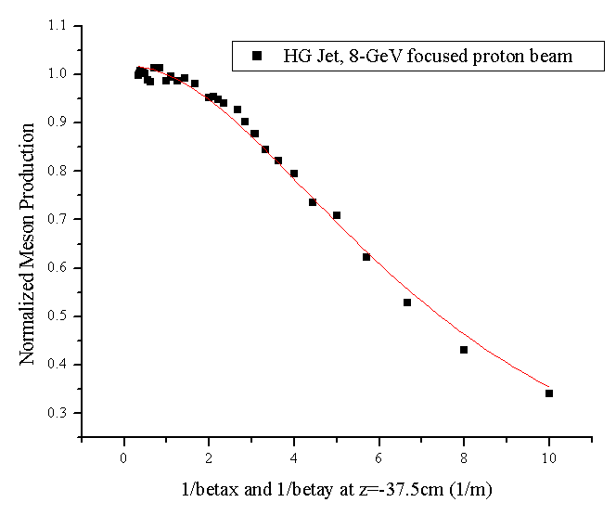
Focused Incident Proton Beam at 8 GeV (Cont’d)
Non-Linear Fit
Y=N/(1+K2/beta⁻²)
N=1.018
Sqrt(K2)=0.1368
Proton beam emittance is 4.8 μm with beam radius of 0.12 cm and β* of 0.3 m.

Slide 19
Summary
8 GeV optimized parameters:
  Hg r=4.04 mm; beam/jet crossing angle=20.6 mrad ; beam angle = 117 mrad.
  Ga r= 4.4 mm; beam/jet crossing angle = 13 mrad; beam angle of 88 mrad.
8GeV meson production for Ga is 12.9% less than for Hg.

Slide 20
Summary (Cont’d)
Ga production peaks near KE = 5 GeV and is comparable to Hg at that KE.
For Hg, meson production is reduced by 15% for a proton beam emittance of 5 μm compared to a 0 μm emittance beam.

