Slide 1
Meson Production Comparison between Hg and Ga at 8 GeV
X. Ding, UCLA
Target Studies, Oct. 04, 2011

Slide 2
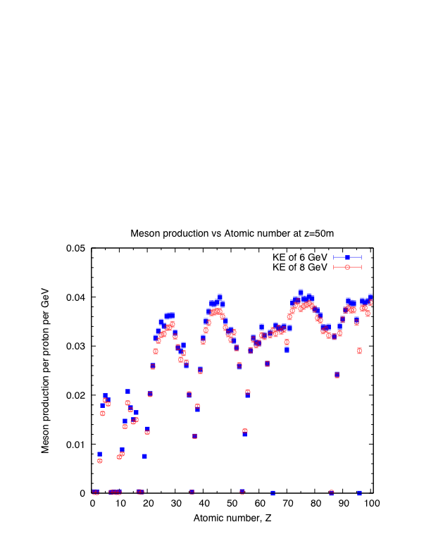
Meson Productions at 6 and 8 GeV
(All using the same geometry as Hg case)

Slide 3
Optimized Target Parameters at z=-37.5 cm
The mercury jet target geometry. The proton beam and mercury jet cross at z=-37.5 cm.
Target material | Hg | Ga
Target radius (Rtg) | 0.38 cm | 0.42 cm
Proton Beam Angle (θb) | 99 mrad | 77 mrad
Crossing Angle of Beam/Jet (θc) | 19.14 mrad | 9 mrad
Path length of proton beam inside the jet [2Rtg/sin(θc)] | 39.7 cm | 93.3 cm

Slide 4
Meson Production Comparison at Z = 5000 cm
Target material | Hg | Ga
Meson Production per proton per GeV (errorbar) before optimization (0.5cm/67mrad/33mrad) | 0.03665 (0.0003) | 0.02961 (0.00026)
Meson Production per proton per GeV (errorbar) after optimization | 0.039837 (0.00032) (14.3% higher than GA case) | 0.034157 (0.00028)
The new optimization is based on a jet that with azimuth below the beam at z = -37.5 cm.
Further optimization with different azimuths is possible.

Slide 5
BACKUP

Slide 6
MARS Results by J. Back

