Slide 1
Irradiation study of Ti-6Al-4V and Ti-6Al-4V-1B for FRIB beam dump:
Preliminary results
Aida Amroussia, PhD Student
Chemical Engineering and Materials Science
Michigan State University
Feb. 21, 2014

Slide 2
Outline
Irradiation of samples with high energy heavy ions (NSCL-MSU)(Ca 40 @ 50 MeV/u) and low energy heavy ions at CIMAP-France(Ar 36 @ 36 MeV).
Surface characterization using SEM-EBSD
Comparing the same areas on the samples before and after irradiation.

Slide 3
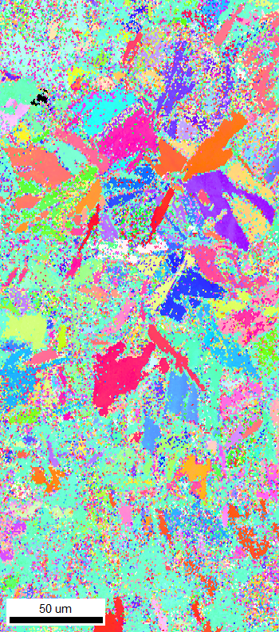
Observations
Deterioration of the quality of the EBSD scan after irradiation.
Sample 3 Ti64-1B
Irradiated at T-350C and a fluence of 1.00E+15
Ions/cm and dpa of 0.038dpa
IPF map before irradiation IPF map after irradiation

Slide 4
Close analysis of few grains:
Before irradiation After irradiation

Slide 5
Samples irradiated at high fluence and low Temperature
Sample 4 Ti64
Irradiated at T=20C and a fluence of 1.00E+15 Ions/cm , estimated dpa of 0.038dpa
- No-EBSD possible
-EDS analysis to get the composition of this layer

Slide 6
Conclusion and future work
No or little change in the grain orientations at the surface of the samples.
Nano-indentation: Obtain the properties of the materials in depth
FIB: characterize the microstructure in depth

