Slide 1

Irradiation study of Ti-6Al-4V and Ti-6Al-4V-1B for FRIB beam dump:
Aida Amroussia, PhD Student
Chemical Engineering and Materials Science
Michigan State University
May 19, 2014

Slide 2
Outline
Irradiation of samples with high energy heavy ions (NSCL-MSU)(Ca 40 @ 2000 MeV) and low energy heavy ions at CIMAP-France
XRD and TEM observations( in collaboration with CIMAP)
Surface characterization using SEM-EBSD
Nano-indentation tests
Vickers Hardness tests
Insitu-tensile tests

Slide 3
Irradiation experiments
Facilities | Beam | Energy [MeV] | Range [µm] | S_{e} [keV/nm] | Fluence [ions/cm²] | Max dpa in sample | Date | Number of samples | Type
IRRSUD | ⁸²Kr | 25 | 4.73 | 9.9 | 5.10¹¹-5.10¹²-2.10¹⁴ | 0.6 | Jul-13 | 6 | Foils
IRRSUD | ¹³¹Xe | 92 | 8.5 | 19.7 | 2.10¹¹ | 0.001 | Jul-13 | 2 | Foils
IRRSUD | ⁸²Kr | 45 | 6.43 | 13.1 | 5.10¹¹-5.10¹³ | 0.16 | Jul-13 | 4 | Foils
IRRSUD | ⁸²Kr | 45 | 6.43 | 13.1 | 2.10¹⁴ 2.5.10¹⁵ | 8 | Oct-13 | 6 | Foils
IRRSUD | ³⁶Ar | 36 | 6.8 | 7.5 | 10¹⁵ | 1.5 | Dec-13 | 23 | TEM and dogbone
IRRSUD | ¹²⁹Xe | 92 | 8.5 | 19.7 | If 3 10¹⁴ (~10h) | Estimated 1.7 | Planned in June-2014
NSCL | ⁴⁰Ca | 2000 | 800 | 1.5 | 6 10¹² | 10⁻⁵ | Aug-13 | 1 x Ti64 | Dogbone

Slide 4
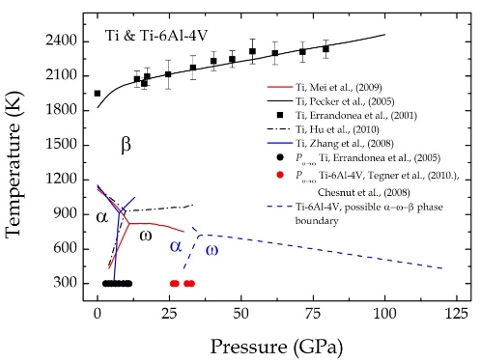

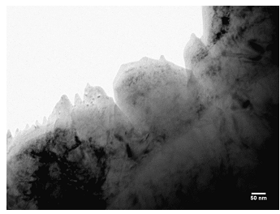
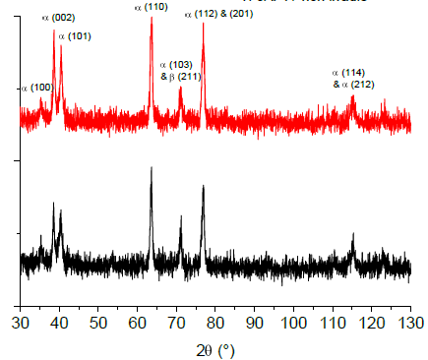
XRD and TEM observations( in collaboration with CIMAP)
No evidence of phase transformation or ion track formation in Ti-6Al-4V
  Ti-alloys are not sensitive to electronic excitation by swift heavy ions compared to pure Titanium
Intensity (u.a.)
M. Toulemonde et al./ NIMB 277 (212) 28-39
Xe 92 MeV – 2 10¹¹ ions/cm²
pristine
TEM image of a Ti-6Al-4V foil irradiated with Kr 45 MeV – 5 10¹³ ions/cm²
2 θ (º)
N. Velisavljevic, et al., Titanium Alloys at Extreme Pressure Conditions, Titanium Alloys - Towards Achieving Enhanced Properties for Diversified Applications. (2012)
Notes:
Frederique ppt

Slide 5
Characterization of the microstructure and mechanical properties:
Scanning electron microscopy (SEM) as well as electron backscatter diffraction (EBSD) were used to characterize the microstructure of the samples before and after irradiation.
Nano-indentation , Vickers Hardness and in-situ tensile tests were used to investigate the change in the mechanical properties.

Slide 6
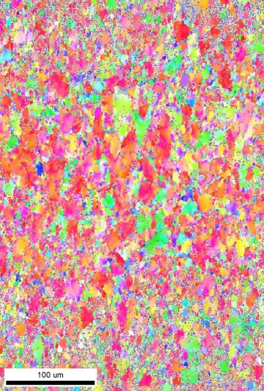
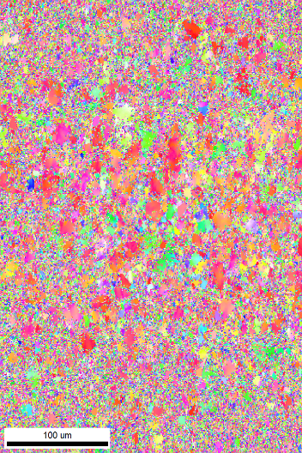
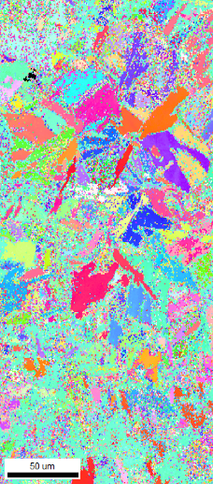
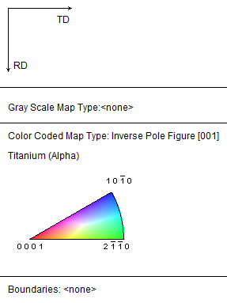
Observations
Deterioration of the quality of the EBSD scan after irradiation.
Ti-6Al-4V Ti-6Al-4V-1B
IPF map before irradiation IPF map after irradiation
IPF map before irradiation IPF map after irradiation
Ti-6Al-4V Irradiated at NSCL: Ca@2000MeV
T=20 ͦC and a fluence of 6.10¹²Ions.cm⁻² and
dpa at the surface of 10⁻⁵dpa
Ti-6Al-4V-1B Irradiated at CIMAP: Ar@36MeV
T=350 ͦC and a fluence of 10¹⁵ Ions/cm and
dpa at the surface of 0.038dpa

Slide 7
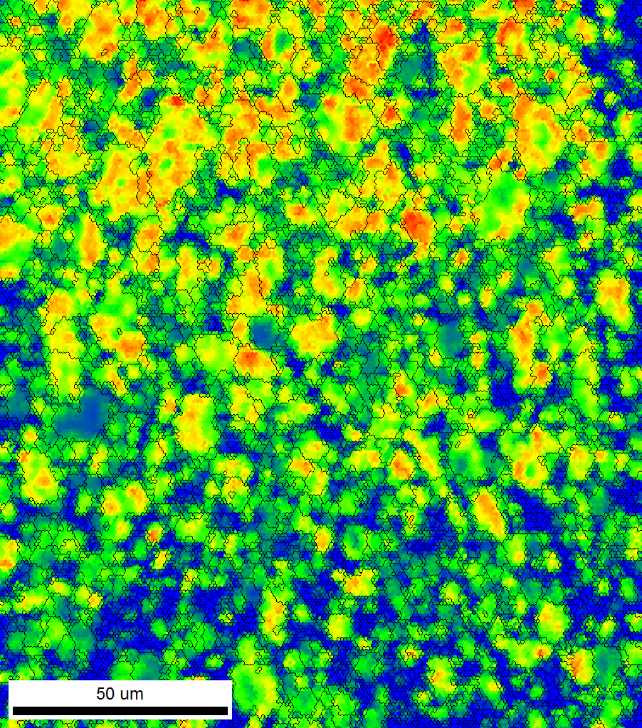
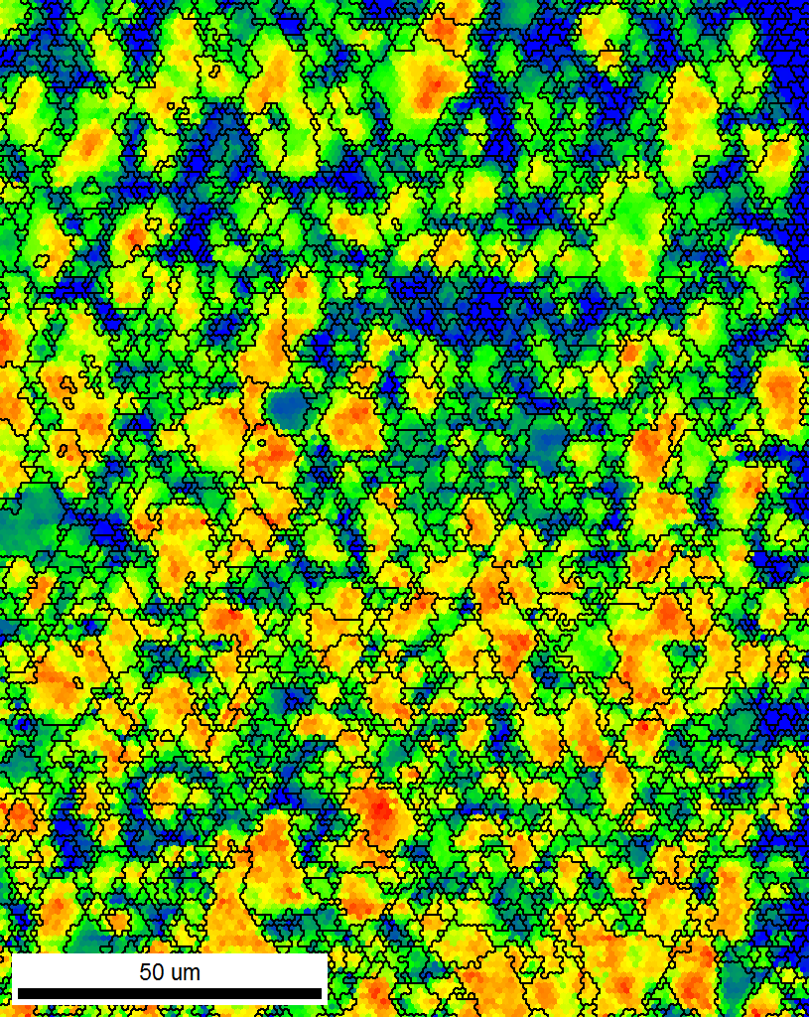
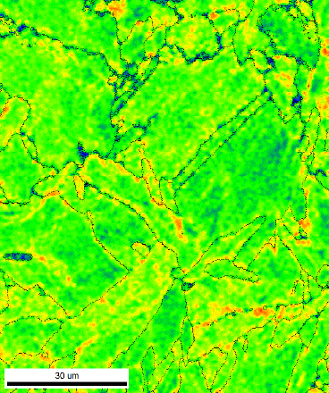
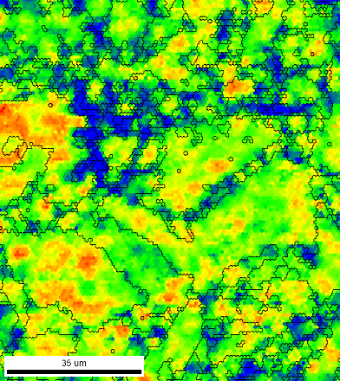
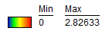
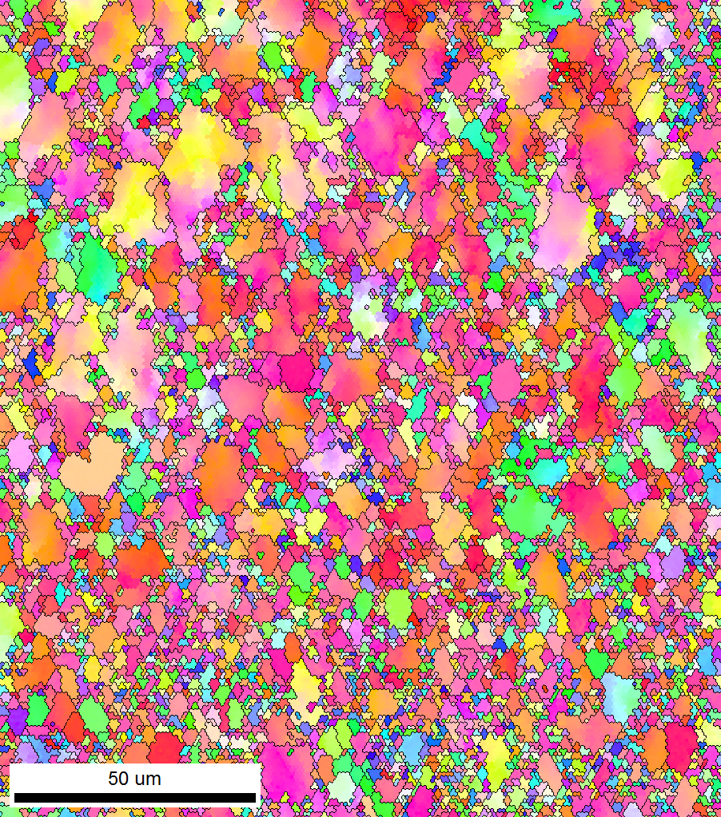
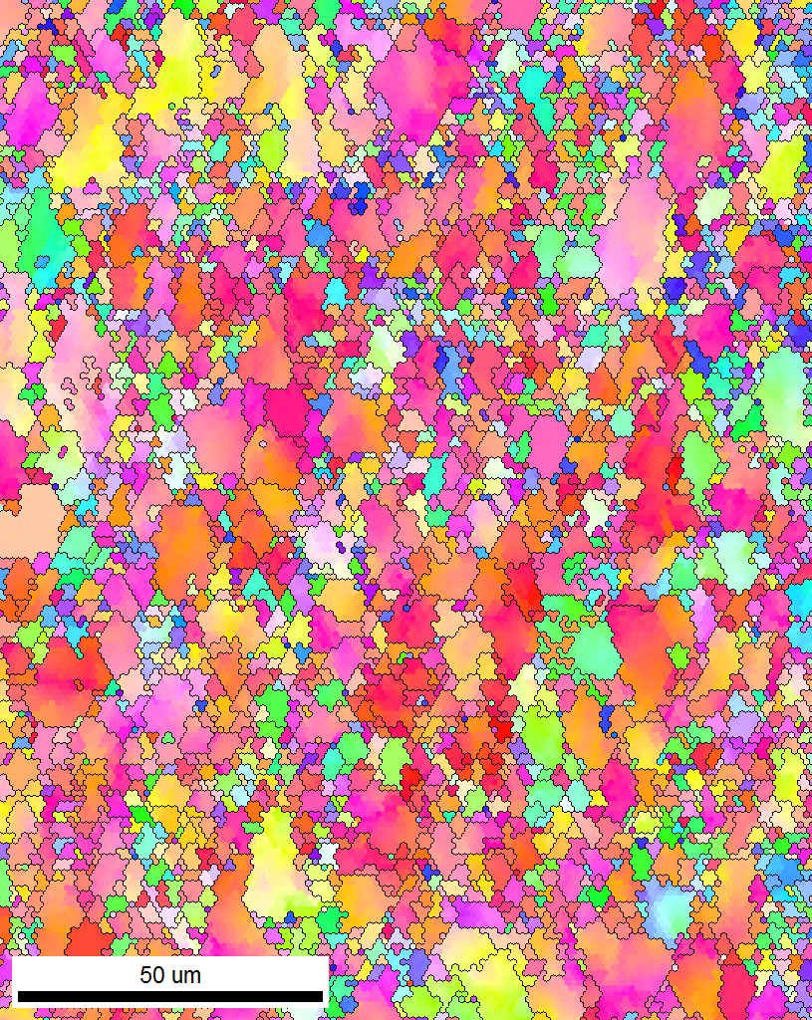
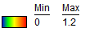
SEM and EBSD characterization of the surface of the samples:
No change in the microstructure or the orientation of the grains at the surface.
Irradiated at CIMAP: Ar@36MeV
T= 350 ^{O}C
Fluence = 10¹⁵ ions.cm⁻²
Dose at the surface= 0.038dpa
SEM image of the EBSD area before (a) and after (b) irradiation for Ti-6Al-4V
IPF and local average misorientation maps the grains before and after irradiation of Ti-6Al-4V
IPF and local average misorientation maps the grains before and after irradiation of Ti-6Al-4V-1B

Slide 8
Local Average misorientation charts
Low energy irradiation: Ar36@36MeV
Comparison between Ti-6Al-4V and Ti-6Al-4V-1B only alpha phase
Ti-6Al-4V Ti-6Al-4V-1B
Unexpected changes in the local average misorientation for Ti-6Al-4V-1B

Slide 9
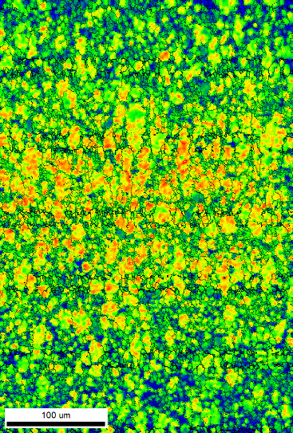
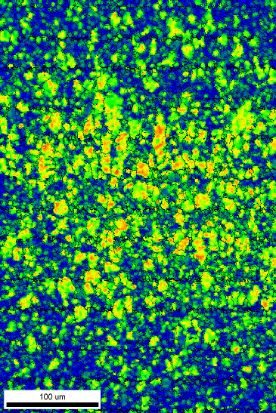
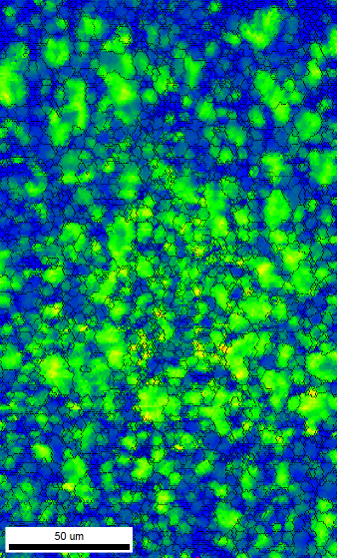
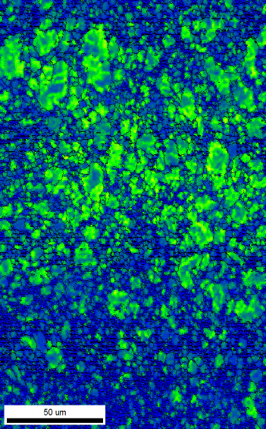
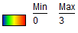
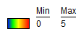
Local Average misorientation charts
Comparison between high energy and low energy irradiation
At high energy irradiation, the local average misorientation are more affected in Ti-6Al-4V

Slide 10
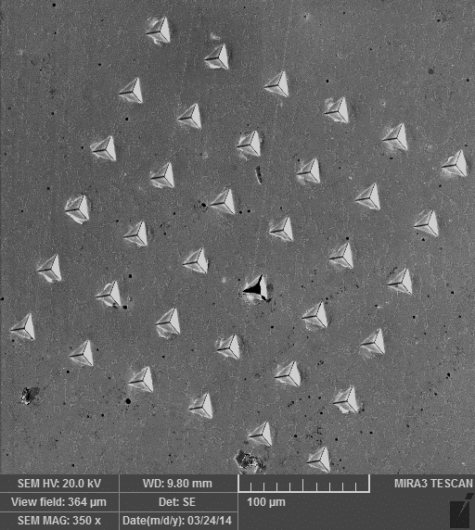
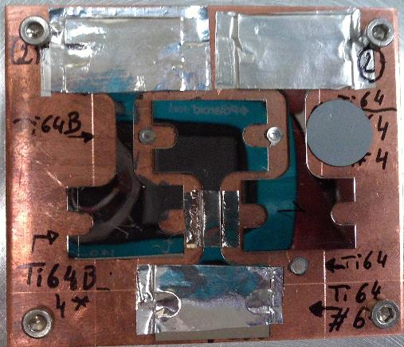
Mechanical testing: Nano-indentation
Obtain the properties of the materials in depth.
Parameters:
Berkovich tip
Strain rate : 0.05s⁻¹
Poisson ratio=0.33
Distance between indents: 50µm
a
Irradiated
Non irradiated
a
SEM image of nanoindents matrix in Ti-6Al-4V irradiated at T= 20 ^{O}C and a fluence of 10¹⁵ ions.cm⁻²
Al mask
In all samples one grip was masque in order to compare irradiated to not irradiated properties in the same sample
Notes:
For this tip width= 7*depth= 7*2=14microns

Slide 11
Nano-indentation results
Ti-6Al-4V
Ar36 @36MeV
T= 20 ^{O}C
Fluence = 10¹⁵ Ions.cm⁻²
Dose= 0.038dpa
No change in hardness was observed
Decrease in the elastic modulus after irradiation
Notes:
Tahniten

Slide 12
Vickers Hardness tests:
Ar @36 MeV
No change in hardness

Slide 13
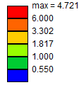
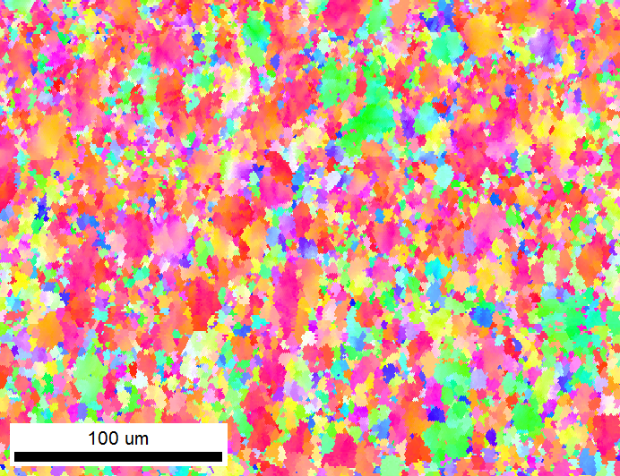
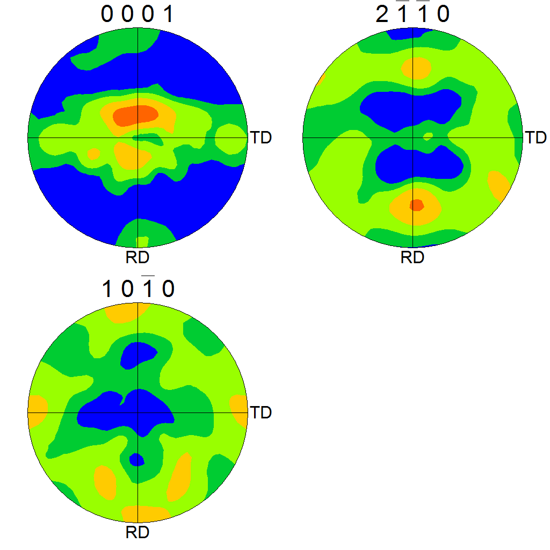
In-situ Tensile tests: Preliminary results
Ion beam : Ca 40 @2000MeV
T= 20^{O}C
Fluence = 6.10¹² ions.cm⁻²
Max dpa= 10⁻⁵ dpa
a
b
SEM images of the same area (a) before the tensile test and (b) at 13% strain
IPF map , {0001} and {10-10} pole figures of the α phase in the same area before irradiation

Slide 14
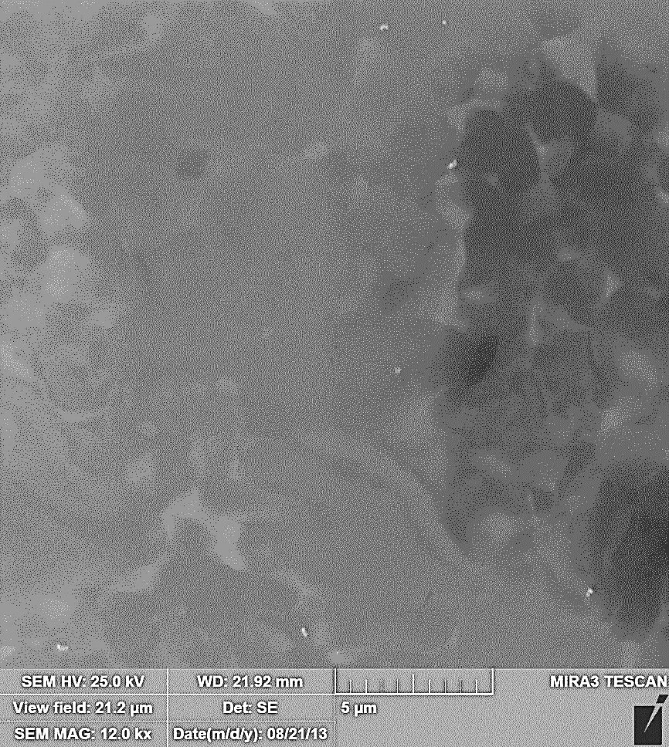
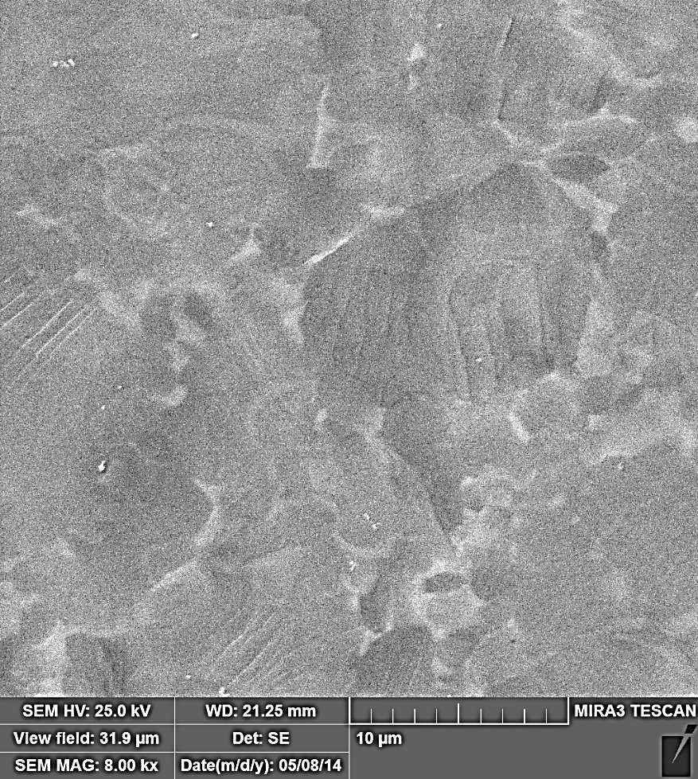
Evolution of the microstructure during the test
Ion beam : Ca 40 @2000MeV
T= 20^{O}C
Fluence = 6.10¹² ions.cm⁻²
Max dpa= 10⁻⁵ dpa
a
b
Slip lines
Microstructure of irradiated Ti-6Al-4V (a) before the tensile test and (b) at 5.27% strain

Slide 15
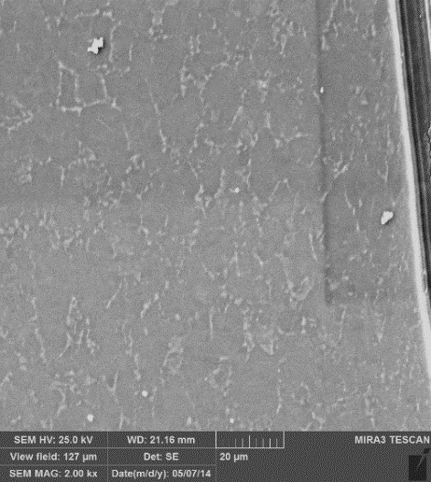
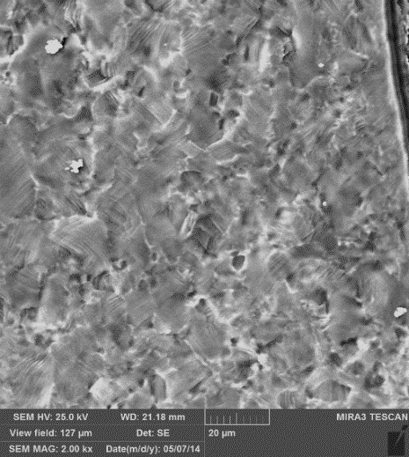
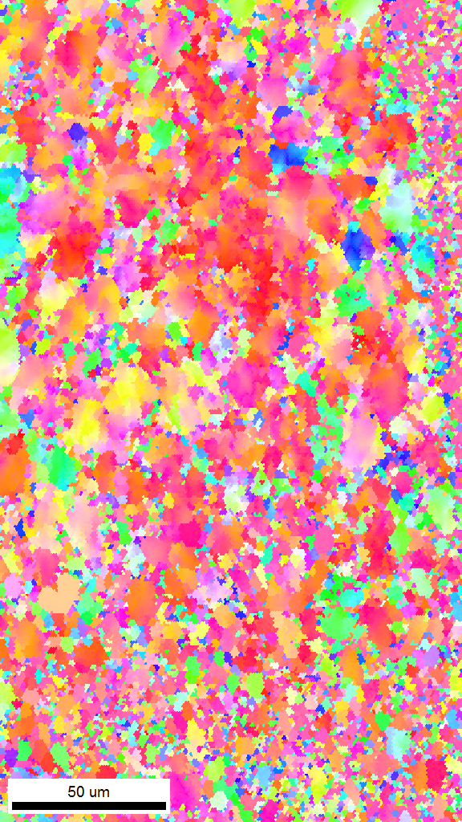
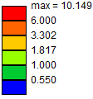
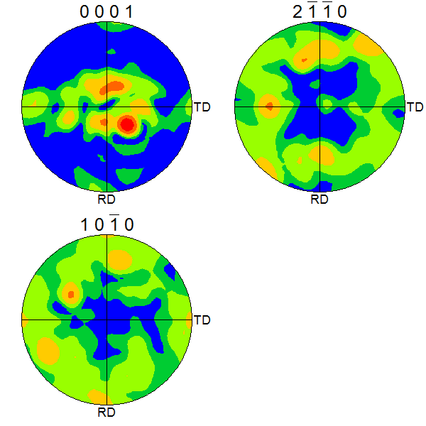
In-situ Tensile tests: Preliminary results
Ion beam : Ar@36MeV
T= 350 ^{O}C
Fluence = 10¹⁵ ions.cm⁻²
Max dpa= 1.5 dpa
a
b
c
SEM images of the same area (a) before the tensile test (b) at 18.7 % strain, (c) failure surface
IPF map , {0001} and {10-10} pole figures of the α phase in the same area before irradiation

Slide 16
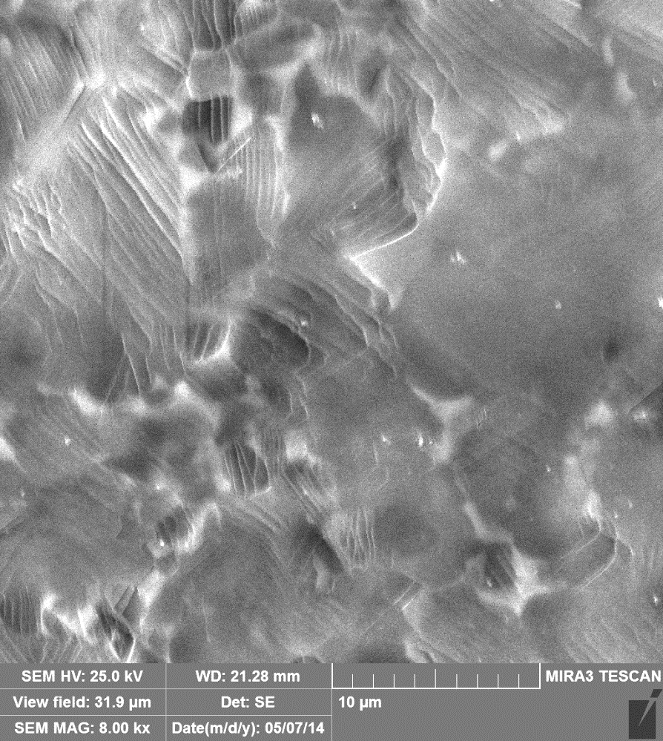
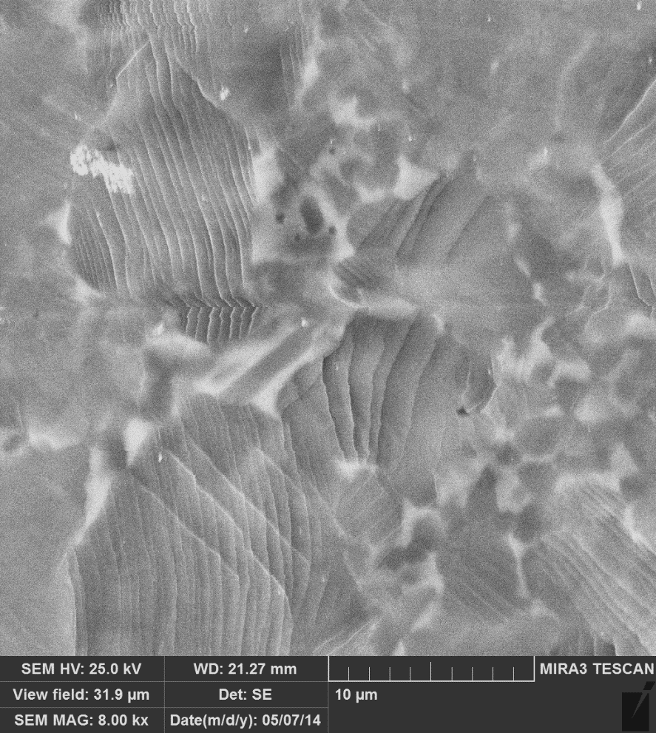
Ion beam : Ar@36MeV
T= 350 ^{O}C
Fluence = 10¹⁵ ions.cm⁻²
Max dpa= 1.5 dpa
Evolution of the microstructure during the test
a
b
Slip lines
Slip lines
Microstructure of irradiated Ti-6Al-4V (a) at 6.77% strain and (b) at 9.38% strain

Slide 17


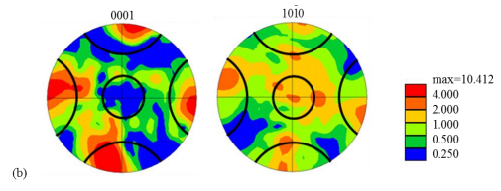
In-situ Tensile tests: Preliminary results
Texture of the tested Ti-6Al-4V
Ion beam : Ca 40 @2000MeV
T= 20^{O}C
Fluence = 6.10¹² ions.cm⁻²
Max dpa= 10⁻⁵ dpa
Non-irradiated Ti6Al-4V sample [Li.]
Ion beam : Ar@36MeV
T= 350 ^{O}C
Fluence = 10¹⁵ ions.cm⁻²
Max dpa= 1.5 dpa
Hongmei L,”ANALYSIS OF THE DEFORMATION BEHAVIOR OF THE HEXAGONAL CLOSE-PACKED ALPHA PHASE IN TITANIUM AND TITANIUM ALLOYS”, PhD disseretation , Michigan State University

Slide 18
In-situ Tensile tests: Comparison with other Ti64 RT tension Test
For low energy irradiation no change in the mechanical properties ( the damage is only on the surface (7 microns).
For high energy irradiation, even at low doses, we observed a significant decrease in the UTS.
More tests are required

Slide 19
Conclusion
Ongoing analyses:
  Nano-indentation tests on the cross sections of the samples will allow extraction of hardness and Young modulus for different dpa doses.
  In-situ tensile tests: Comparison between non irradiated and irradiated Ti-alloys and slip trace analysis
Future analyses
  New EBSD analyses planned after electro-polishing the samples
  Swelling measurements on each samples
  Possibility to use FIB (Focused Ion Beams) to study the damage in the depth of the sample for TEM, SEM/EBSD analyses
  In-situ irradiation and creep test

