Slide 1
Radiation damage of materials relevant for FRIB production target and beam dump
F. Pellemoine
May 21, 2014

Slide 2
Outline
FRIB context
FRIB production target
  Radiation damage studies in graphite
  Annealing of radiation damage at high temperature
FRIB beam dump
  Radiation damage studies in Titanium alloys
  Low energy swift heavy ion irradiation
FRIB production target and beam dump
  Irradiation studies of ferrofluidic feedthrough
Summary

Slide 3
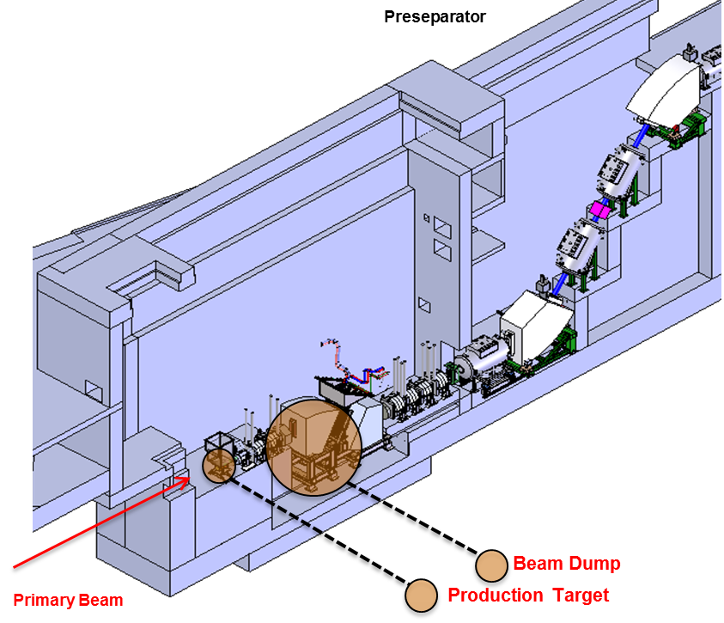
In-flight Rare Isotope Beam Production Facility
Swift Heavy-ion induced radiation damage
  5·10¹³ U ions/s
  Understanding Swift Heavy Ion (SHI) effects on material that can limit target and beam dump lifetime
  Different than neutron or proton
  irradiation
    Low gas production
    High dpa rate
    Electronic excitation ⇨ track formation
    along the ion path in material
      Electronic stopping power ~ 1-20 keV/nm
      for heavy ion beam
        Only 10⁻⁶ keV/nm for proton @ 120 GeV
        in graphite

Slide 4
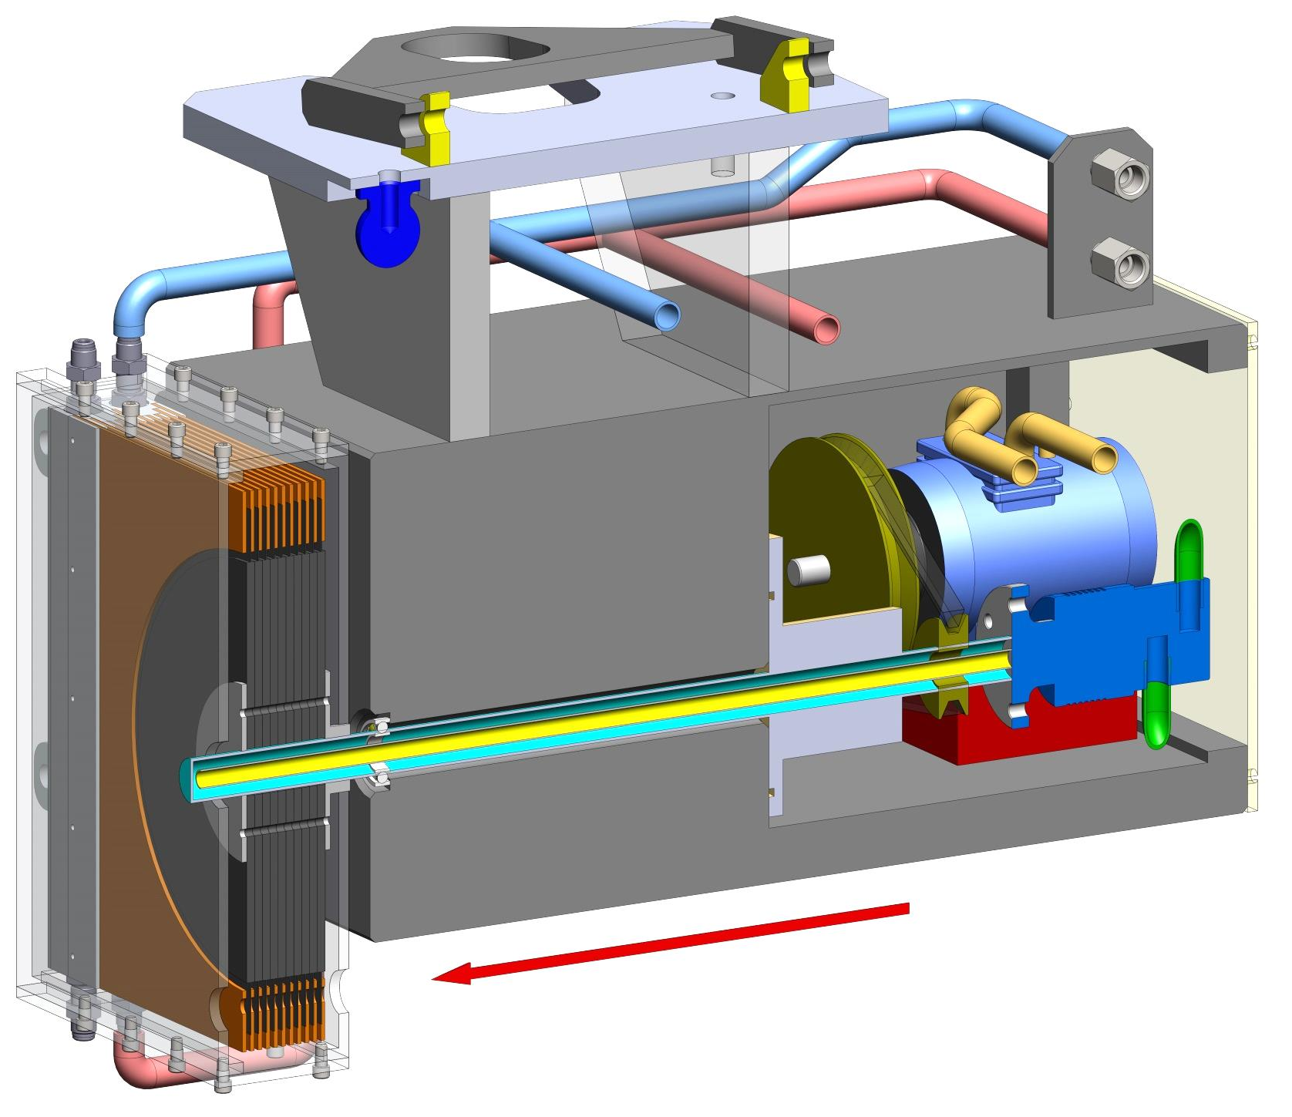
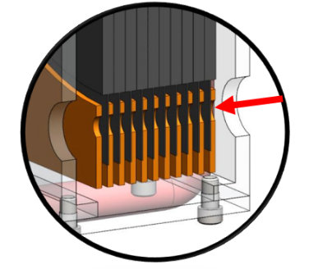
FRIB Production Target Design
Rotating multi-slice graphite target chosen for
FRIB baseline cooled by thermal radiation
Target parameters defined by thermo-
mechanical simulations
  5000 RPM and 30 cm diameter to limit
  maximum temperature and amplitude of
  temperature changes
  High temperature: ~ 1900ºC
    Evaporation of graphite mitigated
Target requirements
  Up to 100 kW power deposition in 1 mm
  diameter beam spot
  Target lifetime of 2 weeks desired to meet
  experimental program requirements
    fluence ~7·10¹⁸ ion/cm²
    dpa (U beam) ~ 7 (dpa/rate ~ 6·10⁻⁶ dpa/s)
Shield block
Pneumatic motor
Ferrofluidic
Feedthrough
Beam
Multi-slice target / heat exchanger

Slide 5
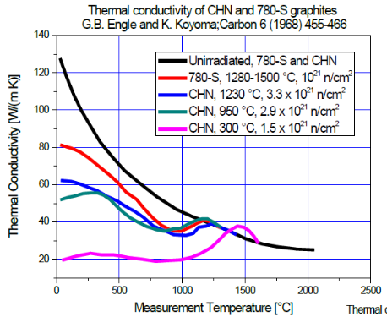
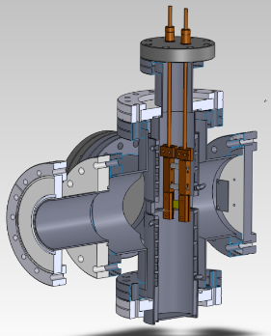
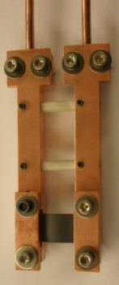

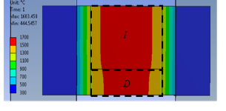
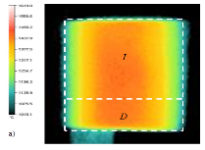


Radiation Damage Studies in Graphite
For Better Lifetime Predictions
Irradiations by charged heavy ion induce changes of
physical properties ⇨ decrease target performance
  Thermo-mechanical properties (thermal conductivity, tensile and flexural strength), Electronic properties (Resistivity), Structural properties (microstructure and dimensional changes, Swelling)
Most of the studies were done with neutron and proton
irradiation but not a lot of data for heavy ion beams
How much will annealing help?
Two types of polycrystalline graphite (5 and 13 µm grain size) irradiated with Au-beam 8.6 MeV/u
  Up to 5.6·10¹⁰ cm⁻².s⁻¹, Fluence up to 10¹⁵ cm⁻²
  Samples heated to different temperature
I = 35 A + beam
I = 35 A
T_{max} = 1600 ºC
T_{max} = 1480 (± 30 ºC)
Notes:
Continuous irradiation by charged heavy ions may give rise to degradation of the graphite target material properties, decrease of target performance over time and can generate an ultimate failure during operation. The structural behavior of the production targets will depend not only on the irradiation history, but also on the target material, manufacturing process, chemical environment and temperature.

Slide 6
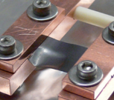
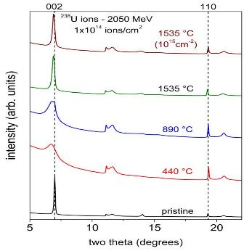
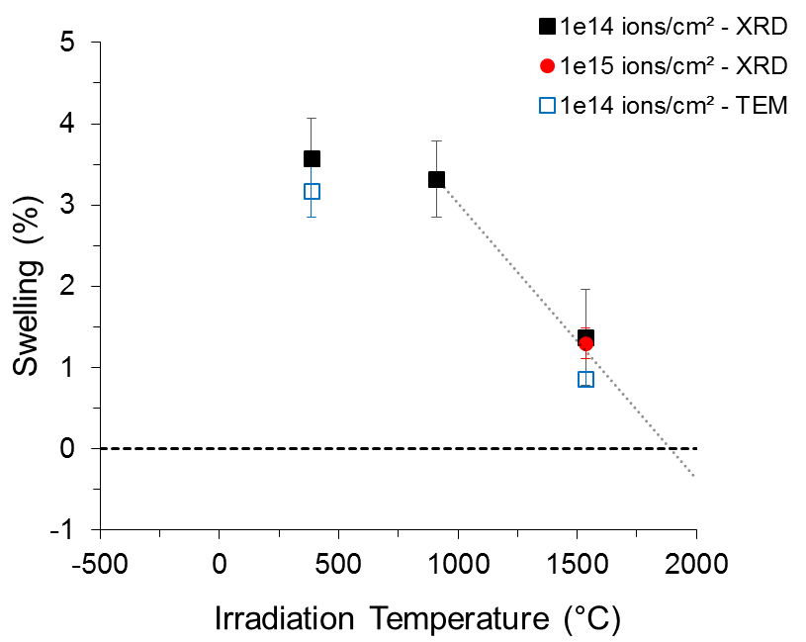
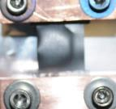
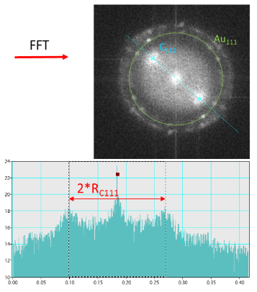
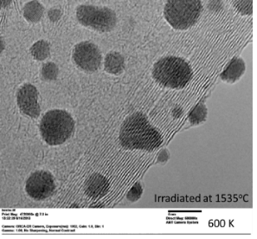
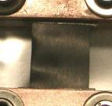
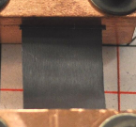
Radiation Damage Studies in Graphite
Annealing of Damage at High Temperature (> 1300ºC)
1 A - 350°C 10¹⁴ cm⁻²
11 A - 750°C 10¹⁴ cm⁻²
25 A - 1205°C 10¹⁴ cm⁻²
35 A - 1635°C 10¹⁵ cm⁻²
X-Ray Diffraction analyses
TEM analyses
Swelling is completely recovered at 1900ºC

Slide 7



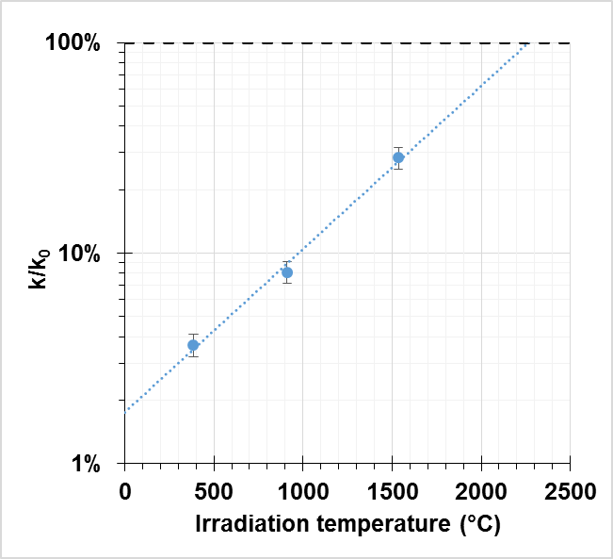
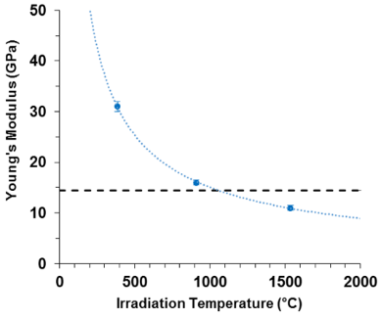
Radiation Damage Studies in Graphite
Annealing of Damage at High Temperature (> 1300ºC)
Additional analyses (Young’s modulus, thermal diffusivity, electrical resistance) of
irradiated samples all confirm annealing at high temperature
Results of material property changes were used as input in thermo-mechanical studies
  Swelling is completely recovered at 1900ºC
  30% of thermal conductivity value will be recovered but lead to insignificant change in average
  temperature of the production target. Main heat transfer in target is thermal radiation at
  high temperature
  Electrical resistivity change has no impact on thermo-mechanical behavior
Annealing promises sufficient lifetime for FRIB beam production targets
Young’s Modulus of irradiated graphite samples - ¹⁹⁷ Au – fluence 10¹⁴ ions/cm²
Thermal conductivity change of irradiated graphite samples - ¹⁹⁷ Au – fluence 10¹⁴ ions/cm²
Electrical resistivity change of irradiated graphite samples - ¹⁹⁷ Au

Slide 8
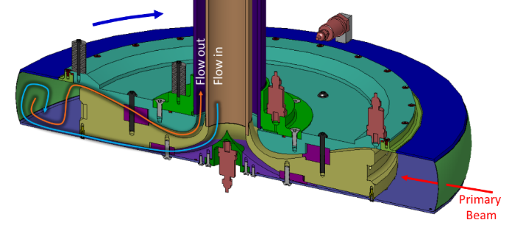
FRIB Beam Dump Design
Water-filled rotating drum beam dump chosen for FRIB baseline
Parameters defined by thermo-mechanical simulations
  400 RPM rotational speed and 70 cm diameter to limit maximum temperature and amplitude of temperature changes
Beam Dump lifetime of 1 year (5500 h) desired
  fluence ~10¹⁸ ion/cm²
  dpa (U beam) ~ 8.5 (dpa/rate ~ 4·10⁻⁷ dpa/s)
No heavy ion beam facility exists that allows us to test all challenges combined together
  Perform studies that combine some
  material challenges using existing facilities
    Electron beams, neutron beams, SHI beams
    Radiation damage, corrosion, creep
M. Avilov’s talk (yesterday)

Slide 9
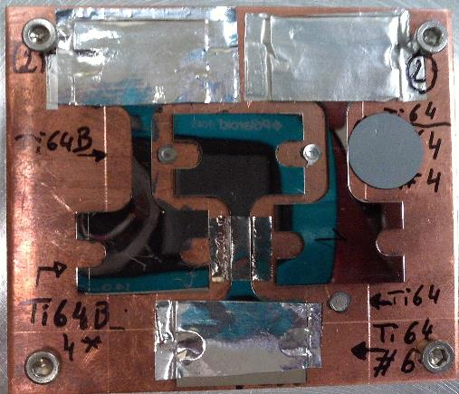
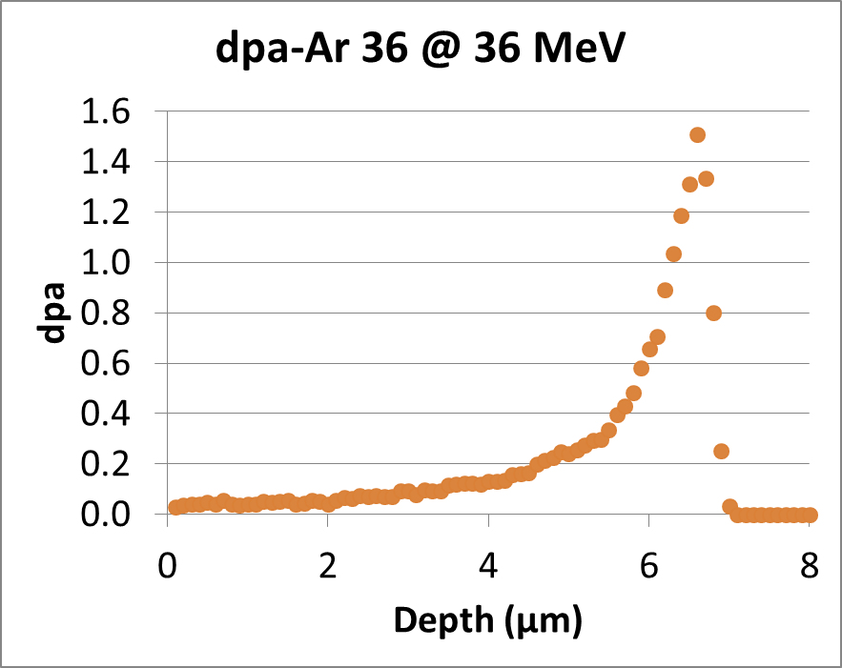

Radiation Damage Studies
For Better Lifetime Predictions
Systematic comparative radiation damage studies between both Ti-alloys
  Use of Ti-6Al-4V-1B is preferred for shell material compare to Ti-6Al-4V
  (M. Avilov’s Talk)
Study influence of different parameters on radiation damage
  Ion species, beam energy, electronic energy loss Se, fluence
    IRRSUD - CIMAP – France: low energy ion beams on Ti-6Al-4V and Ti-6Al-4V-1B
      4 beams (³⁶Ar to ¹³¹Xe), 4 energies (25 to 92 MeV), fluence from 2·10¹¹ to 2.5·10¹⁵ ions/cm²
      41 samples irradiated: foils, dog-bone and TEM
Al mask
Sample surface
Ti mask - 6 µm
Ti mask
Notes:
A variety of irradiation studies using swift heavy ions (SHI) are going on for two kinds of Ti alloy: Ti-­6Al­‐4V and Ti­‐6Al­‐4V-1B, which is used for the wall of the beam dump drum, in order to investigate the radiation damage.

Slide 10
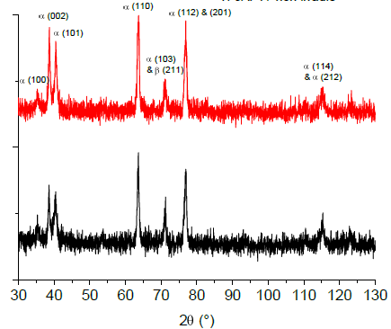
Radiation Damage Studies in Ti-alloys
Electronic Excitation Influence
Are Ti-alloys sensitive to electronic excitation?
No evidence of phase transformation and ion track in Ti-6Al-4V that promises good radiation resistance of this alloy
  Ti-alloys not sensitive to electronic excitation by swift heavy ions (Se~
  13 keV/nm – Kr @ 45 MeV; 20 keV/nm – Xe @ 92 MeV)
    FRIB: Se from 0.08 keV/nm (with O beam) and 12.6 keV/nm (with U beam)
Preliminary XRD results with Ti-6Al-4V
Ti-6Al-4V TEM analyses
Intensity (u.a.)
Xe 92 MeV – 2 10¹¹ ions/cm²
pristine
2 θ (º)
Kr 45 MeV – 5 10¹³ ions/cm²
Notes:
A variety of irradiation studies using swift heavy ions (SHI) are going on for two kinds of Ti alloy: Ti-­6Al­‐4V and Ti­‐6Al­‐4V-1B, which is used for the wall of the beam dump drum, in order to investigate the radiation damage.

Slide 11


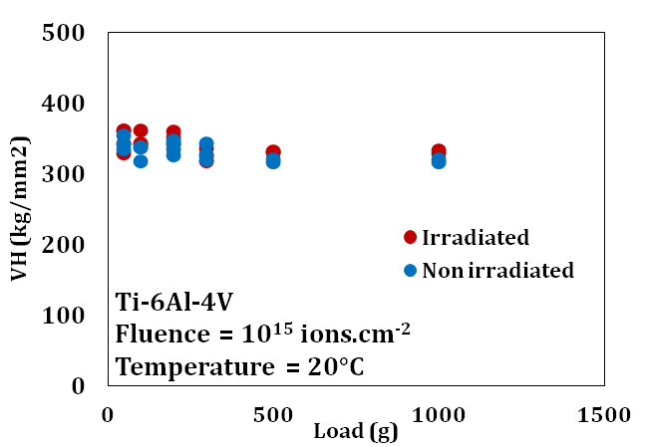
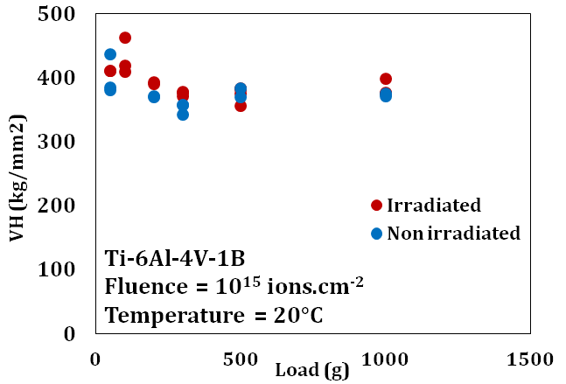
Low Energy SHI Beam Irradiations
No Significant Change Observed
Collaboration with C. Boehlert and A. Amroussia (CHEMS)
  Michigan State University Strategic Partnership Materials under Extreme Conditions (MaTX)
Preliminary results from SEM (Scanning Electron Microscope) / EBSD (Electron Backscatter Diffraction) analyses show no significant change in the microstructure or in orientation
of the grain at the surface of the samples
  Degradation of the quality of the EBSD scan after irradiation
Vickers Hardness tests show no significant change but
damage on the surface is very low (~ 0.038 dpa, 2·10⁻⁶dpa/s)
Before irradiation
Ti-6Al-4V
Ti-6Al-4V-1B
Ti-alloys at 350 ºC irradiated with ³⁶ Ar at 36 MeV
10¹⁵ ions/cm² - 0.038 dpa on surface
After irradiation
Notes:
Analyses of samples irradiated in December are just started and still ongoing in collaboration with C. Boehlert group, expert in Ti-alloys in the framework of SPG MaTX.
Preliminary results show that no significant change in grain orientations was observed at the surface.
Other analyses are under preparation to extract mechanical properties of Ti-alloys in the depth of the samples by using nano-indentation technic. Hardness and young modulus measurements will give us mechanical behavior of Ti-alloys under heavy ion irradiation.
Future analyses will allow us to go deeper in the understanding of heavy ion – induced irradiation damage in Ti-alloys which could reduce lifetime of the beam dump.

Slide 12
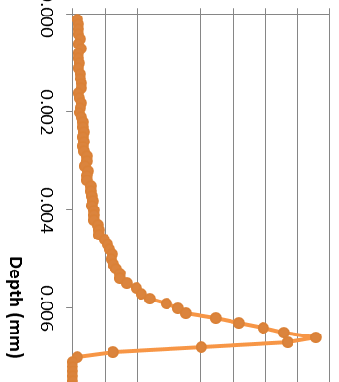
SHI Irradiation Study of Ti-alloys
36Ar @ 36 MeV
Analyses ongoing
  Nano-indentation study will allow extraction
  of hardness and Young modulus in the cross
  section of the sample in order to reach
  higher dpa
  In-situ SEM during tensile tests (MSU –
  C. Boehlert)
    Study doesn’t give bulk properties of Ti-alloys but
    allows us to observe if the deformation mechanisms
    on irradiated Ti-alloys are different from un-irradiated
    samples
Future analyses
  New EBSD analyses planned after polishing
  samples
  Swelling study for each samples
  Possibility to use FIB (Focused Ion Beams) to study damage in the depth of the sample for TEM, SEM/EBSD analyses
Ti-alloy sample
Notes:
Analyses of samples irradiated in December are just started and still ongoing in collaboration with C. Boehlert group, expert in Ti-alloys in the framework of SPG MaTX.
Preliminary results show that no significant change in grain orientations was observed at the surface.
Other analyses are under preparation to extract mechanical properties of Ti-alloys in the depth of the samples by using nano-indentation technic. Hardness and young modulus measurements will give us mechanical behavior of Ti-alloys under heavy ion irradiation.
Future analyses will allow us to go deeper in the understanding of heavy ion – induced irradiation damage in Ti-alloys which could reduce lifetime of the beam dump.

Slide 13
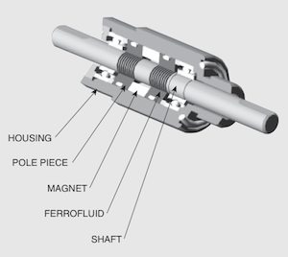
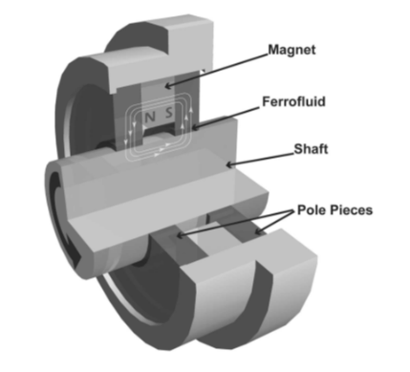
Design Support for Target and Beam Dump
Radiation Effects in Ferrofluidic Feedthroughs
Ferrofluidic Feedthrough will be used in both units (target and beam dump)
Maximum dose to Ferrofluidic Feedthroughs
  Target (2 weeks of operation)
    1 MGy (¹⁸O beam at 266 MeV/u with 15” cast iron shielding)
    Estimate 7.5 MGy without shielding
  Beam dump (1 year of operation)
    3.5 MGy (¹⁸O beam, 637 MeV/u (conservative upgrade-energy assumption) with 5” of steel shielding)

Slide 14

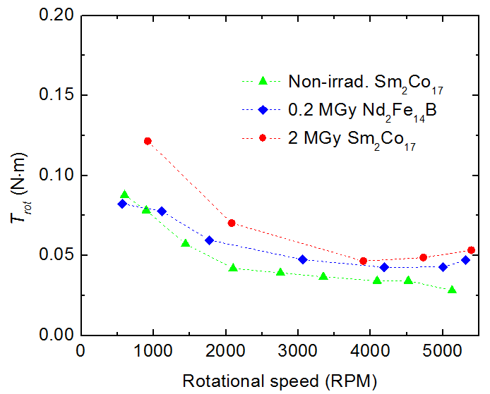
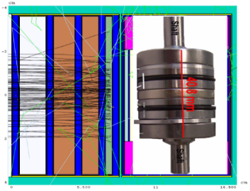
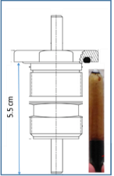
Design Support for Target and Beam Dump
Radiation Effects in Ferrofluidic Feedthroughs
FFFT irradiation tests at BNL in June 2011
  0.2, 2, 20 MGy mixed proton, neutron and gamma irradiation from stopped proton beam
Torque and vacuum tests performed in Nov 2011 and Feb 2012
  No significant change in FFFT performance observed up to a total dose of 2 MGy
    Feedthrough blocked for a total dose of 20 MGy
    No significant leaks found
FFFT is a valid technical choice
BLIP Isotope Target
Neutron irradiation space
112 MeV Proton Beam from Linac

Slide 15
Summary
Radiation damage on material for FRIB project are performed
  with heavy ion beams
    Polycrystalline graphite (E = 8.6 MeV/A at GSI)
    Titanium alloy : Ti-6Al-4V and Ti-6Al-4V-1B (E = 1 MeV/A at CIMAP)
  with secondary beams at BNL
    Ferrofluidic feedthrough
Graphite and FFFT studies promise a sufficient lifetime for FRIB production target
No show-stoppers in Beam dump material studies foreseen but need more investigation with higher dpa and higher energy beam to be closer to FRIB conditions

Slide 16
Acknowledgements
GSI – Darmstadt, Germany
  Markus Bender
  Markus Krause
  Daniel Severin
  Marilena Tomut
  Christina Trautmann
University of Michigan
  Maik Lang
  Rod Ewing
  Weixing Li
University of Reims Champagne-Ardenne, France
  Mihai Chirtoc
  Nicolas Horny
Institute of Solid State Physics, University of Latvia
  I. Manika
  J. Maniks
  R. Zabels
Brookhaven National Laboratory
  Leonard Mausner
  Joseph O’Conor
  Nikolaos Simos
GANIL-CIMAP, France
  Florent Durantel
  Clara Grygiel
  Isabelle Monnet
  Florent Moisy
  Marcel Toulemonde
MSU Department of Chemical Engineering and Material Science
  Aida Amroussia
  Carl Boehlert
FRIB
  Mikhail Avilov
  Tiffany Fourmeau
  Sandrina Fernandes
  Wolfgang Mittig
  Reginald Ronningen
  Mike Schein

Slide 17
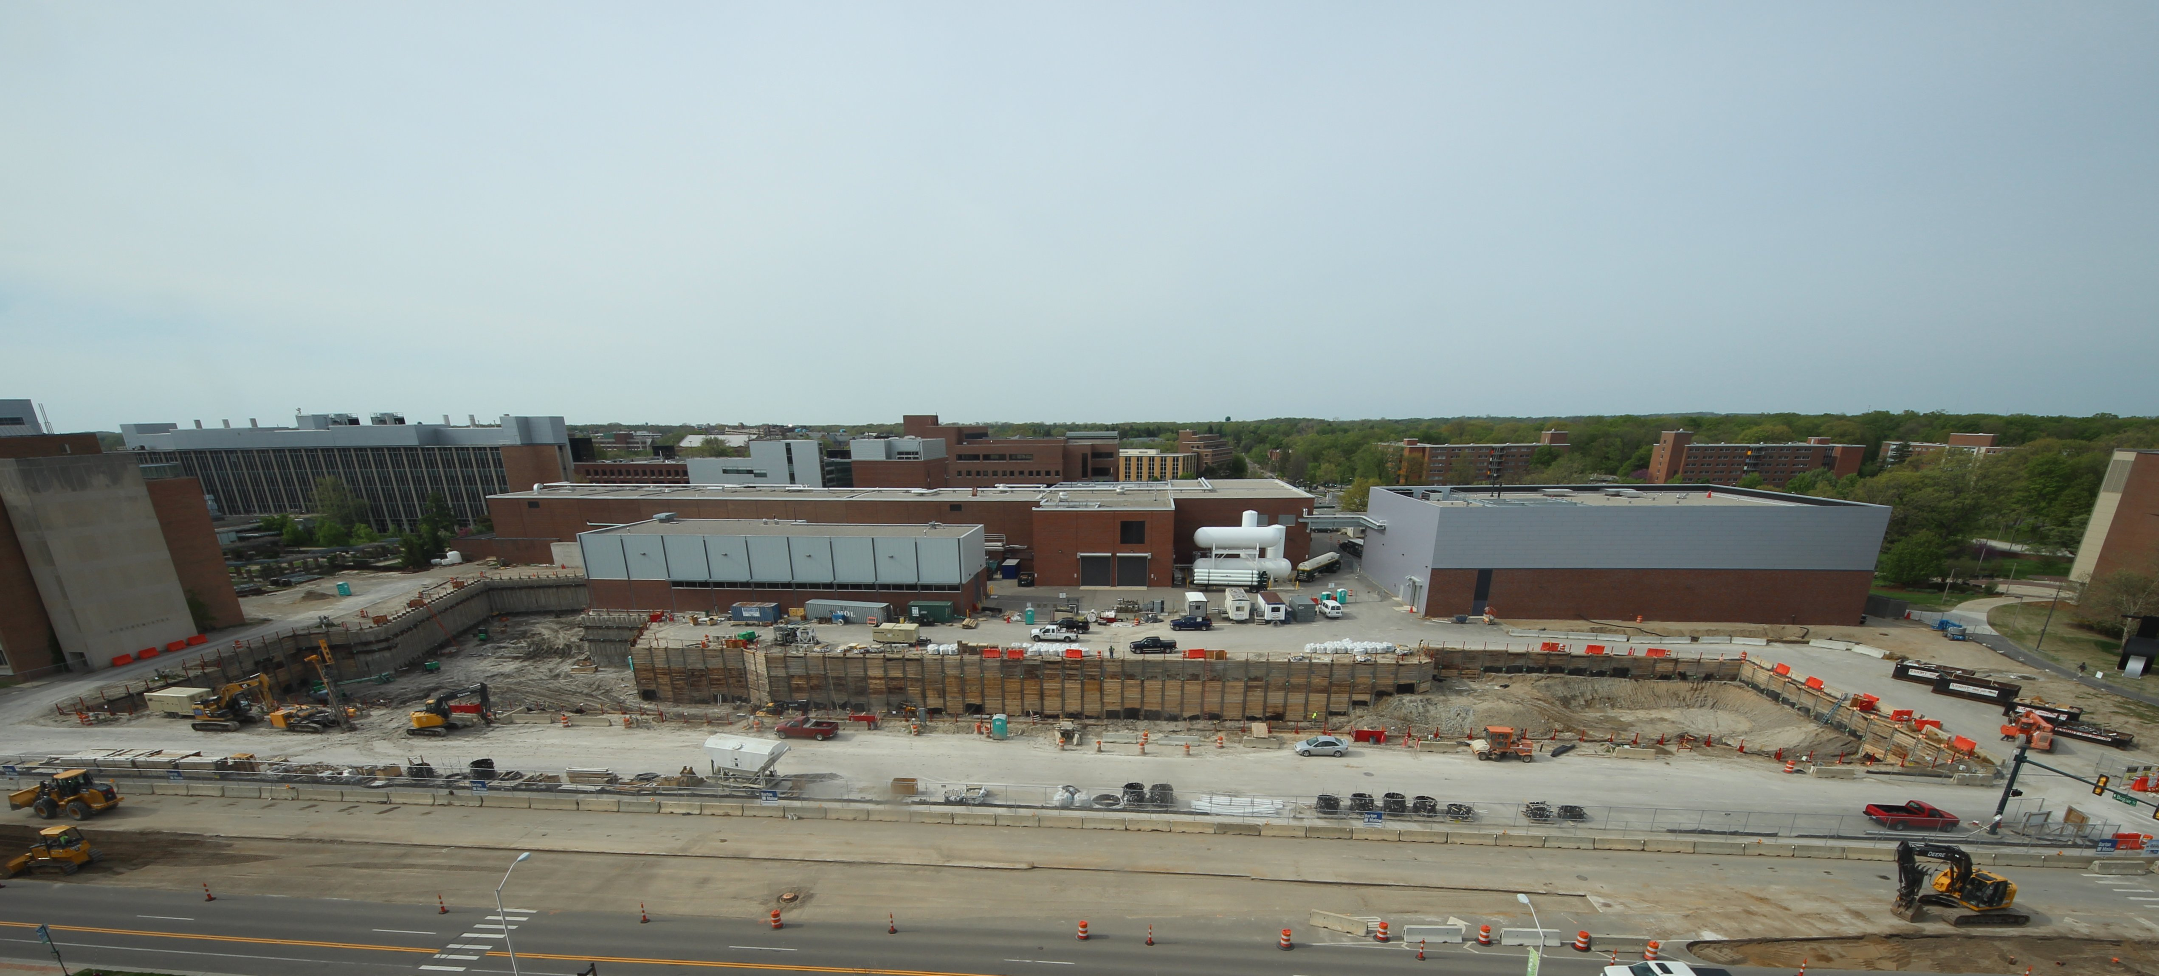
Thanks for your attention
May 19th 2014

Slide 18
Back up slides
Ti-alloys irradiations at CIMAP and NSCL
Facilities | Beam | Energy [MeV] | Range [µm] | S_{e} [keV/nm] | Fluence [ions/cm²] | Max dpa in sample | Date | Number of samples | Type
IRRSUD | ⁸²Kr | 25 | 4.73 | 9.9 | 5.10¹¹-5.10¹²-2.10¹⁴ | 0.6 | Jul-2013 | 6 | Foils
 | ¹³¹Xe | 92 | 8.5 | 19.7 | 2.10¹¹ | 0.001 | Jul-2013 | 2 | Foils
 | ⁸²Kr | 45 | 6.43 | 13.1 | 5.10¹¹-5.10¹³ | 0.16 | Jul-2013 | 4 | Foils
 | ⁸²Kr | 45 | 6.43 | 13.1 | 2.10¹⁴ 2.5.10¹⁵ | 8 | Oct-2013 | 6 | Foils
 | ³⁶Ar | 36 | 6.8 | 7.5 | 10¹⁵ | 1.5 | Dec-2013 | 23 | TEM and dogbone
 | ¹²⁹Xe | 92 | 8.5 | 19.7 | 3 10¹⁴ estimated | 1.7 (Estimated) | June-2014 scheduled |  | Dogbone
NSCL | ⁴⁰Ca | 2000 | 800 | 1.5 | 6 10¹² | 10⁻⁵ | Aug-2013 | 1 x Ti64 | Dogbone

