Slide 1
Radiation Damage and Annealing in Graphite:
Ways to Improve the Lifetime of Targets
Frederique Pellemoine
Wolfgang Mittig
May 19, 2015

Slide 2
Outline
FRIB High-power production targets
  Design and challenges
  Irradiation and annealing studies of graphite
    Temperature effect
NSCL-FRIB stripper
  Challenges
  Irradiation and annealing studies of graphite
    Temperature effects
Conclusions

Slide 3
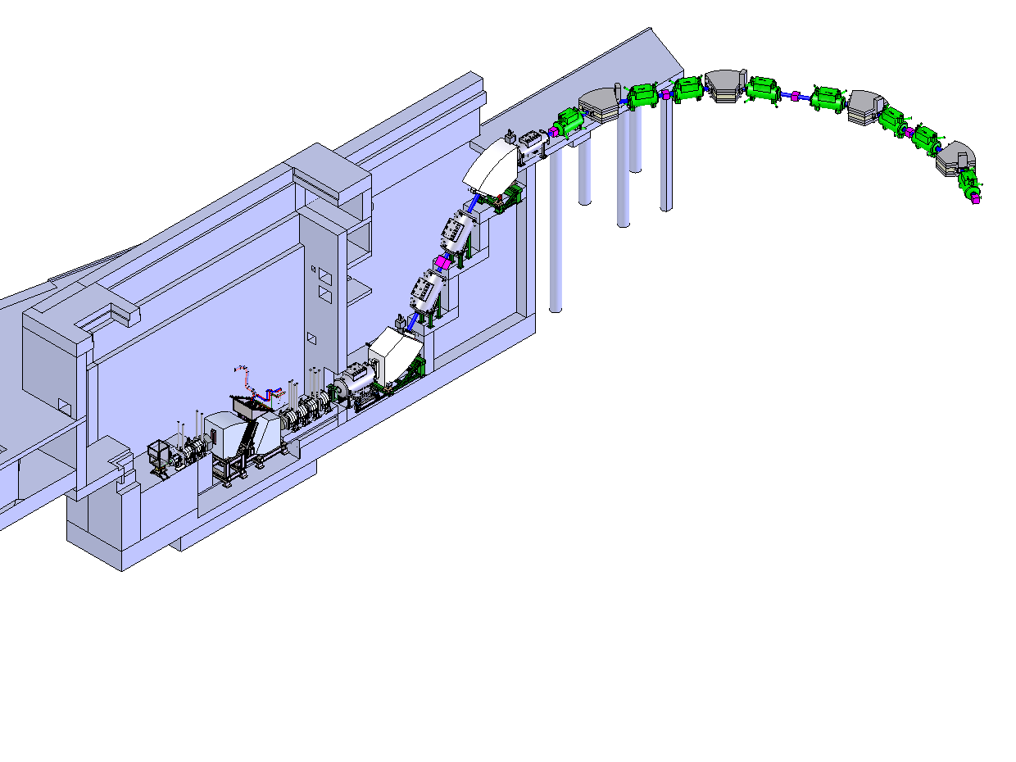
High-Power Production Target
Scope and Technical Requirements
In-flight rare isotope beam production with beam power of 400 kW at 200 MeV/u for ²³⁸U and higher energies for lighter ions
High power capability
  Up to 100 kW in a ~ 0.3 - 8 g/cm² target for rare
  isotope production via projectile
  fragmentation and fission
Required high resolving power of
fragment separator
  1 mm diameter beam spot
  Maximum extension of 50 mm in
  beam direction
Target lifetime of 2 weeks to meet
experimental program requirements
Preseparator
Primary Beam
Production target

Slide 4
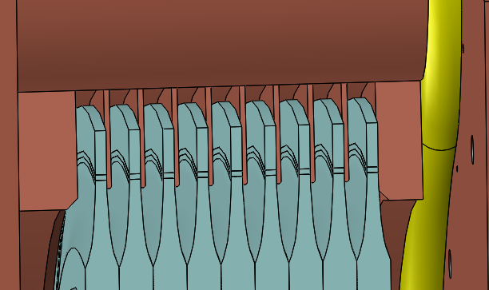
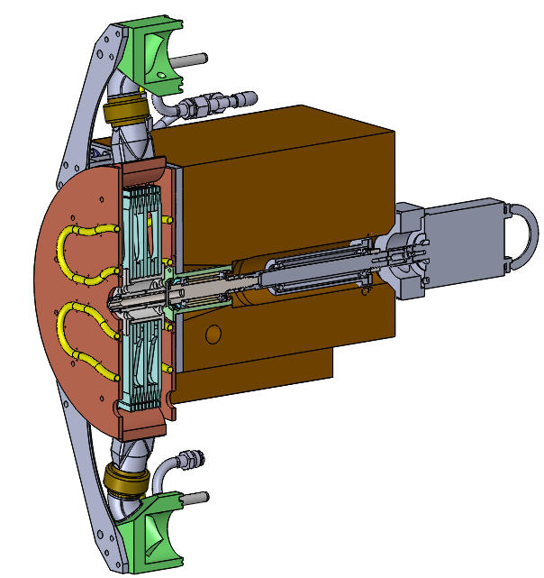
FRIB Production Target
Rotating Multi-slice Graphite Target Design
Rotating multi-slice graphite target chosen for FRIB baseline
  Increased radiating area and reduced total power per slice by using multi-slice target
  Use graphite as high temperature material
  Radiation cooling
Design parameters
  Optimum target thickness is ~ ⅓ of ion range
    0.15 mm to several mm
  Maximum extension of 50 mm in beam direction including slice thickness and cooling fins to meet optics requirements
  5000 rpm and 30 cm diameter to limit maximum temperature and amplitude of temperature changes
Shield block
Radiation resistance
and vacuum compatible motor
Beam
Multi-slice target / heat exchanger

Slide 5
FRIB Production Target
Challenges
Thermo-mechanical challenges
  High power density: ~ 20 - 60 MW/cm³
    High temperature: ~ 1900 ºC: Evaporation of graphite, stress
  Rotating target
    Temperature variation: Fatigue, Stress waves through target
Swift Heavy Ion (SHI) effects on graphite
  Radiation damage induce material changes
    Property changes: thermal conductivity, tensile and flexural strength, electrical resistivity, microstructure and dimensional changes, …
  Swift heavy ions (SHI) damage not well-known
  5·10¹³ U ions/s at 203 MeV/u may limit target lifetime
    Fluence of ~9.4·10¹⁸ ions/cm² and 10 dpa estimated for 2 weeks of operation
Similar challenges at
  Facility for Antiproton and Ion Research (FAIR) at GSI
  Radioactive Ion Beam Factory (RIBF) at RIKEN

Slide 6
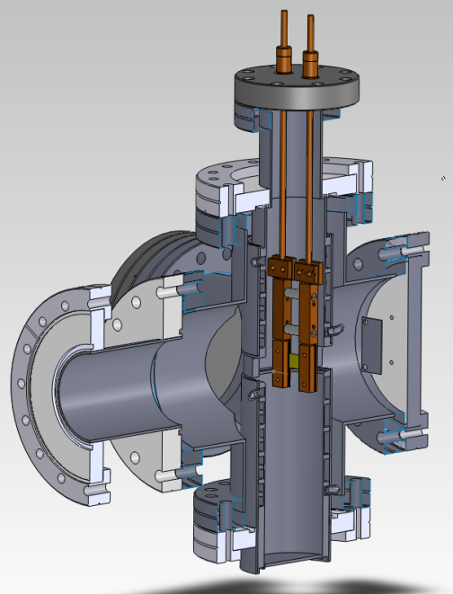
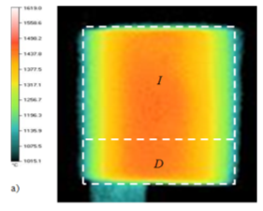
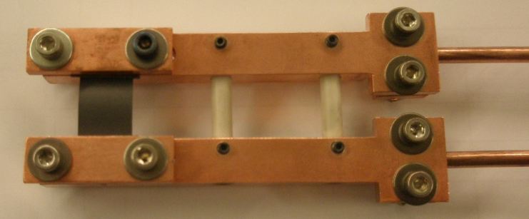
Irradiation Test at UNILAC at GSI/Darmstadt
Polycrystalline isotropic graphite
  2 Grades MERSEN 2360 (5 μm ) / 2320 (13 μm)
Irradiation test at UNILAC at GSI/Darmstadt
  Au-beam 8.6 MeV/u
    Up to 5.6·10¹⁰ ions/cm²·s and fluence up to 10¹⁵ ions/cm²
      Equivalent to a fluence of 10¹⁸ ions/cm² for FRIB beam energy
      or 2 days of operation
    Electronic energy loss ≈ 20 keV/nm
  Ohmic heating (up to 35 A, 250 W) of samples
  to different temperature during irradiation
I = 35 A
I = 35 A + beam
T_{max} = 1480 (± 30 ºC)
T_{max} = 1635ºC

Slide 7



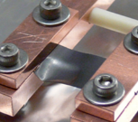
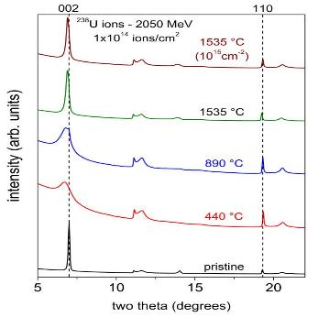
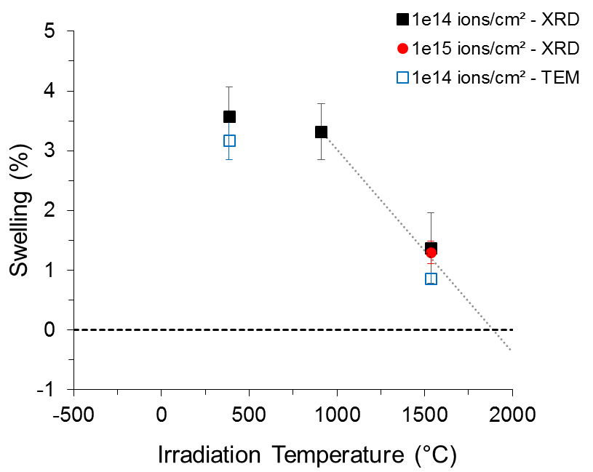
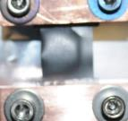
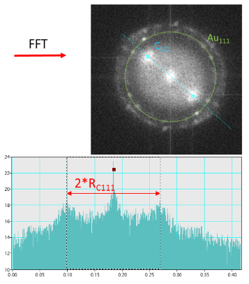
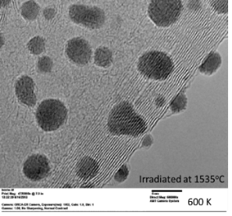
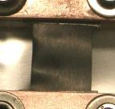
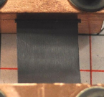
Radiation Damage Studies in Graphite [1]
Annealing of Damage at High Temperature (> 1300ºC)
1 A - 350°C 10¹⁴ cm⁻²
11 A - 750°C 10¹⁴ cm⁻²
25 A - 1205°C 10¹⁴ cm⁻²
35 A - 1635°C 10¹⁵ cm⁻²
X-Ray Diffraction analyses
TEM analyses
Swelling is completely recovered at 1900ºC

Slide 8
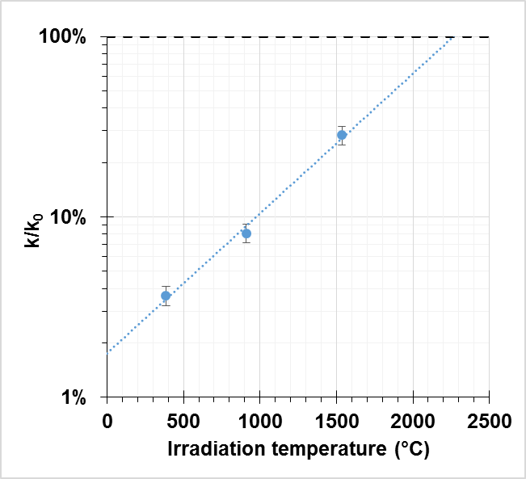



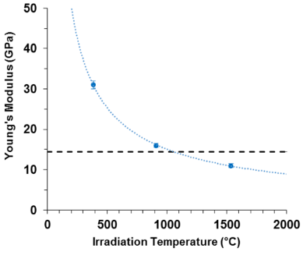
Radiation Damage Studies in Graphite [2]
Annealing of Damage at High Temperature (> 1300ºC)
pristine
Annealing at high temperature confirmed
Thermal conductivity change of irradiated graphite samples - ¹⁹⁷ Au fluence 10¹⁴ ions/cm²
Electrical resistance change of irradiated graphite samples - ¹⁹⁷ Au
Young’s Modulus of irradiated graphite samples - ¹⁹⁷ Au
fluence 10¹⁴ ions/cm²
pristine

Slide 9
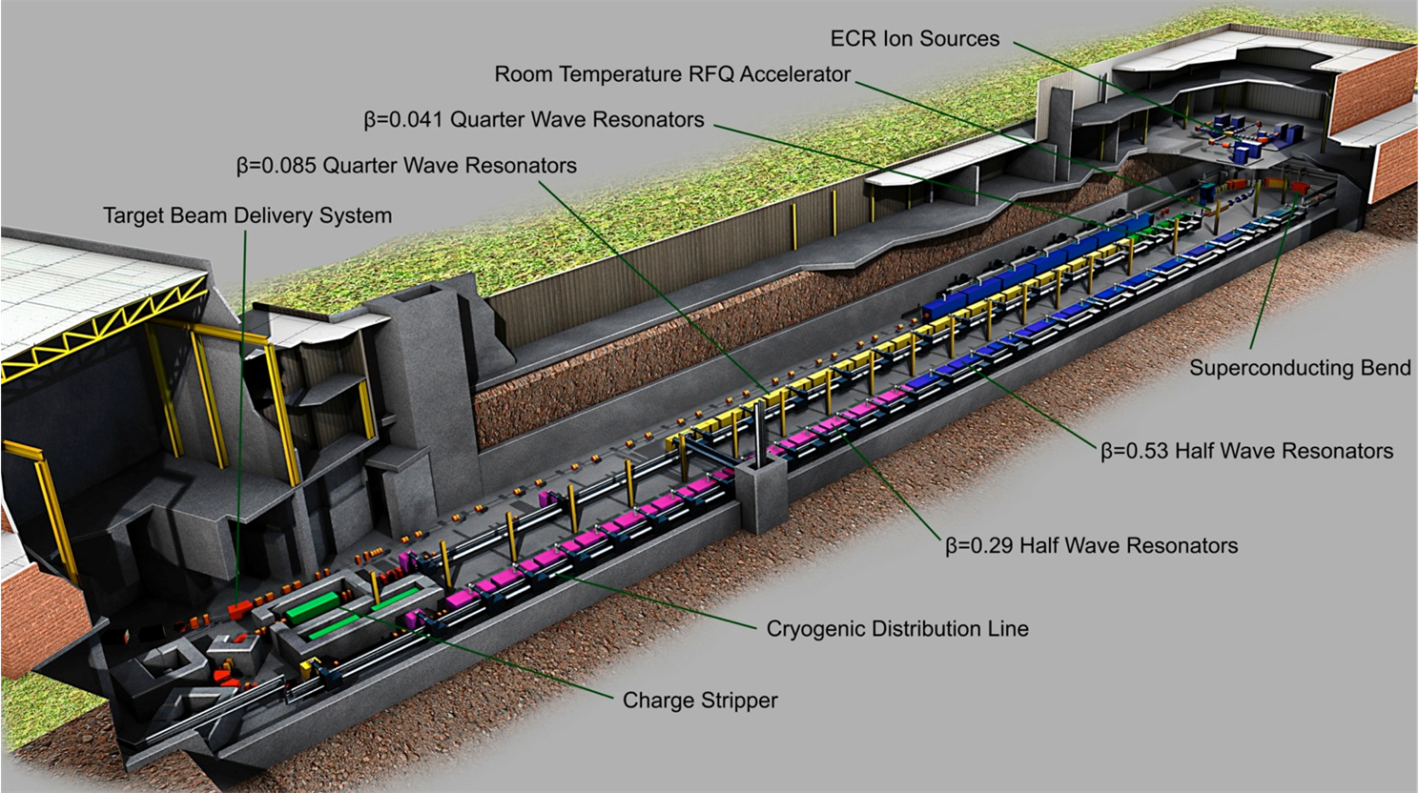
NSCL-FRIB Strippers
Challenges
It is known that thin foils (stripper) used in accelerator suffer a quick degradation due to radiation damage such as swelling and thermo-mechanical changes
  Limits the lifetime of few hours
How can we improve the lifetime?
  Annealing at high temperature
  Influence of nano-structure on annealing
  FRIB full intensity Li film stripper
  ….

Slide 10
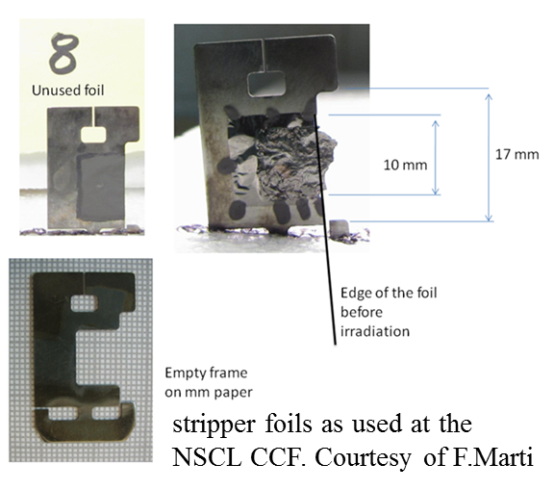
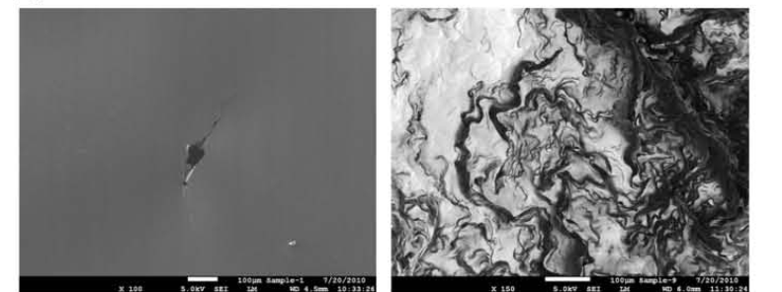
NSCL-FRIB Strippers
Radiation Damage
Recent tests at NSCL have shown quick deterioration of graphite foils under heavy ion bombardment due to thermal and mechanical stresses and radiation damage
  Carbon irradiated with Pb beam @ 8.1 MeV/u
    Se= 24 keV/nm, fluence = 4.5·10¹⁶ ions/cm²
SEM photographs of unused carbon foil (left) showing a small pinhole for illustration and a foil exposed to 8.1 MeV/u Pb beam
F. Marti et al., "A carbon foil stripper for FRIB", TUP 106, Proceedings of Linear Accelerator Conference LINAC2010, Tsukuba, Japan, TUP105, 2010.

Slide 11
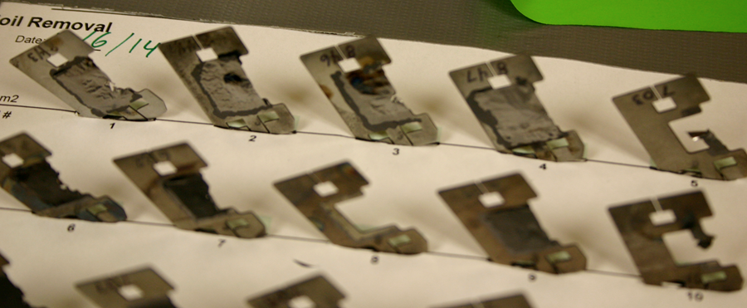
NSCL-FRIB Strippers
Irradiated Strippers at NSCL
Current carbon strippers used at NSCL

Slide 12
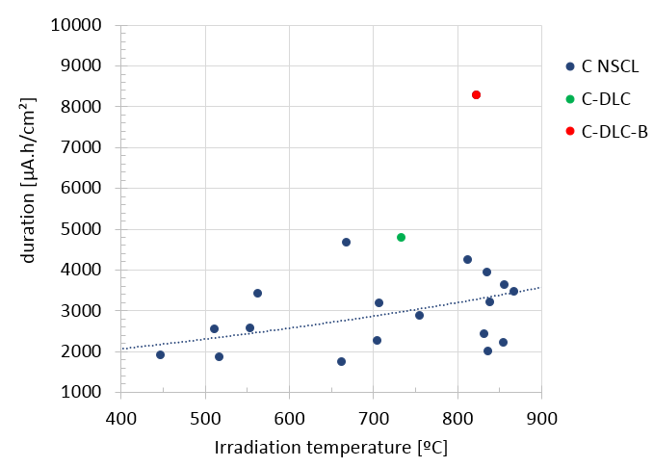
Improvement of the lifetime
Previous studies [3] showed annealing effects of radiation damage at high temperature. The heating by the beam was evaluated to produce temperatures of up ~900 ºC. A clear tendency of increased lifetime with irradiation temperature was observed.
The lifetime of the 10 multilayer foil C-DLC-B was significantly higher (factor 3) than the standard C-NSCL foils. The 10 multilayer foil C-DLC was somewhat superior (about a factor 2) as compared to the standard foils.
Lifetime time (μA·h/cm²) as a function of the irradiation temperature and the microstructure of graphite stripper foils.
[3] S. Fernandes et al., “In-Situ Electric Resistance Measurements and Annealing Effects of Graphite Exposed to Swift Heavy Ions”, Nucl. Instrum. Methods Phys. Res. B 314 (2013) 125-129.

Slide 13
Summary and Conclusions
Heavy-ion irradiation tests and annealing studies performed in the context of high-power target and strippers for high intensity accelerator were performed
High temperature annealing of heavy-ion induced radiation damage observed in production target
  First experiment of this kind
  Confirmed by several analysis
Graphite as a material for FRIB beam production targets promises sufficient lifetime
High temperature annealing of heavy-ion induced radiation damage observed in NSCL strippers

Slide 14




Acknowledgements
FRIB/NSCL Michigan State University
  Mikhail Avilov, Saul Beceiro Novo, Sandrina Fernandes, Felix Marti, Mike Schein, Andreas Stolz, Genevieve West
GSI Helmholtzzentrum für Schwerionenforschung GmbH
  Markus Bender, Markus Krause, Daniel Severin, Marilena Tomut, Christina Trautmann
University of Michigan
  Rodney Ewing, Maik Lang, Weixing Li

Slide 15
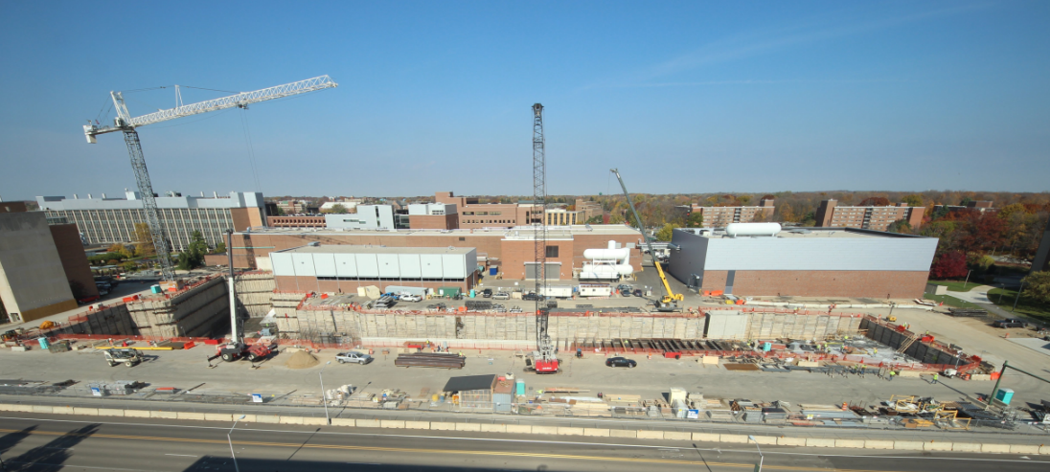
Thank you for your attention
FRIB construction area – October 27 2014

Slide 16
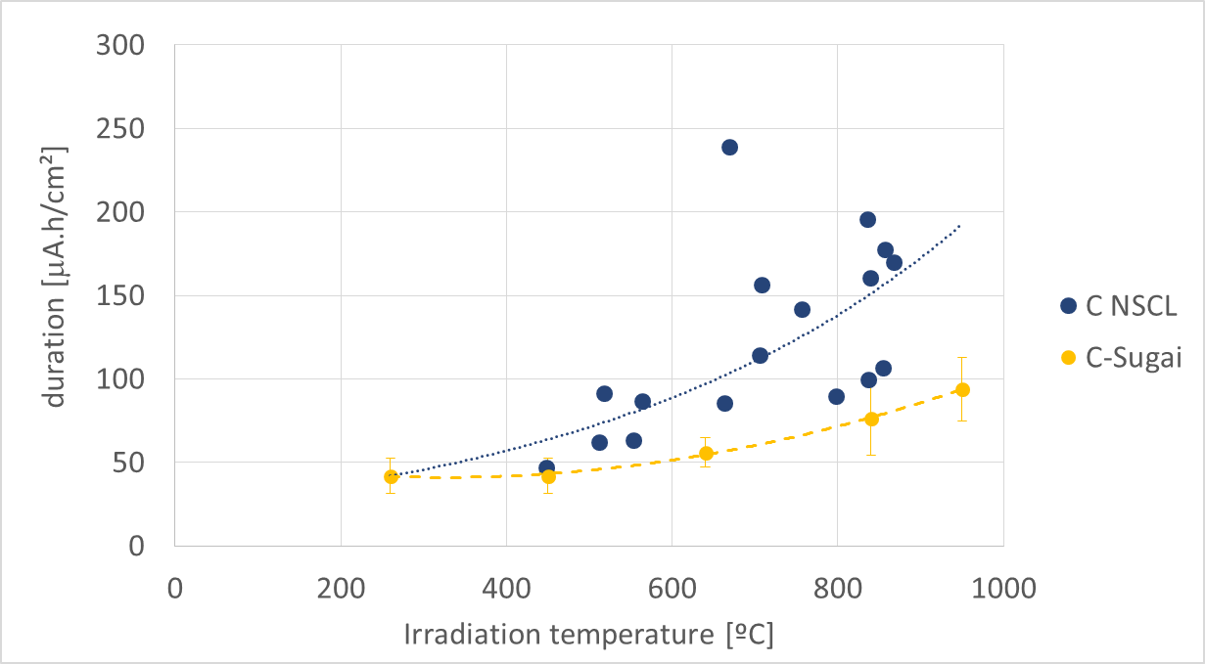
NSCL-FRIB Strippers
Lifetime measurement at NSCL
Effect of the temperature on lifetime improvement observed at NSCL
Preliminary results
⁷⁸ Kr¹⁴⁺ @ 13 MeV/u
²⁰ Ne @ 3.2 MeV
Sugai et al., NIMB 269 (2011) 223-228

