Slide 1

MERIT – THE High Intensity Liquid Mercury Target Experiment at the CERN PS
Outline
Introduction
Experimental apparatus
Analysis results
I. Efthymiopoulos, A. Fabich, F. Haug, M. Palm, J. Lettry, H. Pernegger, R.Steerenberg, A. Grudiev, CERN
H.G. Kirk, T. Tsang, BNL - N.Mokhov, S.Striganov, FNAL
A. Carroll, V.B. Graves, P. Spampinato, ORNL - K.T. McDonald, Princeton Univ.
J.R.J. Bennett, O. Caretta, P. Loveridge, RAL - H. Park, SUNY at Stony Brook
IEE-Nuclear Science Symposium
Dresden, October 23, 2008

Slide 2
The MERcury Intense Target Experiment
Introduction
The MERIT experiment is a proof‐of‐principle test of a target system for a high power proton beam to be used as front‐end for a neutrino factory or a muon collider
Generating neutrino beams:
In both cases the production of intense neutrino beam originates from high-intensity proton beams impinging in a target material
  intense pion beams ⬄ high-intensity proton beams impinging on a target
decay
μ
±
ν
(
ν
)
Superbeams
⎯
⎯
⎯
→
p
+
→
π
±
μ
μ
A
X
decay
decay
⎯
⎯
→
±
ν
ν
ν
ν
Neutrino factory or muon collider
⎯
⎯
±
⎯
⎯
→
μ
ν
(
ν
)
e
(
)
μ
μ
e
μ
μ
e

Slide 3
The MERcury Intense Target Experiment
Introduction
Present experiments indicate that solid target systems (graphite, Be, Ta, etc. ) cannot be reliably used for proton beam powers at the multiMW scale
The use of liquid targets (Hg or PbBi, etc.) in a free jet configuration is an interesting alternative. It avoids the use of beam windows and offers the possibility of re-generation of the target volume at each pulse.
However, there are important issues to clarify:
  the stability of the liquid jet, in particular in the presence of a magnetic field required for the capture of the secondary particles
  the formation of caviation due to the energy deposition in the target volume →inefficiencies in the secondary particle flux production
The MERIT experiment is designed to provide answers to both questions and therefore validate the liquid target concept

Slide 4
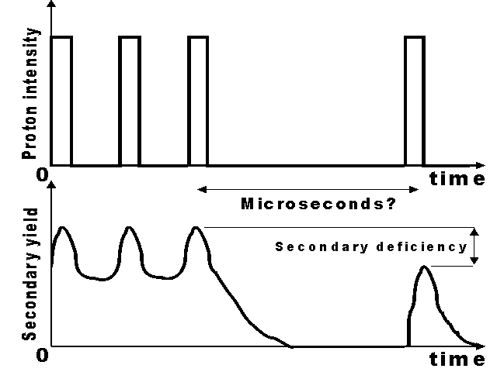
The MERcury Intense Target Experiment
Scientific goals
Study the impact of an intense proton beam with a free mercury jet, at the presence of high magnetic field
e.g. MHD effects on a mercury jet
  jet dispersal at t=100μs with magnetic field varying from 0-10 Tesla
    Magnetic pressure suppresses jet break-up
Study the secondary particle yield and possible cavitation formation
Use the “pump-probe” method
  Few high-intensity bunches – “pump” followed by other bunches – “probe” at variable delay
    observe the secondary particle flux vs time
    deficiencies could be a sign of cavitation formation
0T
10T
R.Samulyak-BNL

Slide 5
The MERcury Intense Target Experiment
Key parameters of the experiment
14 and 24 GeV/c proton beam pulses from CERN Proton Synchrotron (PS);
  1÷16 bunches/pulse, with variable spacing in between; up to 3.5×10¹² protons/bunch
Beam spot at the target σ_{t} ~1.2mm;
Capture system: solenoid with 15T field surrounding the target
  proton beam axis at 67mrad to magnet axis
Target: free mercury jet of 1-cm Ø; velocity up to 20m/s
  jet axis at 33mrad to magnet axis ; interaction region ~30cm (2 λ_{int})
The experiment took data for three weeks in autumn 2007
  ≈ 360 beam pulses in total; with each beam pulse “a separate experiment”
    vary bunch intensity, bunch spacing, # of bunches
    vary magnetic field strength
    vary beam-jet alignment, beam spot size
Data analysis ongoing – results obtained so far will be shown here

Slide 6
The MERcury Intense Target Experiment
Outline
Introduction
Experimental apparatus
Analysis results

Slide 7
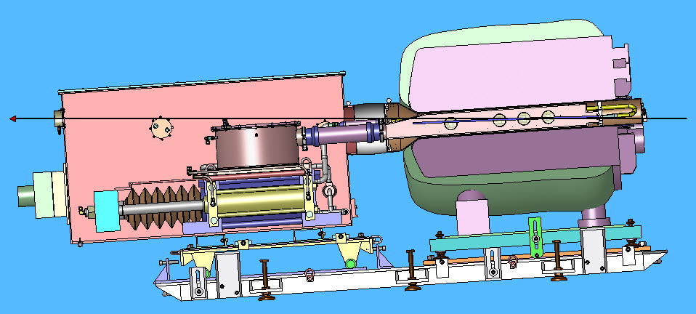
MERIT – Experimental setup
Schematic layout
Solenoid
Jet Chamber
Secondary
Containment
Syringe Pump
Proton
Beam
4
3
2
1
The experiment was specially designed to avoid opening the primary container (Hg-wet volume) at CERN
  180deg bend in the Hg-delivery piping system upstream; likely cause of deterioration in the quality of the Hg-jet

Slide 8
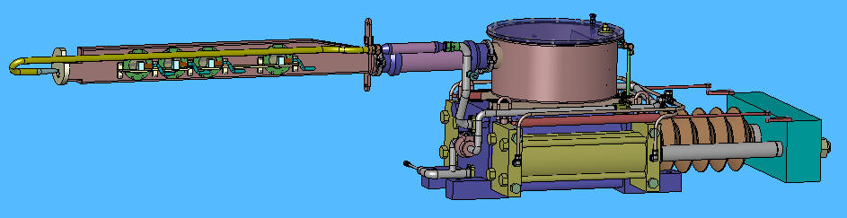
MERIT – Experimental setup
Hg-delivery system
Reservoir; collects the mercury returning at the end of the injection/jet
1” pipe to transport mercury to nozzle at upstream end of primary vessel
Local electronics ; Hg-jet speed control
V. Graves - ORNL
Optical diagnostics mounted on the outside of the primary vessel
Pressure monitor of Hg-supply pipe during pulsing
Syringe system; can produce a Hg-jet for 15s (~23lt )
System parameters:
Piston velocity : 3.0 cm/s
Hg jet duration of 12s ;
Drive cylinders: 15-cm diam, 45 lt/min, 2.1 MPa

Slide 9
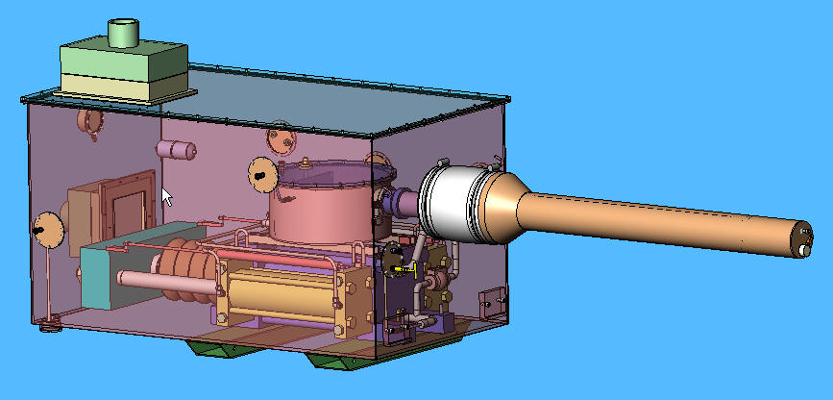
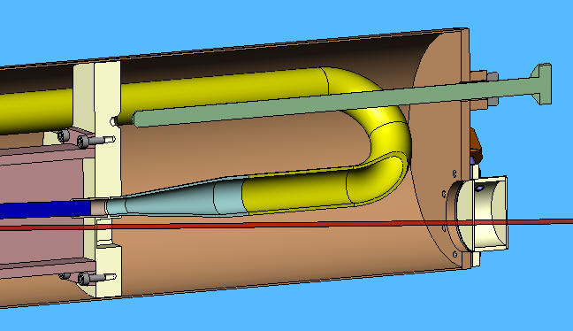
MERIT – Experimental setup
Hg-delivery system
Charcoal filters to monitor the Hg-vapor
V. Graves - ORNL
Double container (primary and secondary) for safety requirements
Upstream window; Ti6AlV4, double pressurized wall to detect failure

Slide 10
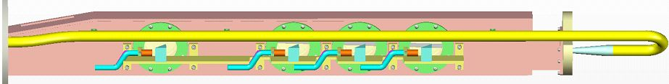
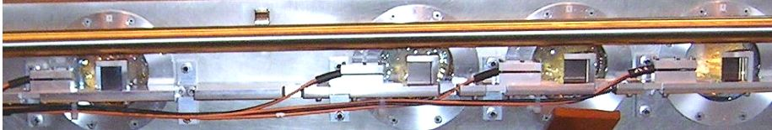
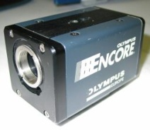
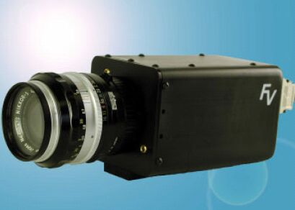
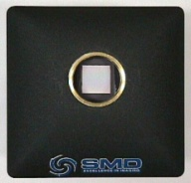
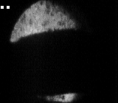
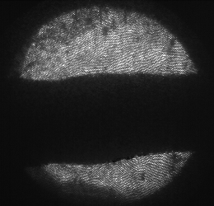
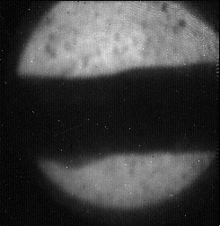
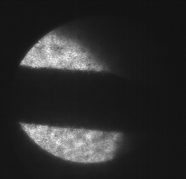
MERIT – Experimental setup
Optical diagnostics
Viewport 4, Olympus
33 µs exposure; 160x140 pixels
Viewport 3, FV Camera
6 µs exposure; 260x250 pixels
Viewport 2, SMD Camera
0.15 µs exposure; 245x252 pixels
Viewport 1, FV Camera
6 µs exposure; 260x250 pixels
Nov. 11, 2007 Shot # 17020, 8 bunches, 6x10¹² protons, 7 Tesla, 15 m/s jet

Slide 11
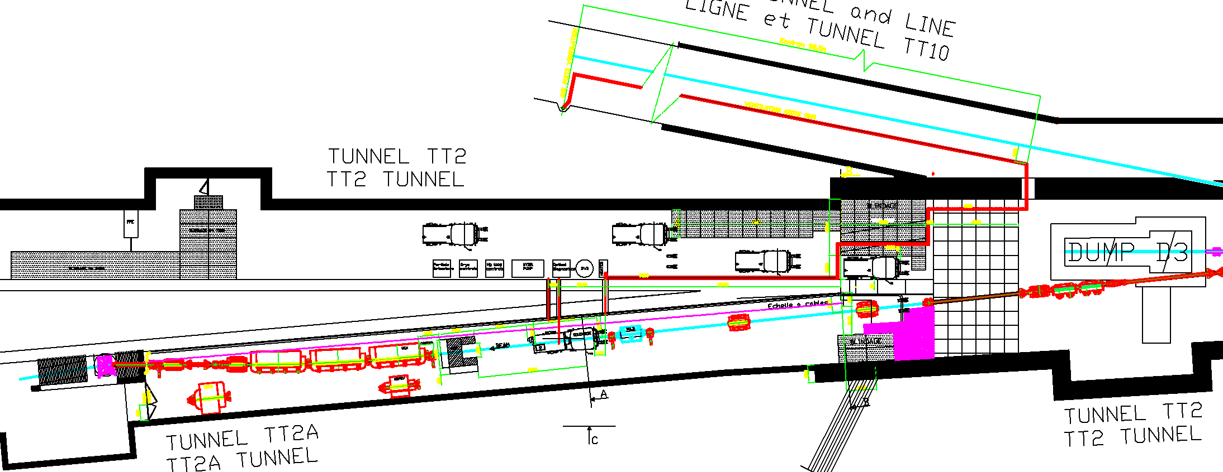
MERIT – Experimental setup
Experimental layout
Material access shaft
N2 Exhaust line
Racks & electronics
Personnel access
Upstream beam elements (new)
Quadrupoles for final focusing
Collimator
Beam profile measurement
Beam intensity measurement
Beam dump
Solenoid & Hg loop

Slide 12
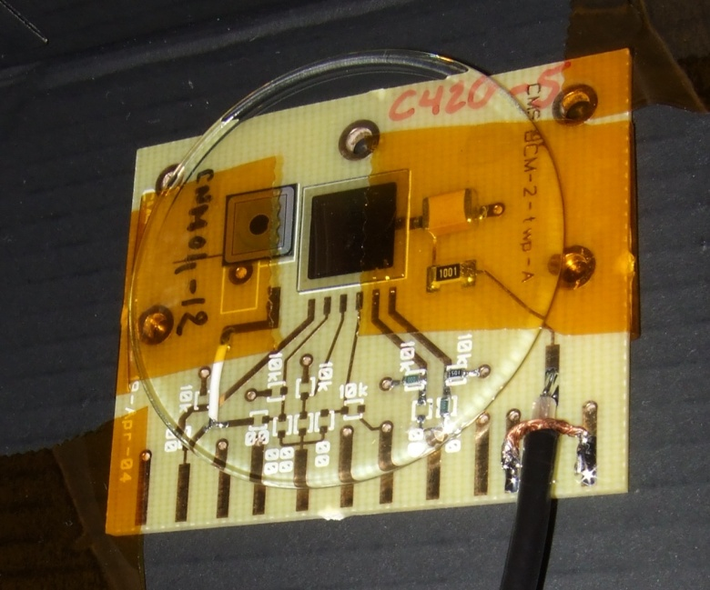
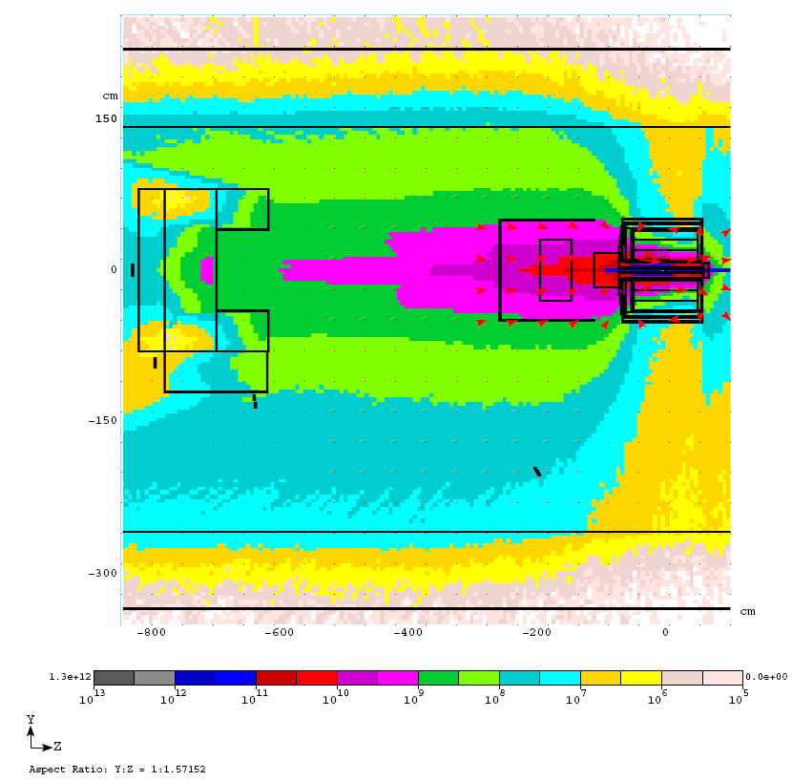
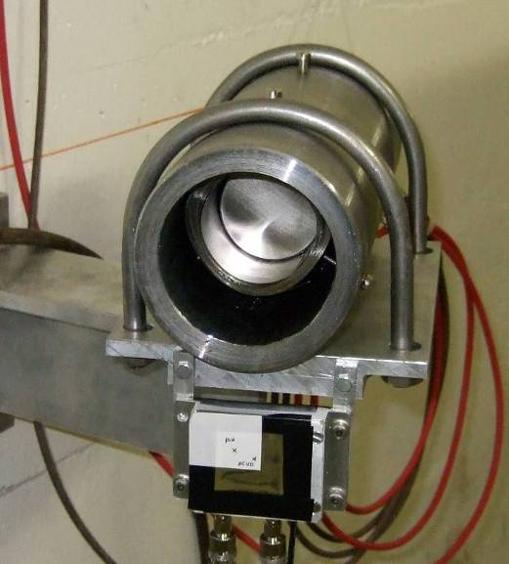
MERIT – Experimental setup
Particle flux detectors
pin diode
~1cm² active area
200 μm thick
pCVD diamond
7.5×7.5 mm² active area
300 μm thick
bypass capacitor 100nF/500V
Particle fluxes - 3×10¹³ protons (MARS Simulation)
charged hadrons (E>200 KeV)
neutrons (E>100 KeV)
ACEM detector
pCVD diamond & pin diode
particle detectors
S.Striganov - FNAL

Slide 13
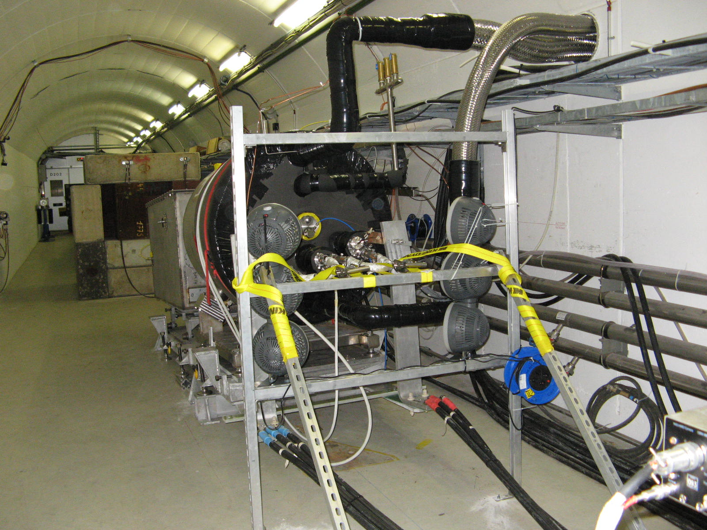
MERIT – Experimental setup
Complete installation in the nTOF tunnel

Slide 14
The MERcury Intense Target Experiment
Outline
Introduction
Experimental apparatus
Analysis results

Slide 15
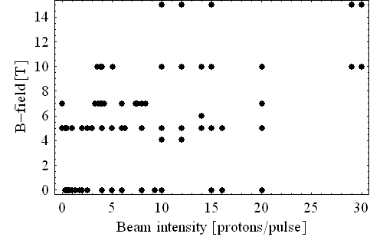
MERIT – Analysis results
Beam shots summary
30×10¹² protons @ 24 GeV/c
115 kJ of beam power
a PS machine record !
Beam size and density for 30×10¹² protons
Beam | Horiz. | Vert. | Spot | Beam Density
[GeV/c] | [mm] | [mm] | [mm2] | [J/gr @ 30 TP]
14 | 2.40 | 1.37 | 10.35 | 94.5
24 | 1.74 | 1.04 | 5.72 | 171
Notes:
15

Slide 16
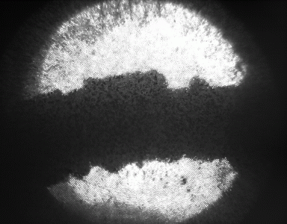
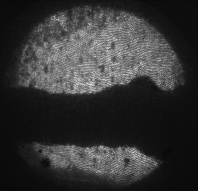
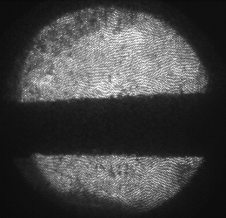
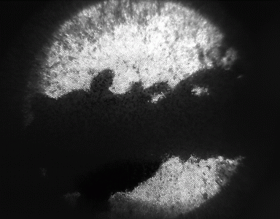
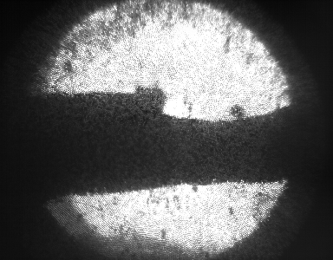
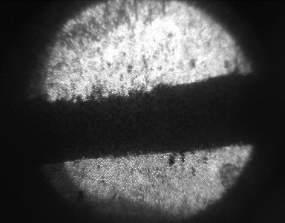
MERIT – Analysis results
Beam-Hg-jet interaction examples – 14 GeV/c beam
8×10¹² protons, 0T field
8×10¹² protons, 5T field
12×10¹² protons, 10T field
4×10¹² protons, 0T field
16×10¹² protons, 5T field
20×10¹² protons, 10T field

Slide 17
MERIT – Analysis results
Hg-jet properties without beam
Jet width vs magnetic field
Hg-pressure vs magnetic field
Jet speed vs magnetic field
Jet velocity not noticeably reduced on entering magnetic field.
Pressure needed for v = 15 m/s does not increase with magnetic field.
Vertical height of jet not affected by magnetic field – but the height is ≈ double the nozzle diameter.

Slide 18
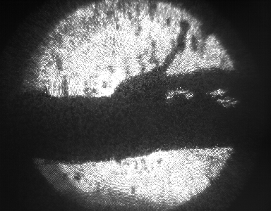
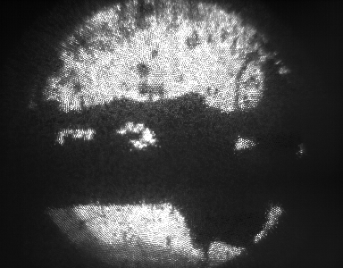
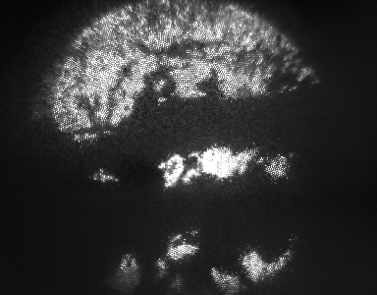
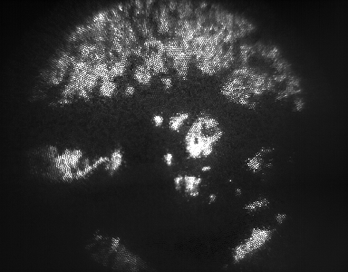
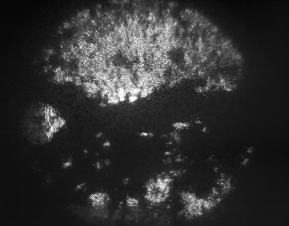
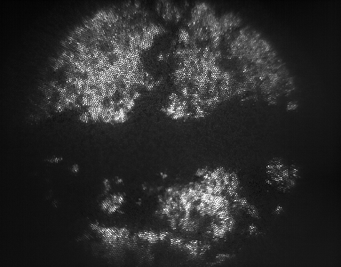
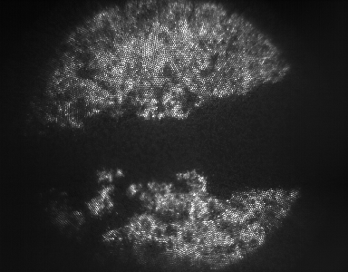
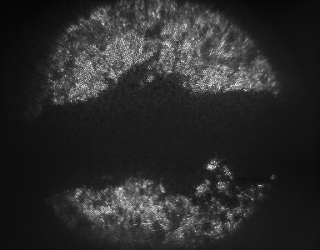
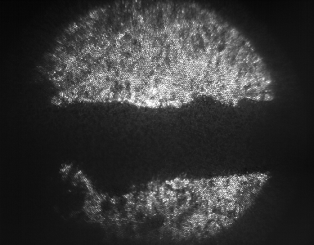
MERIT – Analysis results
Interaction example - 16×10¹² protons, 5T, 14 GeV/c
time
time
time
interaction
Center
time
time
time
Note disruption of top of jet at early times, and of bottom at later times.
“Disruption length” inferred from number of frames the disruption lasts.

Slide 19
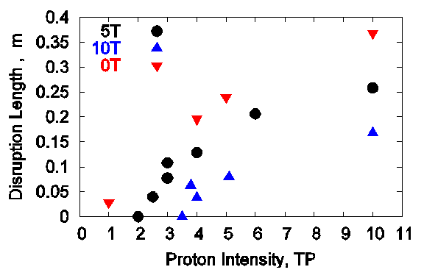
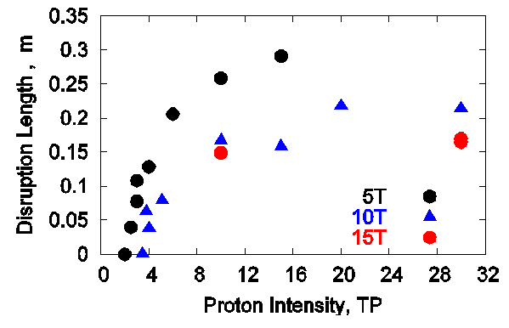
MERIT – Analysis results
Disruption length vs beam intensity
14 GeV beam
24 GeV beam
Disruption length is never longer than length of overlap of beam and jet.
Maximum disruption length same at 14 and 25 GeV/c.
Disruption length smaller at higher magnetic field.
Disruption threshold increases at higher magnetic field.

Slide 20
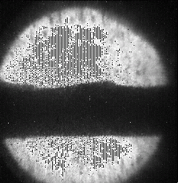
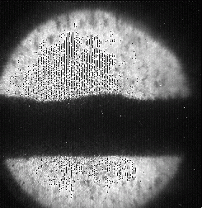
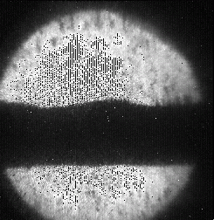
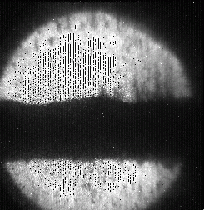
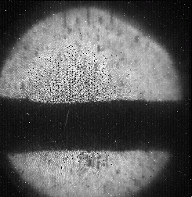
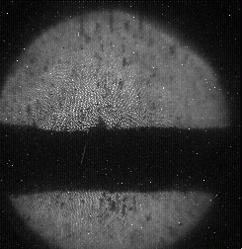
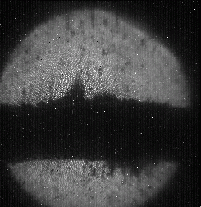
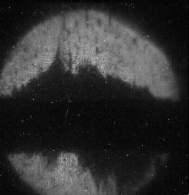
MERIT – Analysis results
Jet Breakup Velocity Observed at Port 2 with Fast Camera
3.8×10¹² protons, 10T → v=24m/s
t = 0
t = 0.150 ms
t = 0.175 ms
t = 0.375 ms
10×10¹² protons, 10T, v=54m/s
t = 0
t = 0.075 ms
t = 0.175 ms
t = 0.375 ms

Slide 21
MERIT – Analysis results
Jet Breakup Velocity Measurements
14 GeV/c
24 GeV/c
Beam spot area at 24 GeV/c is (14/24) of that at 14 GeV/c.
Beam intensity = energy/cm² is (24/14)² ≈ 3 times greater at 24 than at 14 GeV/c.
Measurements are consistent with model that breakup velocity∝beam intensity.

Slide 22
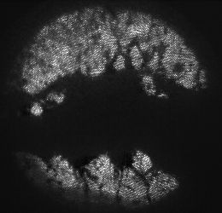
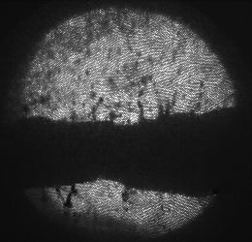
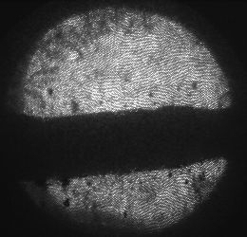
MERIT – Analysis results
Pump-Probe study: 4 ×10¹² p. – “pump” + 4 ×10¹² p. – “probe” at 14 GeV/c
Δt_{(pump-probe)} = 0s
single-turn extraction
Δt_{(pump-probe)} = 3.2 μs
“probe” extracted in subsequent turn
Δt _{(pump-probe)} = 5.8 μs
“probe” extracted after 2nd full turn
Target supports 14-GeV/c, 4×10¹² protons beam at 172 kHz rep rate without disruption.
Preliminary analysis of studies at 14 GeV/c with 15×10¹² protons-pump and 5×10¹² protons-probe with delays of 2-700 μs indicate little change in secondary particle production by probe.
  Initial breakup of jet does not reduce particle production immediately.
  May be able to use bunch trains of several-hundred μs length.

Slide 23
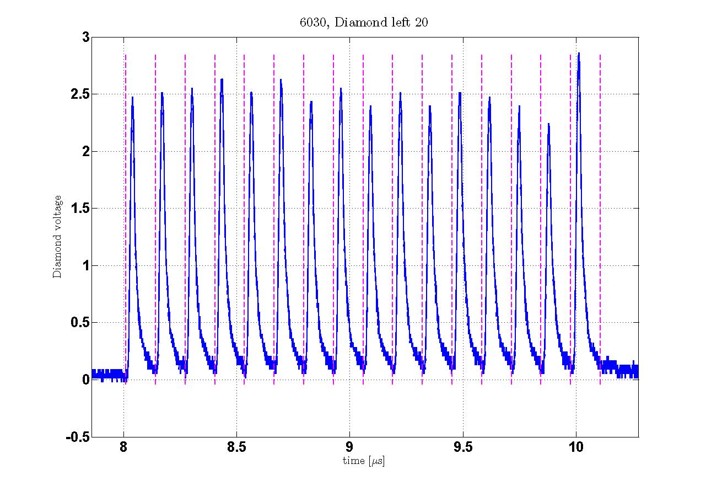
MERIT – Analysis results
Particle detector data – pCVD diamond detector response
pCVD diamond response
  for multi-bunch beam pulse
Response linearity
Δt=131 ns
14 GeV beam; 4×10¹² protons
10T field Field; 15m/s Hg Jet
Good performance
Able to identify individual bunches event at the highest intensities
Data analysis ongoing…

Slide 24
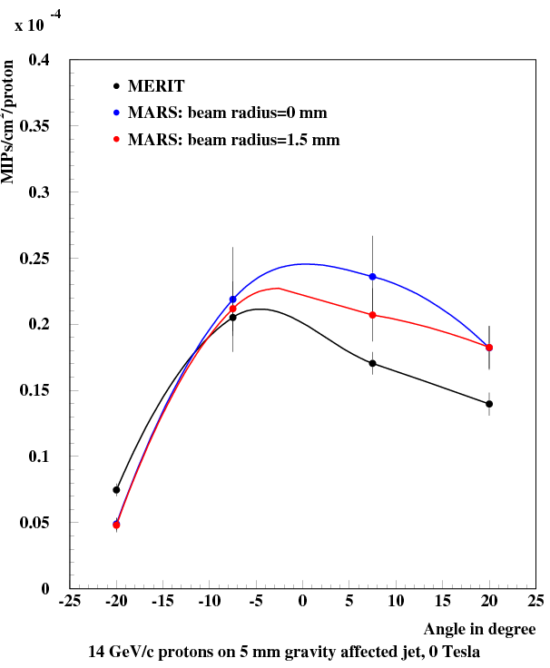

MERIT – Analysis results
Particle detector - flux measurement
Comparison with MARS simulation
preliminary
preliminary

Slide 25
Summary
The MERIT experiment took beam as scheduled for three weeks in autumn 2007 at CERN PS. All systems performed well, the run with beam was smooth and the whole scientific program was completed
The primary objective to conduct a successful and safe experiment at CERN was amply fulfilled
Important results validating the liquid metal target concept are coming out as the analysis progresses
The MERIT experiment represents a big step forward in the targetry R&D for high power targets.

