Slide 1
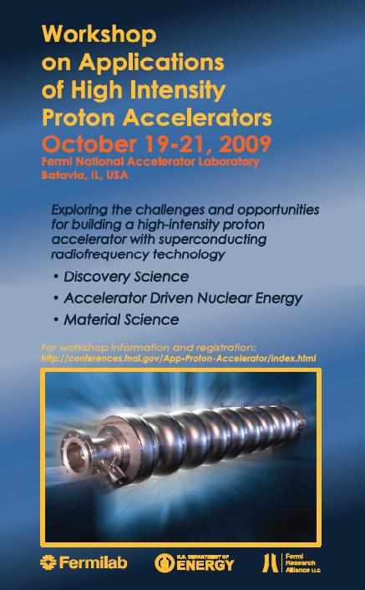
Target Station Infrastructure
The CNGS Experience
Outline
Introduction to CNGS
Review on issues since the startup of the facility in 2006
Lessons learned – things we would do differently today
D. Autiero, I. Efthymiopoulos, A. Ferrari, E. Gschwendtner, A. Guglielmi, A. Pardons, P. Sala, H. Vincke, J. Wenninger
Workshop on Applications of High Intensity Proton Accelerators
Dresden, October 23, 2008

Slide 2
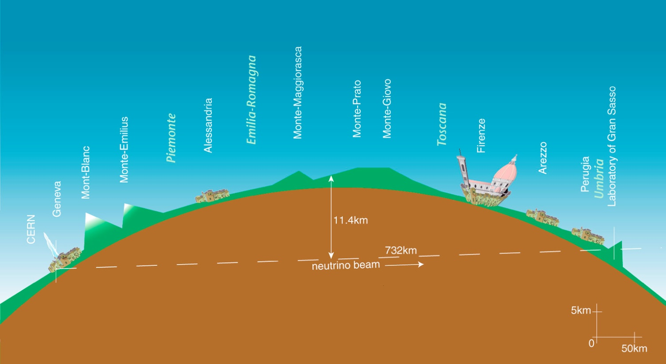
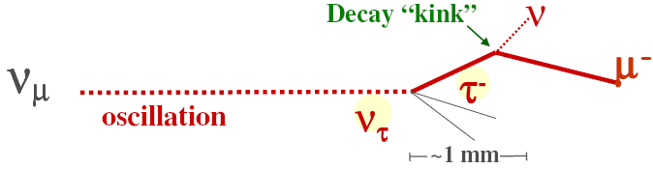
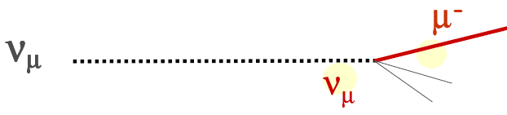
CERN Neutrinos to Gran Sasso
Introduction
Principle
At CERN: Produce a beam of ν_{μ} neutrinos at CERN pointing towards Gran Sasso using an intense proton beam extracted from SPS at 400 GeV/c impinging a graphite target
At Gran Sasso: detect the ν_{τ} neutrinos resulting from the oscillation of ν_{μ} neutrinos in the ~730K km of earth
  ν_{τ} appearance optimized experiments: OPERA (~1.2kt), ICARUS(600 t)
Signal event
Background event

Slide 3
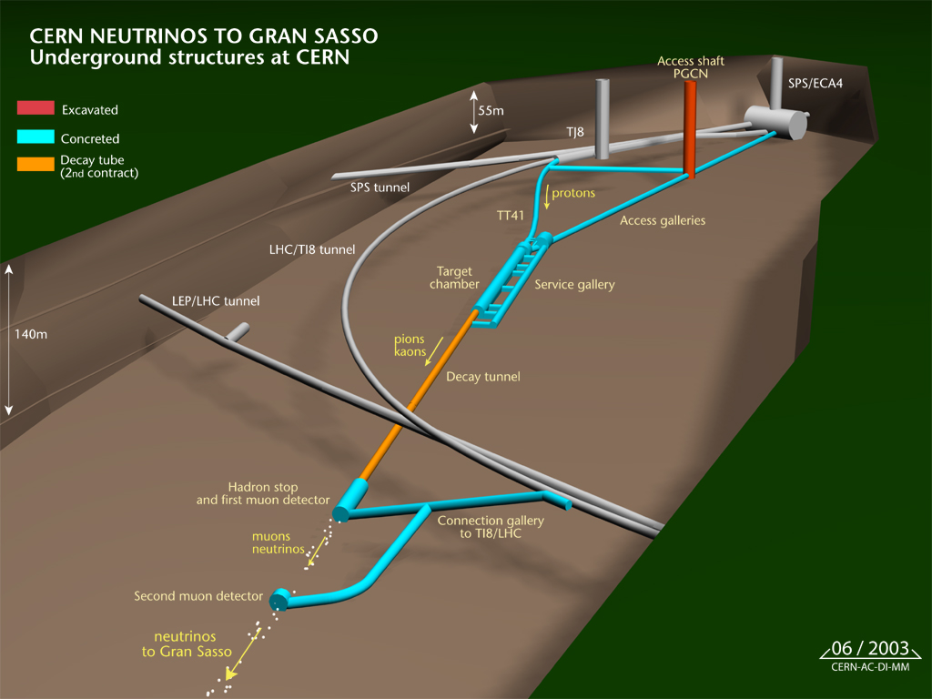
CERN Neutrinos to Gran Sasso
Facility layout

Slide 4
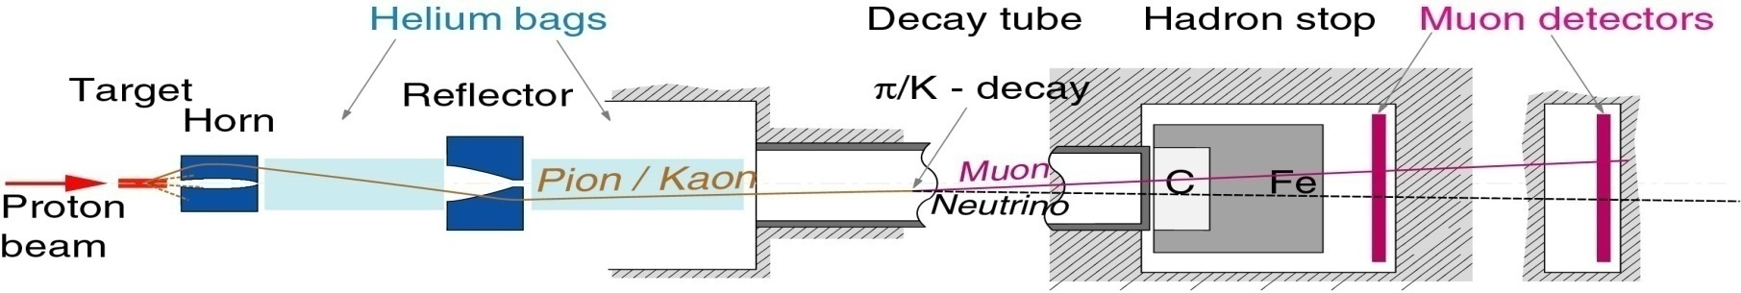
CERN Neutrinos to Gran Sasso
The secondary beam
p + C → (interactions) → π⁺, K⁺ → (decay) → μ⁺ + ν_{μ}
800m
100m
1000m
26m
67m
vacuum
Proton beam parameters
Energy | 400 GeV/c
Cycle length | 6 seconds 2 extractions/cycle, 50ms apart
Extraction | 2.4 x 10¹³ protons 10.5 μs long pulse
Beam power | 510 kW
Installation completed in June 2006
Commissioning in 2006
In operation since 2007
4.5 × 10¹⁹ protons/year – 5 year program
  ~3.5 × 10¹¹ ν_{μ} / year at Grand Sasso
  ~3000 CC ν_{μ} interactions/kt/year at the experiment
  ~2÷3 ν_{τ} interactions detected/year (OPERA)

Slide 5
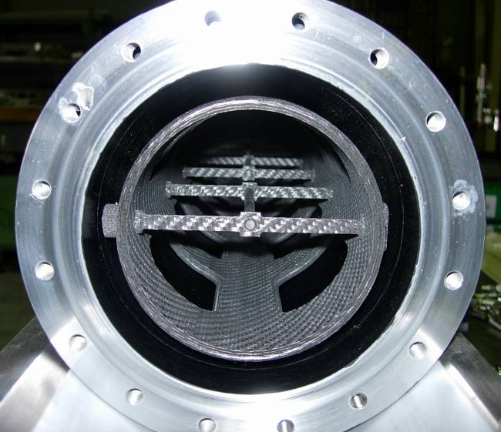
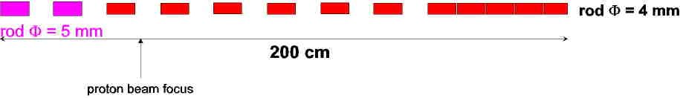
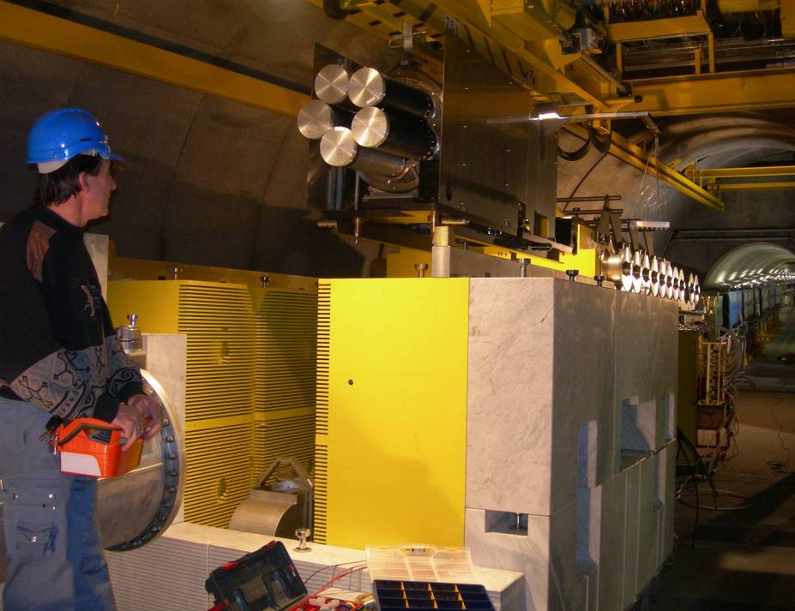
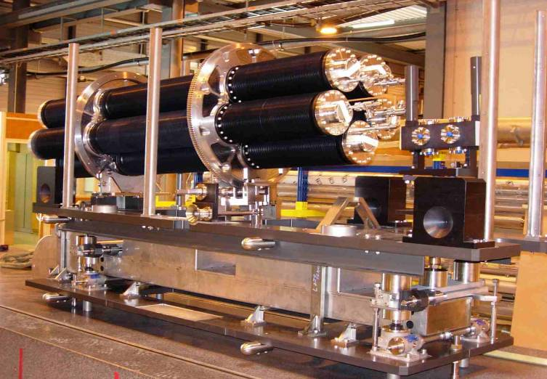
Key elements of the secondary beam
The target station
Interspaced graphite rods, to optimize pion production
  10cm long, 5(4) mm Ø, 200 cm (~2.7 λ_{int}) total length
beam
Target unit with 5 target assemblies – in-situ spares
L. Bruno, et. al, CERN

Slide 6
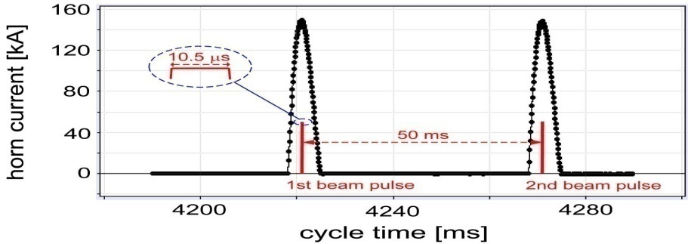
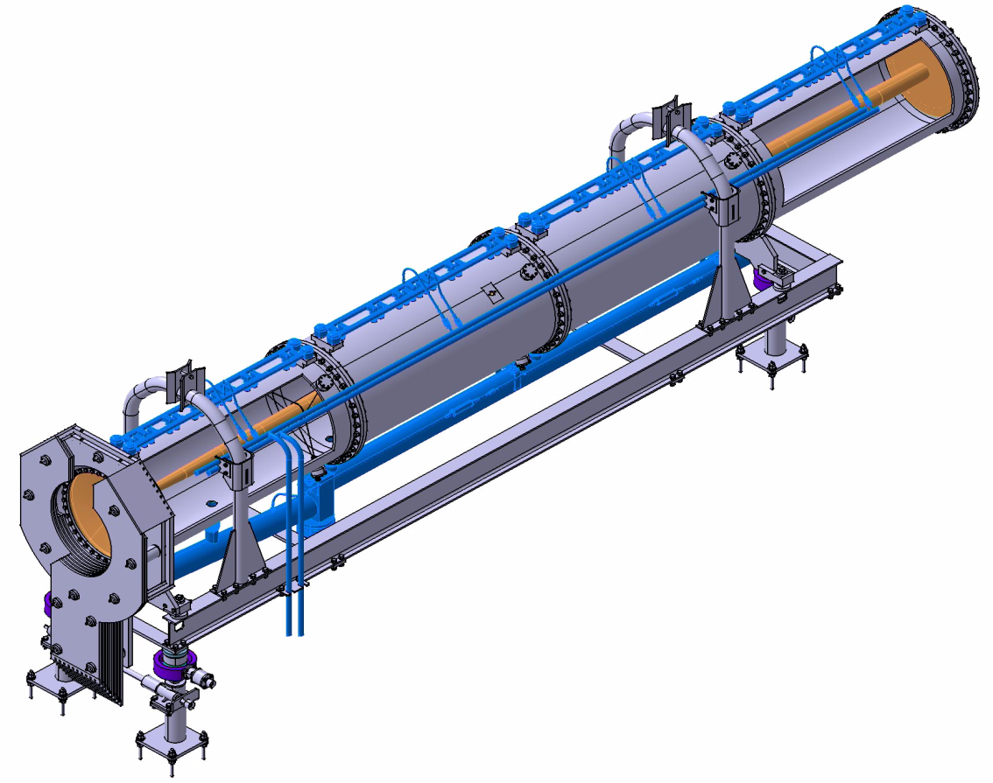
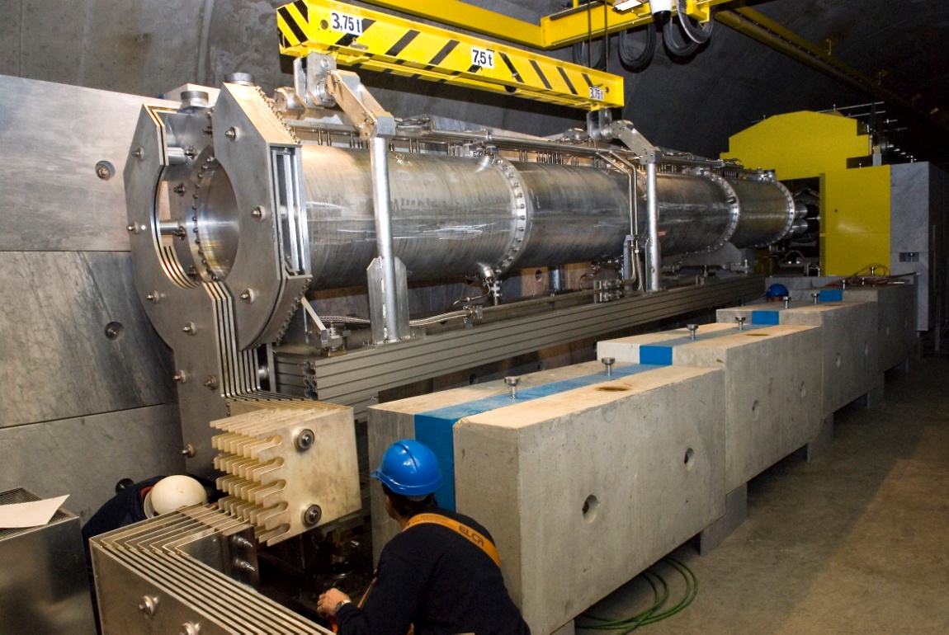
Key elements of the secondary beam
The magnetic horns
Current: 150kA (horn) – 180 kA (reflector)
  Pulse duration 7ms
CNGS – horn:
~7m long, 700mm Ø
Inner conductor: 1.8mm thick, 30÷136mm Ø
Made of Aluminum
Water cooled

Slide 7
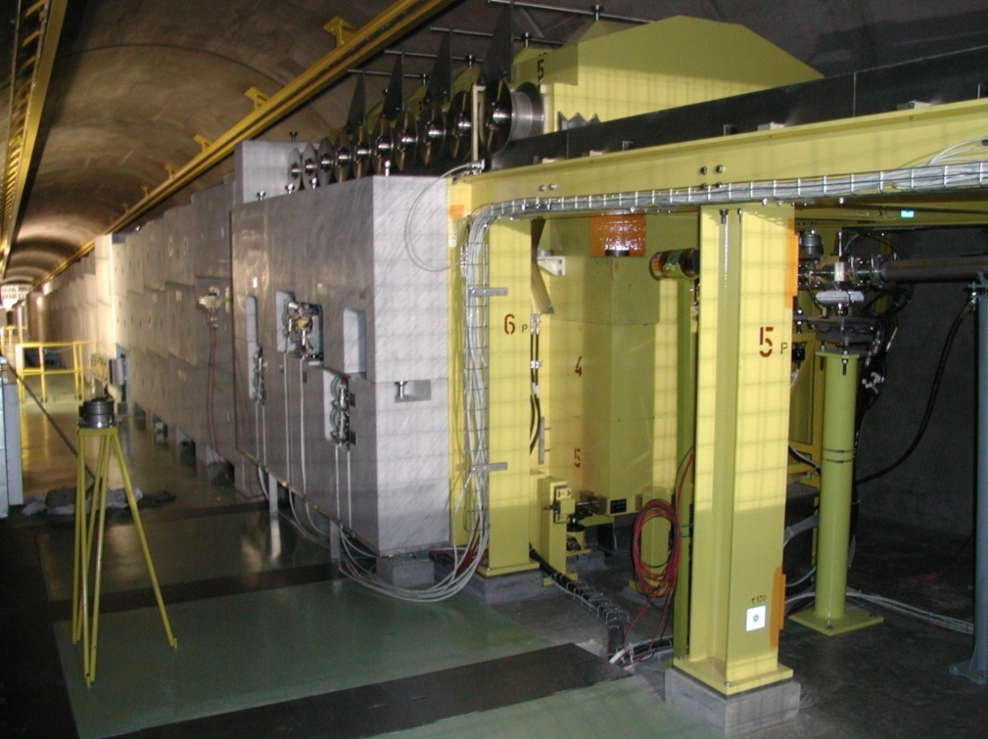
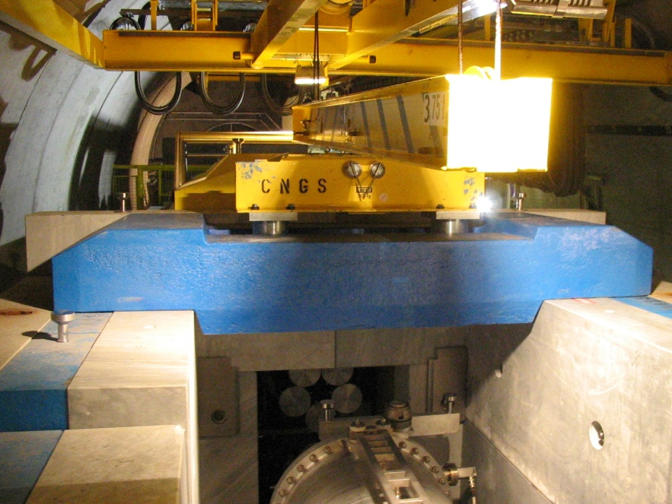
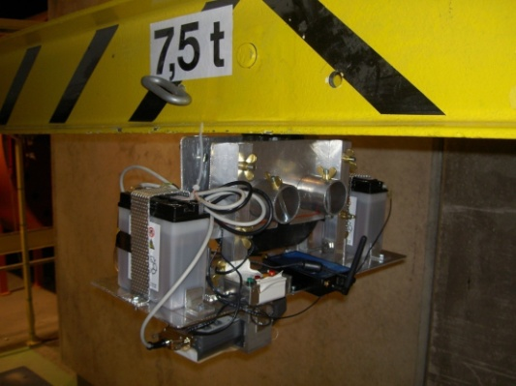
Key elements of the secondary beam
Radiation environment
Optimized shielding
  Marble – iron – concrete
  Remote handling
Remote station for radiation survey in the target chamber

Slide 8
CNGS Target Area
Design baseline
The target area design in a high-power ν-beam is always very challenging :
  the target must sustain the energy deposition and induced stress waves from the beam impact
  the choice of materials has to be adopted to the high-radiation environment
  the high remnant radiation environment limits access possibilities for service & maintenance
CNGS baseline :
  over-designed using safety factors for present and future intensity upgrades
  provision for spares of the most sensitive equipment and well studied exchange procedures (HAZOP)
M.Meddahi, E.Schaposnicova - CERN-AB-2007-013 PAF
I per PS batch | # PS batches | I per SPS cycle | 200 days, 100% efficiency, no sharing | 200 days, 55% efficiency, no sharing | 200 days, 55% efficiency, 60% CNGS sharing
 |  | [prot./6s cycle] | [pot/year] | [pot/year] | [pot/year]
2.4×10¹³ - Nominal CNGS | 2 | 4.8×10¹³ | 1.38×10²⁰ | 7.6×10¹⁹ | 4.56×10¹⁹
3.5×10¹³ - Ultimate CNGS | 2 | 7.0×10¹³ | (2.02×10²⁰) | (1.11×10²⁰) | (6.65×10¹⁹)
Design limit for the target
working hypothesis for RP calculations
CNGS working hypothesis

Slide 9
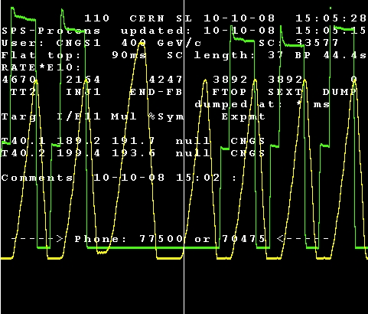
CNGS Operation
Summary
Year | Protons on target
2006-comm. | 6.87 × 10¹⁵
2006 | 8.48 × 10¹⁷
2007-comm. | 5.0 × 10¹⁶
2007 | 7.86 × 10¹⁷
2008 | 1.78×10¹⁹
2009 | 2.55 ×10¹⁹ (today) 3.20 ×10¹⁹ (expected)
2006- run
  failure in reflector cooling circuit
2007- run
  radiation effects on ventilation system electronics
  broken flexible stripline cable
2008- shutdown
  failure in target rotation mechanism – inspection
  horn/reflector cooling system filter improvements
  handling of tritiated water
☞ further info on CNGS operation performance: talk by E. Gschwendtner (WG1 - Tuesday PM)
CNGS
CNGS
LHC
CNGS
CNGS
CNGS
SPS machine super-cycle

Slide 10
CNGS Operation
Summary
Focusing on the problems we had, should be balanced with the smooth startup, commissioning and operation of the facility which will soon complete a second year of physics with the maximum available intensity from CERN/SPS.
Important to notice the early failures we had or “teething problems”, were on peripheral components
  Lesson #1 : the design of the identified critical items typically receives most of the attention and is well done – or at least we know what to do in case of failures. The reality says the problem often comes from the peripheral components receiving less of attention or not subject to the same rigorous quality assurance
    the LHC experience for the QRL installation and cable splicing problem confirms it as well
Since the failures happened too early, we were forced to do unforeseen interventions for repairs – too early to waste our spares!
  Lesson #2 : tooling and procedures for interventions to repair early failures should be included in the design of a facility
We profited from the repair work to do improvements and preventive maintenance on similar elements installed on other equipment

Slide 11
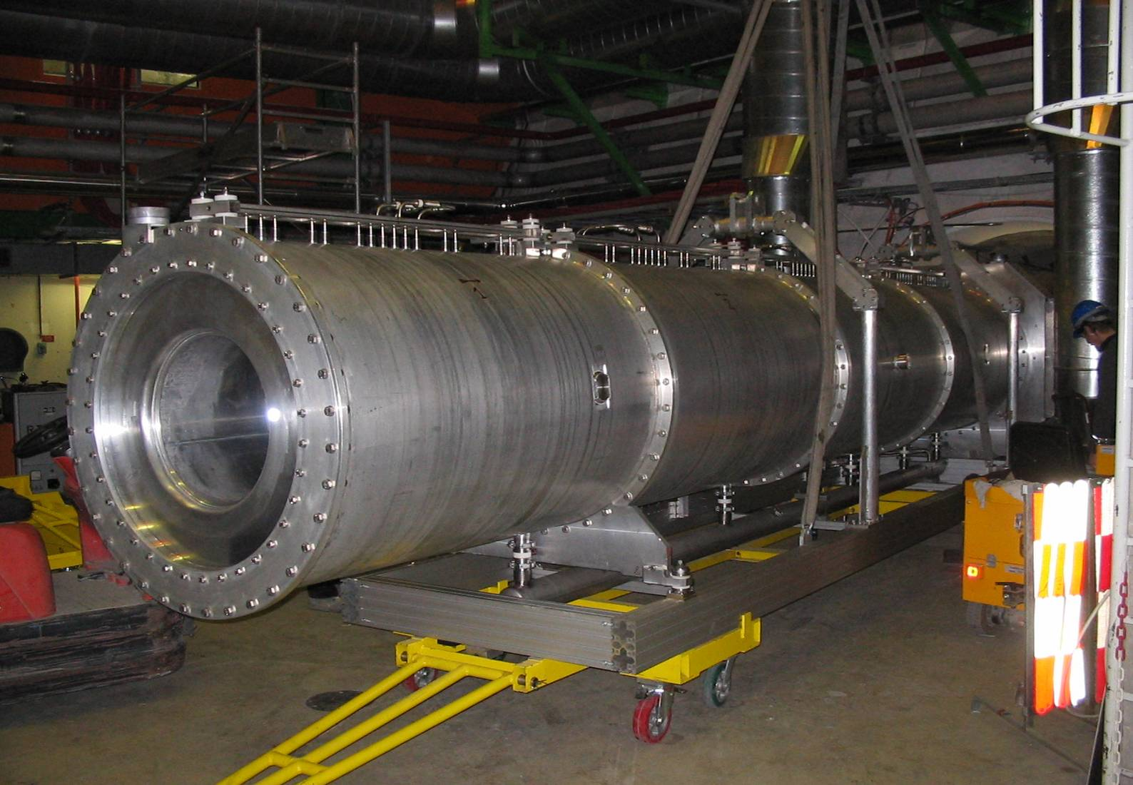
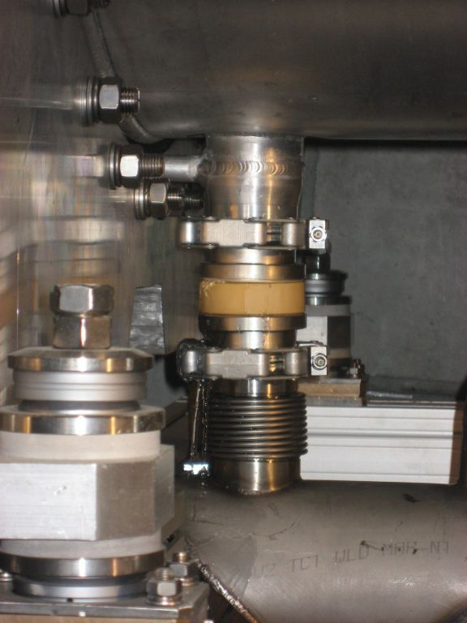
Horn & Reflector issues
Reflector water leak
  Observed high refill rate in the closed circuit water cooling system of the reflector, and increased water level in the sumps
  fault in one of the ceramic insulating connectors of the reflector

Slide 12

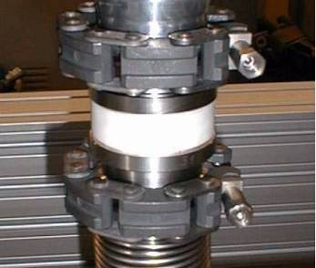
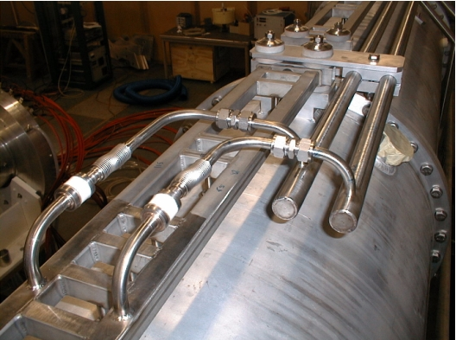
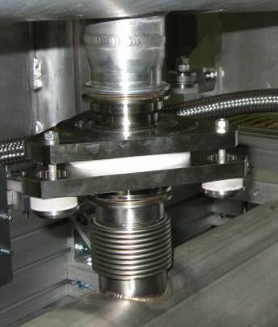
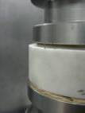
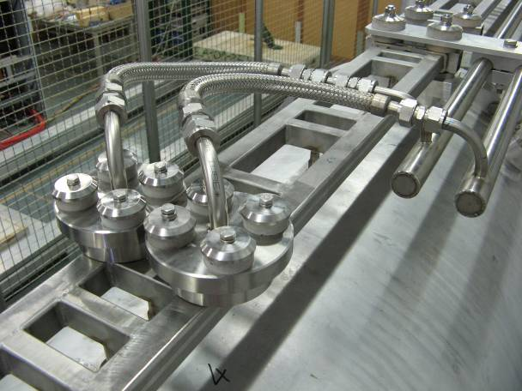
Horn & Reflector issues
Water inlets & Outlets repair & improvements
  Water outlets
  Water inlets
Old design
    Ti-ceramic assembly, machined, brazed
    Bellows absorbs misalignments
    Shear stress from brazing (thermal) too high
    Non optimal geometry for the ceramic
New design
    No brazing, no machining, soft seal, ceramic only in compression
    Thorough testing in the spare horn
    Replaced all water inlets & outlets in horn & reflector

Slide 13
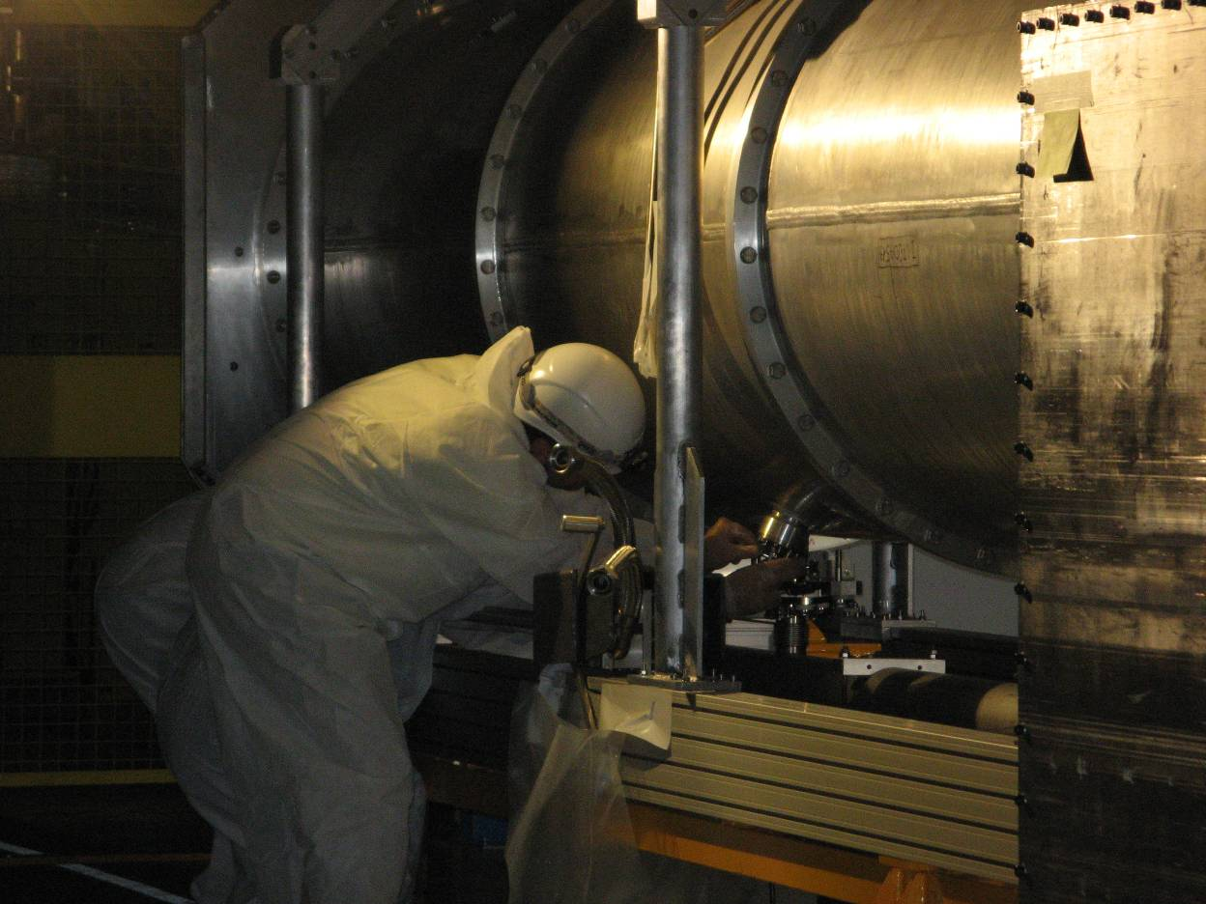
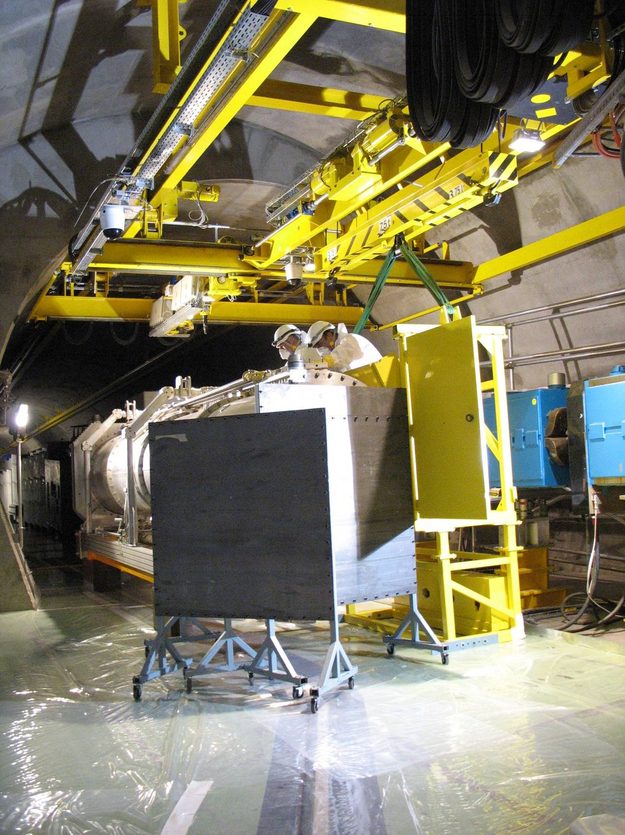
Horn & Reflector issues
Water inlets & Outlets repair & improvements
  Only possible since we haven’t been running for long
  Work in a radioactive environment:
    detailed radiation dose planning and minimization before intervention
    practice sessions with spare horn
    dose sharing
    additional mobile local shielding

Slide 14
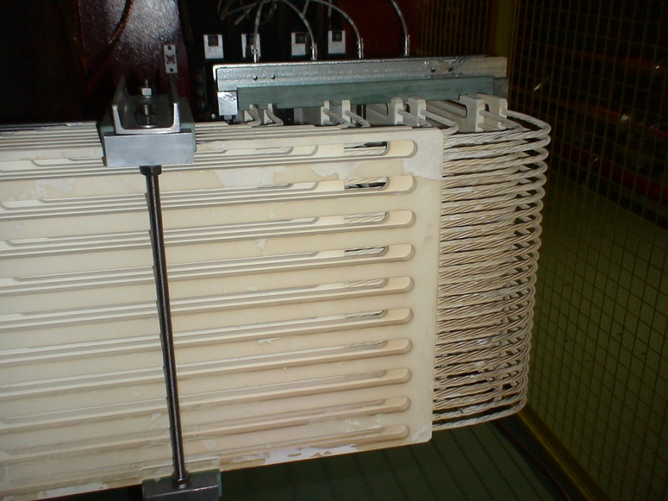
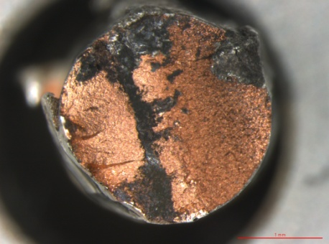
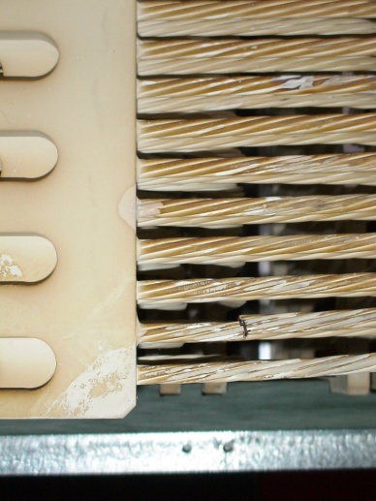
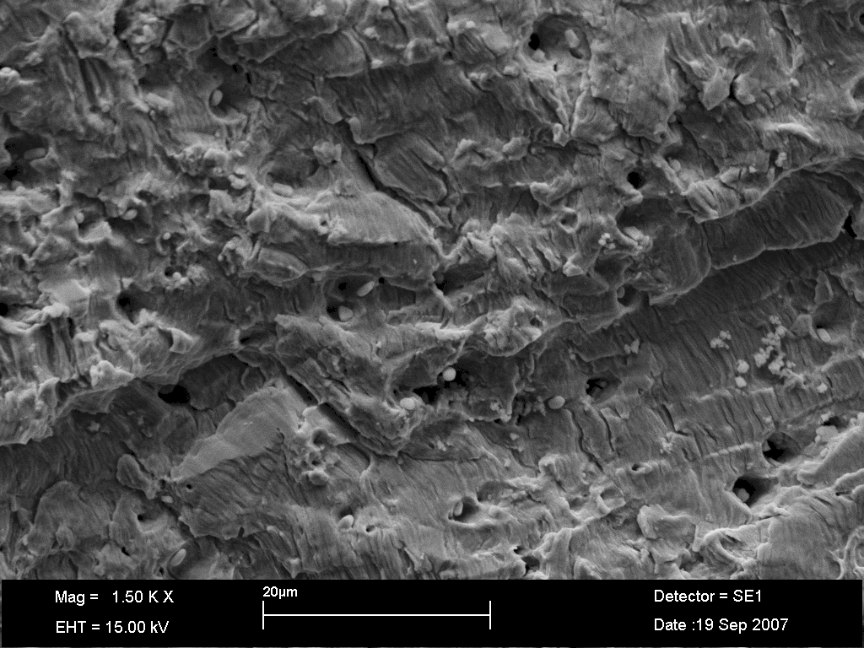
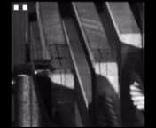
Horn & Reflector issues
Stripline repair & improvements
Old design for flexible part
    Clamped plates, twisted cables, brazed
    No control of the large magnetic forces during pulsing (measured ±2mm)
    The cable was finally broken due to fatigue after ~300k pulses
    Metallurgical analysis of the broken cable:
    Beach marks
    Striations
    Secondary cracks
    Stripline plates and cables during pulsing
    Images recorded at 1kHz, play-back 40 times slower
A. Gerardin, G. Arnau Izquierdo, CERN – TS/MME

Slide 15
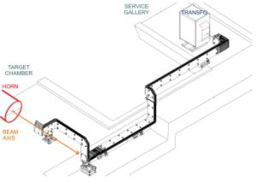
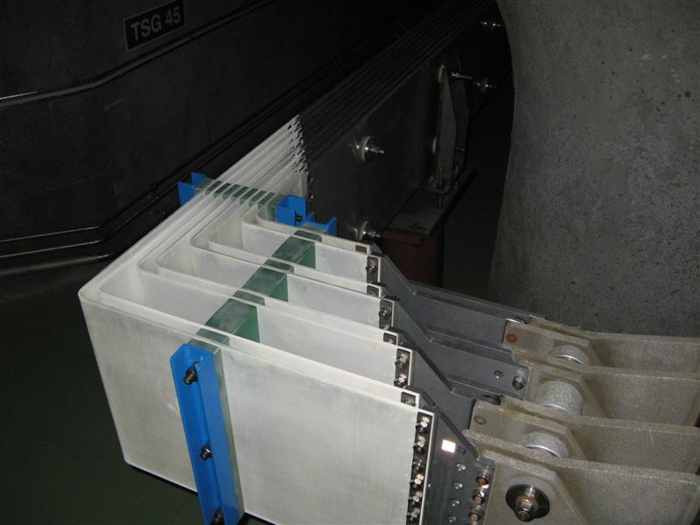
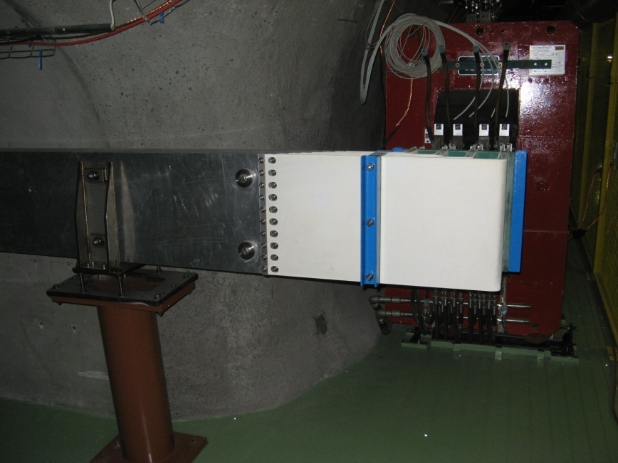
Horn & Reflector issues
Stripline repair & improvements
New design
  No brazing, semi-flexible (allows for thermal dilatation) fully clamped plates
  Vibrations during pulsing reduced to ±0.2 mm
  No change in the impedance or current flow properties
Preventive maintenance : replace all flexible striplines of both horns

Slide 16
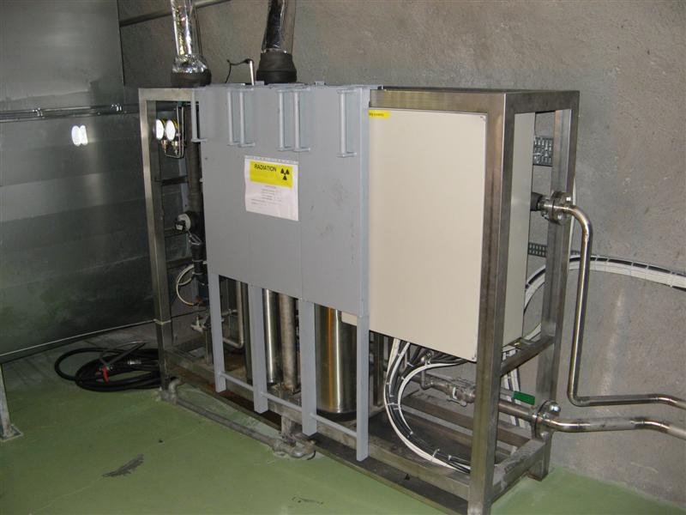
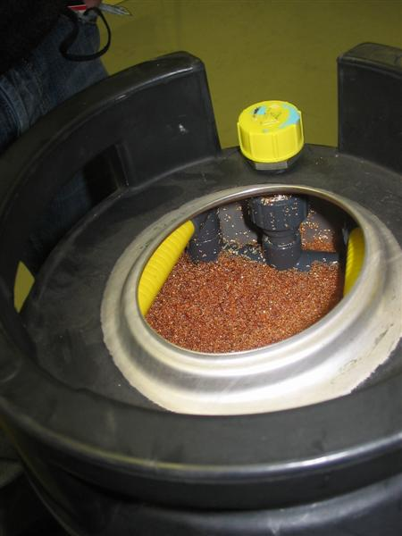
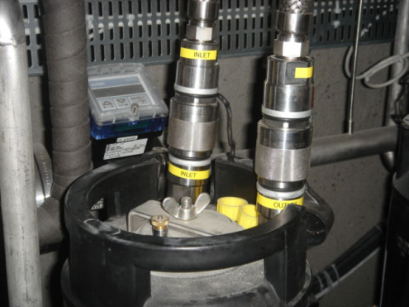
Horn & Reflector issues
Cooling system filters lifetime
Resin filters are used to maintain a low conductivity level in the cooling circuit
  Two reasons:
    avoid short-circuit inside the horn
    limit long-term corrosion effects
  About 1/3 of the flow goes through the filters
  Required level: [0.1,10.0]μS/cm
Two filters in place (active + spare) equipped with quick connectors
  Filters get activated – moved to temporarily storage for initial cool-down before taken to waste
Main issues:
Filter lifetime - saturation
  wished to be one year, but difficult to estimate
  2008 run showed they saturate much sooner !!
  long access (>20h stop) each time to replace them (10min)
We discovered the filters had plastic pieces (tubes) inside; not a real issue but better to avoid
The filters are radioactive waste, their use must be optimized

Slide 17
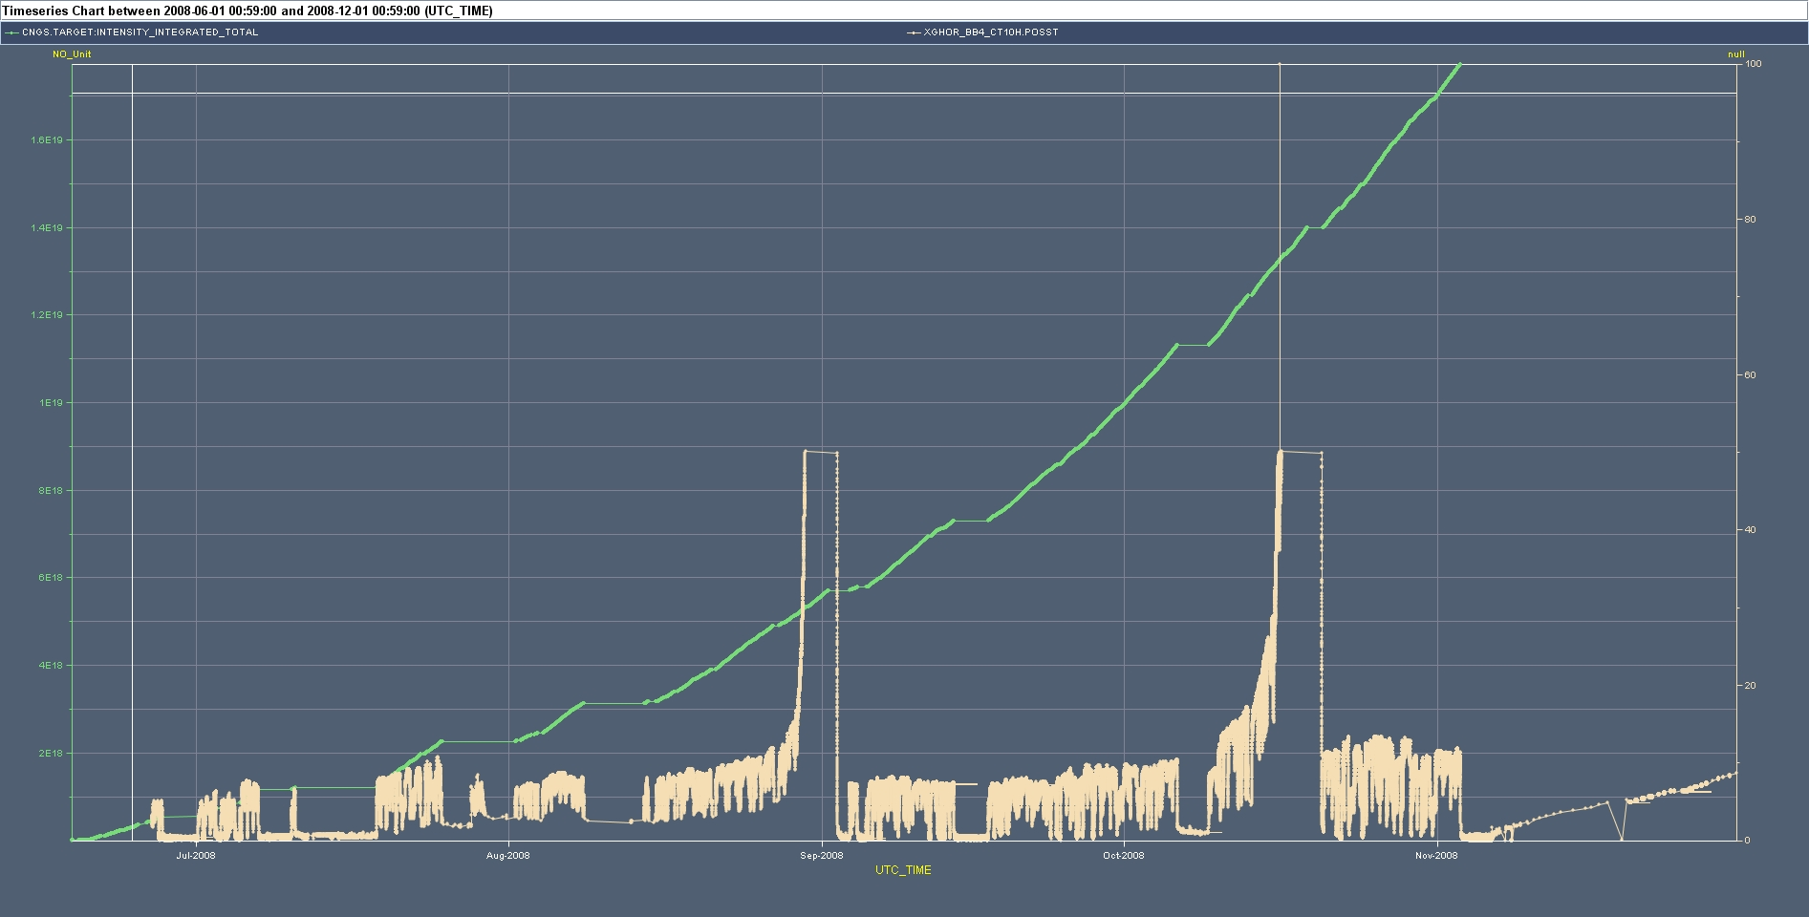
Horn & Reflector issues
Cooling system filters lifetime
2008 run
Integrated pot
45 days
Filter exchange
Filter exchange
Water conductivity
7.5E18 pot
Limit for safe operation : 10μS/cm
Use of original filter cartridges would imply ~6 filter exchanges for a nominal CNGS year (4.5×10¹⁹ pot) !

Slide 18
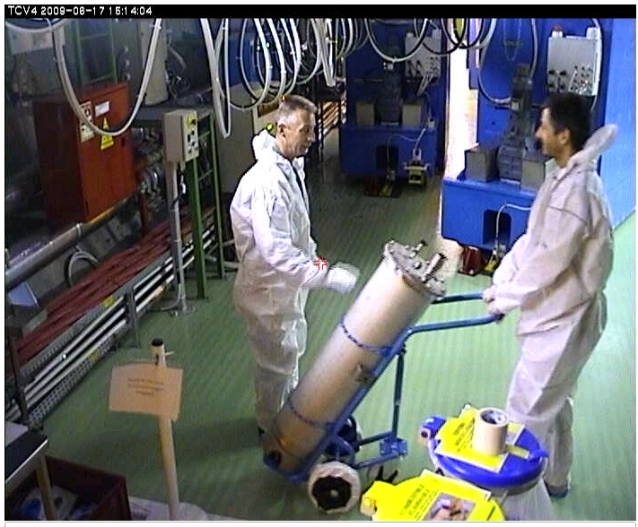
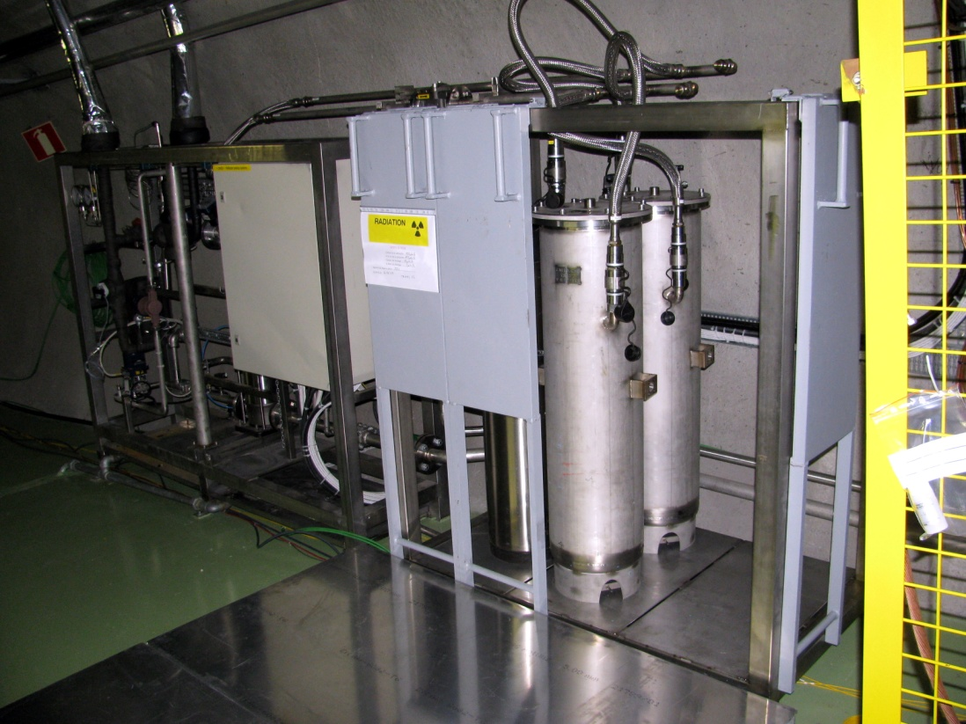
Horn & Reflector issues
Cooling system filters lifetime
New home-made cartridge design
Increase × 2.5 the filter capacity of the system → one exchange / year
  modify piping to accept more filters in parallel
Optimized design
  maintain the quick connectors and optimize manipulation (installation/removal) operations
  easy emptying of the resin material allows re-use of the cartridges → less waste

Slide 19
Horn & Reflector issues
Lessons learned
Careful and “safe” engineering with well known and calculable techniques should be preferred
  brazing better to be avoided ; use ceramics in compression only
  design modifications should be accompanied with studies and calculations – e.g. avoid last minute machining
  sounds trivial but for screws/bolts : use same size for same purpose, think their position and manipulation in a future intervention
  maintain a good record of installed elements with photos/videos
Forces in high-current conductors should be considered in the design
  include dynamic studies not only static
  risky to extrapolate from known configurations
In high-radiation environment interventions, planning, analysis and practice is essential to minimize the dose
For “consumables” , optimization of the radioactive waste should be included in the design
  balance between commercial (easy to get) components and home-made designs

Slide 20
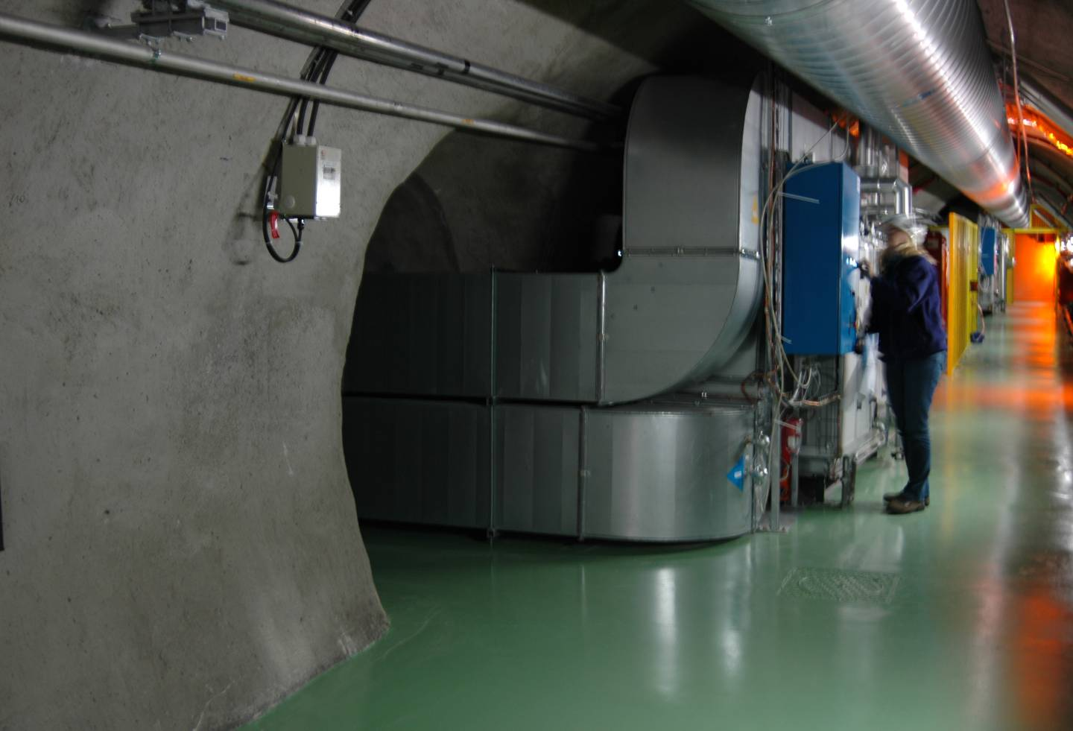
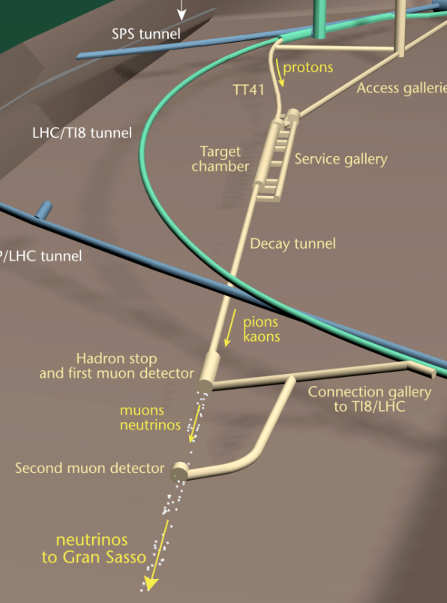
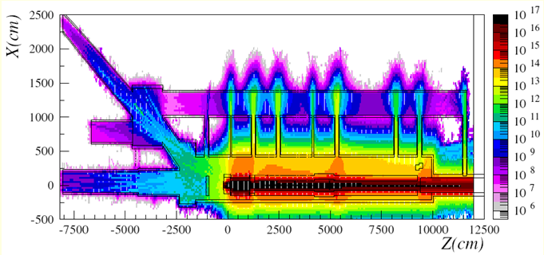
Radiation effects on electronics
Failure of ventilation system electronics
All CNGS electronics were installed in the service gallery and upstream cavern
  At that time only personnel dose and not SEE to electronics were considered
  Radiation levels during operation exceed the limits COTS electronics can withstand → also triggered a LARGE campaign for LHC !!
The ventilation system electronics in the service gallery failed first (only at 10¹⁶ pot!), all the rest would have followed if we had been running longer
Ventilation units in the TSG4 gallery
High-energy (>20MeV) hadrons fluence (h/cm²) for 4.5E19 pots (1-year)
FLUKA Simulation : L.Sarchiapone et. al, 2008

Slide 21
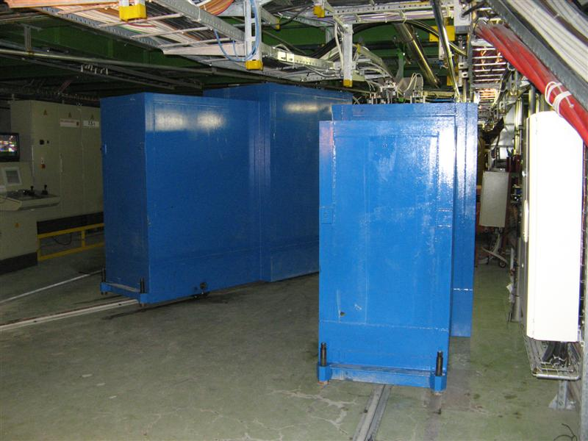
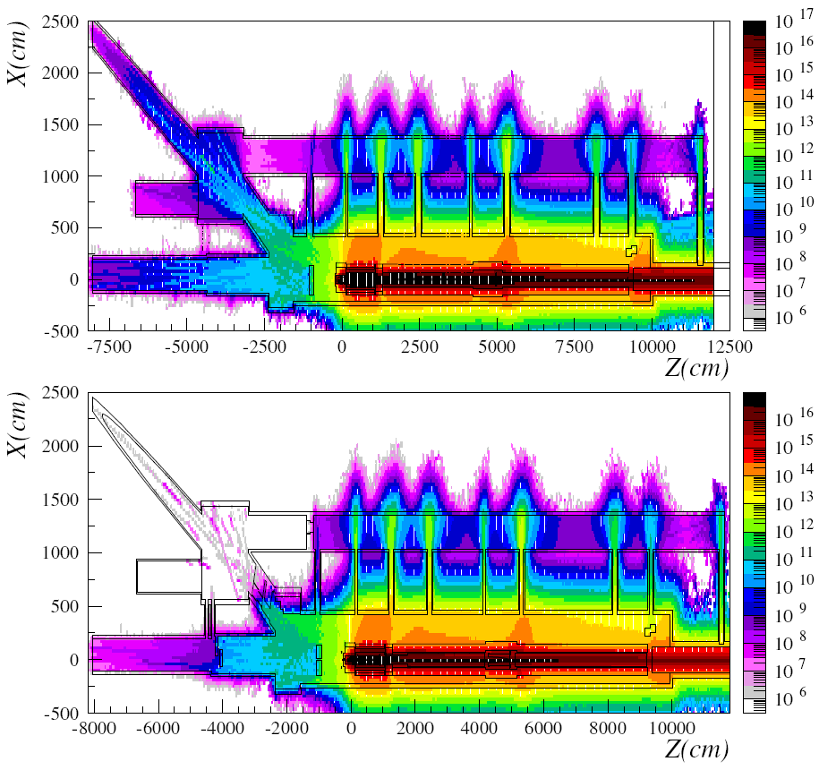
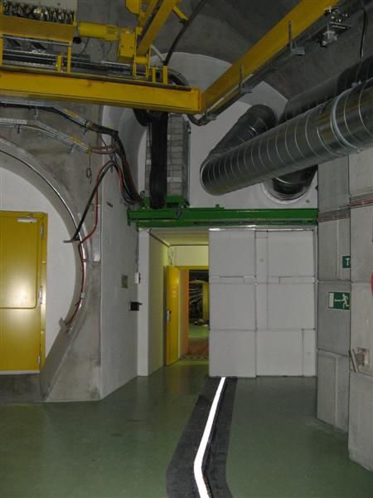
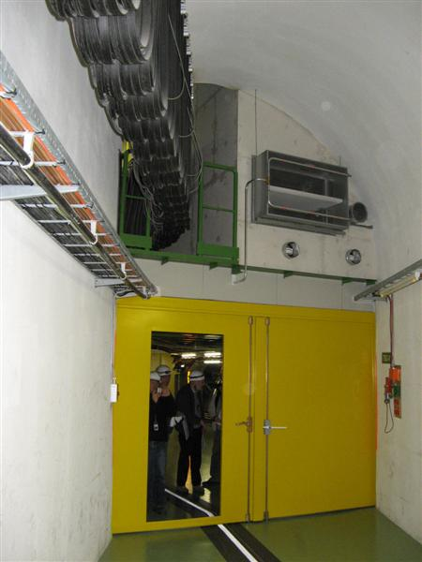
Radiation effects on electronics
Protecting the electronics – additional shielding
Group all the electronics in a single area
Add shielding to reduce the radiation levels ; opted for × 1000 reduction
  Concrete walls up to 6m thick, ~53m³ of concrete in total were installed!
High-energy (>20MeV) hadrons fluence (h/cm²) for 4.5E19 pot
2007
Mobile shielding plugs for TSG41 (20t) and TSG4 (15t, 6% slope!)
“radiation safe” areas for electronics
Shielding in TSG41 tunnel
Towards the target chamber
2008
FLUKA Simulation : L.Sarchiapone et. al, 2008
2007
2008

Slide 22
Radiation effects on electronics
Lessons learned
Radiation effects (singe event effects) to commercial electronics (COTS) is a reality and must be taken seriously into account
  installed electronics – typically from services (ventilation, power, access systems, cranes, etc.)
  but also for equipment during interventions
Recommendation: no electronics in beam tunnels, target and proximity areas where streaming radiation (neutrons) can exceed normal “office” limits
  customizing COTS components would increase substantially the cost and doesn’t really save the problem for installations with >10 years lifetime – new versions, upgrades, etc.
Availability of “as build” simulations is a mandatory tool to understand and evaluate the radiation environment in a facility
  helps primarily for personnel protection, but also to schedule works during interventions

Slide 23
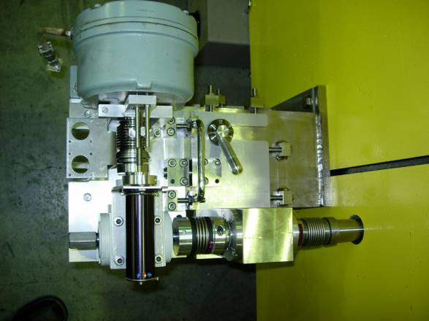
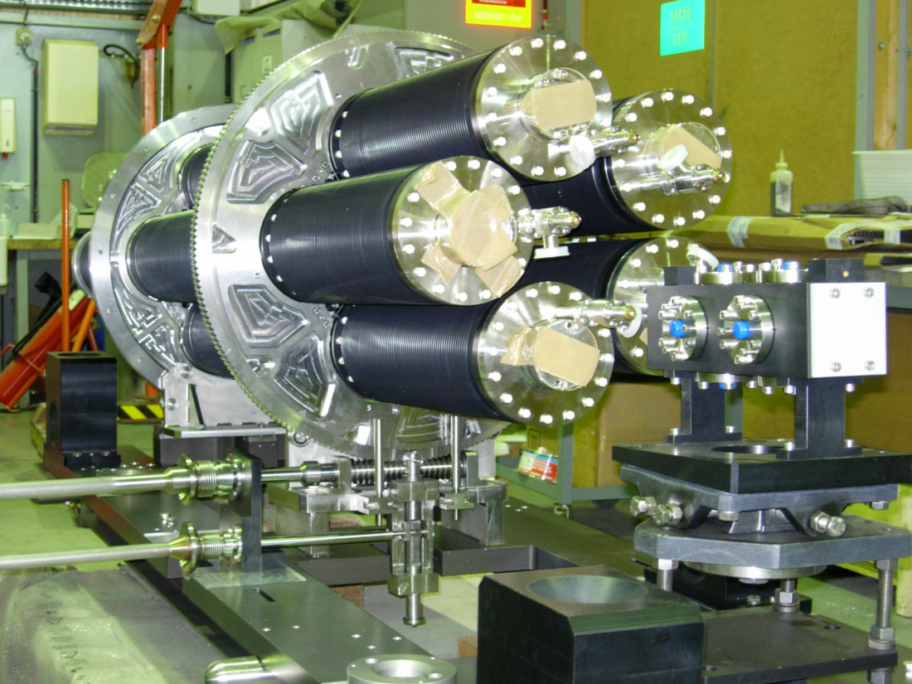
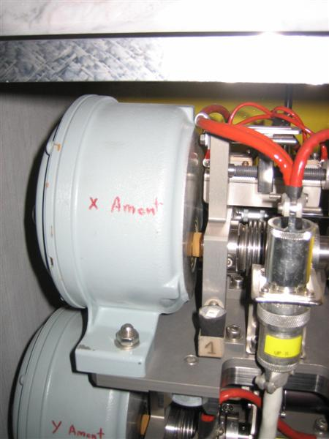

Target motorization failure
Target station design with in-situ spares
Target assembly:
  5 target units (almost identical)
  empty positions in between for beam tuning
  rotation with DC motors and torque limiter outside the shielding.
Increased torque observed in the rotation motor during annual maintenance on March’09
From a first inspection outside the shielding signs of rust observed in parts of the motorizations and limit switches
  Expected due to the radiation environment

Slide 24




Target motorization failure
In-situ inspection (April 8-9, 2008)
Target rotation mechanism – view from web cam
Area preparation : additional shielding & protection
The operations were monitored remotely using the crane and additional web cameras
Target view through the Pb-glass window

Slide 25



Target motorization failure
In-situ inspection (April 8-9, 2008)
Summary of observations:
all four ball-bearings have signs of rust
3 turn when the barrel moves but with difficulty
1 doesn’t turn at all in one direction (at least at startup)
Discussing again with the supplier we discovered that contrary to the specifications the pieces delivered were treated with a lubricant (YVAC3) thought to be radiation hard
New set without lubricant ordered and is under test in the target. Another alternative is the use of ceramic ball-bearings (higher cost)

Slide 26
Target motorization failure
Lessons learned
Rigorous quality assurance for all pieces is vital
  a chain is as strong as it weakest link
Foresee tooling and procedures to observe the components that fail, before exchange them with spares
  understanding the origin of the failure may impact on the decision of using the available spares!

Slide 27

CNGS - water issues
Leak in the TCV4 ventilation unit
Leak of chilled water circuit in one of the TCV4 units installed in the access cavern ( 1st floor )
  small leak, triggered no alarm, but until it was detected ~2.5m3 of water dripped on the floor and on equipment
  fortunately only minor damages
  the water became radioactive as it washed the nearby filters of the ventilation unit
  ended up in the sump of the cavern contaminating the clean drain water in there that had to be pumped
Repaired on time for the 2009 startup with beam
Lesson #12 : A clear separation between the systems that service the radiation areas from the rest should be made
  This may imply constructing additional tunnel/cavern with initial cost increase, but certainly pays off later during operations in case of problems!

Slide 28

CNGS – water issues
CNGS water sumps - layout

Slide 29
CNGS – water issues
CNGS water sumps - overview
Sump | Water source | Flow | Emptying | Volume | Comments
TCV4 | drain pipe work from upstream tunnels | 0.5m³/d | 20 days | 180 m³/y | can receive radioactive water in case of leaks in the ventilation system
TSG4 | target chamber drains condensation water from ventilation system | 3-20 lt/h | 4-5/year | 100 m³/y | radioactive water (mainly H3) from the target area manual emptying to containers
TNM41 | drains along the decay tube and hadron stop area | 1-2 lt/h | 4 fois/an | 20 m³/y | radioactive water along the decay tube hadron stop cooling system water in case of leak high PH value 12
Horns | cooling system | Closed circuit (2×600lt) | ~2-years | 1.2 m³/2y | radioactive water

Slide 30


CNGS – water issues
Handling
Dealing with the drain or infiltration water in underground areas is not trivial.
  it took ~2 years to have infiltrations and thus (radioactive) water in the sump at the end of the decay tube
  Sump at the end of the access tunnels is finally too close to the target area and its services
    since this year we observe increased radioactivity levels in there without being able to identify the source
Getting the water out of the sumps at the end of the target chamber and decay tube not a trivial exercise
Lesson #12 : the issue of the drain water (piping, sumps, service & maintenance) needs to be carefully studied for future facilities
  may impact on civil engineering costs
  separate and isolate as much as possible the radioactive areas and tunnels – if something goes wrong we may end up with large quantities of water to handle
  transporting water tanks (or pipes) in steep slopes (i.e future installations !!) not an easy issue

Slide 31
Summary
Making and operating high-intensity beam facilities is always an interesting challenge !!
In CNGS lot of effort was put in the project/design phase to address most of the issues and learn from the available expertise and experience
We are now collecting experience in operating the facility that is important to share with other colleagues
The problems we faced were successfully resolved thanks to the competences and motivation of several colleagues from many CERN groups and external teams
We hope our problems were really child diseases of the facility and we look forward to the interesting physics results from the Grand Sasso experiments - hopefully soon!

