Slide 1
Rotating Tungsten Helium cooled Target
RoTHeTa
ρθ
Cyril Kharoua
Daniela Ene, Ferenc Mezei, Etam Noah, François Plewinski, Pascal Sabbagh,
Luca Massidda (CRS4, Sardinia)
Peter Sievers (retired from CERN)
Fernando Sordo (ESS-Bilbao)
4th High Power Targetry Workshop
Malmö 2011-05-02

Slide 2
Outline
Some history
Practical motivation for Helium cooling
Practical motivation for Granular Target
Practical motivation for Rotating Target
Main parameters of the RoTHeTa
Neutronic performance
Thermo-Mechanical study
Loop characteristics
Rotating seal
Maintenance
Lifetime
Conclusion

Slide 3
Some history
Granular Tungsten target helium cooled was first proposed by Peter Sievers for a MW neutrino factory
First we have considered spheres in a stationary target
Optimum configuration for cooling, thermal shock and thermal stress
Heavy cooling requirements (High Pressure!)
Under the ESS condition a rotating wheel, fitted with tungsten rods and cooled with helium is a viable solution…

Slide 4
Practical Motivation for Helium Cooling
Objectives:
  Avoid Liquid metal technology
  Avoid Water cooling / corrosion issue related to tungsten target and therefore avoid cladding
Advantages:
  Known technology
  Low activity in the cooling fluid
  Leak tightness
Drawbacks:
  Pressurized gas equipment (3-10bar)
  Leak tightness

Slide 5
Practical Motivation for Granular Target
Objectives:
  Allows cooling fluid to remove heat within the target (directly where it is deposited)
Advantages:
High density target (75% to 90% of pure tungsten)
  No thermal shock and low stress level
  Flexible target material (choice, arrangement, geometry…)

Slide 6
Practical Motivation for a Rotating Target
Objectives:
  Increase lifetime (window, tungsten…)
  Alleviate the heat removal
Advantages:
  Dilution of specific activity and after heat
  Less frequent maintenance and handling of radioactive material
  Solid waste
  Upgradeable for higher beam power
Drawbacks:
  Not yet proven concept (but we do not need to re-invent the wheel!)
Rotating seals to be adapted from existing solutions
Heavy assembly

Slide 7

Main Parameters of the
Helium Cooled Rotating Granular Target
A 2.5GeV elliptic Gaussian beam with an RMS of σ_{x}= 5 cm and σ_{y}= 1.5 cm (beam footprint at 4σ of 20cm x 6cm), an average power of 5 MW, pulsed at 20 Hz
The wheel is rotating at 30RPM (0.5Hz)
The energy deposition calculated with FLUKA gave a maximum Power density (time average for 1/40 of the wheel) of 75W/cm³ (40 times less than in the static target case).
External wheel diameter is150 cm and internal diameter of 50 cm. The helium is blown over the total surface continuously.
Initially rods of 2cm diameter, now 1cm diameter

Slide 8
Neutronic performance
Brightness at 5 MeV (left) and at 10 MeV (right) on the moderator surface for a 1ms pulse length.
The rotating target made of rod cooled by helium will allow a density of 90% of the raw material, which shall give a performance close to the pure tungsten configuration.
courtesy F. Sordo et al.

Slide 9
Neutronic performance
Franz Gallmeier investigation (previous TSCS meeting) extended
  Rotating target configuration (run though optimization loop)
  Extrapolation with density (not so accurate)
Element | Effective density | Φ_{cold@10m} | Φ_{cold@10m} | Φ_{cold@10m} | Comment
 | (1/cm³) | (n/cm²/prot.) | Perf in % vs. Best | Loss in % vs. Best
W | 19.4 | 6.28E-08 | 100.00% | 0.00% | Calculated
Sphere pure W | 14 | 5.66E-08 | 90.07% | 9.93% | Calculated
Sphere Densimet (*) | 13.875 | 5.61E-08 | 89.26% | 10.74% | Educated guess
Rods Densimet (*) | 16.65 | 6.06E-08 | 96.47% | 3.53% | Educated guess
Tungsten is the most favourable target material, and its dilution is not affecting significantly the neutron production
*DENSIMET is a tungsten alloy with appropriate properties
courtesy F. Gallmeier

Slide 10
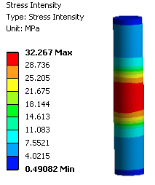
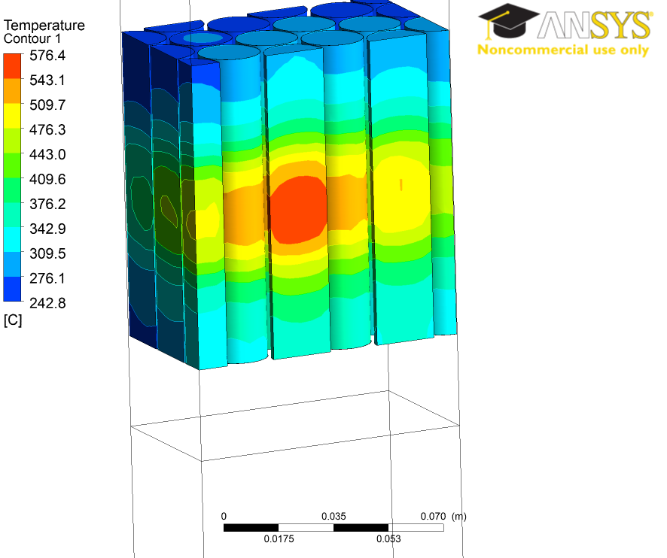
Thermo-mechanical study
2cm Rods
            With a He-cooling circuit set at: Po = 10 Bar, v(He) 8 m.s⁻¹(mass flow of about 20kg/s!!! Which could reduced by tuning it for different zones)
                The peak temperature in the hottest rods is about 577°C (Inlet Temperature was 200°C)
                Helium ∆T_{bulk}=30K
                Stress in the rods is low even in a fatigue regime (endurance), about 30 to 50 MPa

Slide 11
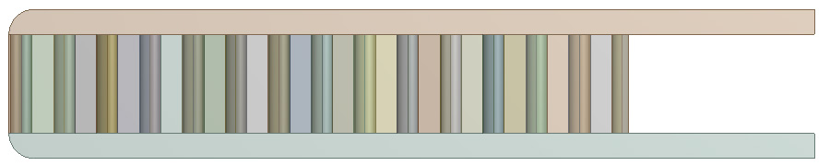

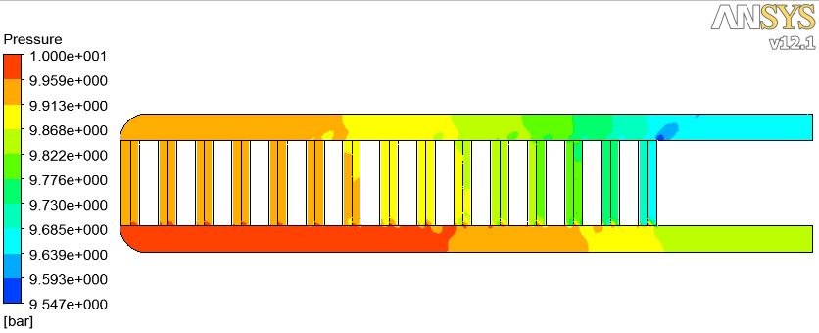
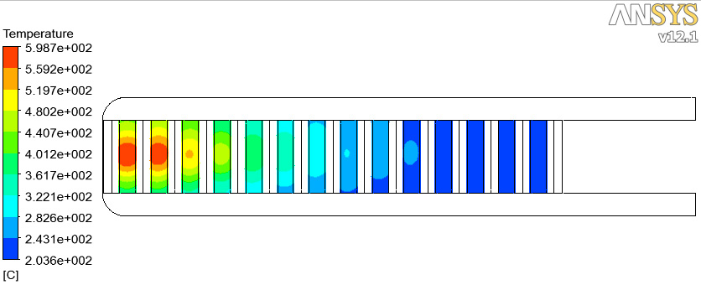
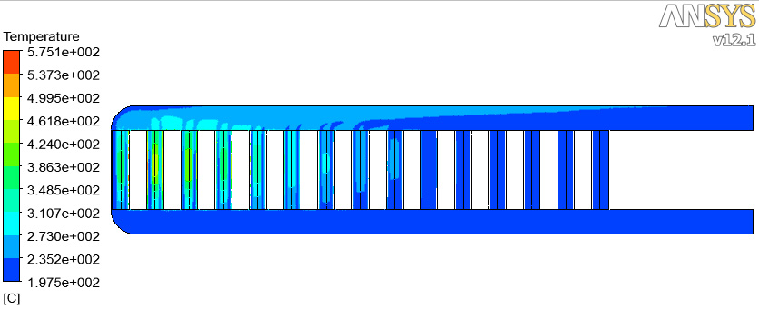
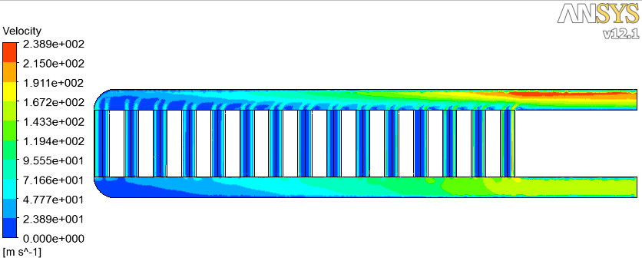
Thermo-mechanical study
Helium Outlet
Helium Inlet
            He in inlet is at 200°C and exit at about 230°C
            Pressure drop is about 0.2bar and Pumping power about 250kW
Rotation axis

Slide 12
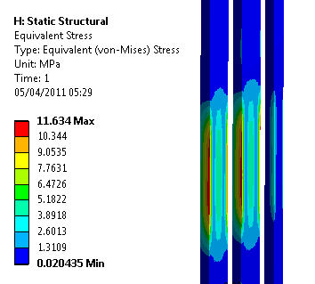
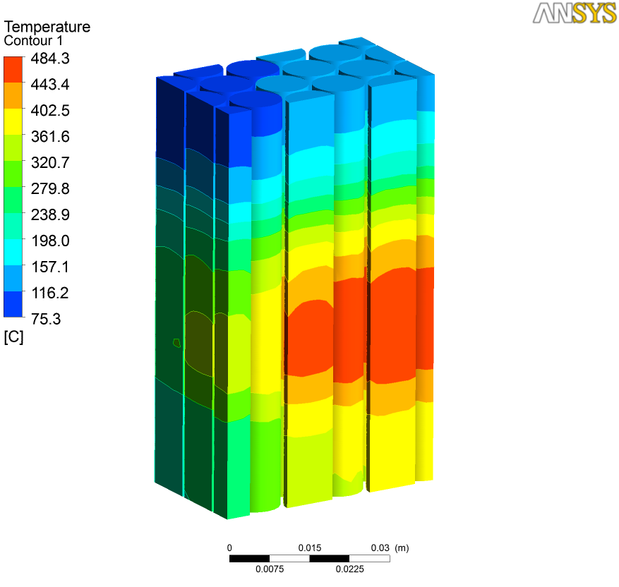
Thermo-mechanical study
1cm Rods
            With a more moderate He-cooling circuit (Po = 3 Bar, inlet v(He) of 4 m.s-1, mass flow of 3kg/s)
                The peak temperature in the hottest rods is about 485°C
                Helium ∆T_{bulk}= 200K
                Stress in the rods is very low even in a fatigue regime (endurance), about 10 to 20 Mpa

Slide 13
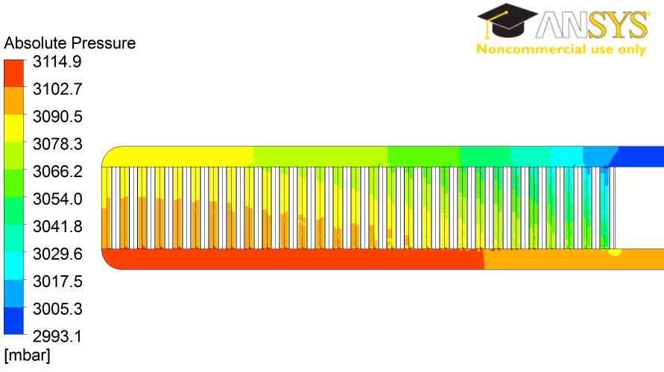
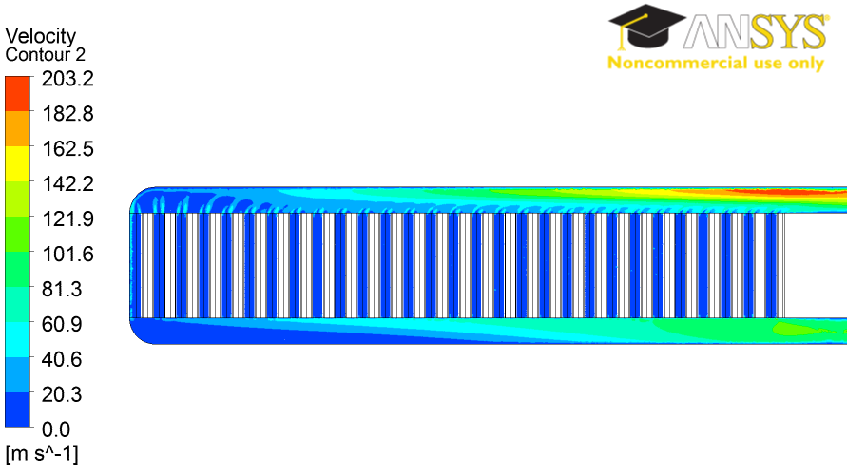
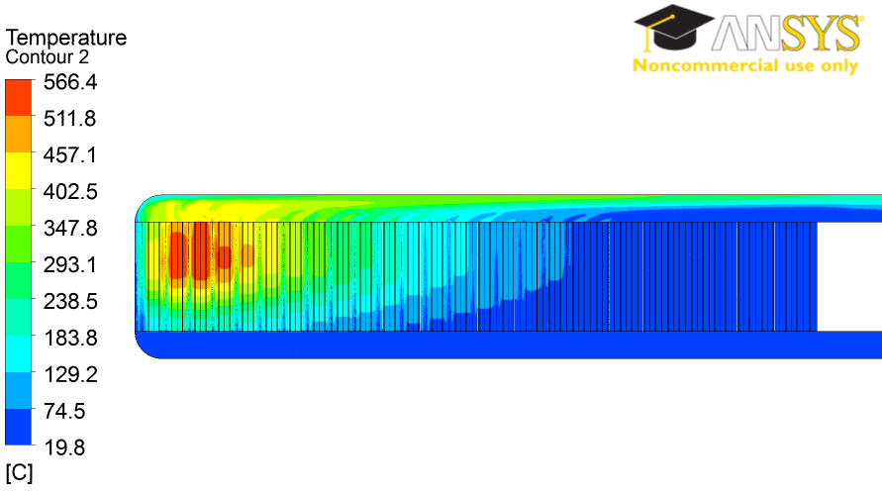
Thermo-mechanical study
1cm Rods
For 3kg/s mass flow rate for 3 bar He
Here the pressure drop is 0.1bar equivalent to 62kW of pumping power.

Slide 14

Cross flow configuration
H₂O
H₂
p
W
He: ∼ 0.3 m³, ∼ 10 bar
He: ∼ 5 m³, > 1 bar
No contact labyrinth
(Pump outside)
Containment with flange connection of target trolley & utilities

Slide 15
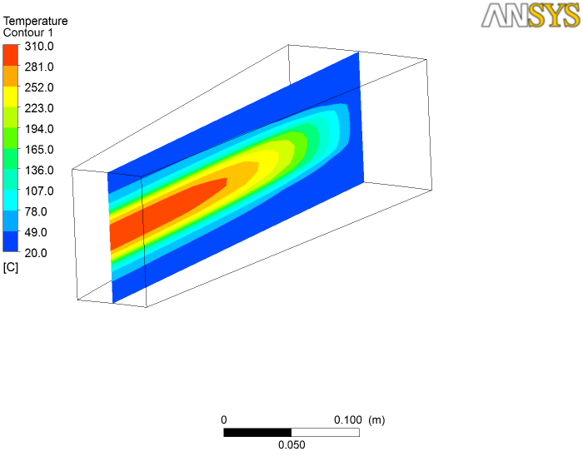
Thermo-mechanical study
Cross flow configuration
Transverse cross flow is under estimation
The objective is to use a lower mass flow rates and increase the bulk ∆T in Helium
First estimation show the possibility to consider 2cm rods with 1mm gap (82%of the full W density).
  Mass flow rates is about 3kg/s
  ∆T_{bulk}=200K
  T_{max in He}=310°C
  ∆P≈1bar (VDI WärmeAtlas)

Slide 16
Helium loop Pressure drop estimation
The main component of the loop to be considered for the overall pressure head required at the pump are:
            The target material (see previous slides)
            The target shaft and other straight pipe (Half of the target)
            The Inlet rotating seals and outlet rotating seals
            The filters (Half of the target)
            The heat exchanger (Half of the target)
The Inlet and Outlet rotating seals could be assumed to have the same pressure drop
The Heat exchanger could be assumed to have half of the pressure drop seen in the target material

Slide 17
Helium loop Pressure drop estimation
A preliminary assessment could give indication of the pressure drop in the main component of the loop, for Helium flowing at 3kg/s and 3bar for a global volume of 2m³
 | Pressure drop [bar]
The target material | 0.1
The target shaft and other straight pipe | 0.05
The Inlet rotating seals | 0.1
The outlet rotating seals | 0.1
The filters | 0.05
The heat exchanger | 0.05
 | 0.45 | Total
Pumping Power | 282.7 kW
Preliminary estimation

Slide 18
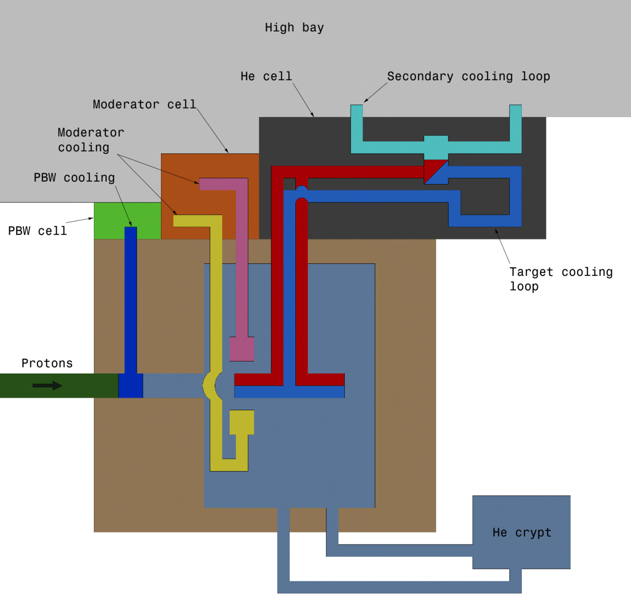
Helium Loop and ancillaries loop

Slide 19
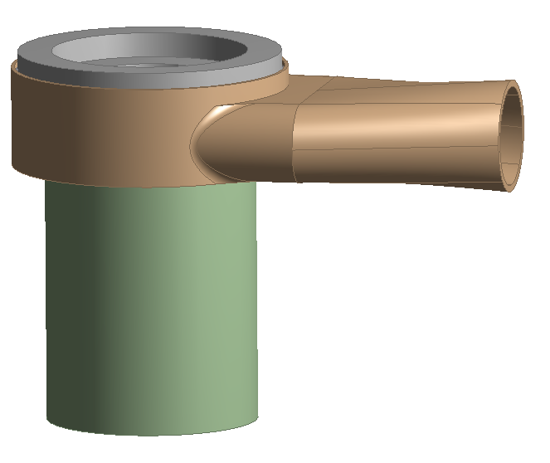
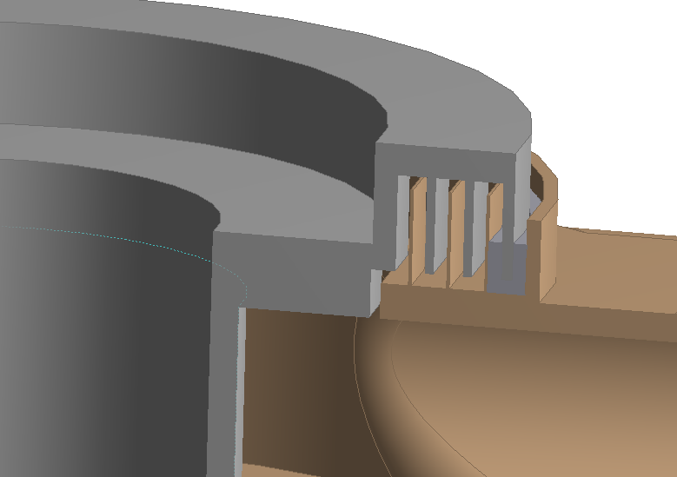
Leak in Rotating Seals
Differential pumping seal with chicanes between 3 bar and atmospheric pressure.
For 0.1mm wide and 50cm long path => at most 2g/s
Pumping of the leak occurs in the last chicane

Slide 20
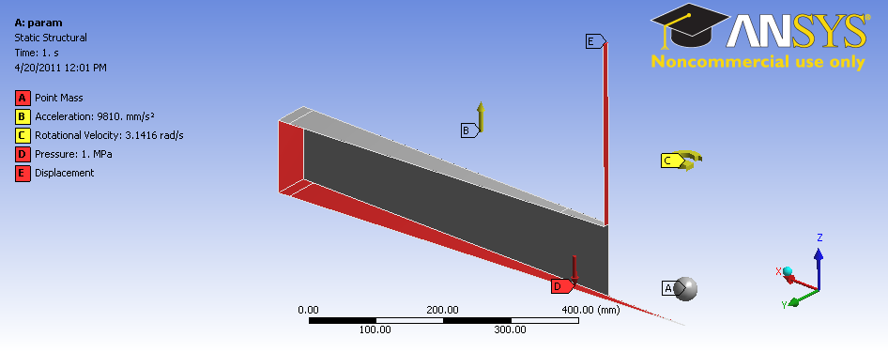
Structural analysis
Structural analysis
  Simplified shell model (sector)
  Parameterized model (number of ribs, thickness)
  No thermal loads defined, but gravity, pressure (3bar), rotational velocity
  Simplified post-processing using RCC-MRx criteria

Slide 21
Structural analysis
The table here summarize the ratio between the acceptable limit (according to RCC-MRx criteria) and the calculated stress.
At 3bar with ribs every 12degree, the minimum thickness of material could be 3mm.
If the pressure can be further reduced, the number of needed ribs (or shell thickness) will be reduced
 |  | Angle between 2 ribs
 |  | 9 | 12 | 30 | 45 | 60
Thickness (mm) | 3 | 0.57 | 0.94 | 3.35 | 4.70 | 5.69
 | 4 | 0.32 | 0.53 | 2.24 | 3.57 | 4.51
 | 5 | 0.21 | 0.34 | 1.48 | 2.62 | 3.53
 | 6 | 0.14 | 0.24 | 1.03 | 1.91 | 2.72
 | 7 | 0.11 | 0.17 | 0.76 | 1.42 | 2.08
 | 8 | 0.08 | 0.13 | 0.58 | 1.09 | 1.61

Slide 22
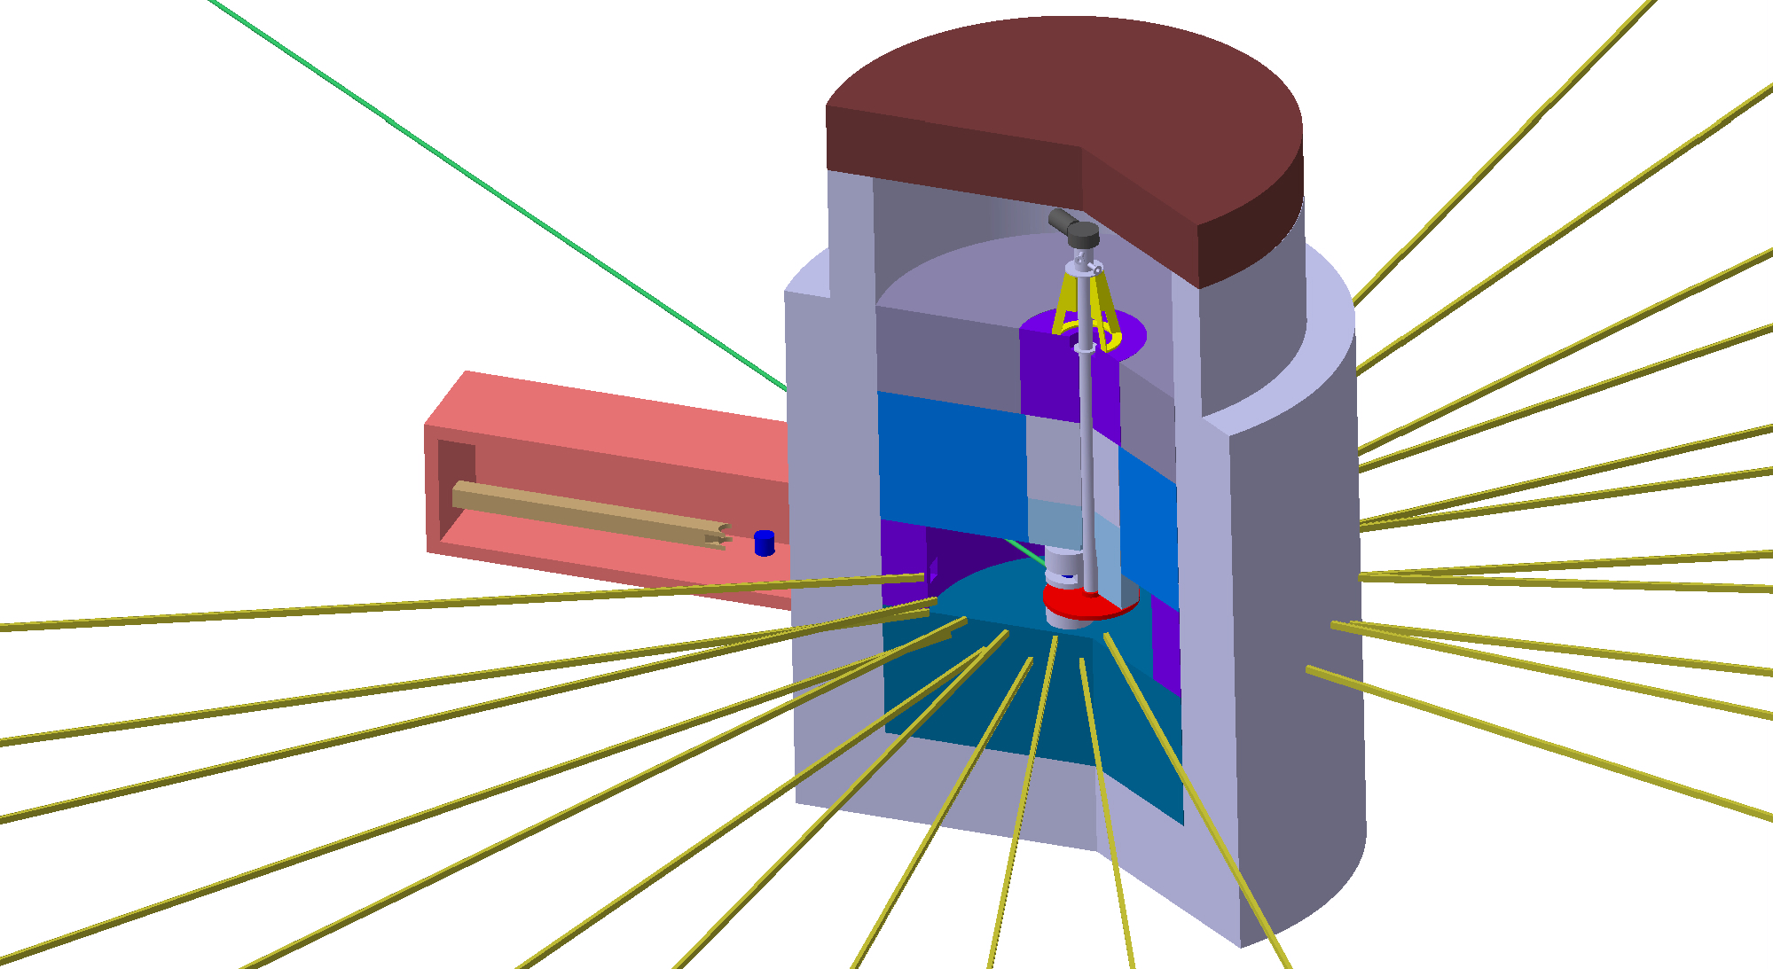
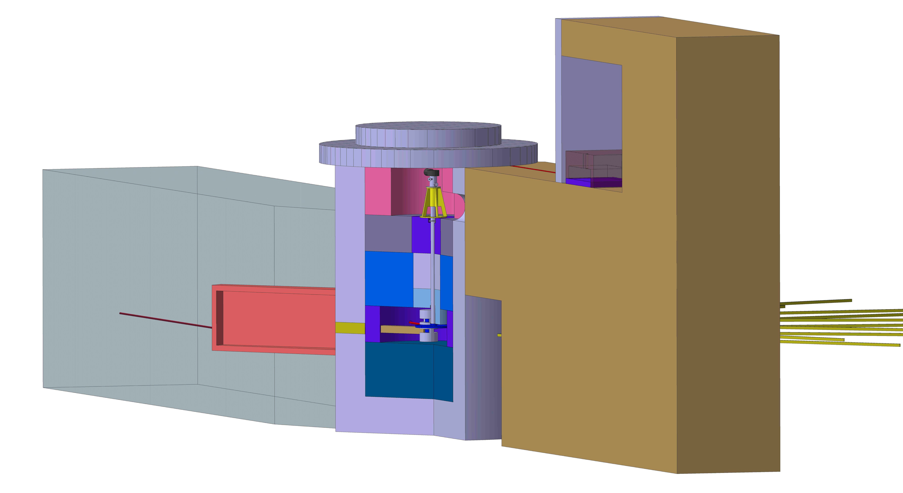
Maintenance / Layout

Slide 23
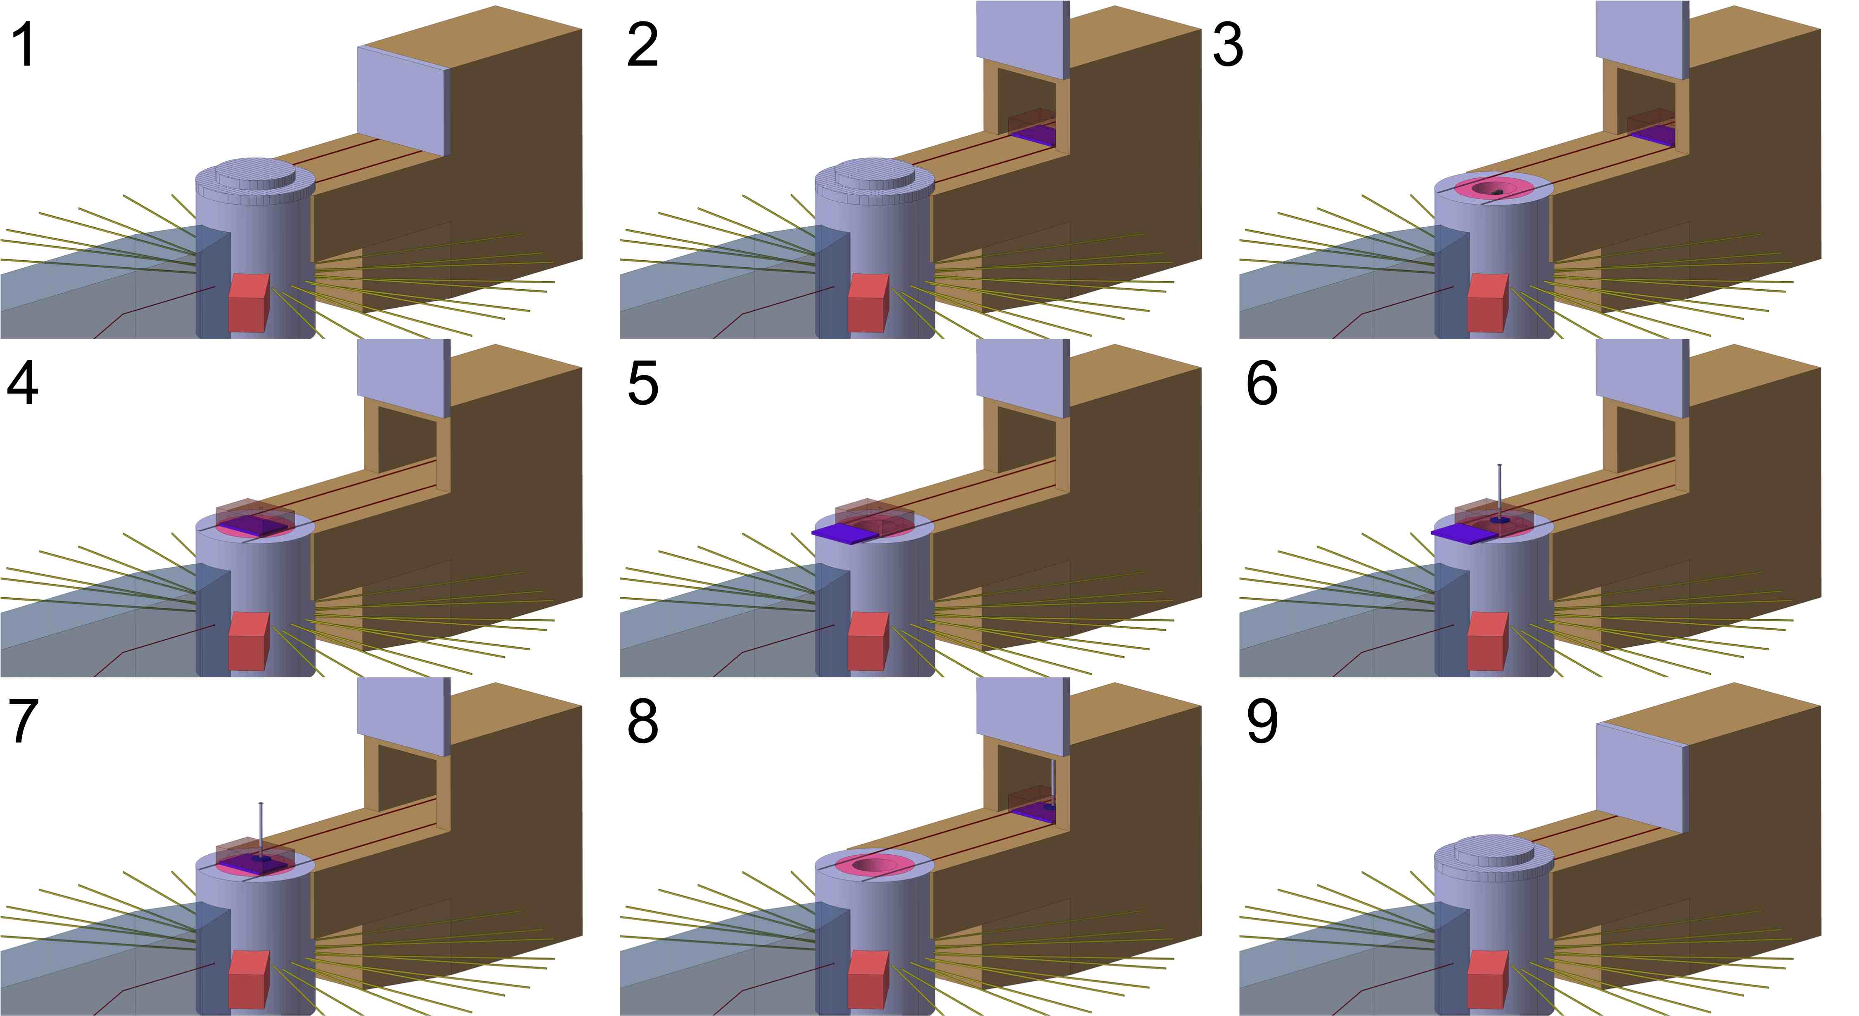
Maintenance / Layout

Slide 24
Maintenance / Layout
Exchange procedure: a proposal
  Hot cell could be separated from the target station / monolith allowing an operation of it more disconnected from the target operation
  In order to reduce the weight carried by the overhead crane the flask is moved on rails
Basic maintenance is performed on helium circuit (rotating seal, filters, pumps, heat exchanger) by hands on it. The exposure to radiation shall be low.

Slide 25
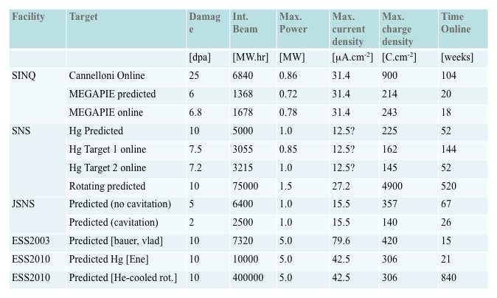
Lifetime
The lifetime of such target is supposed to be about 40 times longer than the static target
            As radiation damage will be spread over a large surface/volume
            Fatigue is negligible in the first estimation (non irradiated)

Slide 26
Conclusion
3bar of pressure seems a viable option with 1cm rods, but further study shall be carried on to confirm and determine the minimum pressure acceptable
Neutron yield is optimum
Some of the main challenges lie in the replacement of the target and its associated downtime
Attention has to be paid to local leak and radioactive release
Special attention has to be paid to the rotating seal

Slide 27
Thank you for your attention

