Slide 1
R&D effort for the design of the Multi Megawatt Target Station of EURISOL
C. Kharoua, ESS-S based at CERN, Geneva
On behalf of the EURISOL-DS Collaboration
Task#2 (led by Yacine Kadi, CERN)
European Organization for Nuclear Research, CERN
CH-1211 Geneva 23, SWITZERLAND
Cyril.kharoua@esss.se
(October 20, 2009)
Project supported by the European Commission under the FP6
“Research Infrastructure Action- Structuring the European Research Area”
EURISOL-DS Project Contract no. 515768 RIDS
Cyril. Kharoua@esss.se / Workshop on Applications of High Intensity Proton Accelerators October 19-21, 2009 Fermi National Accelerator Laboratory, Batavia, IL, USA

Slide 2
Presentation outline
The EURISOL Project
The MMW spallation target design
The baseline design with window
The innovative windowless design
Conclusion
Cyril. Kharoua@esss.se / Workshop on Applications of High Intensity Proton Accelerators October 19-21, 2009 Fermi National Accelerator Laboratory, Batavia, IL, USA

Slide 3
The Aim of EURISOL
The EURISOL program aims at the construction beyond the year 2012, of the ‘3rd generation’ European Isotope Separation On-Line (ISOL) Radioactive Ion Beam (RIB) facility
It will extend and amplify the existing work presently being carried out at the 1st generation RIB facilities in Europe and other parts of the world
The EURISOL facility will play a complementary role to the recently approved SPIRAL-II and the FAIR project at GSI Darmstadt, Germany, the European ‘2nd generation’ ISOL and In-Flight RIB facilities
Cyril. Kharoua@esss.se / Workshop on Applications of High Intensity Proton Accelerators October 19-21, 2009 Fermi National Accelerator Laboratory, Batavia, IL, USA

Slide 4
EURISOL Roadmap
Phase 1: Preliminary Design Study of EURISOL (2000 - 2003), the ‘next-generation’ European ISOL Radioactive Ion Beam (RIB) facility => enhance RIB yields (vs. 1999 data) by factors of 2 to 4 orders of magnitude (FP5)
Phase 2: Design Study (2005 - 2009) address the main technological challenges leading to a full engineering design (FP6)
Phase 3: Full Engineering Design (3y)
Phase 4: Construction of the facility (> 2012)
Cyril. Kharoua@esss.se / Workshop on Applications of High Intensity Proton Accelerators October 19-21, 2009 Fermi National Accelerator Laboratory, Batavia, IL, USA

Slide 5
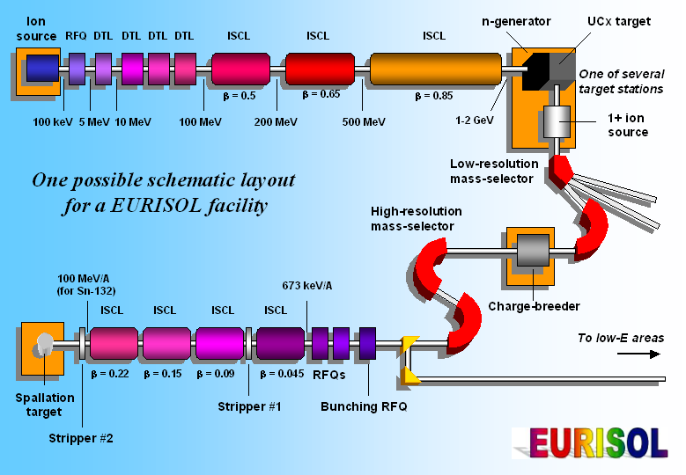
EURISOL facility layout
Cyril. Kharoua@esss.se / Workshop on Applications of High Intensity Proton Accelerators October 19-21, 2009 Fermi National Accelerator Laboratory, Batavia, IL, USA

Slide 6
EURISOL Target Stations
100 kW direct targets
MMW converter target
RIB production:
Spallation-evaporation
Main: P-rich
(10 to 15 elements
below target material)
Residues: N-rich
(A few elements
below target material)
Target materials:
Oxides
Carbides
Metal foils
Liquid metals
RIB production:
Fission
N-rich
Wide range
Z = 10 to Z = 60
Target material:
U (baseline)
Th
Converter:
Hg
Cyril. Kharoua@esss.se / Workshop on Applications of High Intensity Proton Accelerators October 19-21, 2009 Fermi National Accelerator Laboratory, Batavia, IL, USA

Slide 7
Presentation outline
The EURISOL Project
The MMW spallation target design
The baseline design with window
The innovative windowless design
Conclusion
Cyril. Kharoua@esss.se / Workshop on Applications of High Intensity Proton Accelerators October 19-21, 2009 Fermi National Accelerator Laboratory, Batavia, IL, USA

Slide 8
EURISOL-DS Target Challenges
EURISOL shall deliver RIB’s 3 orders of magnitude higher intensity than in presently operating facilities.
Increase the intensity of the beam driver by the same order of magnitude
High-Power issues
Thermal management
Target melting
Target vaporization
Thermal shock
Beam-induced pressure waves
Material properties
Radiation / Safety
Radiation protection
Radioactivity inventory
Remote handling
Cyril. Kharoua@esss.se / Workshop on Applications of High Intensity Proton Accelerators October 19-21, 2009 Fermi National Accelerator Laboratory, Batavia, IL, USA

Slide 9
Liquid metal Target
Remove heat from reaction zone by moving the target material
No radiation damage in target material
Low specific decay heat due to large target mass
No need for decay heat removal in reaction zone
Good arguments but....
.....need to be proven at these Powers!
Cyril. Kharoua@esss.se / Workshop on Applications of High Intensity Proton Accelerators October 19-21, 2009 Fermi National Accelerator Laboratory, Batavia, IL, USA

Slide 10
The Choice of Hg as a Target
Mercury has the highest density of all heavy liquid metals and hence produces the brightest neutron source
Mercury is liquid at room temperature and hence needs no auxiliary heating
Mercury produces practically no alpha-emitters with any sizable life time
Hg purification
Hg disposal in the form of a stable solid amalgam
→ LBE (Lead Bismuth Eutectic) might be an other option
Cyril. Kharoua@esss.se / Workshop on Applications of High Intensity Proton Accelerators October 19-21, 2009 Fermi National Accelerator Laboratory, Batavia, IL, USA

Slide 11
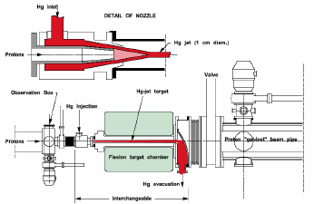
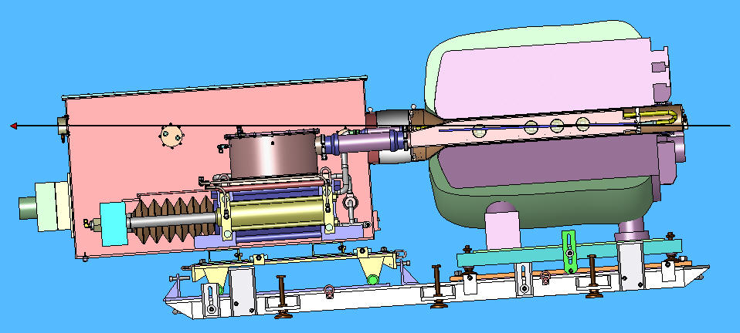
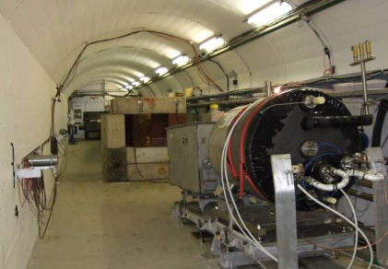
Target initial design
Initial RTD proposal
A proof-of-principle test of a target station suitable for a ν-Factory or μ- Collider source
PS extracted proton beam of 14(24)-GeV, incident on a free mercury jet target located inside a 15-T capture solenoid magnet.
Hg-jet hydraulic system
Hg-container
Solenoid
The originally proposed Hg – jet formation
Diameter of jet 10 – 20 mm;Q=2.5 l/s; p>50bars!!!
Proton Beam
Cyril. Kharoua@esss.se / Workshop on Applications of High Intensity Proton Accelerators October 19-21, 2009 Fermi National Accelerator Laboratory, Batavia, IL, USA

Slide 12
Target initial design
Initial RTD proposal:
Complexity and reliability issue
Need of an active beam dump
Small beam size inducing high Power density
High leakage of particles (Shielding issue, Thermal load on nearby structures)
Need of a solenoid 15T (cryogenics, compromising the use of fission target close to neutron source)
Cyril. Kharoua@esss.se / Workshop on Applications of High Intensity Proton Accelerators October 19-21, 2009 Fermi National Accelerator Laboratory, Batavia, IL, USA

Slide 13
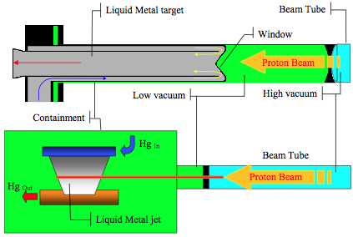
Multi-MW Liquid Hg Target
 | Beam diameter |  | Units
Gaussian beam geometry | 15 mm | 25 mm
Beam power | 4 |  | MW (continuous)
Beam particle energy | 1 |  | GeV
Beam current | 4 |  | mA
Beam escapes | 2x10⁸ |  | primary/cm²/s/MW of beam
Estimated peak temperature in the liquid | 261 | 180 | °C
Estimated peak temperature in the window | 260 | 258 | °C
Maximum velocity | 6 |  | m/s
Maximum loss of pressure | 5 |  | bar
Peak power density in the Mercury | 1.8 | 0.8 | kW/cm³/MW of beam
Peak power density in the window | 0.9 | 0.3 | kW/cm³/MW of beam
Beam power deposition in the Mercury | 2.3 | 2.3 | MW/cm³/MW of beam
Estimated Stress level in the window | <140 | <110 | MPa
New proposal: 2 designs
Compact Hg-loop with beam widow and Confined transverse film windowless
Cyril. Kharoua@esss.se / Workshop on Applications of High Intensity Proton Accelerators October 19-21, 2009 Fermi National Accelerator Laboratory, Batavia, IL, USA

Slide 14
Presentation outline
The EURISOL Project
The MMW spallation target design
The baseline design with window
The innovative windowless design
Conclusion
Cyril. Kharoua@esss.se / Workshop on Applications of High Intensity Proton Accelerators October 19-21, 2009 Fermi National Accelerator Laboratory, Batavia, IL, USA

Slide 15
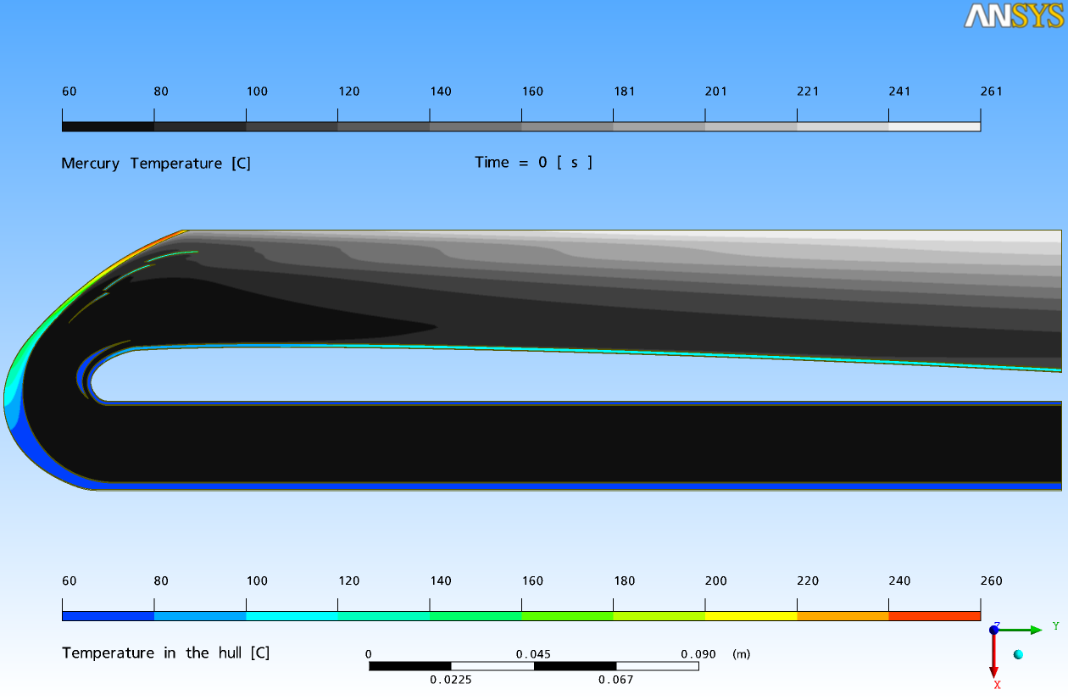
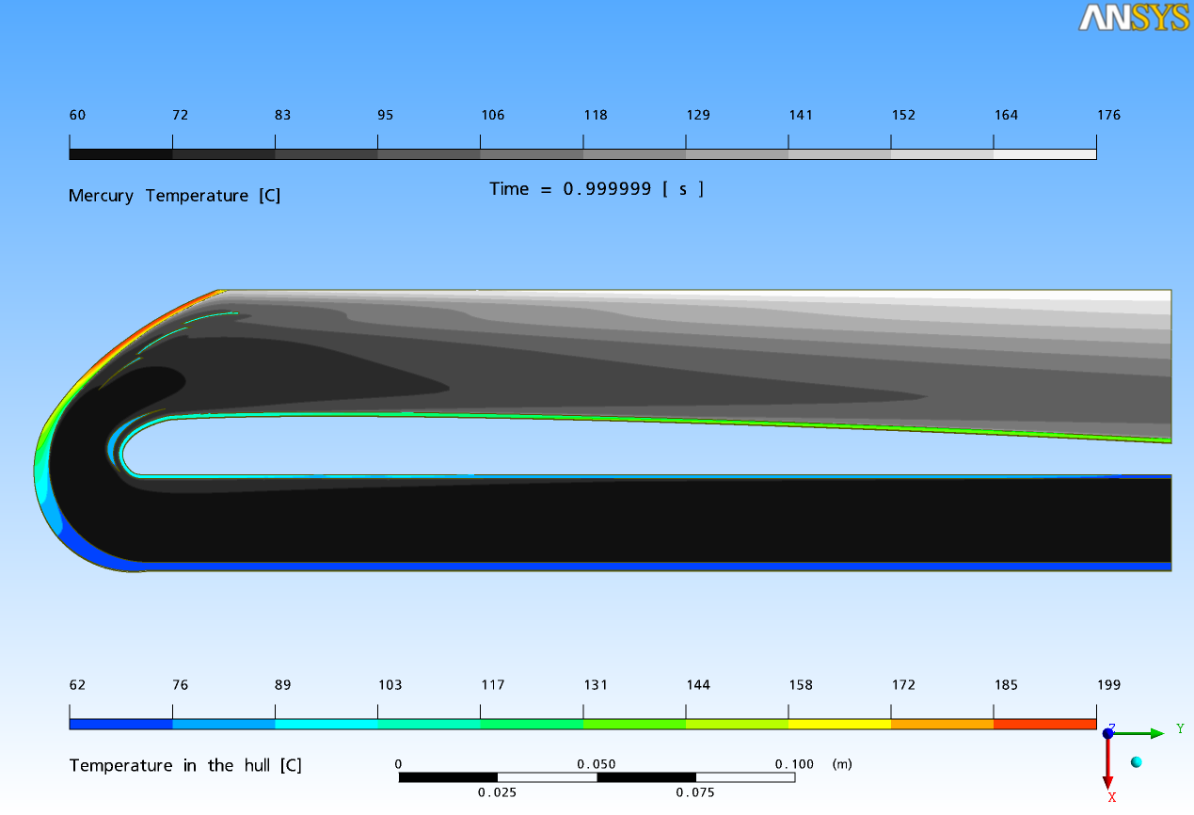
2D CFD & Structural Analysis
The CGS (Coaxial Guided Stream) design
Ref K. Samec et al. (PSI)
Power density distribution for the considered beam widths, along the beam axis and around the window
Cyril. Kharoua@esss.se / Workshop on Applications of High Intensity Proton Accelerators October 19-21, 2009 Fermi National Accelerator Laboratory, Batavia, IL, USA

Slide 16
3D CFD & Structural Analysis
Ref K. Samec (CERN) et al.
Cyril. Kharoua@esss.se / Workshop on Applications of High Intensity Proton Accelerators October 19-21, 2009 Fermi National Accelerator Laboratory, Batavia, IL, USA

Slide 17
3D CFD & Structural Analysis
Ref K. Samec (CERN) et al.
Cyril. Kharoua@esss.se / Workshop on Applications of High Intensity Proton Accelerators October 19-21, 2009 Fermi National Accelerator Laboratory, Batavia, IL, USA

Slide 18
3D CFD & Structural Analysis
Ref K. Samec (CERN) et al.
Cyril. Kharoua@esss.se / Workshop on Applications of High Intensity Proton Accelerators October 19-21, 2009 Fermi National Accelerator Laboratory, Batavia, IL, USA

Slide 19
3D CFD & Structural Analysis
Ref K. Samec (CERN) et al.
Cyril. Kharoua@esss.se / Workshop on Applications of High Intensity Proton Accelerators October 19-21, 2009 Fermi National Accelerator Laboratory, Batavia, IL, USA

Slide 20
Coaxial Guided Stream design (CGS)
Cyril. Kharoua@esss.se / Workshop on Applications of High Intensity Proton Accelerators October 19-21, 2009 Fermi National Accelerator Laboratory, Batavia, IL, USA

Slide 21
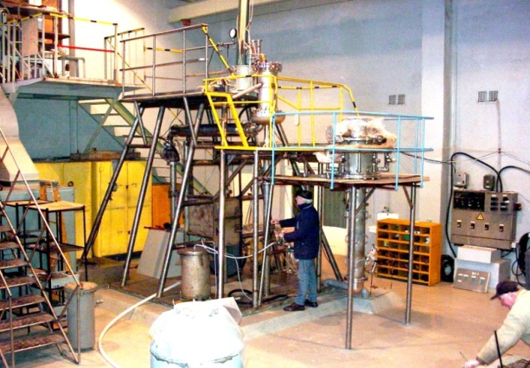
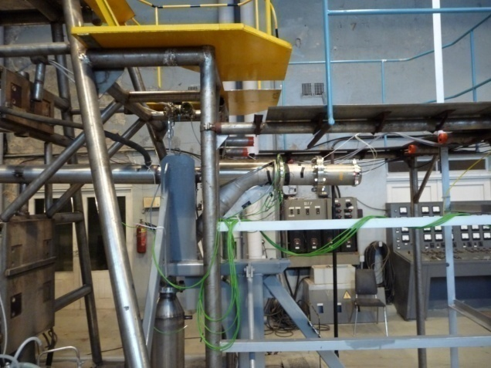
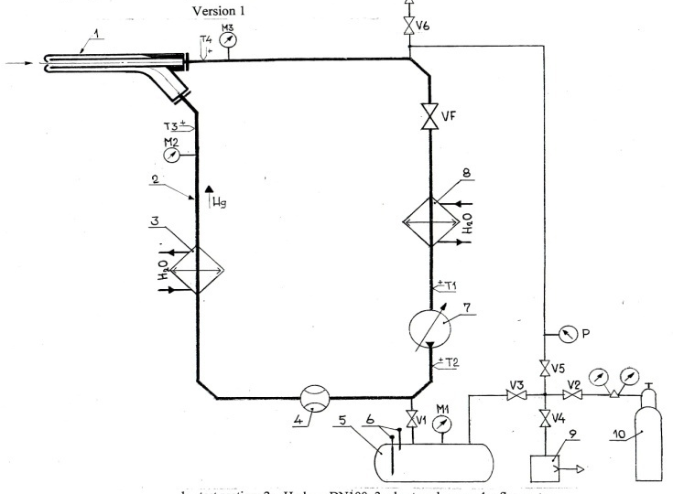
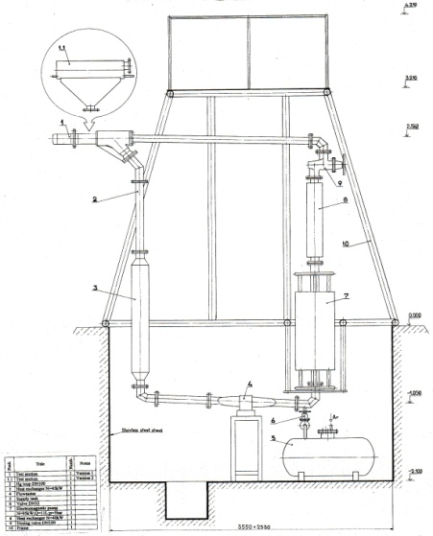
Liquid Hg Loop for tests of target mock-ups and other components
Existing Hg – loop in Institute of Physics) parameters of EMP p=4 bars; Q~12l/s
1 – test section; 2 – Hg loop DN100; 3 – heat exchanger; 4 – flowmeter;
5 – supply tank; 6 –level meter; 7 – electromagnetic pump; 8 – heat exchanger;
9 – vacuum pump; 10 – argon vessel; M1…M3 – pressure meter; P – vacuum
gauge; T1…T4 – thermocouple; V1…V6 – valve; VF – dosing valve;
Cyril. Kharoua@esss.se / Workshop on Applications of High Intensity Proton Accelerators October 19-21, 2009 Fermi National Accelerator Laboratory, Batavia, IL, USA

Slide 22
Liquid Hg Loop at IPUL
Cyril. Kharoua@esss.se / Workshop on Applications of High Intensity Proton Accelerators October 19-21, 2009 Fermi National Accelerator Laboratory, Batavia, IL, USA

Slide 23
Experimental Program
Sergejs Dementjevs (PSI) et al.
Cyril. Kharoua@esss.se / Workshop on Applications of High Intensity Proton Accelerators October 19-21, 2009 Fermi National Accelerator Laboratory, Batavia, IL, USA

Slide 24
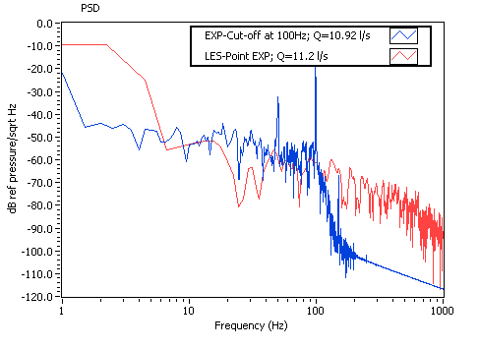
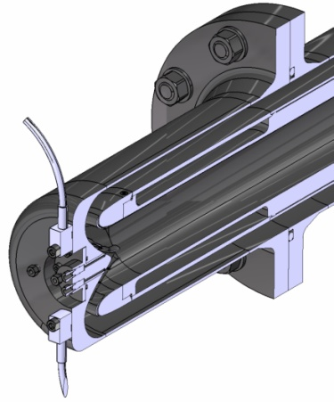
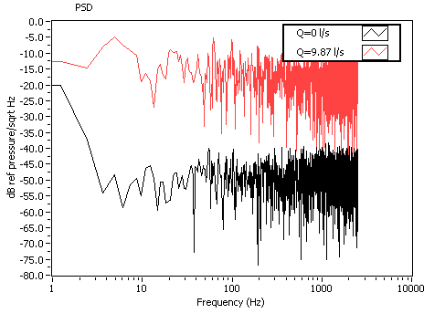
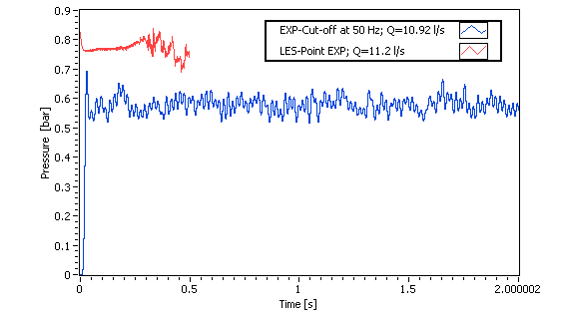
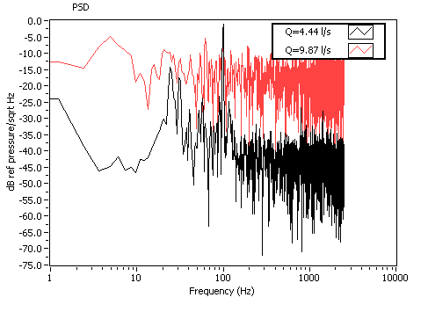
METEX experiment
Pressure sensor at the window
11 L/s reached (~150kg/s)
Acceptable vibration behaviour of the target
Power Spectral Density of the “horizontal” acceleration sensor signal
Acceleration sensors fixed on the BEW mock-up
To be published:
Rade Milenkovich (PSI) et al.
Laure blumenfeld (CEA Saclay / CERN)
Peak from the pump is at 100Hz
Cyril. Kharoua@esss.se / Workshop on Applications of High Intensity Proton Accelerators October 19-21, 2009 Fermi National Accelerator Laboratory, Batavia, IL, USA

Slide 25
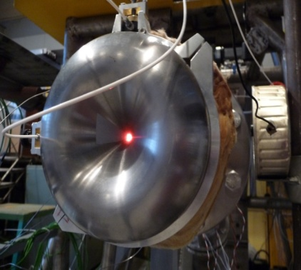
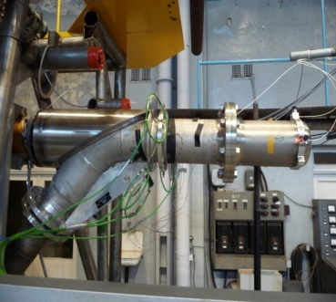
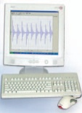
Cavitation detection
The incident Laser signal is reflected by the surface of the vibrating object
Laser Doppler Vibrometers operate on the Doppler principle, measuring back-scattered laser light from a vibrating structure, to determine its vibrational velocity and displacement.
During the METEX experiment the LDV was used to measured the velocity of the wall at the window of the CGS (Coaxial Guided Stream) target design.
The objective was to detect the occurrences of cavitations.
The signal is then compared through the interferometer
Though the Doppler phenomena the velocity vibration is determined
The output signal is then recorded in the time space.
Signal
To be published:
Cyril Kharoua (CERN) et al.
Cyril. Kharoua@esss.se / Workshop on Applications of High Intensity Proton Accelerators October 19-21, 2009 Fermi National Accelerator Laboratory, Batavia, IL, USA

Slide 26
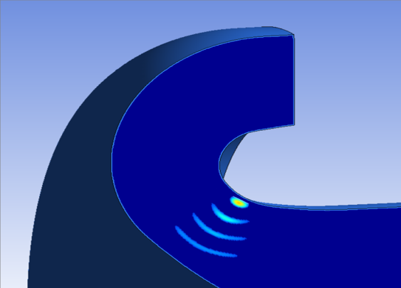
Cavitation detection
CFD simulation and prediction of cavitations zone
Cavitation Zone
CFD Model
Velocity Distribution
Pressure Distribution
The CFD predictions performed with ANSYS CFX show a zone of high pressure drop at the turn.
The bubbles created in this region are collapsing right after and creating pressure waves.
The waves are travelling toward the window where the laser measures the velocity vibration of the wall.
Laser point
Cavitation Bubble implosion and pressure wave propagation
Cyril. Kharoua@esss.se / Workshop on Applications of High Intensity Proton Accelerators October 19-21, 2009 Fermi National Accelerator Laboratory, Batavia, IL, USA

Slide 27
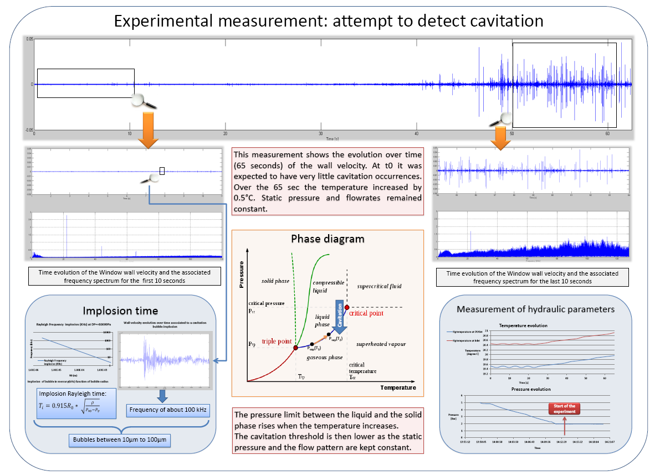
Cavitation detection
Cyril. Kharoua@esss.se / Workshop on Applications of High Intensity Proton Accelerators October 19-21, 2009 Fermi National Accelerator Laboratory, Batavia, IL, USA

Slide 28
Conclusion on the CGS design
The experiment proved the feasibility of the concept
A better and stronger design of the blades needs to be studied
This design shows some weak points: the stress level in the window is rather high and might lead to a short lifetime
Cyril. Kharoua@esss.se / Workshop on Applications of High Intensity Proton Accelerators October 19-21, 2009 Fermi National Accelerator Laboratory, Batavia, IL, USA

Slide 29
Presentation outline
The EURISOL Project
The MMW spallation target design
The baseline design with window
The innovative windowless design
Conclusion
Cyril. Kharoua@esss.se / Workshop on Applications of High Intensity Proton Accelerators October 19-21, 2009 Fermi National Accelerator Laboratory, Batavia, IL, USA

Slide 30
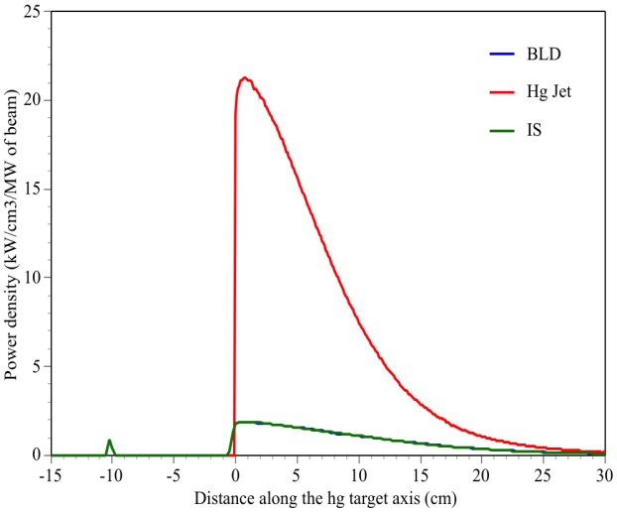
An innovative target design
The Windowless Transverse Film design (WTF)
The CGS design remain sensitive to the structural weakness linked with the window:
Thermal stresses due to the high deposition in the window
Pitting damage induced by possible cavitation
These factor can drastically reduce the window life time
Therefore it was proposed to study another type of design, so called windowless.
The objective is to have the beam interacting directly with the spallation target material by the mean of a Free surface of liquid metal.
It is also possible to design the target more compact and to reduce the beam size.
This design is called the Windowless Transverse Film design.
Initial design iteration
Cyril. Kharoua@esss.se / Workshop on Applications of High Intensity Proton Accelerators October 19-21, 2009 Fermi National Accelerator Laboratory, Batavia, IL, USA

Slide 31
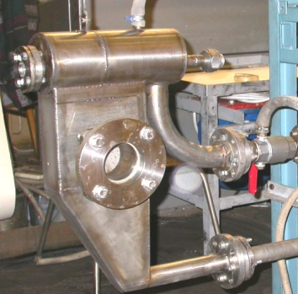
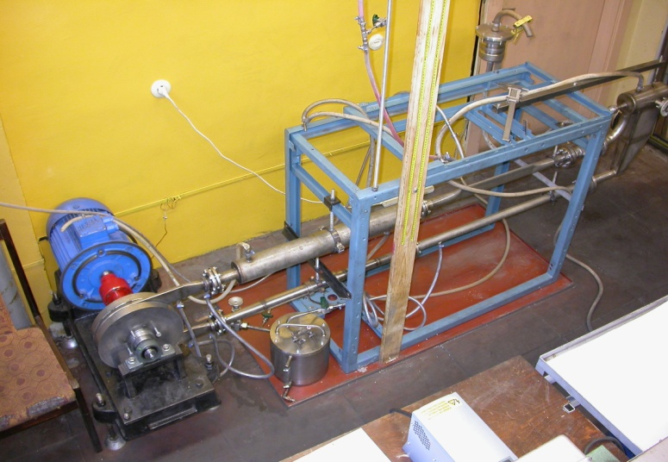
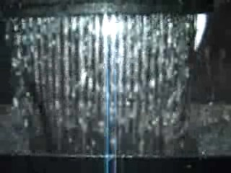
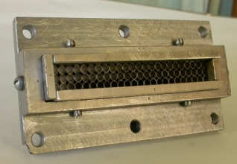
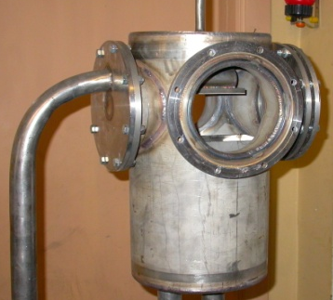
Experiments of Hg Transverse film
on InGaSn Loop : Inlet Design
Erik Platacis et al. (IPUL, Riga)
Transverse Hg film
Modules of transverse film injectors
Test chambers
InGaSn test loop of transverse film target module
a
a
b
b
P=3 bar; Q~1.5 l/s
c
c
a – with rectangular cell inner structure
b – with round cell inner structure
c – with parallel separator inner structure
Cyril. Kharoua@esss.se / Workshop on Applications of High Intensity Proton Accelerators October 19-21, 2009 Fermi National Accelerator Laboratory, Batavia, IL, USA

Slide 32
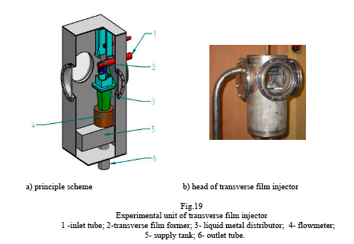
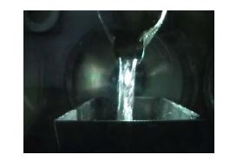
Experiments of Hg Transverse film
on InGaSn Loop : Inlet Design
Erik Platacis et al. (IPUL, Riga)
Cyril. Kharoua@esss.se / Workshop on Applications of High Intensity Proton Accelerators October 19-21, 2009 Fermi National Accelerator Laboratory, Batavia, IL, USA

Slide 33
WTF converter
CFD analysis
4cm
Largest power deposition occurs in the first 10 cm after the impact point for a 2mm σ beam:
maximum value of ~80 kW/cm³/MW of beam power at ~0.5 cm from the impact point.
Once the proton range is reached, the power densities drop sharply, to values below 500 W/cm³/MW of beam.
30cm
y
x
z
p+
40cm
Cyril. Kharoua@esss.se / Workshop on Applications of High Intensity Proton Accelerators October 19-21, 2009 Fermi National Accelerator Laboratory, Batavia, IL, USA

Slide 34
WTF converter
CFD analysis
The maximum energy deposition calculated in the target is 0.08 GeV/ cm³/proton which is equivalent to 80kW/ cm³/MW of beam.
So in the case of a 4 MW beam, the peak power density corresponds to 320kW/cm³.
Cyril. Kharoua@esss.se / Workshop on Applications of High Intensity Proton Accelerators October 19-21, 2009 Fermi National Accelerator Laboratory, Batavia, IL, USA

Slide 35
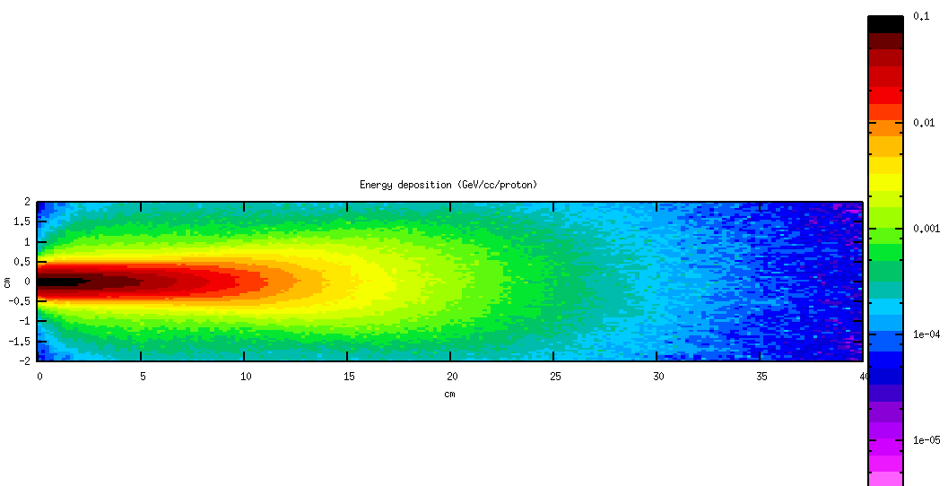
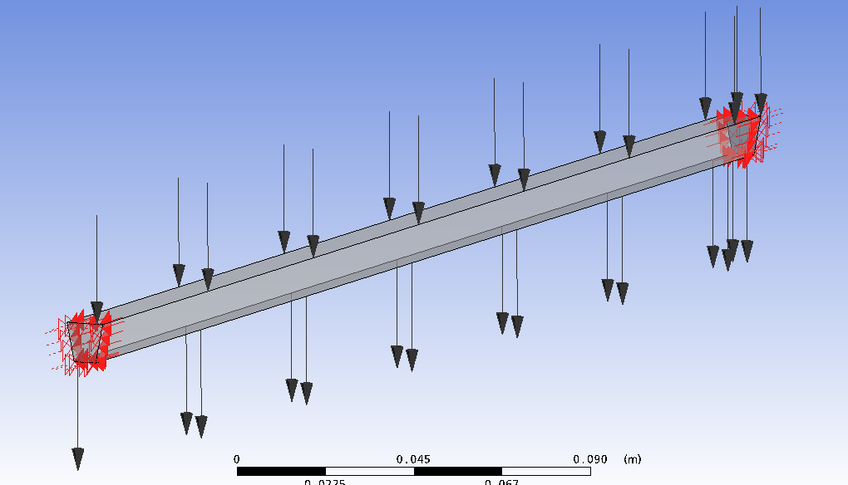
WTF converter
CFD analysis
Power density (GeV/cm³/primary) in a Hg target for a 1 GeV proton beam.
Inlet velocity
1.2cm
Temperature distribution in the Mercury flowing at 0.5m/s
Temperature distribution in the Mercury flowing at 5m/s
Need of 5m/s but not all the way along the beam
The target will be splited in 3 sections
Cyril. Kharoua@esss.se / Workshop on Applications of High Intensity Proton Accelerators October 19-21, 2009 Fermi National Accelerator Laboratory, Batavia, IL, USA

Slide 36
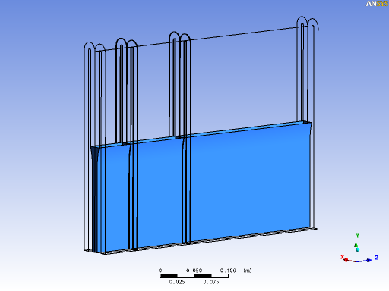
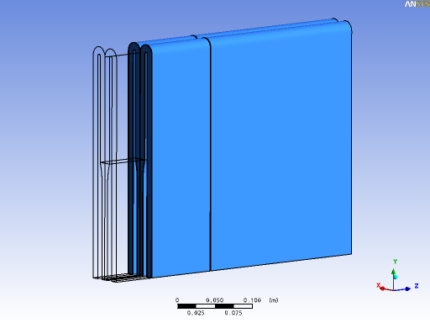
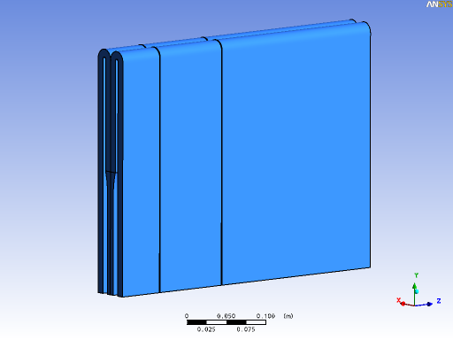
WTF converter
CFD analysis
Section2
Section3
Section1
Cyril. Kharoua@esss.se / Workshop on Applications of High Intensity Proton Accelerators October 19-21, 2009 Fermi National Accelerator Laboratory, Batavia, IL, USA

Slide 37
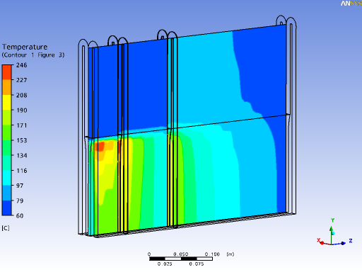
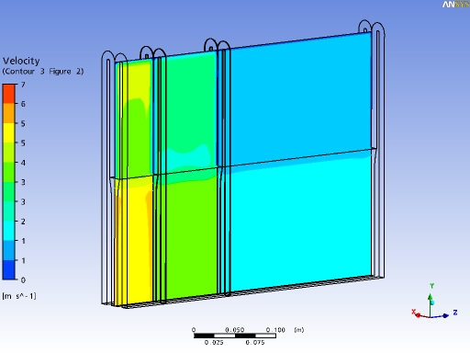
WTF converter
CFD analysis
Section2
Section3
Section1
Velocity distribution in the mercury
Temperature distribution in the mercury
Cyril. Kharoua@esss.se / Workshop on Applications of High Intensity Proton Accelerators October 19-21, 2009 Fermi National Accelerator Laboratory, Batavia, IL, USA

Slide 38
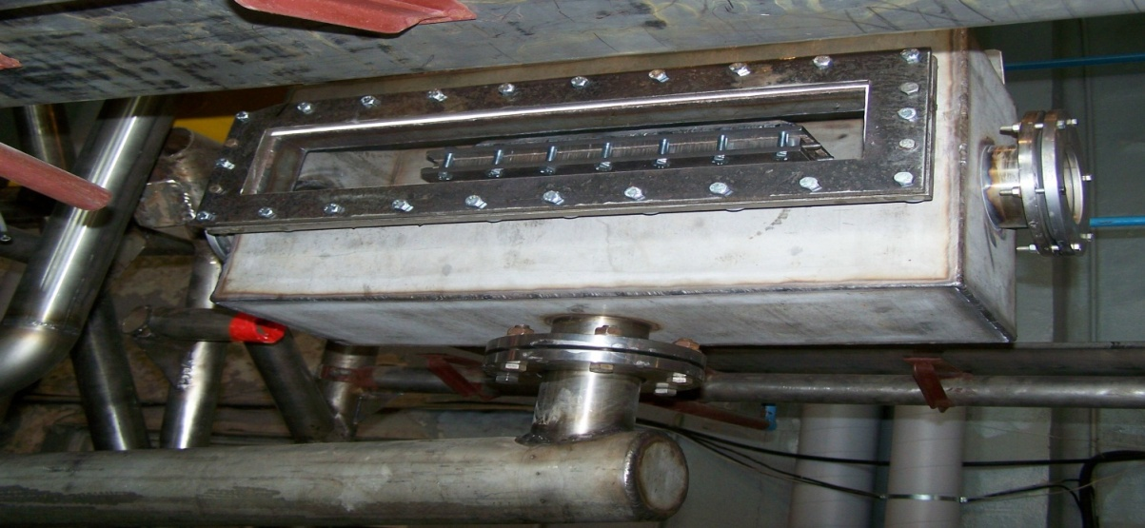
WTF converter
Experience
Section 3 with ~300mm long and 16 mm width. Flow velocity of 2.2 m/s
Movie on section 3
Collector and Nozzle test banch
Movie on section 1 and 2
Cyril. Kharoua@esss.se / Workshop on Applications of High Intensity Proton Accelerators October 19-21, 2009 Fermi National Accelerator Laboratory, Batavia, IL, USA

Slide 39
Conclusion on the WTF design
Considerable efforts were put into the design of the inlet nozzle
More efforts have to be made on:
The measurement to characterize the integrity of the “curtain”
The overall design of the target
Cyril. Kharoua@esss.se / Workshop on Applications of High Intensity Proton Accelerators October 19-21, 2009 Fermi National Accelerator Laboratory, Batavia, IL, USA

Slide 40
The MMW target station Integration
→The EURISOL MMW target is made to provide an intense flux of neutron … but the aim of the station is to produce intense Radioactive Ion Beam (RIB) though Fission
Cyril. Kharoua@esss.se / Workshop on Applications of High Intensity Proton Accelerators October 19-21, 2009 Fermi National Accelerator Laboratory, Batavia, IL, USA

Slide 41
Summary and Outlook
A conceptual lay-out of the target station with all target positions and services has been achieved
Detailed neutronic and release studies have been carried out for different combinations of moderators and fission target composition
R&D effort are still required on the target development for both design
Cyril. Kharoua@esss.se / Workshop on Applications of High Intensity Proton Accelerators October 19-21, 2009 Fermi National Accelerator Laboratory, Batavia, IL, USA

Slide 42
Thank you for your attention…
Thank you to all contributors
Cyril. Kharoua@esss.se / Workshop on Applications of High Intensity Proton Accelerators October 19-21, 2009 Fermi National Accelerator Laboratory, Batavia, IL, USA

