Slide 1
Graphite progress update
BJ Marsden and G Hall
Nuclear Graphite Research Group,
School of MACE,
The University of Manchester
28 March 2013

Slide 2
Introduction
POCO vs. “nuclear grade” graphite
  HOPG as an example
Environment = LBNE
  1 dpa
  ≤300ºC
  non-oxidising environment
Neutron c.f. proton irradiation
Continuous c.f. pulsed irradiation
Some recommendations

Slide 3
POCO vs. “nuclear grade” graphite
POCO chosen based upon
  past experience (irradiation stability)
  grain structure (isotropy)
  high strength
Similar (historical) conclusions in fission area
  used as specimen holders, restraints etc.
  manufacturing limits → restricted usage
POCO different than nuclear grades
  ultrafine grain size (1-5 µm c.f. ≥10 µm)
  fine pore structure (0.3-0.8 µm c.f. ≥8 µm)
  CTE near perfect (~8 × 10⁻⁶ K⁻¹ c.f. ~4 × 10⁻⁶ K⁻¹)

Slide 4
POCO vs. “nuclear grade” graphite
POCO is probably a sintered material
  previous differences
  no visible “binder” phase
  often no impregnation
POCO can have a lower graphitisation
temperature than standard (2800ºC) e.g.
  AXF-Q1 = 2300ºC
  ZXF-5Q = 2500ºC
  AXF-8Q1 = 2800ºC
  affects properties and irradiation behaviour
POCO AXF-8Q1
EGCR (nuclear grade)
Replica electron micrographs (Pitner, 1971)
Notes:
First letter possibly particle size (Z = 1 µm, A = 5 µm)
Third letter possibly amount of porosity (F = 20%, Z = 28%)
Don’t know what last number relates to.

Slide 5
Grade | ZXF-5Q | AXF-8Q1 | AXZ-5Q | Gilsocarbon | IG-430 | IG-110
Comment | candidate | historical experience (fission) | historical experience (fission) | historical experience (fission) | historical experience (fission) & similar to IG-43 | historical experience (fission)
Particle size (µm) | 1 | 5 | 5 | 500 | 10 | 20
Pore size (µm) | 0.3 | (0.3) | 0.7 | 42 | - | 16
Density (g/cm³) | 1.78 | 1.80 | 1.66 | 1.81 | 1.82 | 1.77
Total porosity (% volume) | 20 | (20) | 28 | 20 | 19 | 21
Open porosity (% of total) | 80 | (80) | 90 | 55 | 65 | 58
Graphitisation temperature (ºC) | 2500 | 2800 | 2500 | ≥2800 | ≥2800 | ≥2800
Notes:
The 0 in IG-430 means it has been purified.

Slide 6
Dimensional change
AXF-8Q1
400 to 700ºC
  data on POCO grades
  negligible dimensional changes
  little data
  nuclear grades shrink within
  this range
≤300ºC
  no data on POCO grades
  expect dimensional changes
  to be greater
    possibly significant
  lower temperature = greater the
  rate of change
~1 dpa
AXZ-5Q1
~1 dpa
Dimensional changes
(Pitner, 1971)

Slide 7
Dimensional change
~1 dpa
~1 dpa
decreasing temperature
decreasing temperature
against grain (AG)
with grain (WG)
Dimensional changes of Pile Grade A (PGA) graphite

Slide 8
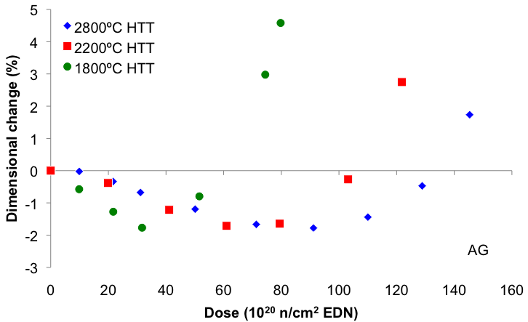
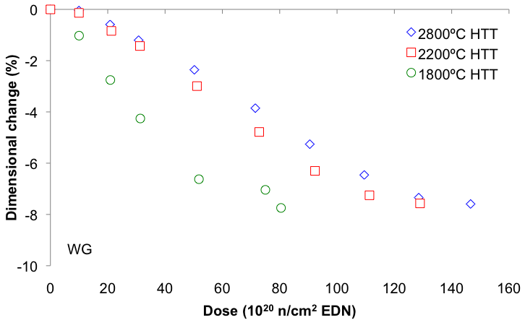
Dimensional change
Decrease in graphitisation
temperature = increase in
dimensional change rate
  at 1 dpa difference between
  2500ºC and 2800ºC is likely
  to be negligible
PGA graphitised to various temperatures
and irradiated at 600ºC
(Brocklehurst and Kelly, 1993)

Slide 9
Dimensional change
Dimensional change under load
  dimensional changes different due to irradiation creep
    reduces stresses in graphite components
  target under initial compressive load
    shrinkage increases
    when already shrinking
    (≥300ºC)
    assume expansion
    decreases when already
    expanding (<300ºC)
  complex interaction in target
    fluence distribution
    temperature distribution
    boundary conditions
Target for LBNE

Slide 10
Dimensional change
Recommendations
  keep graphite at higher temperatures (~300ºC)
  graphitisation at 2500ºC should be ok
  conduct stress analysis of target
    realistic fluence and temperature distributions
Additional recommendation
  conduct experiments on POCO at temperatures of interest

Slide 11
Helium production
Usually not considered in fission
  negligible helium production
  exception when graphite was doped with ¹⁰B
When helium production is not negligible
  highly oriented pyrolytic graphite
  (HOPG) experiences increased
  dimensional changes and
  exfoliation/delamination/flaking
  of layers
    helium trapped in cavities
HOPG doped with ¹⁰B and
irradiated 650ºC
(Kelly and Mayer, 1969)

Slide 12
Helium production
When helium production is not negligible
  POCO and nuclear grade graphites
  have significant amounts of open porosity
    some helium can escape
    remainder could influence dimensional changes
      helium effect secondary to
      effect of boron on nucleation of
      interstitial loops
Recommendation
  conduct further investigations
  and/or scoping calculations to
  determine relevance
Dimensional changes of boronised graphite irradiated to 0.13 dpa at 300ºC
(Maruyama and Harayama, 1992)

Slide 13
Thermal conductivity
~1 dpa
Rapid reduction in thermal
conductivity with fluence
  rate of decrease increases
  with decreasing temperature
~1 dpa
decreasing temperature
Thermal conductivity of various irradiated graphites
(Moore et al., 1973)
Thermal conductivity of PGA irradiated at various temperatures
(Birch and Brocklehurst, 1987)

