Slide 1
Graphite progress update
BJ Marsden and G Hall
Nuclear Graphite Research Group, School of MACE, The University of Manchester
22 July 2013

Slide 2
Thermal shock
Graphite has good thermal shock resistance (R)
use as crucibles, moulds, dies, and electrodes
Unirradiated (calculated)
POCO ZXF-5Q ≈ 47 kW/m
Toyo Tanso IG-430 ≈ 112 kW/m
Reduces with irradiation
Reduces with oxidation
Notes:
ZXF-5Q average due to low thermal conductivity, high Young’s modulus, and high CTE. None of POCO grades examined have an above average resistance.
IG-430 good due to high thermal conductivity, lower CTE, and lower Young’s modulus.
Limited experimental data

Slide 3
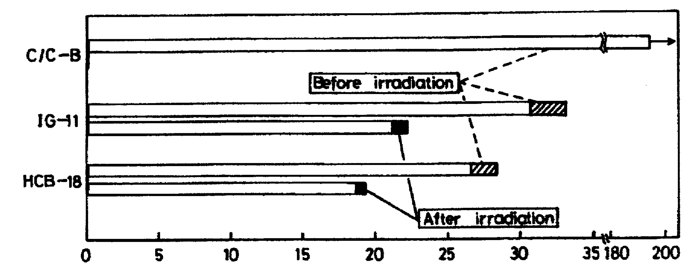
Thermal shock
Thermal shock resistance of graphites before and after irradiation to 16-17 × 10²⁰ n/cm² (>0.18 MeV) at 600-850ºC (Sato et al., 1980)
ln(R/R₀)
R (kW/m)
Thermal shock resistance of graphites before and after irradiation to 11-15 × 10²⁰ n/cm² (>0.18 MeV) at 750-1000ºC (Sato et al., 1989)
Weight loss (%)
Thermal shock resistance of oxidised IG-430 graphite (Kurumada et al., 1997)

Slide 4
Summary
LBNE
POCO ZXF-5Q, 1 dpa, ≤300ºC, no oxidation
T2K
Toyo Tanso IG-430, 1 dpa, 700 to 800ºC, ~8% oxidation
No ‘show stoppers’ found
no obvious better choice of grade
recommend (scoping) thermo-mechanical analyses
irradiation-induced dimensional and materials properties changes
oxidation
recommend further calculations (or experiments) on thermal shock resistance
Notes:
POCO good choice for LBNE as reduced dimensional changes useful as running at lower temperatures.
However, thermal shock resistance not particularly high
IG-430 good choice for T2K as should have a higher thermal shock resistance and POCO experience DCs at these temperatures.

