Slide 1
The 325 MHz Solution
David Neuffer
Fermilab
January 15, 2013

Slide 2
Outline
Front End for the IDS Neutrino Factory
  Basis for engineering/costs
    Rf, requirements
    Engineering required
  Redesign for 325 MHz
    ??
rf gradient/ B concerns
  Transit Time Factor
  Pill-box radius

Slide 3
Front End rf
μCol-νFact Front End was matched to 201.25 MHz
  matched to Fermilab Linac
  Cooling at 200, 400, 600, 800 …MHz
Project X is matched to 1300 MHz (ILC)
  match to 650 /325/ 162.5…
    433, 216.67, …
  match to 162.5 or 216.7 is similar to 201.25
Match to 325 MHz is not as straightforward
  requires ~500 → 325 MHz rf in Buncher /Rotator
  apertures are more restricted

Slide 4
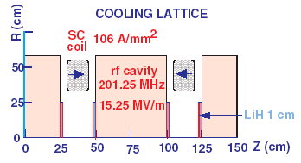
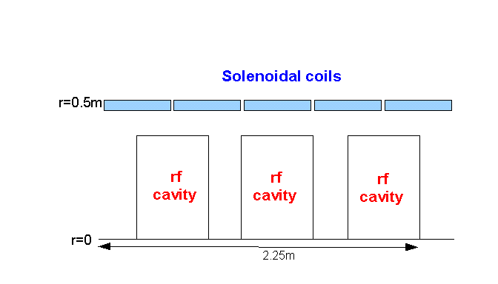
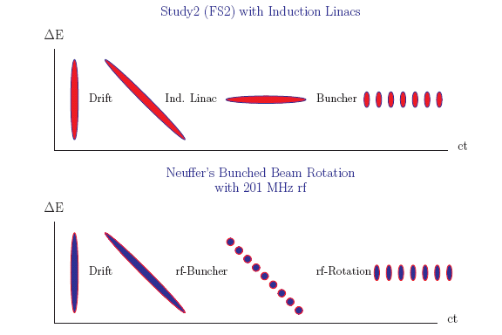
IDS Baseline Buncher and φ-E Rotator
Drift (π→μ)
“Adiabatically” bunch beam first (weak 320 to 232 MHz rf)
Φ-E rotate bunches – align bunches to ~equal energies
  232 to 202 MHz, 12MV/m
Cool beam 201.25MHz
p
π→μ
FE Target
Solenoid
Drift
Buncher
Rotator
Cooler
18.9 m
~60.7 m
~33m
42 m
~80 m

Slide 5
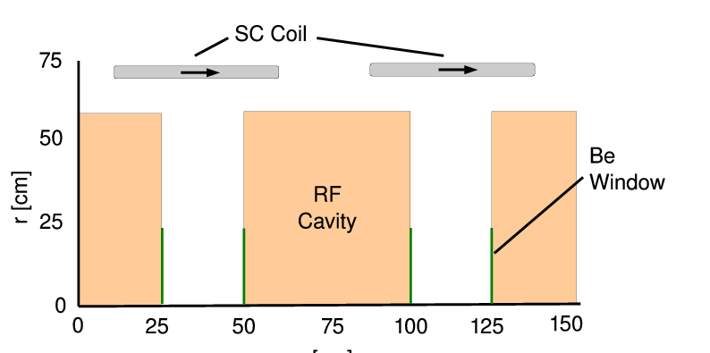
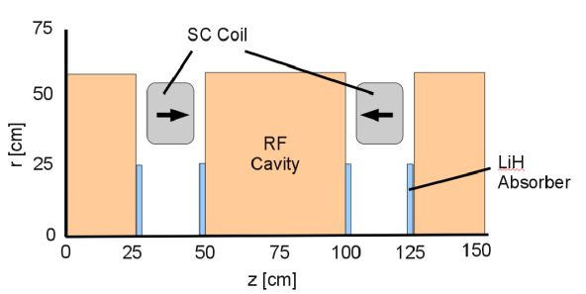
Rf Buncher/Rotator/Cooler requirements
Buncher
  37 cavities (13 frequencies)
  13 power supplies (~1—3MW)
RF Rotator
  56 cavities (15 frequencies)
  12 MV/m, 0.5m
  ~2.5MW (peak power) per cavity
Cooling System – 201.25 MHz
  100 0.5m cavities (75m cooler), 15MV/m
  ~4MW /cavity – most expensive item
Front End section | Length | #rf cavities | frequencies | # of freq. | rf gradient | rf peak power requirements
Buncher | 33m | 37 | 319.6 to 233.6 | 13 | 4 to 8 | ~1 to 3.5 MW/freq.
Rotator | 42m | 56 | 230.2 to 202.3 | 15 | 12.5 | ~2.5MW/cavity
Cooler | 75m | 100 | 201.25MHz | 1 | 16 MV/m | ~4MW/cavity
Total | ~240m | 193 |  | 29 | ~1000MV | ~550MW 400MW from cooling

Slide 6
rf constraints
Transit time factor
  T = 0.8 (200MHz,0.5m)
  0.52 (325MHz,0.5m)
  0.21 (450 MHz,0.5m)
  0.75(450 MHz,0.25m)
    must use shorter rf cavities
Pillbox radius:
  r₀= 0.38 m at 300 MHz
  r₀= 0.255 m at 450 MHz
g =0.25m
g =0.50m
J₀(2.405x)

Slide 7
Components of 325MHz System
Drift
  20T→ 2T
Buncher
  P_{o}=250MeV/c
  P_{N}=154 MeV/c; N=12
  V_{rf} : 0→ 15 MV/m
    (2/3 occupied)
  f_{RF} : 550→ 371MHz
Rotator
  V_{rf} : 20MV/m
    (2/3 occupied)
  f_{RF} : 370→ 326MHz
  N=12.05
  P_{0,} P_{N}→245 MeV/c
Cooler
  325 MHz
  25 MV/m
  2 1.5 cm LiH absorbers
  /0.75m

Slide 8
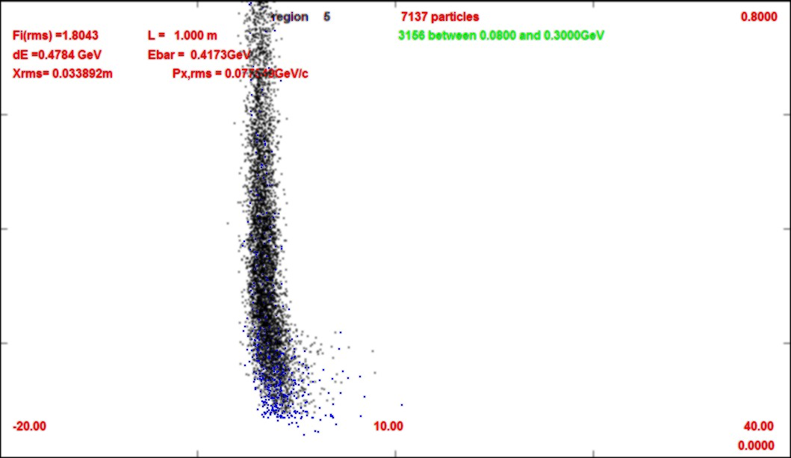
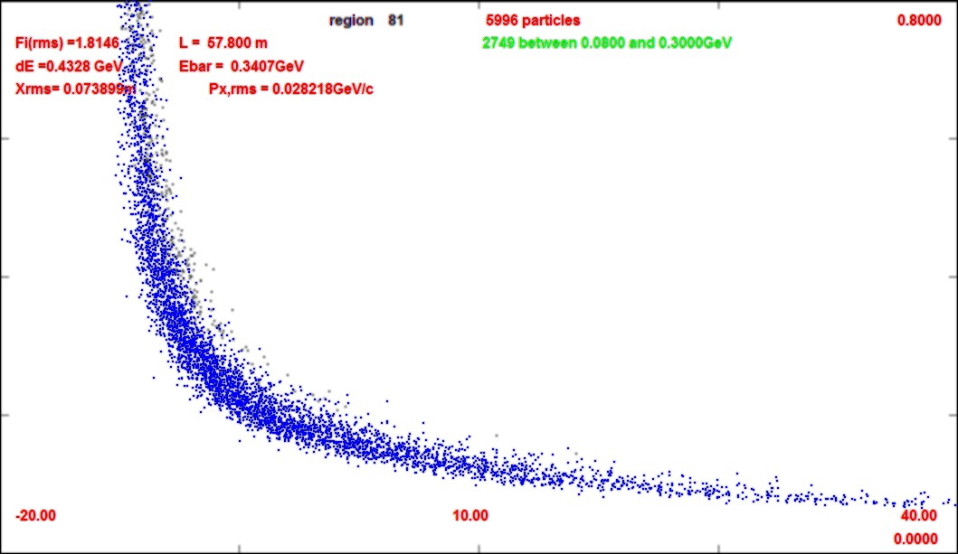
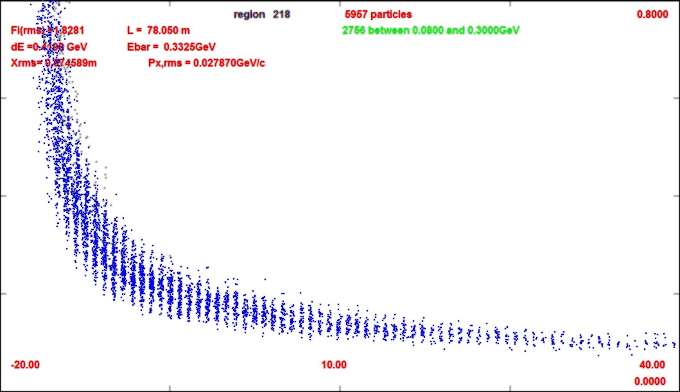
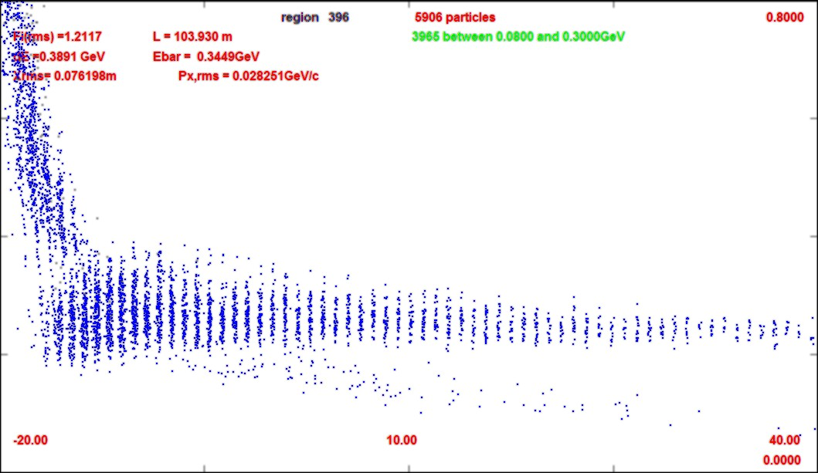
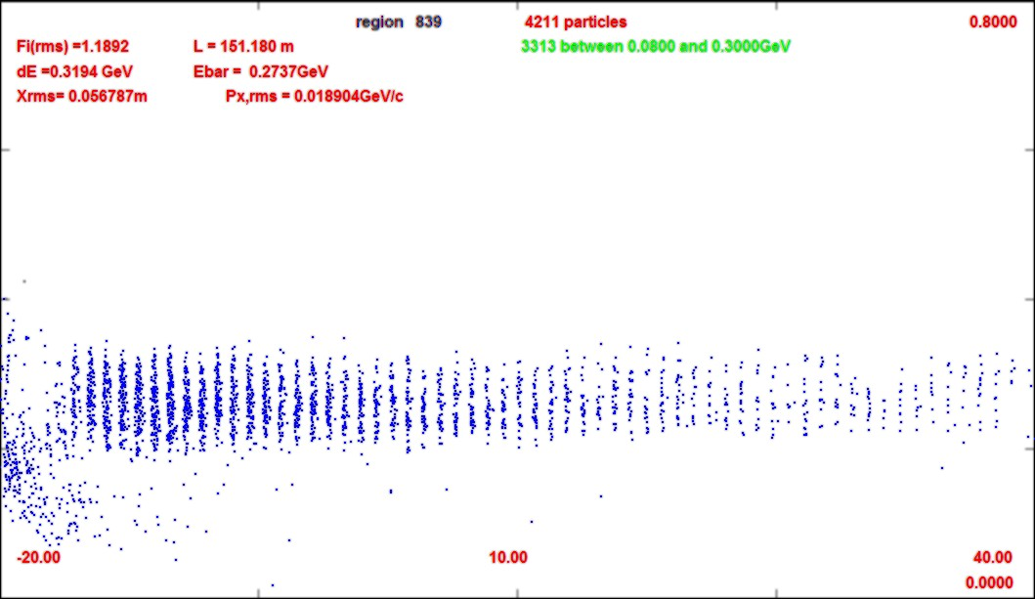
Propagation through the transport
0.8 GeV/c
Z=1m
0.0 GeV/c
Z=58m
0.8 GeV/c
Z=78m
0.0 GeV/c
Z=104m
0.8 GeV/c
Z=151m
-20m
-40m
0.0 GeV/c

Slide 9
Variant 325MHz System
Drift
  20T→ 2T
Buncher
  P_{o}=250MeV/c
  P_{N}=154 MeV/c; N=12
  V_{rf} : 0→ 15 MV/m
    (2/3 occupied)
  f_{RF} : 490→ 365MHz
Rotator
  V_{rf} : 20MV/m
    (2/3 occupied)
  f_{RF} : 364→ 326MHz
  N=12.045
  P_{0,} P_{N}→245 MeV/c
Cooler
  325 MHz
  25 MV/m
  2 1.5 cm LiH absorbers
  /0.75m

Slide 10
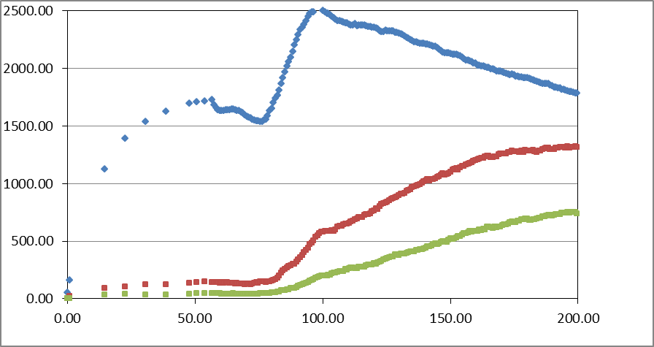
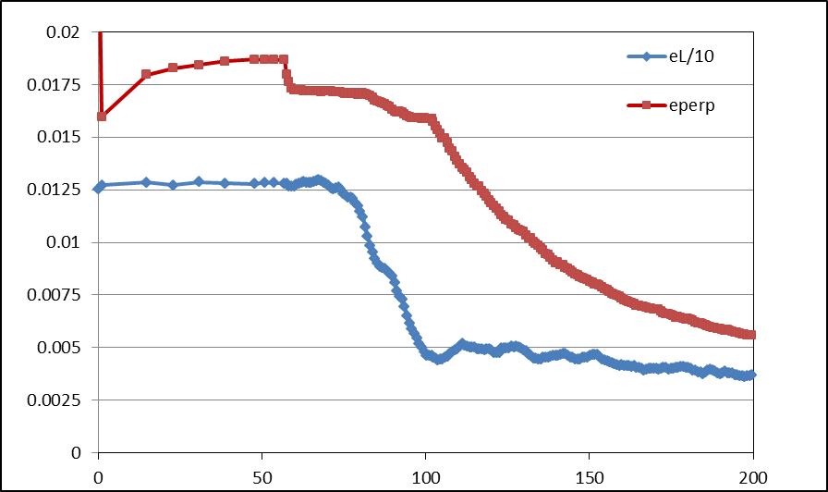
Simulation Results
Simulation obtains
  ~0.125 μ/p within acceptances
  with ~60m Cooler
  shorter than baseline
But
  uses higher gradient
  325 MHz – less power
N :0.15<P<0.35 MeV/c
N: ε_{T}<0.03; A_{L}<0.2
N: ε_{T}<0.015; A_{L}<0.2

Slide 11
Variations
Gradient is a bit higher than IDS baseline or initial Muon Collider version
  15/20/25 MV/m → 0.125 μ/p
  12.5/18/22.5 → 0.115
  12/16/20 MV/m → 0.102
  12/15/18 MV/m → 0.095
Apertures are smaller
  Use higher field transport to make beam smaller?
  2T → 3T ? (with stronger focusing making the beam smaller
    first try had similar to baseline (not much better…)

Slide 12
Summary
325 Mhz Front End Possible
  similar capture to baseline
  shorter system
Needs higher gradient rf and a bit stronger transverse focusing

Slide 13

Answers to Questions

