Slide 1
Neutrino Factory Front End (IDS)
Chicane update
David Neuffer
February 12, 2013

Slide 2
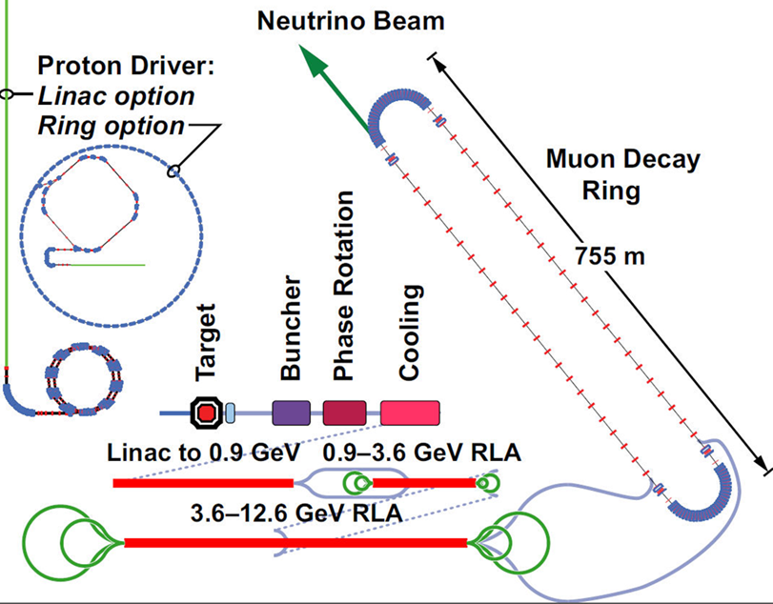
Outline
Front End for the IDS Neutrino Factory
  Losses – control
    Chicane, proton absorber
    rematching OK
Re-Match includes chicane + absorber
  similar to baseline
    less background beam
Discretized rf version
  New today
  fewer rf frequencies

Slide 3
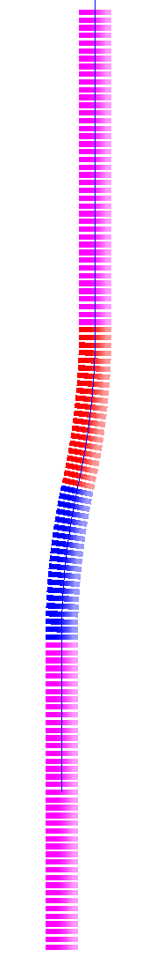
Add chicane and absorber
ICOOL version
  2 Bent Solenoids – 10m
  5m, 1.5T, 12.5º,0.27GeV/c
  5m, 1.5T, -12.5º ,0.27GeV/c
    bend radius is 22.92m (1/r=0.043636)
    B_{y}=0
Be Absorber – 10cm thick
ICOOL BSOL element:
π⁻, μ⁻
π⁺, μ⁺
proton
absorber
bend
back
p, π⁻, μ⁻
π⁺, μ⁺
bend
out
SREGION ! bentsol
5.0 1 1e-2
1 0. 1.0
BSOL
1 1.5 0.0 1 0.27 0.0 0.043636 0.0 0.0 0.0 0. 0. 0. 0. 0.
VAC
NONE
0. 0. 0. 0. 0. 0. 0. 0. 0. 0.
field
taper
target
station

Slide 4
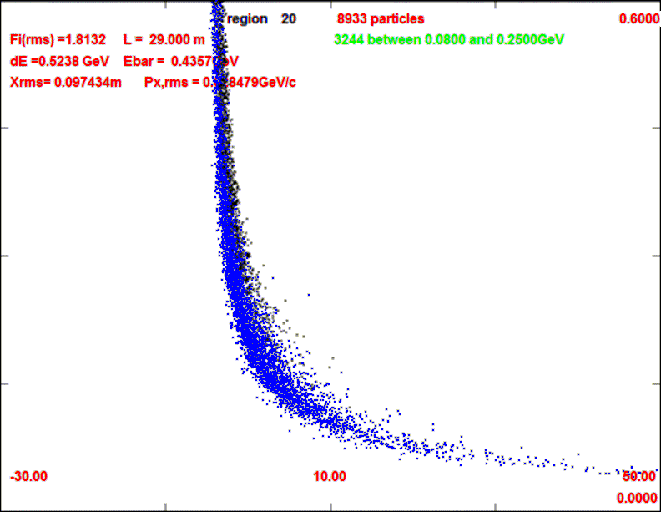
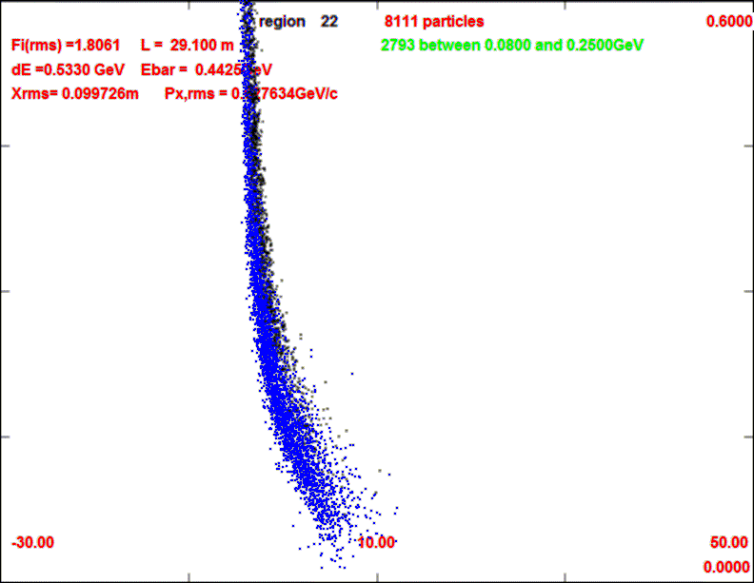
Front End with Absorber-Rematch
p
π →μ
FE Target
Solenoid
Drift
Buncher
Rotator
Cooler
18.9 m
10.1 m
0.1 m Be
~40.8m
~33m
36 m
up to 100m
with absorber
    particle 1-270 MeV/c
    particle 2-185 MeV/c
  absorber at 29m
    10cm Be
    particle 1-237 MeV/c
    particle 2-144 MeV/c
  Bunch N=10
  Rotate N=10.045
  Cool -201.25MHz
    p_{ref}=230 MeV/c
29m
29.1m

Slide 5
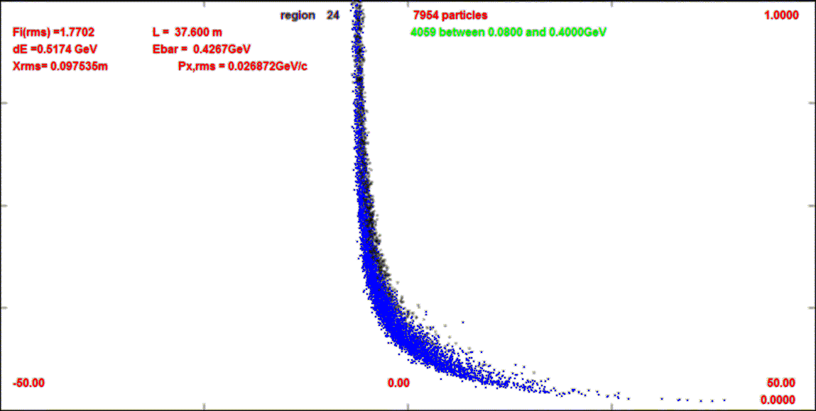
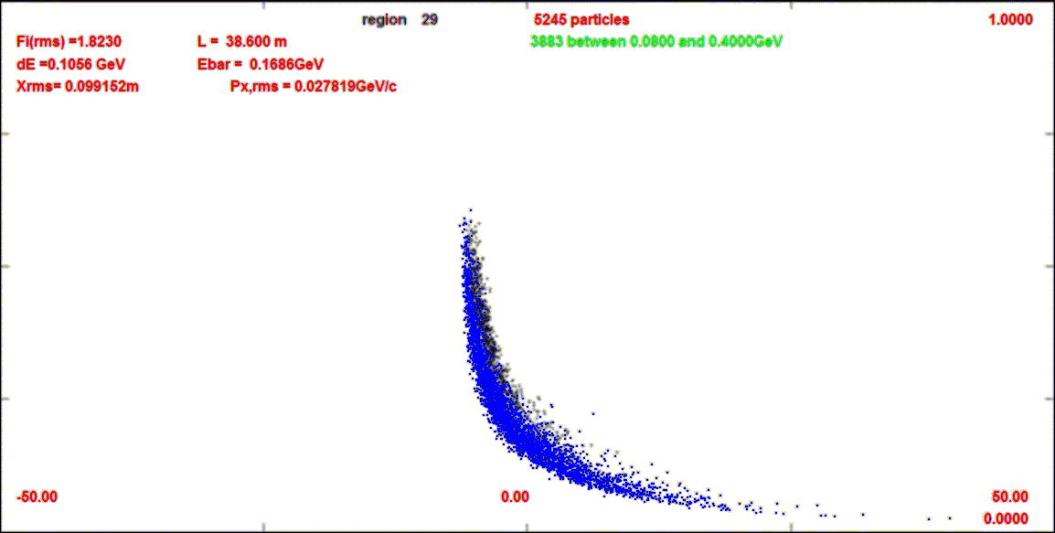
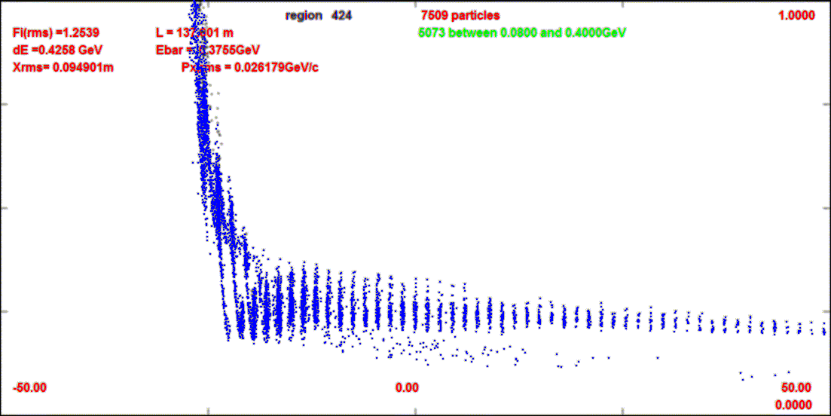
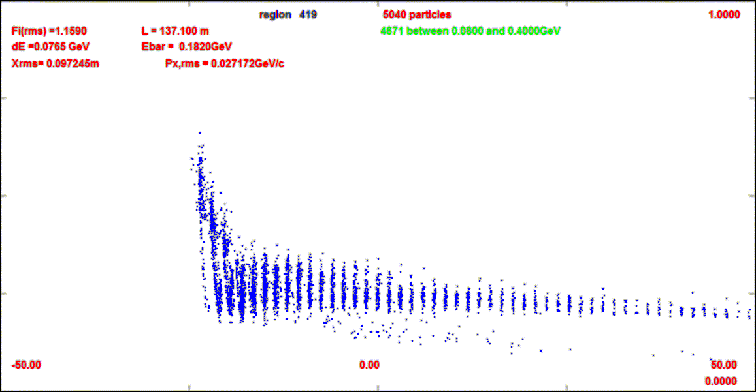
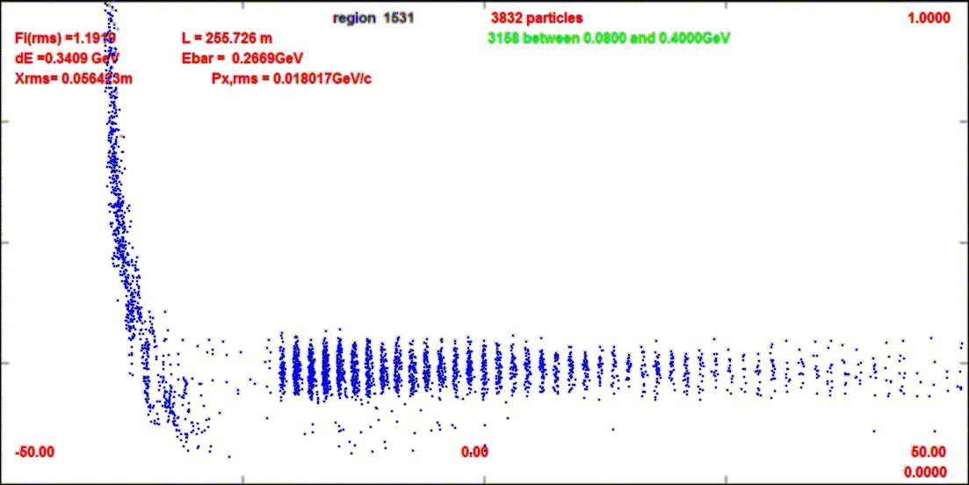
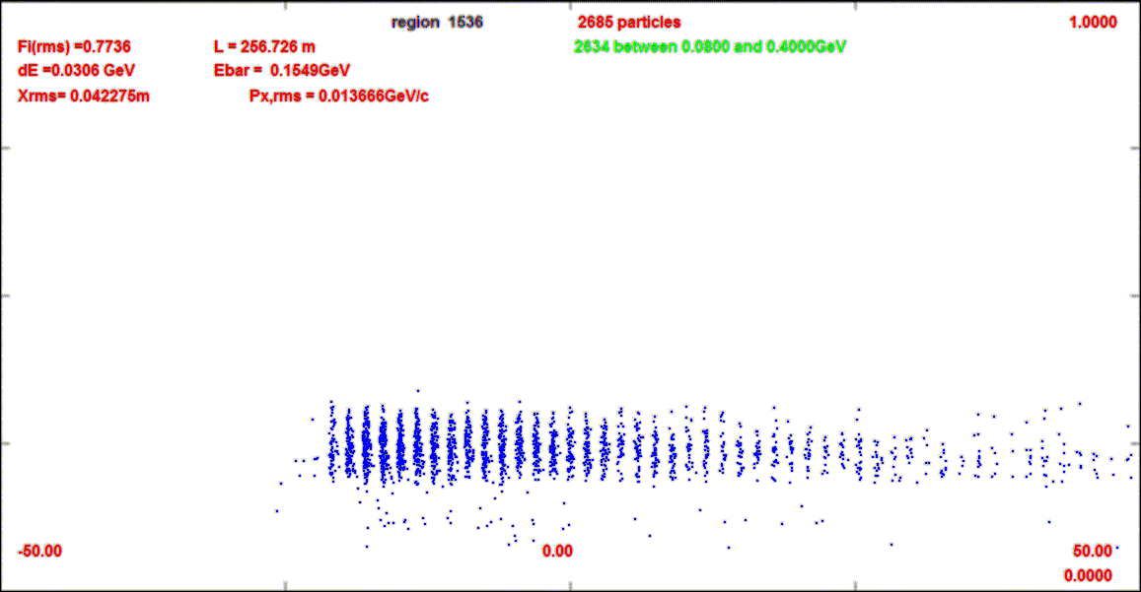
Compare-absorber vs absorber+chicane
This compares absorber only (10cm Be) to chicane (BSOL) + absorber
1.0 GeV/c
z=38m
z=38m
0
z=137m
z=137m
z=255m
z=255m

Slide 6
ICOOL Simulation results
Similar to without absorber
  ~10m shorter drift
  ~10% fewer μ’s within acceptance
  drop of ~20% intensity at absorber
  but longitudinal emittance also reduced
    surviving μ’s are stretched in longitudinal phase space
To do
  include chicane + absorber
  establish beam loss improvement – μ loss level
  decide optimal configuration
0.2
μ⁻/p (0.15<P<0.35l)
0.1
μ⁻/p
(ε_{L}<0.2, ε_{t}<0.03)
0
ε_{L}/10
ε_{t}

Slide 7
Discretization Exercise
Reduce number of frequencies to make implementation more “practical”
Buncher is 33m (44 rf cavities)
  reduce to 14 frequencies
  358.92, 341.02,328.73, 317.27,306.63,
  296.65, 287.31, 278.53, 270.28, 262.50,
  255.16, 248.21, 241.63, 235.40
Rotator is 36m (48 rf cavities)
  reduce to 18 frequencies
  231.55, 228.01, 224.87, 222.06, 219.60, 217.31, 214,82, 212.26, 210.10, 208.27, 206.75, 205.49, 204.47, 203.65, 203.03, 202.57, 202.28, 202.13
Performance slightly reduced
  more sensitive to rotator discretion
μ/p (10000p)

Slide 8
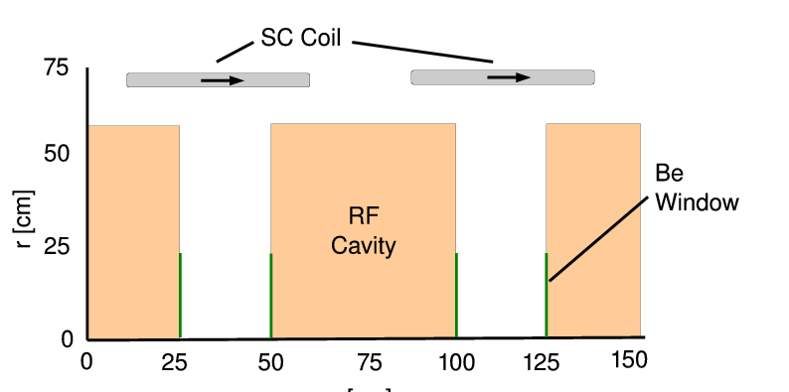
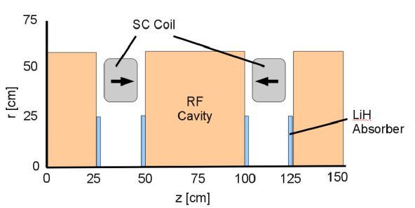
Rf Buncher/Rotator/Cooler requirements
Buncher
  44 cavities (14 frequencies)
  13 power supplies (~1—3MW)
RF Rotator
  48 cavities (18 frequencies)
  13 MV/m, 0.5m
  ~2.5MW (peak power) per cavity
Cooling System – 201.25 MHz
  100 0.5m cavities (75m cooler), 16MV/m
  ~4MW /cavity – most expensive item
Front End section | Length | #rf cavities | frequencies | # of freq. | rf gradient | rf peak power requirements
Buncher | 33m | 44 | 358.9 to 235.4 | 14 | 0 to 12 | ~1 to 6 MW/freq.
Rotator | 36m | 48 | 231.5 to 202.1 | 18 | 13 | ~2.5MW/cavity
Cooler | 75m | 100 | 201.25MHz | 1 | 16 MV/m | ~4MW/cavity
Total | ~240m | 192 |  | 33 | ~1000MV | ~550MW 400MW from cooling

Slide 9
Summary
Neutrino Factory Front End:
  Discretized version of front end + Chicane/absorber presented
  201.25 MHz version

Slide 10
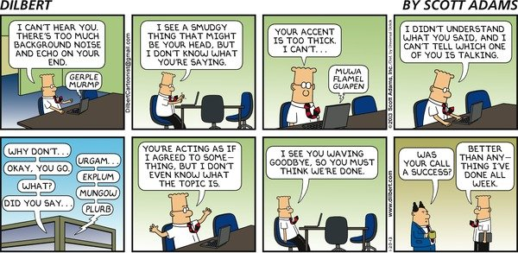
Phone meetings …

