Slide 1
Neutrino Factory Front End (IDS)
-chicane & absorber
David Neuffer
C. Rogers, P. Snopok, C. Yoshikawa, …
2012

Slide 2
Outline
Front End for the IDS Neutrino Factory
  Basis for engineering/costs
    Rf, requirements
    Engineering required
Losses – control
    Chicane, proton absorber
    rematching OK
rf gradient/ B concerns
  alternatives
    gas-filled rf/insulated rf/low-B/bucked coil
  gas-filled rf results ?

Slide 3
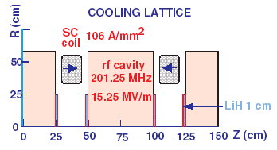
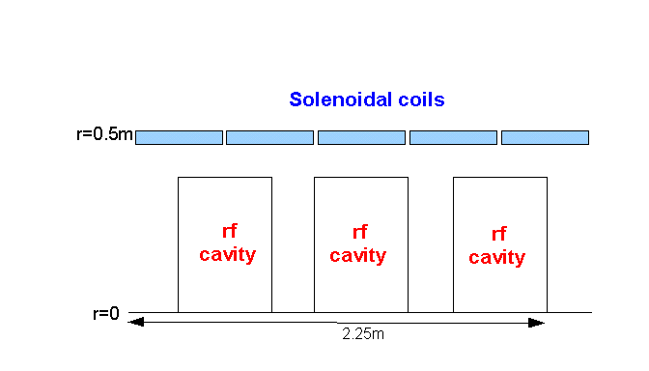
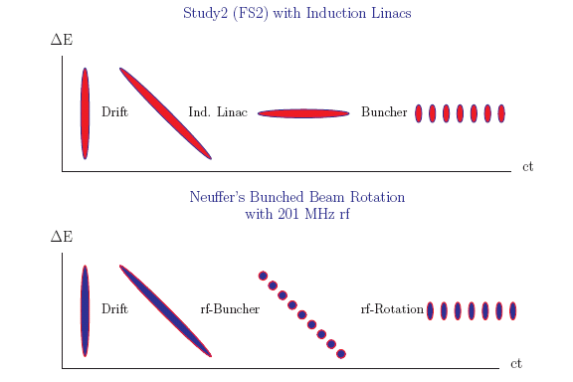
IDS Baseline Buncher and φ-E Rotator
Drift (π→μ)
“Adiabatically” bunch beam first (weak 320 to 232 MHz rf)
Φ-E rotate bunches – align bunches to ~equal energies
  232 to 202 MHz, 12MV/m
Cool beam 201.25MHz
p
π→μ
FE Target
Solenoid
Drift
Buncher
Rotator
Cooler
18.9 m
~60.7 m
~33m
42 m
~80 m

Slide 4
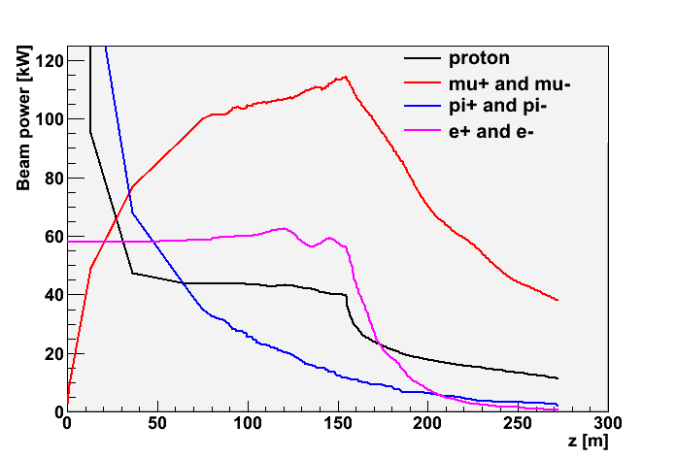
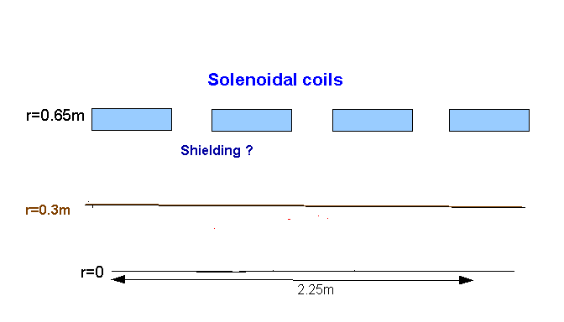
Problem: Beam losses along Front End
Start with 4MW protons
  End with ~50kW μ⁺ + μ⁻
    plus p, e, π, …
    ~20W/m μ-decay
  ~0.5MW losses along transport
    >0.1MW at z>50m
Want “Hands-on” maintenance
  hadronic losses < 1W/m
    Booster, PSR criteria
  Simulation has >~100W/m
    With no collimation, shielding, absorber strategy
Drift
Cool
p
π→μ
FE Target
Solenoid
Drift
Buncher
Rotator
Cooler
12.7 m
~60.0 m
~33m
42 m
~90 m
Shielding ?

Slide 5
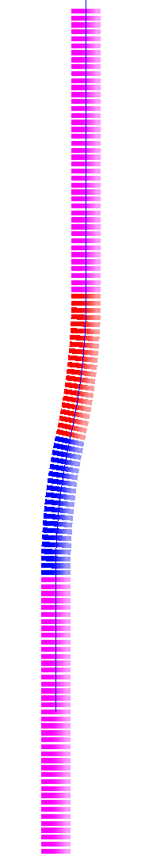
Design Concept
Bent solenoid chicane induces vertical dispersion in beam
  bend out – 5m, 12.5°
  Single chicane will contain both signs
    Opposite signs have dispersion in opposite sense
  Little disruption to the actual beam
  High momentum particles scrape
Subsequent proton absorber to remove low momentum protons
  Non-relativistic protons don't have much energy, even for relatively
  large momenta
  (~10cm Be)
π⁻, μ⁻
π⁺, μ⁺
proton
absorber
bend
back
p, π⁻, μ⁻
π⁺, μ⁺
bend
out
field
taper
target
station

Slide 6
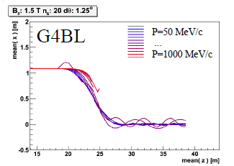
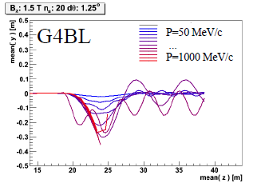
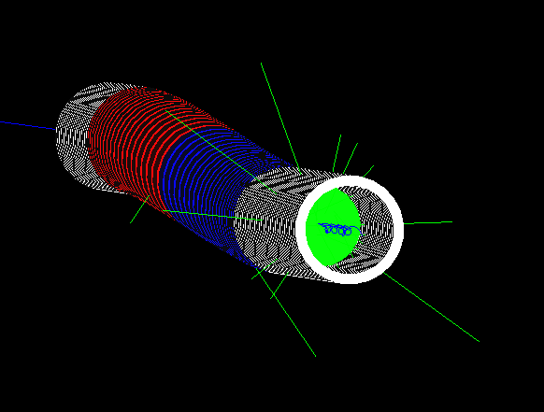
Chicane + absorber
Chicane effect:
  P > ~500MeV/c are lost
  P < ~500MeV pass through
    displaced by ~1.1m
  Nominal Path length increased by only 8cm
    orbits perturbed
absorber effect
  removes low energy particles
    designed to remove protons
  distorts energy distribution
    energy phase-rotation distorted; must be rematched

Slide 7
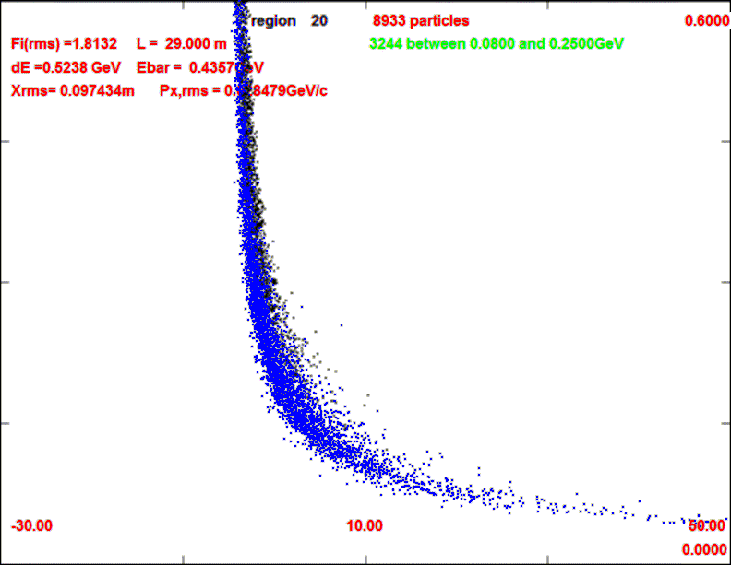
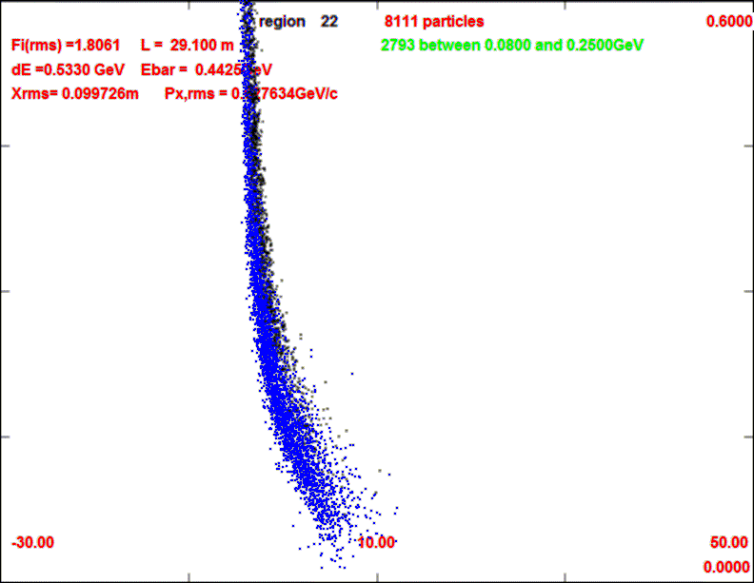
Front End with Absorber-Rematch
p
π →μ
Chicane
here
FE Target
Solenoid
Drift
Buncher
Rotator
Cooler
18.9 m
10.1 m
0.1 m Be
~39.5m
~33m
42 m
~80 m
with absorber
    particle 1-270 MeV/c
    particle 2-185 MeV/c
  absorber at 29m
    10cm Be
    particle 1-237 MeV/c
    particle 2-144 MeV/c
  Bunch N=10
  Rotate N=10.04
  Cool -201.25MHz
    p_{ref}=230 MeV/c
29m
29.1m

Slide 8
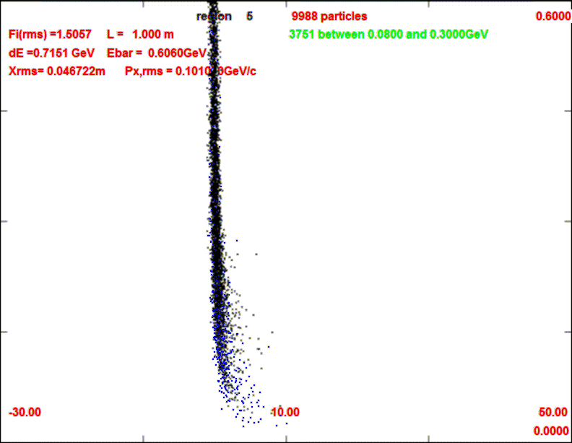
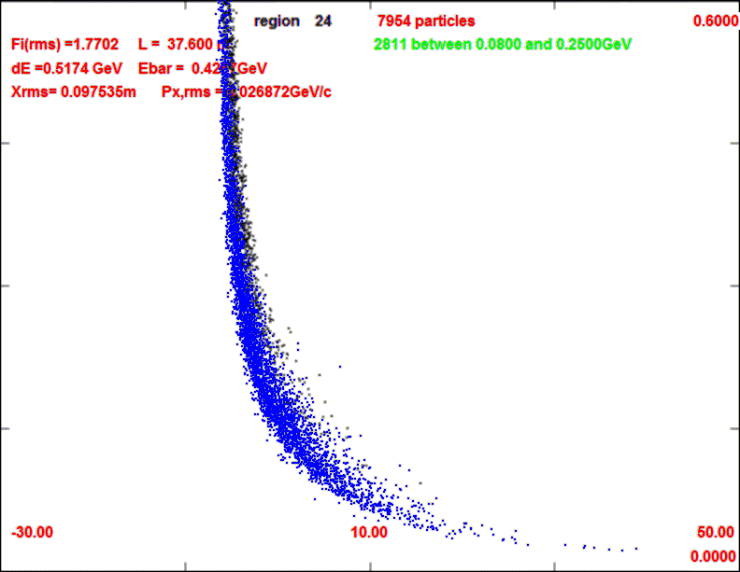
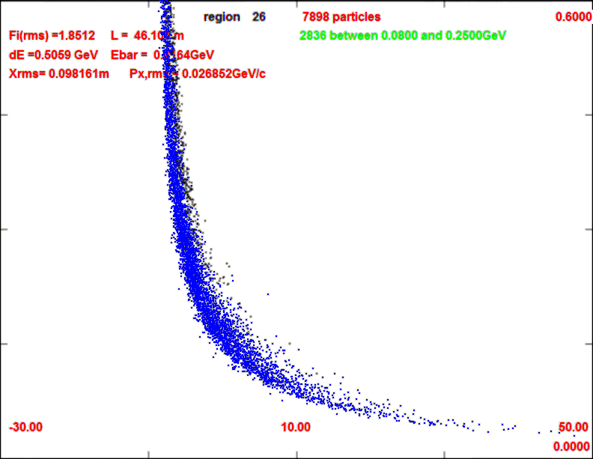
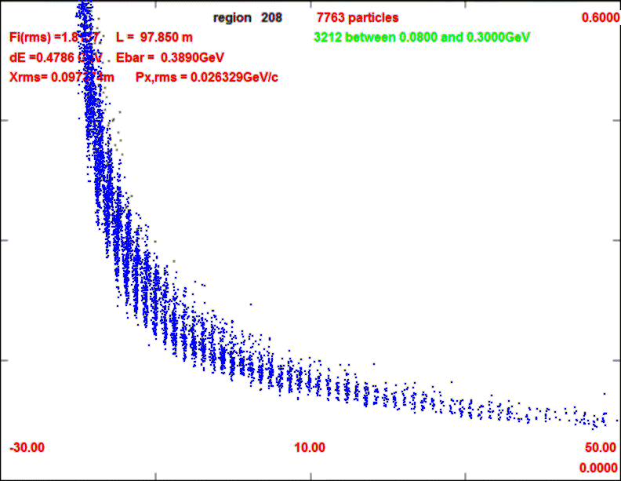
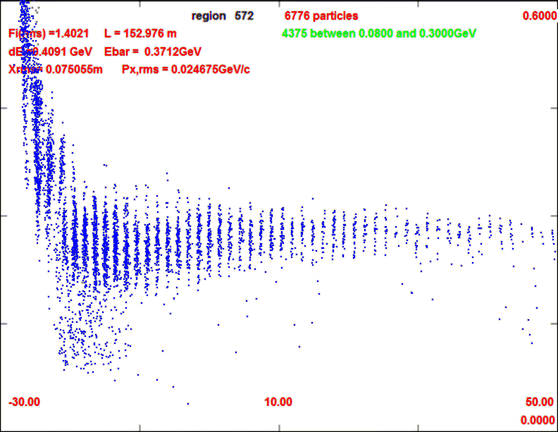
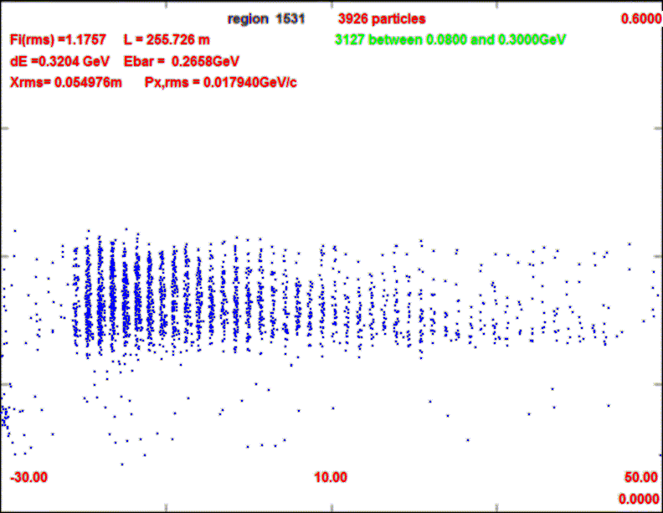
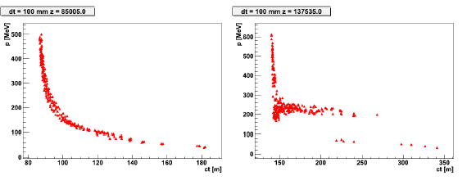
Longitudinal beam through system
ICOOL
0.1m Be absorber
29m
38m
1m
29.1m
46m
98m
152m
252m
G4BL

Slide 9
ICOOL Simulation results
Similar to without absorber
  ~10m shorter drift
  ~10% fewer μ’s within acceptance
  drop of ~20% intensity at absorber
  but longitudinal emittance also reduced
    surviving μ’s are stretched in longitudinal phase space
To do
  include chicane + absorber
  establish beam loss improvement – μ loss level
  decide optimal configuration
0.2
μ⁻/p (all)
0.1
μ⁻/p
(ε_{L}<0.2, ε_{t}<0.03)
0
ε_{L}/10
ε_{t}

Slide 10
Add chicane to absorber
Try in ICOOL
  2 Bent Solenoids – 10m
  5m, 1.5T, 12.5º,0.27GeV/c
  5m, 1.5T, -12.5º ,0.27GeV/c
    bend radius is 22.92m (1/r=0.043636)
    B_{y}=0
Match to channel
  add 1m drift
ICOOL BSOL element:
π⁻, μ⁻
π⁺, μ⁺
proton
absorber
bend
back
p, π⁻, μ⁻
π⁺, μ⁺
bend
out
SREGION ! bentsol
5.0 1 1e-2
1 0. 1.0
BSOL
1 1.5 0.0 1 0.27 0.0 0.043636 0.0 0.0 0.0 0. 0. 0. 0. 0.
VAC
NONE
0. 0. 0. 0. 0. 0. 0. 0. 0. 0.
field
taper
target
station

Slide 11
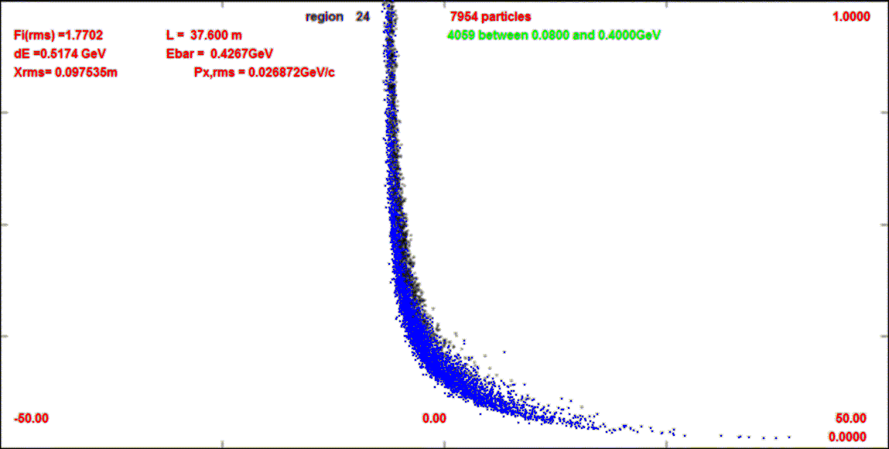
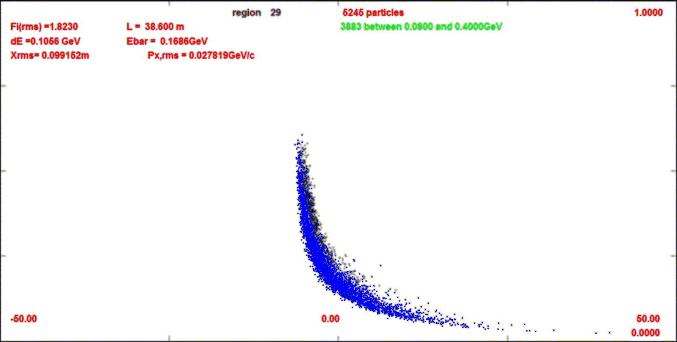
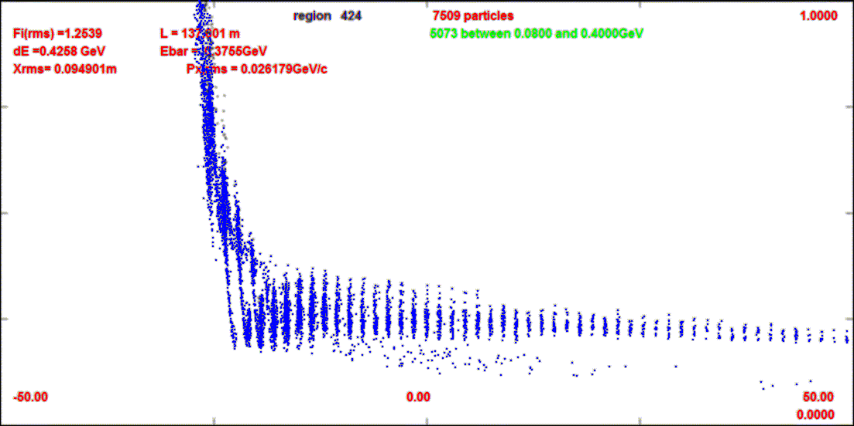
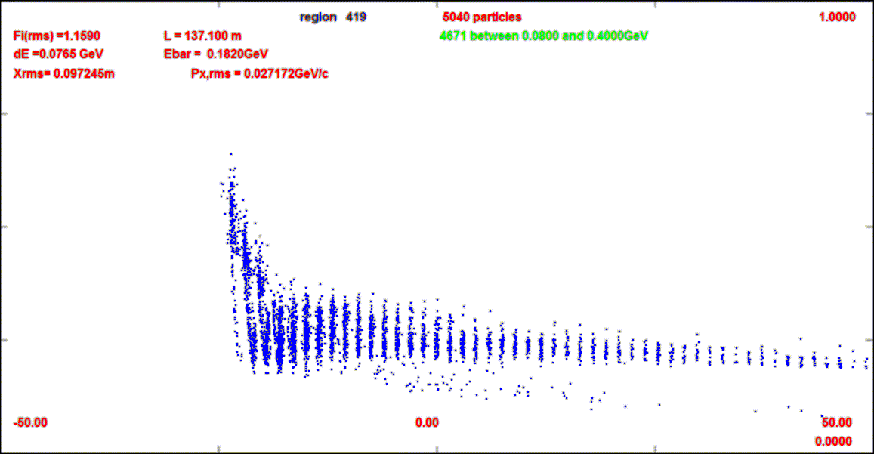
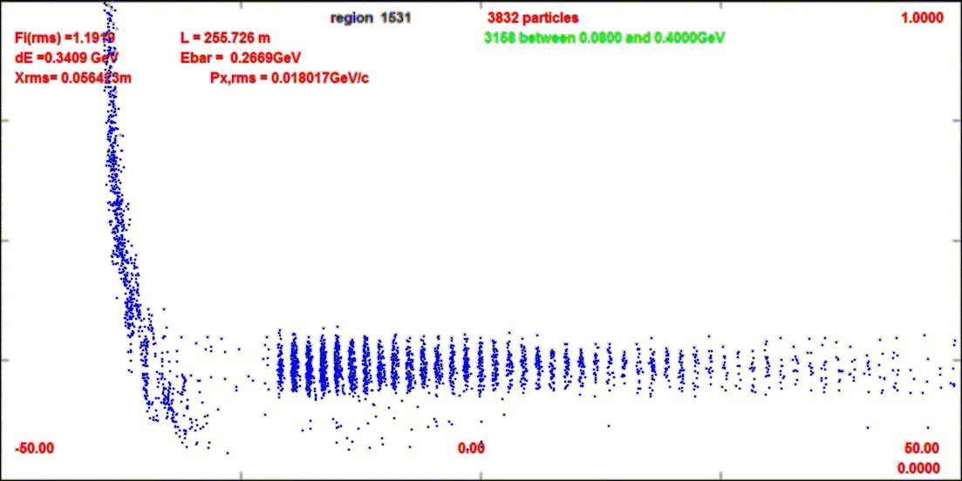
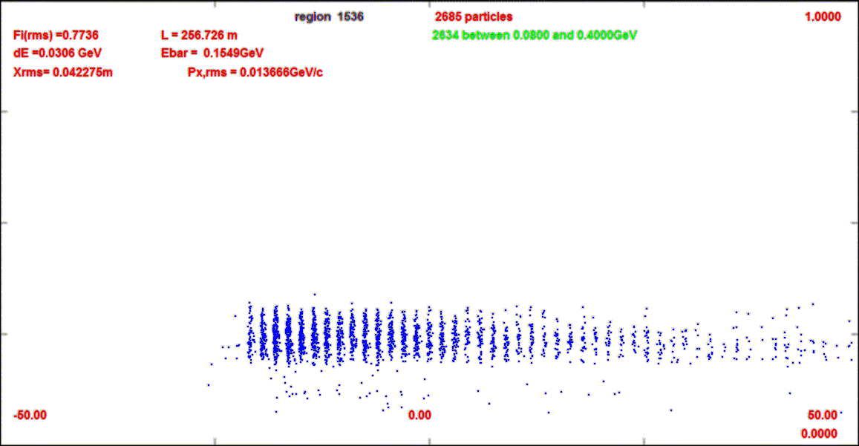
Compare-absorber vs absorber+chicane
This compares absorber only (10cm Be) to chicane (BSOL) + absorber
1.0 GeV/c
z=38m
z=38m
0
z=137m
z=137m
z=255m
z=255m

Slide 12
chicane+absorber works in ICOOL
Chicane does not reduce transmission by much:
  0.098 → 0.094 (?) within acceptance
    ~0.107 without chicane/absorber
  Removes unwanted high energy particles
    eliminates prepulse from high-energy muons
  Works for both μ+ and μ⁻
π⁻, μ⁻
π⁺, μ⁺
proton
absorber
bend
back
p, π⁻, μ⁻
π⁺, μ⁺
bend
out
field
taper
target
station

Slide 13
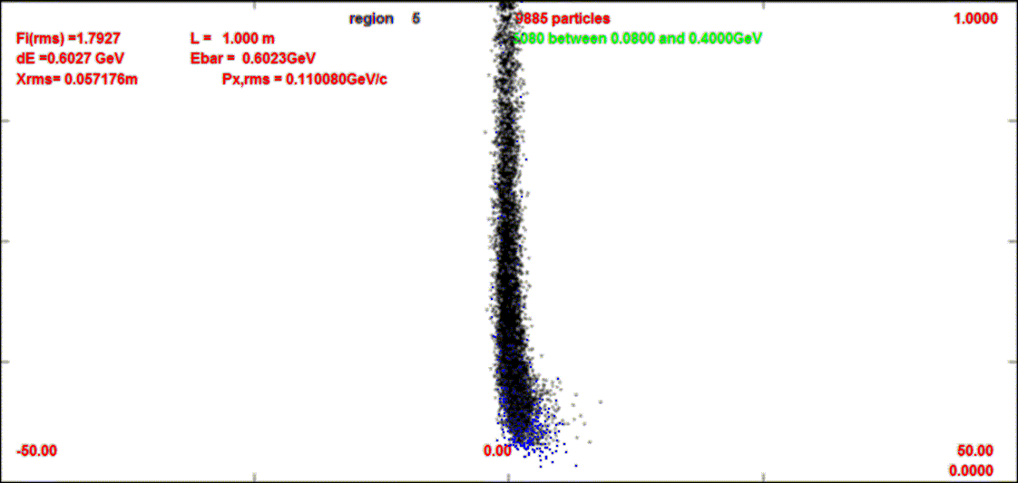
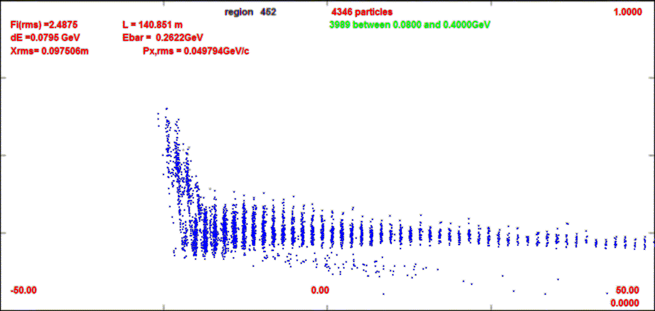
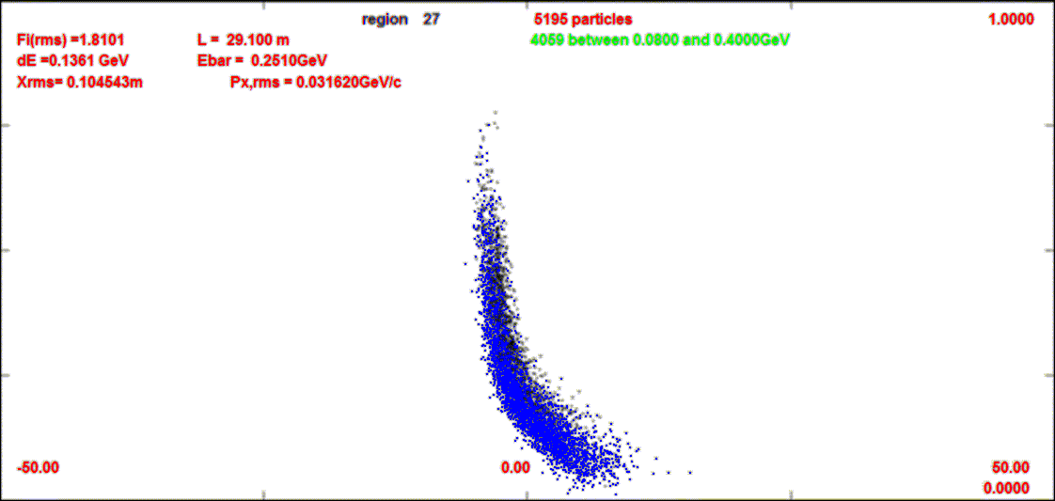
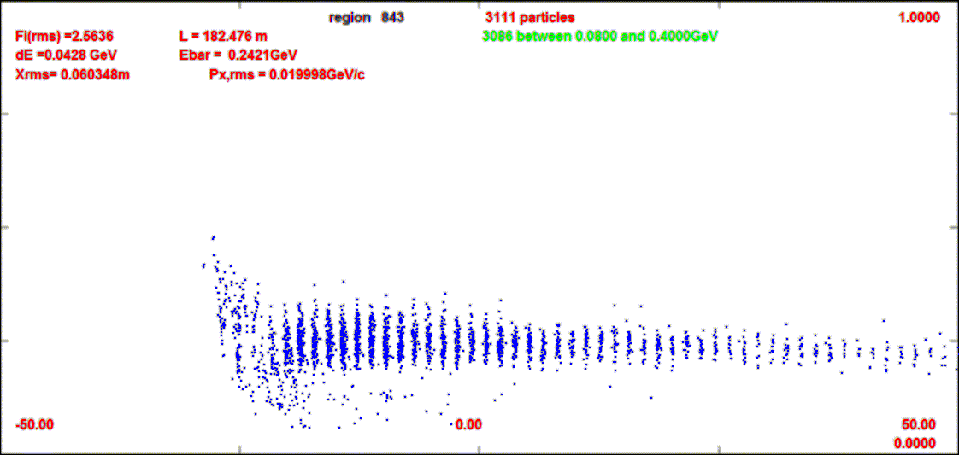
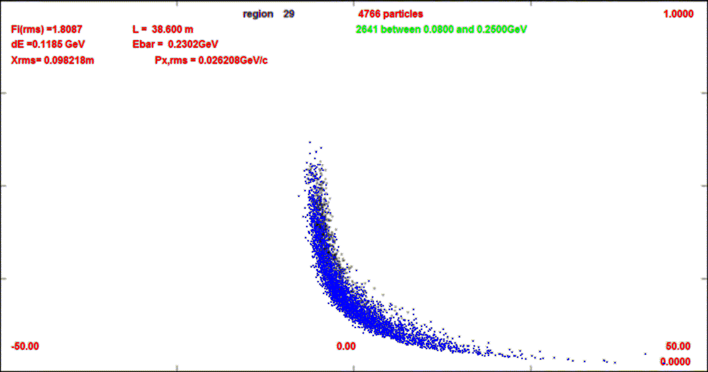

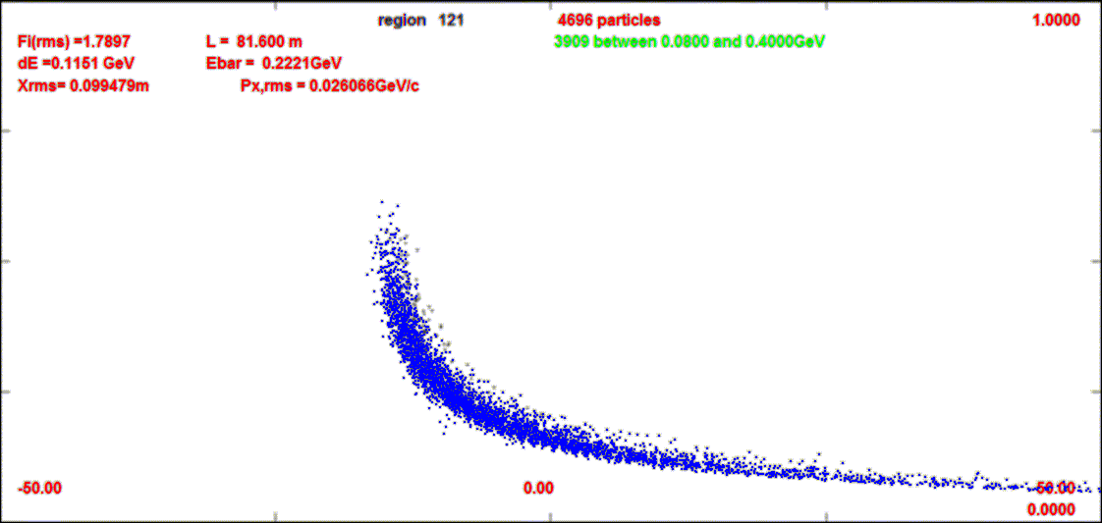
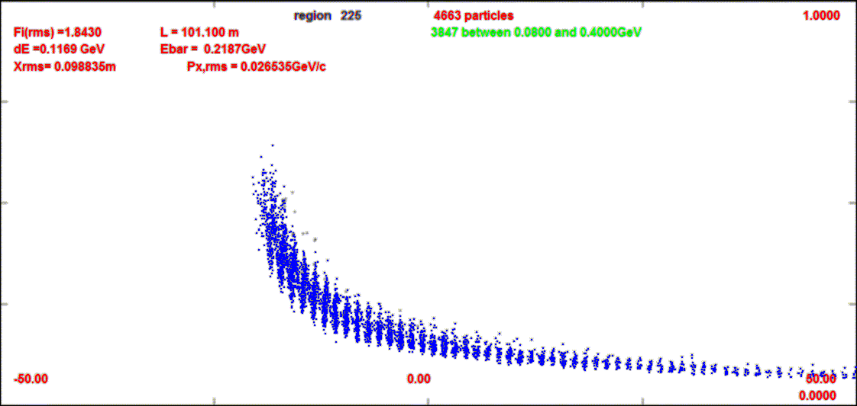
Chicane + absorber
Negative initial beam from IDS study
~0.098 → ~0.094 μ/p
~0.107 without chicane absorber

Slide 14
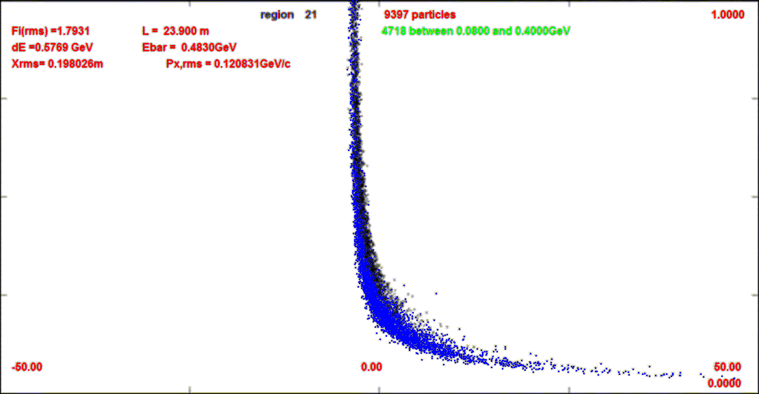
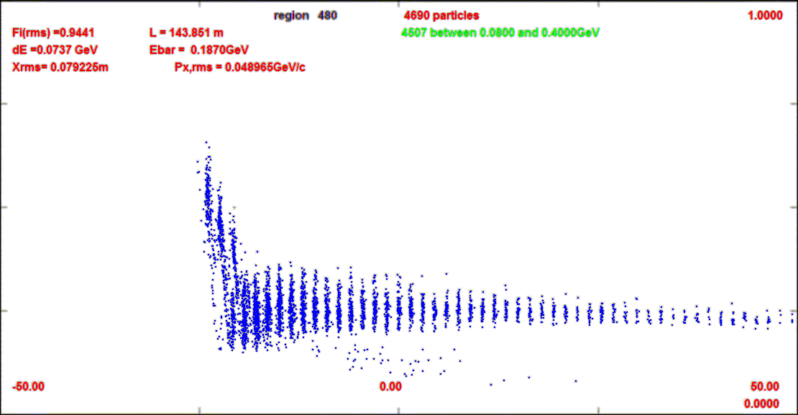

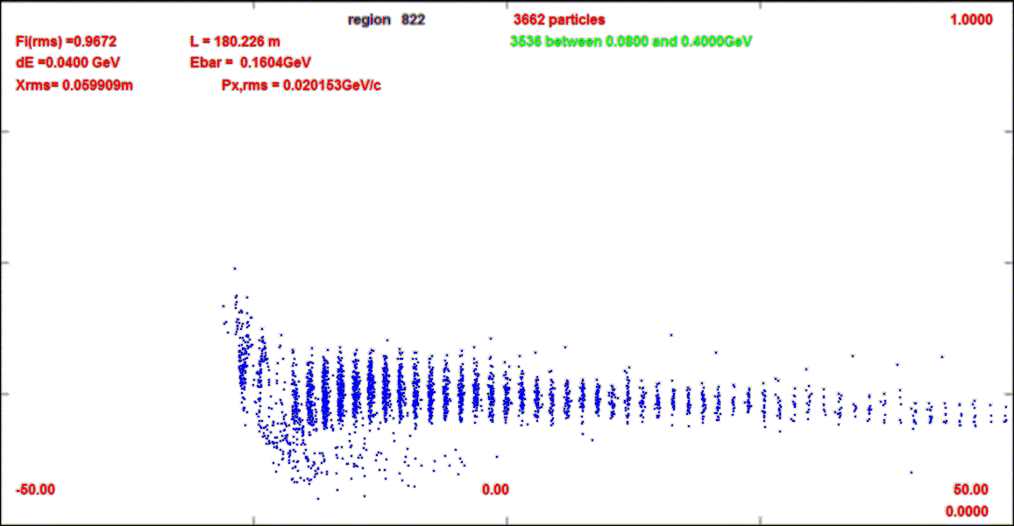
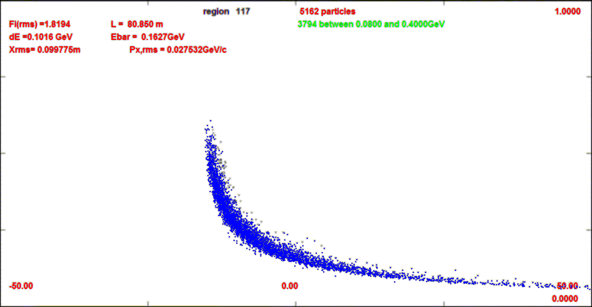

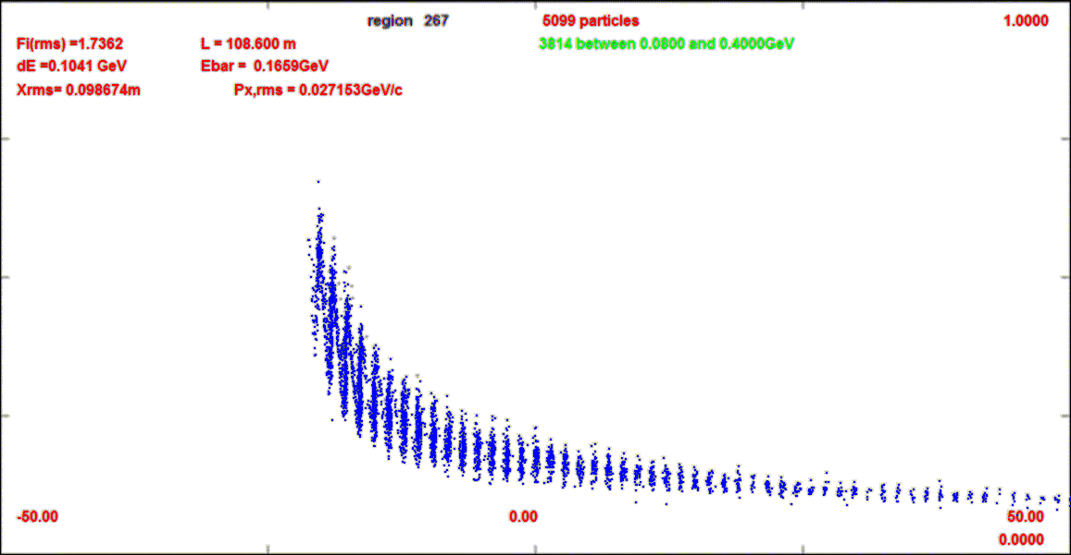
Chicane + Absorber simulation
23.9m
z=144m
38.6m
z=180m
z=256m
80m
109m
Positive initial beam
~0.092 → ~0.088 μ/p
~0.102 w/o absorber/chicane

Slide 15
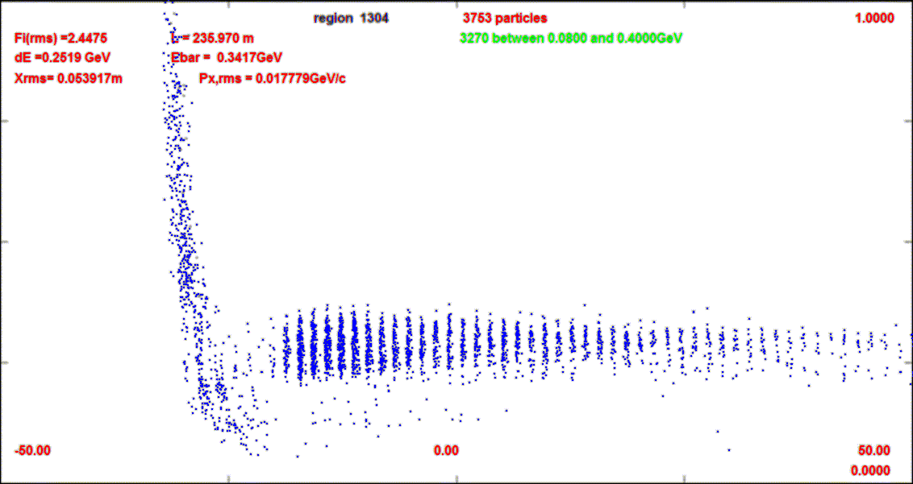
Comments on Simulation Results
chicane increases initial transverse rms emittance a bit
  ~0.018→ 0.020m
ecalc9 longitudinal emittance much smaller with absorber + chicane
  ~0.10 m
  →0.075 – absorber only
  →0.046 – chicane + absorber ?
early μ’s are removed
  μ’s from higher energies do not propagate down the system, do not give added background

Slide 16
Problems ?
Chicane + absorber works better than expected
  Did I miss something?
Have not done any significant optimization
  Continuous frequency change
muon throughput (probably) reduced from baseline
  ~15% ??
  much cleaner throughput
    high-energy preflash removed
    smaller longitudinal emittance

Slide 17
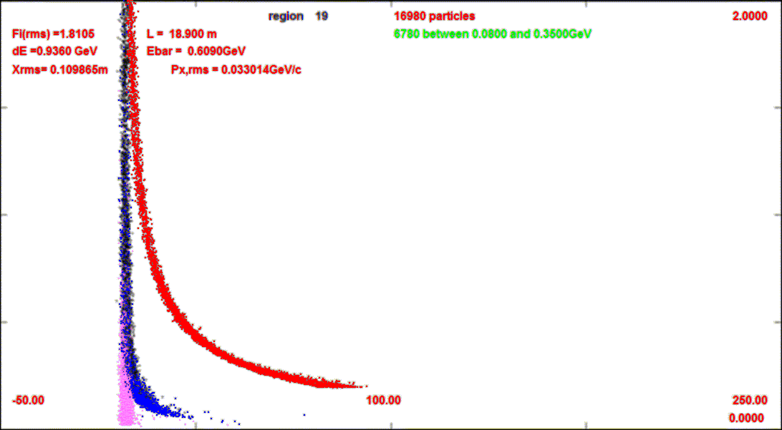
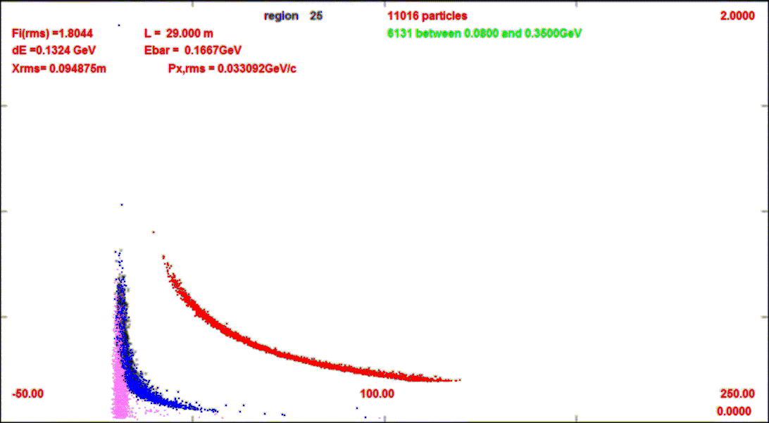
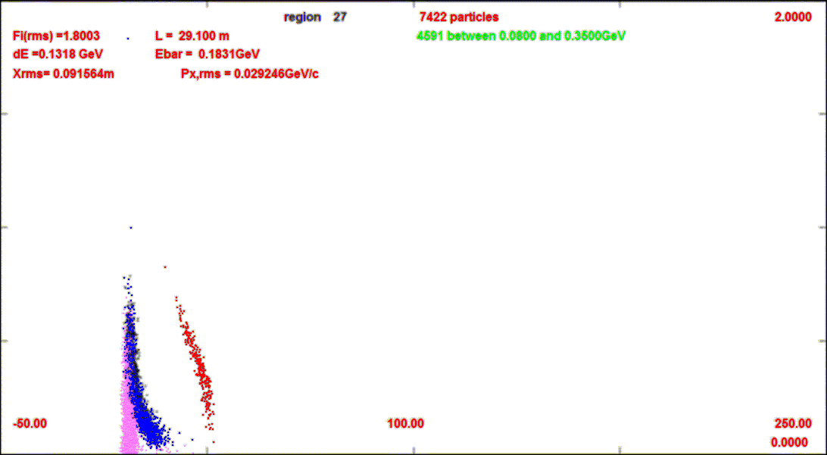
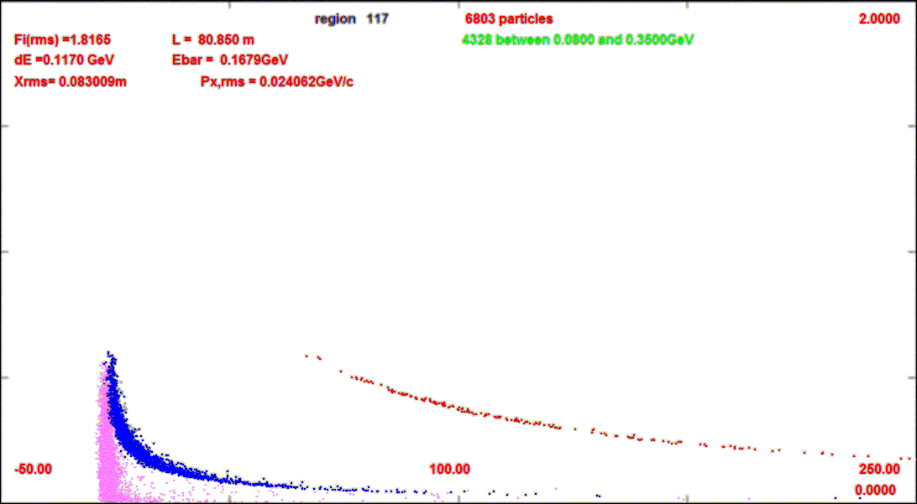
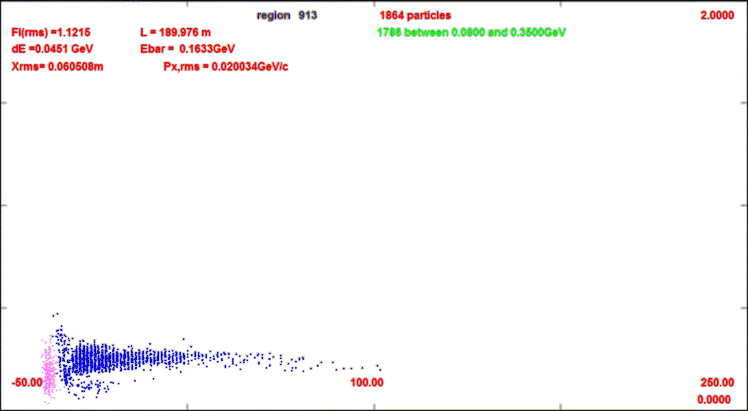
Include other particles
2.0GeV/c
Track with protons, positrons
  p-red, e⁺- violet,
  μ-blue, π-black
Use initial Mars from Kirk
  p cut off at 200MeV/c (T=20MeV)
    π, e⁺ also cut at T=20MeV
Results
  Chicane cuts out P > ~
Absorber reduces protons (~0.1)
  positrons not as reduced
  Cooling channel removes surviving p’s, e⁺ ‘s
z=19m
0
z=29m
after chicane
z=29.1m
after absorber
z=82m
z=180m
-50m
+250m

