Slide 1
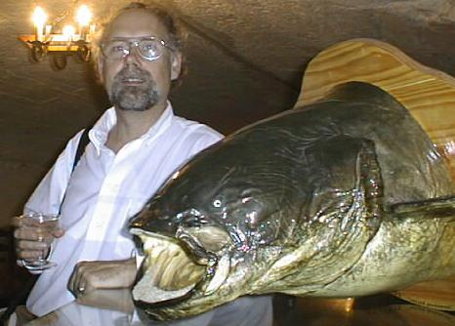
Neutrino Factory Front End (IDS) and Variations
NuFACT99 -Lyon
David Neuffer
G. Prior, C. Rogers, P. Snopok, C. Yoshikawa, …
August 2011

Slide 2
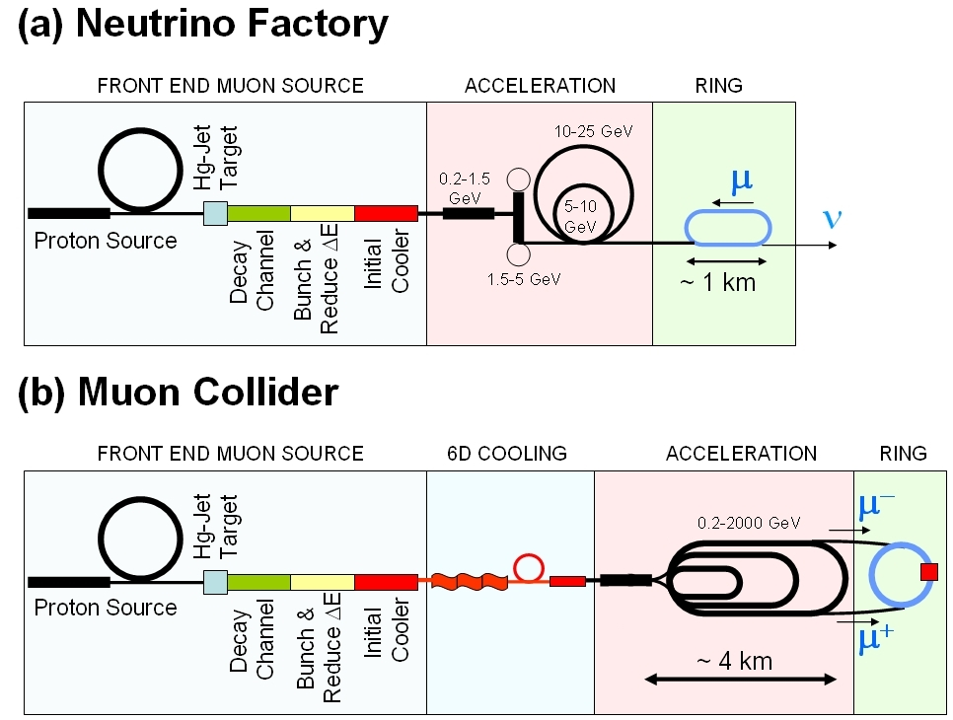
Outline
Front End for the IDS Neutrino Factory
  baseline design for IDS
    Developed from study 2A, ISS
  Basis for engineering/costs
    Rf requirements
Variations
  rf gradient/ B concerns
    alternatives
      gas-filled rf/insulated rf/low-B/
  Losses – control
    Chicane, proton absorber
μ⁺-μ⁻ Collider Front End
  Shorter bunch train
    Larger V’, rebunching
  Rebuncher
    Time reverse front-end

Slide 3
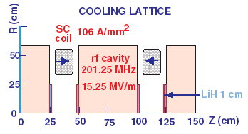
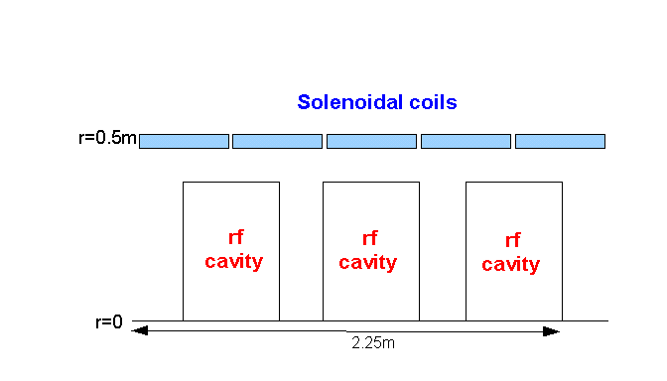
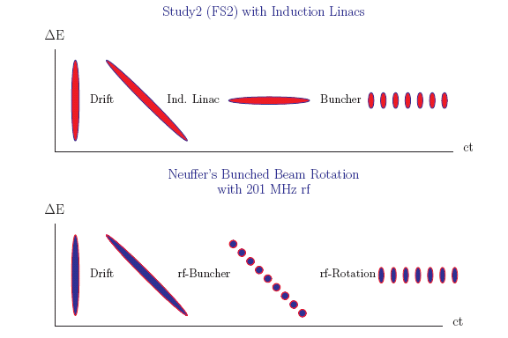
IDS Baseline Buncher and φ-E Rotator
Drift (π→μ)
“Adiabatically” bunch beam first (weak 320 to 232 MHz rf)
Φ-E rotate bunches – align bunches to ~equal energies
  232 to 202 MHz, 12MV/m
Cool beam 201.25MHz
p
π→μ
FE Target
Solenoid
Drift
Buncher
Rotator
Cooler
18.9 m
~60.7 m
~33m
42 m
~80 m

Slide 4
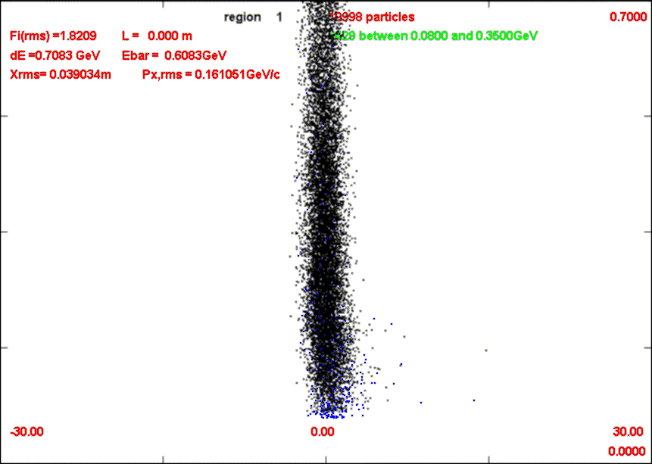
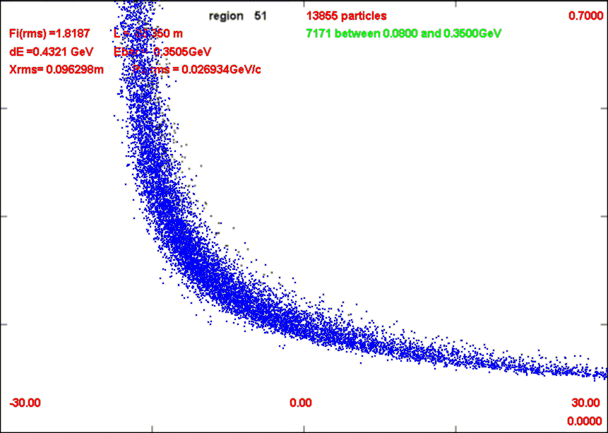
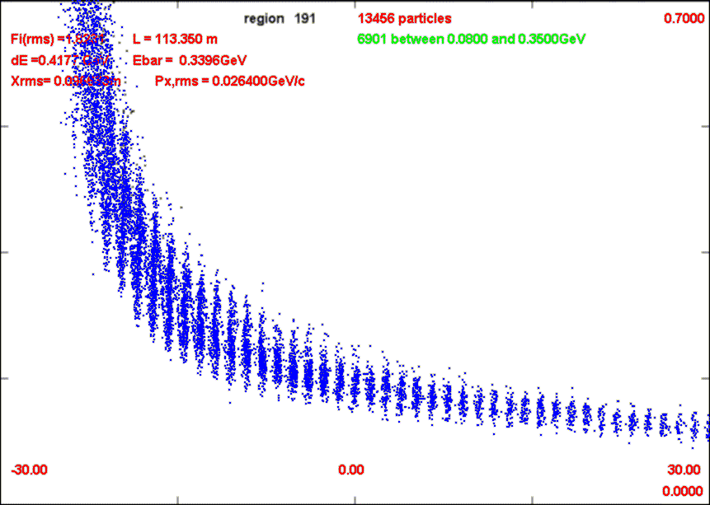
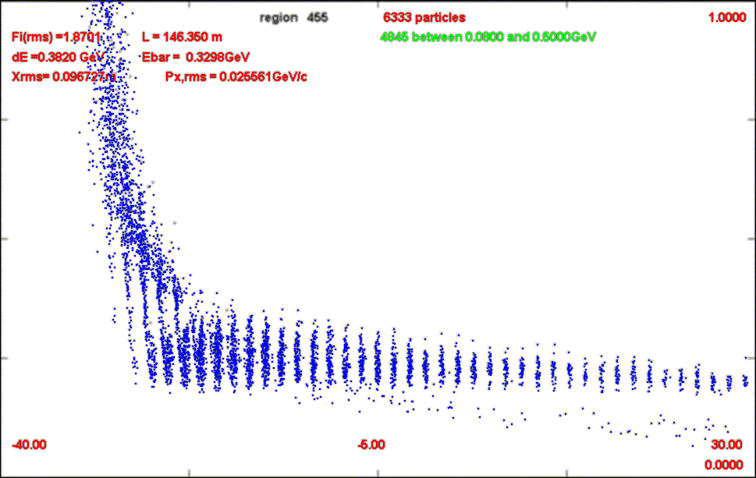
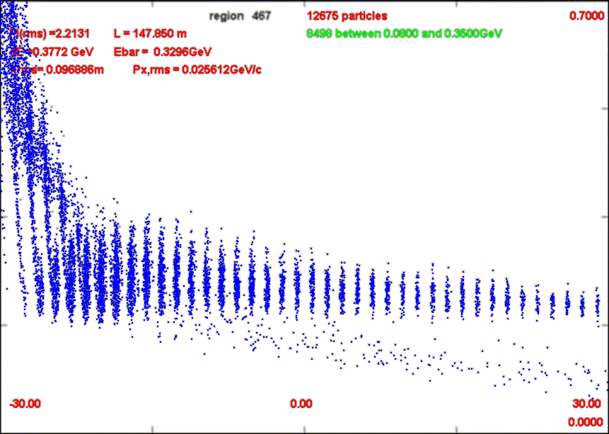
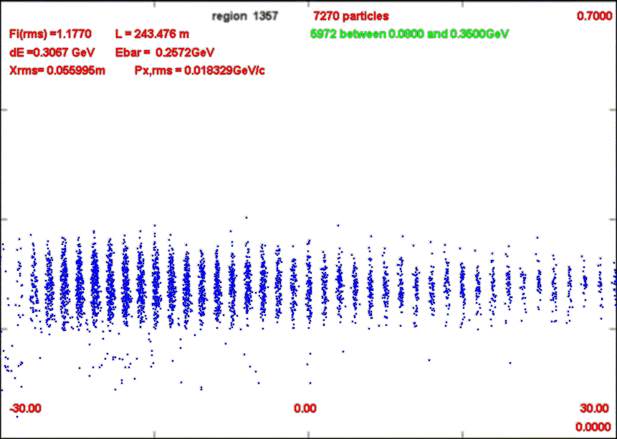
Neutrino Factory Front End
700 MeV/c
Drift from target ~80m
  Beam lengthens
Buncher (~33m)
  N=10
  P₀=233MeV/c, P_{N}=154MeV/c
  330 → 235 MHz
  V’= 0→9 MV/m
Rotator (~42m)
  N=10.05 –
    accelerate/decelerate bunches
  235 → 202 MHz,V’= 12 MV/m
Cooler (~80m)
  201.25 MHz, ASOL lattice
  15MV/m in rf cavities
  LiH or H₂ cooling
Captures both μ⁺ and μ⁻
0m
-30m
30m
0 MeV/c
Drift - 80m
Δ=10λ_{rf}
Bunch-110m
v
Δ=10.05λ_{rf}
Rotate-155m
23 bunches
Cool-240m

Slide 5
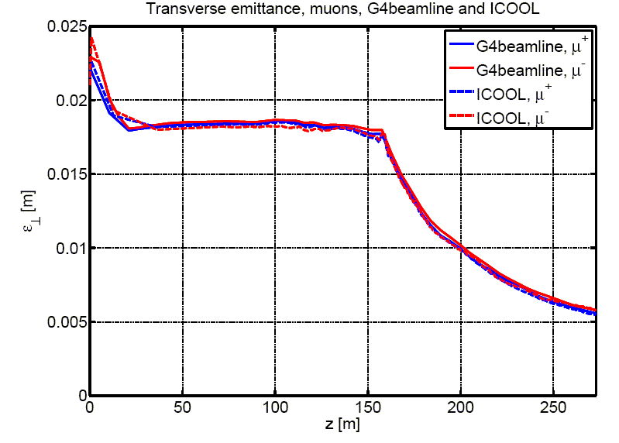
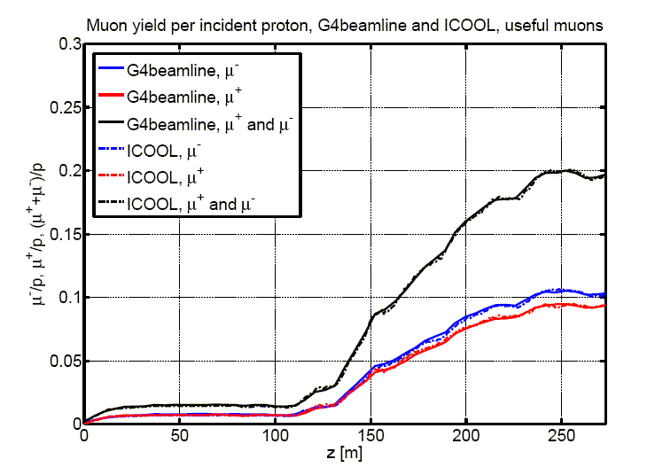
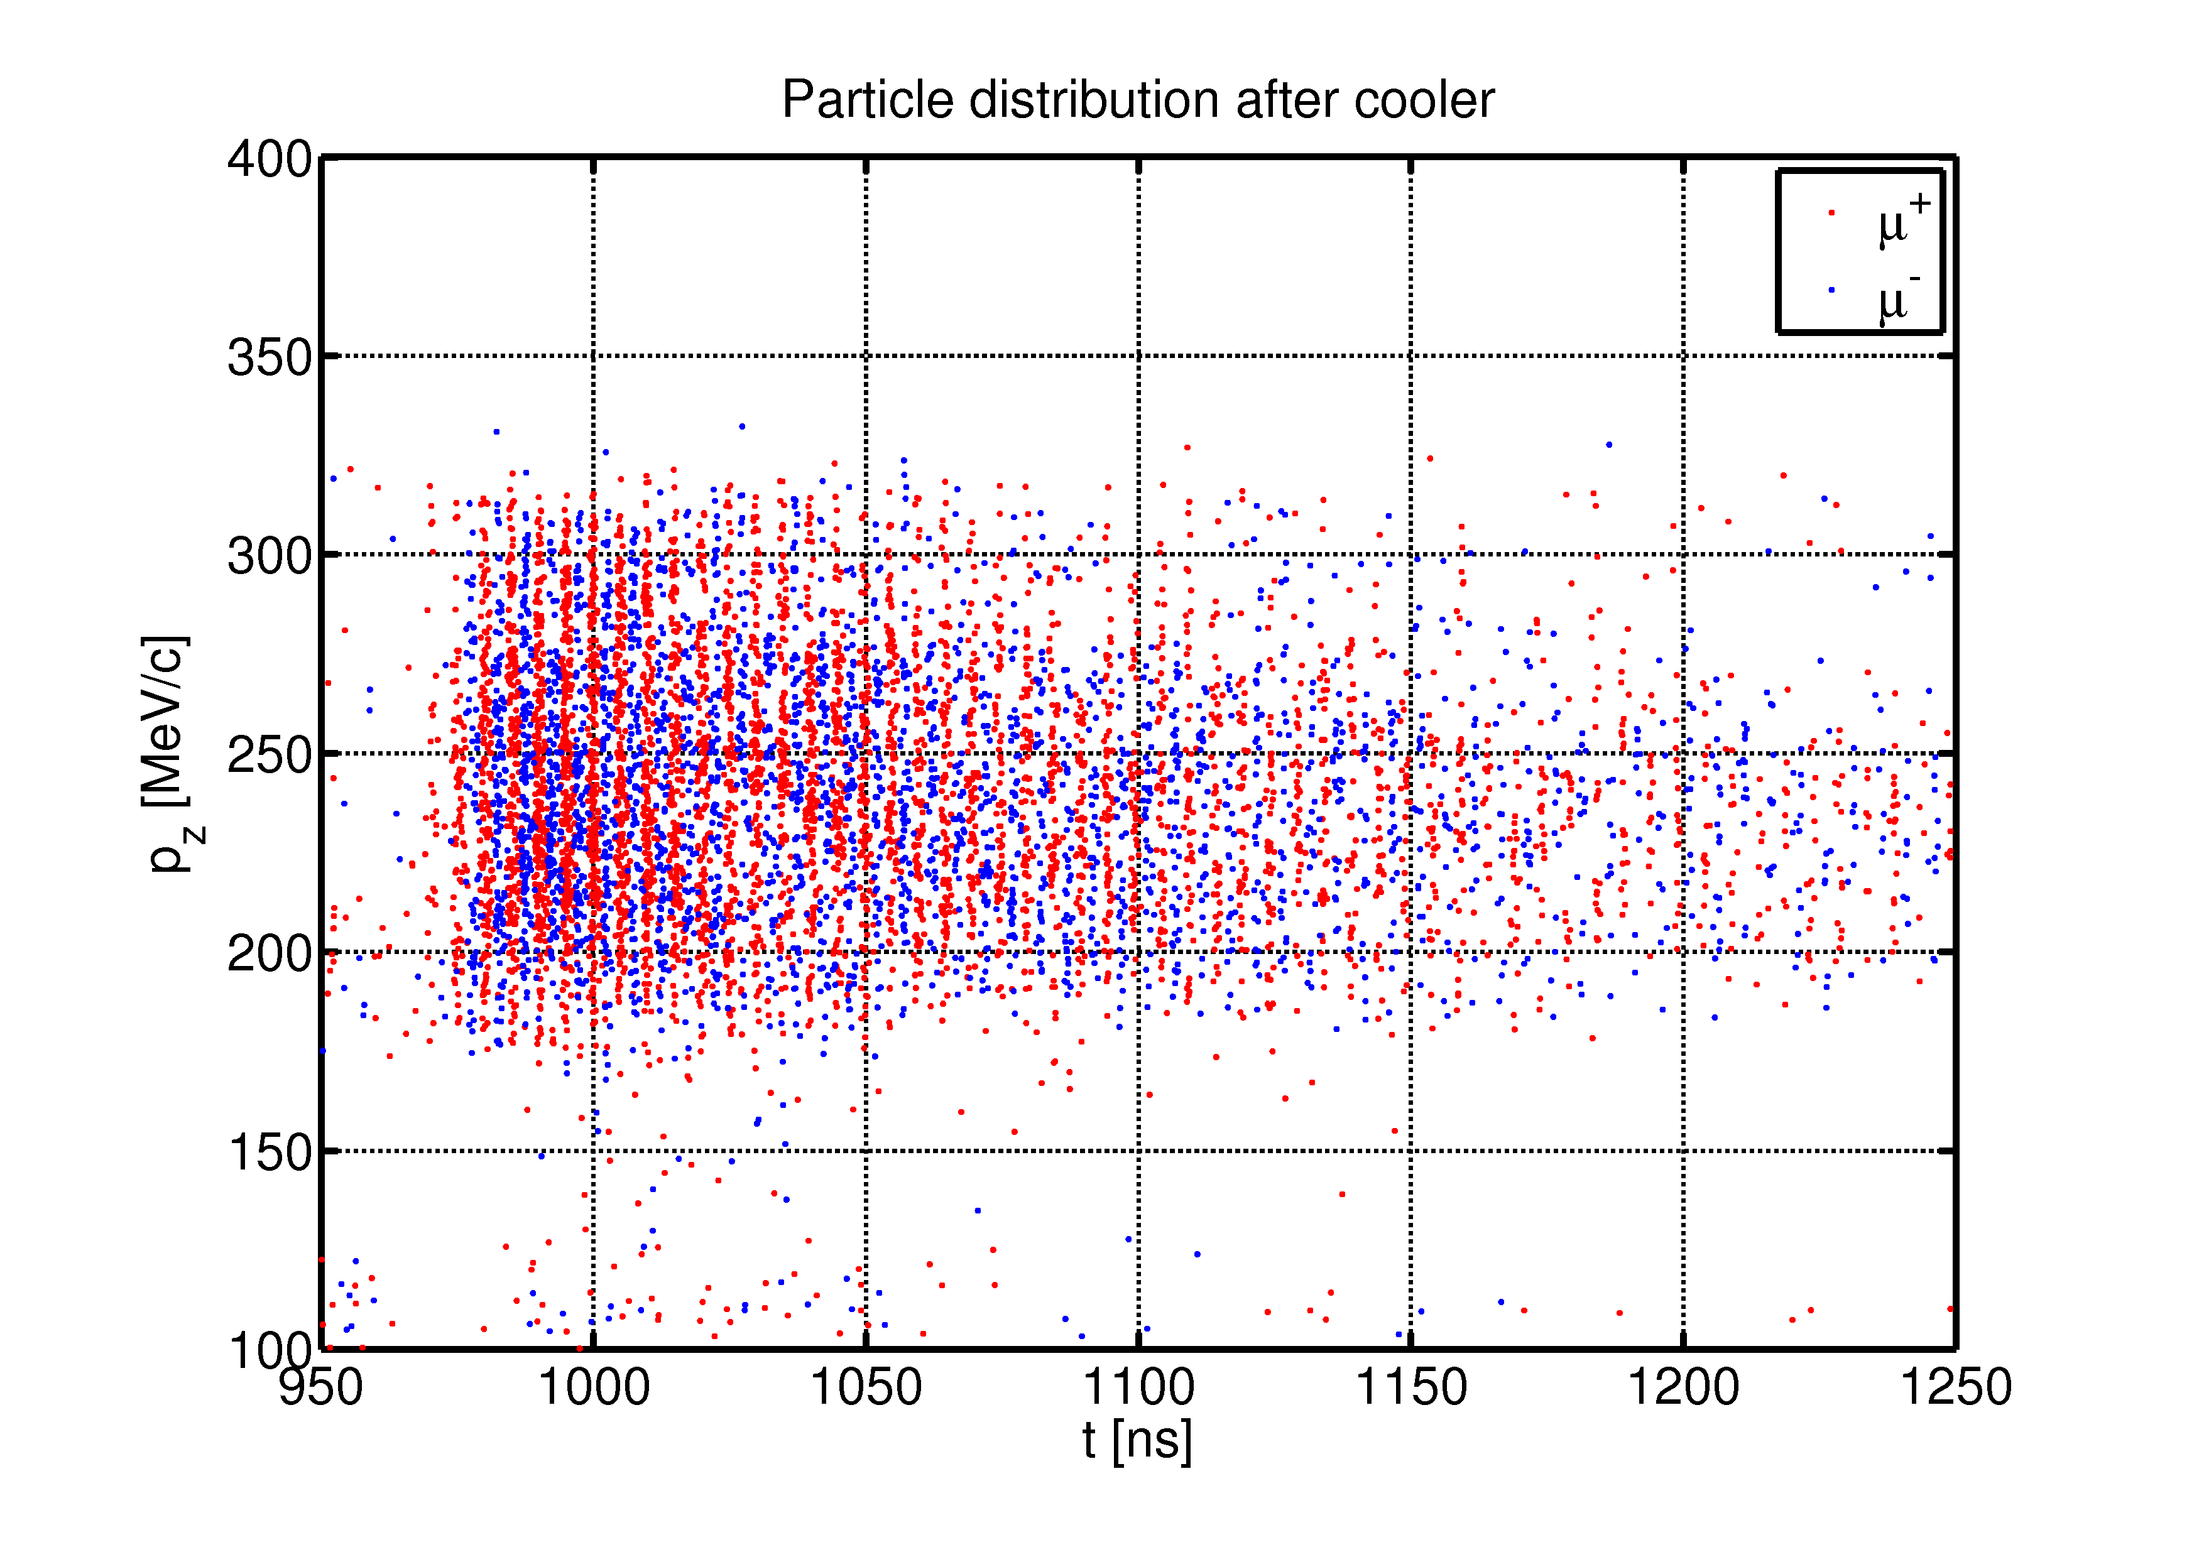
ICOOL - G4beamline
P. Snopok has run the IDS front end with both ICOOL & G4 beamline
  High statistics (>10⁵ tracks)
  Obtains ~0.1 μ⁺ and μ⁻ /8 GeV p within acceptances
    ε_{T} < 0.03, ε_{L} < 0.15
Validation of simulation codes
  Simultaneous simulation of both signs

Slide 6
Parameters of IDR baseline
Initial drift from target to buncher is 79.6m
  18.9m (adiabatic ~20T to ~1.5T solenoid)
  60.7m (1.5T solenoid)
Buncher rf – 33m
  320 → 232 MHz
  0 → 9 MV/m (2/3 occupancy)
  B=1.5T
Rotator rf -42m
  232 → 202 MHz
  12 MV/m (2/3 occupancy)
  B=1.5T
Cooler (50 to 90m)
  ASOL lattice, P₀ = 232MeV/c,
  Baseline has 15MV/m, 2 1.1 cm LiH absorbers /cell

Slide 7
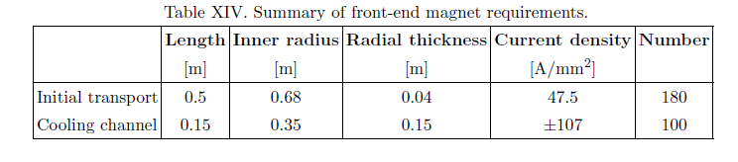
IDS : hardware specification
Specify front end in specific rf cavities, frequencies
Buncher – 13 rf frequencies
  319.63, 305.56, 293.93, 285.46, 278.59, 272.05, 265.80, 259.83, 254.13, 248.67, 243.44, 238.42, 233.61 (13 f)
  ~100MV total
    Keep V’ < ~7.5MV/m
Rotator – 15 rf frequencies
  230.19, 226.13, 222.59, 219.48, 216.76, 214.37,212.28, 210.46,208.64, 206.90, 205.49,204.25, 203.26, 202.63,202.33 (15 f)
  336MV total, 56 rf cavities
    12MV/m at 2/3 occupancy
Cooler
  201.25MHz –up to 75m ~750MV
    ~15 MV/m, 100 rf cavities
Magnet Requirements:

Slide 8
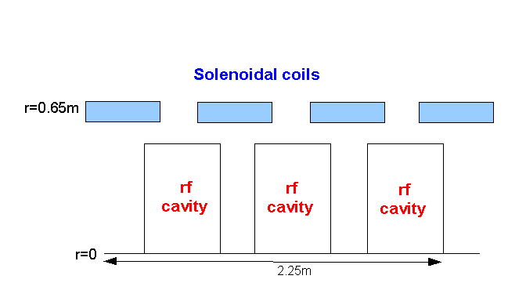
Rf Buncher/Rotator/Cooler requirements
Buncher
  37 cavities (13 frequencies)
  13 power supplies (~1—3MW)
RF Rotator
  56 cavities (15 frequencies)
  12 MV/m, 0.5m
  ~2.5MW (peak power) per cavity
Cooling System – 201.25 MHz
  100 0.5m cavities (75m cooler), 15MV/m
  ~4MW /cavity
Front End section | Length | #rf cavities | frequencies | # of freq. | rf gradient | rf peak power requirements
Buncher | 33m | 37 | 319.6 to 233.6 | 13 | 4 to 7.5 | ~1 to 3.5 MW/freq.
Rotator | 42m | 56 | 230.2 to 202.3 | 15 | 12 | ~2.5MW/cavity
Cooler | 75m | 100 | 201.25MHz | 1 | 15 MV/m | ~4MW/cavity
Total drift) | ~240m | 193 |  | 29 | ~1000MV | ~550MW

Slide 9
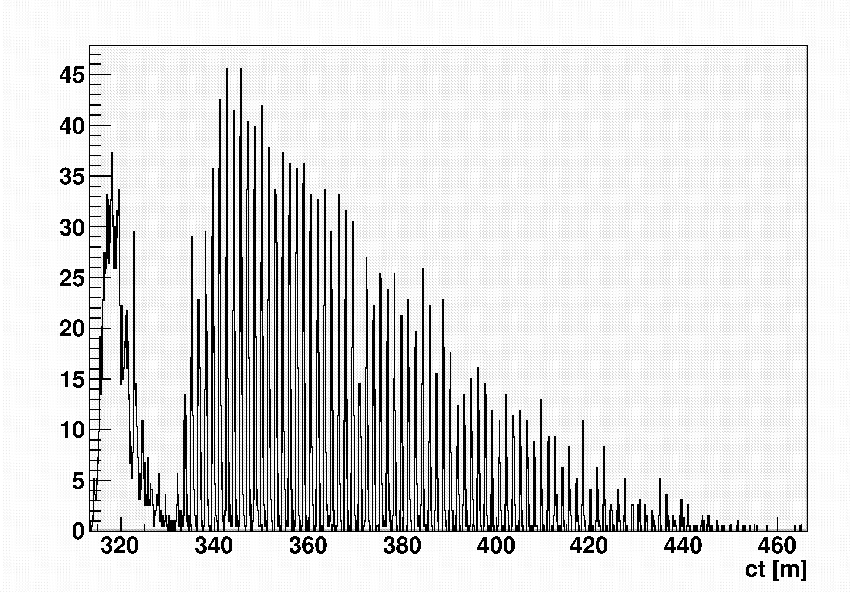
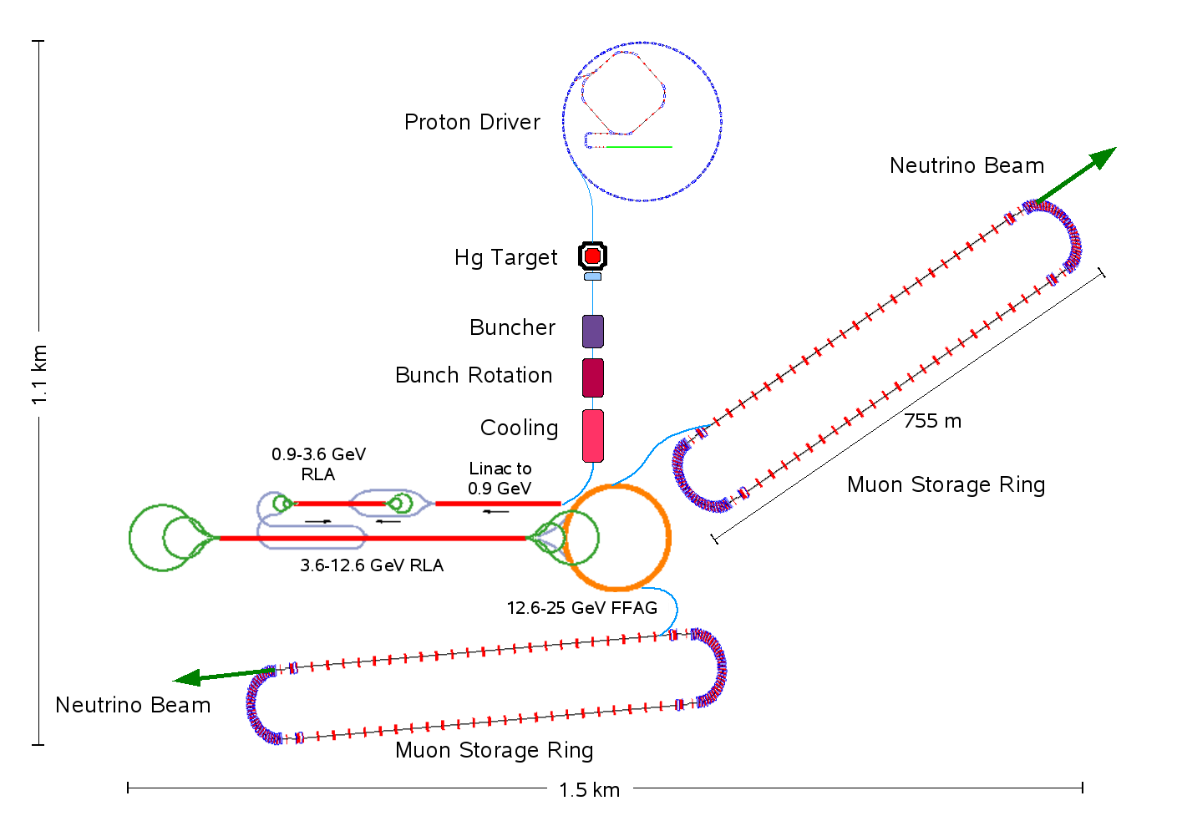
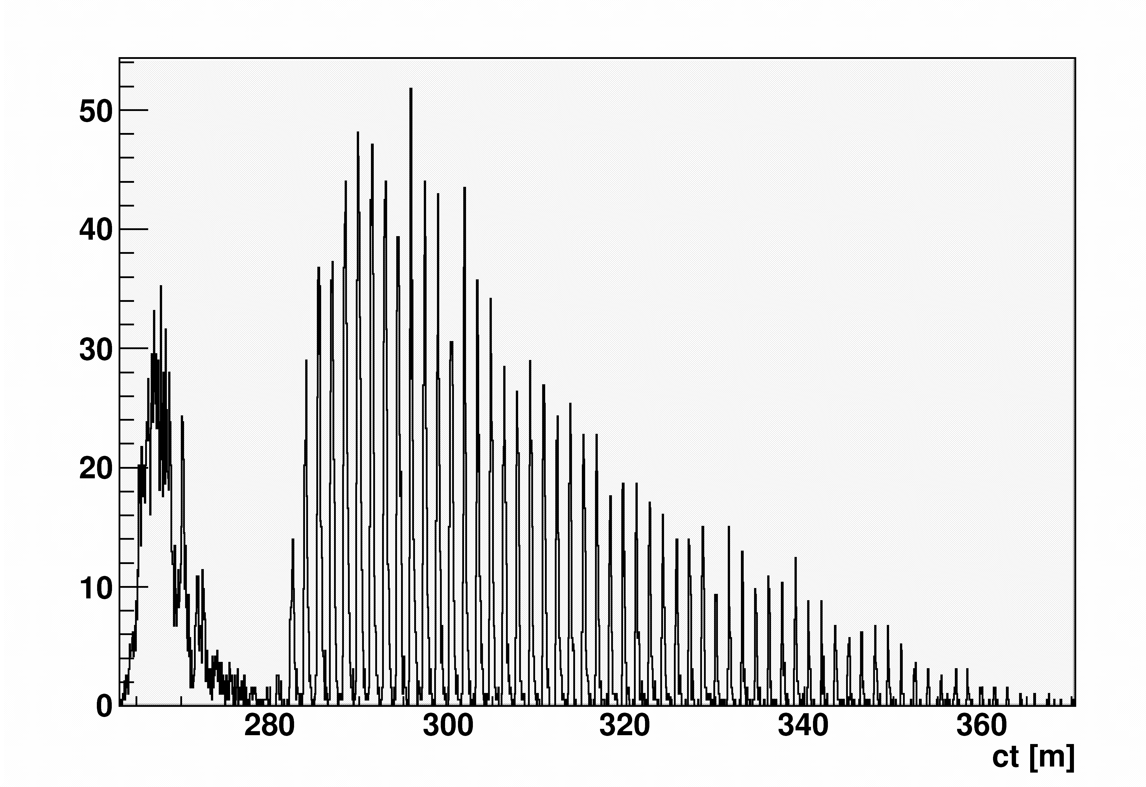
How Long a Bunch Train for IDS?
ISS study alotted space for 80 bunches (120m long train)
For IDS 80m (54 bunches) is probably plenty
ISS
Study ISS
~80m
Muon Decays
120m
100
ν
IDS
IDS: ~3 bunch trains simultaneously
-both μ+ and μ⁻
~60m
80m

Slide 10
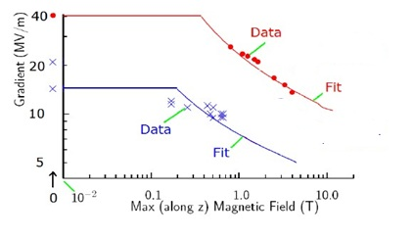
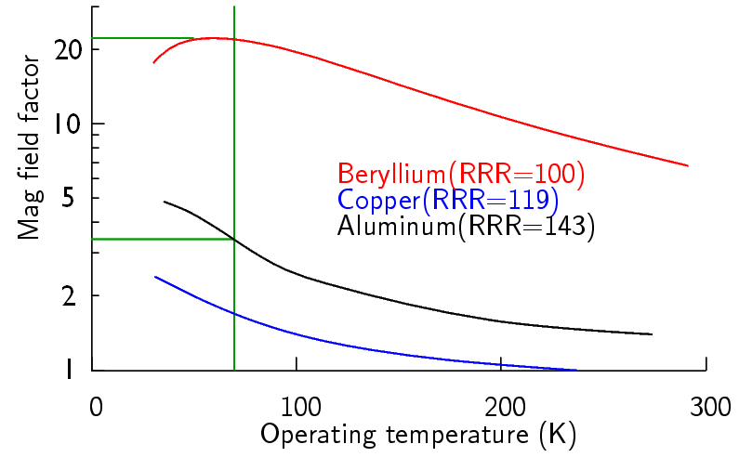
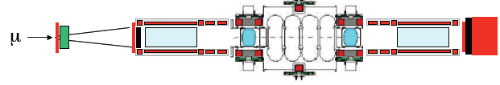
Possible rf cavity limitations
V’_{rf} may be limited in B-fields
  800 MHz pillbox cavity
  200 MHz pillbox test (different B)
NF needs up to ~1.5T, 12 MV/m
    More for cooling
Potential strategies:
Use Be Cavities (Palmer)
Use lower fields (V’, B)
  <10MV/m at 1.5T?
  Need variant for cooling ?
Cooling channel variants
  Use gas-filled rf cavities
  Insulated rf cavities
  Bucked coils (Alekou)
  Magnetic shielding
805MHz
201MHz
Need More Experiments !

Slide 11
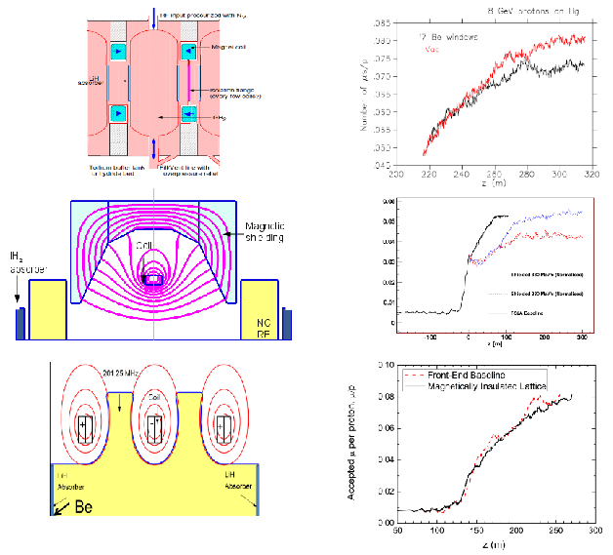
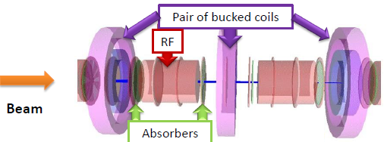
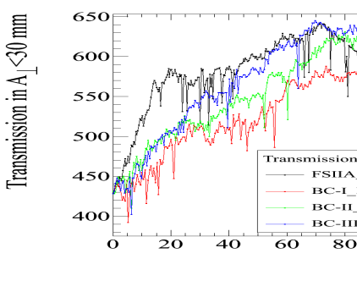
Cooling Lattice variations
Gas-filled rf
  With LiH absorbers
Magnetically shielded
  Small B at rf
Magnetically Insulated
  B  rf surface
Bucked Coil
  Reduced B in rf
  Alekou

Slide 12
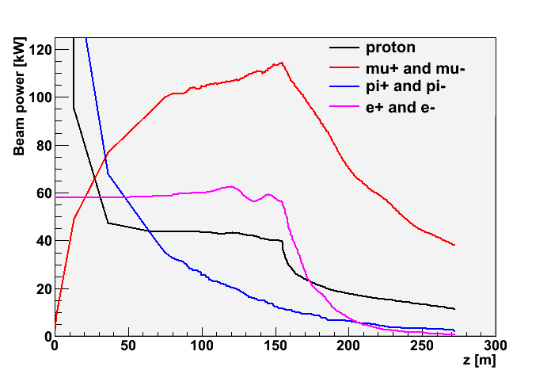
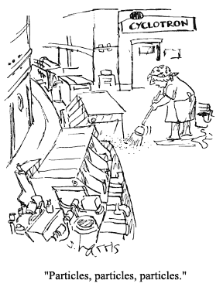
Problem: Beam losses along Front End
Start with 4MW protons
  End with ~50kW μ⁺ + μ⁻
    plus p, e, π, …
    ~20W/m μ-decay
  ~0.5MW losses along transport
    >0.1MW at z>50m
Want “Hands-on” maintenance
  hadronic losses < 1W/m
  Booster, PSR criteria
  Simulation has >~100W/m
    With no collimation, shielding, absorber strategy
Drift
Cool

Slide 13
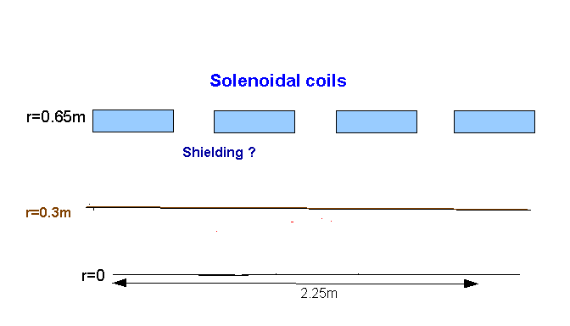
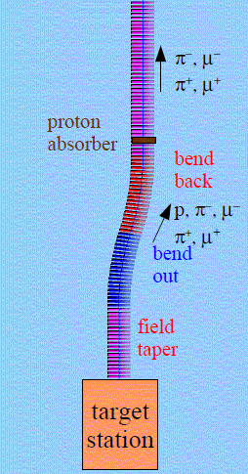
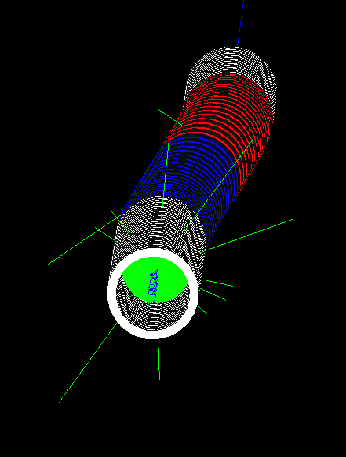
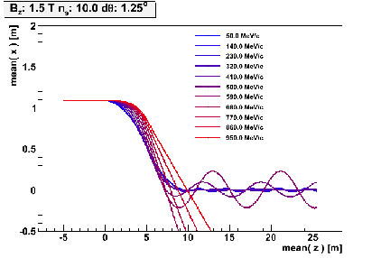
Control of Front End Losses
Add shielding
  Resulting losses ?
Chicane and proton absorber to localize losses (C. Rogers)
  Removes most protons
  Most desired μ’s survive
  Greatly reduces downstream activation problem
p
π→μ
FE Target
Solenoid
Drift
Buncher
Rotator
Cooler
12.7 m
~60.0 m
~33m
42 m
~90 m
Shielding ?

Slide 14
Muon Collider/NF Beam Preparation
Baseline Muon Collider beam preparation system identical to that for Neutrino Factory
  downstream portions (6D cooling, acceleration, collider) are distinct
    much more cooling and acceleration needed for collider
Neutrino
Factory
Muon
Collider

Slide 15

Front End for Muon Collider
Muon Collider front end is different
  must capture μ⁺ and μ⁻
  want single bunches (not trains)
    Bunches are recombined …
  Maximum μ/bunch wanted
  Longitudinal cooling needed;
  Larger rf gradient can be used (?)
    NF will debug gradient limits
    Cost is less constrained
Use shorter BR system, more gradient, and capture at higher momentum
  230 → 270 MeV/c
  150m → 120m
  9/12/15 MV/m → 15/16/18 or 15/18/20 MV/m
  1.5T→2T

Slide 16
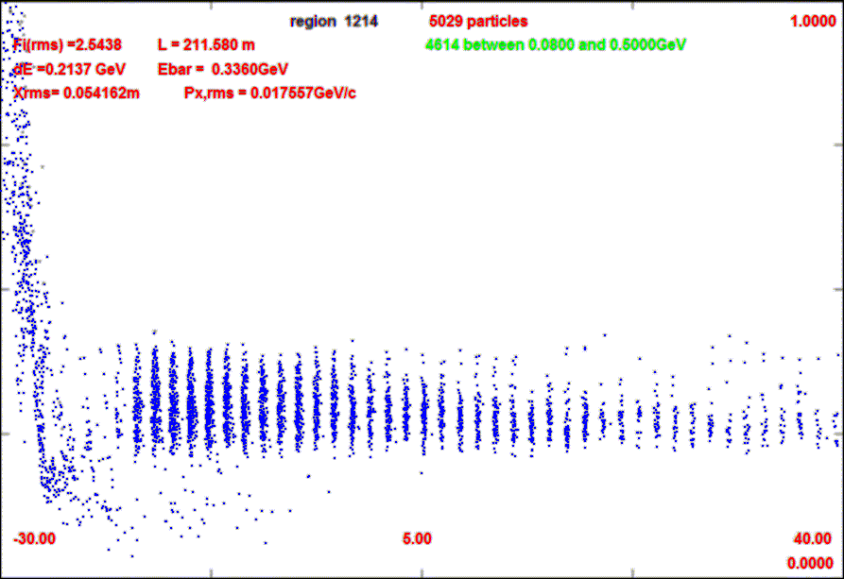
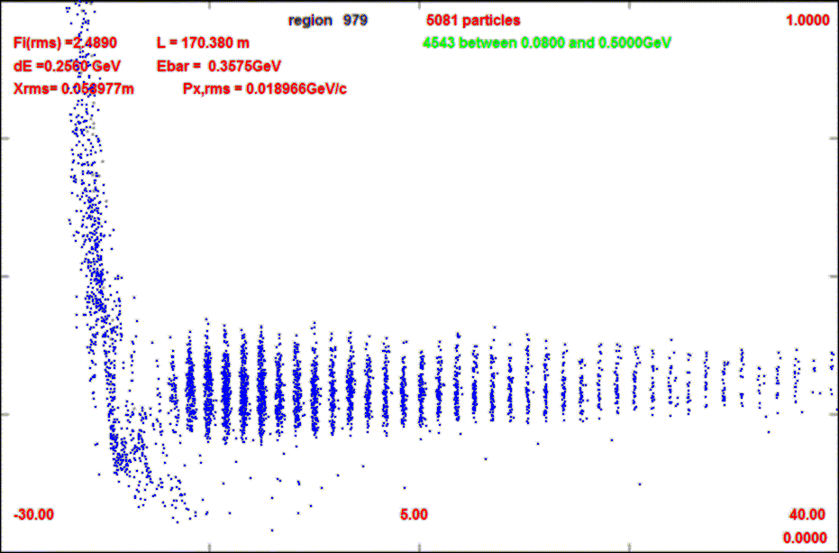
Muon Collider variants
ΔN: 10→8
Rf gradients: 12.5 → 15 → 18 MV/m
  Or 15 → 18 → 20 MV/m
Shorter system ~102m
p
π→μ
FE Target
Solenoid
Drift
Buncher
Rotator
Cooler
14.05 m
~33m
~25.5m
27 m
~80 m

Slide 17
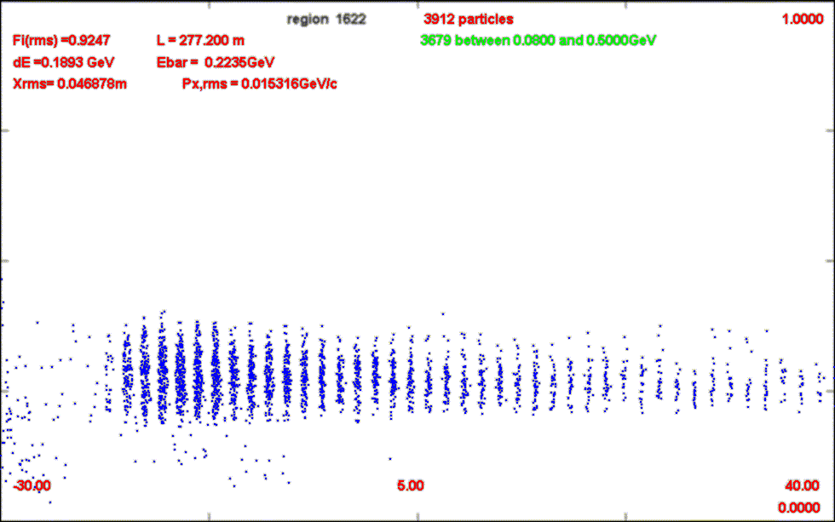
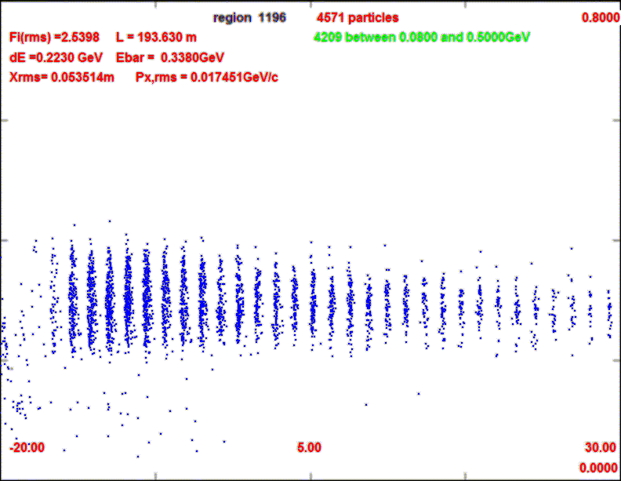
Variant front ends for muon collider
Table 1: Comparison of muon source front end systems.
Front end Scenario | Drift, Buncher, Rotator Length | Rf Voltages | Full length (w 75m cooling) | μ⁺/p (ε_{t}<0.03, ε_{L}<0.3m) | μ⁻/p (ε_{t}<0.03, ε_{L}<0.3m) | Core bunches, N_{B,} all μ⁻/p
IDS/NF | 80.6, 33, 42m | 0→9, 12, 15 | 230m | 0.086 | 0.116 | 20/0.107
N=10 | 55.3, 31.5, 33 | 0→12, 15, 18 | 205 | 0.106 | 0.143 | 16/0.141
N=8 | 47.8, 35.5, 27 m | 0→15, 18, 20 | 180 | 0.102 | 0.136 | 13/0.123

Slide 18
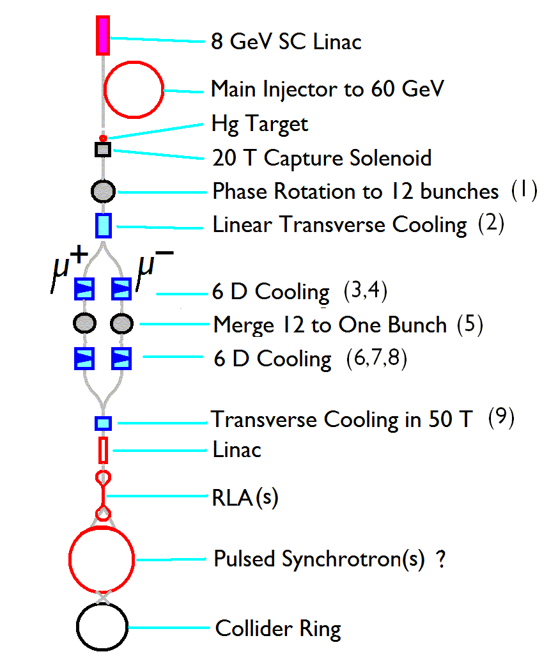
Integrate into 6-D cooling system
Initial Cooling transition
  NF transverse cooling only
  Transition to 6-D cooling needed
    Snake ? HCC? “Guggenheim”?
    Split μ⁺- μ⁻
    Cool 6-D by large factors
Recombine Bunches
    After cooling to small bunches
  Front end splits 1 huge emittance bunch into string of smaller ε –bunches
    Can we time reverse to combine cooled bunched to single bunches ?

Slide 19
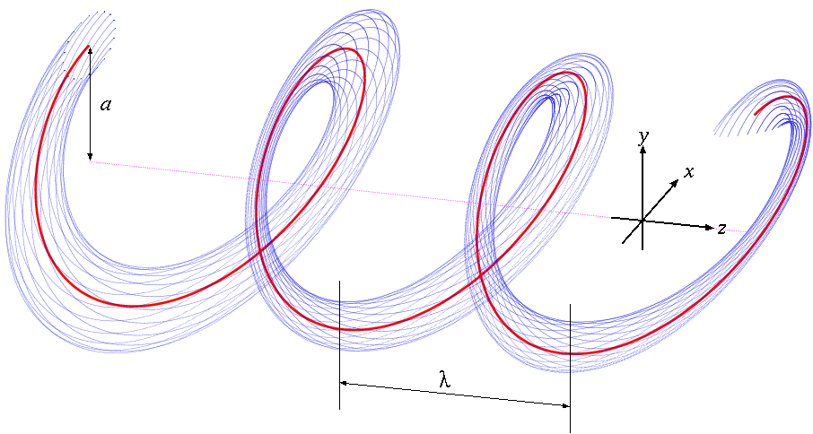
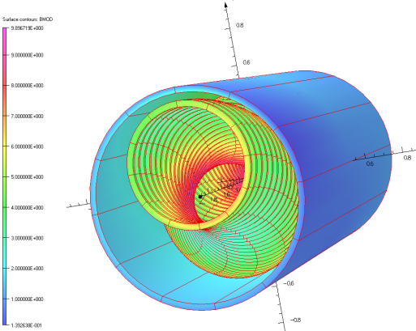
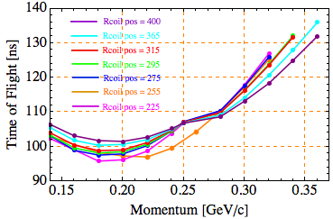
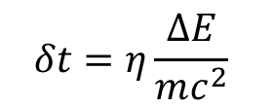
Bunch Recombination: Helical Channel
Would like a large dependence of path length on energy
Helical channel naturally has that
  Linear dependence is nicest …
η=0.43 looks possible
  HC – B= 4.2T b_{d}=0.75, b_{q}=0.4
  κ=1, λ=1.6m, P₀=290MeV/c
  Dˆ=1.7, D=0.44m
    “γ_{t}”=1.085
$$δt=η\frac{ΔE}{mc^{2}}$$

Slide 20
Longitudinal Dynamics in Helical Channel
Set up an HCC & see if bunch recombination is possible
  κ=1, η=0.43
    λ=1m
Very linear bunching over T=150—280 MeV
See if one can set up HC line for rebunching with this case
  Defer matching problem by using constant HCC

Slide 21
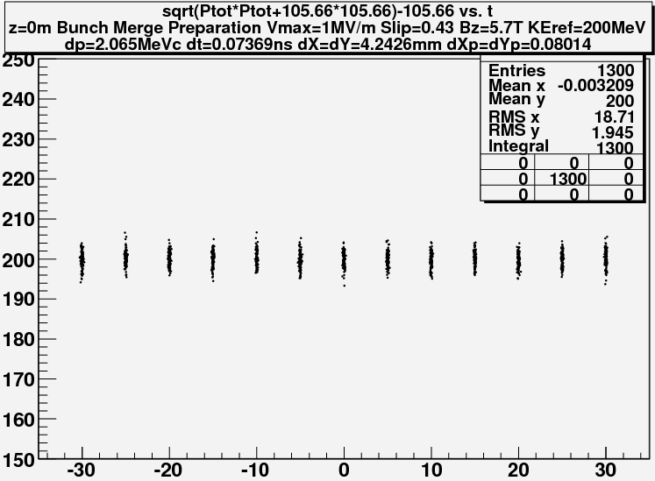
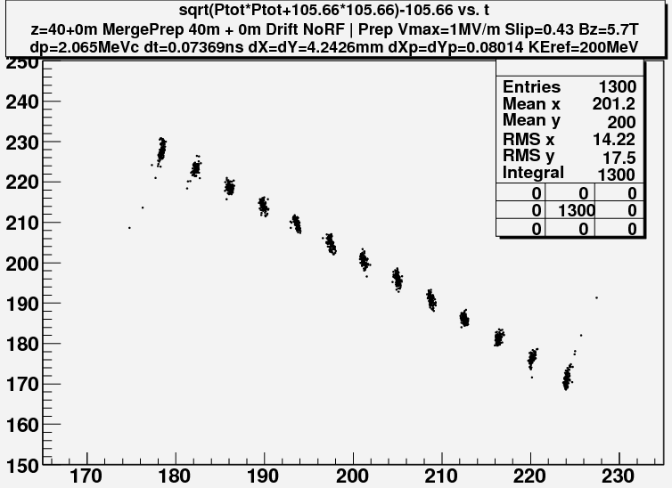
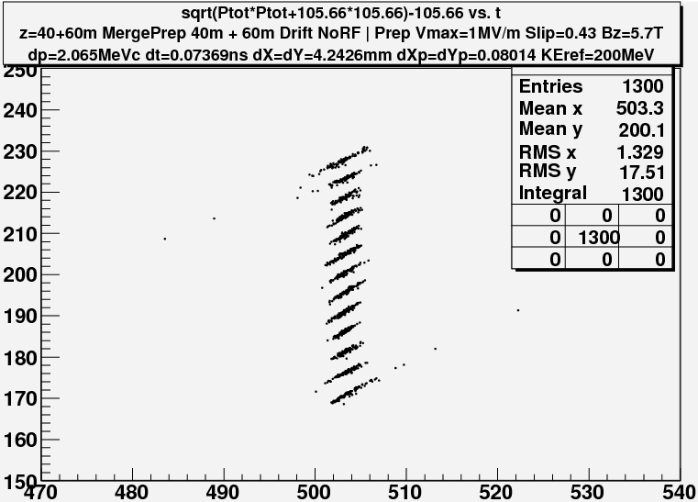
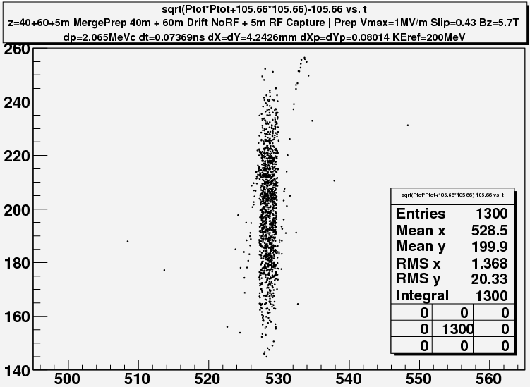
Simulate in 3-D- G4BL
–C Yoshikawa
z = 0 m
Obtain beam from end of 3-stage HCC channel - K. Yonehara
  13 bunches, ε_{L} =0.0011m
  η=0.43 transport
40m 1MV/m rf
  204 → 270 MHz
    (+45° to -45° ) (N=12.25)
    η=0.43
60m drift
200MHz rf -10MV/m
  >95% capture
  ε_{L} = ~0.040
60ns
z = 40 m
60MeV
z = 100 m
z = 105m

Slide 22
Summary
Muon Collider:
  Need to integrate bunch combiner into complete cooling scenario
ν-Factory front end
  costing exercise for IDR
    “Most Likely” cost range?
  rf in magnetic fields ?
    adapt to rf measurements
  manage losses
    chicane/absorber/…
    simulation studies

Slide 23
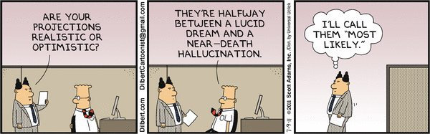
Questions?

