Slide 1
Chicane Beam Dynamics
David Neuffer
August 14, 2012

Slide 2
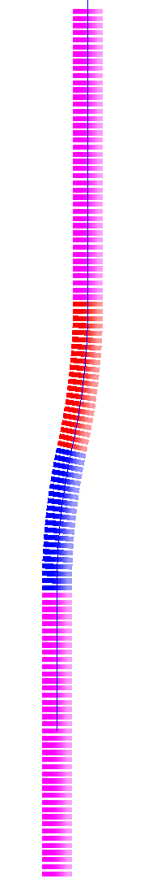
Chicane/Absorber Design Concept
Bent solenoid chicane induces vertical dispersion in beam
  bend out – 5m, 12.5°
  Single chicane will contain both signs
    Opposite signs have dispersion in opposite sense
  Little disruption to the central beam
  High momentum particles scrape
Subsequent proton absorber to remove low momentum protons
  Non-relativistic protons don't have much energy, even for relatively
  large momenta
  (~10cm Be)
π⁻, μ⁻
π⁺, μ⁺
proton
absorber
bend
back
p, π⁻, μ⁻
π⁺, μ⁺
bend
out
field
taper
target
station

Slide 3
Front End with Absorber-Rematch
p
π →μ
FE Target
Solenoid
Drift
Buncher
Rotator
Cooler
18.9 m
10.1 m
0.1 m Be
~39.5m
~33m
42 m
~80 m
with absorber
    particle 1-270 MeV/c
    particle 2-185 MeV/c
  absorber at 29m
    10cm Be
    particle 1-237 MeV/c
    particle 2-144 MeV/c
  Bunch N=10
  Rotate N=10.04
  Cool -201.25MHz
    p_{ref}=230 MeV/c

Slide 4
Add chicane to absorber
ICOOL version
  2 Bent Solenoids – 10m
  5m, 1.5T, 12.5º,0.27GeV/c
  5m, 1.5T, -12.5º ,0.27GeV/c
    bend radius is 22.92m (1/r=0.043636)
    B_{y}=0
Match to channel
  add 1m drift
ICOOL BSOL element:
π⁻, μ⁻
π⁺, μ⁺
proton
absorber
bend
back
p, π⁻, μ⁻
π⁺, μ⁺
bend
out
SREGION ! bentsol
5.0 1 1e-2
1 0. 1.0
BSOL
1 1.5 0.0 1 0.27 0.0 0.043636 0.0 0.0 0.0 0. 0. 0. 0. 0.
VAC
NONE
0. 0. 0. 0. 0. 0. 0. 0. 0. 0.
field
taper
target
station

Slide 5
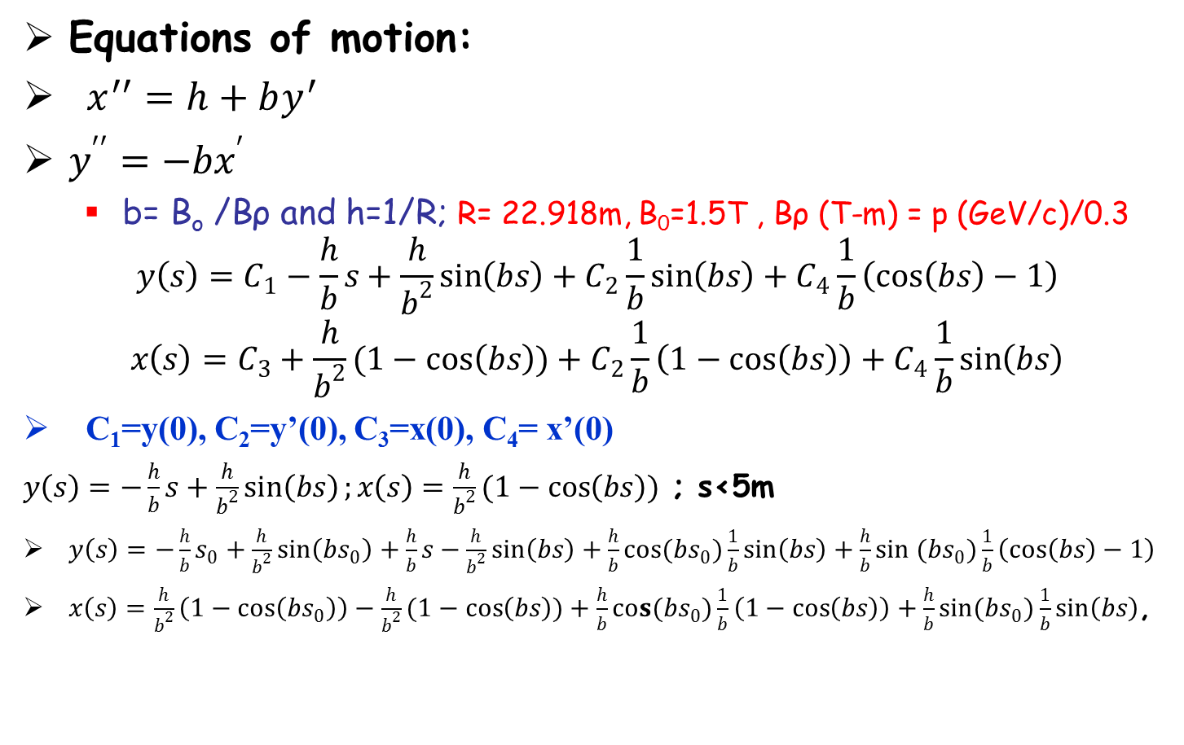
Equations of motion and solution
π⁻, μ⁻
π⁺, μ⁺
proton
absorber
bend
back
Equations of motion:
$x^{′′}=h+by^{′}$
$y^{′′}=−bx^{′}$
  b= B_{o} /Bρ and h=1/R; R= 22.918m, B₀=1.5T , Bρ (T-m) = p (GeV/c)/0.3
$$y\left(s\right)=C_{1}−\frac{h}{b}s+\frac{h}{b^{2}}\sin\left(bs\right)+C_{2}\frac{1}{b}\sin\left(bs\right)+C_{4}\frac{1}{b}\left(\cos\left(bs\right)−1\right)$$
$$x\left(s\right)=C_{3}+\frac{h}{b^{2}}(1−\cos\left(bs\right))+C_{2}\frac{1}{b}\left(1−\cos\left(bs\right)\right)+C_{4}\frac{1}{b}\sin\left(bs\right)$$
C₁=y(0), C₂=y’(0), C₃=x(0), C₄= x’(0)
$y\left(s\right)=−\frac{h}{b}s+\frac{h}{b^{2}}\sin\left(bs\right);x\left(s\right)=\frac{h}{b^{2}}(1−\cos\left(bs\right))$ ; s<5m
$y\left(s\right)=−\frac{h}{b}s_{0}+\frac{h}{b^{2}}\sin\left(bs_{0}\right)+\frac{h}{b}s−\frac{h}{b^{2}}\sin\left(bs\right)+\frac{h}{b}cos(bs_{0})\frac{1}{b}\sin\left(bs\right)+\frac{h}{b}sin (bs_{0})\frac{1}{b}\left(\cos\left(bs\right)−1\right)$
$x\left(s\right)=\frac{h}{b^{2}}\left(1−\cos\left(bs_{0}\right)\right)−\frac{h}{b^{2}}(1−\cos\left(bs\right))+\frac{h}{b}cos(bs_{0})\frac{1}{b}\left(1−\cos\left(bs\right)\right)+\frac{h}{b}sin(bs_{0})\frac{1}{b}\sin\left(bs\right)$,
p, π⁻, μ⁻
π⁺, μ⁺
bend
out
field
taper
target
station
5<s+s₀<10m; s₀=5m

Slide 6
reference particles in chicane
x deviation
  p=0.2, 0.3, 0.4, 0.5, 0.6, 0.7,0.8 ,0.9
y deviation
  p=0.2, 0.3, 0.4, 0.5, 0.6, 0.7, 0.8, 0.9

Slide 7
More reference particles
x motion
  p=0.05, 0.1, 0.15, 0.2, 0.25, 0.3, 0.35 ,0.4
y motion
  p=0.05, 0.1, 0.15, 0.2, 0.25, 0.3, 0.35 ,0.4

Slide 8
motion within chicane
vertical dispersion
  D=-h p s /(0.3B₀)
    s<s₀
  D=h p (s-s₀) /(0.3B₀)
    s₀<s<2s₀
oscillatory motion
  period is Λ= 2π p/(0.3B₀)
  initial amplitude is
  A=hp²/(0.3B₀)²

Slide 9
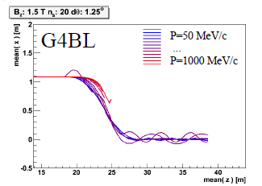
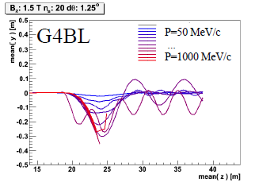
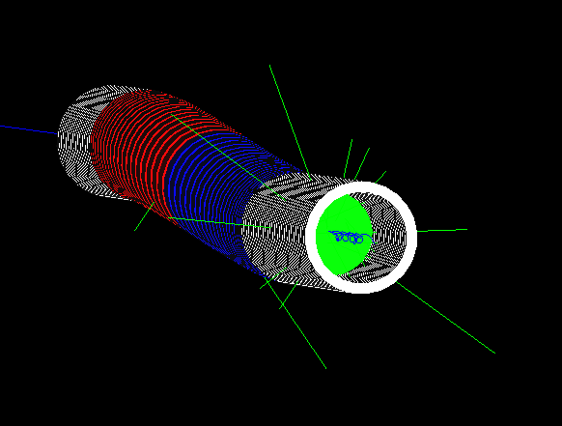

Chicane + absorber
Chicane effect:
  P > ~500MeV/c are lost
  P < ~500MeV pass through
    displaced by ~1.1m
  Nominal Path length increased by only 8cm
    orbits perturbed
absorber effect
  removes low energy particles
    designed to remove protons
  distorts energy distribution
    energy phase-rotation distorted; must be rematched

Slide 10
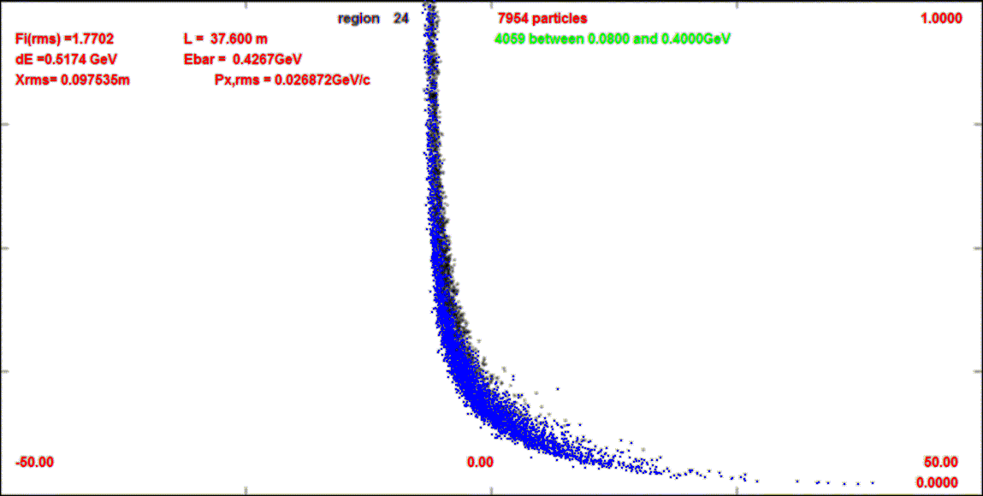
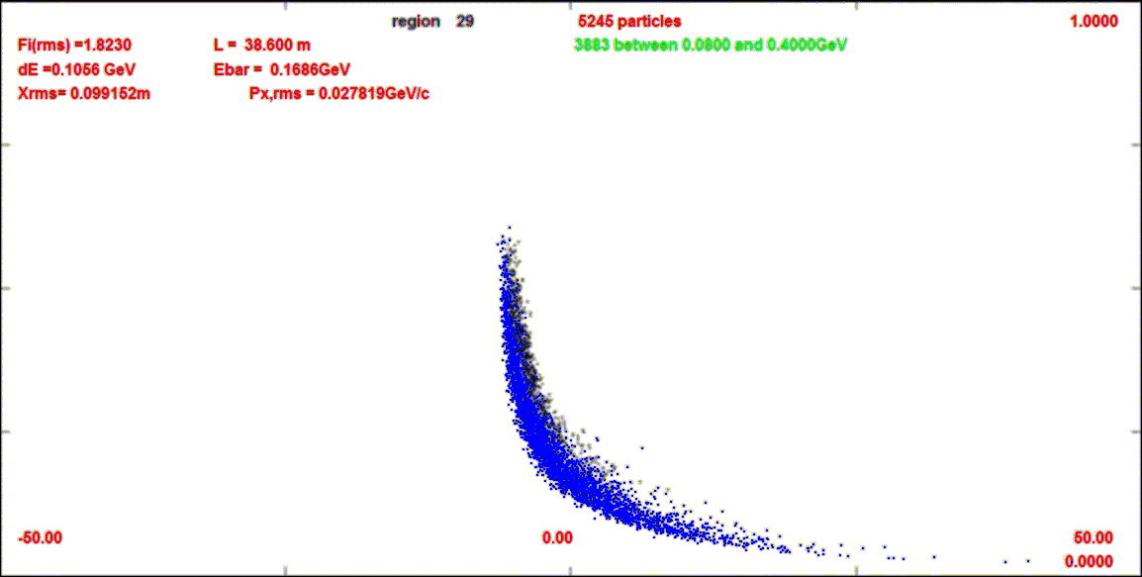
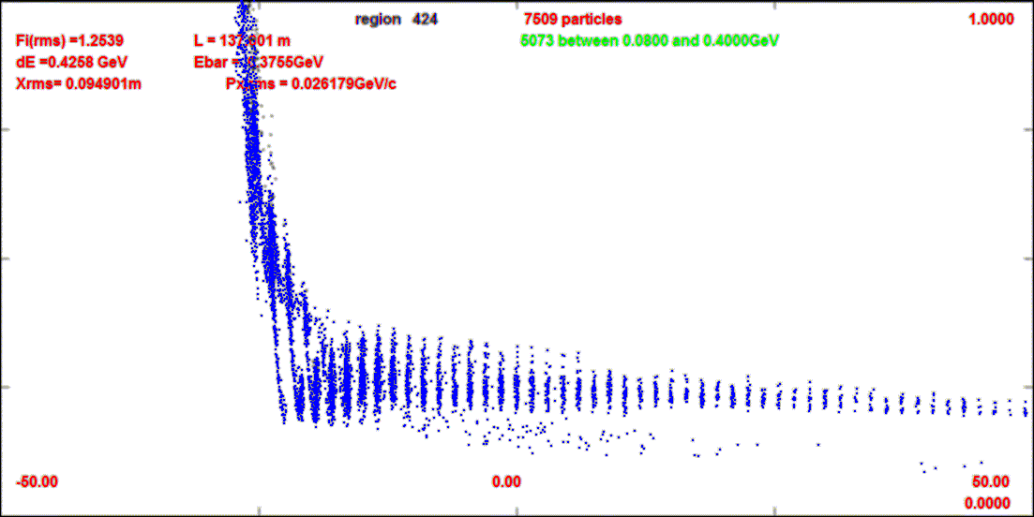
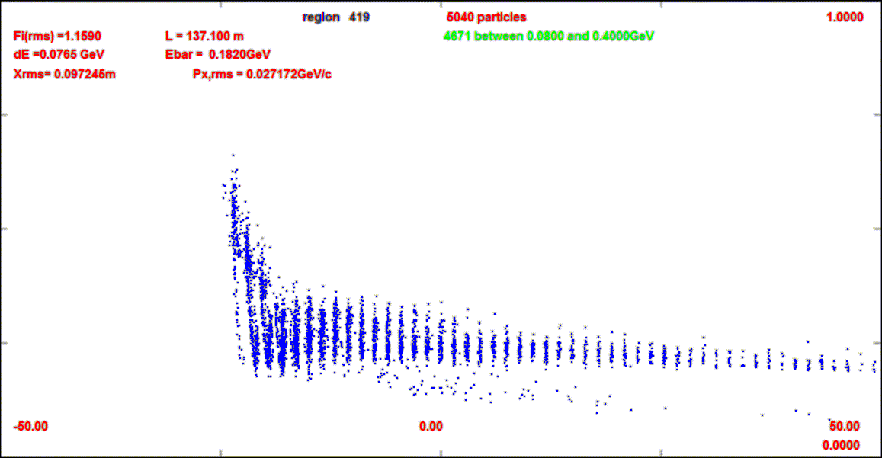
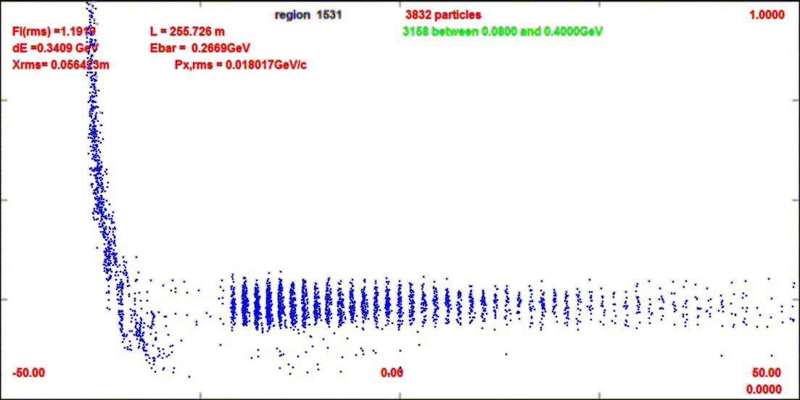
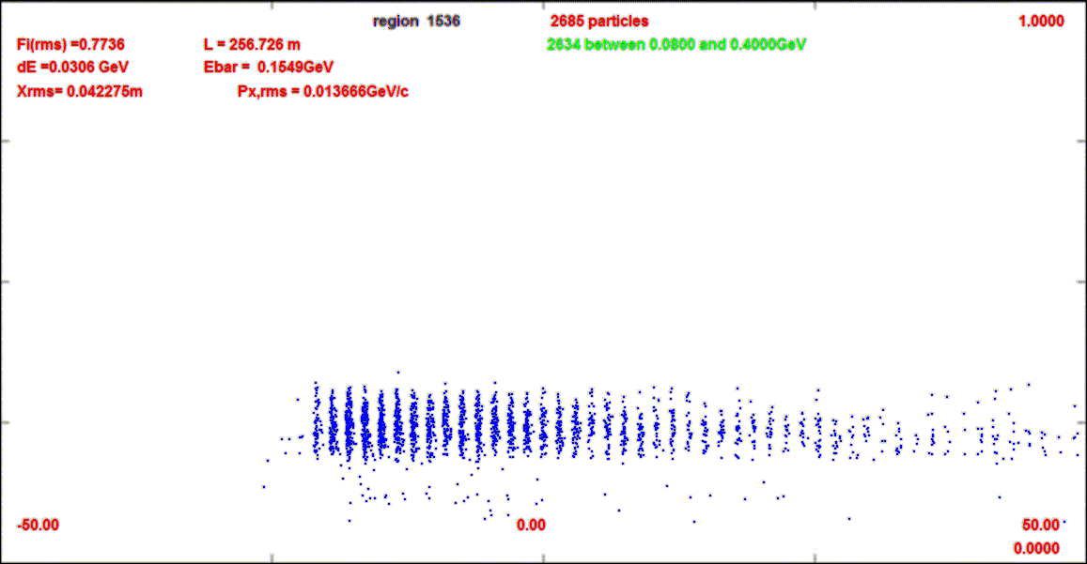
Compare-absorber vs absorber+chicane
This compares absorber only (10cm Be) to chicane (BSOL) + absorber
1.0 GeV/c
z=38m
z=38m
0
z=137m
z=137m
z=255m
z=255m

