Slide 1
Energy-Phase Rotation with a proton absorber
David Neuffer
September 27, 2011

Slide 2
Outline
Front End for the Neutrino Factory-IDS
Beam loss and control
Add Chicane + Proton absorber
Chicane removes high-energy particles
Proton Absorber removes low energy
Need to rematch bunching and phase rotation
compensate for energy loss in absorber

Slide 3
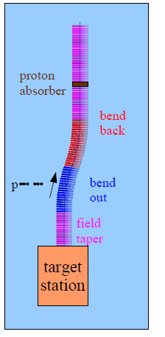
Chicane, Absorber geometry
Chicane:
bend out
L=5m, θ=12.5°
bend back
L=5m, θ=-12.5°
centroid displacement of 1.1m
composed of displaced, tilted B=1.5T coils
~0.25m segments
Absorber:
10cm Be
~30MeV energy loss

Slide 4
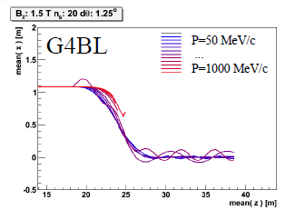
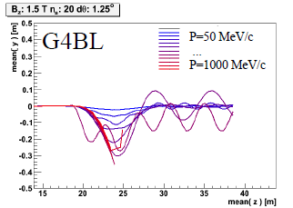
Chicane effect:
P > ~500MeV/c are lost
P < ~500MeV pass through
displaced by ~1.1m
Nominal Path length increased by only 8cm
orbits perturbed
absorber effect
removes low energy particles
designed to remove protons
distorts energy distribution
energy phase-rotation distorted; must be rematched

Slide 5
Front End: IDS Baseline
p
π→μ
FE Target
Solenoid
Drift
Buncher
Rotator
Cooler
18.9 m
~60.7 m
~33m
42 m
~80 m
IDS setup
particle 1-233 MeV/c
particle 2-154MeV/c
Drift
Bunch N=10
Rotate N=10.05
Cool -201.25MHz
with absorber
particle 1-270 MeV/c
particle 2-185 MeV/c
absorber at 29m
10cm Be
particle 1-237 MeV/c
particle 2-144 MeV/c
Bunch N=10
Rotate N=10.04
Cool -201.25MHz
p_{ref}=230 MeV/c

Slide 6
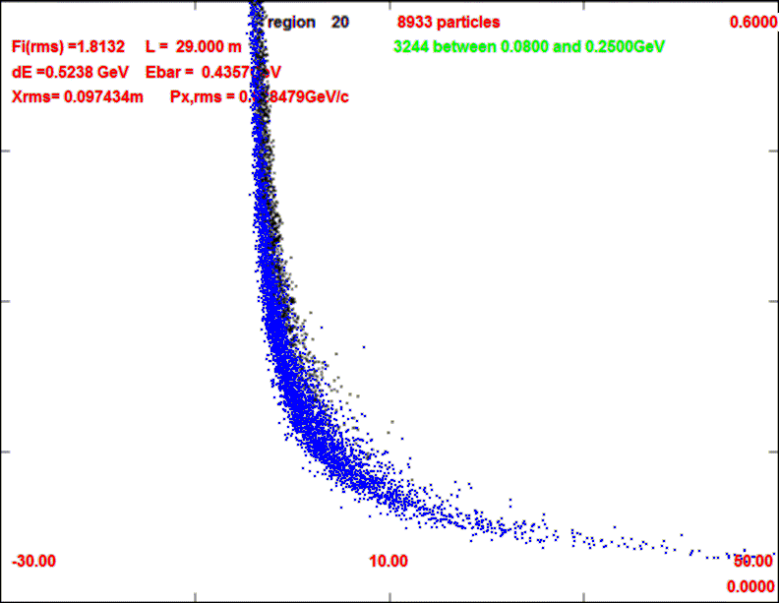
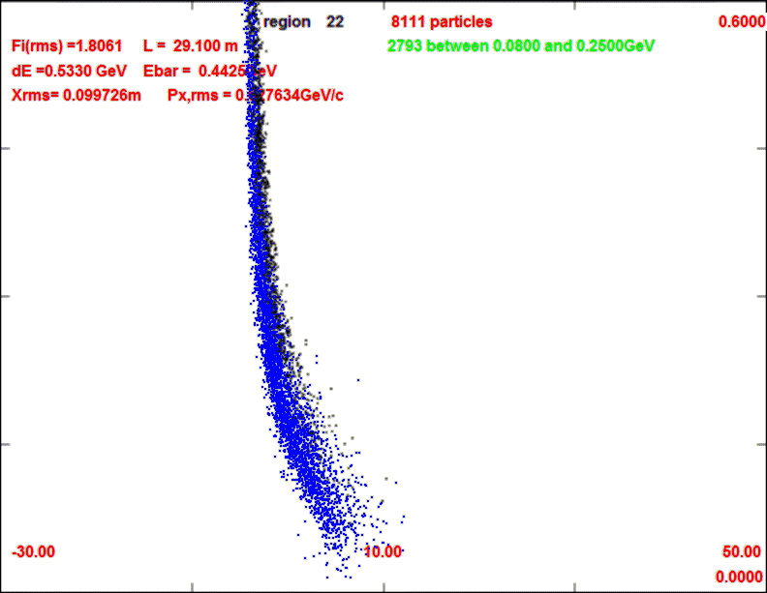
Front End with Absorber
p
π →μ
FE Target
Solenoid
Drift
Buncher
Rotator
Cooler
18.9 m
10.1 m
0.1 m Be
~39.5m
~33m
42 m
~80 m
with absorber
particle 1-270 MeV/c
particle 2-185 MeV/c
absorber at 29m
10cm Be
particle 1-237 MeV/c
particle 2-144 MeV/c
Bunch N=10
Rotate N=10.04
Cool -201.25MHz
p_{ref}=230 MeV/c
29m
29.1m

Slide 7
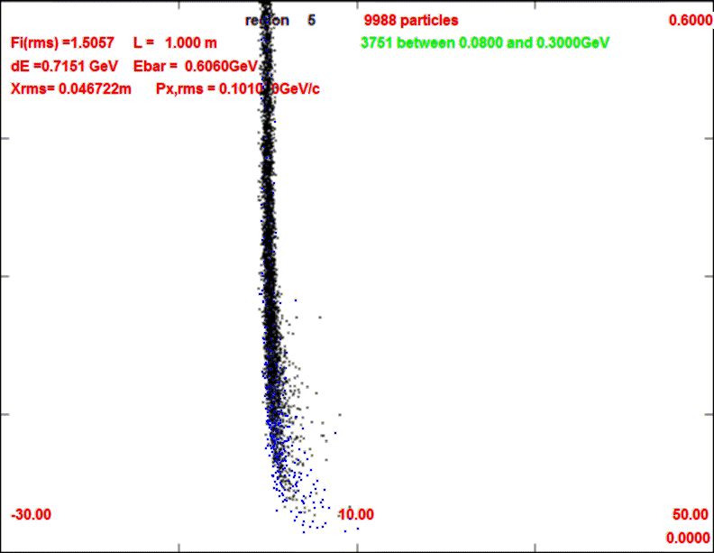
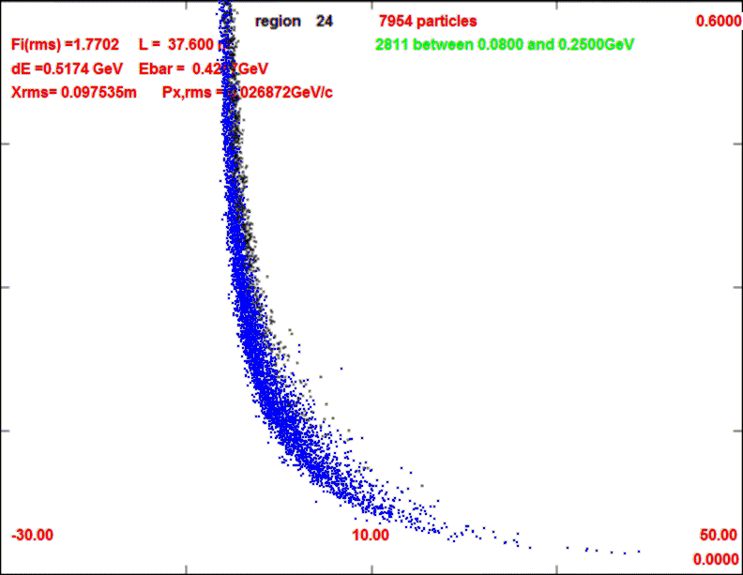
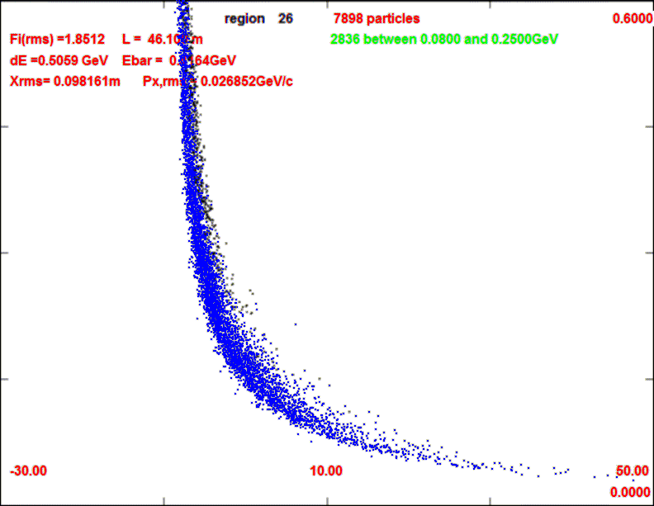
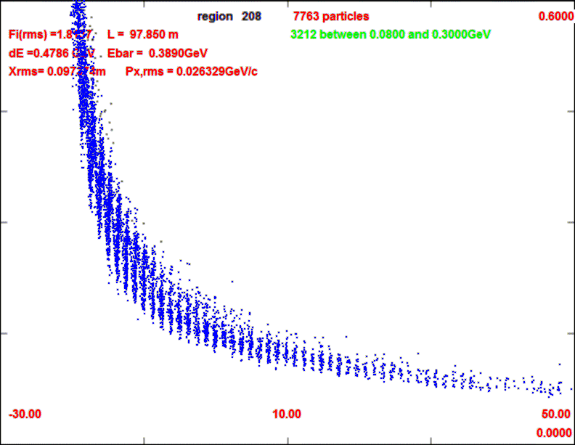
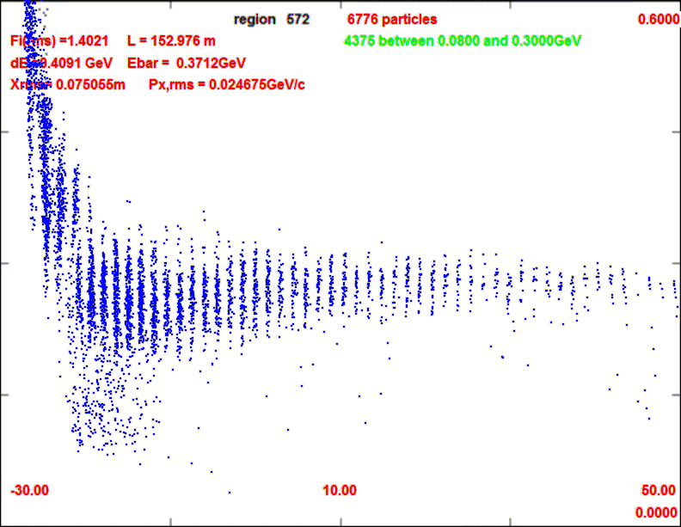
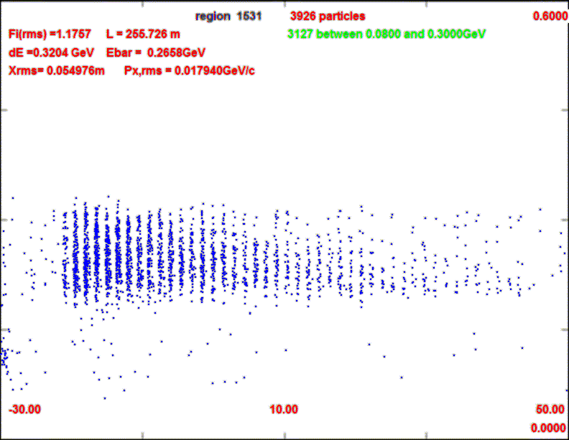
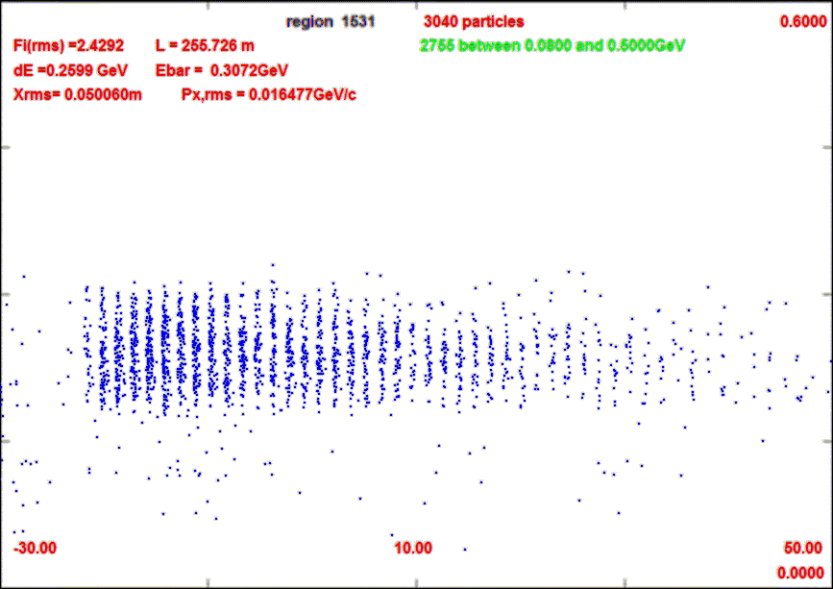
Longitudinal beam through system
0.1m Be absorber
29m
38m
1m
29.1m
46m
98m
152m
252m

Slide 8
ICOOL Simulation results
Similar to without absorber
~10m shorter drift
~10% fewer μ’s within acceptance
drop of ~20% intensity at absorber
but longitudinal emittance also reduced
surviving μ’s are stretched in longitudinal phase space
0.2
μ⁻/p (all)
0.1
μ⁻/p
(ε_{L}<0.2, ε_{t}<0.03)
0
ε_{L}/10
ε_{t}

Slide 9
Summary; to do
Procedure for rematching bunching/rotation with “proton” absorber is demonstrated
track reference particles with energy loss through system
results similar to without absorber
~10% fewer μ’s accepted
Losses reduced by some factor
Chicane + Absorber Geometry needs to be defined and simulated
~10—20% less μ/p (?)
Losses reduced/controlled by ?
Is this version preferred?

