Slide 1
Front End RF and Gas Cavities
David Neuffer
Fermilab
October 11, 2011

Slide 2
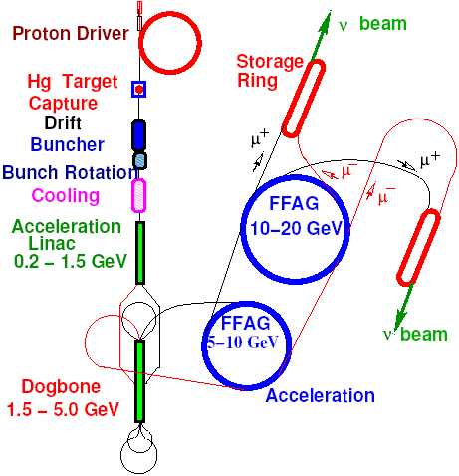
0utline
Introduction
ν-Factory Front end
rf/B limitation
gas-filled rf
ν-Factory→μ⁺-μ⁻ Collider
Discussion
p
π→μ
FE Target
Solenoid
Drift
Buncher
Rotator
Cooler
18.9 m
~60.7 m
~33m
42 m
~80 m

Slide 3
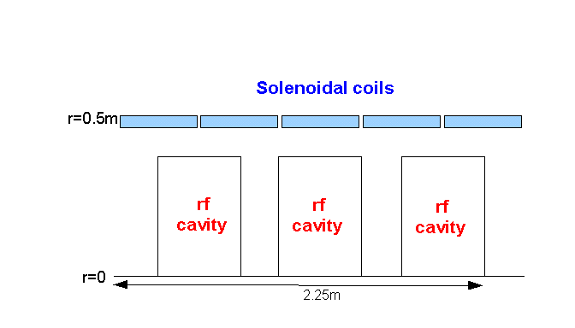
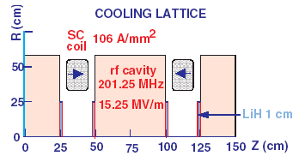
Parameters of IDR baseline
Initial drift from target to buncher is 79.6m
18.9m (adiabatic ~20T to ~1.5T solenoid)
60.7m (1.5T solenoid)
Buncher rf – 33m
320 → 232 MHz
0 → 9 MV/m (2/3 occupancy)
B=1.5T
Rotator rf -42m
232 → 202 MHz
12 MV/m (2/3 occupancy)
B=1.5T
Cooler (50 to 90m)
ASOL lattice, P₀ = 232MeV/c,
Baseline has ~16MV/m, 2 1.1 cm LiH absorbers /cell

Slide 4
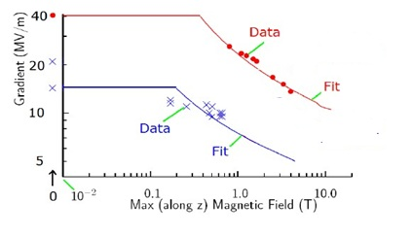
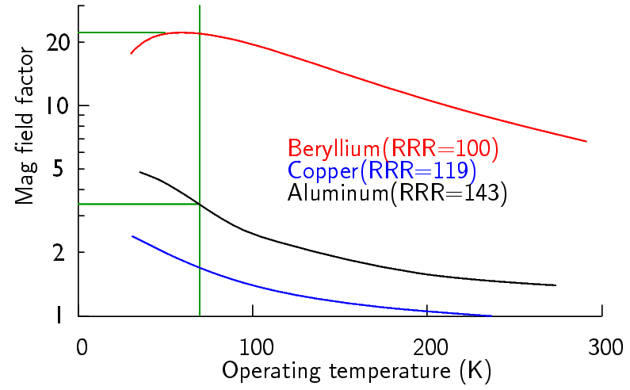
Possible rf cavity limitations
V’_{rf} may be limited in B-fields
800 MHz pillbox cavity
200 MHz pillbox test (different B)
NF needs up to ~1.5T, 12 MV/m
More for cooling
Potential strategies:
Use Be Cavities (Palmer)
Use lower fields (V’, B)
<10MV/m at 1.5T?
Need variant for cooling ?
Cooling channel variants
Use gas-filled rf cavities
Insulated rf cavities
Bucked coils (Alekou)
Magnetic shielding
805MHz
201MHz
Need More Experiments !
at ~200MHz
with B ~B_{frontend}

Slide 5
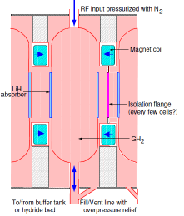
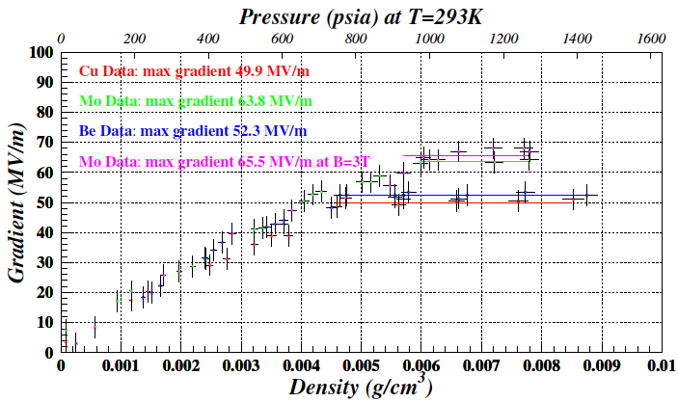
H₂ gas-filled rf in front end cooling section
Scenario I
include only enough gas to prevent breakdown – ~20 atm
E/P = ~9.9 V/cm/Torr
Scenario II
include gas density to provide all cooling
~100atm
E/P ~2

Slide 6
beam in rf cavity
ionization produces electrons along the beam path
~1 e⁻ / 35eV of energy loss (?)
μ in H₂ – 4.1 MeV/gm/cm²
At Liquid density (0.0708) 8290 e⁻ /cm
At 1 atm ~9.82 e⁻/cm
At 20 atm ~196 e⁻/cm
At 100atm ~980 e⁻/cm
Electrons have low energy collisions with H₂ in electric field, equilibrating to a meant velocity proportional
baseline 200 MHz cavity is 0.5m long
10⁴ e/cavity per μ at 20 atm
5×10⁴e/cavity at 100 atm

Slide 7
Electrons within cavity
Electrons have low energy collisions with H₂ in electric field, equilibrating to a mean velocity proportional to x=E/P (Hylen)
$\vec{v}(x)=μ_{H}(x)\vec{x}×5.9×{10}^{5}$ m/s
$μ_{H}(x)≅0.0172x^{−0.53}{(1−0.024x^{0.71})}^{−1.75}$
x is in V/cm/Torr
Electrons extract energy from the cavity from eV·E
Energy loss per rf cycle:
$ΔΕ≅\int_{−\frac{π}{2}}^{\frac{π}{2}}{eμ_{H}(x\cos{θ)x\cos{θ 5.935×{10}^{5}E_{rf}\cos{θdθ}}}}$
assumes electron velocity tracks Electric field through rf cycle
∆E = 2.6×10⁻¹⁶ J (x=10) or ∆E = 1.1×10⁻¹⁶ J (x=2)
16MV/m, 200 MHz

Slide 8
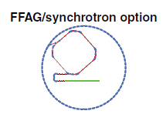
Beam Scenario ?
Muon + intensity depends on proton production intensity
Assume 4MW – 8GeV
N_{p} ≈ 3×10¹⁵/s
60 Hz scenario
~5×10¹³/bunch
Each bunch produces train of secondary bunches
~20 bunches, 0.2 μ/p
~5×10¹¹ charges/bunch
50 Hz, 5 bunches/cycle
~1.2×10¹³/bunch
~10¹¹ charges/bunch

Slide 9
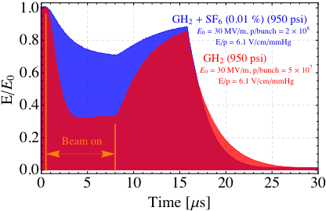
Effect in rf cavity:
Baseline stored energy in 1 rf cavity is 158J
5×10¹¹×10⁴× 2.6×10⁻¹⁶ J/cavity/bunch/rf cycle
~1.3J/rf cycle
but we have ~20 bunches
~26J/rf cycle
after 20 rf cycles
lose 200J
Assumes no recombination/loss of electrons over 100ns
(20 cycles)
100 atm scenario is only a factor of 2 worse.

Slide 10
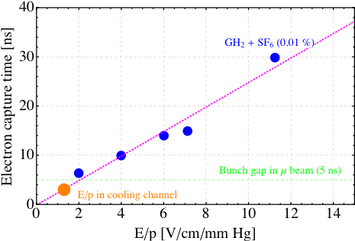
Mitigation
Fewer p/bunch
50Hz, 5 bunches, 2MW scenario reduces by factor of ~10
manageable
Must reduce free electron lifetime in gas
if < ~10ns problem is manageable
< ~200ns (KY)
Is smaller with small amount of dopant

Slide 11
Conclusions
Gas-filled rf in ν-Factory Front end Cooling could have large beam-loading effect
Require electron recombination within ~20ns
Can obtain this with dopant in H₂
Gas-Filled rf can be used in Front end
is not trouble-free however

