Slide 1
Bunch trains for Neutrino factory/ Collider
David Neuffer
November 2013

Slide 2
Outline
Front End
“Muon Collider” versions
325 MHz
Add Chicane/Absorber
  rematch

Slide 3
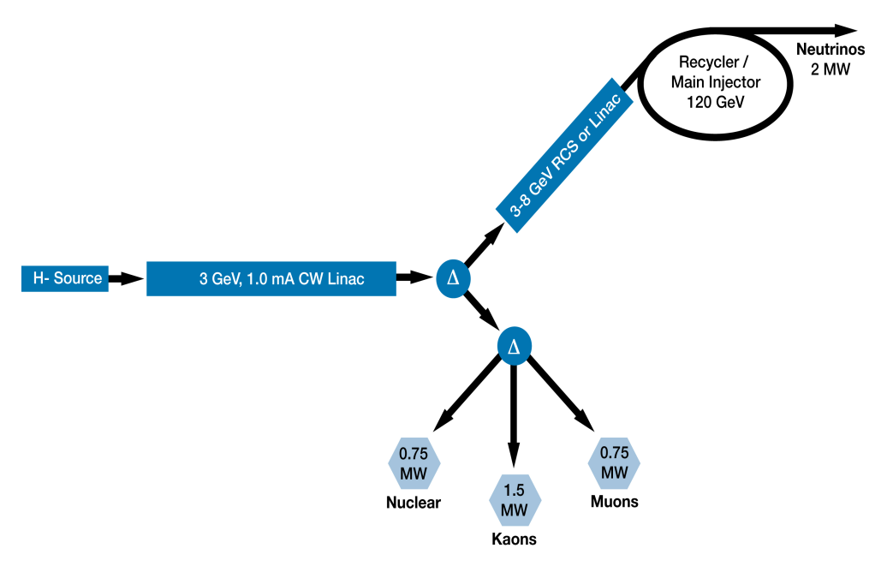
Fermilab PIP X 4
Linac, Accumulator, Compressor run at 15 Hz – 4 bunches
  bunches at 60 Hz
    4 bunches
  1 bunch at time into neutrino factory
    1 μ⁺ and 1 μ⁻ batch per cycle
    60 Hz neutrino factory
  Without trombone
    60 Hz single p bunch for collider
  With trombone
    4→1 15 Hz bunches for collider

Slide 4
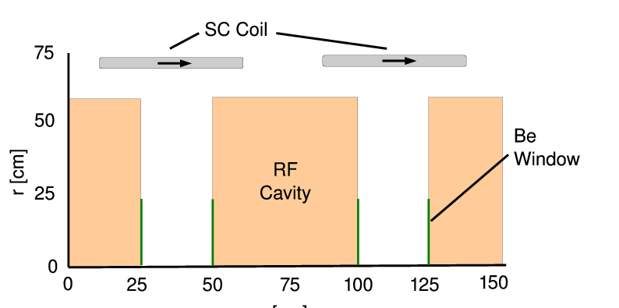
325MHz System “Collider”
Drift
  20T→ 2T
Buncher
  P_{o}=250MeV/c
  P_{N}=154 MeV/c; N=10
  V_{rf} : 0→ 15 MV/m
    (2/3 occupied)
  f_{RF} : 490→ 365MHz
Rotator
  V_{rf} : 20MV/m
    (2/3 occupied)
  f_{RF} : 364→ 326MHz
  N=12.045
  P_{0,} P_{N}→245 MeV/c
Cooler
  245 MeV/c
  325 MHz
  25 MV/m
  2 1.5 cm LiH absorbers
  /0.75m

Slide 5
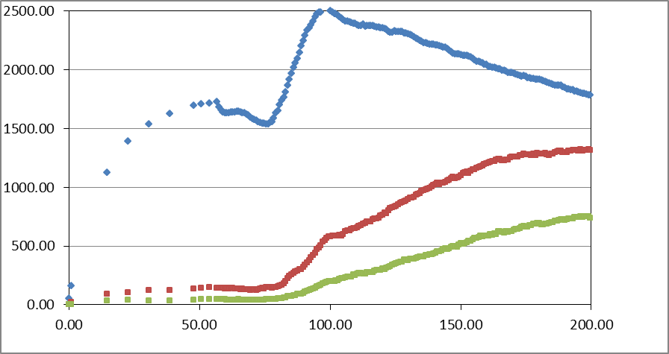
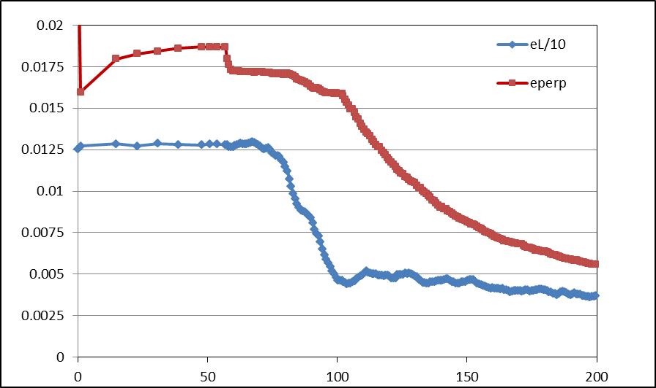
Simulation Results
Simulation obtains
  ~0.125 μ/p within acceptances
  with ~60m Cooler
  shorter than baseline NF
But
  uses higher gradient
  shorter than baseline NF
  325 MHz – less power
  more bunches in bunch train
N :0.15<P<0.35 GeV/c
N: ε_{T}<0.03; A_{L}<0.2
N: ε_{T}<0.015; A_{L}<0.2
Useful
cooling

Slide 6
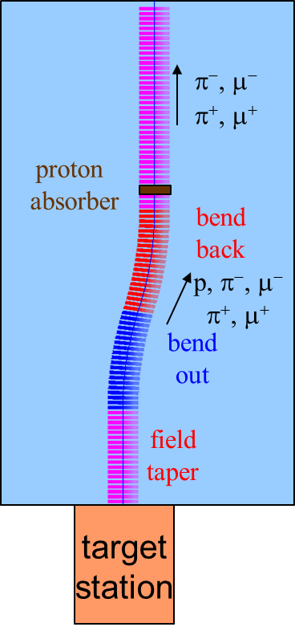
325 Collider w/Updated Chicane/Absorber
Chicane
p
π →μ
FE Target
Solenoid
Drift
Buncher
Rotator
Cooler
6.5+13m chicane
+30.1 m drift
0.1 m Be
14.75 m
~20.5m
~21m
24 m
~80 m
13m chicane
  *6.5m → +21.67°,-21.67º
    particle 1-283 MeV/c
    particle 2-194 MeV/c
  Add 30m drift before absorber
absorber at ~65m
    10cm Be
    particle 1-250 MeV/c
    particle 2-154 MeV/c
  Bunch (N=12) 0→15 MV/m :496→ 365 MHz
  Rotate (N=12.045 )– 20MV/m : 365→326.5MHz
  Cool -325MHz -25 MV/m
    p_{ref}=245 MeV/c
SREGION ! bentsol
6.0 1 1e-2
1 0. 1.0
BSOL
1 2.0 0.0 1 0.283 0.0 0.058181 0.0 0.0 0.0 0. 0. 0. 0. 0.
VAC
NONE
0. 0. 0. 0. 0. 0. 0. 0. 0. 0.

Slide 7
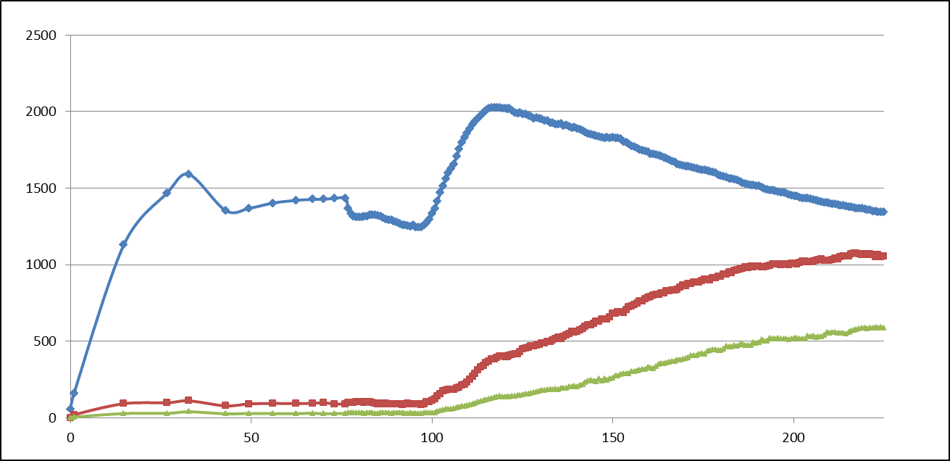
ICOOL results
325 “muon collider” with chicane absorber
  with added drifts between chicane and absorber
    ~30m
  ~0.12 μ/p → ~0.1 μ/p
  smaller emittance beams
    scraped to better fit
All μ+ (0.15<p_{μ} <0.35)
μ+ (A <0.03, A_{L} <0.2)

Slide 8
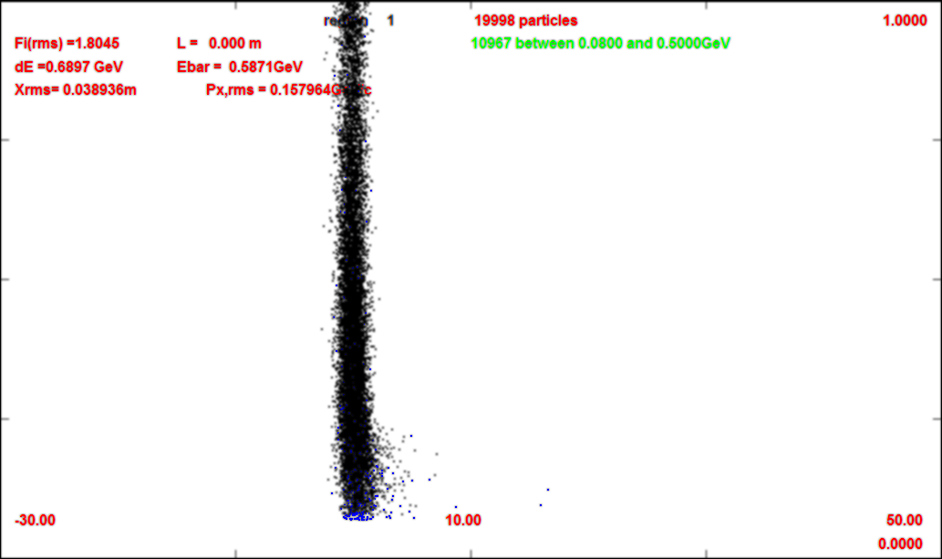
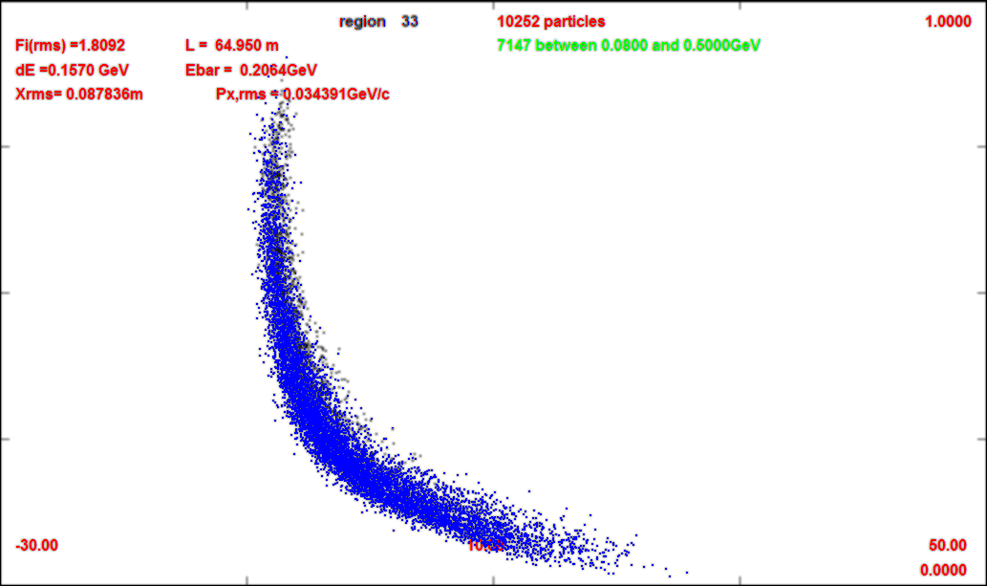
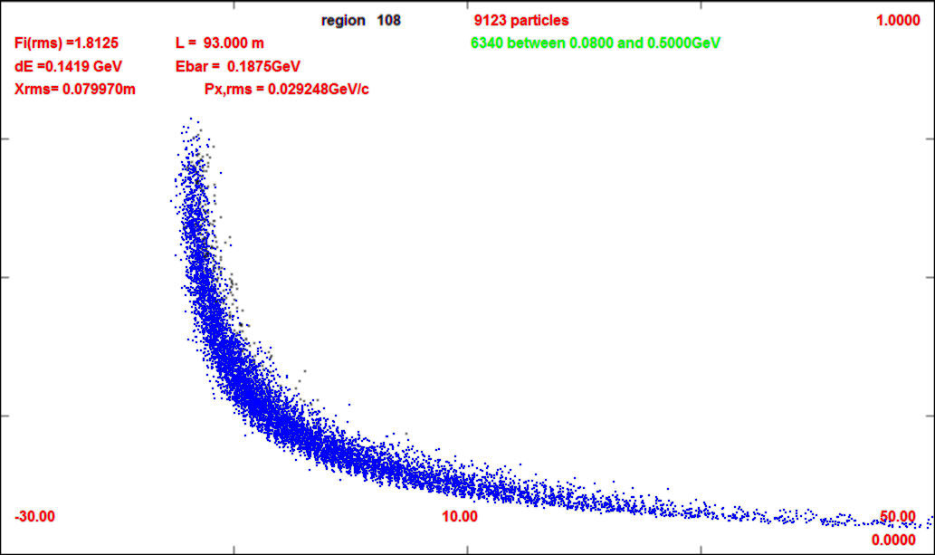
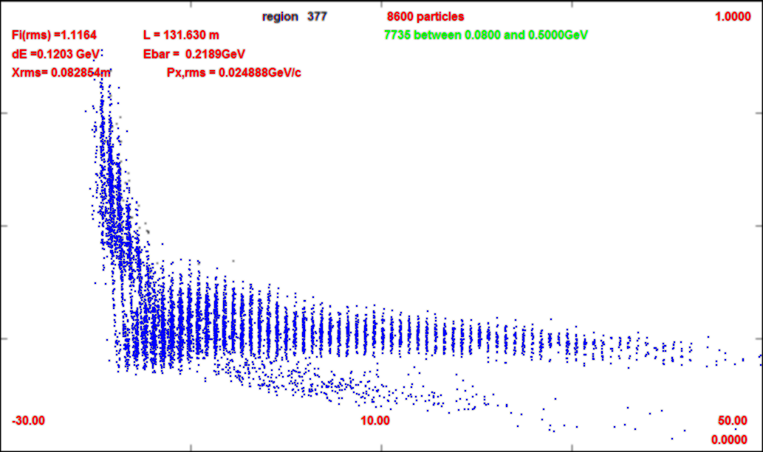
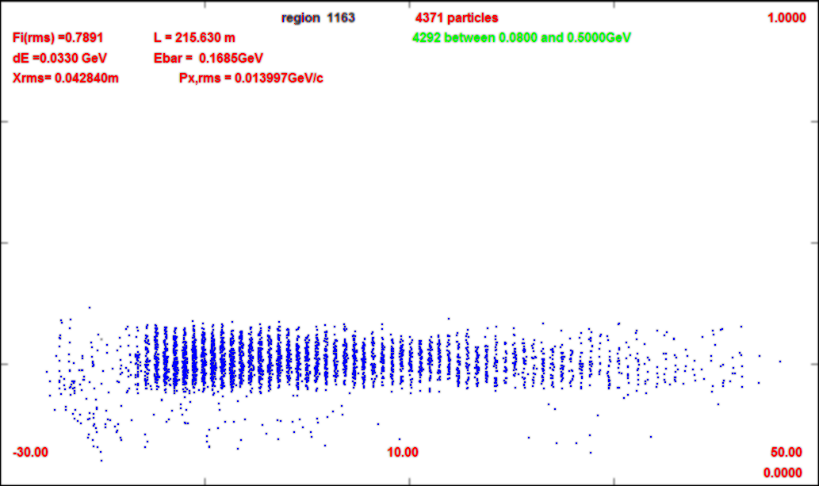
325 (w chicane/absorber)
1.0 GeV/c
~60 m long bunch train
  ~60 325 MHz buckets
For collider choose “best 21 bunches “
  (~19m)
Includes ~2/3 of captured μ’s
  many are lost
21bunches are recombined to 1 in collider scenario
  It is more difficult to recombine 21 than 12
Would like to extend acceptance or generate shorter train
0m
0.0 GeV/c
65m
93m
~ end of rotator
131m
~ After ~80m
215m

Slide 9
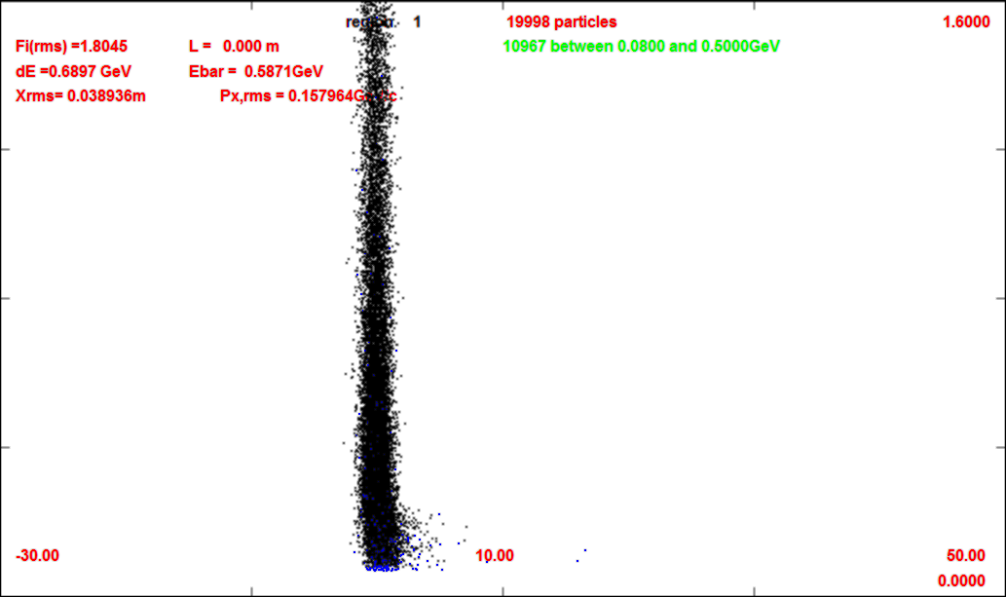
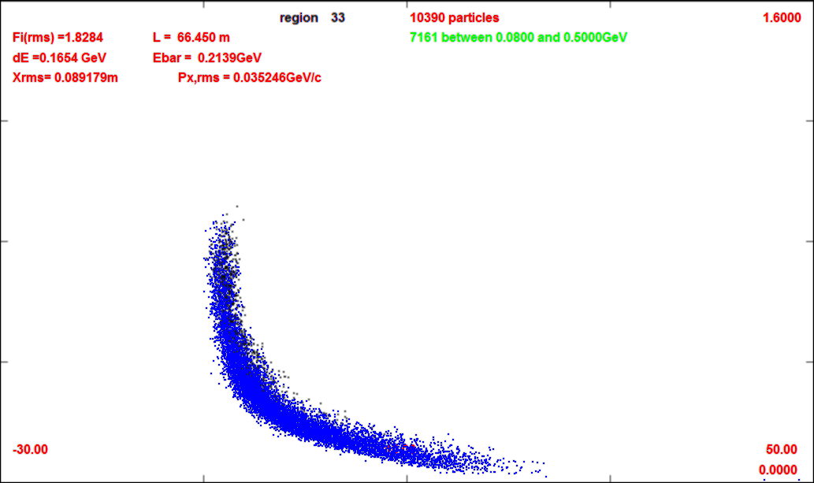
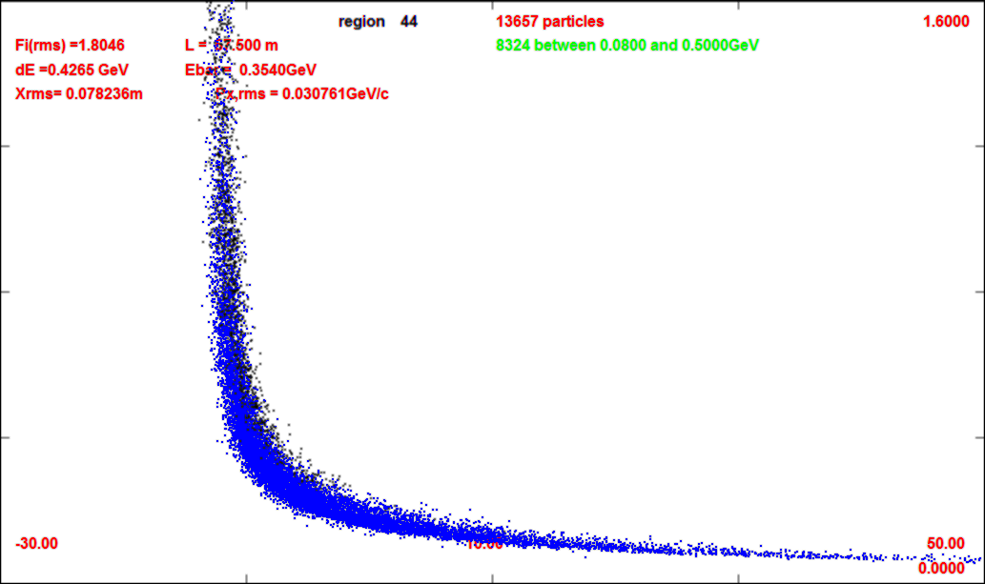
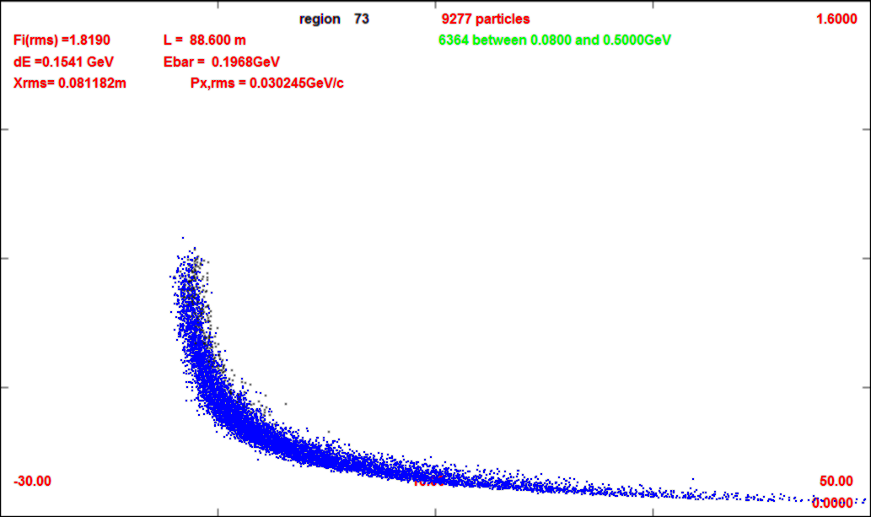
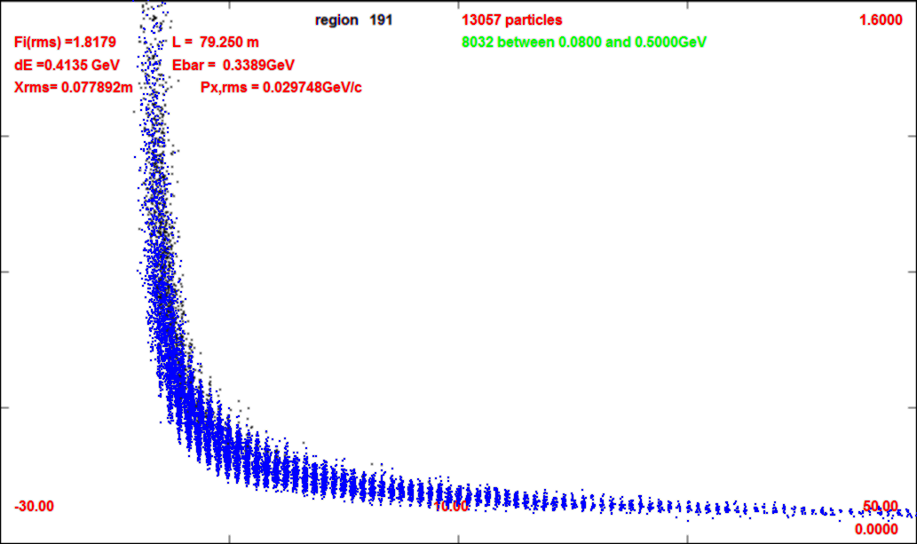
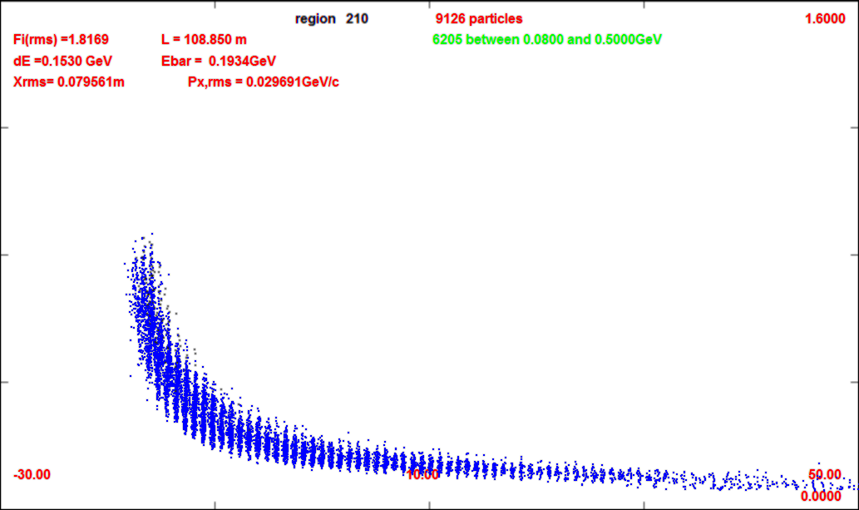
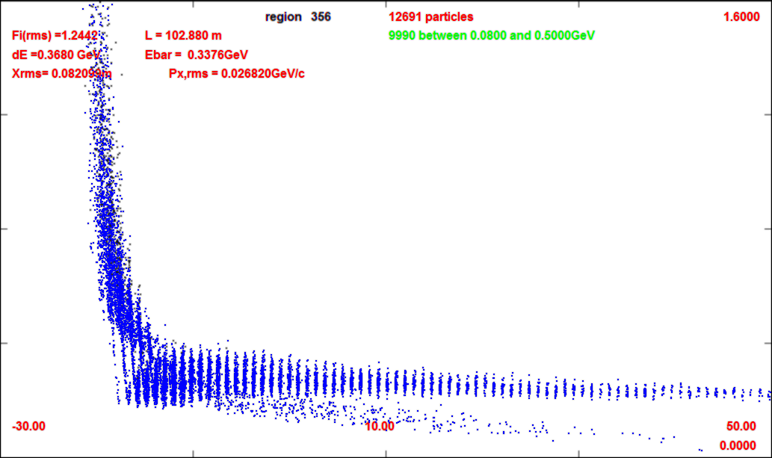
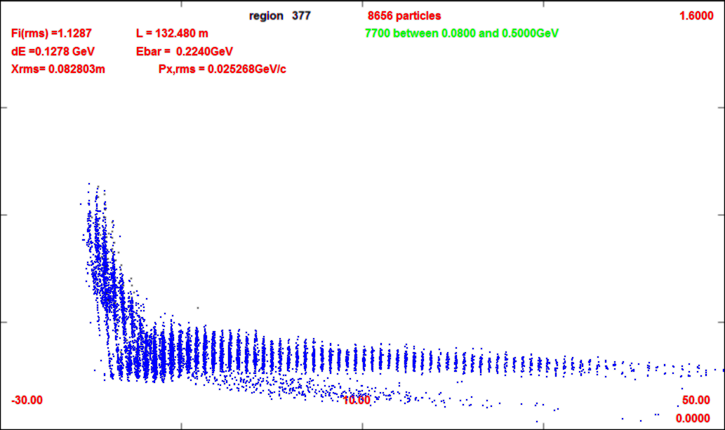
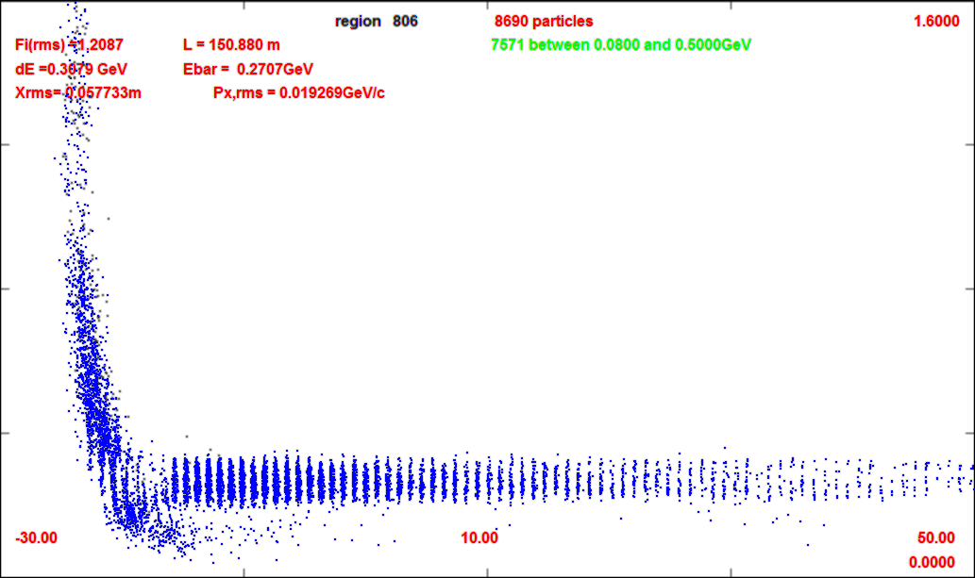
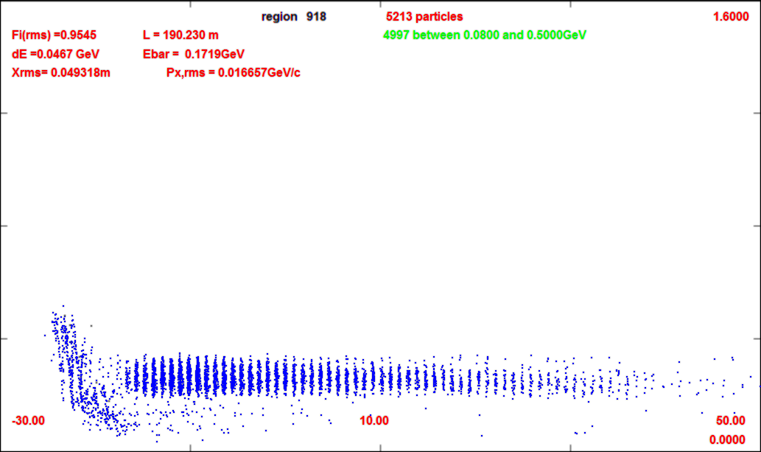
Compare without/with chicane
0m (production target)
-30m
-50m
1600 GeV/c
0m
66m (after chicane/absorber)
1600 GeV/c
0 GeV/c
57m
88m (after drift)
0 GeV/c
109m (after buncher)
79m
102m
-30m
132m (after rotator)
50m
21 bunches for Collider
152m
190m (after cooling)

Slide 10
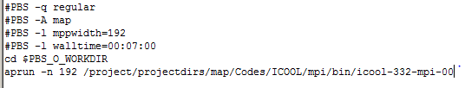
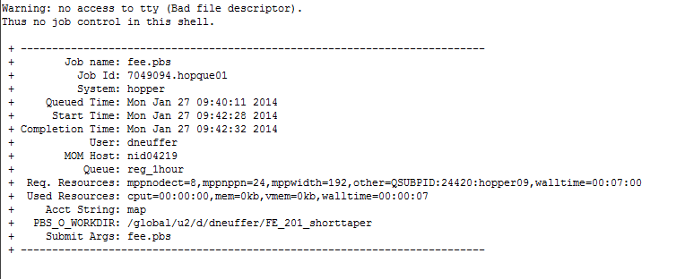
Simulation nonresults
NERSC does not work (for me)
Batch Jobs submitted “run” using no time, no output, no useful diagnostics
  has run properly a couple of times
Hidden UNIX system feature?

Slide 11
Summary
Are studying 325 MHz version (~Collider)
  produces more bunches in same length bunch train than 200 MHz
  requires more bunches to be recombined ~12 → 21
    more difficult … ?
    HCC recombiner ?
  Are including chicane/absorber
  Would like to fit more μ in fewer bunches

Slide 12

Weekly Summary

