Slide 1
Chicane Update
David Neuffer
January 14, 2014

Slide 2
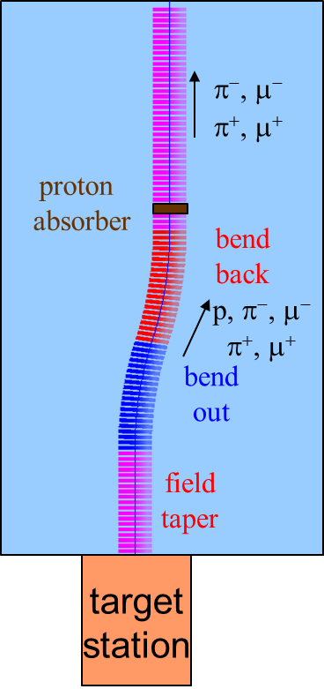
200 MHz Front End with Absorber-Rematch
p
π →μ
FE Target
Solenoid
Drift
Chicane
Buncher
Rotator
Cooler
18.9 m
10.1 m
0.1 m Be
~40.5m
~33m
42 m
~80 m
with absorber & chicane
particle 1-270 MeV/c
particle 2-185 MeV/c
10m chicane (+/- 12.5°)
absorber at 29m
10cm Be
particle 1-237 MeV/c
particle 2-144 MeV/c
Bunch N=10
Rotate N=10.045
Cool -201.25MHz
p_{ref}=235 MeV/c
SREGION ! bentsol
5.0 1 1e-2
1 0. 1.0
BSOL
1 1.5 0.0 1 0.27 0.0 0.043636 0.0 0.0 0.0 0. 0. 0. 0. 0.
VAC
NONE
0. 0. 0. 0. 0. 0. 0. 0. 0. 0.

Slide 3
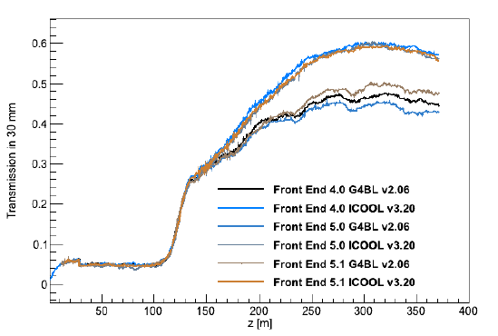
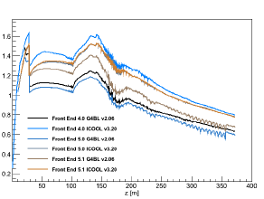
Chicane Anomaly (Rogers)
G4BL version does not work as well as ICOOL version
Comparison
same mu/p after rotator
less gain from cooling
more loss of beam in chicane / absorber
Design differences
ICOOL model idealized
no fringe fields
G4BL coils
smaller aperture cuts ?
design matched within ICOOL
not rematched for G4bl
scraping of larger amplitudes would give this behavior

Slide 4
Chicane Anomaly (Snopok)
Anomaly is due to difference in G4BL/ICOOL in modeling π interactions
Icool is missing nuclear interactions that cause π loss in material
ICOOL adds μ’s from π’s that have not decayed before absorber.
Decay length for π’s is 7.8βγ m
βγ = ~2
Absorber is 29m downstream
→ Place absorber further downstream
π ‘s decay before absorber

Slide 5
325 Front End with Absorber-Rematch
Chicane
p
π →μ
FE Target
Solenoid
Drift
Buncher
Rotator
Cooler
4+10.1 m
0.1 m Be
14.75 m
~39.5m
~21m
24 m
~80 m
“Muon collider” version
*+12.5°,-12.5º
Add chicane + absorber
particle 1-283 MeV/c
particle 2-194 MeV/c
absorber at 29m
10cm Be
particle 1-250 MeV/c
particle 2-154 MeV/c
Bunch N=12 0→15 MV/m :496→ 365 MHz
Rotate N=12.045 – 20MV/m : 365 → 326.5 MHz
Cool -325MHz -25 MV/m
p_{ref}=245 MeV/c
SREGION ! bentsol
5.0 1 1e-2
1 0. 1.0
BSOL
1 2.0 0.0 1 0.283 0.0 0.043636 0.0 0.0 0.0 0. 0. 0. 0. 0.
VAC
NONE
0. 0. 0. 0. 0. 0. 0. 0. 0. 0.

Slide 6
Update Chicane to reduce π losses
Chicane
p
π →μ
FE Target
Solenoid
Drift
Buncher
Rotator
Cooler
4+12m chicane
+10 .1 m drift
0.1 m Be
14.75 m
~33.1m
~21m
24 m
~80 m
Add 10 m drift after chicane
*6m → +15°,-15º
Add chicane + absorber
particle 1-283 MeV/c
particle 2-194 MeV/c
absorber at 41m
10cm Be
particle 1-250 MeV/c
particle 2-154 MeV/c
Bunch (N=12) 0→15 MV/m :496→ 365 MHz
Rotate (N=12.045 )– 20MV/m : 365 → 326.5 MHz
Cool -325MHz -25 MV/m
p_{ref}=245 MeV/c
SREGION ! bentsol
6.0 1 1e-2
1 0. 1.0
BSOL
1 2.0 0.0 1 0.283 0.0 0.043636 0.0 0.0 0.0 0. 0. 0. 0. 0.
VAC
NONE
0. 0. 0. 0. 0. 0. 0. 0. 0. 0.

Slide 7
325 case with/without chicane
2.0 GeV/c
Compare beam in Buncher without and with chicane/abs
high-energy tail removed
(> ~0.7 GeV/c)
p, π removed earlier
Figures show μ⁺ only
P, cτ coordinates
without chicane/absorber
0
2.0 GeV/c
with chicane/absorber
0
-30m
50m

Slide 8
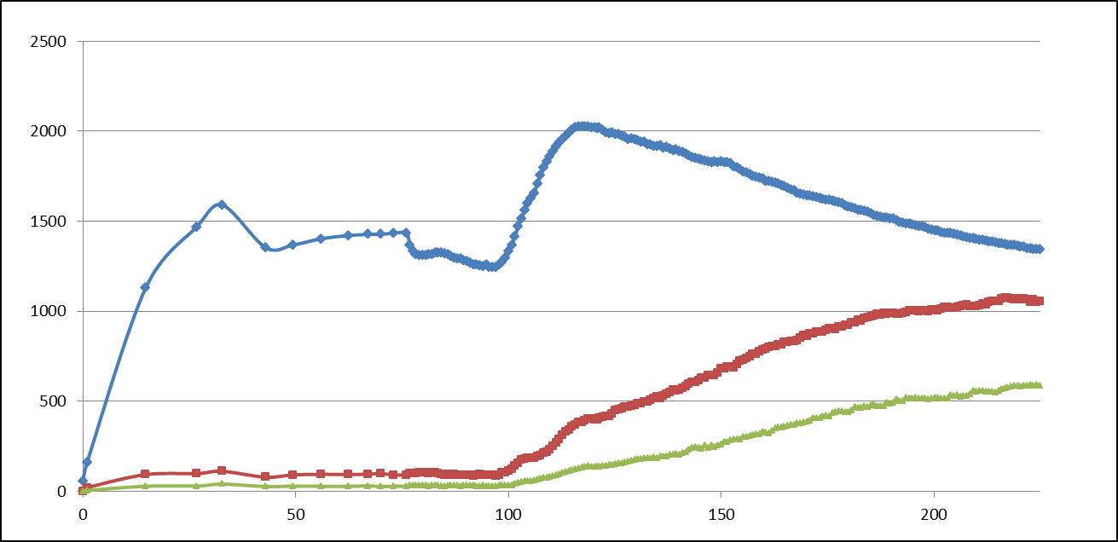
ICOOL results
Increased added drift
Added drifts of 10, 20, 30m before absorber
similar ICOOL results to + 0
z=+ 10 slightly better
small drop for z=20, 30
~5%
All μ+ (0.15<p_{μ} <0.35)
μ+ (A <0.03, A_{L} <0.2)

Slide 9
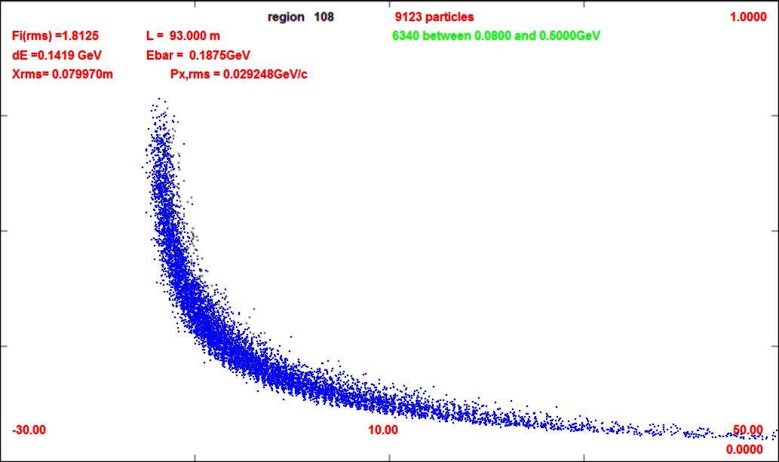
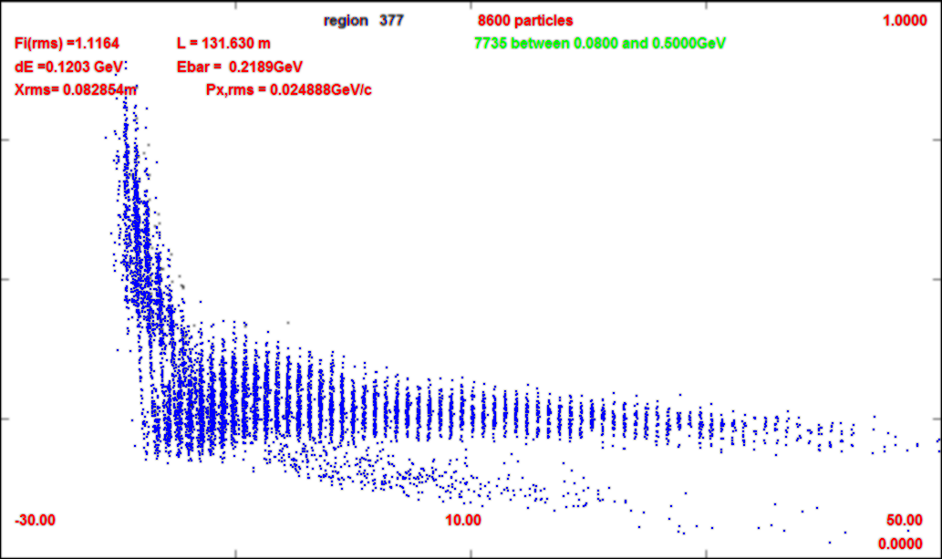
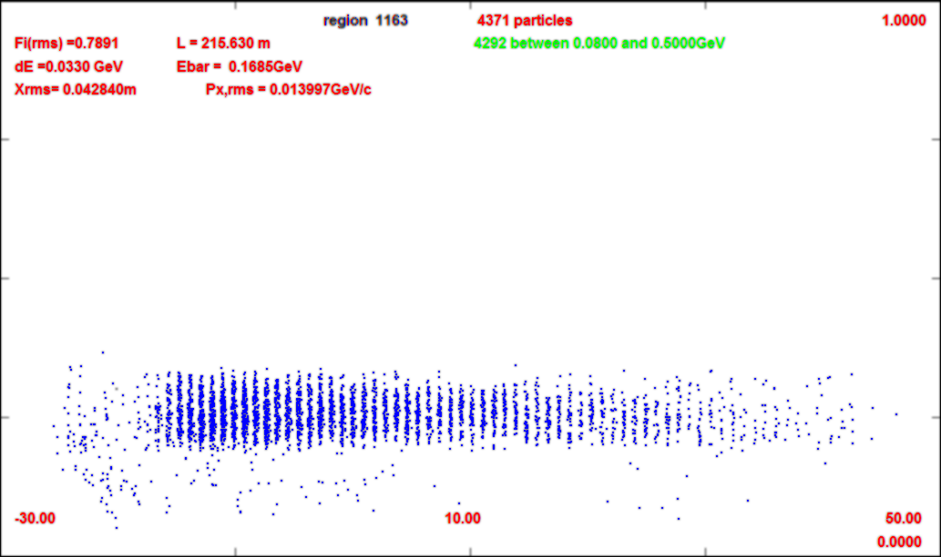
Simulation through system
Not a large difference in beam dynamics
for +30 case absorber is ~64m
~21.8m more to start of buncher
Prepulse not completely eliminated
1.0 GeV/c
0m
0.0 GeV/c
65m
93m
131m
215m

Slide 10
Current Status

