Slide 1
Front End for MAP Neutrino Factory/Collider rf considerations
David Neuffer
May 29, 2014

Slide 2
Outline
Previous baseline was 200 MHz (IDS nu Factory)
  Rf, power req.
Front End for MAP NF/MC 325 MHz
  Bunch train shorter than IDS …
  With Chicane/Absorber
  Current baseline
    Use short taper
Variations under study

Slide 3
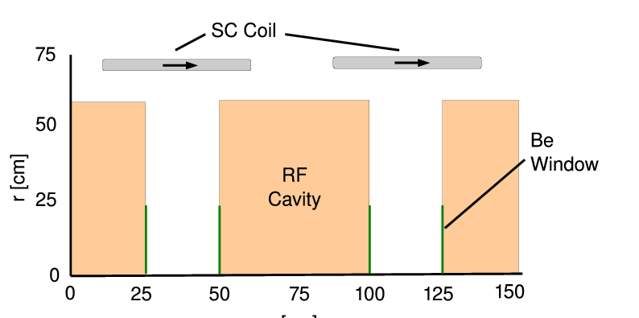
325MHz System “Collider”
Drift
  20T→ 2T
Buncher
  P_{o}=250MeV/c
  P_{N}=154 MeV/c; N=10
  V_{rf} : 0→ 15 MV/m
    (2/3 occupied)
  f_{RF} : 490→ 365MHz
Rotator
  V_{rf} : 20MV/m
    (2/3 occupied)
  f_{RF} : 364→ 326MHz
  N=12.045
  P_{0,} P_{N}→245 MeV/c
Cooler
  245 MeV/c
  325 MHz
  25 MV/m
  2 1.5 cm LiH absorbers
  /0.75m

Slide 4
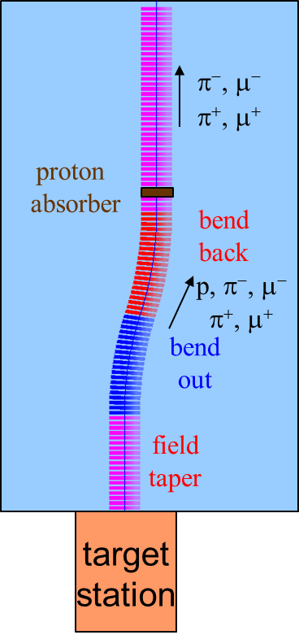
325 Collider Update w/Chicane/Absorber
Chicane + Absorber
p
π →μ
FE Target
Solenoid
15m drift +13m chicane
+30.1 m drift
Drift
Buncher
Rotator
Cooler
0.1 m Be
6 m
~22m
~21m
24 m
~80 m
Add 30 m drift after chicane
  *6.5 m → +15°,-15º
Add chicane + absorber
    particle 1-283 MeV/c
    particle 2-194 MeV/c
  absorber at 41m
    10 cm Be
    particle 1-250 MeV/c
    particle 2-154 MeV/c
  Bunch (N = 12) 0→15 MV/m: 496→ 365 MHz
  Rotate (N=12.045 )– 20 MV/m: 365 → 326.5 MHz
  Cool -325 MHz -25 MV/m
    P_{ref} = 245 MeV/c
SREGION ! bentsol
6.5 1 1e-2
1 0. 1.0
BSOL
1 2.0 0.0 1 0.283 0.0 0.058181 0.0 0.0 0.0 0. 0. 0. 0. 0.
VAC
NONE
0. 0. 0. 0. 0. 0. 0. 0. 0. 0.

Slide 5
ICOOL results
325 “muon collider” with chicane absorber
  with added drifts between chicane and absorber
    ~30 m
  ~ 0.105 μ/p → but smaller emittance beams
    scraped to better fit?
Change to shorter taper
  15 m → 6 m
  (Hisham) slight improvement in throughput (~ 5%)
  We are using Hisham’s more recent distributions
    Gains ~ 5-10%
    Total is now ~ 0.115 μ/p (in baseline ICOOL simulation units)
Better Rotator/Cooler match (Diktys)
  +5%
  Cooler will be replaced by better 6-D cooler (Alexahin)

Slide 6
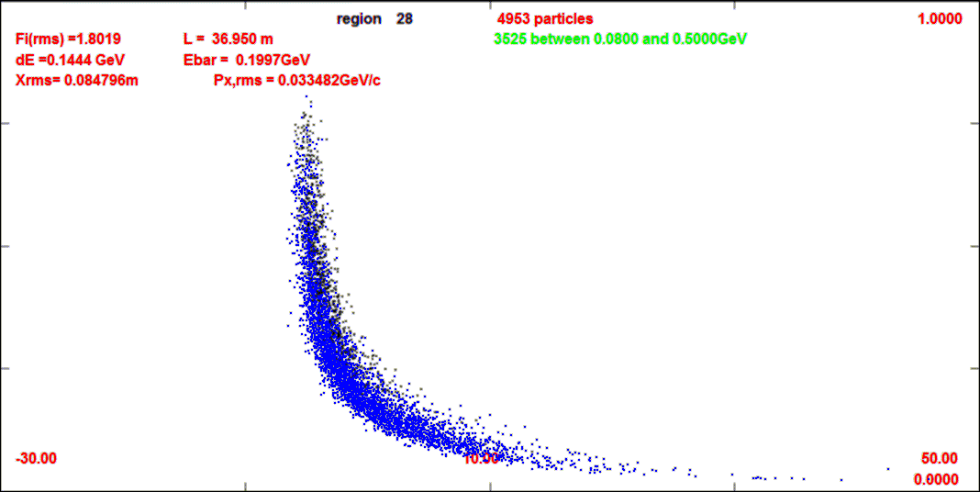
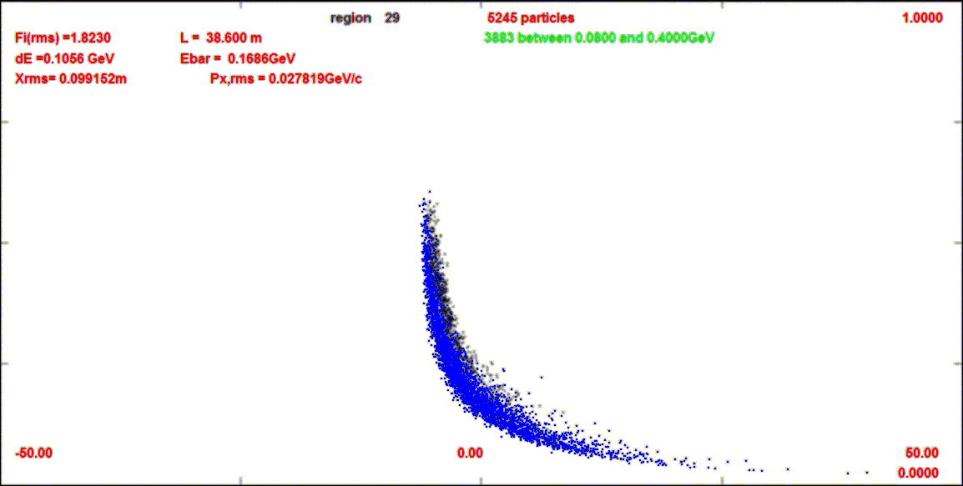
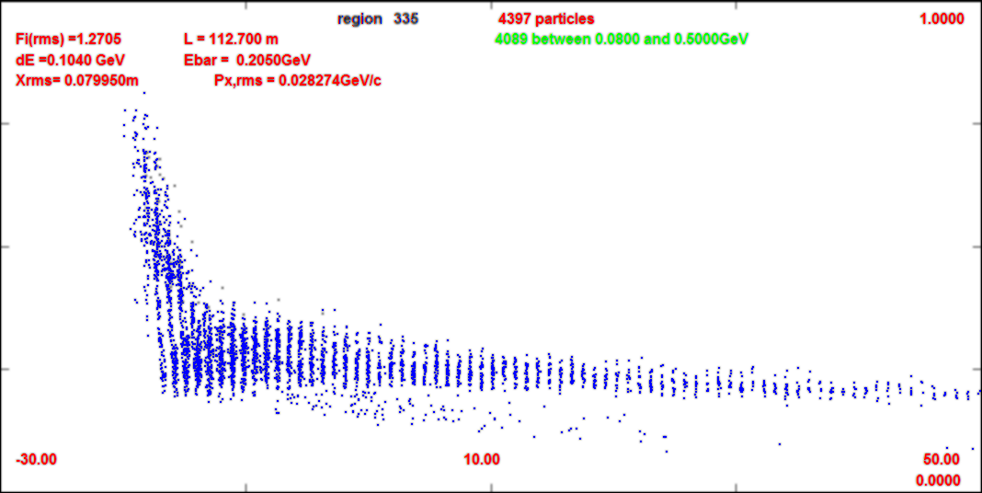
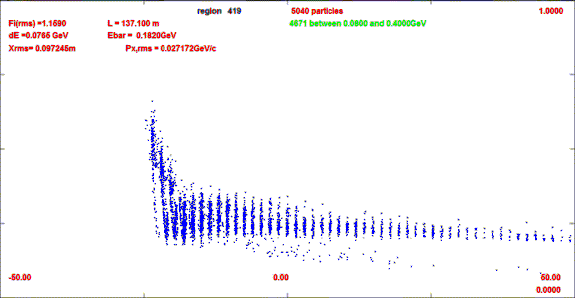
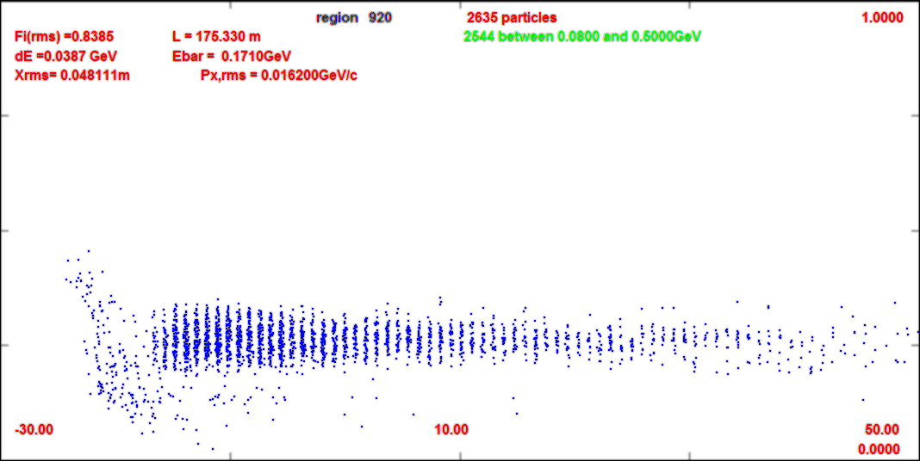
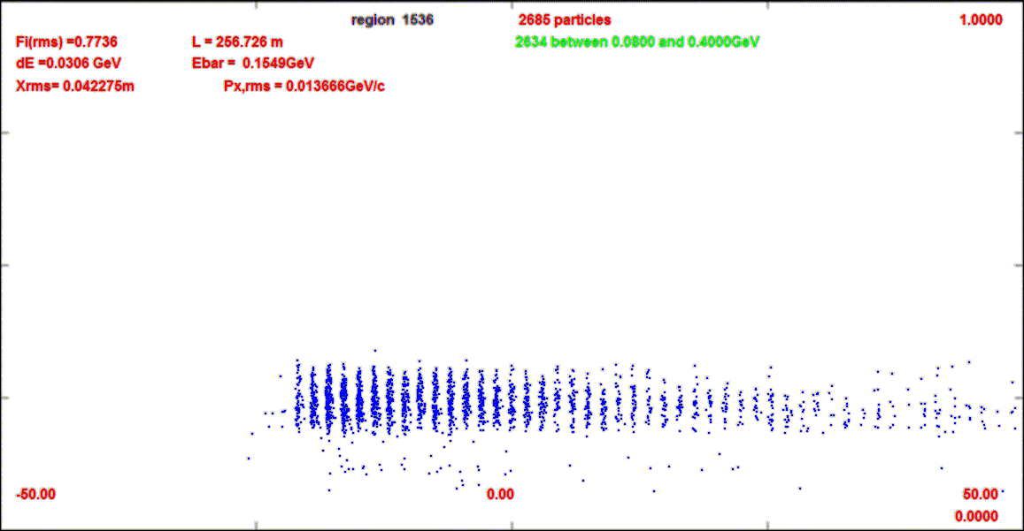
Compare 325 w chicane vs old 200
High P cutoff is ~700 MeV/c (from ~500 MeV/c)
1.0 GeV/c
z=38m
0
z=137m
z=255m

Slide 7
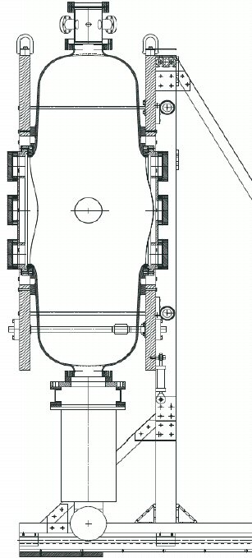
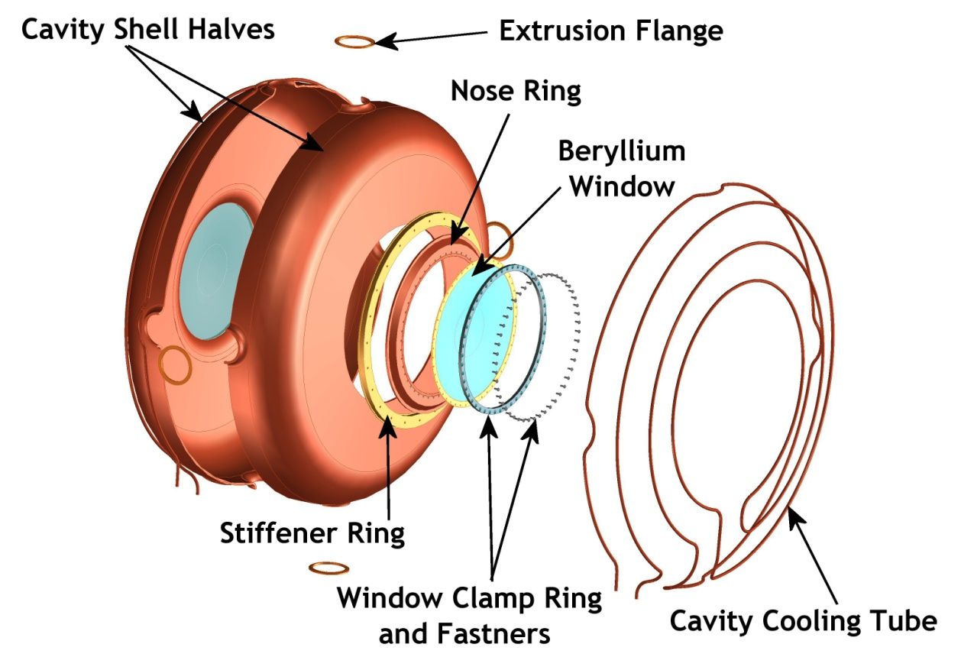
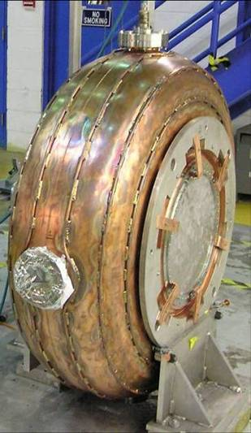
Rf cavity
Concept design construction operation

Slide 8
MAP rf properties (~ MICE rf)
Assume pillbox, Cu walls
  Compare with MICE rf
Q = ~58000
  a=0.574m, L=0.5, f=200MHz
  T_{t}=0.83
P₀ = 1.35 MW at 10MV/m
  f=200MHz, L=0.5m, E₀=10MV/m
  U₀ = 62J, T_{fill} = 63.7μs
  P₀ = 3MW at 15MV/m
MICE rf parameters | Value
Radius (mm) | 610
Length (mm) | 430
RT² _{(MΩ}/m) | 22
Power needed (16MV/m) | 4MW
Quality factor, Q₀ | 54,000

Slide 9
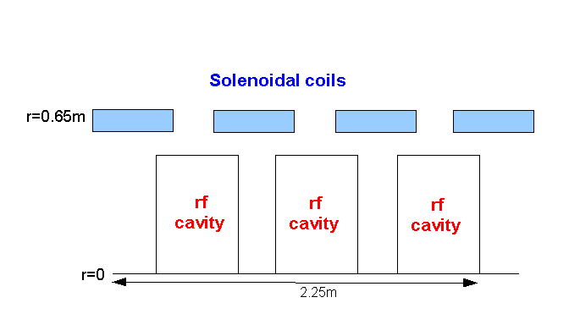
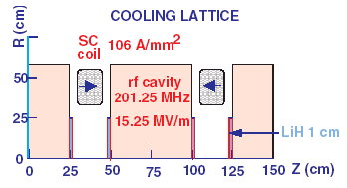
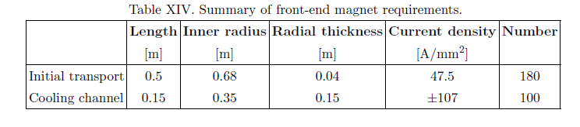
IDS RF requirements
Buncher
  37 cavities (13 frequencies)
  13 power supplies (~1—3MW)
RF Rotator
  56 cavities (15 frequencies)
  12 MV/m, 0.5m
  ~2.5MW (peak power) per cavity
Cooling System – 201.25 MHz
  100 0.5m cavities (75m cooler), 15MV/m
  ~4MW /cavity
Front End section | Length | #rf cavities | frequencies | # of freq. | rf gradient | rf peak power requirements
Buncher | 33m | 37 | 319.6 to 233.6 | 13 | 4 to 7.5 | ~1 to 3.5 MW/freq.
Rotator | 42m | 56 | 230.2 to 202.3 | 15 | 12 | ~2.5MW/cavity
Cooler | 75m | 100 | 201.25MHz | 1 | 15 MV/m | ~4MW/cavity
Total drift) | ~240m | 193 |  | 29 | ~1000MV | ~550MW
rf
Magnet Requirements:

Slide 10
Rf Buncher/Rotator requirements
Buncher -21m
  37 cavities (14 frequencies)
  13 power supplies (~1—3MW)
RF Rotator -24m
  64 cavities (16 frequencies)
  20 MV/m, 0.25m
  ~2 MW (peak power) per cavity
Cooling System – 201.25 MHz
  200 0.25m cavities (75m cooler), 25MV/m
  ~4MW /cavity
Front End section | Length | #rf cavities | frequencies | # of freq. | rf gradient | rf peak power requirements
Buncher | 21m | 37 | 484 to 365 | 14 | 0 to 16 | 0—1.34 MW/cavity
Rotator | 24m | 56 | 364to 326 | 16 | 20 | ~2.4 MW/cavity
Cooler | 75m | 200 | 325 | 1 | 25 MV/m | ~3.7MW/cavity
Total df+bxr+rttr | ~134m | 93 |  | 30 | ~500MV | 140MW
rf

Slide 11
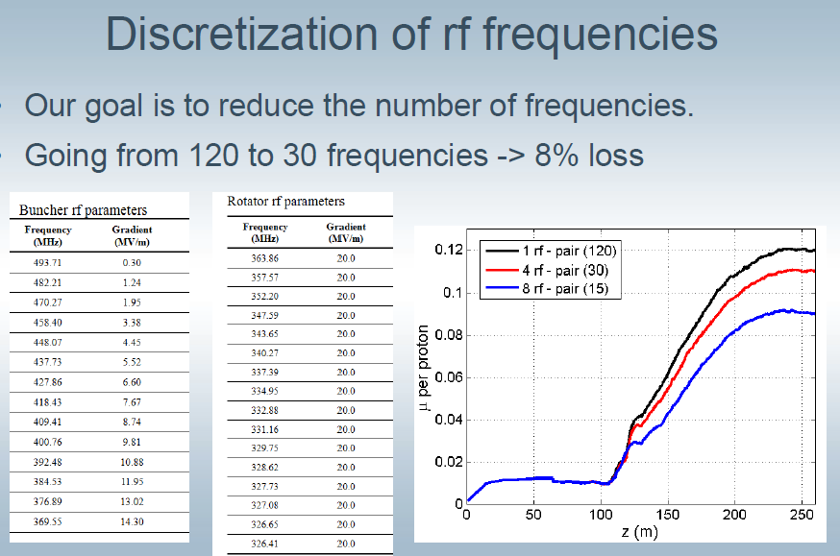
First result on discretization

Slide 12
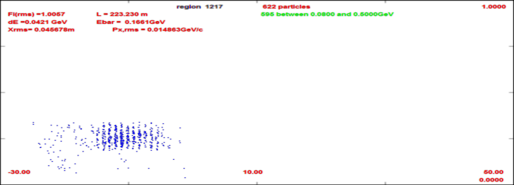
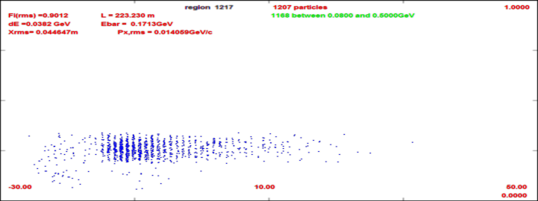
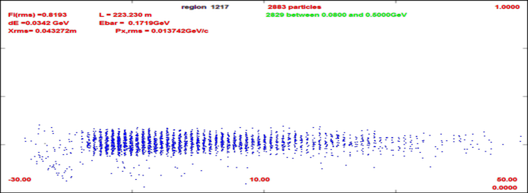
Dependence on rf gradient
With same cooling channel
  25MV/m IDS 4-D cooling
Change Buncher/Rotator peak rf voltage
  0 –25 MV/m
Longer bunch train captured with larger V’
20 MV/m
0 MV/m
10 MV/m

Slide 13
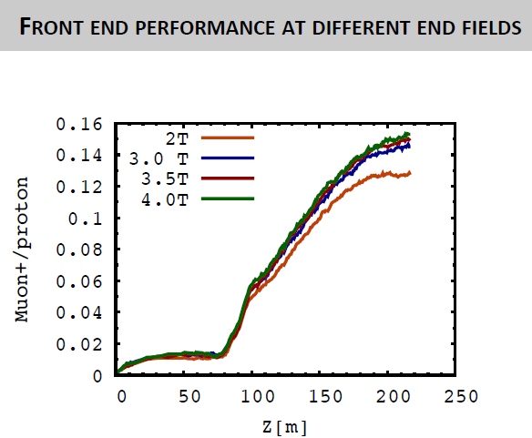
Dependence on B_{final}

Slide 14
Summary
We are studying 325 MHz based front end
  produces more bunches in same length bunch train than 200 MHz
  requires more bunches to be recombined ~12 → 21
    more difficult … ?
    HCC recombiner ?
  Including chicane/absorber
    Improved matching
  Would like to fit more μ in fewer bunches

Slide 15


Current Status
P5 process:
P5 Result:

Slide 16
Supplemental slides

Slide 17
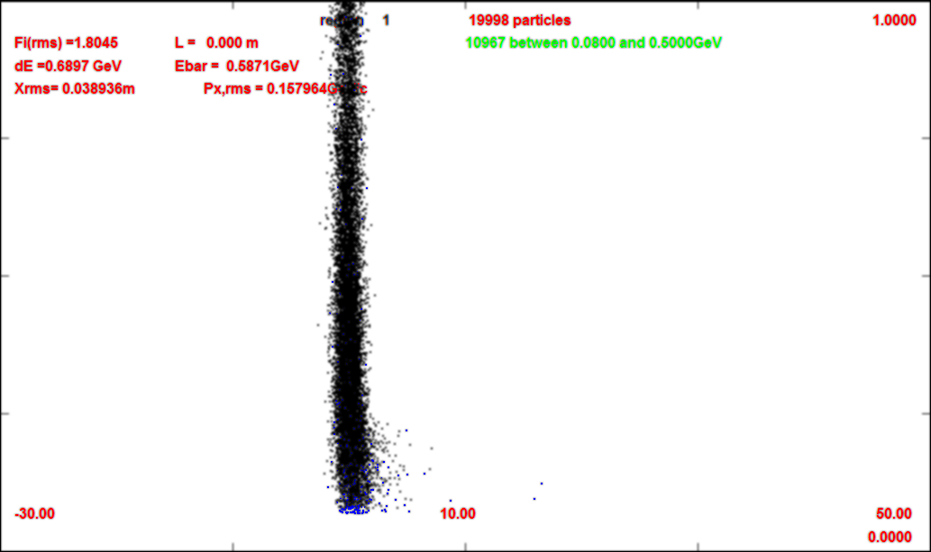
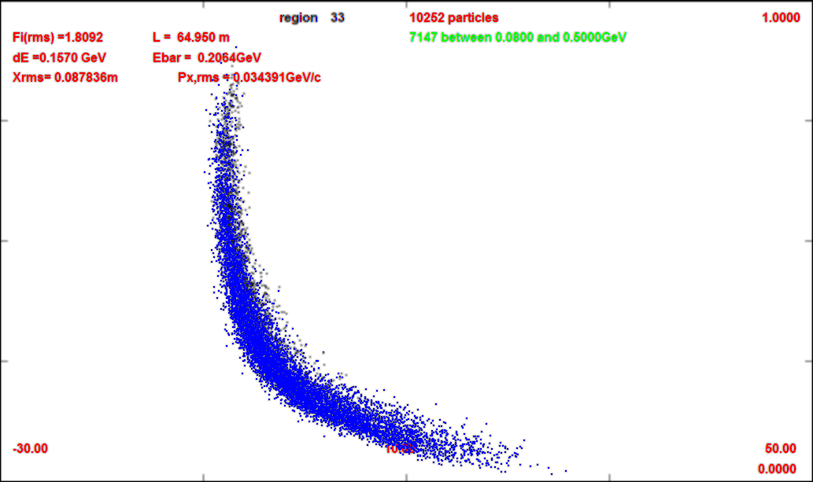
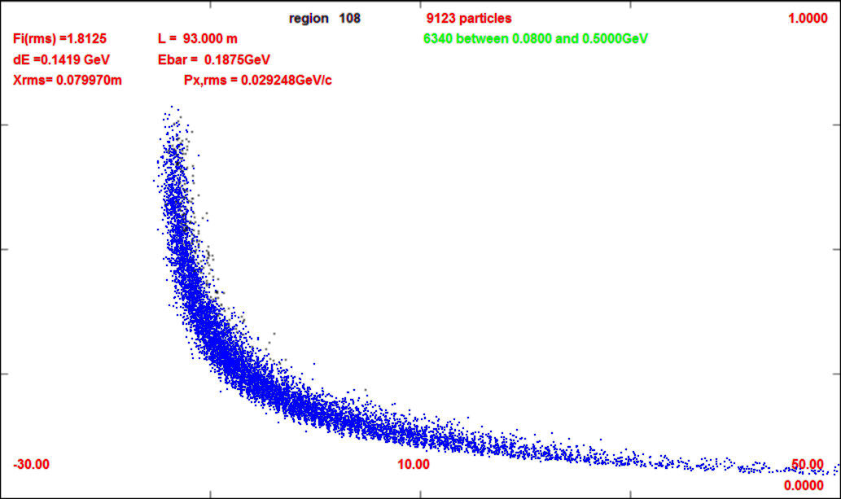
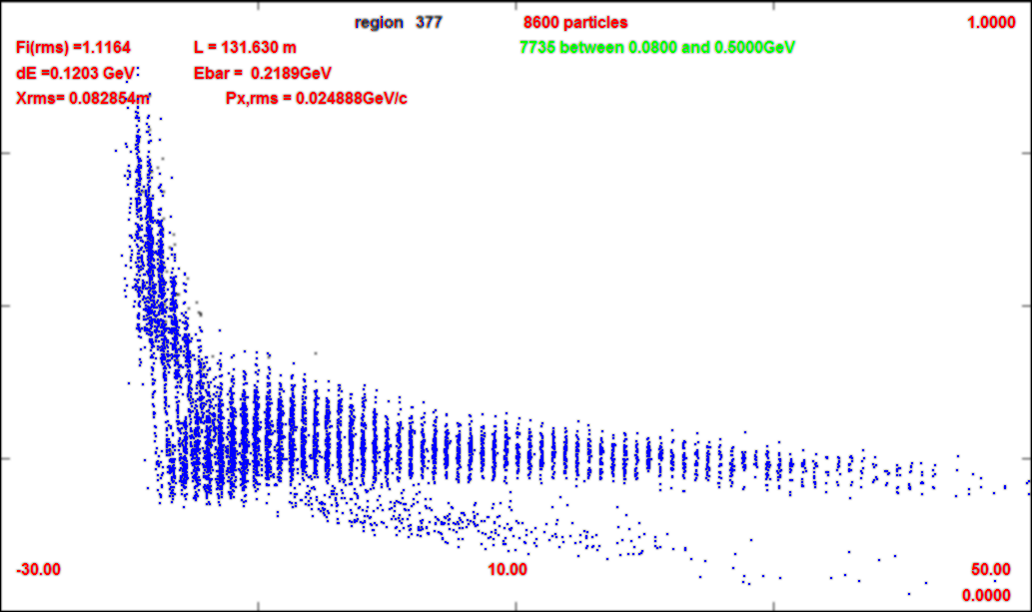
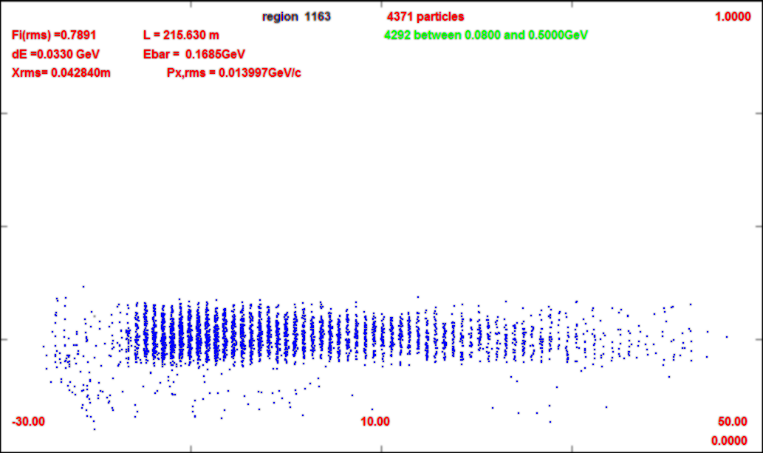
325 (w chicane/absorber)
1.0 GeV/c
~60 m long bunch train
  ~60 325 MHz buckets
For collider choose “best 21 bunches “
  (~19m)
Includes ~2/3 of captured μ’s
  many are lost
21bunches are recombined to 1 in collider scenario
  It is more difficult to recombine 21 than 12
Would like to extend acceptance or generate shorter train
0m
0.0 GeV/c
65m
93m
~ end of rotator
131m
~ After ~80m
215m

Slide 18
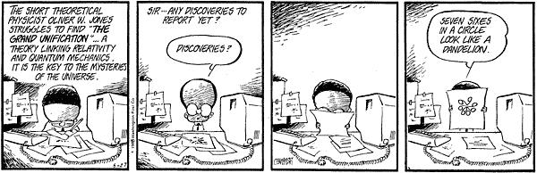

P5 result

