Slide 1
Front End – present status
David Neuffer
December 4, 2014

Slide 2
Outline
Previous Versions
  201.25 MHz baseline examples
    24/8GeV initial beam
Front End for Muon Collider/ Neutrino Factory
  Baseline for MAP
    8 GeV proton beam on Hg target
  325 MHz
  With Chicane/Absorber
Current status
  New targetry
    6.75 GeV on C target
  Possible changes

Slide 3
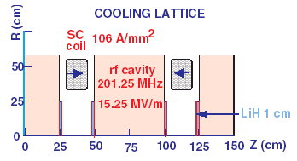
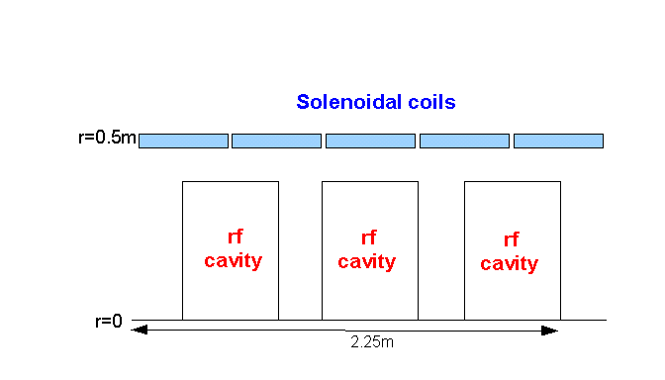
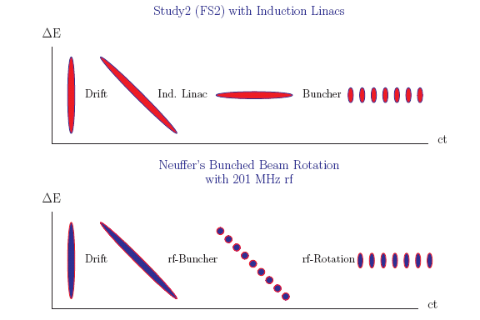
IDS Baseline Buncher and φ-E Rotator
Drift (π→μ)
“Adiabatically” bunch beam first (weak 320 to 232 MHz rf)
Φ-E rotate bunches – align bunches to ~equal energies
  232 to 202 MHz, 12MV/m
Cool beam 201.25MHz
Captures and Cools both μ⁺ and μ⁻
p
π→μ
FE Target
Solenoid
Drift
Buncher
Rotator
Cooler
18.9 m
~60.7 m
~33m
42 m
~80 m

Slide 4
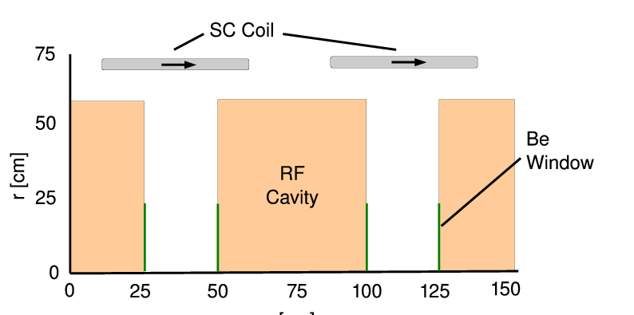
325MHz System “Collider”
Drift
  20T→ 2T
Buncher
  P_{o}=250MeV/c
  P_{N}=154 MeV/c; N=10
  V_{rf} : 0→ 15 MV/m
    (2/3 occupied)
  f_{RF} : 490→ 365MHz
Rotator
  V_{rf} : 20MV/m
    (2/3 occupied)
  f_{RF} : 364→ 326MHz
  N=12.045
  P_{0,} P_{N}→245 MeV/c
Cooler
  245 MeV/c
  325 MHz
  25 MV/m
  2 1.5 cm LiH absorbers
  /0.75m

Slide 5
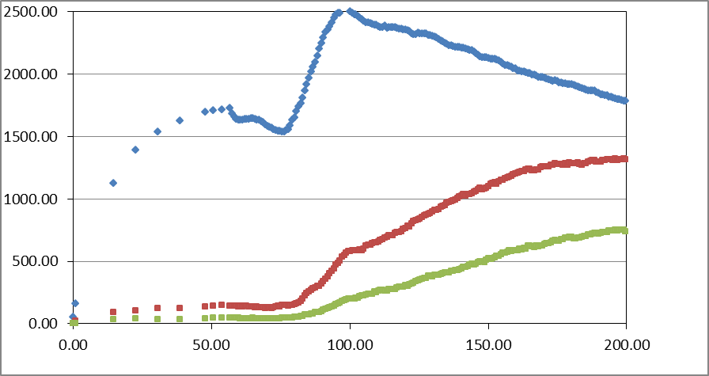
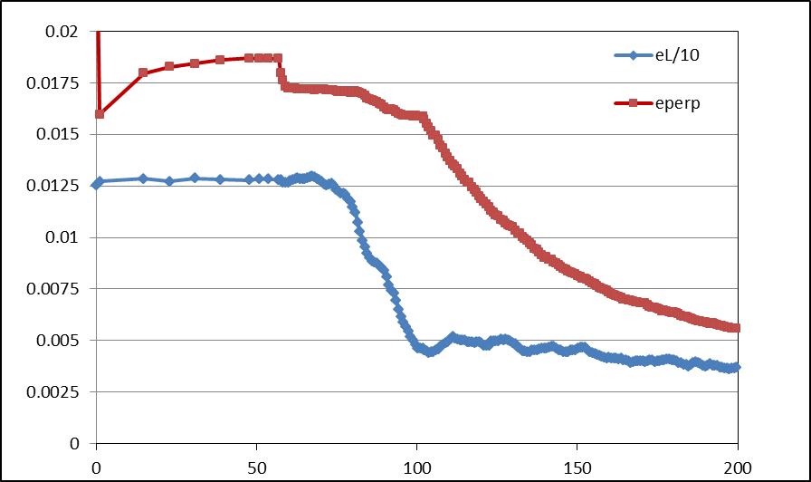
Simulation Results
Simulation obtains
  ~0.125 μ/p within acceptances
  with ~60m Cooler
  325 MHz – less power
  shorter than baseline NF
But
  uses higher gradient
  higher frequency rf → smaller cavities
  shorter than baseline NF
  more bunches in bunch train
N :0.15<P<0.35 GeV/c
N: ε_{T}<0.03; A_{L}<0.2
N: ε_{T}<0.015; A_{L}<0.2
Useful
cooling

Slide 6
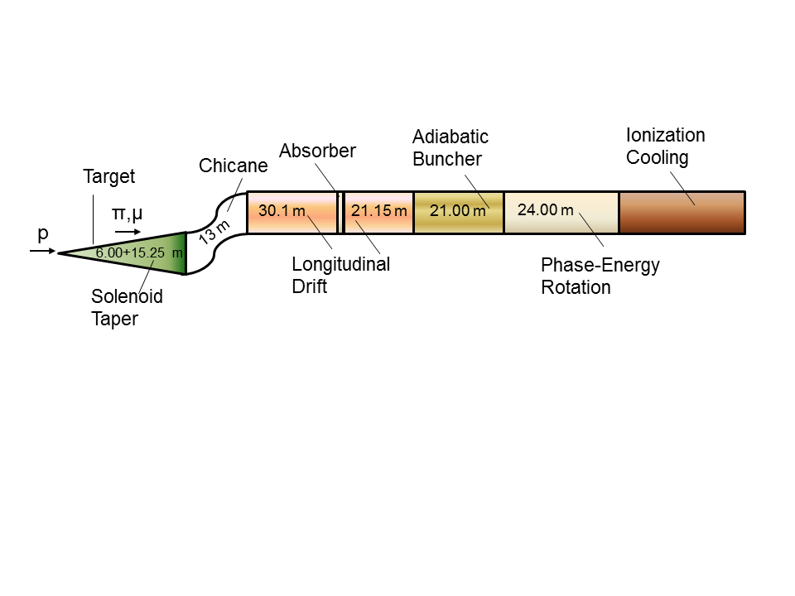
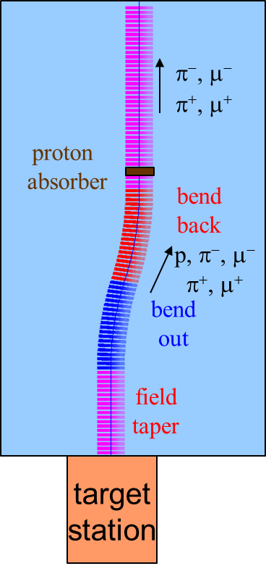
325 “Collider “ w Chicane/Absorber
Chicane + Absorber
SREGION ! bentsol
6.5 1 1e-2
1 0. 1.0
BSOL
1 2.0 0.0 1 0.283 0.0 0.058181 0.0 0.0 0.0 0. 0. 0. 0. 0.
VAC
NONE
0. 0. 0. 0. 0. 0. 0. 0. 0. 0.
Add 30 m drift after chicane
  *6.5m → +21.67°,-21.67º
Add chicane + absorber
    particle 1-283 MeV/c
    particle 2-194 MeV/c
  absorber at 54m
    10cm Be
    particle 1-250 MeV/c
    particle 2-154 MeV/c
  Bunch (N=12) 0→15 MV/m :496→ 365 MHz
  Rotate (N=12.045 )– 20MV/m : 365 → 326.5 MHz
  Cool -325MHz -25 MV/m
    p_{ref}=245 MeV/c

Slide 7
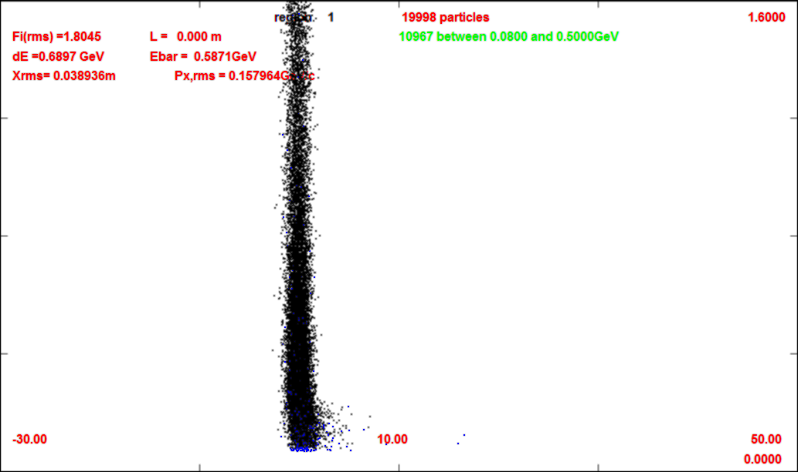
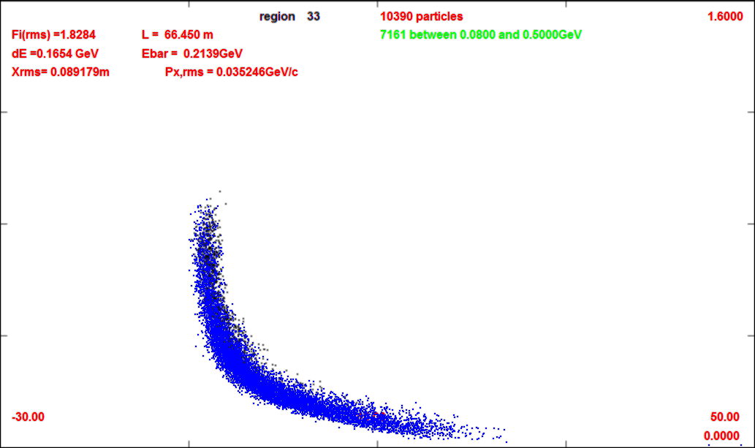
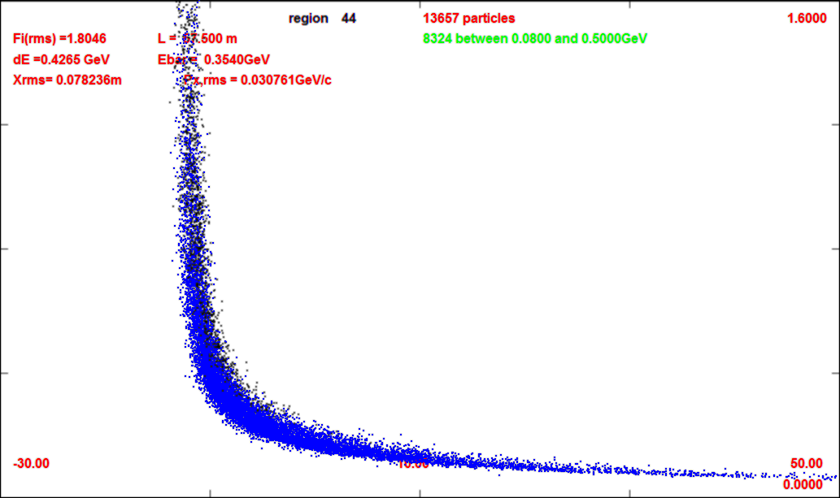
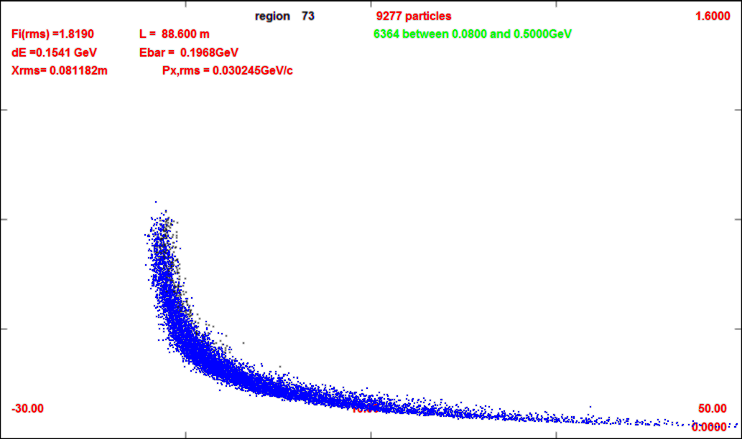
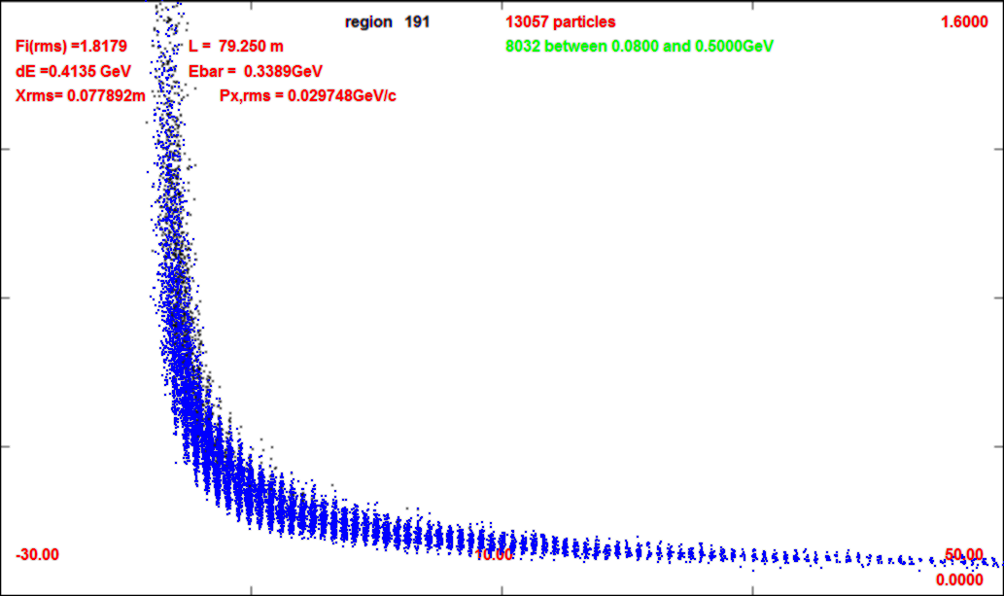
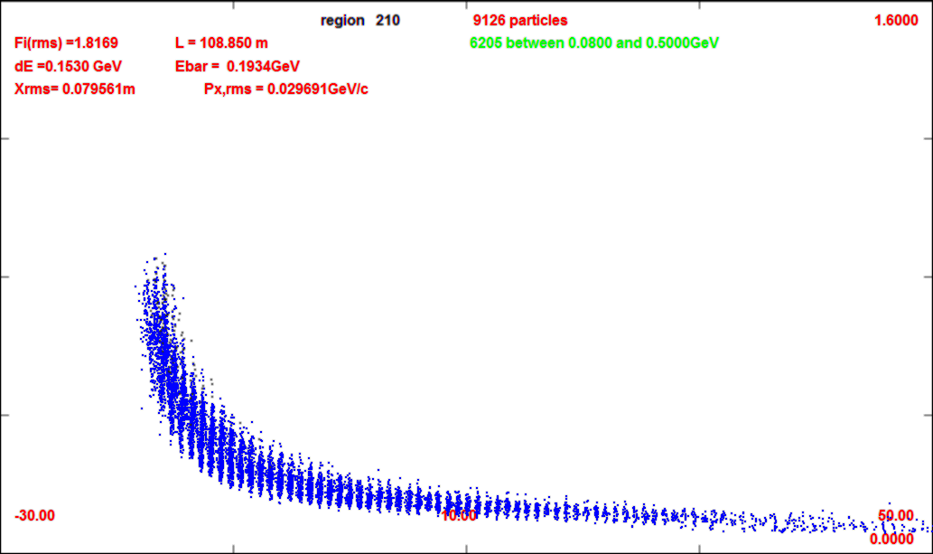
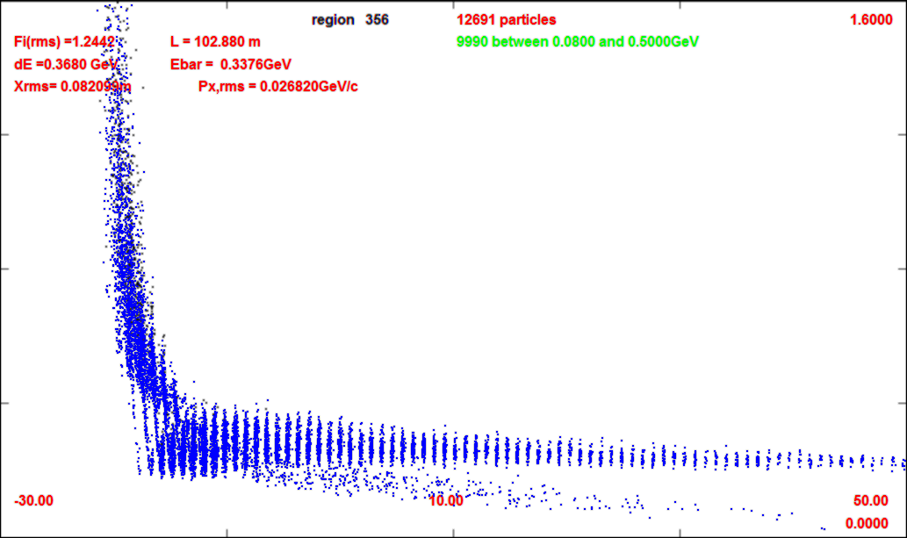
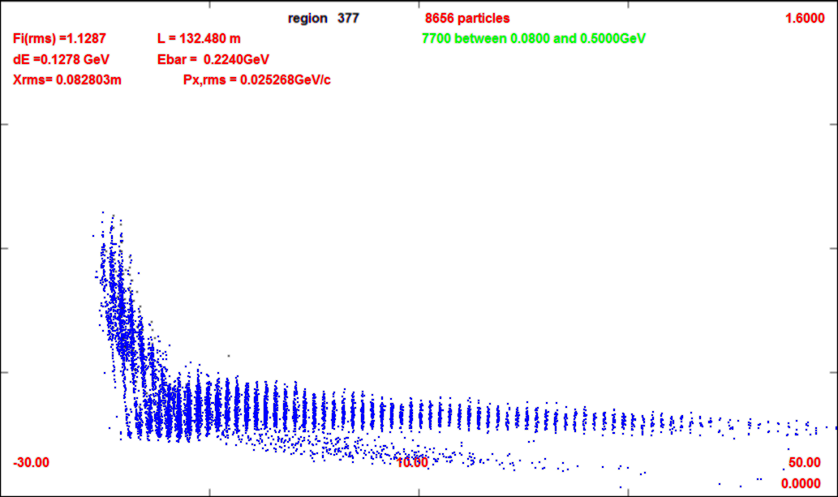
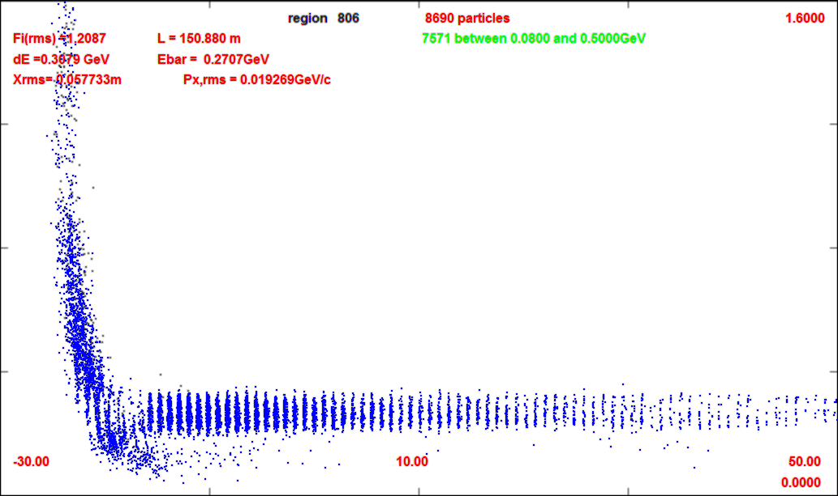
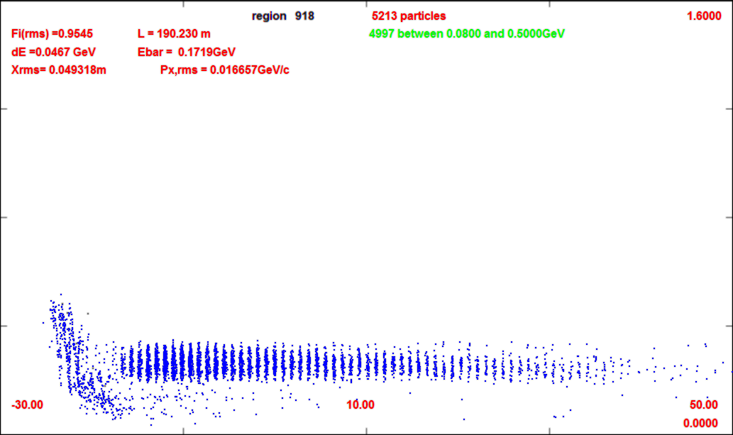
Compare without/with chicane
0m (production target)
-30m
-50m
1600 GeV/c
0m
66m (after chicane/absorber)
1600 GeV/c
0 GeV/c
57m
88m (after drift)
0 GeV/c
109m (after buncher)
79m
102m
-30m
132m (after rotator)
50m
21 bunches for Collider
152m
190m (after cooling)

Slide 8
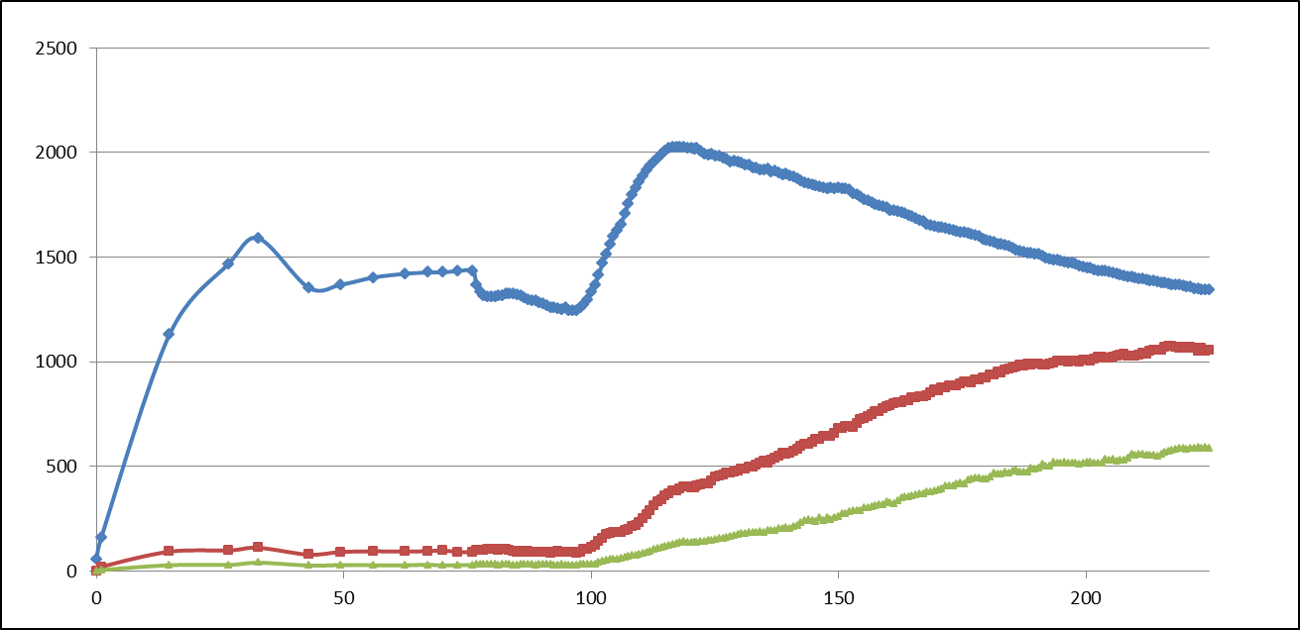
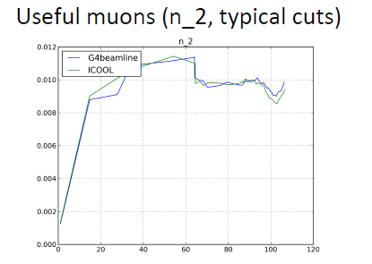
ICOOL results
325 “muon collider” with chicane absorber
  with added drift between chicane and absorber
    ~30m
  ~0.12 μ/p → ~0.105 μ/p
  smaller emittance beams
    scraped to better fit
All μ+ (0.15<p_{μ} <0.35)
μ+ (A <0.03, A_{L} <0.2)

Slide 9
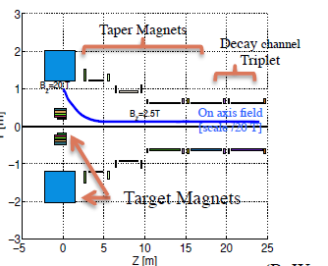
ICOOL results
Change to shorter taper
  15m → 6m
  (Hisham) slight improvement in throughput (~5%)
  We were using Hishams more recent distributions
    (May 2014)
    Gains ~5—10%
    Total is now ~0.115 μ/p (in baseline ICOOL simulation units)

Slide 10
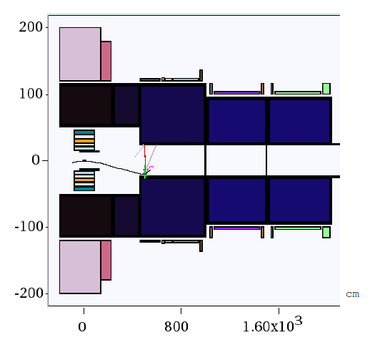
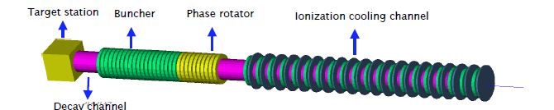
New Proton Driver parameters
6.75 GeV p, C target
  20→2T short taper
    ~5m (previously 15)
  X. Ding produced particles at z=2m using Mars
  short initial beam
Redo ICOOL data sets to match initial beam
  ref particles redefined
    in for003.dat
    and for001.dat

Slide 11
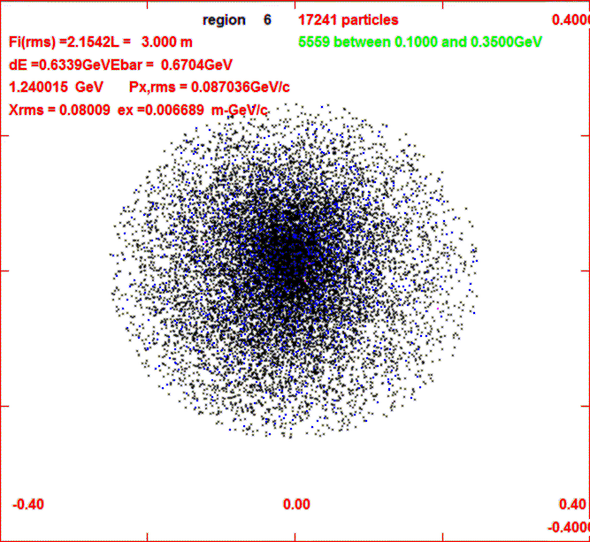
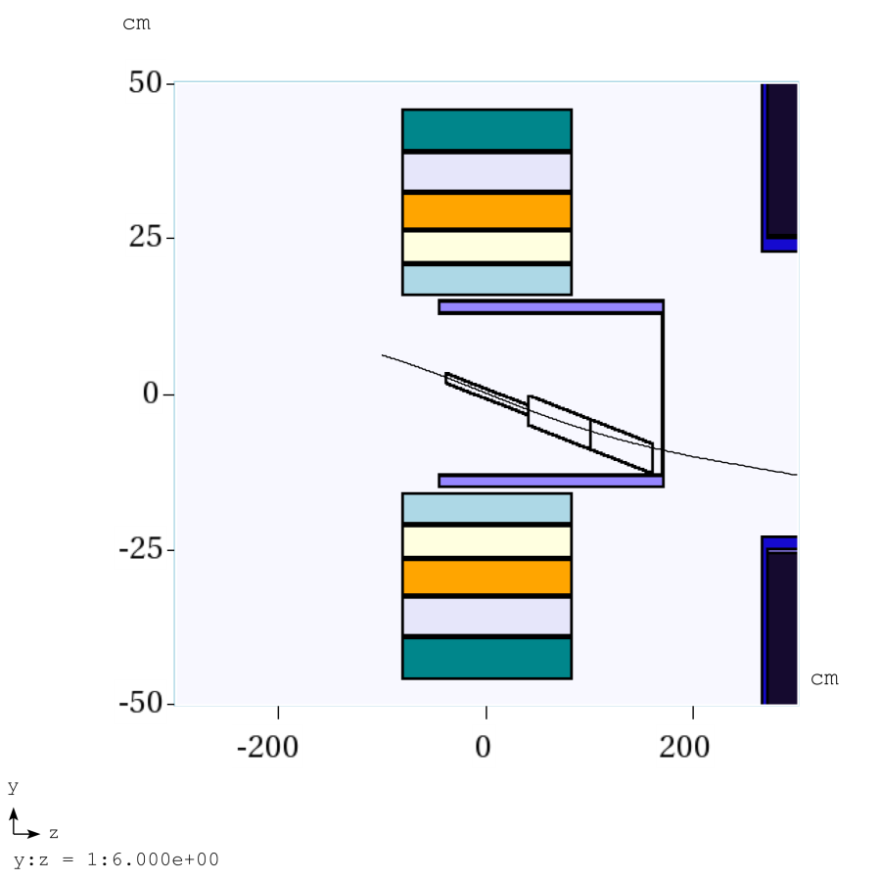
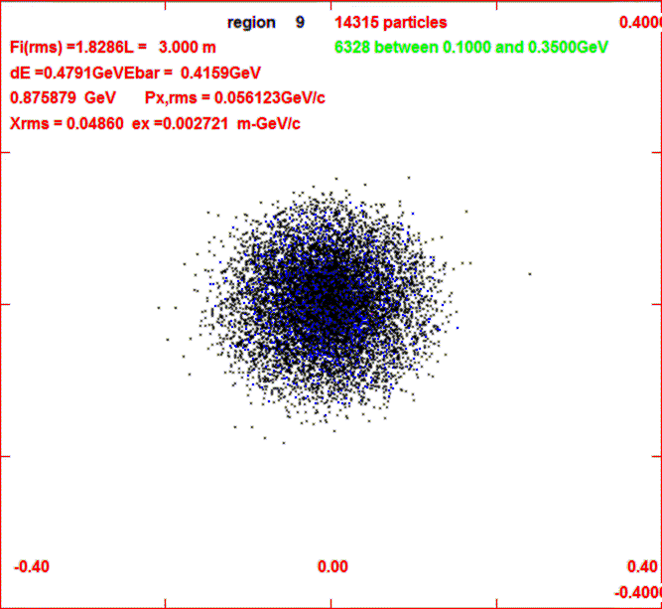
Use old FE with new initial beam
New beam has too large initial size and divergence
  initial transverse emittance >2X larger
    0.0027 → 0.0067 m-GeV/c
  ~half of initial beam lost in <6m
new beam at z=3m
-0.4
0.4
old beam at z=3m
-0.4
0.4

Slide 12
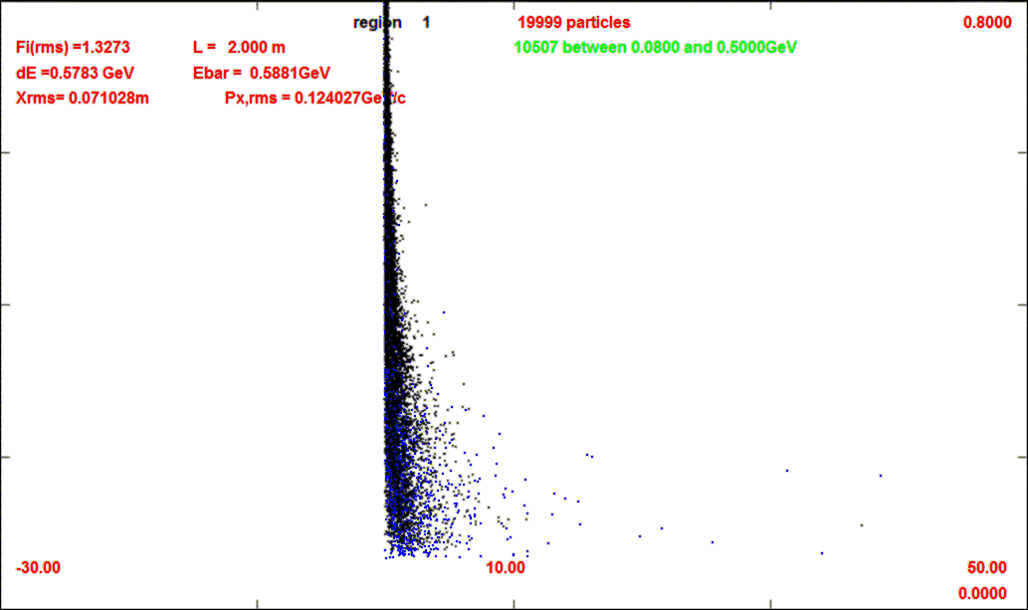
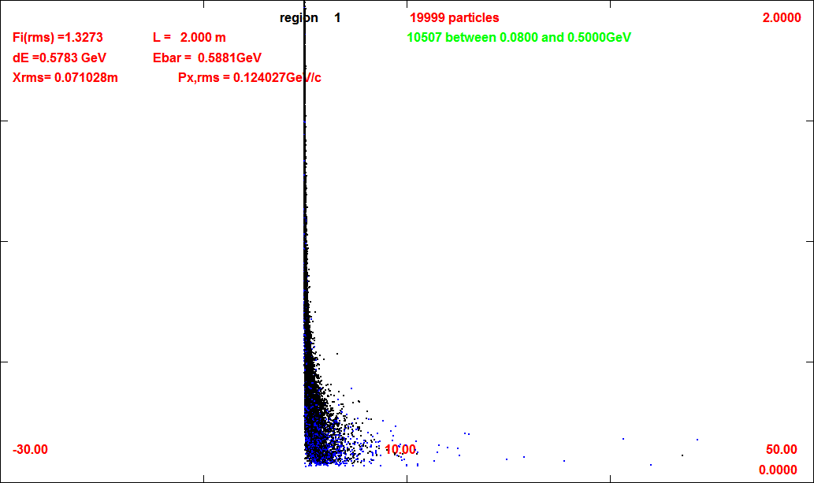
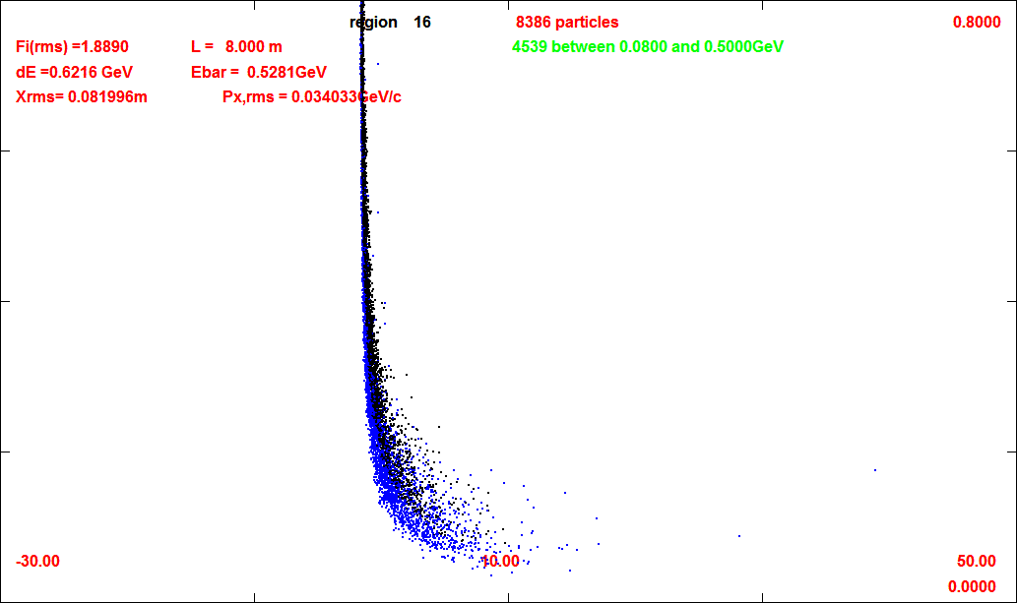
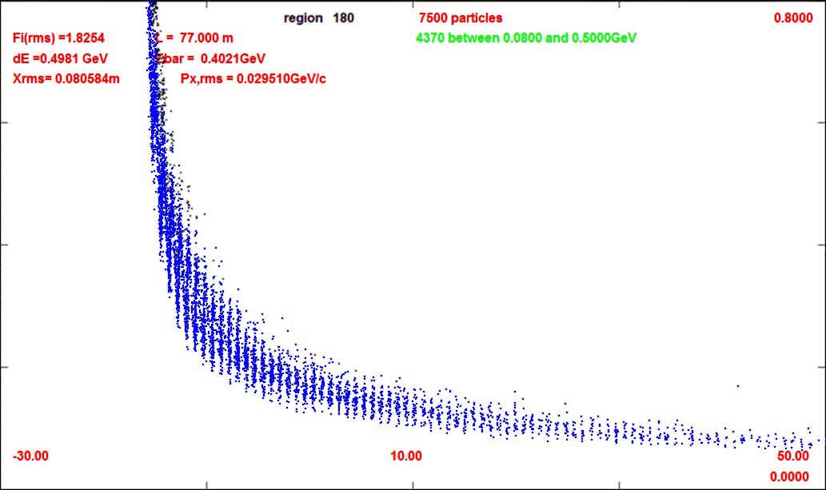
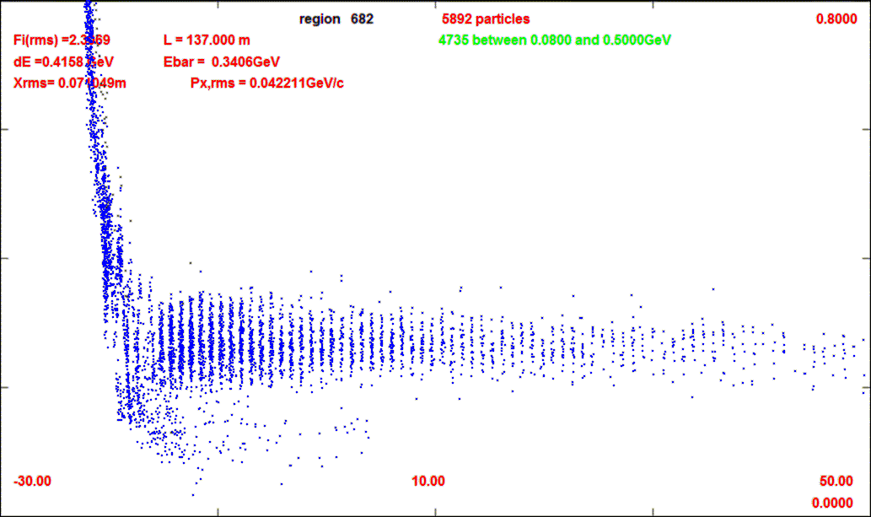
First simulations results
~60% of initial particles are lost in first 6m
  previous front end lost ~20%
Beam starts out very large
  previous much smaller in
  front end simulations
μ/p reduced by factor ~ 2
  → ~0.0545 μ⁺/p
  ~0.042 μ⁻/p
    μ⁻ less than μ⁺
Not fully reoptimized for new initial beam
z=2m
20000
z=8m
8386
z=77m
7500
z=137m
5892

Slide 13
6.75 GeV p/ C target – First Look
Much worse than previous 8 GeV p / Hg target
6.75 (~25% less), Hg → C …
  but initial beam has very large phase space
Causes for early losses ???
  Long C target not a good match to short taper ?
    target should be within lens center …
  “Beam dump” after target blows up π beam ??
Bugs, errors?
  Changes in Mars production code ??
  normalization error ??
  initialization errors
    starts from z=2m rather than z=0
After initial factor of 2 loss, very similar to old front end case
  not yet reoptimized
To investigate/debug/reoptimize ..

Slide 14
Other topics to explore
Replace vacuum rf with gas-filled rf
  Do Buncher / phase rotation function as well ?
Replace initial 4-D Cooler with 6-D cooler
  Has been initiated by Yuri
  Would like a reference version to use as acceptance baseline
Integrate Buncher / Phase-rotation / Cooling
  more compact system
  adiabatic → snap rotation
Transform to general R&D
  initial beam →???
    lower B-field, lower energy
  other uses (mu2e … LFV expts.

Slide 15

Any comments?

