Slide 1
Front End – present status
David Neuffer
March 17, 2015

Slide 2
Outline
Front End for Muon Collider/ Neutrino Factory
Baseline for MAP
8 GeV proton beam on Hg target
325 MHz
With Chicane/Absorber
Current status
New targetry
6.75 GeV on C target
New Mars generated beams
Mars ouput much different from previous version
Buncher rotator with H₂ gas
rematches OK except for loss at beginning of buncher
can cool and rotatoe simultaneously

Slide 3
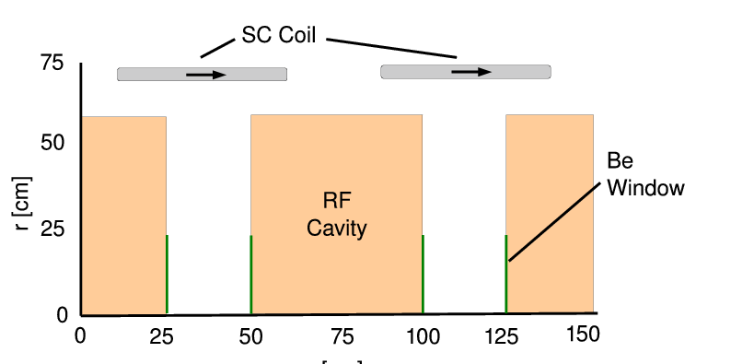
325MHz System “Collider”
Drift
20T → 2T
Buncher
P_{o} = 250MeV/c
P_{N} = 154 MeV/c; N = 10
V_{rf} : 0 → 15 MV/m
(2/3 occupied)
f_{RF} : 490 → 365 MHz
Rotator
V_{rf} : 20MV/m
(2/3 occupied)
f_{RF} : 364 → 326 MHz
N = 12.045
P_{0,} P_{N} → 245 MeV/c
Cooler
245 MeV/c
325 MHz
25 MV/m
2 1.5 cm LiH absorbers
/0.75m

Slide 4
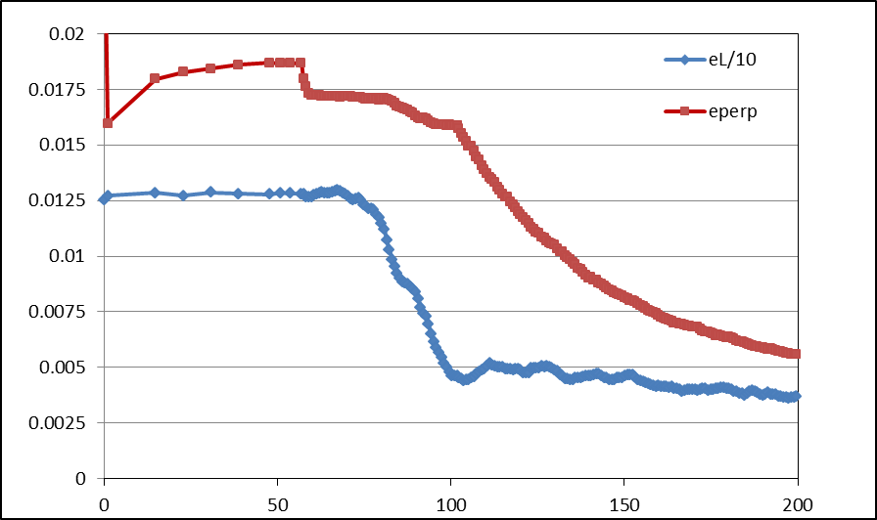
Simulation Results
Simulation obtains
~0.125 μ/p within acceptances
with ~60m Cooler
325 MHz – less power
shorter than baseline NF
But
uses higher gradient
higher frequency rf → smaller cavities
shorter than baseline NF
more bunches in bunch train
N :0.15<P<0.35 GeV/c
N: ε_{T}<0.03; A_{L}<0.2
N: ε_{T}<0.015; A_{L}<0.2
Useful
cooling

Slide 5
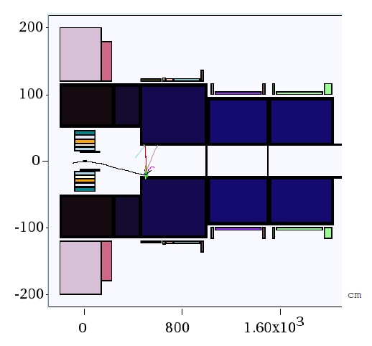
New Proton Driver parameters
6.75 GeV p, C target
20 → 2T short taper
~5 m (previously 15)
X. Ding produced particles at z = 2 m using Mars
short initial beam
Redo ICOOL data sets to match initial beam
ref particles redefined
in for003.dat
and for001.dat

Slide 6
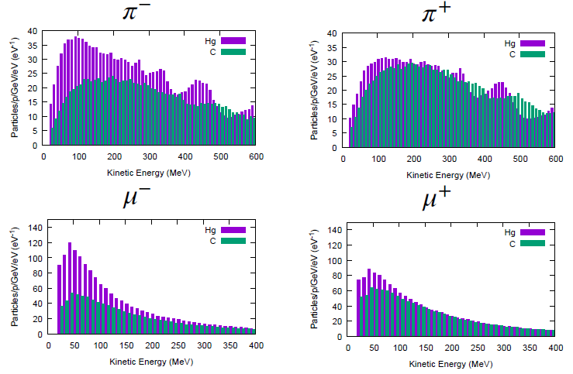
Following Scott’s review of front end
Use his initial distributions (obtained by X. Ding)
8 GeV protons on Hg target
+ and minus
6.75 GeV protons on C target
Start beam from z =10 m
must retranslate into ICOOL reference particles
Early losses on apertures have already occurred
23 cm apertures

Slide 7
ICOOL translation tips
start at “z =10 m”
(particle time zero is at -1 m)
reference particles
250 MeV/c ; 154 MeV/c μ⁺
165.75 MeV ; 81.1 MeV μ⁺
time set by 1 m as 6.75 GeV proton + 10m as μ⁺
reference particles set in for003.dat, not for001.dat
01-Feb-2015 X. Ding C 10 m -
0.0 0.250 3.95709E-08 0.0 0.154 4.381345E-08 2
1 1 -3 0 4.354479e-008 1.000000e+000 0.03737 0.03656 0 7.861861e-004 2.558375e-002 2.189235e-001 0 0 0
3 1 -3 0 3.712592e-008 1.000000e+000 -0.03459 -0.11247 0 1.617131e-001 3.506310e-002 4.670452e-001 0 0 0
6 1 -3 0 3.748837e-008 1.000000e+000 0.00304 -0.04460 0 -1.827203e-002 -5.931789e-002 7.809555e-001 0 0 0
10 1 -3 0 3.738523e-008 1.000000e+000 0.07979 0.13944 0 -4.890422e-002 3.733585e-001 1.515145e+000 0 0 0
In ICOOL for001.dat
REFP
2 0 0 0 3
REF2
2 0 0 0

Slide 8
First simulation results
Simulation results
Hg target 8 GeV –end of cooling
~0.0756 μ⁺/p; ~0.0880 μ-/p;
C target 6.75 GeV p
~0.0613 μ⁺/p; ~0.0481 μ⁻/p;
0.0726 μ⁺/p; ~0.0570 μ⁻/p when multiplied by 8/6.75
Previous front ends had ~0.1 to ~0.125 μ/p

Slide 9
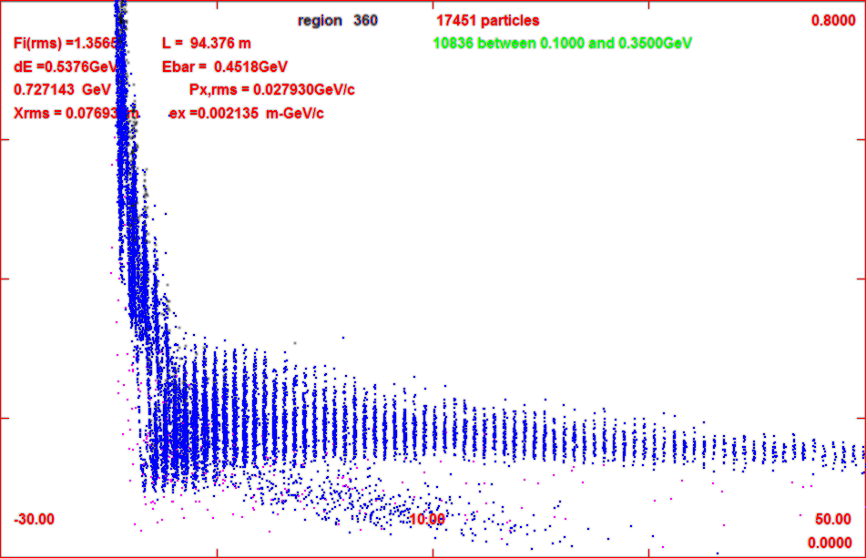
Progression of beam through system
z = 11 m
z = 104 m
z = 135 m

Slide 10
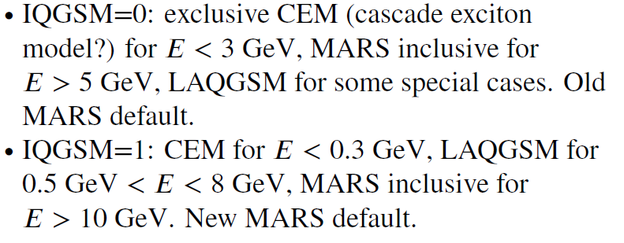
6.75 GeV p/ C target – 8GeV Hg
Simulations capture typically somewhat less than before
Big difference in MARS production model
Mars Inclusive → LAQGSM=1
Drop in production for ~8 GeV
Are previous MARS simulations that showed an advantage in production for ~8 GeV still true ?

Slide 11
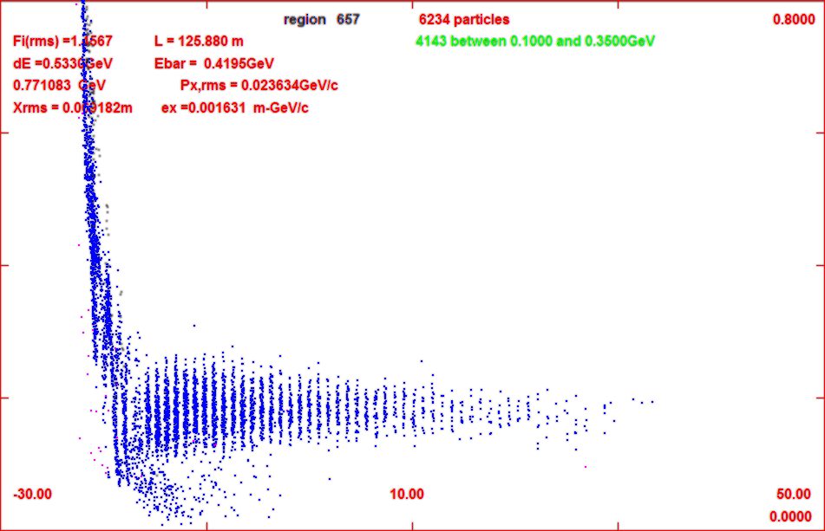
Add gas-filled rf in buncher/rotator
34 – 100 atm equivalent
1.14 MeV/m
34 atm
3.45 MeV/m
100atm
for 34 atm
add ~2 MV/m to rf
First tries with ICOOL
GH in buncher 1 atm
no change in capture
Change to 34 atm by
DENS GH 34.0
Runs OK but
reduces capture by 20%
mostly from low-E muons
shorter bunch train
gas
z=71m
gas
z=135m
no gas

Slide 12
Updated gas-filled front end
added gas in rotator
34 atm
dE/dx
Increased rf a bit
Buncher 15z → 2+20(z/24) MV/m
Rotator 20 → 25
ref particles decelerate to 230Mev/c
Cooler 25 → 28 MV/m
Results are not so bad
8 GeV Hg + → 0.0718 μ/p
8 GeV Hg - → 0.0773 μ/p
6.75 GeV C + → 0.0539 μ⁺/p
6.75 GeV C -→ 0.0430 μ⁻/p
~10% worse than baseline
Tweak of reference particle to fit ICOOL features
REFP
2 0.250 0. 1.7 4
REF2
2 0.154 0. 7.1
use phase model 4
tracks reference particles energy loss in drft/absorber but not in rf
fixed energy gain.loss in rf
ref particle acceleration fitted to

Slide 13
FrontEnd variations
Reduce buncher gas to 17 atm
~ 10% better
back to ~ baseline
~0.062 μ⁺/p
change decelerating rotator back to constant energy rotator
C → ~0.063 μ⁺/p
about the same
no real advantage/disadvantage in deceleration
Note initial beam is “cooled”, but only in one dimension
B = 2T – no field flip
Angular momentum increases
z | ε_{t} | ℓ=L/2 | ε₊ | ε₋
59 | 0.0184 | 0.0054 | 0.0246 | 0.0138
78 | 0,0173 | 0.0059 | 0.0243 | 0.0124
102 | 0.0151 | 0.0074 | 0.0242 | 0.0095

Slide 14
Effect of new initial distributions
Redo with old initial beams
2010 Hg 8 GeV p (older MARS)
0.114 μ⁺/p
2014 Hg 8 GeV p (old MARS)
0.112 μ⁺/p
Compare with current BEAM
Hg 8 GeV p (new MARS)
0.072 μ⁺/p
Major difference is newer MARS model

Slide 15
Beam difference notes
Most of loss in intrinsic performance is from gas in buncher
Beam enters completely unbunched
Initial rf is weak; and slowly increases
After some initial loss, SIMILAR TO GAS-FREE BASELINE

Slide 16
Increase rotator to 100atm
Buncher at 17 atm
LESS INITIAL LOSS
Increase Buncher gradient to 28 MV/m
to compensate energy loss
Fairly good performance
~0.06 3μ/p (C 6.75)
More cooling in Rotator
1-D cooling (2T solenoid)
one mode highly damped
Significant initiation of cooling
(integrating rotator/cooler)
z | ε_{t} | ℓ=L/2 | ε₊ | ε₋
77 | 0.0176 | 0.0061 | 0.0248 | 0.0124
89 | 0,0144 | 0.0077 | 0.0241 | 0.0087
102 | 0.0128 | 0.0088 | 0.0242 | 0.0066

Slide 17
Next steps

