Slide 1
Front End – present status
David Neuffer
March 31, 2015

Slide 2
Outline
Front End for Muon Collider/ Neutrino Factory
  Baseline for MAP
    8 GeV proton beam on Hg target
  325 MHz
    With Chicane/Absorber
Current status
  New targetry
    6.75 GeV on C target
  New Mars generated beams
    Mars output much different from previous version
  Buncher-Rotator with H₂ gas
    rematches OK except for loss at beginning of buncher
    can cool and rotate simultaneously

Slide 3
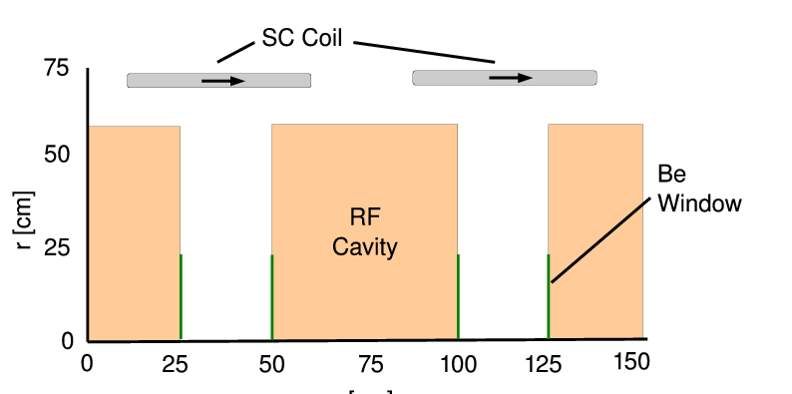
325 MHz System “Collider”
Drift
  20 T → 2 T
Buncher
  P_{o} = 250 MeV/c
  P_{N} = 154 MeV/c; N = 10
  V_{rf} : 0 → 15 MV/m
    (2/3 occupied)
  f_{RF} : 490→ 365 MHz
Rotator
  V_{rf} : 20 MV/m
    (2/3 occupied)
  f_{RF} : 364→ 326 MHz
  N = 12.045
  P_{0,} P_{N} → 245 MeV/c
Cooler
  245 MeV/c
  325 MHz
  25 MV/m
  2 1.5 cm LiH absorbers
  /0.75m

Slide 4
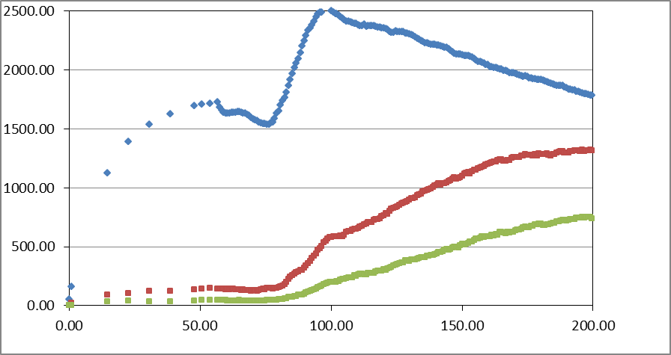
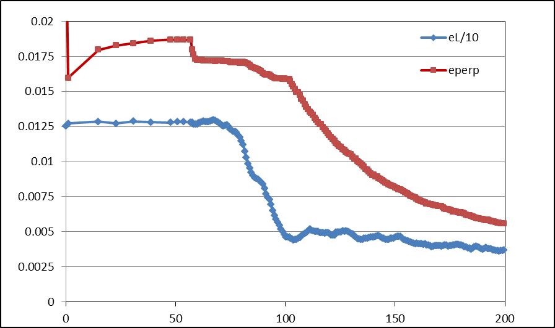
Simulation Results
Simulation obtains
  ~0.125 μ/p within acceptances
  with ~60 m Cooler
  325 MHz – less power
  shorter than baseline NF
But
  uses higher gradient
  higher frequency rf → smaller cavities
  shorter than baseline NF
  more bunches in bunch train
N :0.15<P<0.35 GeV/c
N: ε_{T}<0.03; A_{L}<0.2
N: ε_{T}<0.015; A_{L}<0.2
Useful
cooling

Slide 5
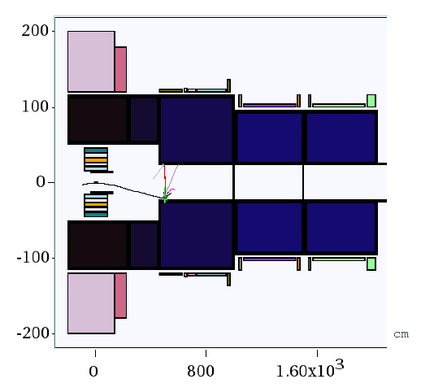
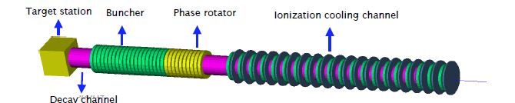
New Proton Driver parameters
6.75 GeV p, C target
  20 → 2 T short taper
    ~ 5 m (previously 15)
  X. Ding produced particles at z = 2 m using Mars
  short initial beam
Redo ICOOL data sets to match initial beam
  ref particles redefined
    in for003.dat
    and for001.dat

Slide 6
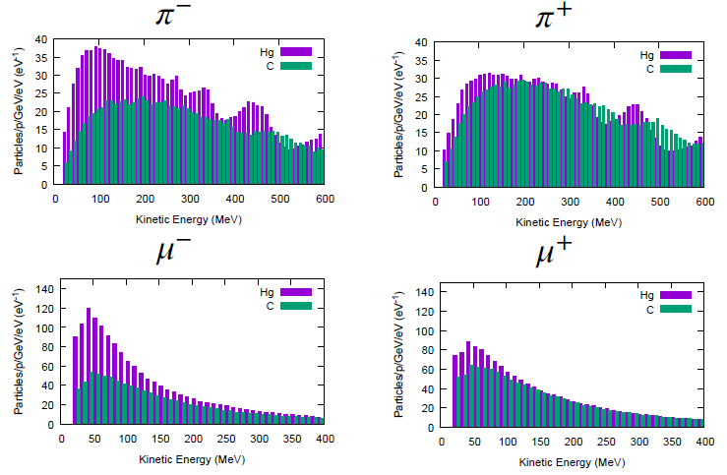
Following Scott’s review of front end
Use his initial distributions (obtained by X. Ding)
  8 GeV protons on Hg target
    + and minus
  6.75 GeV protons on C target
  Start beam from z = 10 m
    must retranslate into ICOOL reference particles
  Early losses on apertures have already occurred
    23 cm apertures

Slide 7
ICOOL translation tips
start at “z = 10 m”
  (particle time zero is at -1 m)
reference particles
  250 MeV/c ; 154 MeV/c μ⁺
    165.75 MeV ; 81.1 MeV μ⁺
  time set by 1m as 6.75 GeV proton + 10 m as μ⁺
  reference particles set in for003.dat, not for001.dat
01-Feb-2015 X. Ding C 10 m -
0.0 0.250 3.95709E-08 0.0 0.154 4.381345E-08 2
1 1 -3 0 4.354479e-008 1.000000e+000 0.03737 0.03656 0 7.861861e-004 2.558375e-002 2.189235e-001 0 0 0
3 1 -3 0 3.712592e-008 1.000000e+000 -0.03459 -0.11247 0 1.617131e-001 3.506310e-002 4.670452e-001 0 0 0
6 1 -3 0 3.748837e-008 1.000000e+000 0.00304 -0.04460 0 -1.827203e-002 -5.931789e-002 7.809555e-001 0 0 0
10 1 -3 0 3.738523e-008 1.000000e+000 0.07979 0.13944 0 -4.890422e-002 3.733585e-001 1.515145e+000 0 0 0
In ICOOL for001.dat
REFP
2 0 0 0 3
REF2
2 0 0 0

Slide 8
First simulation results
Simulation results
  Hg target 8 GeV –end of cooling
  ~0.0756 μ⁺/p; ~0.0880 μ-/p;
  C target 6.75 GeV p
  ~0.0613 μ⁺/p; ~0.0481 μ⁻/p;
    0.0726 μ⁺/p; ~0.0570 μ⁻/p when multiplied by 8/6.75
  Previous front ends had ~0.1 to ~0.125 μ/p

Slide 9
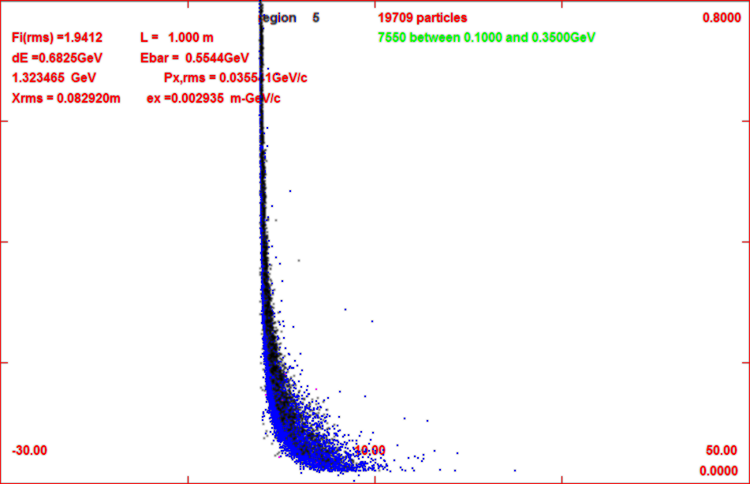
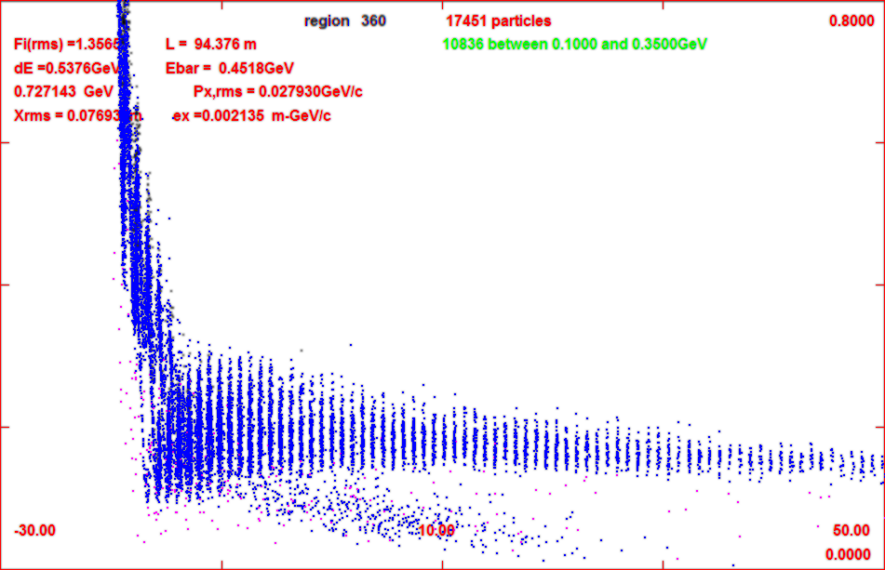
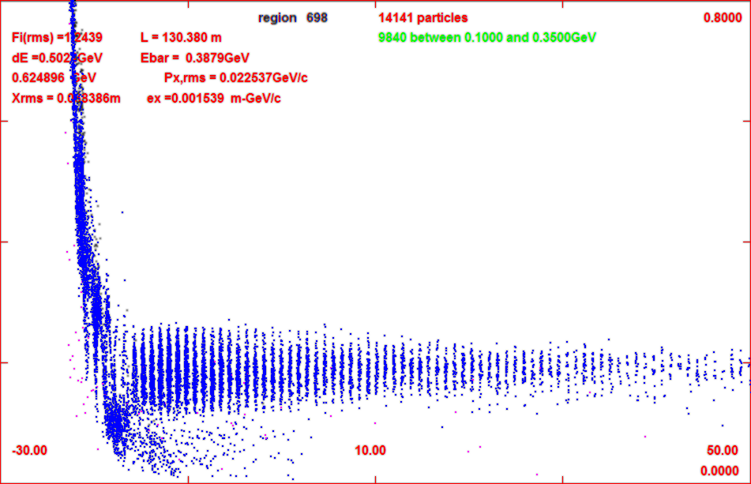
Progression of beam through system
z = 11 m
z = 104 m
z = 135 m

Slide 10
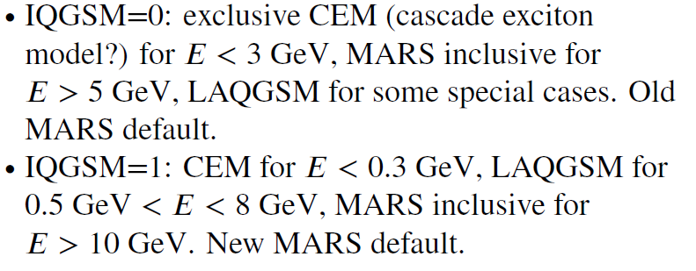
6.75 GeV p/ C target – 8 GeV Hg
Simulations capture typically somewhat less than before
  Big difference in MARS production model
    Mars Inclusive → LAQGSM=1
  Drop in production for ~8 GeV
    Are previous MARS simulations that showed an advantage in production for ~8 GeV still true ?

Slide 11
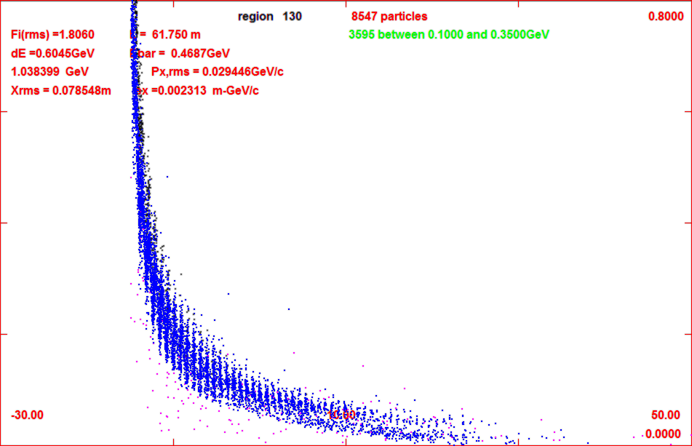

Add gas-filled rf in buncher/rotator
34 – 100 atm equivalent
  1.14 MeV/m
    34 atm
  3.45 MeV/m
    100 atm
  for 34 atm
    add ~2 MV/m to rf
First tries with ICOOL
  GH in buncher 1 atm
    no change in capture
  Change to 34 atm by
    DENS GH 34.0
  Runs OK but
    reduces capture by 20%
    mostly from low-E muons
      shorter bunch train
gas
z= 71 m
gas
z = 135 m
no gas

Slide 12
Updated gas-filled front end
added gas in rotator
  34 atm
    dE/dx
Increased rf a bit
  Buncher 15z → 2+20(z/24) MV/m
  Rotator 20 → 25
    ref particles decelerate to 230 Mev/c
  Cooler 25 → 28 MV/m
Results are not so bad
  8 GeV Hg + → 0.0718 μ/p
  8 GeV Hg - → 0.0773 μ/p
  6.75 GeV C + → 0.0539 μ⁺/p
  6.75 GeV C -→ 0.0430 μ⁻/p
  ~10% worse than baseline
Tweak of reference particle to fit ICOOL features
  REFP
  2 0.250 0. 1.7 4
  REF2
  2 0.154 0. 7.1
  use phase model 4
    tracks reference particles energy loss in drft/absorber but not in rf
    fixed energy gain.loss in rf
  ref particle acceleration fitted to

Slide 13
FrontEnd variations
Reduce buncher gas to 17 atm
  ~ 10% better
  back to ~ baseline
  ~0.062 μ⁺/p
change decelerating rotator back to constant energy rotator
  C → ~0.063 μ⁺/p
  about the same
  no real advantage/disadvantage in deceleration
Note initial beam is “cooled”, but only in one dimension
  B = 2 T – no field flip
  Angular momentum increases
z | ε_{t} | ℓ=L/2 | ε₊ | ε₋
59 | 0.0184 | 0.0054 | 0.0246 | 0.0138
78 | 0,0173 | 0.0059 | 0.0243 | 0.0124
102 | 0.0151 | 0.0074 | 0.0242 | 0.0095

Slide 14
Effect of new initial distributions
Redo with old initial beams
  2010 Hg 8 GeV p
    0.114μ⁺/p
  2014 Hg 8 GeV p
    0.112μ⁺/p
  Compare with current BEAM
    Hg 8 GeV p
    0.072 μ⁺/p
Major difference is newer MARS model

Slide 15
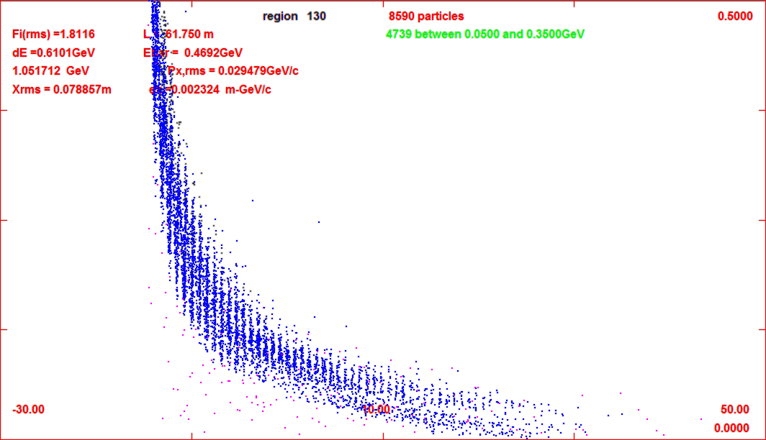
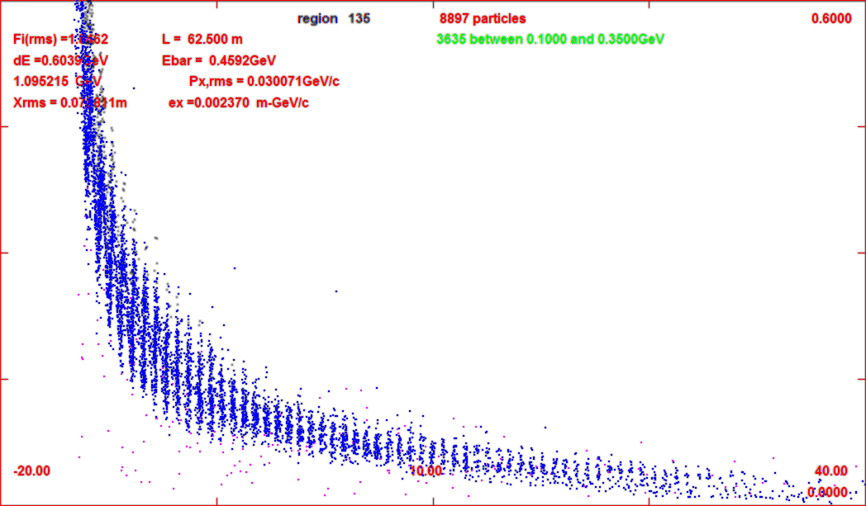
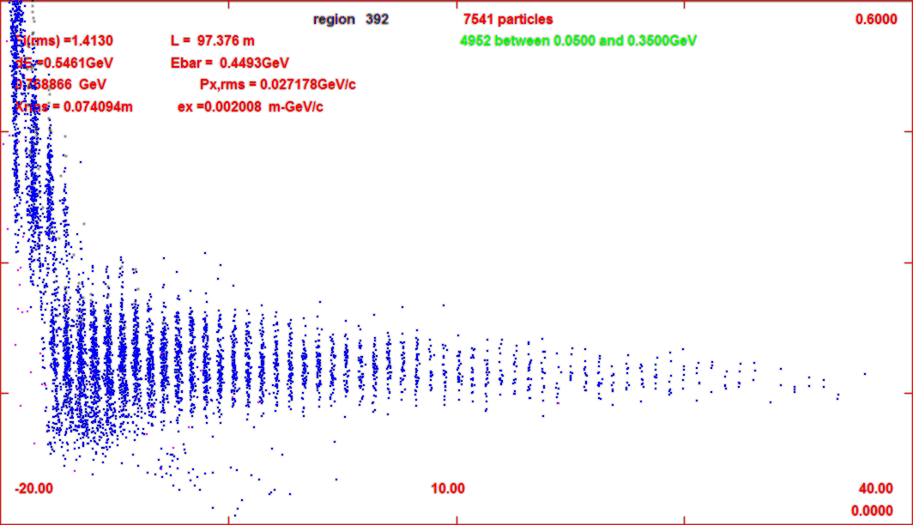
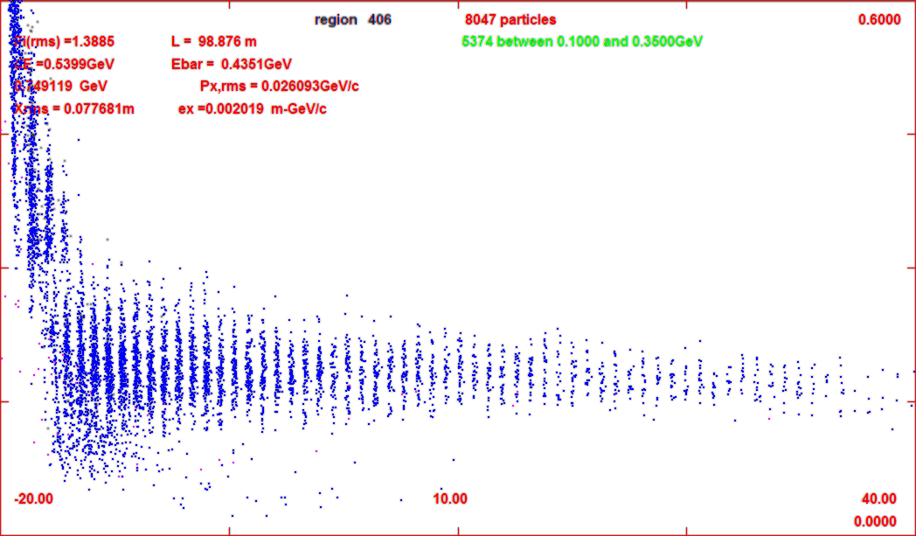
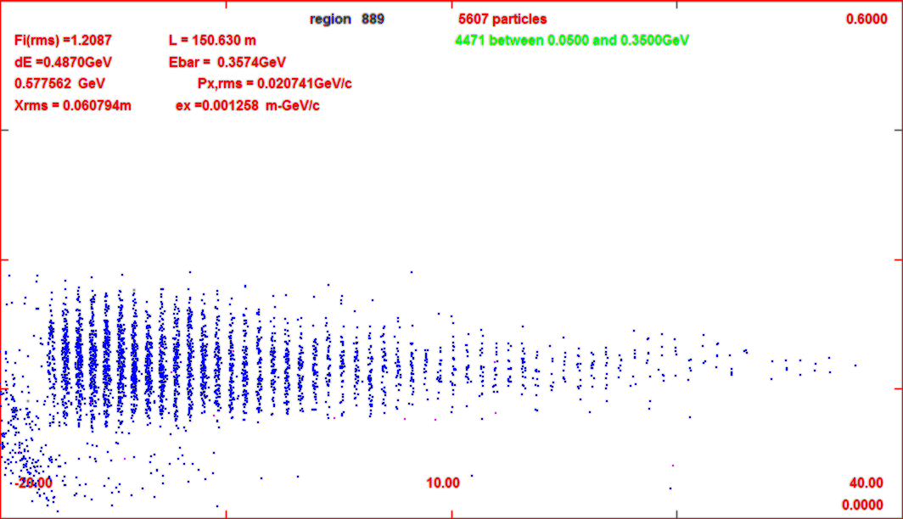
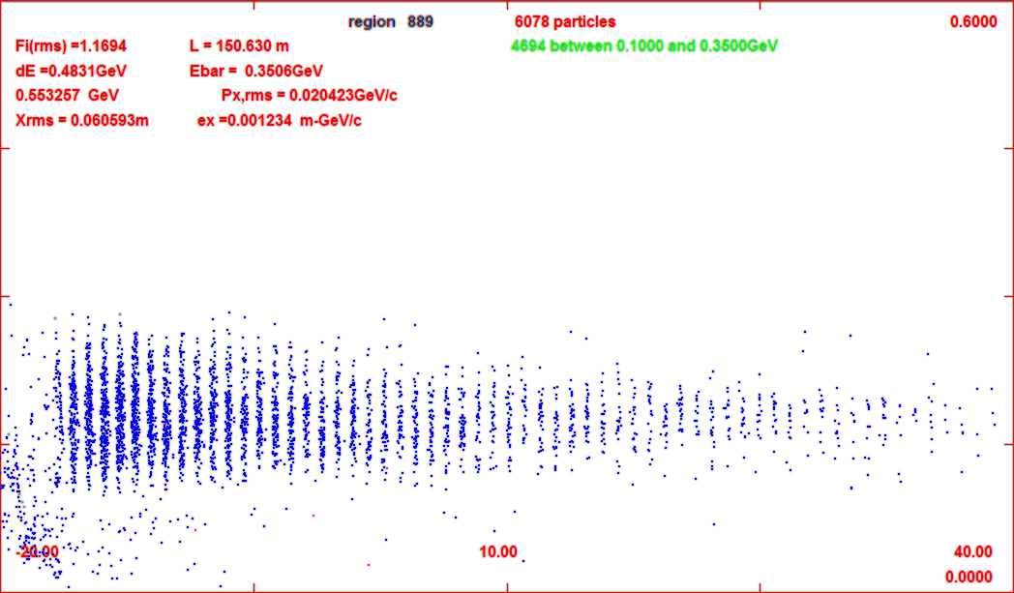
34 --- 34 atm
17 --- 34 atm
600 MeV/c
0.065 μ⁺/p
0.058 μ⁺/p
z = 72
z = 108
40m
-20m
40m
-20m
z = 150

Slide 16
Beam difference notes
Most of loss in intrinsic performance is from gas in buncher
  Beam enters completely unbunched
  Initial rf is weak; and slowly increases
After some initial loss, SIMILAR TO GAS-FREE BASELINE

Slide 17
Increase rotator to 100 atm
Buncher at 17atm
  LESS INITIAL LOSS
With V =20/25/28
  ~0.059 μ/p (C 6.75)
  ~10% less than 17/34
Increase Rotator gradient to 28 MV/m
  to compensate energy loss
Fairly good performance
  ~0.063 μ/p (C 6.75)
More cooling in Rotator
  1-D cooling (2T solenoid)
  one mode highly damped
Significant initiation of cooling
  (integrating rotator/cooler)
  shortens following cooler
z | ε_{t} | ℓ=L/2 | ε₊ | ε₋
77 | 0.0176 | 0.0061 | 0.0248 | 0.0124
89 | 0,0144 | 0.0077 | 0.0241 | 0.0087
102 | 0.0128 | 0.0088 | 0.0242 | 0.0066

Slide 18
Tried higher
100 atm → 150 atm
Preliminary results
  seems a bit worse than 100 atm
Not much more cooling
  limited by 1-D cooling in fixed field ??

Slide 19
Future projects
Go to longer system
  B/R/C →24 m /30 m/50 m
  D → 17/ 100 atm ??
try alternating solenoid in rotator ?

Slide 20

Next steps

