Slide 1
Front End – gas-filled cavities
David Neuffer
May 19, 2015

Slide 2
Outline
Front End for Muon Collider/ Neutrino Factory
Baseline for MAP
8 GeV proton beam on Hg target
325 MHz
With Chicane/Absorber
Current status
New targetry
6.75 GeV on C target
New Mars generated beams
Mars ouput much different from previous version
Buncher rotator with H₂ gas
rematches OK except for loss at beginning of buncher
can cool and rottoe simultaneously
beam for Low-energy muons
150 MeV/c buncher/rotator

Slide 3
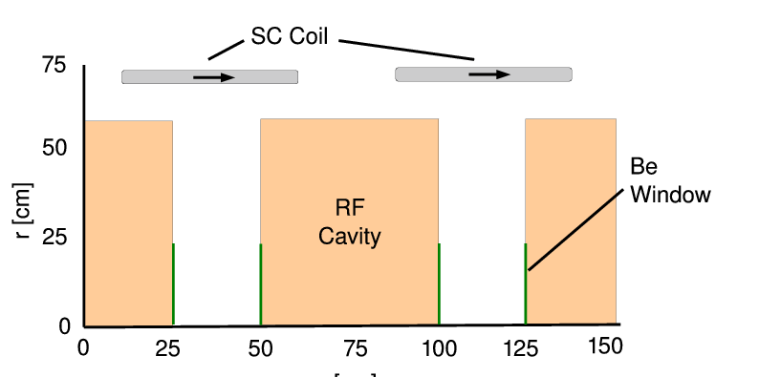
325MHz “Collider” front end
Drift
20 T → 2 T
Buncher
P_{o} = 250MeV/c
P_{N} = 154 MeV/c; N = 10
V_{rf} : 0 → 15 MV/m
(2/3 occupied)
f_{RF} : 490 → 365 MHz
Rotator
V_{rf} : 20MV/m
(2/3 occupied)
f_{RF} : 364→ 326 MHz
N = 12.045
P_{0,} P_{N} → 245 MeV/c
Cooler
245 MeV/c
325 MHz
25 MV/m
2 1.5 cm LiH absorbers
/0.75m

Slide 4
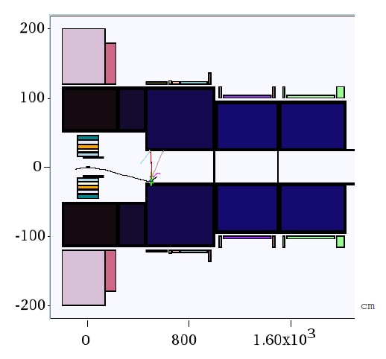
New Proton Driver parameters
6.75 GeV p, C target
20 → 2 T short taper
~5 m (previously 15)
X. Ding produced particles at z = 2 → 10 m using Mars
short initial beam
Redo ICOOL data sets to match initial beam
ref particles redefined
in for003.dat
and for001.dat

Slide 5
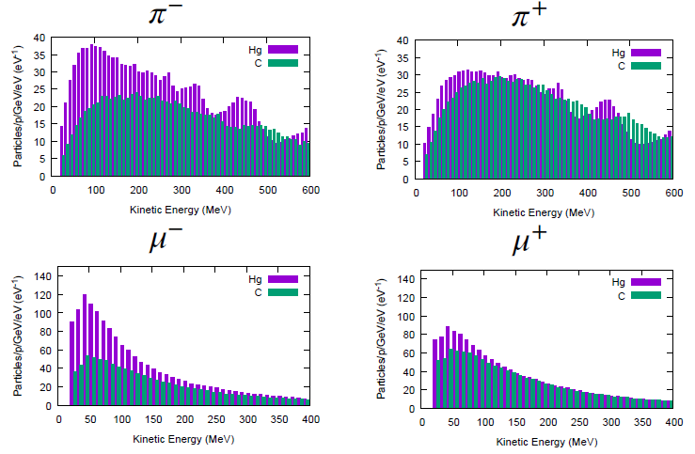
Following Scott’s review of front end
Use initial distributions (obtained by X. Ding)
8 GeV protons on Hg target
+ and - particles
6.75 GeV protons on C target
Start beam from z = 10 m
must retranslate into ICOOL reference particles
Early losses on apertures have already occurred
23 cm apertures

Slide 6
ICOOL translation tips
start at “z = 10 m”
(particle time zero is at -1 m)
reference particles
250 MeV/c ; 154 MeV/c μ⁺
165.75 MeV ; 81.1 MeV μ⁺
time set by 1 m as 6,75 GeV proton + 10 m as μ⁺
reference particles set in for003.dat, not for001.dat
for003.dat
01-Feb-2015 X. Ding C 10 m -
0.0 0.250 3.95709E-08 0.0 0.154 4.381345E-08 2
1 1 -3 0 4.354479e-008 1.000000e+000 0.03737 0.03656 0 7.861861e-004 2.558375e-002 2.189235e-001 0 0 0
3 1 -3 0 3.712592e-008 1.000000e+000 -0.03459 -0.11247 0 1.617131e-001 3.506310e-002 4.670452e-001 0 0 0
6 1 -3 0 3.748837e-008 1.000000e+000 0.00304 -0.04460 0 -1.827203e-002 -5.931789e-002 7.809555e-001 0 0 0
10 1 -3 0 3.738523e-008 1.000000e+000 0.07979 0.13944 0 -4.890422e-002 3.733585e-001 1.515145e+000 0 0 0
In ICOOL for001.dat
REFP
2 0 0 0 3
REF2
2 0 0 0

Slide 7
Simulation results
Simulation results
Hg target 8 GeV –end of cooling
~0.0756 μ⁺/p; ~0.0880 μ-/p;
C target 6.75 GeV p
~0.0613 μ⁺/p; ~0.0481 μ⁻/p;
0.0726 μ⁺/p; ~0.0570 μ⁻/p when multiplied by 8/6.75
Previous front ends had ~0.1 to ~0.125 μ/p
Redo with old initial beams
2010 Hg 8GeV p
0.114μ⁺/p
2014 Hg 8GeV p
0.112μ⁺/p

Slide 8
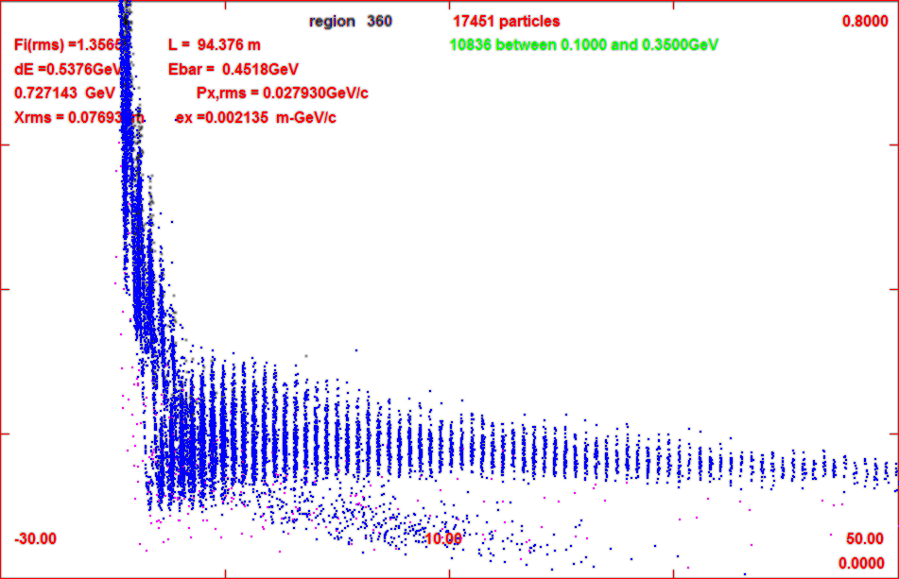
Progression of beam through system
0.8 GeV
z = 11 m
o
z = 104 m
-30m
-50m
z = 135 m

Slide 9
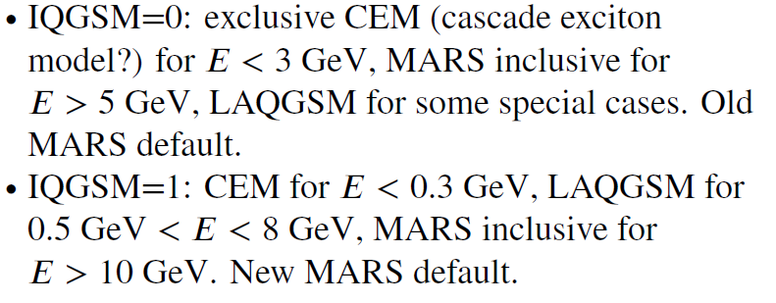
6.75 GeV p/ C target – 8GeV Hg
Simulations capture typically somewhat less than before
Big difference in MARS production model
Mars Inclusive → LAQGSM=1
Drop in production for ~8 GeV
Are previous MARS simulations that showed an advantage in production for ~8 GeV still true ?

Slide 10
Studies on gas-filled rf for buncher/rotator
Stratakis et al. have done cooling channel with gas-filled rf
~34 atm H₂ to stop breakdown
Extrapolate back to include buncher/rotator
use gas to suppress breakdown in buncher/rotator
rf in ~2 T solenoids

Slide 11
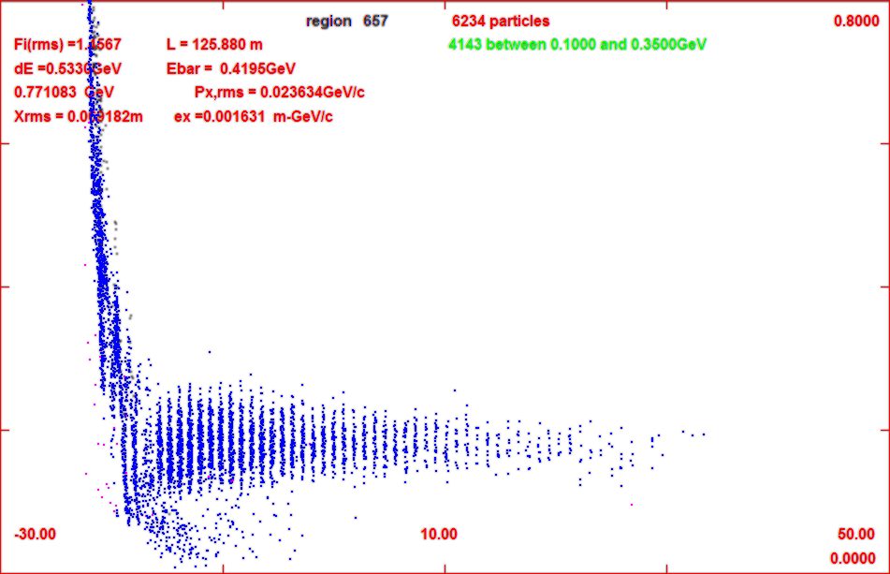
Add gas-filled rf in buncher/rotator
34 – 100 atm equivalent
1.14 MeV/m
34 atm
3.45 MeV/m
100atm
for 34 atm
add ~2 MV/m to rf
First tries with ICOOL
GH in buncher 1 atm
no change in capture
Change to 34 atm by
DENS GH 34.0
Runs OK but
reduces capture by 20%
mostly from low-E muons
shorter bunch train
gas
z = 71 m
0
gas
z = 135 m
no gas
-30 m
50 m

Slide 12
Updated gas-filled front end
added gas in rotator
34 atm
dE/dx
Increased rf a bit
Buncher 15z → 2+20(z/24) MV/m
Rotator 20 → 25
ref particles decelerate to 230Mev/c
Cooler 25 → 28 MV/m
Results are not so bad
8GeV Hg + → 0.0718 μ/p
8GeV Hg - → 0.0773 μ/p
6.75 geV C + → 0.0539 μ⁺/p
6.75 geV C -→ 0.0430μ⁻/p
~10% worse than baseline
Tweak of reference particle to fit ICOOL features (for 100atm)
REFP
2 0.250 0. 1.55 4
REF2
2 0.154 0. 6.9
use phase model 4
tracks reference particles energy loss in drft/absorber but not in rf
fixed energy gain.loss in rf
ref particle acceleration fitted to end at ~245 MeV/c

Slide 13
FrontEnd variations
Reduce buncher gas to 17 atm
~ 10% better
back to ~ baseline
~0.062 μ⁺/p
decelerating rotator or constant energy rotator?
C → ~0.063 μ⁺/p
about the same
no real advantage/disadvantage in deceleration
Note initial beam is “cooled”, but only in one dimension
B = 2 T – no field flip
Angular momentum increases
z | ε_{t} | ℓ=L/2 | ε₊ | ε₋
59 | 0.0184 | 0.0054 | 0.0246 | 0.0138
78 | 0,0173 | 0.0059 | 0.0243 | 0.0124
102 | 0.0151 | 0.0074 | 0.0242 | 0.0095

Slide 14
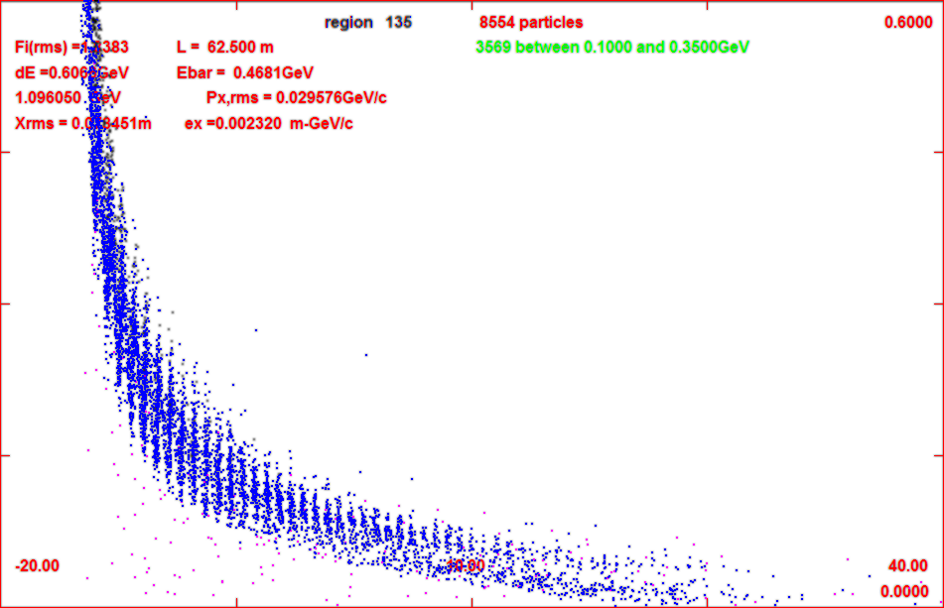
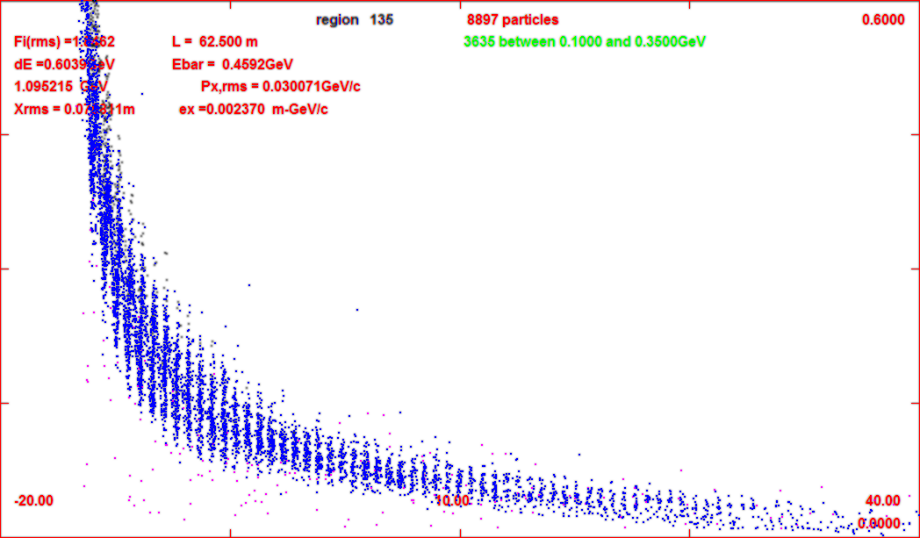
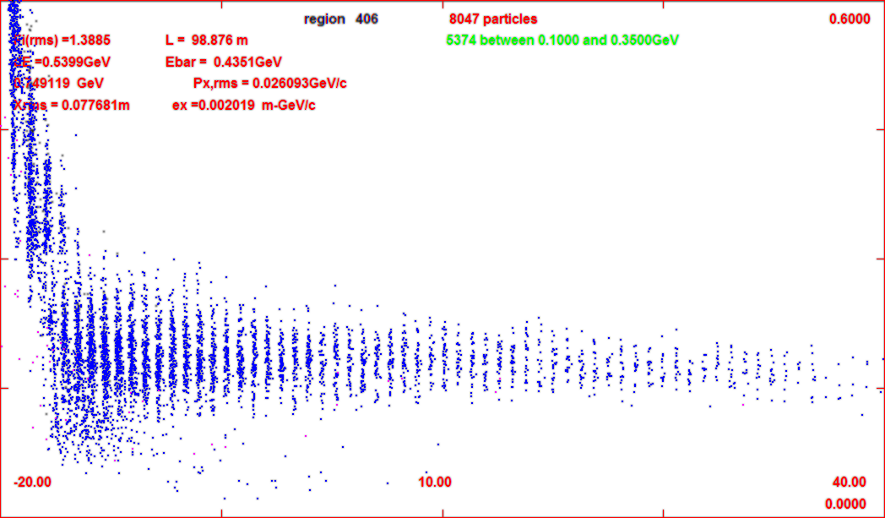
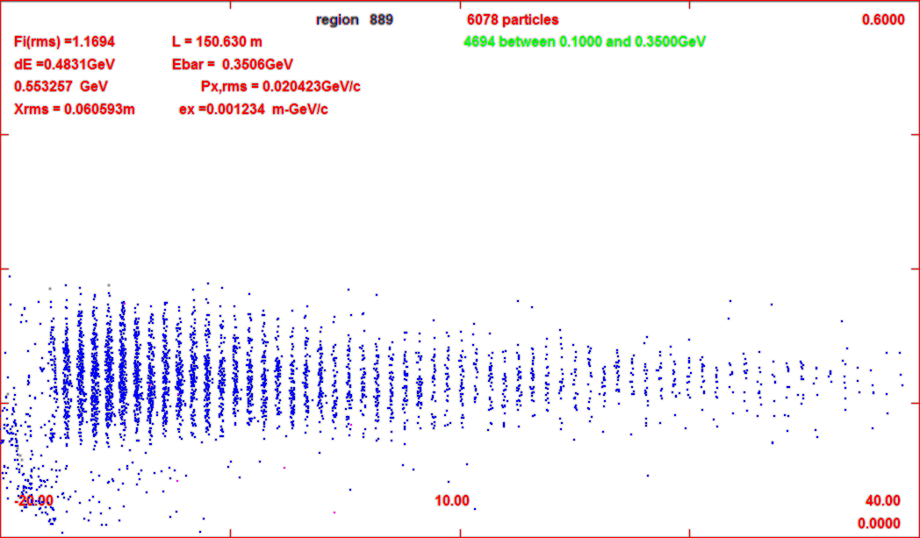
Compare 17/34
34 --- 34 atm
17 --- 34 atm
600 MeV/c
0.065 μ⁺/p
0.058 μ⁺/p
z = 72 m
z = 108 m
40m
-20m
40m
-20m
z = 150 m

Slide 15
Increase rotator to 100atm
Buncher at 17atm
LESS INITIAL LOSS
With V = 20/25/28
~0.059 μ/p (C 6.75)
~10% less than 17/34
Increase Rotator gradient to 28 MV/m
to compensate energy loss
Fairly good performance
~0.063 μ/p (C 6.75)
Buncher at 34 atm
~0.058 μ/p (C 6.75)
V = 22/28/30 MV/m
worse than 17/100 case
More cooling in Rotator
1-D cooling (2T solenoid)
one mode highly damped
Significant initiation of cooling
(integrating rotator/cooler)
shortens following cooler
z | ε_{t} | ℓ=L/2 | ε₊ | ε₋
77 | 0.0176 | 0.0061 | 0.0248 | 0.0124
89 | 0,0144 | 0.0077 | 0.0241 | 0.0087
102 | 0.0128 | 0.0088 | 0.0242 | 0.0066

Slide 16
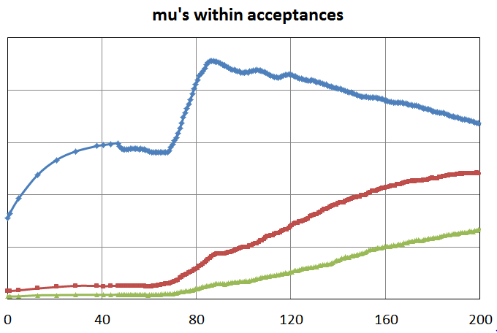
Beam difference notes
Most of loss in intrinsic performance is from gas in buncher
Beam enters completely unbunched
Initial rf is weak; and slowly increases
After some initial loss, SIMILAR TO GAS-FREE BASELINE
0.125
0.10
0.075
N: ε_{T}<0.03; A_{L}<0.2
0.05
0.025
0.0

Slide 17
Continue Cooling with H2 Gas
Previous cases used baseline front end cooling
2 LiH 1.5 cm absorbers per cell
240 atm of H₂
~8.3 MV/m loss from gas
Preliminary results
Throughput improved to ~0.068 μ⁺/6.75 GeV proton C target

Slide 18
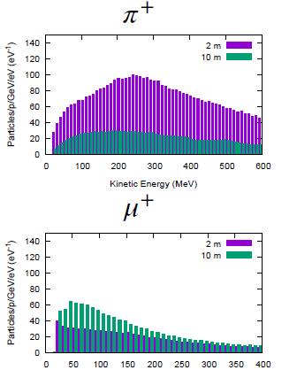
Low-E capture
Capture at low momentum
prepare beam for low-E μ experiment
Somewhat scaled back version of front end
30.4m drift
shorter buncher /rotator
12 m / 13.5 m
0 → 15 MV/m, 15 MV/m
vacuum rf
B=2T
Parameters
150 MeV/c … 100 MeV/c reference particles
77.8 // 39.8 MeV
Bunch to 150 MeV/c
Cooling at 2 T

Slide 19
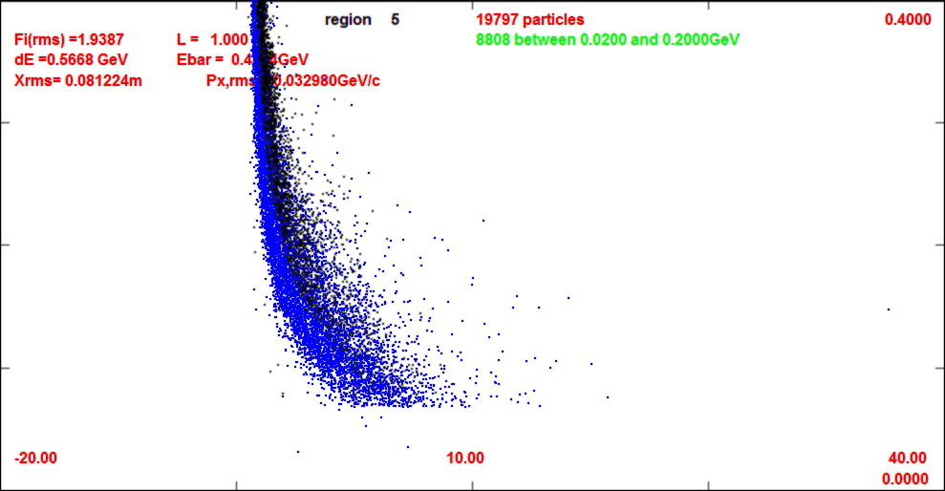
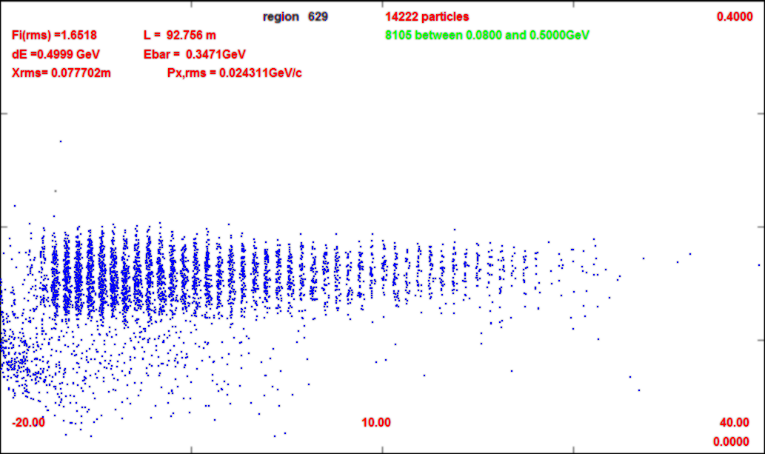
simulation of low-E buncher
Used Ding initial beam
initial beam cut off at ~70 MeV/c
21 MeV kinetic energy
bunch train formed
Cooling from 60m ➔ 100m
longitudinal antidamping
g_{L} = ~ -0.5
B=2T , 2cm
more used to separate captured from uncaptured beam
~0.05 μ/p within acceptance ??
not sure what acceptance criteria to use
0.4
L = 11 m
0.0
0.4 GeV/c
L = 60 m
0.0
0.4
L = 100 m
0.0

Slide 20
LHC discoveries motivate future research…

Slide 21
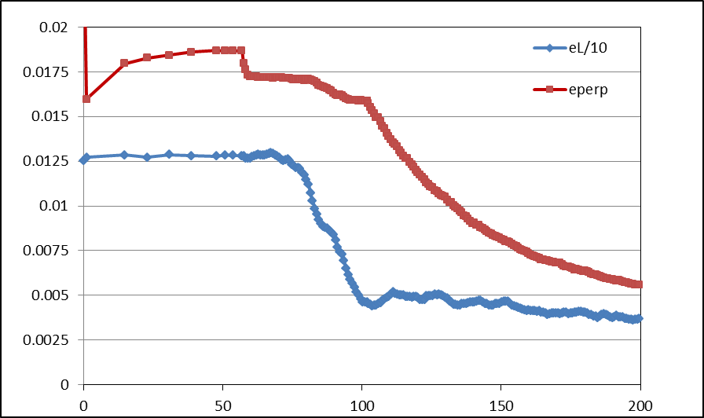
Simulation Results
Simulation obtains
~0.125 μ/p within acceptances
with ~60m Cooler
325 MHz – less power
shorter than baseline NF
But
uses higher gradient
higher frequency rf → smaller cavities
shorter than baseline NF
more bunches in bunch train
N :0.15<P<0.35 GeV/c
N: ε_{T}<0.03; A_{L}<0.2 c
N: ε_{T}<0.015; A_{L}<0.2
Useful
cooling

