Slide 1
Status of Beta Beam R&D:
Radioactive ion production
Etam NOAH
(October 21, 2009)
On behalf of EURISOL-DS*/ISOLDE-CERN
Acknowledgements: Mats Lindroos, Thierry Stora, Elena Wildner and Beta-beam team
*Project supported by the European Commission under the FP6
“Research Infrastructure Action- Structuring the European Research Area”
EURISOL-DS Project Contract no. 515768 RIDS

Slide 2
Outline
Beta-beams:
  Neutrino beams
  EURISOL-DS beta-beam
Ion production issues:
  Production options
  The ISOL method
  Production and extraction of ⁶He
EURISOL-DS 100 kW targets:
  100 kW liquid metal target
  100 kW oxide target

Slide 3
Introduction to beta-beams
Beta-beam proposal by Piero Zucchelli
  A novel concept for a neutrino factory: the beta-beam, Phys. Let. B, 532 (2002) 166-172.
AIM: production of a pure beam of electron neutrinos (or antineutrinos) through the beta decay of radioactive ions circulating in a high-energy (γ~100) storage ring.
First study in 2002
  Make maximum use of the existing infrastructure.
Ions move almost at the speed of light

Slide 4
Beta-beam basics
  Book: Beta Beams: Neutrino Beams, Mats Lindroos, Mauro Mezzetto, Imperial College Press (24 Sep 2009).
Aim: production of (anti-)neutrino beams from the beta decay of radio-active ions circulating in a storage ring
  Similar concept to the neutrino factory, but parent particle is a beta-active isotope instead of a muon.
Beta-decay at rest
  ν−spectrum well known from the electron spectrum
  Reaction energy Q typically of a few MeV
Accelerate parent ion to relativistic γ_{max}
  Boosted neutrino energy spectrum: E_{ν} ≤ 2γQ
  Forward focusing of neutrinos: θ ≤ 1/γ
Pure electron (anti-)neutrino beam!
  Depending on β⁺- or β⁻ - decay we get a neutrino or anti-neutrino
  Two different parent ions for neutrino and anti-neutrino beams
Physics applications of a beta-beam
  Primarily neutrino oscillation physics and CP-violation (high energy)
  Cross-sections of neutrino-nucleus interaction (low energy)
ν
Beta-beam
ν
⁶He
boost

Slide 5
The Beta-beam Options
Low energy beta-beams
  Nuclear physics, double beta-decay nuclear matrix elements, neutrino magnetic moments
The medium energy beta-beams or the EURISOL beta-beam
  Lorenz gamma approx. 100 and average neutrino energy at rest approx. 1.5 MeV (P. Zucchelli, 2002)
The high energy beta-beam
  Lorenz gamma 300-500 and average neutrino energy at rest approx. 1.5 MeV
The very high energy beta-beam
  Lorenz gamma >1000
The high Q-value beta-beam
  Lorenz gamma 100-500 and average neutrino energy at rest 6-7 MeV
The Electron capture beta-beam

Slide 6
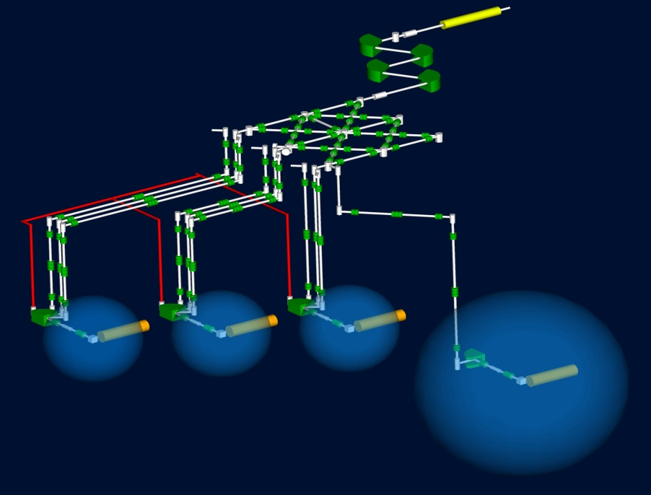
The EURISOL-DS
100 kW direct targets
mMW fission target
RIB production:
Spallation-evaporation
Main: P-rich
(10 to 15 elements
below target material)
Residues: N-rich
(A few elements
below target material)
Target materials:
Oxides
Carbides
Metal foils
Liquid metals
RIB production:
Fission
N-rich
Wide range
Z = 10 to Z = 60
Target material:
U (baseline)
Th
Converter:
Hg
Participants:
~20 institutions
Contributors:
~20 institutions
EU suport (~30%):
~9.2 MEuros
Duration:
2005-2009
12 Tasks

Slide 7
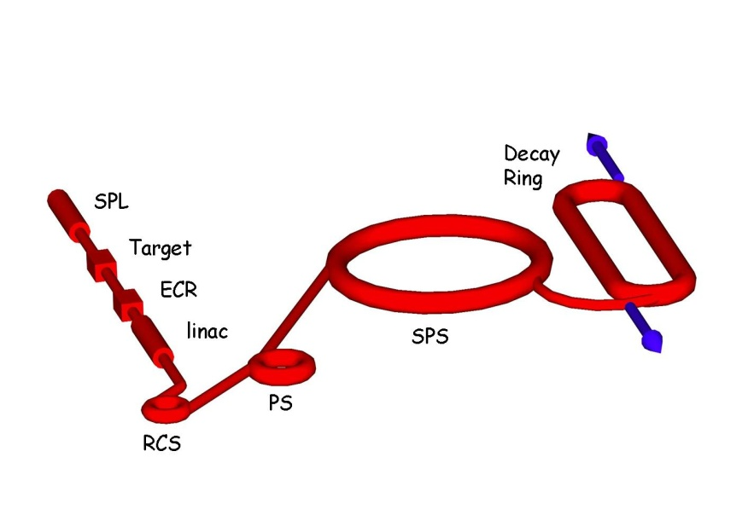
The EURISOL Scenario
Based on CERN boundaries
Ion choice: ⁶He and ¹⁸Ne
Relativistic gamma=100/100
  SPS allows maximum of 150 (⁶He) or 250 (¹⁸Ne)
  Gamma choice optimized for physics reach
Based on existing technology and machines
  Ion production through ISOL technique
  Bunching and first acceleration: ECR, linac
  Rapid cycling synchrotron
  Use of existing machines: PS and SPS
Opportunity to share a Mton Water Cerenkov detector with a CERN superbeam, proton decay studies and a neutrino observatory
Achieve an annual neutrino rate of either
  2.9*10¹⁸ anti-neutrinos from ⁶He
  Or 1.1 10¹⁸ neutrinos from ¹⁸Ne
EURISOL scenario

Slide 8
Possible beta-beam complex
Low-energy part
High-energy part
Ion production
Acceleration
Neutrino source
Beam to experiment
Proton Driver SPL
Acceleration to final energy
PS & SPS
Ion production ISOL target & Ion source
Decay ring
Bρ = 1500 Tm
B = ~6 T
C = ~6900 m L_{ss}= ~2500 m
⁶He: γ = 100 ¹⁸Ne: γ = 100
SPS
Existing!!!
Neutrino Source
Decay Ring
Beam preparation ECR pulsed
Ion acceleration Linac, 0.4 GeV
93 GeV
PS
Acceleration to medium energy RCS, 1.5 GeV
.
8.7 GeV
Detector in the Frejus tunnel

Slide 9
Choice of radioactive ion species
Beta-active isotopes
  Production rates
  Life time
  Dangerous rest products
  Reactivity (Noble gases are good)
Reasonable lifetime at rest
  If too short: decay during acceleration
  If too long: low neutrino production
  Optimum lifetime given by acceleration scenario
  In the order of a second
Low Z preferred
  Minimize ratio of accelerated mass/charges per neutrino produced
  One ion produces one neutrino.
  Reduce space charge problem
EURISOL choice in 2002
  ⁶He to produce antineutrinos
  ¹⁸Ne to produce neutrinos

Slide 10
Production of beta-beam isotopes
The Isotope Separation On-Line (ISOL) method at medium energy
  EURISOL type production, uses typically 0.1-2 GeV protons with up to 100-200 kW beam power through spallation, fission and fragmentation
Direct production
  Uses low energy but high intensity ion beams on solid or gas targets. Production through compound nuclei which forms with high cross section at low energies
Direct production enhanced with a storage ring
  Enhancing the efficiency of the direct production through re-circulation and re-acceleration of primary ions which doesn’t react in the first passage through the target.
  Possible thanks to ionization cooling!

Slide 11
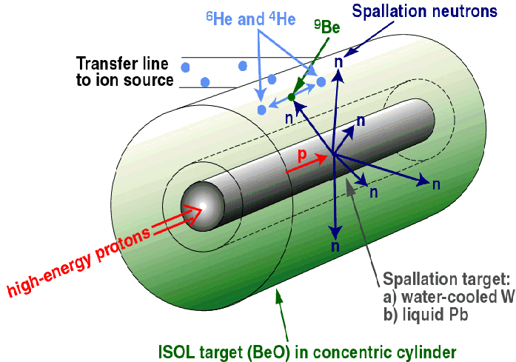
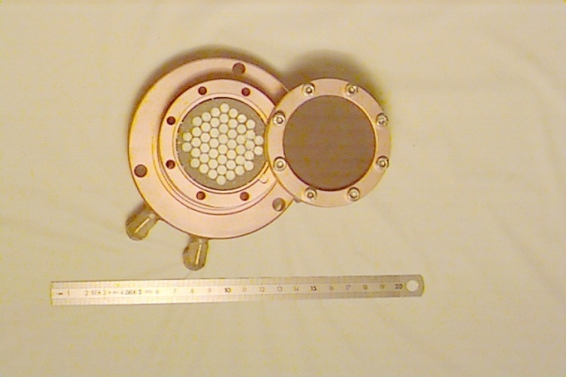
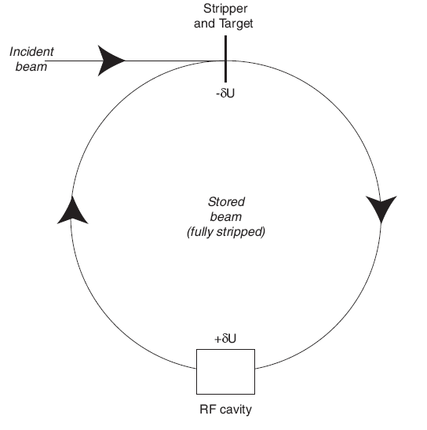
Intensities at source
ISOL method at 1-2 GeV (200 kW)
  >1 10¹³ ⁶He per second
  <8 10¹¹ ¹⁸Ne per second
  ⁸Li and ⁸B not studied
  Studied within EURISOL
Direct production
  >1 10¹³ (?) ⁶He per second
  1 10¹³ ¹⁸Ne per second
  ⁸Li and ⁸B not studied
  Studied at LLN, Soreq, WI and GANIL
Production ring
  10¹⁴ (?) ⁸Li
  >10¹³ (?) ⁸B
  ⁶He and ¹⁸Ne not studied
  Will be studied in the future
Converter technology:
(J. Nolen, NPA 701 (2002) 312c)
Loiselet, LLN
⁷Li
⁶Li
⁷Li(d,p)⁸Li
⁶Li(³He,n)⁸B
C. Rubbia, A Ferrari, Y. Kadi and V. Vlachoudis in NIM A 568 (2006) 475–487

Slide 12
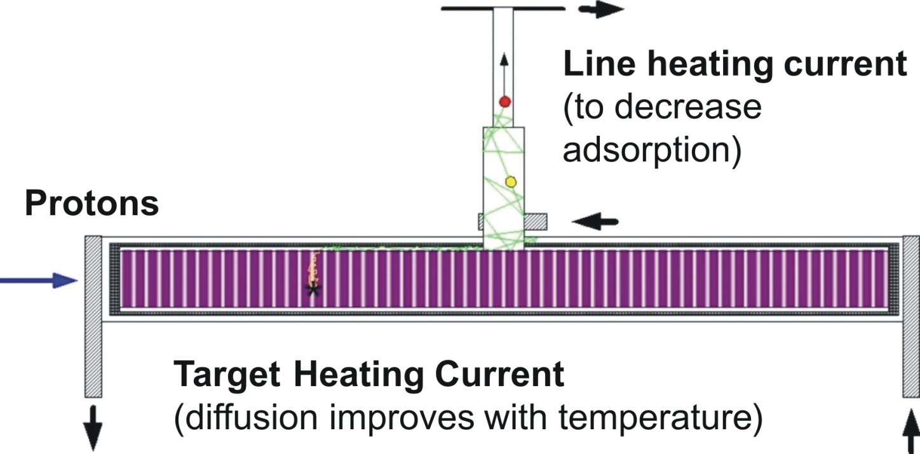
The ISOL method
RIB production and release
RIB target engineering isssues
Ionisation
(RILIS, Surface, FEBIAD/VADIS, ⁻ve)
Primary beam characteristics
Diffusion
Transfer line (Ta, Mo, W, Quartz)
Heated: decrease adsorption in effusion process
Cooled: trap condensable isobaric contaminants
Effusion
Target material 5-200g/cm²
Temperatures: 600°C to > 2000°C
Direct
Isotope production
Chemical compatibility
Energy deposition
Heat transfer mechanisms
Driver beam (protons)
Neutrons
Flux/Energy
Converter

Slide 13
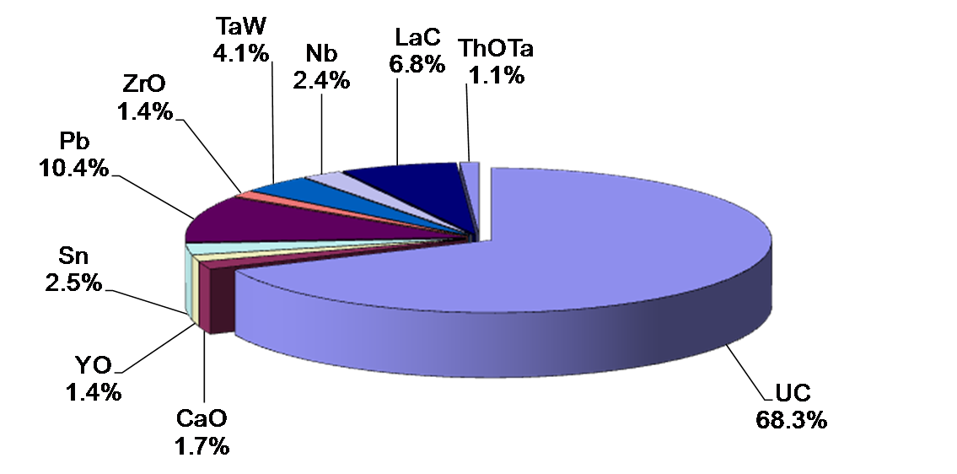
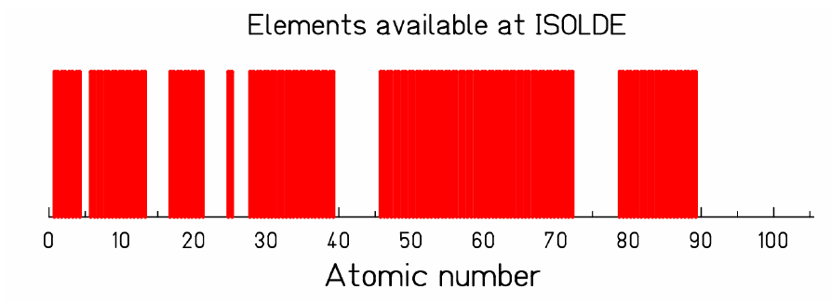
Typical target materials and RIBs
ISOLDE Targets 2008
Target elements
UCx, ThCx
CaO, MgO, Al₂O₃, ZrO
Ta, Nb
Sn, Pb, La
SiC, LaC₂
RIBs

Slide 14
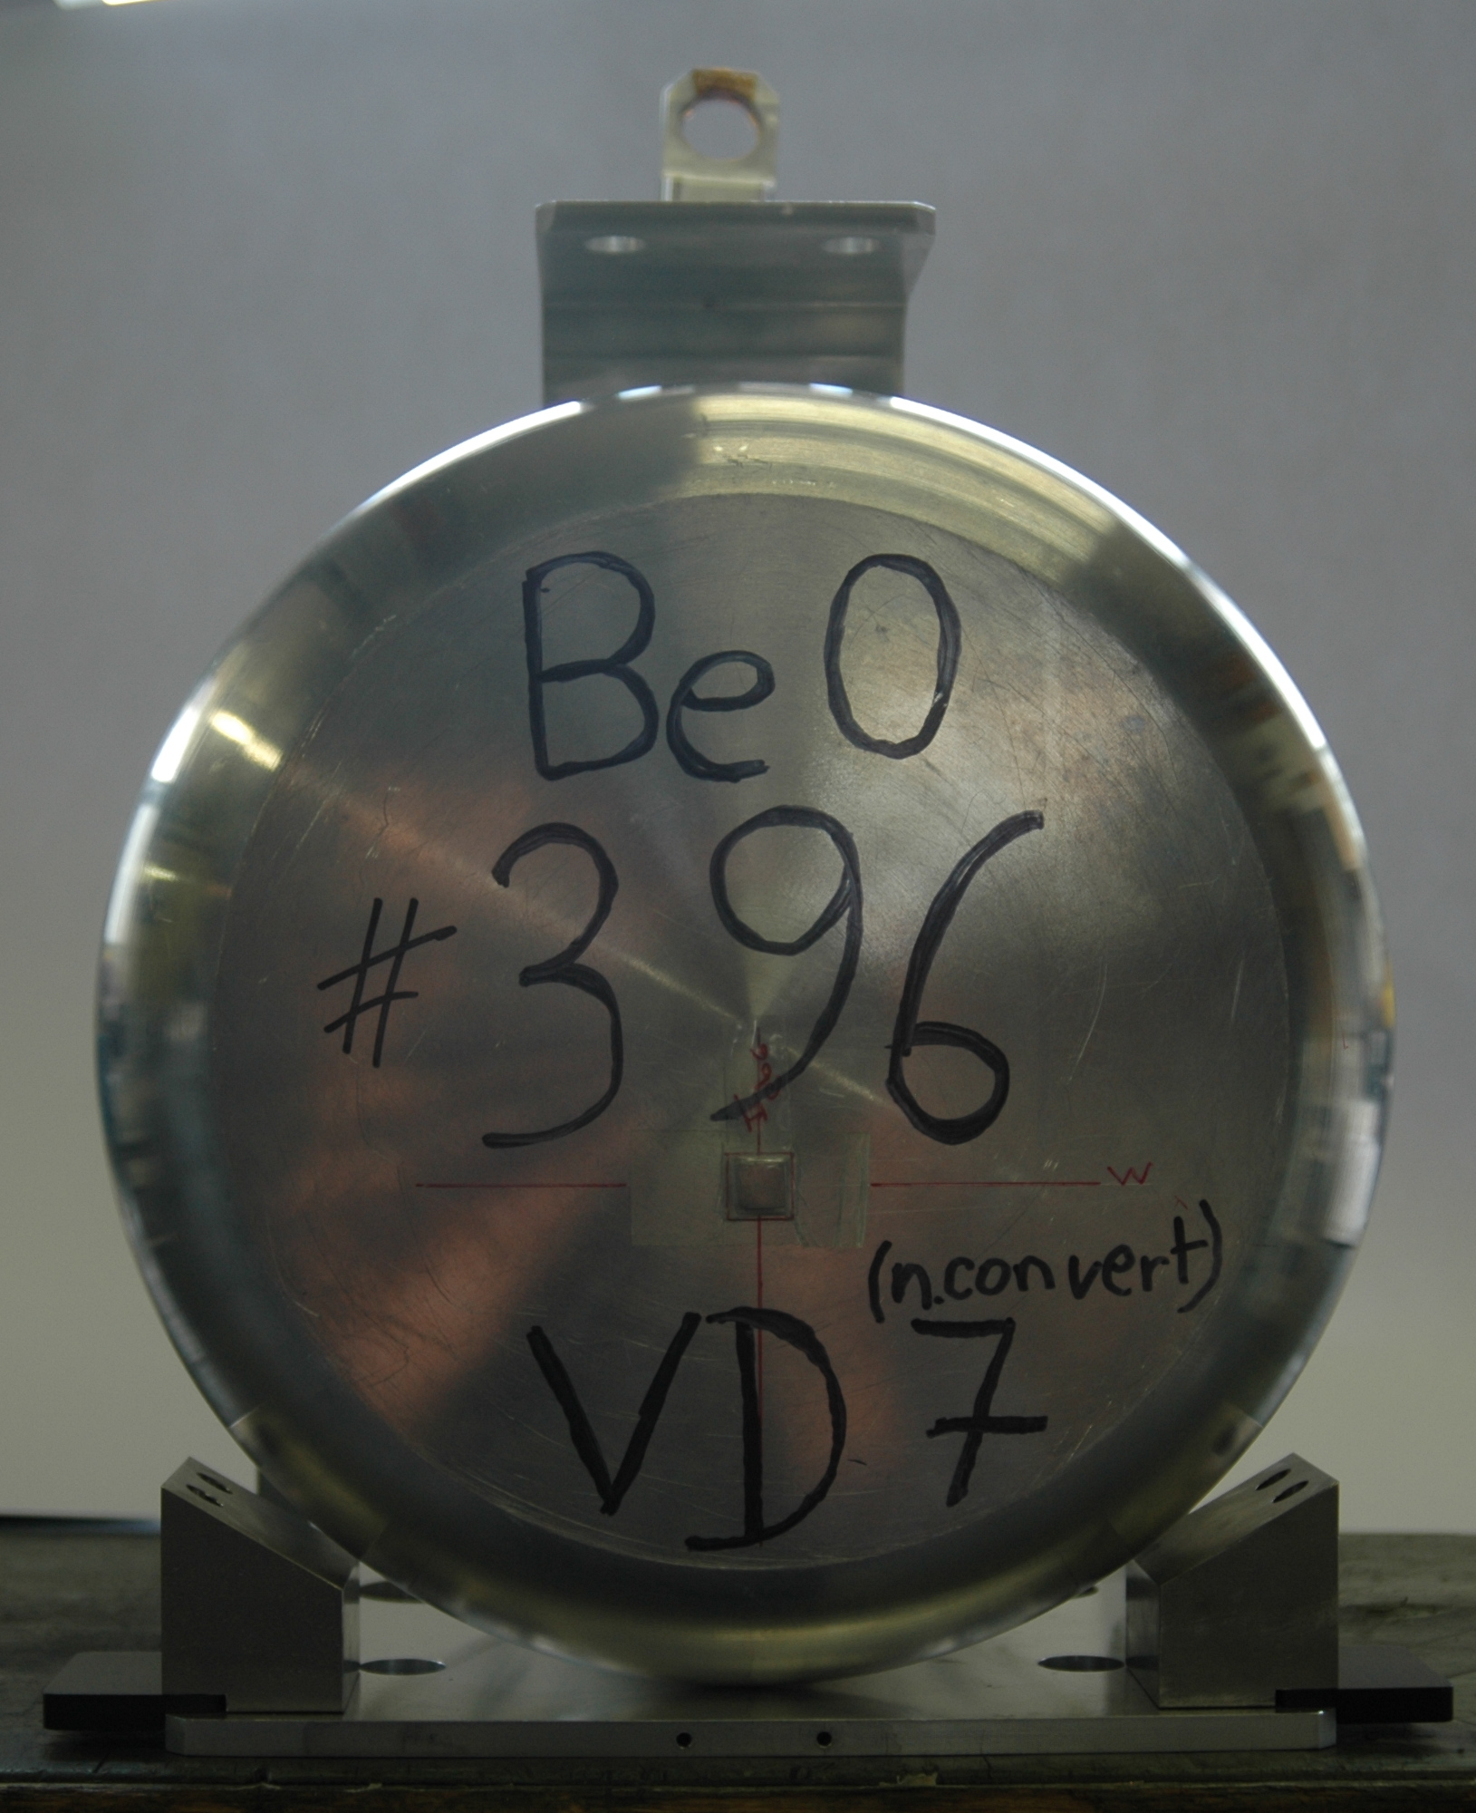
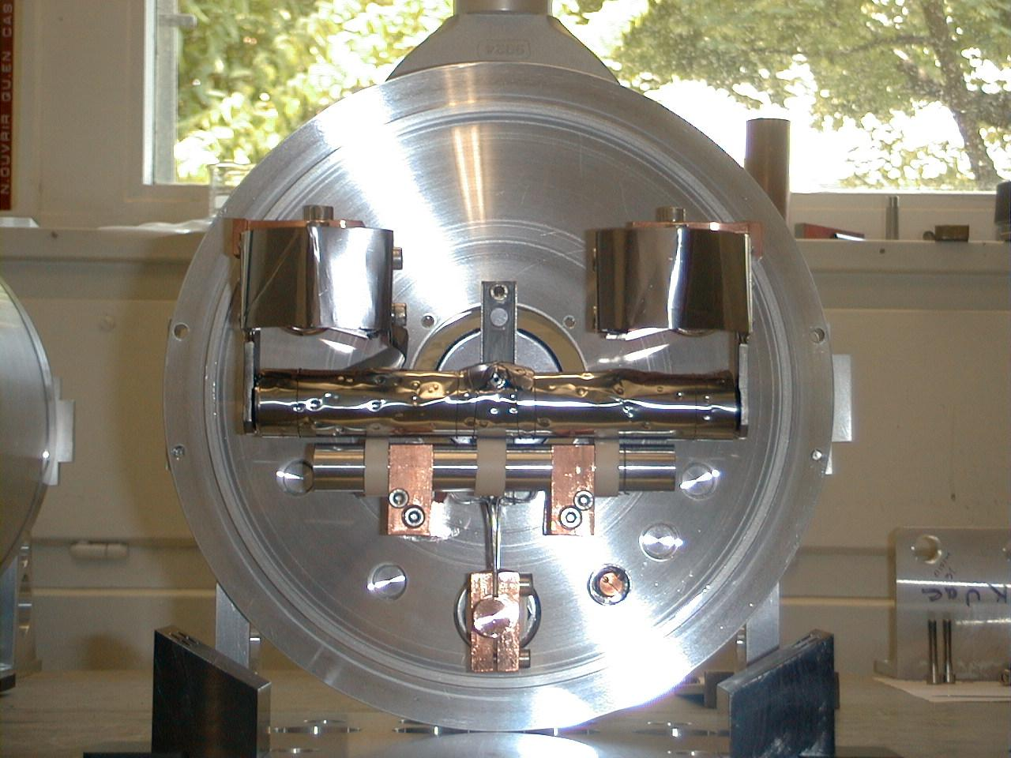
⁶He production at ISOLDE-CERN in 2009
80 porous
BeO pellets
1.4 GeV from PSB
p-n W converter
1+ FEBIAD ion source, cold line
for Noble Gases
Release efficiency
operation temperature
outgasing
materials compatibility
ageing, etc…
t_{1/2}
>85% released

Slide 15
Reaching required ion intensities
⁶He can be achieved:
  Isotope production tested at ISOLDE
  1.3 10¹³ ⁶He/s 100 kW, 40 MeV deuteron beam
  2 10¹³ ⁶He/s 100 kW, 1 GeV proton beam
  10¹⁴ ⁶He/s 200 kW, 2 GeV proton beam
¹⁸Ne challenging:
  ³He, 30 MeV, 200 mA direct on oxide target, 600 kW!
  p, 70 MeV, 30 mA on Al₂O₃ target.
Ø3cm , 15cm
Ø3cm , 24cm

Slide 16
EURISOL 100 kW Direct Target Design
Baseline parameters
FLUKA ANSYS
Thermal conductivity
Target material ageing
HEAT:
Deposition, transfer
FLUKA
Nuclear cross sections:
SigmasWin2000 ABRABLA
ISOTOPE PRODUCTION
RIBO RaBIT
Specific surface
Online tests
ISOTOPE RELEASE:
Diffusion, effusion
CPO VORPAL
Online tests
Emittance meter
ION SOURCE:
Efficiency, emittance
On-paper Target Unit Design
Tests of specific components
Validation
Prototype test
Final Target Unit Design
Target station specifications

Slide 17
EURISOL 100 kW target baseline parameters
Parameter | Symbol | Units | Nval | Range
Target material | Z_{targ} | - | SiC, Ta, BeO, Pb (molten) | Be-U
Beam particles | Z_{beam} | - | Proton | Deuterium – ¹²C
Beam particle energy | E_{beam} | GeV | 1 | 0.5 – 3
Beam current | I_{beam} | μA | 100 | 100 – 1000
Beam time structure | - | - | dc | ac 50Hz 1ms pulse
Gaussian beam geometry | σ_{beam} | mm | 7 | 3 – 20
Beam power | P_{beam} | kW | 100 | 100-1000
Target thickness | X | g/cm² | 200 | 10 – 250
Target radius (cylinder) | r_{targ} | mm | 3σ_{beam} | 3σ_{beam} – 5σ_{beam}
Target temperature | T_{targ} | ºC | 2000 | 500-2500
Number of target containers | j_{targ} | - | 4 | 1 – 10
Plasma ionization outlet diameter | Ø_{out} | mm | 3 | 2 – 6

Slide 18
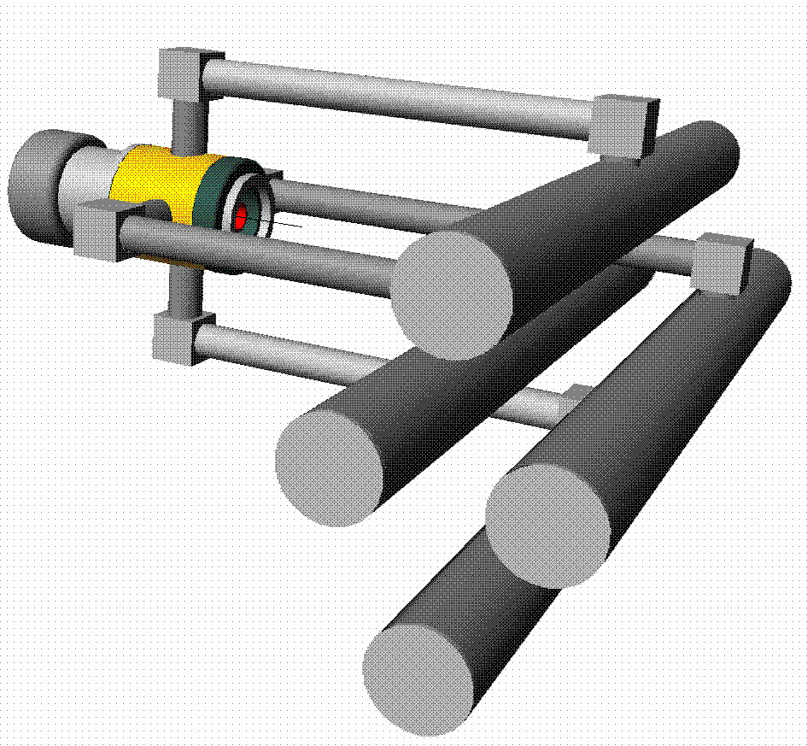
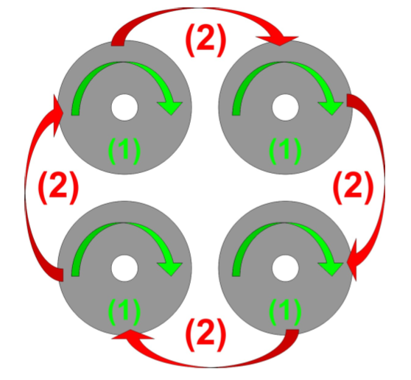
EURISOL 100 kW direct target issues
Heat dissipation + target temperature profile optimisation are main drivers of 100 kW direct target design:
  Uniform high temperature for fast diffusion and effusion
  Avoid cold spots where isotopes could condense
  Heat dissipation by conduction/thermal radiation T⁴
  Compact target geometries to minimise effusion losses
Solid targets: Oxides and Carbides
  Oxides: thermal insulators (e.g. ThO₂ 0.4 W/mK @1673 K)
  Relatively low operation temperature (e.g. CaO 1673 K)
  Composite target pills
  Multibody target concept + neutral beam merging
Solid targets: Metal foils
  Foil thickness optimisation for mechanical properties/diffusion
Liquid metal targets:
  Loop required to dissipate factor x20 more heat than can be accomodated classically
  Diffusion chamber required to optimise release efficiency of short-lived isotopes
Multi-body target
Beam sharing between sub-units of one target station

Slide 19
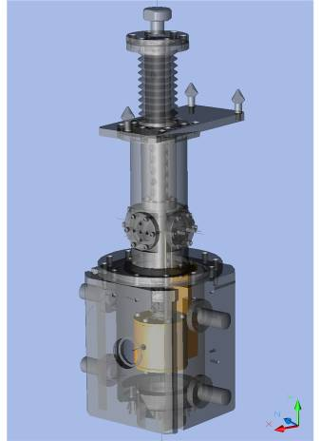
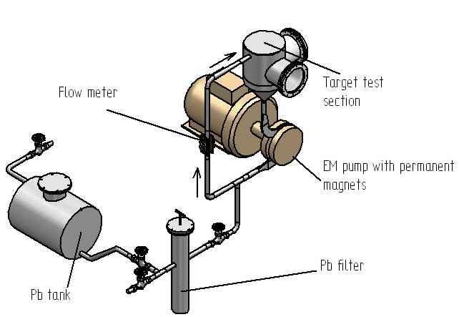
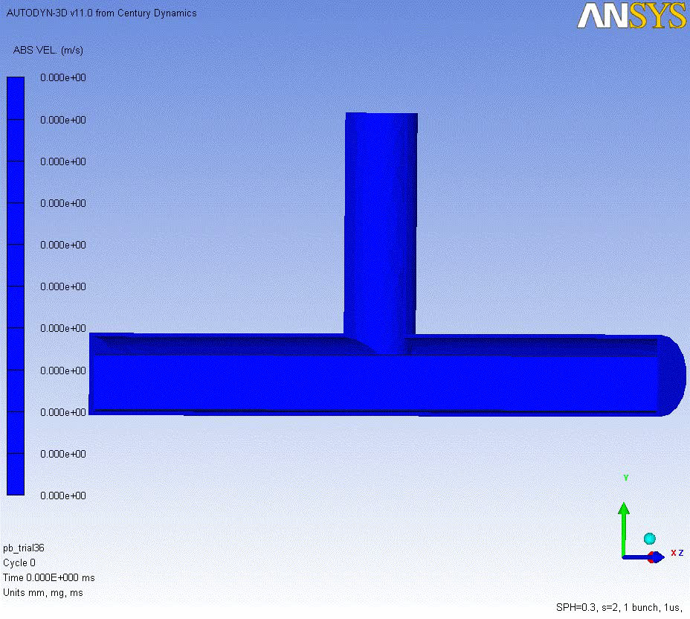
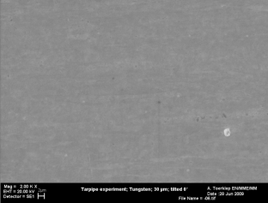
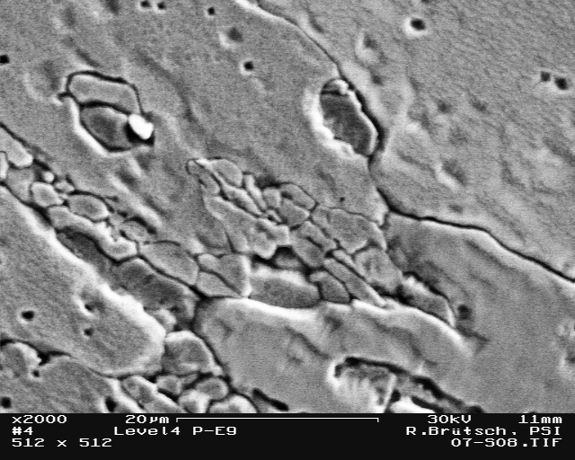
EURISOL 100 kW target developments
Bivalve
TARPIPE
2 water cooled
transfer lines
Oxide target prototype (Al₂O₃)
2 pneumatic
valves
CERN patent
Liquid metal direct target
Transient effects
Flow meter
Target test
station
EM pump with permanent magnets
W - 30μm foil
Pb filter
Pb tank

Slide 20
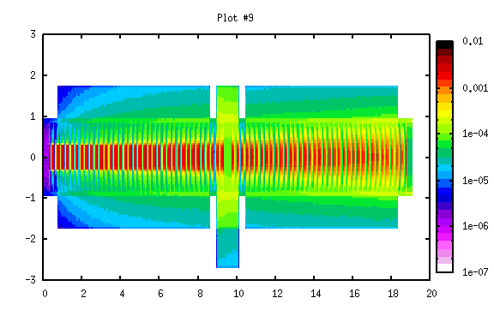
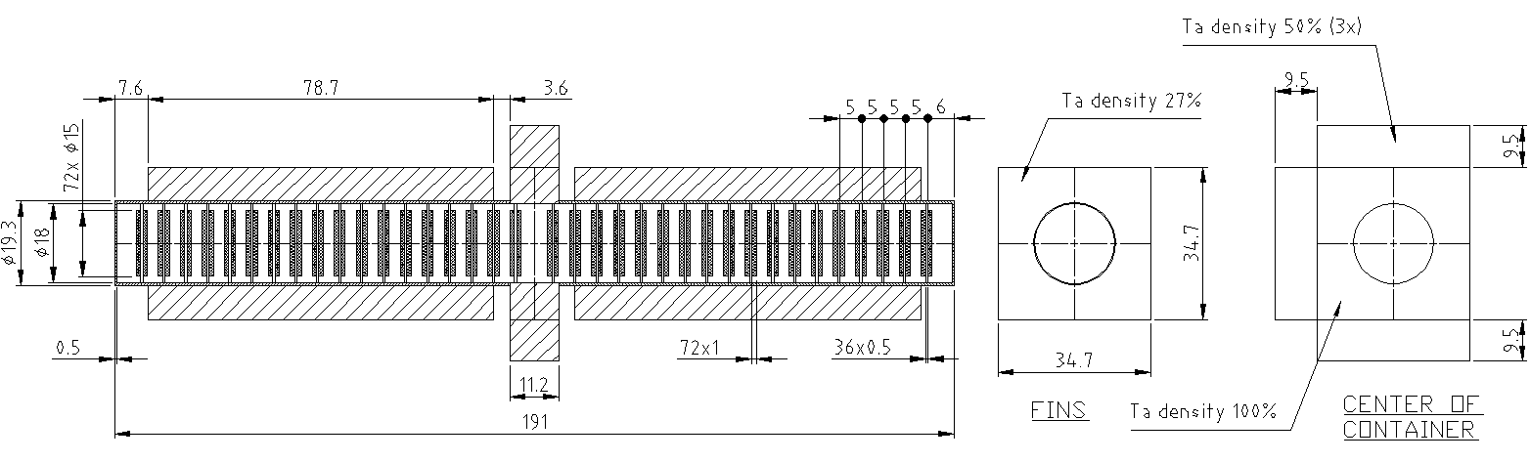
High power oxide direct target prototype

Slide 21
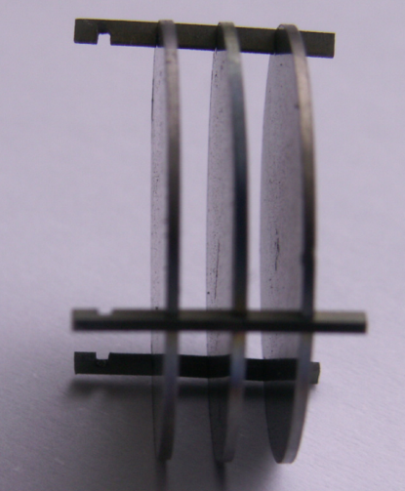
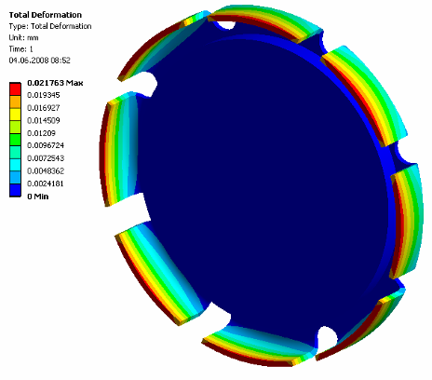
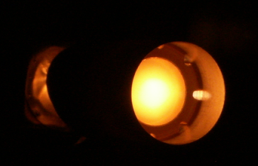
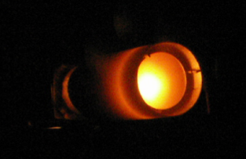
Al₂O₃/Nb composite target
S. Marzari
Earlier concept
Final concept
Deformation = 0.022 mm on each blade
1500 W/m²K
20000 W/m²K
P. Kasprowicz
P. Kasprowicz

Slide 22
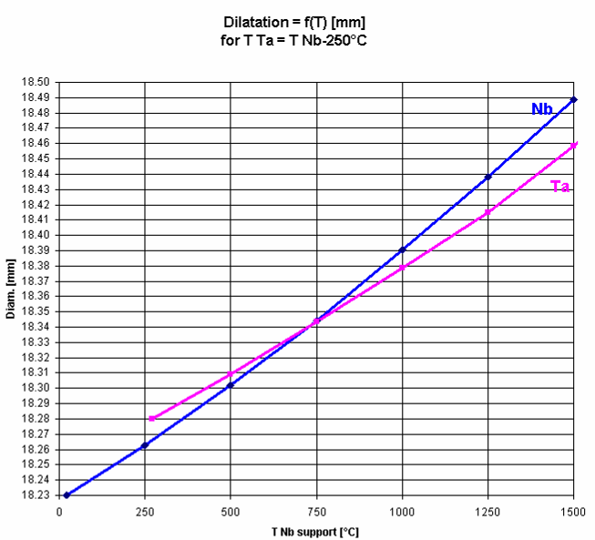
Differential dilatation Ta/Nb

Slide 23
Differential dilatation Ta/Nb
Differential dilatation & contact pressure
Cold mounting
Start heating
(with beam)
Gap 0.05mm

Slide 24
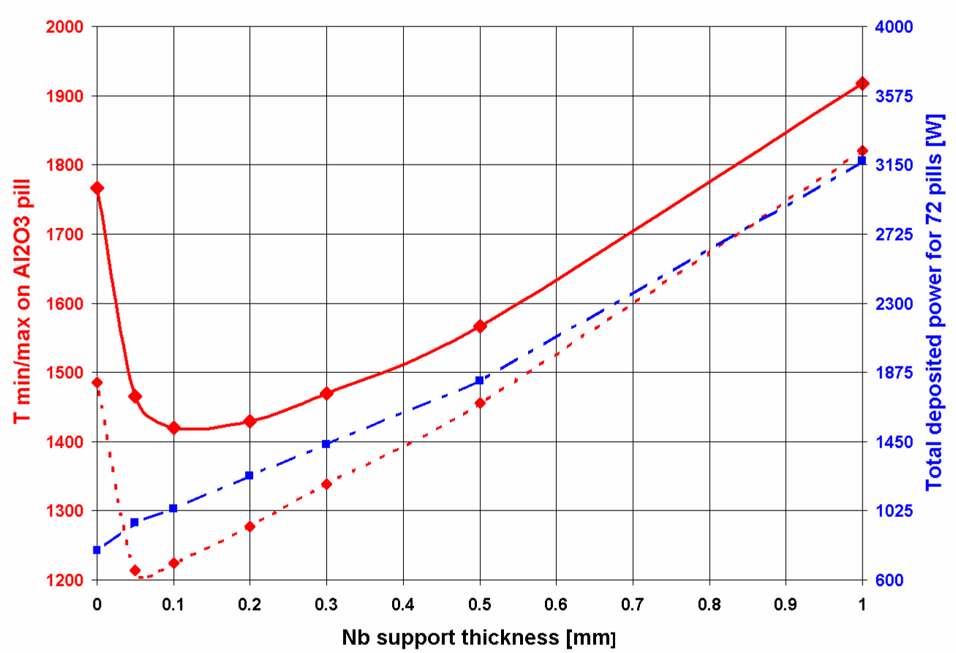
Nb thickness choice
Power deposited by 10 kW beam in 1 composite pill, 1.0 mm thick Al₂O₃ brazed onto Nb, as a function of Nb thickness.
 | Nb Thickness
 | 0.2 mm | 0.5 mm | 1.0 mm
Nb [W] | 6.36 | 16.5 | 33.8
Al₂O₃ [W] | 10.8 | 11 | 11.2
Total [W] | 17.16 | 27.5 | 45
=> 0.3mm is a good compromise between max/min ratio temperature and Nb support construction
FLUKA
ANSYS WB

Slide 25
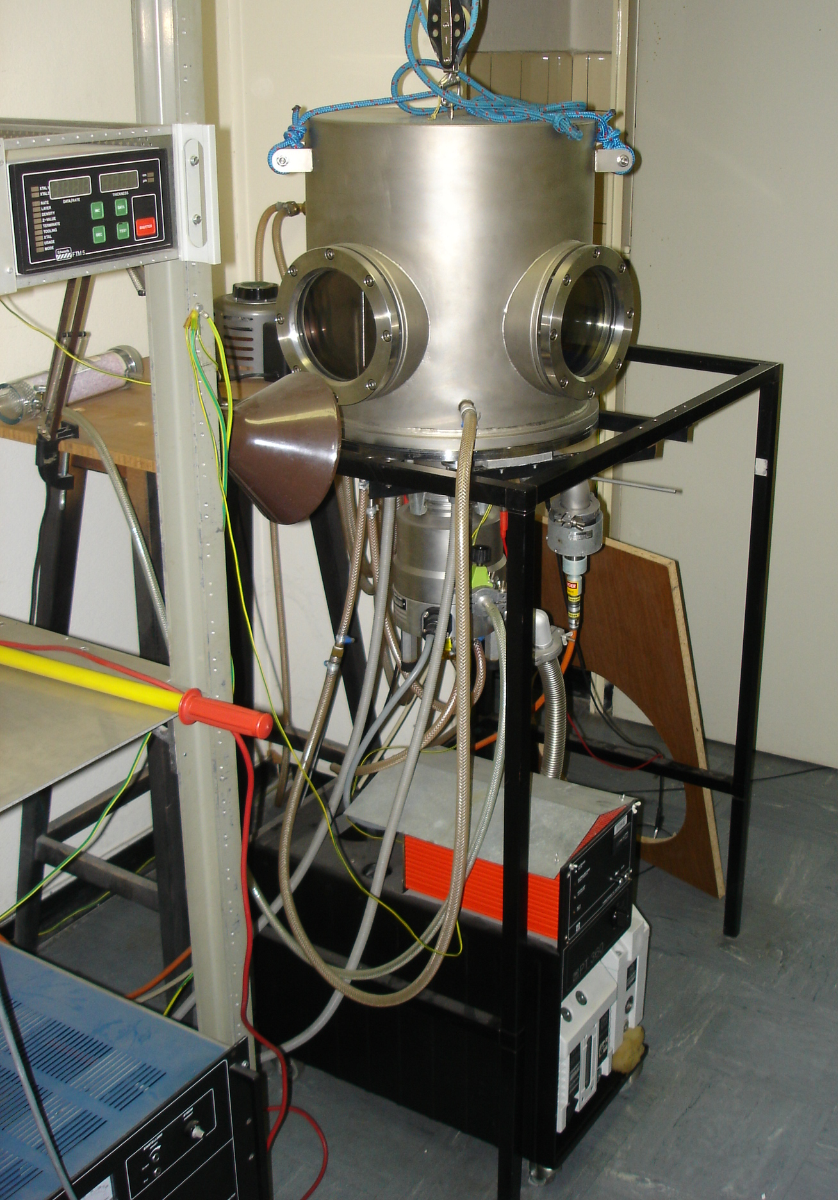
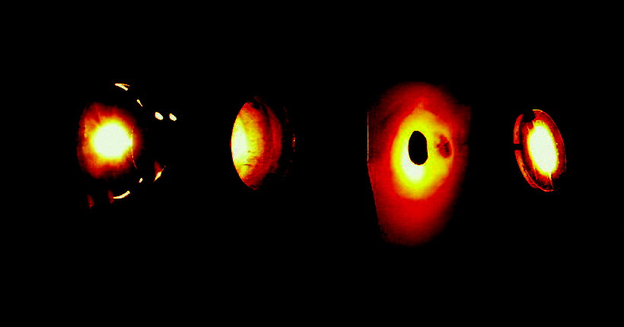
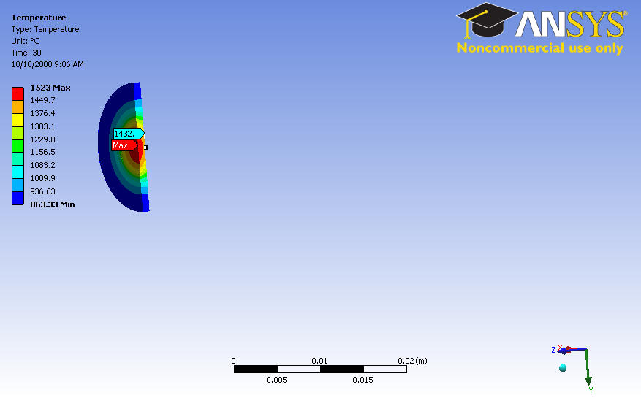
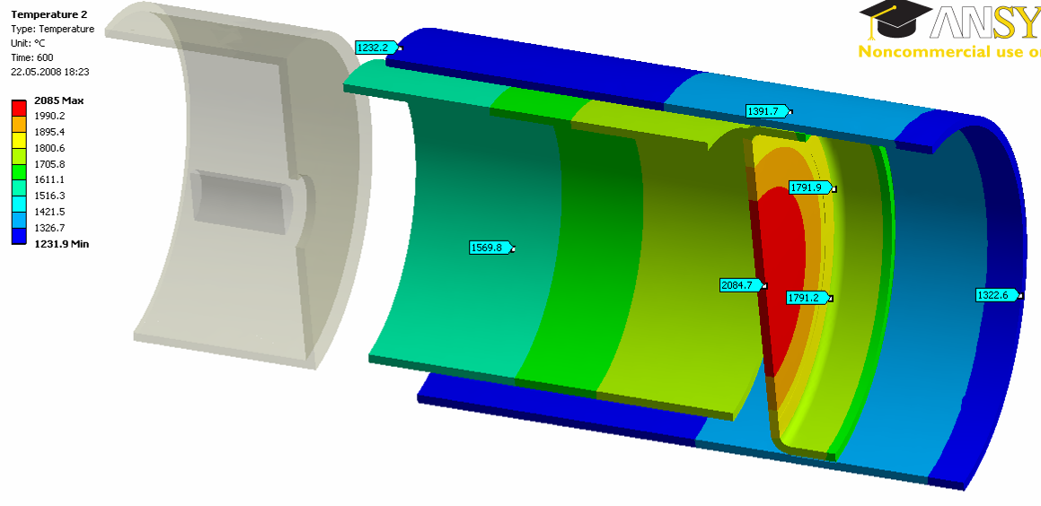
Al₂O₃ thermal conductivity
Measured: electron beam setup
P. Kasprowicz
Power on sample = 28 W
Beam spot < 8 mm
Front = 1524 °C
Back = 1432 °C
σ = 3.7 W/m.K
Container
Pill-container thermal contact conductance
20000 W/m²K
Filament
Collimator
Sample
S. Marzari

Slide 26
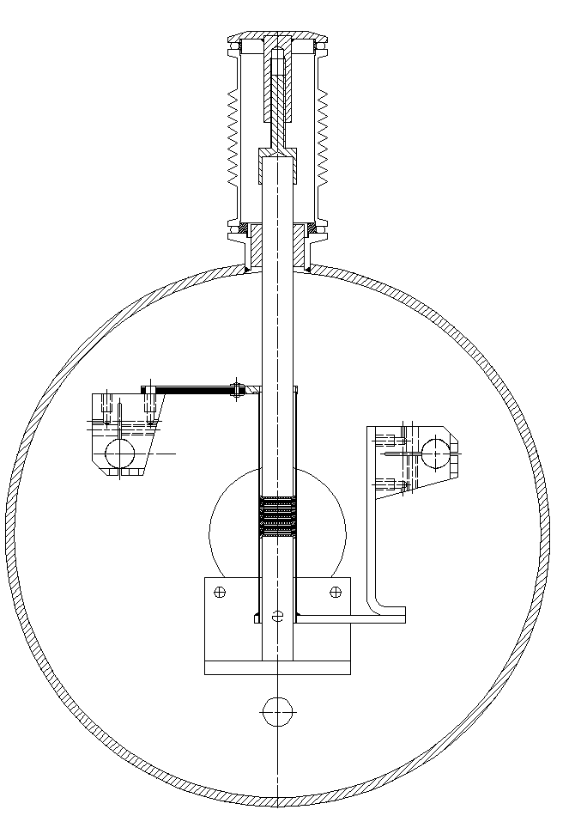
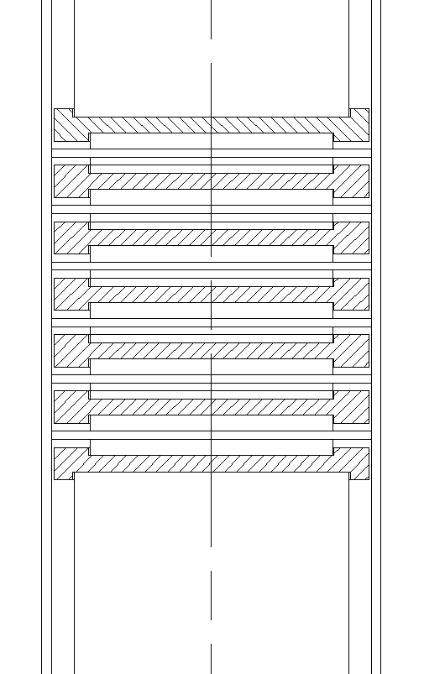
Brazing equipment
=> The pressure applied due to the vacuum on the bellow > 10 kg
Vacuum bellow
Alumina insulator
Zoom
6x pills+ spacers
Alumina insulator

Slide 27
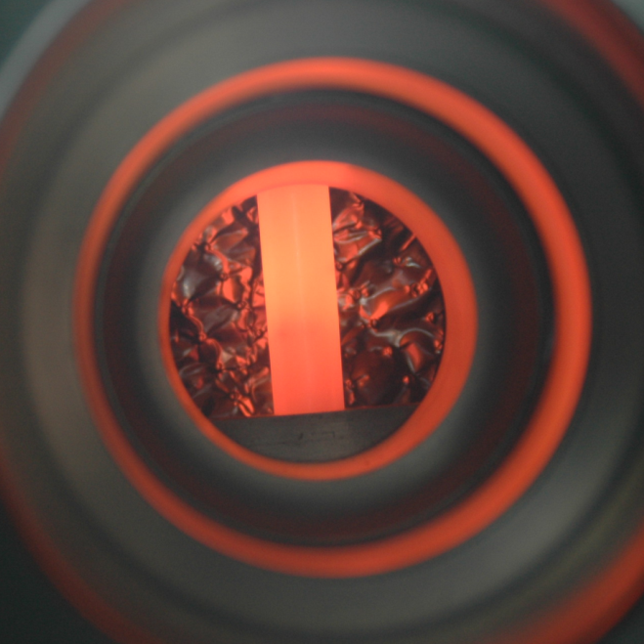
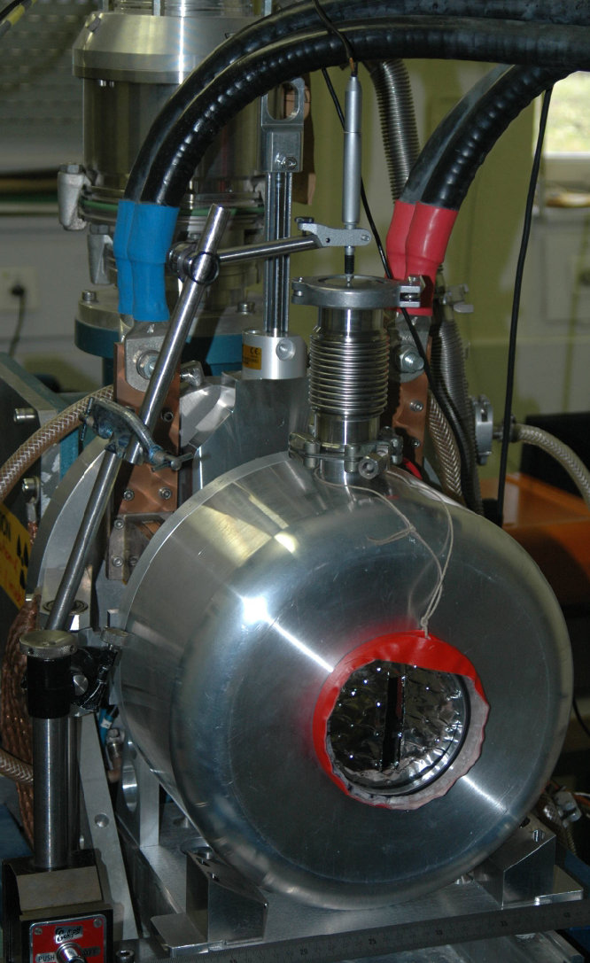
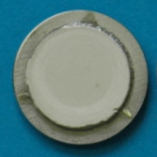
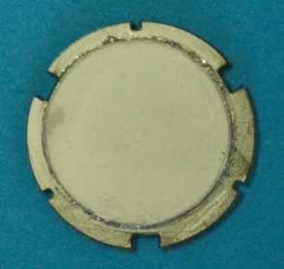
Brazing equipment
Varying temperature and time to obtain the parameters for optimal brazing
Micron meter for dilatation monitoring
Brazed pills after final laser cutting

Slide 28
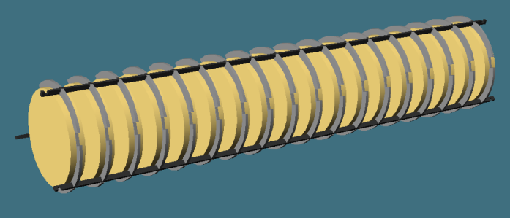
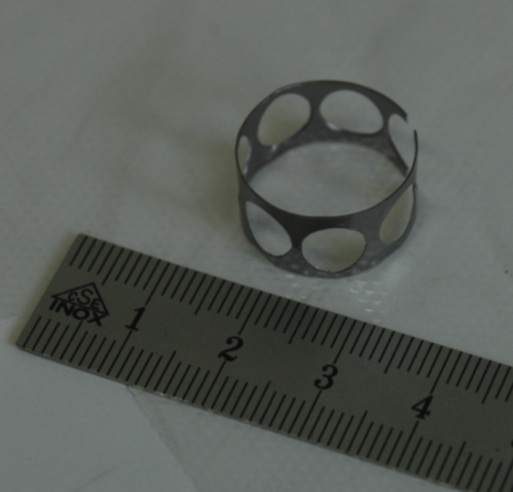
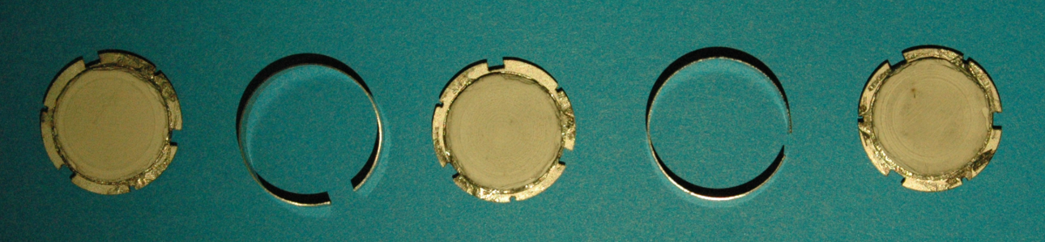
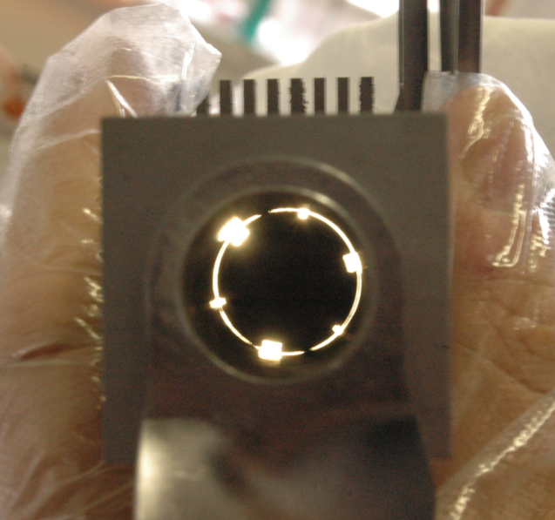
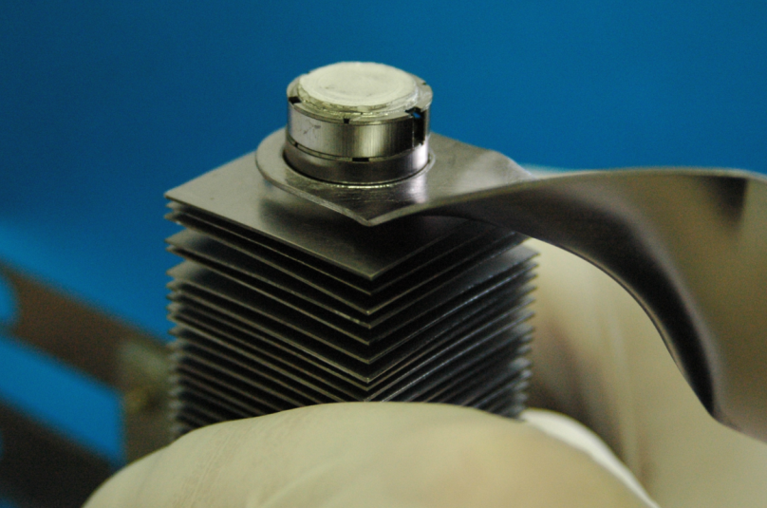
Al₂O₃ target final assembly
During mounting we decide to replace the gap spacers for ring spacers
Central spacer
Average gap ~0.03 mm

Slide 29

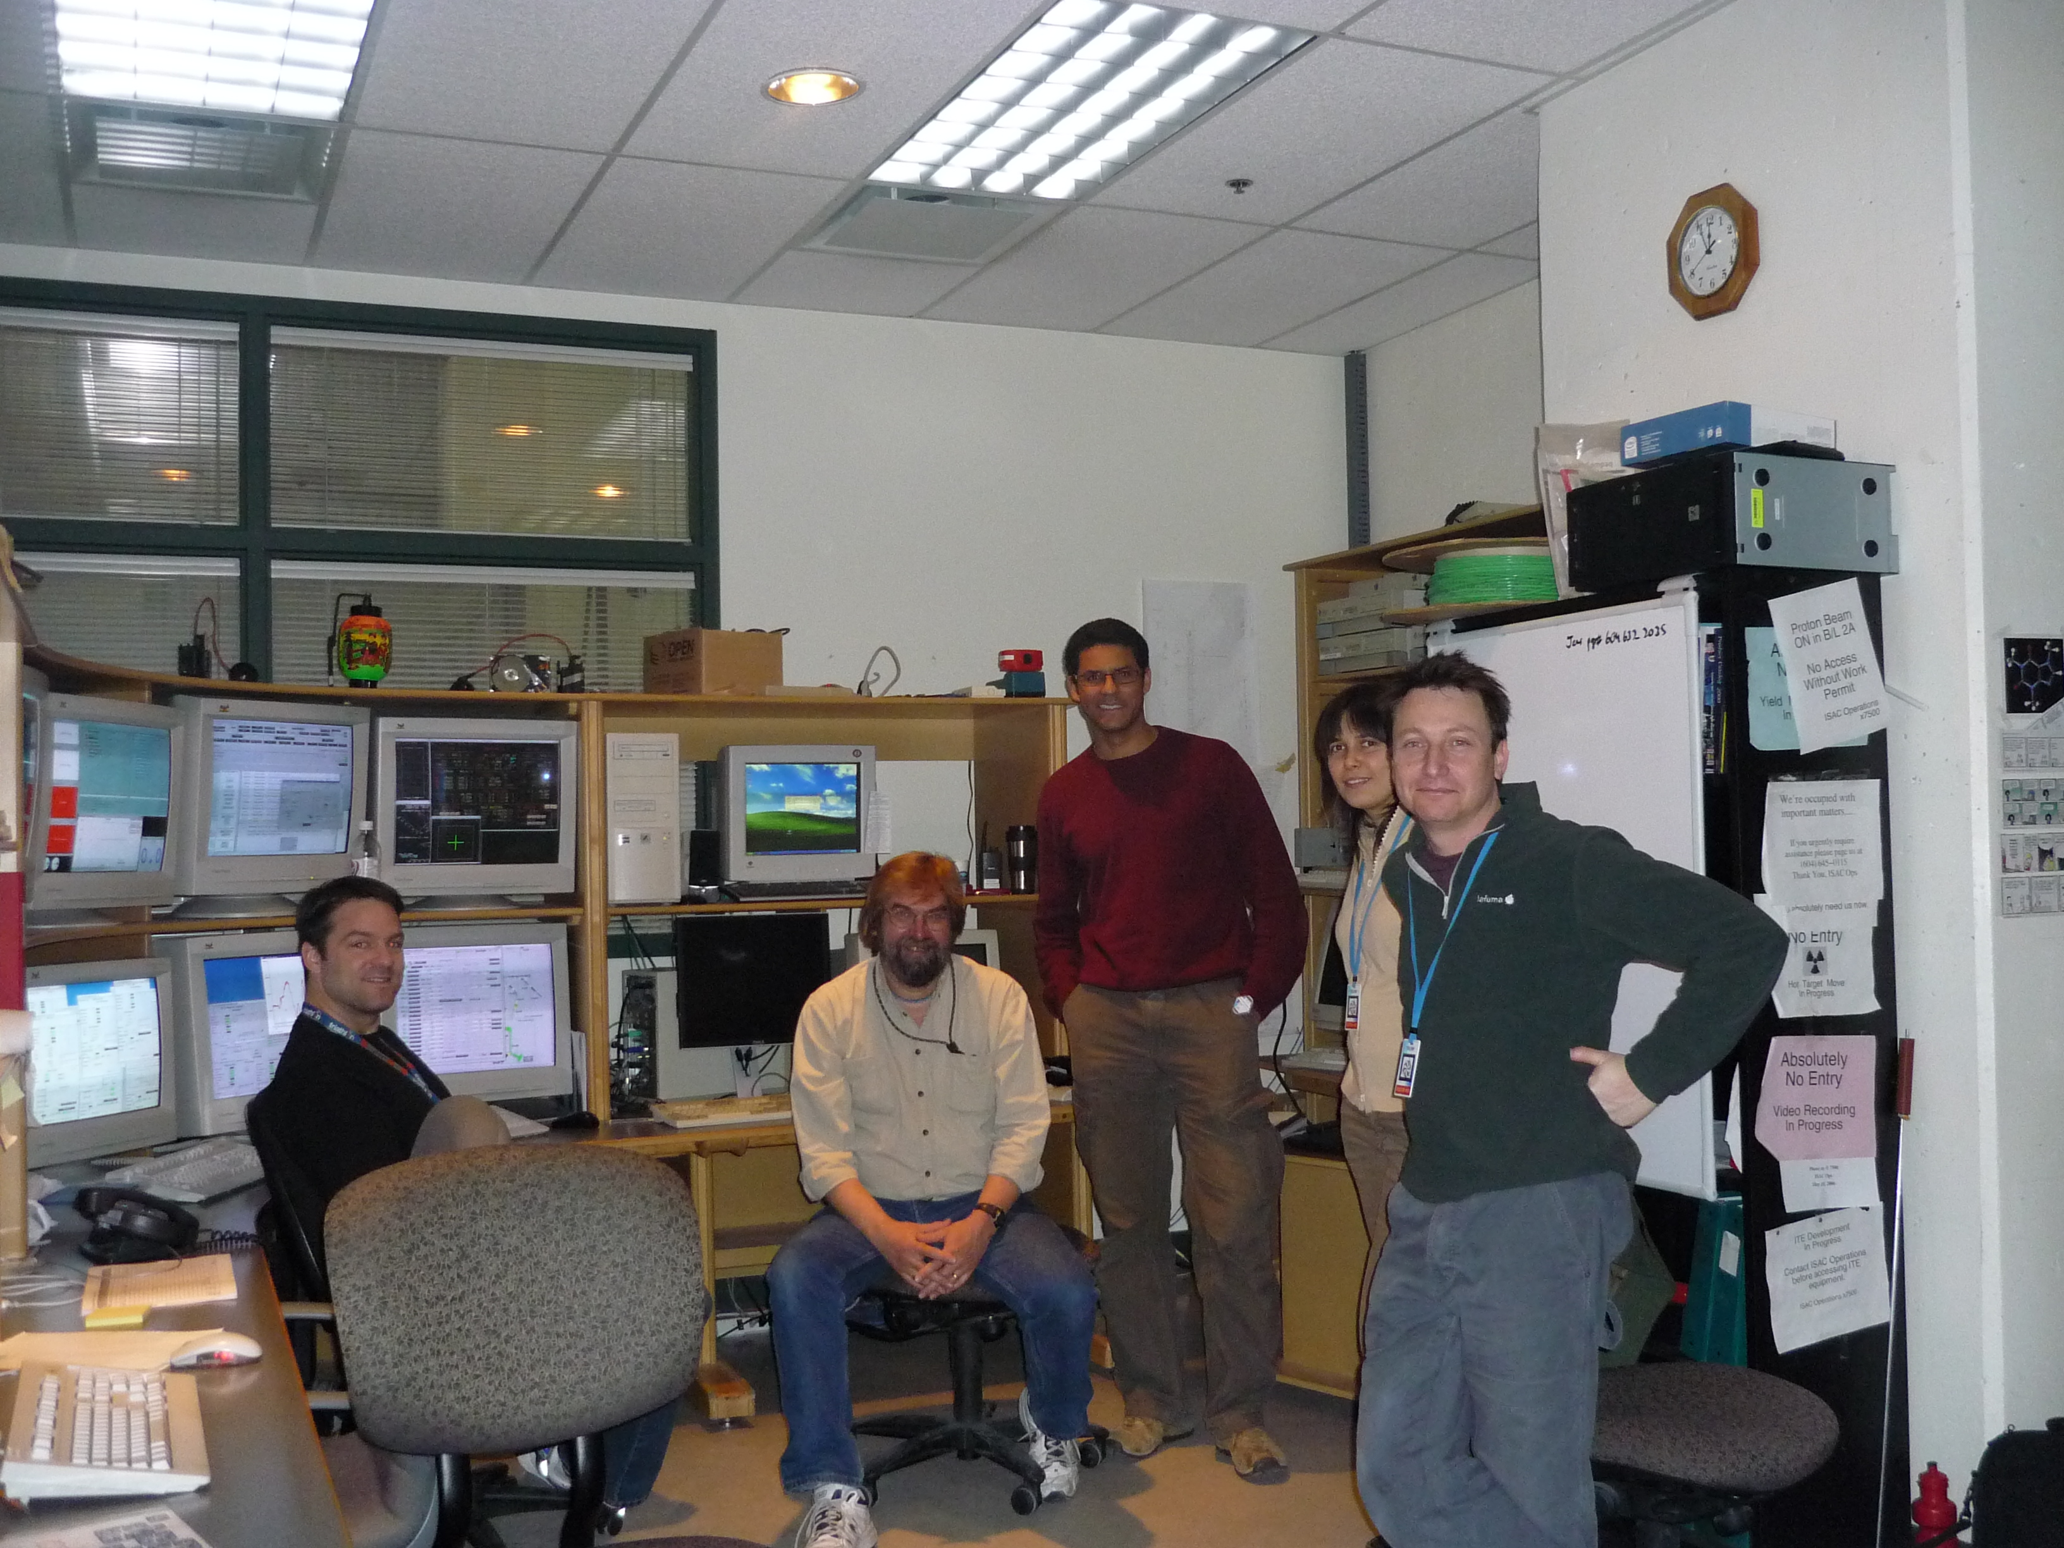
March tests at TRIUMF: 12 kW

Slide 30
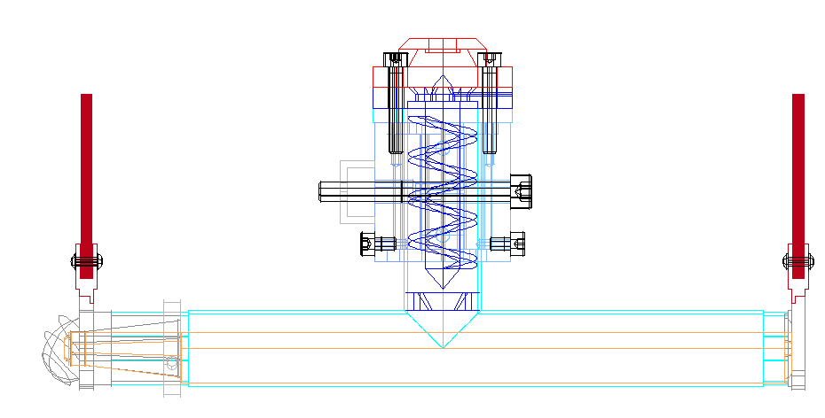
Direct liquid metal targets
Today’s state of the art [ISOLDE]:
  Release fraction < 2% for short-lived Hg
  Diffusion τ >> 10s
  Max. power deposition 1 kW !!!

Slide 31
100 kW liquid metal: loop for heat removal
Loop=Target material: Pb, LBE
  Operating temperature: 1100 K
  ΔT: 100 K
  Flow rate: 0.2 l/s
Beam: 1 GeV H⁺
  100 μA, σ_{x}/σ_{y}=0.3/0.7 cm
  30 kW deposited in target

Slide 32
Diffusion chamber concept
Minimise decay losses due to diffusion times

Slide 33
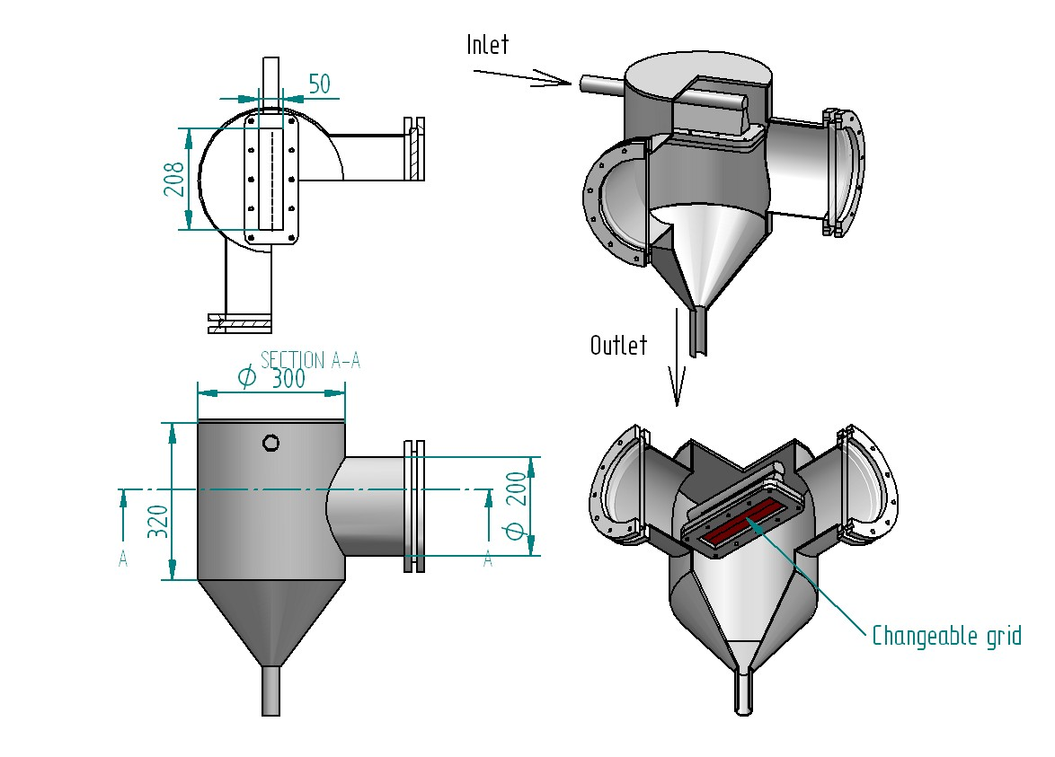
PbBi loop prototype at IPUL Latvia
Inlet
Changeable grid
Outlet

Slide 34

Diffusion chamber prototype at IPUL
PbBi 600ºC

Slide 35
Diffusion chamber prototype at IPUL
PbBi 600ºC

Slide 36
Summary
The EURISOL-DS beta-beam:
  Conceptual design report presented during 2009
  High power target R&D for ¹⁸Ne required
  Full converter-BeO target for ⁶He to be tested
EUROnu DS, FP7 (2008-2012):
  A beta beam facility using ⁸Li and ⁸B
  Production issues (experience from EURISOL-DS)
  Accelerator issues (duty factors, RF and bunch structures)
  Costing
Clear synergies with Radioactive Ion Beam facilities: SPIRAL2, HIE-ISOLDE phase 2 (100 kW), EURISOL

Slide 37
Back up

Slide 38
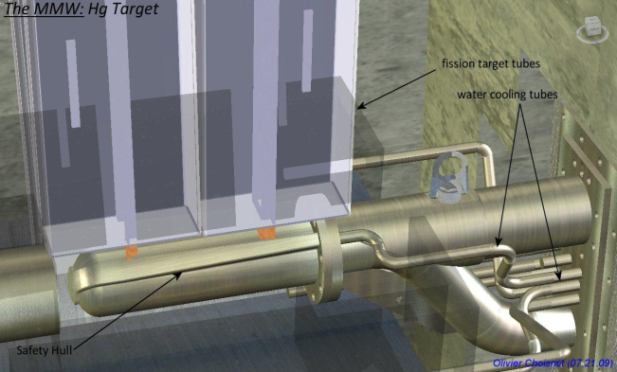
Radioprotection
Residual Ambient Dose Equivalent Rate at 1 m distance from the beam line (mSv h⁻¹)
 | RCS (quad - ¹⁸Ne) | PS (dip - ⁶He) | SPS | DR (arc - ¹⁸Ne)
1 hour | 15 | 10 | - | 5.4
1 day | 3 | 6 | - | 3.6
1 week | 2 | 2 | - | 1.4
Not a show stopper
Annual Effective Dose to the Reference Population (μSv)
RCS | PS | SPS | DR
0.67 | 0.64 | - | 5.6 (only decay losses)
Stefania Trovati, Matteo Magistris, CERN
CERN-EN-Note-2009-007 STI
EURISOL-DS/TASK2/TN-02-25-2009-0048
Yacin Kadi et al. , CERN

Slide 39
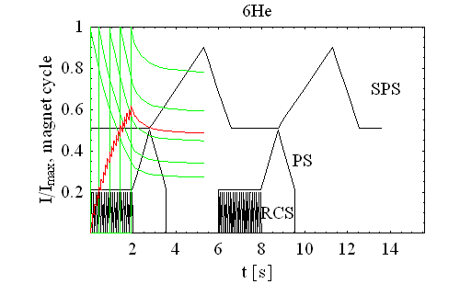
Intensity evolution during acceleration
Bunch
20th
15th
10th
5th
1st
total
Cycle optimized for neutrino rate towards the detector
30% of first ⁶He bunch injected are reaching decay ring
Overall only 50% (⁶He) and 80% (¹⁸Ne) reach decay ring
Normalization
  Single bunch intensity to maximum/bunch
  Total intensity to total number accumulated in RCS

Slide 40
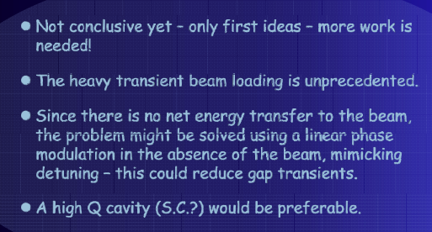
Duty factor and Cavities for He/Ne
10¹⁴ ions, 0.5% duty (supression) factor for background suppression !!!
....
20 bunches, 5.2 ns long, distance 23*4 nanosseconds
filling 1/11 of the Decay Ring, repeated every 23
microseconds
Erk Jensen, CERN

Slide 41
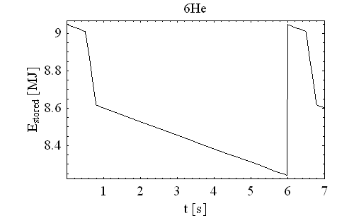
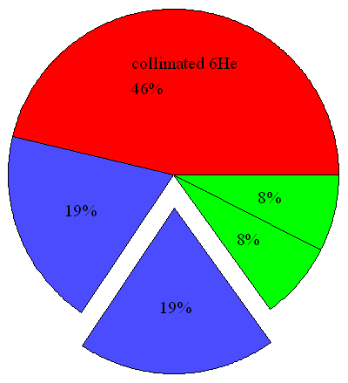
Particle turnover in decay ring
Momentum
collimation
merging
p-collimation
injection
decay losses
Arc
Straight section
Arc
Straight section
Momentum collimation (study ongoing):
~5*10¹² ⁶He ions to be collimated per cycle
Decay: ~5*10¹² ⁶Li ions to be removed per cycle per meter
Dump at the end of the straight section will receive 30kW
Dipoles in collimation section receive between 1 and 10 kW (masks).

Slide 42
EURONU-DS Objectives
A High Intensity Neutrino Oscillation Facility in Europe
  CDR for the three main options: Neutrino Factory, Beta-beam and Super-beam
  Focus on potential showstoppers
  Preliminary costing to permit a fair comparison before the end of 2011 taking into account the latest results from running oscillation experiments
  Total target for requested EU contribution: 4 Meuro
    1 MEuro each for SB, NF and BB WPs
    1 MEuro to be shared between Mgt, Phys and Detectors WPs
    4 year project which started 1st September 2008
First EURONU Town meeting at CERN, 25-26 March 2009

Slide 43
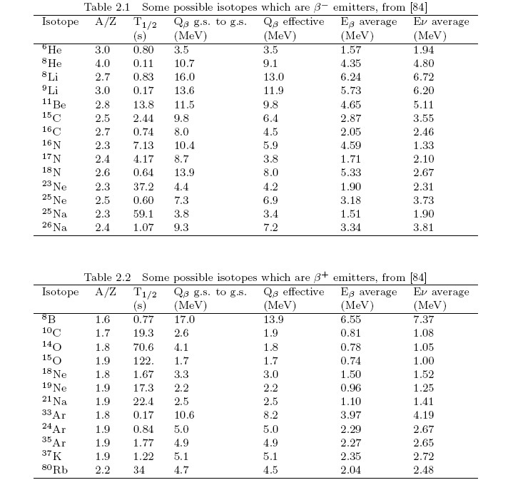
Alternative ions

Slide 44
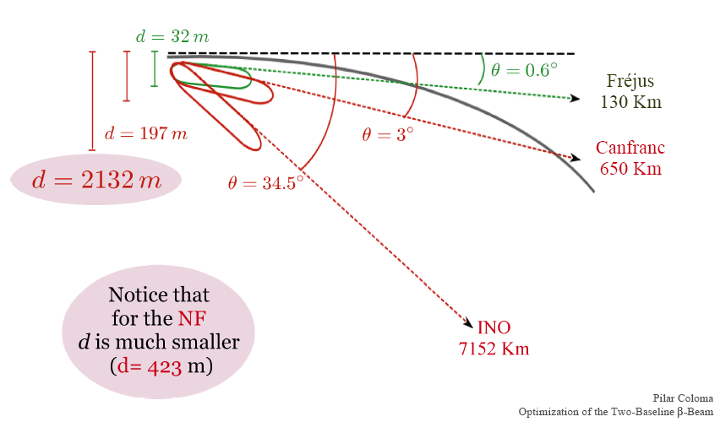
Baseline options: Detectors

Slide 45
⁶He production from ⁹Be(n,α)
Converter technology:
(J. Nolen, NPA 701 (2002) 312c)
Converter technology preferred to direct irradiation (heat transfer and efficient cooling allows higher power compared to insulating BeO).
⁶He production rate is ~2x10¹³ ions/s (dc) for ~200 kW on target.

Slide 46
Direct production: ¹⁶O(³He,n)¹⁸Ne at LLN
Production of 10¹² ¹⁸Ne in a MgO target:
  At 13 MeV, 17 mA of ³He
  At 14.8 MeV, 13 mA of ³He
Producing 10¹³ ¹⁸Ne could be possible with a beam power (at low energy) of 1 MW (or some 130 mA ³He beam).
To keep the power density similar to LLN (today) the target has to be 60 cm in diameter.
To be studied:
  Extraction efficiency
  Optimum energy
  Cooling of target unit
  High intensity and low energy ion linac
  High intensity ion source
Thinn MgO target
Water cooled target holder and beam dump
Ion beam

Slide 47


Light RIB production: 40 MeV Deuteron beam
T.Y.Hirsh, D.Berkovits, M.Hass (Soreq, Weizmann I.)
Studied ⁹Be(n,α)⁶He, ¹¹B(n,α)⁸Li and ⁹Be(n,2n)⁸Be production
For a 2 mA, 40 MeV deuteron beam, the upper limit for the ⁶He production rate via the two stage targets setup is ~6∙10¹³ atoms per second.

Slide 48
A new approach for the production
Beam cooling with ionisation losses – C. Rubbia, A Ferrari, Y. Kadi and V. Vlachoudis in NIM A 568 (2006) 475–487
⁷Li
⁶Li
⁷Li(d,p)⁸Li
⁶Li(³He,n)⁸B
See also: Development of FFAG accelerators and their applications for intense secondary particle production, Y. Mori, NIM A562(2006)591

Slide 49

Bivalve
Bivalve: merging of a double-transfer line system into a single FEBIAD ion source: Elian Bouquerel.
2 water cooled
transfer lines
FEBIAD
2 pneumatic
valves
Online Tests: ISOLDE, April 2007
RIB
35Ar
2 containers (20cm)

Slide 50

Proton beam to ISOLDE
PSB: 1.4 GeV protons
ISOLDE targets
Normal PSB beam
  4 bunches.
  230 ns bunch width.
  573 ns bunch spacing.
  1.2 s repetition rate.
  Most ISOLDE targets.
ISOLDE
 | Current | Power
Average | 1.92 μA | 2.7 kW
Bunch | 8.36 A | 11.7 GW

