Slide 1


First Ideas on the Design
of the Beam Transport
and the Final Focus
for the NF Target
J. Pasternak, Imperial College London / RAL STFC
07.08.2012, Target meeting

Slide 2
Outline
Introduction.
Proton Driver and Target Station.
Choice of the initial and final conditions.
Beam Window considerations.
Preliminary layout.
Towards optics.
Summary and future plans.

Slide 3
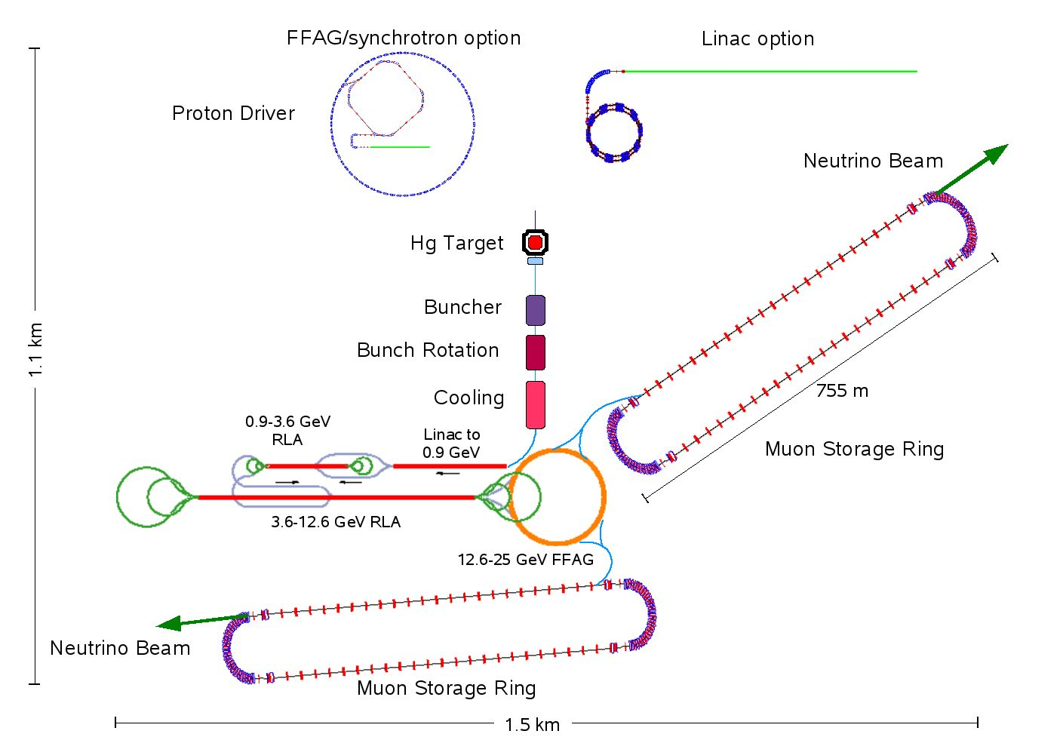
Status of the Neutrino Factory Baseline
after the discovery of the large θ₁₃
X
Effects of large θ₁₃ on the baseline:
Only one decay ring needed with
reduced energy/circumference/cost.
Modifications in the muon acceleration
scheme (only 10 GeV needed).
Modifications
As you can see the Proton Driver
is not connected to the target, why?

Slide 4
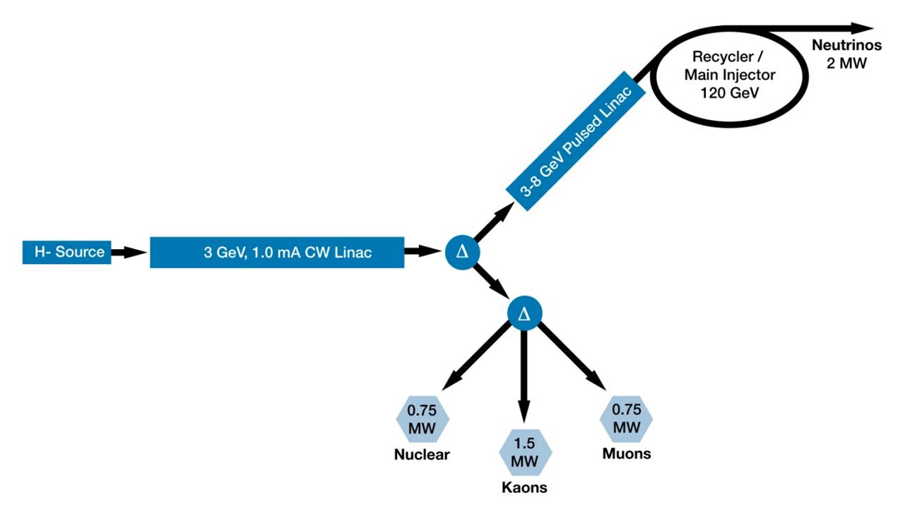
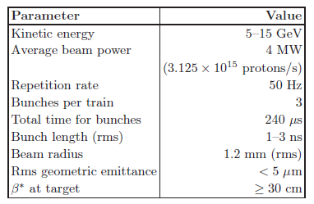
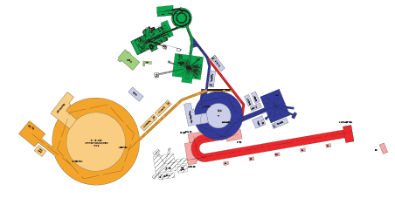
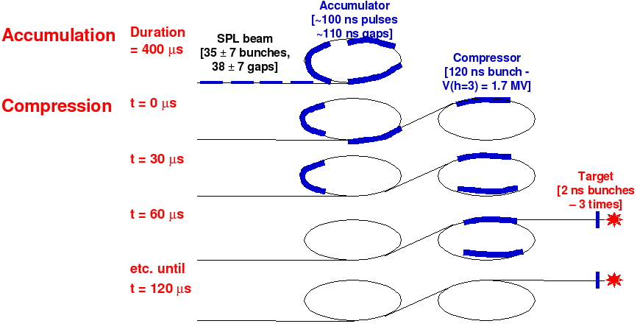
Proton Driver Solutions
accumulator+compressor
Fermilab Solution
5 mA
Project X layout
RAL Solution
CERN Solution

Slide 5
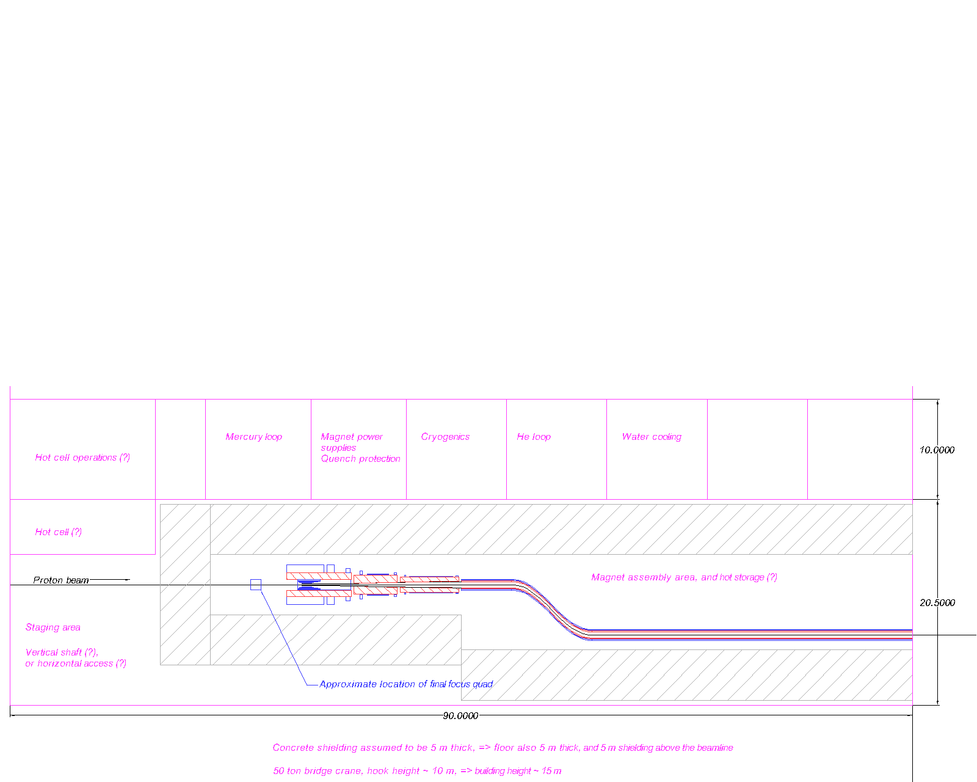
Status of the beam transport from PD to target (up to my knowledge)
Needs more definitions!

Slide 6
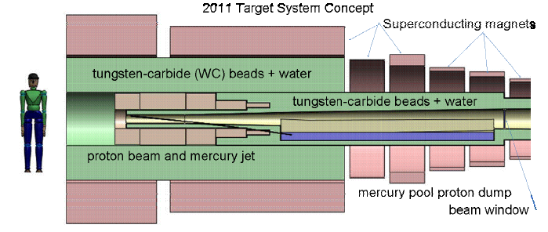
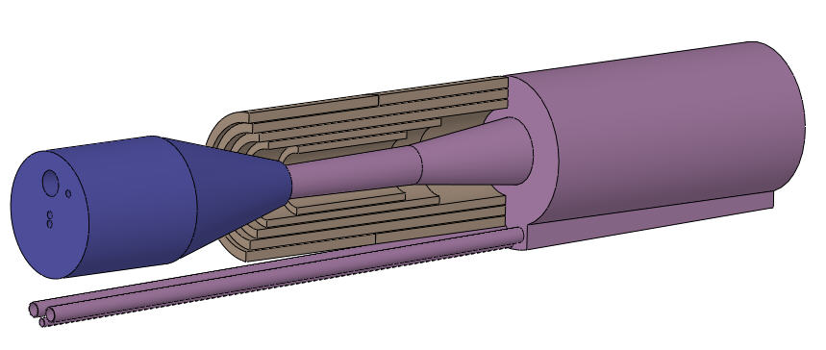
Target
Baseline based on the Mercury jet.
Validated by MERIT experiment
at CERN.
Alternatives include solid target
options and powder jet.
Substantial redesign in order to mitigate
the energy deposition in SC coils.
Cooling system based on (WC beads+water).
Recent new idea: Gallium target!
To be done:
- Final focus.
- Beam window.
- Beam dump.
- and much more!
Target module concept

Slide 7
Target System Baseline
Target type Free mercury jet
Jet diameter 8 mm
Jet velocity 20 m/s
Jet/Solenoid Axis Angle 96 mrad
Proton Beam/Solenoid Axis Angle 96 mrad
Proton Beam/Jet Angle 27 mrad
Capture Solenoid Field Strength 20 T
From H. Kirk’s talk at IDS meeting at VT,
October 2011

Slide 8
Jet/Solenoid/Protons geometry
The mercury jet target geometry. The proton beam and mercury jet cross at z=-37.5 cm.

Slide 9
Starting condition
Parameters | Values
Circumference | 694.352m
Number of Superperiods | 6
Injection/Extraction Energy | 3.2/9.6 GeV
Gamma transition | 13.37
Harmonic number | 17
RF frequency | 7.149-7.311 MHz
Bunch Intensity | 5.208 x 10¹³ protons
Number of Cavities | 91
Energy gain per cavity | 40.4 keV
I shall use RAL solution as an example, but any other may be used.

Slide 10
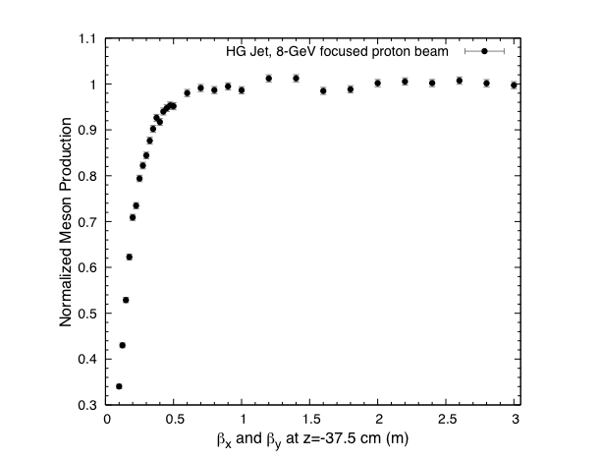
Focused Incident Proton Beam at 8 GeV
(X. Ding’s talk, MAP meeting, March 2012)
It looks, it is not good
to over-focus the beam!
But we should not make
the beam larger then
the target.
Corrent assumptions:
β* = β_{x}= β_{y} =0.65 m,
Geometrical rms emittance
Smaller than 5 π μm.

Slide 11
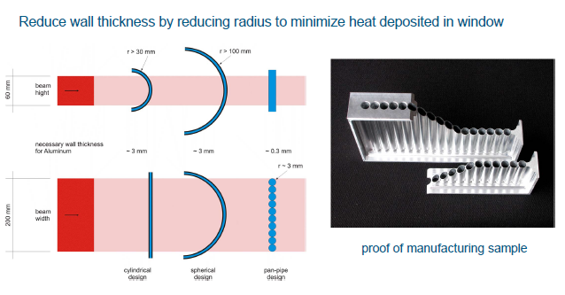
Beam Window Design for 5 MW beam of ESS
(M. Butzek’s talk, May 2011)
Rescaling the beam power to 4 MW and assuming the round beam:
beam radius is 5.5 cm . Let’s take β_{x}= β_{y} =~600 m (to be updated).

Slide 12
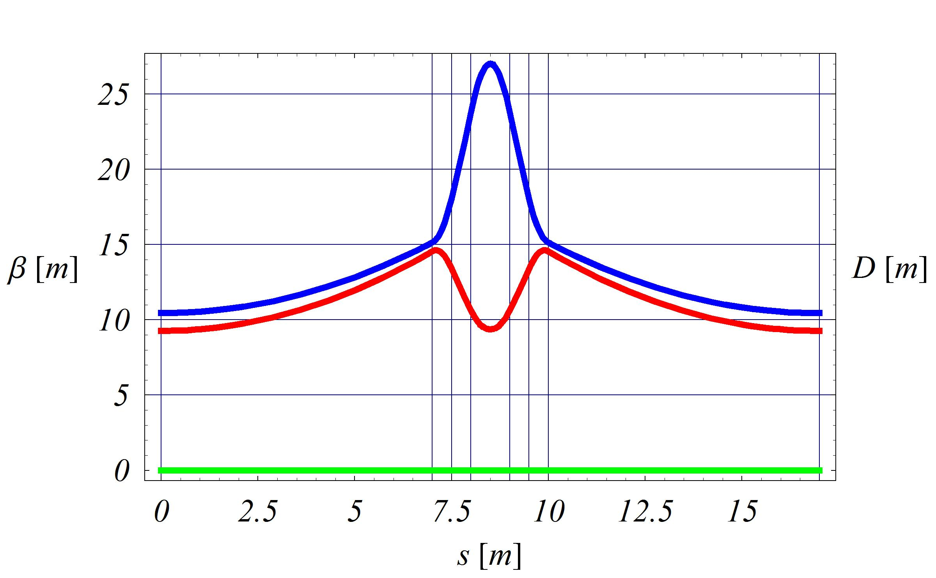
Lattice Building Blocks
Simple optical solution-triplet similar to the RCS lattice cell to be used in the
Beam transport to the channel, with only exceptions of the final focus and
other matching sections.

Slide 13
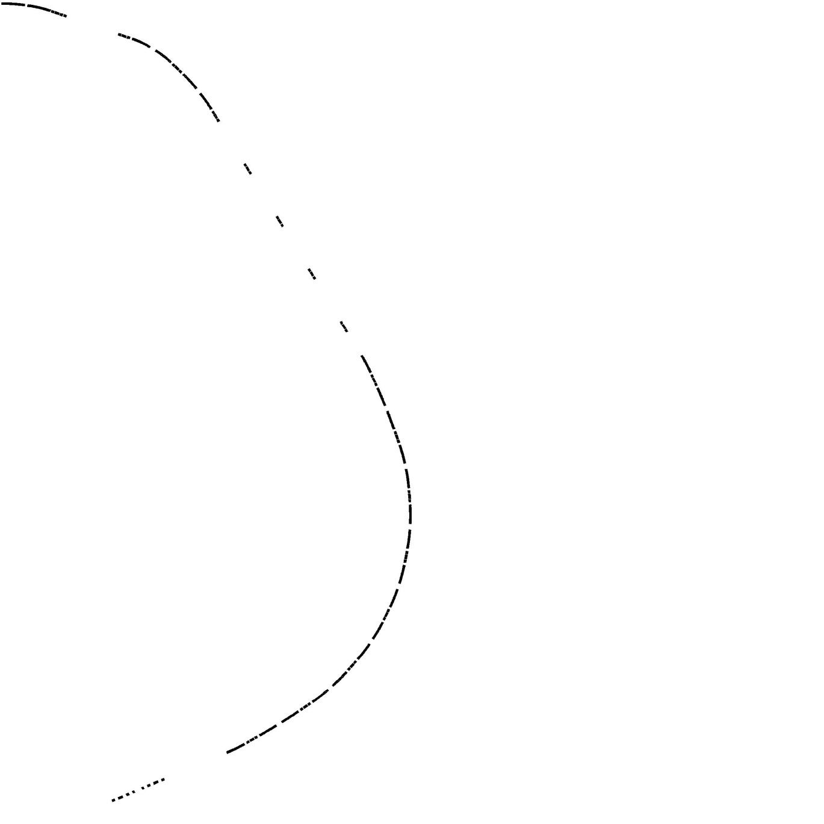
RCS or
Compressor
Preliminary Layout
Of the beam transport to the target
Matching
Septum
Beam dump
Better idea would be to set the dump
as a default configuration so an
additional kicker system would be
required to send the beam to the target.
230 m
Collimation
Beam
Window
Arc to manipulate
the longitudinal dynamics via
controlling eta (to maintain the bunch
compression without the RF system).
Final focus
Target

Slide 14
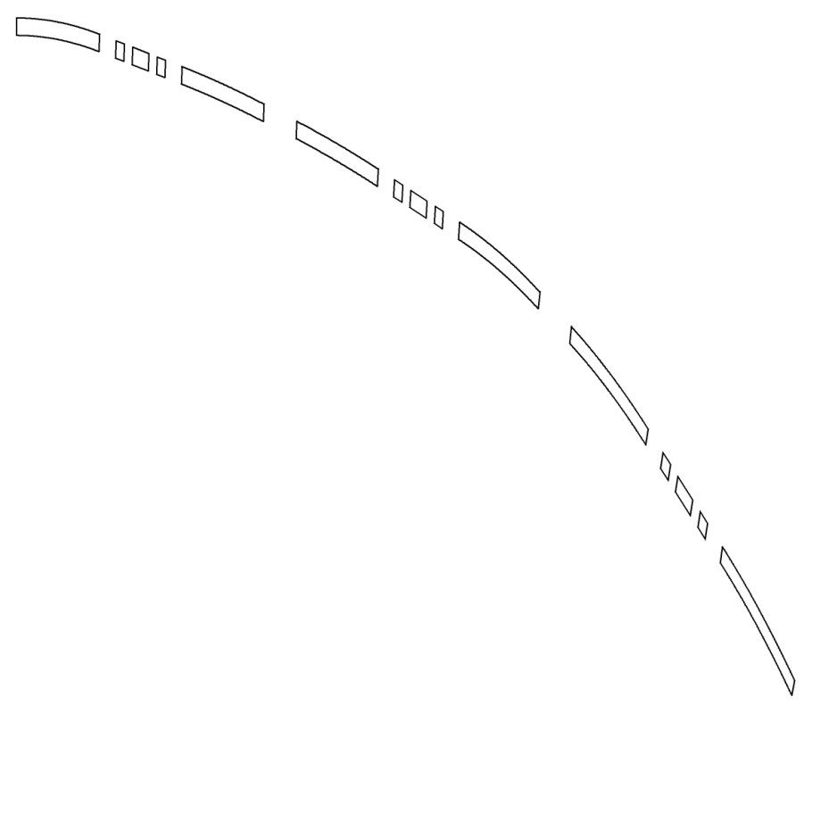
Layout of the arc section, dispersion matching to one regular cell
Space for collimation
Quads
Dipoles
All magnets are of a room-temperature type, with not very high fields!

Slide 15
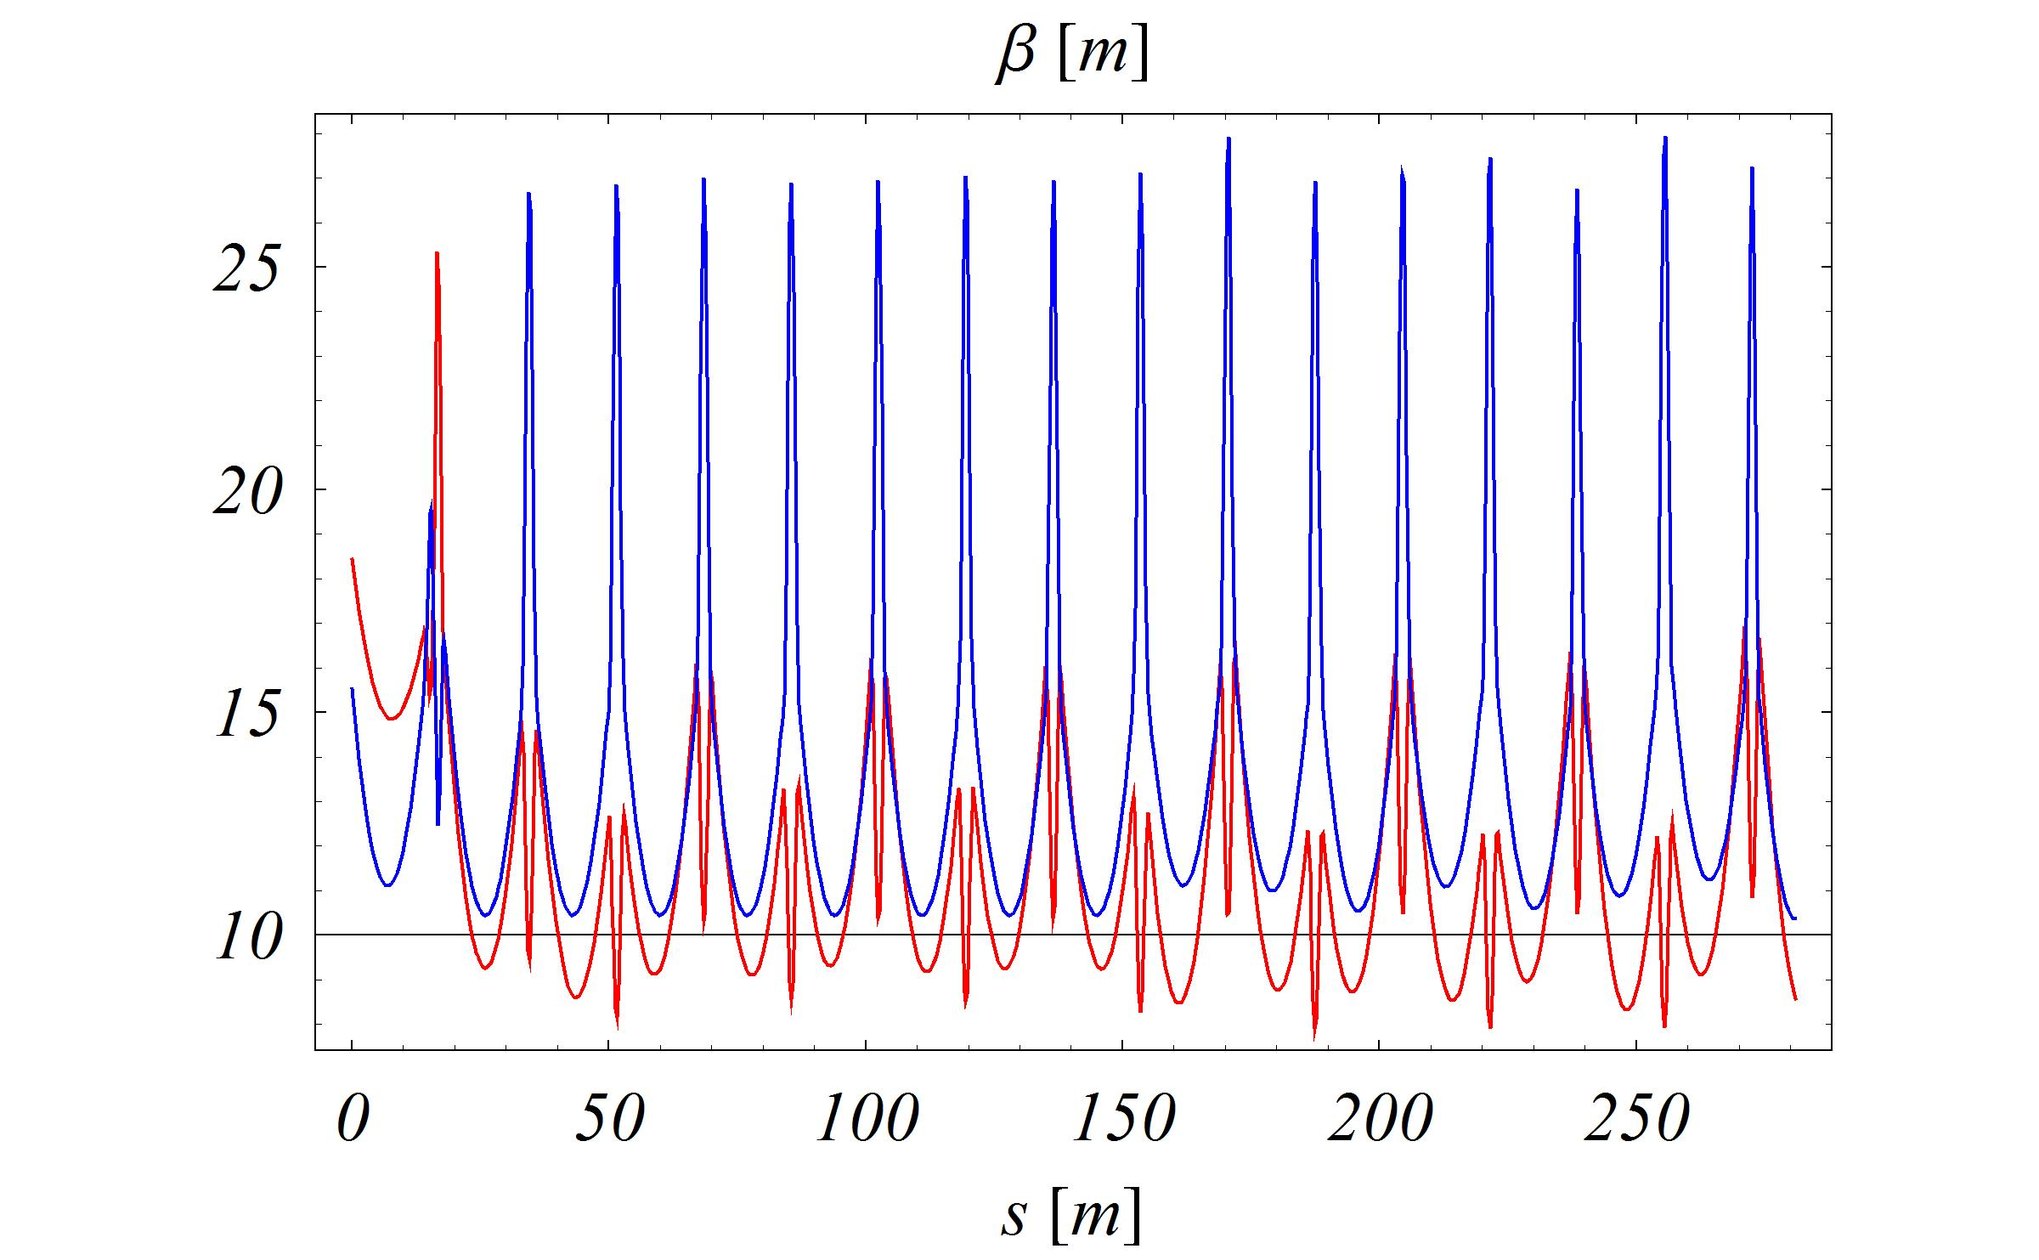
Optics from the RCS to the end of ARC
(small mismatch in horizontal plane)

Slide 16
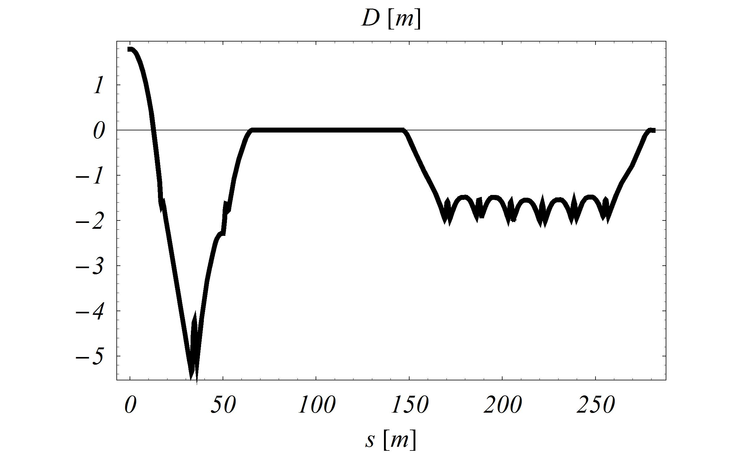
Dispersion from the RCS to the end of the Arc
ARC

Slide 17
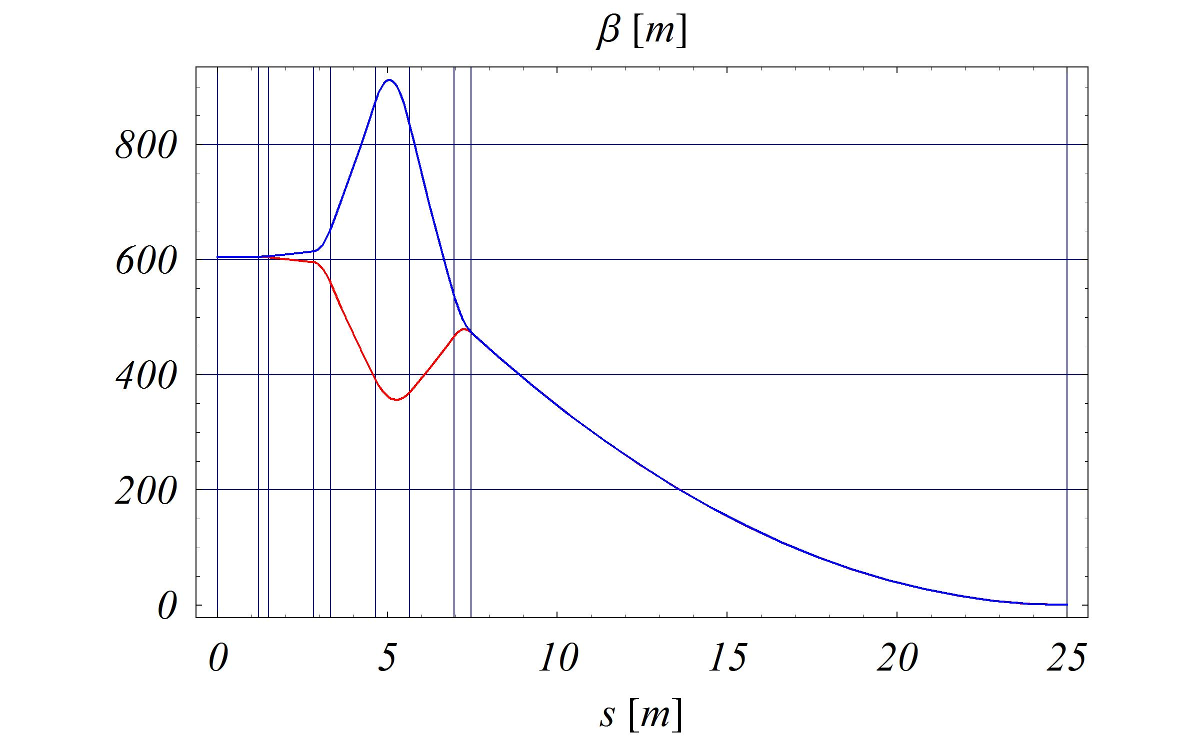
Optics in the Final Focus, for β* of 0.65 m
(However, β* = 0.3 m may be preferred.)
Beam
Window
Position
Target
Position
Final focus consists of 4 room-temperature quads!

Slide 18
Summary
The optics in the beam transport and the final focus is dictated by the beam sizes at the target (1.2 mm rms) and at the beam window (5.5 cm - ??).
Space is needed for the potential emergency beam dump and the collimation.
To maintain the bunch compression the control of eta is required, which can be done in the dedicated arc (longer for 8 GeV at the Project-X, shorter for 9.6 GeV at RAL, CERN solution still to be studied) .
Preliminary geometry and optics has been drafted.
Engineering of the beam window may influence the optics.
More details on the beam window would be highly desirable!

