Slide 1
High power target design and operation considerations for kaon production
Philip Pile
Collider-Accelerator Department
Brookhaven National Laboratory
Upton, New York 11973
Snowmass Workshop
on Intensity Frontier
Apr. 17-20, 2013, Brookhaven National Laboratory

Slide 2
Outline
AGS proton beam, days gone by
LESBIII – a state of the art low energy kaon beam line
Optics considerations for kaon beam line target
LESBIII kaon production target/issues

Slide 3
AGS performance
T. Roser
PROTON BEAM FY96 FY97 FY98/99 FY2000 FY2001 FY2002
SEB SEB FEB (g-2) SEB FEB (g-2) FEB (g-2) FEB (g-2) SEB
Beam Energy 24 GeV 24 GeV 24 GeV 24 GeV 24 GeV 24 GeV 24 GeV* 22 GeV*
Peak Beam Intensity 62 x 10¹² ppp 62 x 10¹² ppp 46 x 10¹² ppp 72 x 10¹² ppp 58 x 10¹² ppp 61 x 10¹² ppp 63 x 10¹² ppp 76 x 10¹² ppp
Total protons accelerated 0.9 x 10²⁰ 0.4 x 10²⁰ 0.1 x 10²⁰ 0.9 x 10²⁰ 0.4 x 10²⁰ 0.5 x 10²⁰ 0.6 x 10²⁰ 0.7 x 10²⁰
Spill Length/Cycle Time 1.6 sec/3.6 sec 1.6 sec/3.6 sec 2.8 sec/5.1 sec 2.4 sec/5.4 sec
-> Duty Cycle 44% 44% 55% 44%
Spill Structure Modulation
(peak-average) /average 20% 20% 20% 20%
Average Availability
/Best Week 76% / 92% 71% / 79% 58 % / 67 % 71% / 88% 55 % / 83 % 74 % / 87 % 83 % / 88 % 85 % / 97 %
HEAVY ION BEAM Au Au Fe (NASA) Au Fe (NASA) Fe (NASA) Fe (NASA) Fe (NASA)
Beam Energy /nucleon 11 / 4 / 2 GeV 11 / 8 / 6 GeV 1.0 / 0.6 GeV 11 GeV 1.0 / 0.6 GeV 1.0 GeV 1.0 GeV 1.0 GeV
Peak Beam Intensity 4 x 10⁸ Au/p 17 x 10⁸ Au/p 20 x 10⁸ Fe/p 9 x 10⁸ Au/bunch 36 x 10⁸ Fe/p 17 x 10⁸ Fe/p 80 x 10⁸ Fe/p 49 x 10⁸ Fe/p
Spill Length/Cycle Time 1.4 sec/3.6 sec 1.5 sec/4.0 sec 1.2 sec/3.0 sec 0.9 sec/3.3 sec 0.9 sec/3.3 sec 0.9 sec/3.3 sec
-> Duty Cycle 39% 38% 40 % 27% 27% 27%
Spill Structure Modulation
(peak-average) /average <20% <20% <20% <20% <20% <20%
Average Availability 80% 82 % 96 % 81 % 90 % 90 % 97 % 84 %
* Westinghouse
Motor Generator

Slide 4
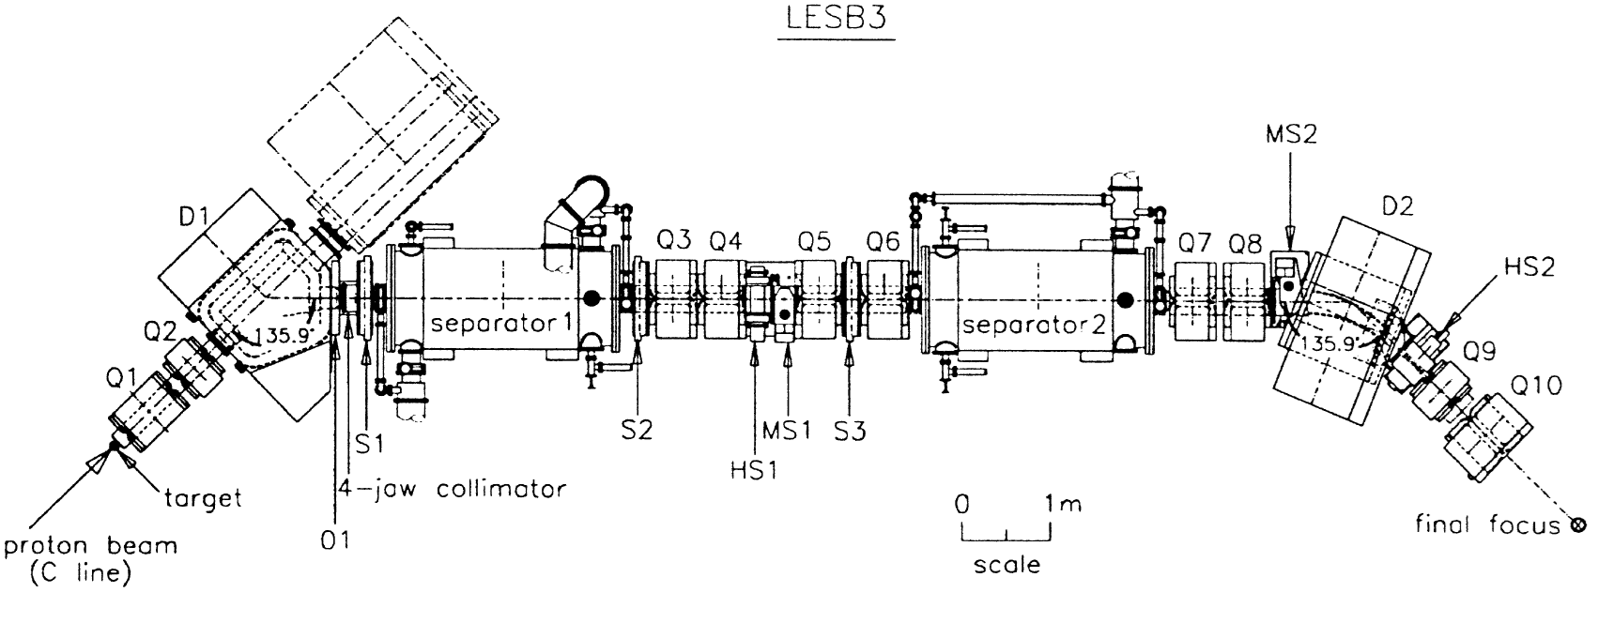
LESBIII (E494 beam line)
=adjustable collimators
EXB Wein Filters
in air
in air
Maximum Momentum: 830 MeV/c
Length: 19.6 meters
Angular acceptance: 12 msr
Momentum acceptance: 4% fwhm
Beam Optics: Corrected to third order
Movable Collimators:
  4Jaw Theta-Phi Collimator
  Horizontal Momentum Collimator
  Two Vertical Collimators (Mass Slits)
  Second horizontal collimator at achromatic focus
Electrostatic Separators:
  Two Stage Separation
  < 625kV, 12.7 cm gap x 2.0 meter - #1
  < 560kV, 10.2 cm gap x 2.0 meter - #2
Target: - 2001-2002
  6 cm long platinum silver soldered to
  water cooled copper base
  Maximum ~30 x 10¹² per second during spill
Production Angle: 0 degrees
Particle Flux (per 10¹³, 22 GeV/c protons on target):
  710 MeV/c positive kaons – 2.0 x 10⁶ with 3:1 π/k

Slide 5
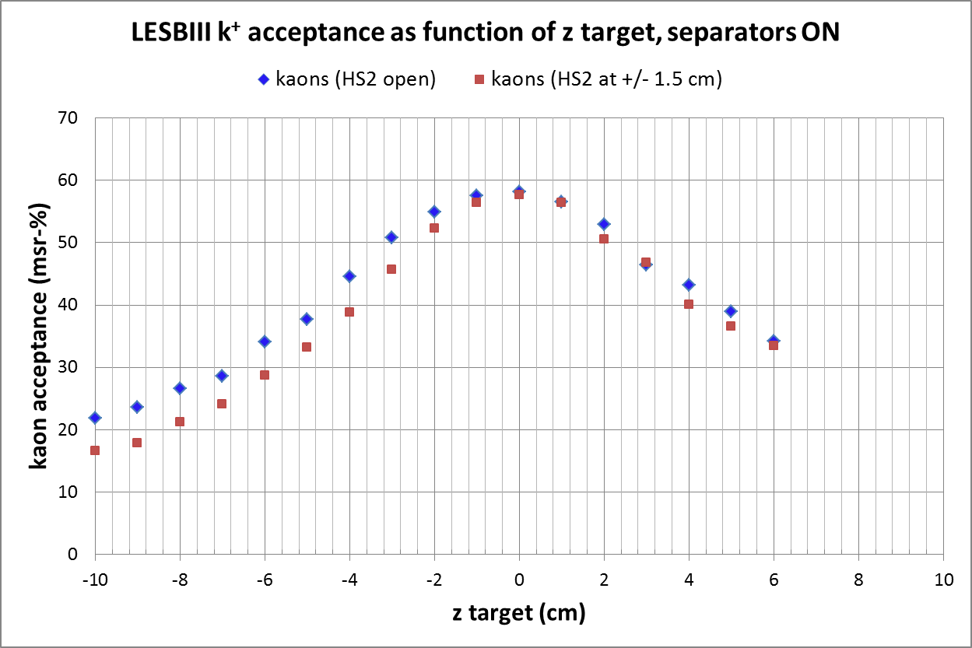
Longitudal acceptance for LESBIII for 800 MeV/c kaons and pions
with EXB separators set to transmit kaons undeflected
TURTLE Simulation
MS1 = 4 mm, MS2 = 5 mm, 4-Jaw and momentum collimators open, vary HS2
Vacuum window
6 cm target

Slide 6
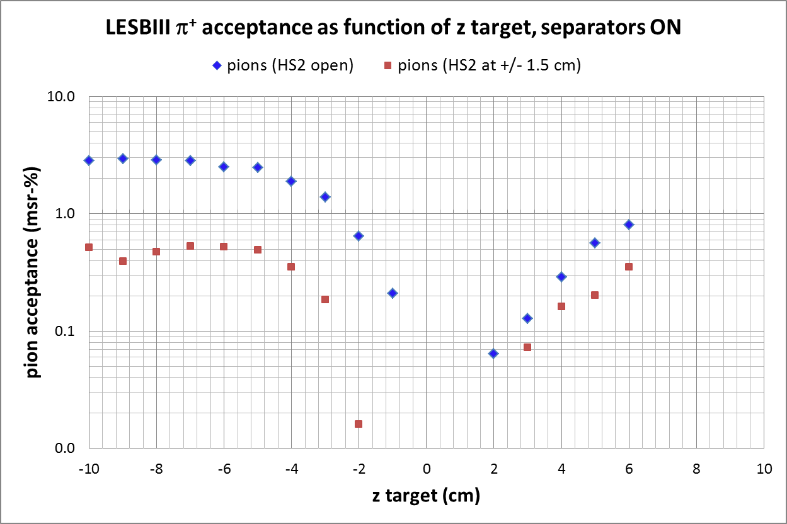
Longitudal acceptance for LESBIII for 800 MeV/c kaons and pions
with EXB separators set to transmit kaons undeflected
TURTLE Simulation
MS1 = 4 mm, MS2 = 5 mm, 4-Jaw and momentum collimators open, vary HS2
6 cm target
Vacuum window

Slide 7
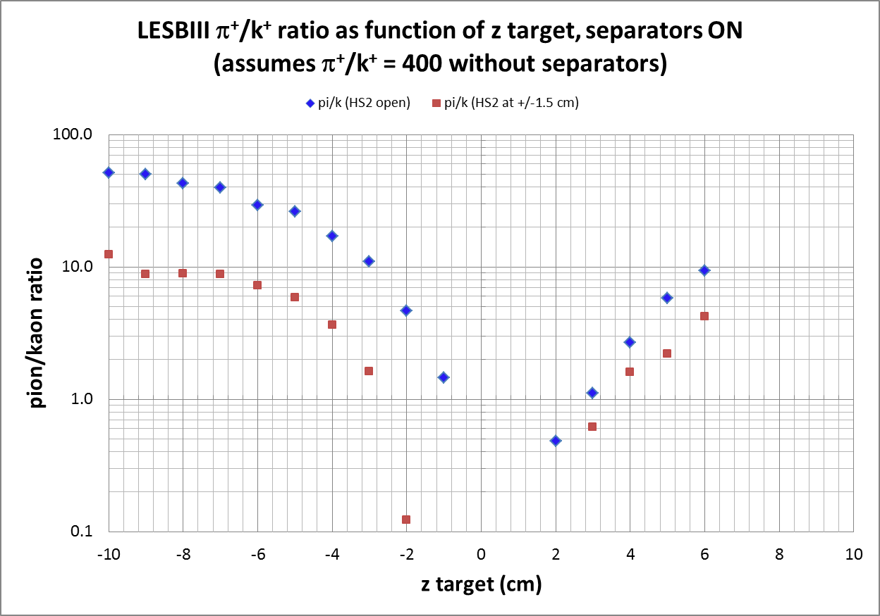
6 cm target
LESBIII vacuum window
MS1 = 4 mm, MS2 = 5 mm, 4-Jaw and momentum collimators open, vary HS2

Slide 8
Turtle simulastion of “cloud pions” in LESBIII, MS1 = 4 mm, MS2 = 5 mm, 4-Jaw and momentum
collimators open, HS2=+/- 1.5 cm, separators set to transmit kaons.
x,y event distribution at center of production target gated by events that make it to the end
Avoid material here that could
become secondary particle source
Note orientation changes (y→-y)
with separator field polarities
Platinum target
Water cooled copper base

Slide 9
Target design considerations
Kaon beam optics
  Short target favored due to longitudal acceptance and kaon beam purity
  E949 settled on conservative 6 cm length
K⁺ production angle – peaked at 0 deg
Target material
  To maximize kaons flux consistent with short target need dense material, we picked platinum (21.5 g/cm³)
Kaon yield
  Relative yields predicted by G4beamline (relative 600 MeV/c K⁺’s in forward 45 deg cone with 24 GeV p’s)
    6 cm Pt = 1.0
    6 cm Cu = 0.53
    6 cm C = 0.12
    6 cm Pt 95 GeV protons (ORKA) = 2.4

Slide 10
Some Target Issues
Inadvertent short spills from the AGS
  In 1997 installed a spill monitor on the AGS extraction beam secondary emission detector (C10 SEC)
  tripped beam off in ~100 msec if rate is > 100 TP/sec..it worked…
Inadvertent high intensity spill
  C-target temperature limit set to trip at 1000 deg C (melting point 1772 deg C).
  Trip point chosen so that stress on the platinum and copper is less than half the maximum hard tensile yield strength as predicted by ANSYS Finite Element calculations.
  Trip response time ~ 200 msec.
  Typical administrative temperature limit for normal spills was 700 deg C.
Target station became contaminated with activated debris from targets
  Target should be enclosed with controlled environment to contain contamination (ours were not)
Unresolved issue:
  Had thermocouple or perhaps deteriorating Pt-Cu bond issue with 2002 target resulting in higher temperature (100 deg C or so) readings for hottest segments late in the run – unresolved as to cause.

Slide 11
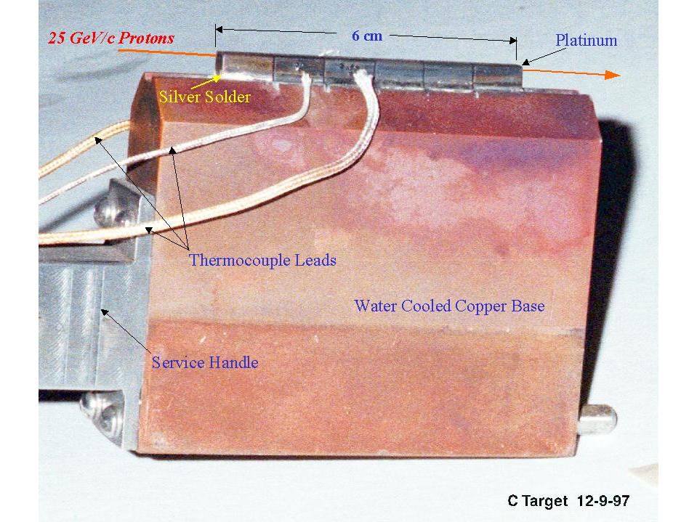
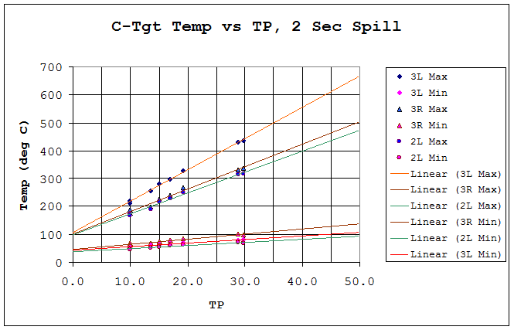
1998-1999 C-target (2490 hours of beam)
24 GeV protons, 2-2.8 sec spill every 4.3-5.1 sec, up to 72 TP available but shared with others,
few x 10¹⁹ protons on target, admin. limit set at 50 TP for 2 sec spill at flat top (~700 deg C)
“Workhorse Target”
Pt, 5.1 x 5.1 x 60 mm (w x h x l)
Silver soldered to copper
5 slots, 6 Pt segments

Slide 12
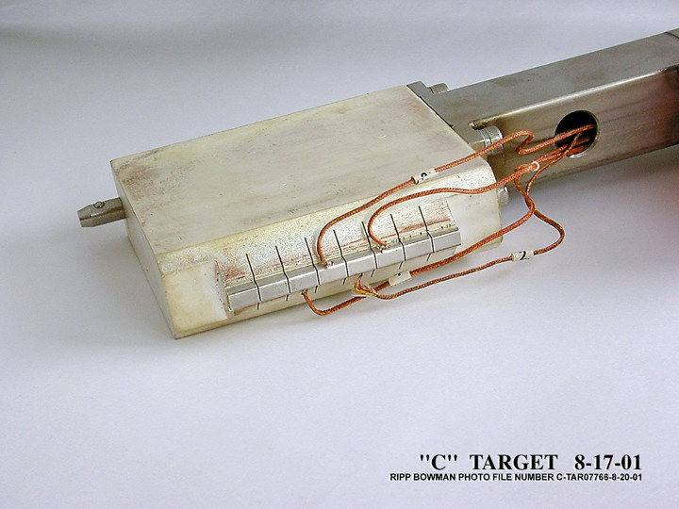
Latest (Last) C-Target Design
changes
C-Target: - 2001-2002
  6 cm long 8 segment platinum, 5.1 mm wide x 3.8 mm high
  Platinum silver soldered to water cooled copper base
  Maximum ~30 x 10¹² per second @ 22 GeV
beam

Slide 13
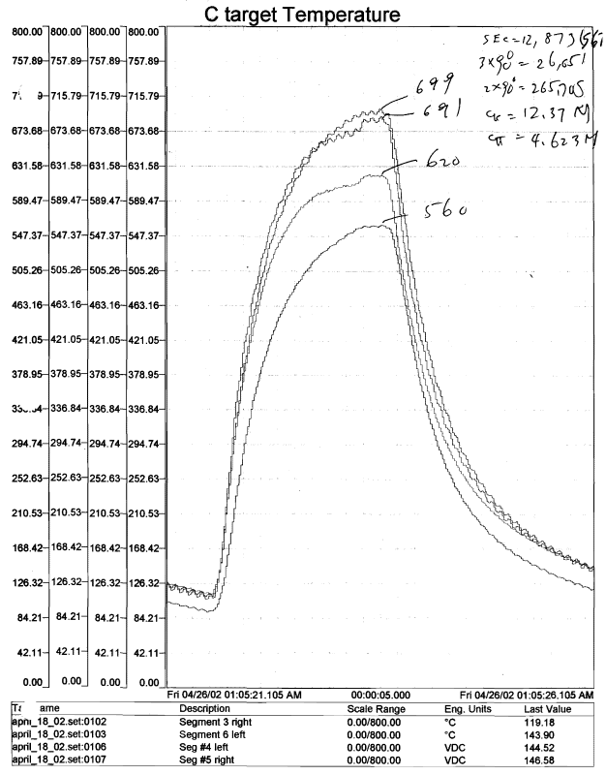
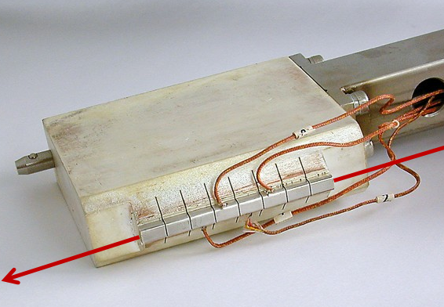
(as measured with type k thermocouples, drilled and peened into platinum)
5R
18 April 2002
22 GeV protons
56 x 10¹² protons per spill
2.2 sec spill every 5.4 sec (41% DF)
Maximum rate on this target was
~70 TP/2.2 sec flat top = 32 TP/sec
Avg Power ~ 45 kW, peak ~110 kW
4L
3R
6L
5R
3R
2.2 sec
6L
4L

Slide 14
E949 targets and ORKA
E949 target maximum protons per spill achieved (22 GeV beam)
  ~70 TP/2.2 sec spill with 5.4 sec repetition ~ 700-800 deg C temperature
  Administrative limit was ~30 TP/sec at flat top
  Peak power during spill = 110 kW
  Average power = 45m kW
So with 1000 deg C limit for the 2002 E949 target
  The 2001 target design is good for ~ 90 TP or 40 TP/sec at flat top
ORKA initial plans
  95 GeV protons
  48 TP/ 4.4 sec spill with 10 sec repetition
  Peak power = 166 kW
  Average power = 73 kW
So with E949 2002 target at ORKA
  Temperature ~ 166/110 x (700-800) = 1050-1200 deg C
This target design might be considered as a “day one” target for ORKA….but see next slides…

Slide 15
Some “Dirty” Laundry…….

Slide 16
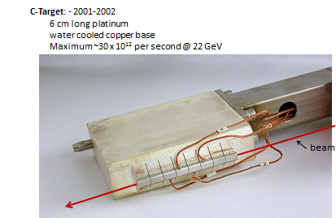
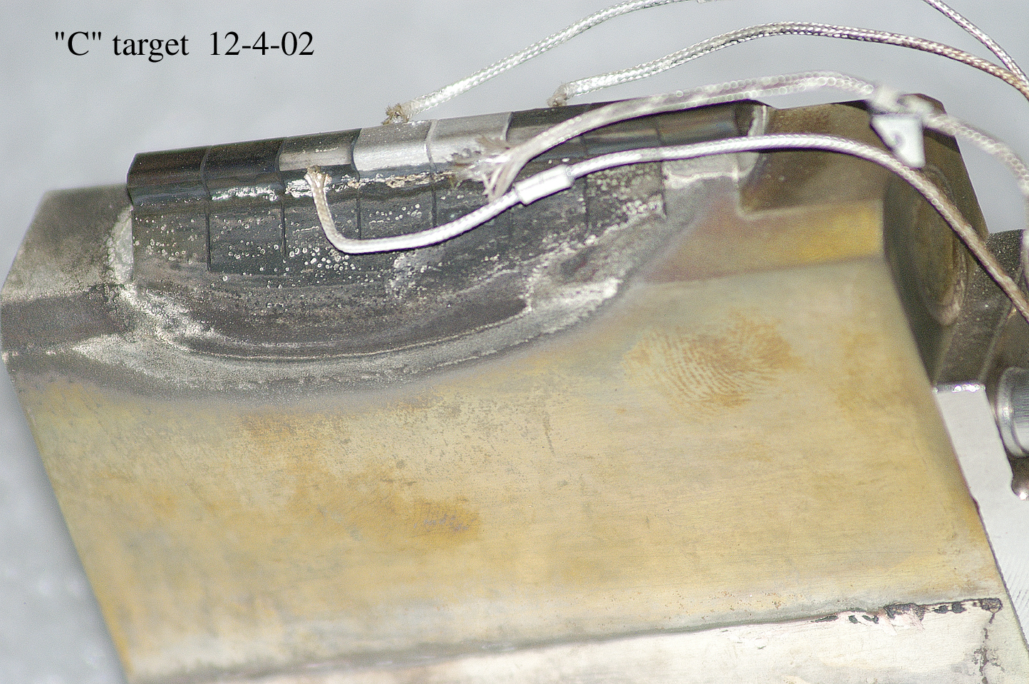
E949, last target design, 2002
“BEFORE”
~0.5 x 10¹⁹ protons
~30-70 x 10¹² protons per 2.2 sec spill
“AFTER”

Slide 17
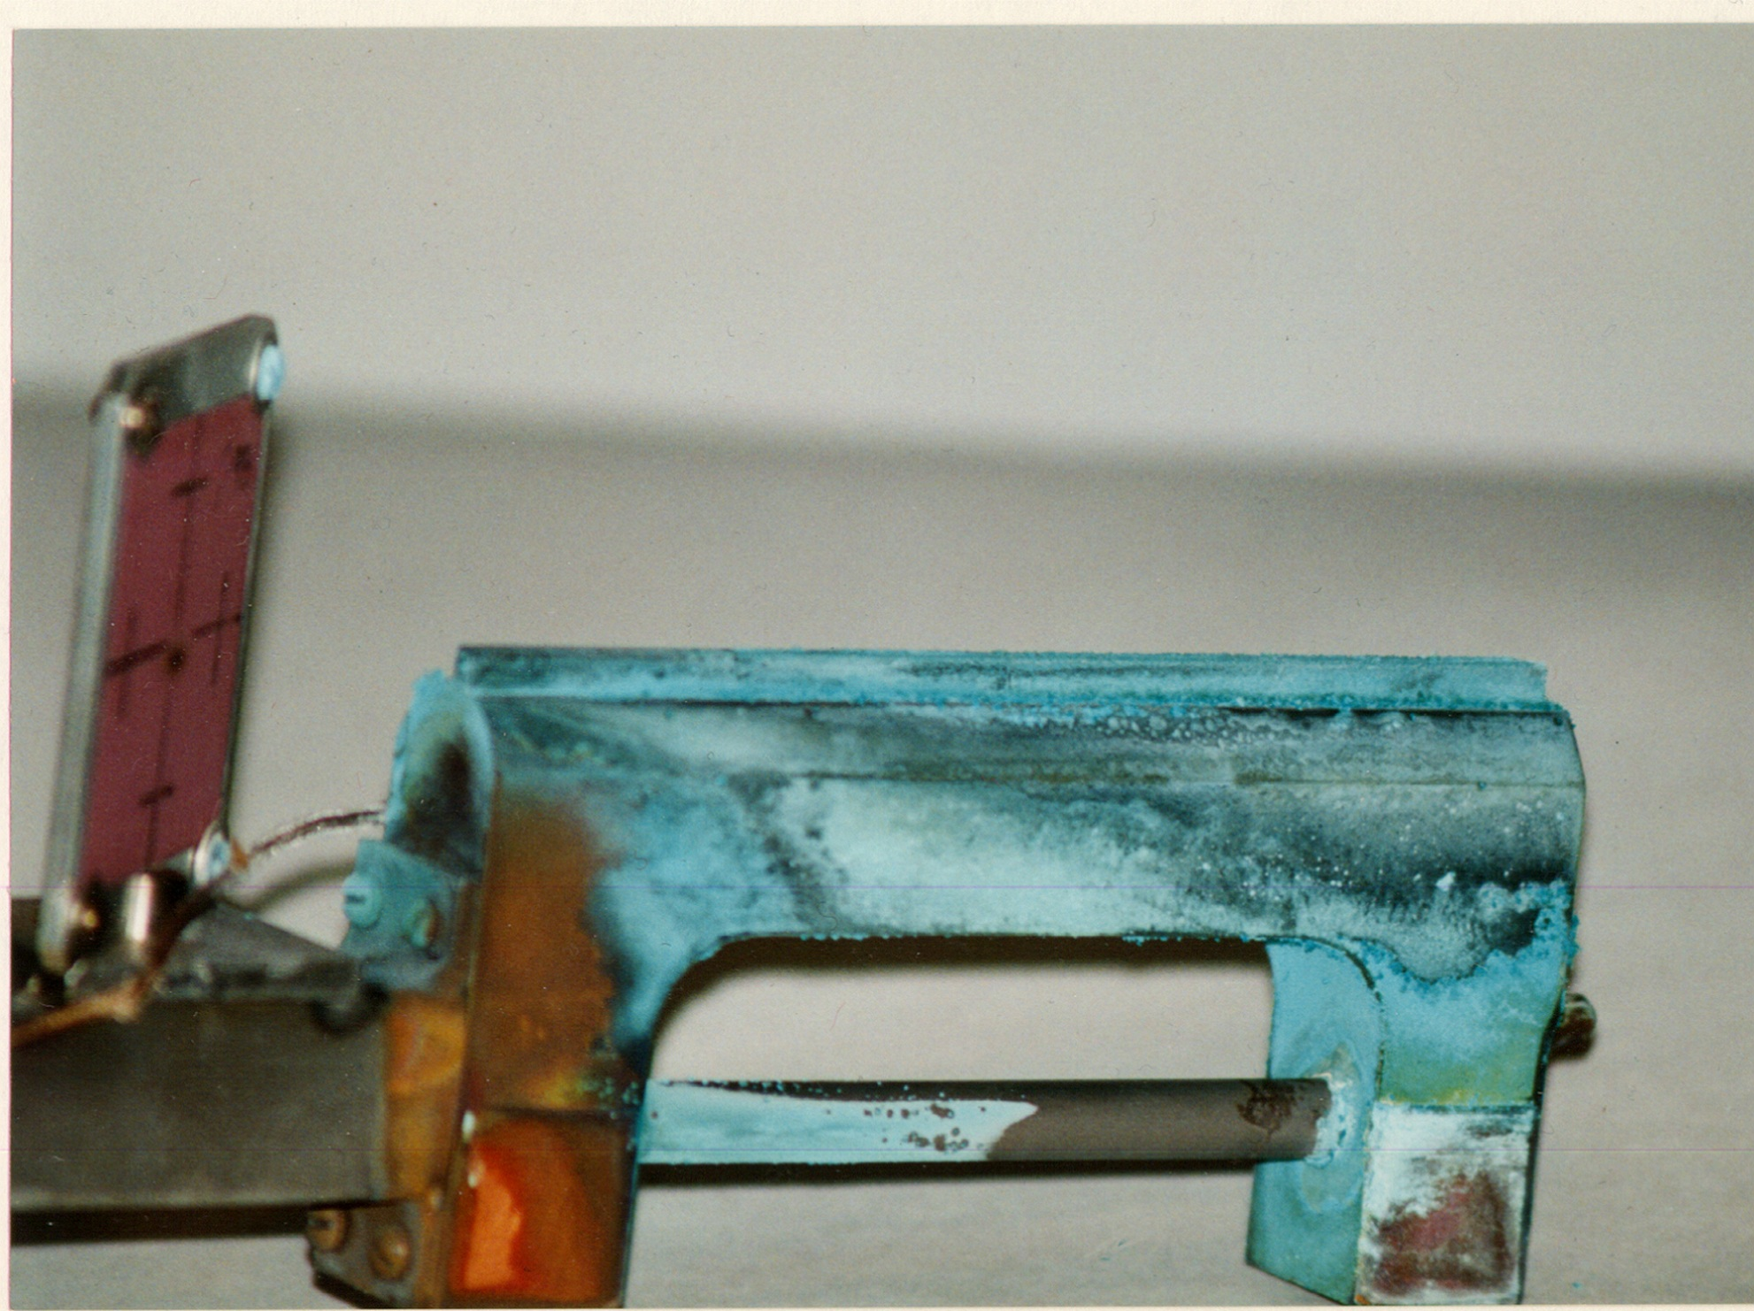
A-Target (E865 - Zeller) after ~10-20TP/spill for a ? years
15 cm long copper target and water cooled base

Slide 18
Path Forward…

Slide 19
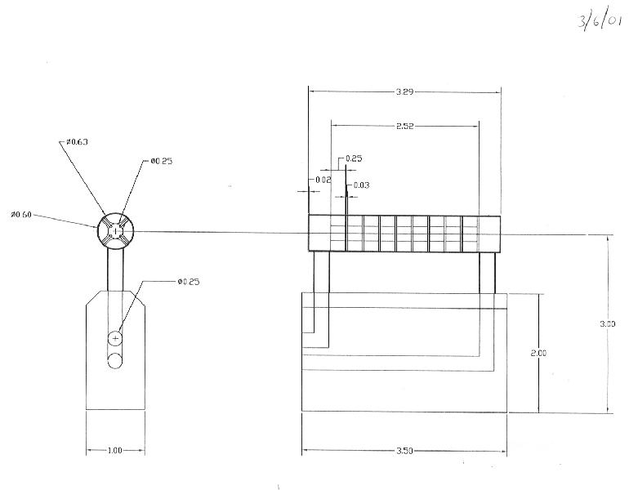
This target design was under consideration for next generation C-target before DOE HEP lost interest in AGS experiments
C-target upgrade – possible approach to a 100 TP Pt target (at ~24 GeV)
(A. Pendzick)
Platinum rod segments
Water cooling
Support spiders
Cu base
dimensions in inches

Slide 20
Thanks to I-H Chiang, Steve Kettell Charlie Pearson
and Al Pendzick for helping remember the past!

Slide 21
Bone yard

Slide 22
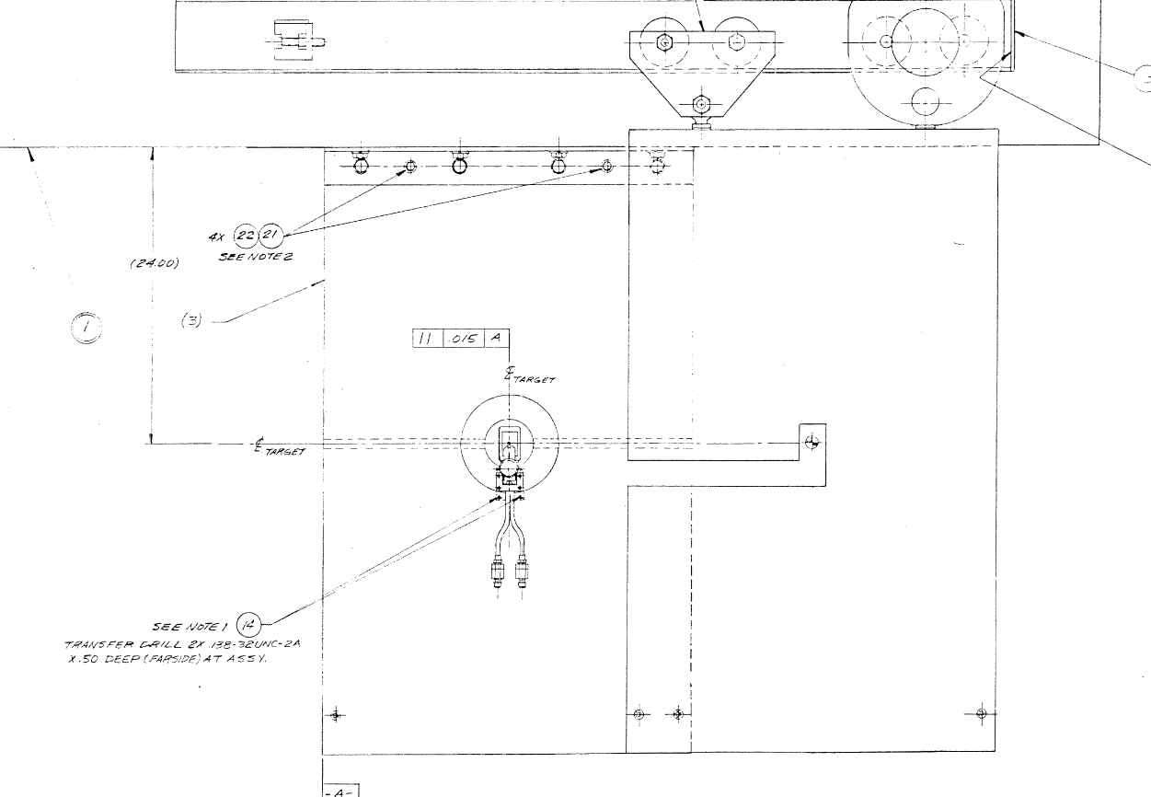
LESBIII target front end magnet shield
target
3” thick steel movable shield
6” thick steel fixed shield

Slide 23
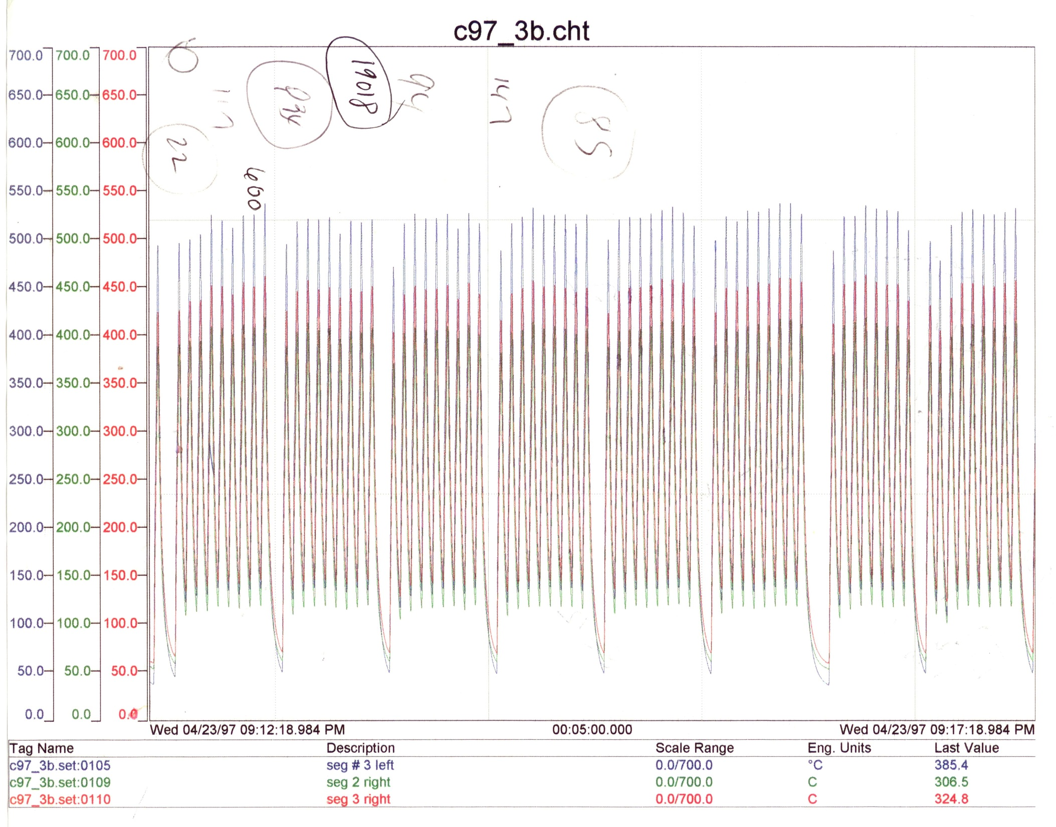
~ 30-40 TP/spill with interruptions for FEB pulse on demand to the
g-2 experiment, 23 April1997

Slide 24
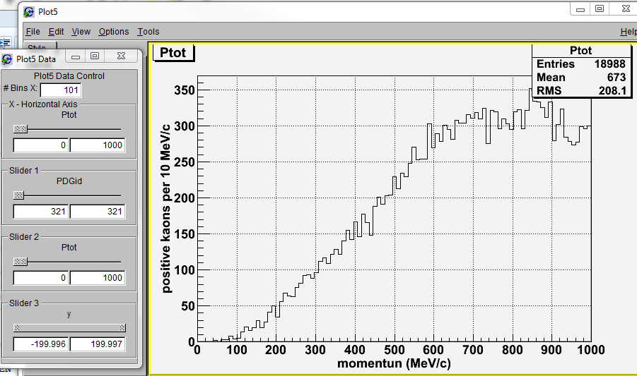
1E6, 24 GeV protons on 5mm wide x 3.8 mm high x 60 mm long platinum target
200 mm radius detector 200 mm d/s tgt center
G4beamline

Slide 25
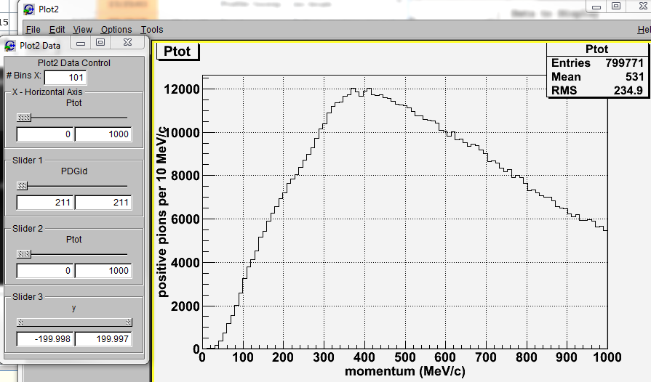
1E6, 24 GeV protons on 5mm wide x 3.8 mm high x 60 mm long platinum target
200 mm radius detector 200 mm d/s tgt center
G4beamline

Slide 26
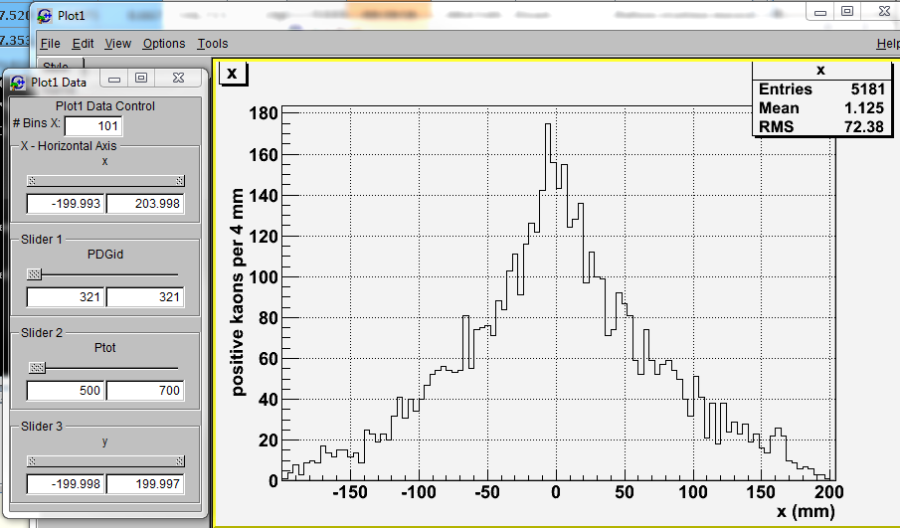
1E6, 24 GeV protons on 5mm wide x 3.8 mm high x 60 mm long platinum target
200 mm radius detector 200 mm d/s tgt center
K⁺ with 500-700 MeV/c
+/- 10 deg
G4beamline

Slide 27
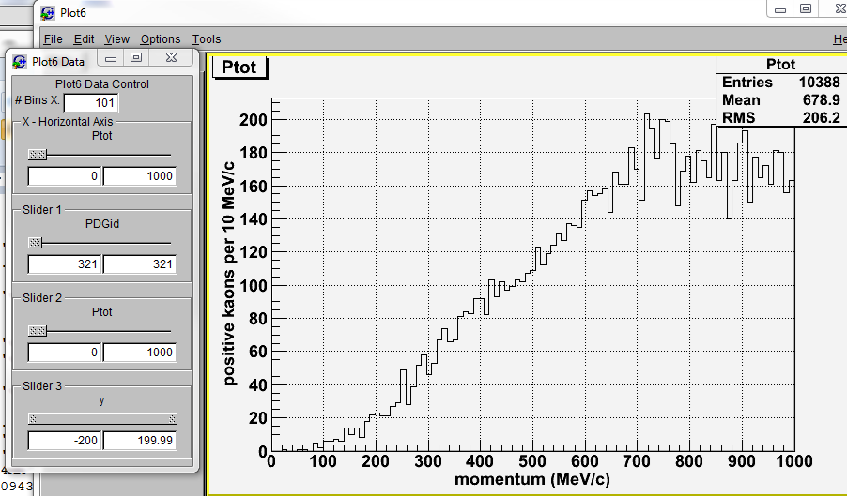
1E6, 24 GeV protons on 5mm wide x 3.8 mm high x 60 mm long copper target
200 mm radius detector 200 mm d/s tgt center
G4beamline

Slide 28
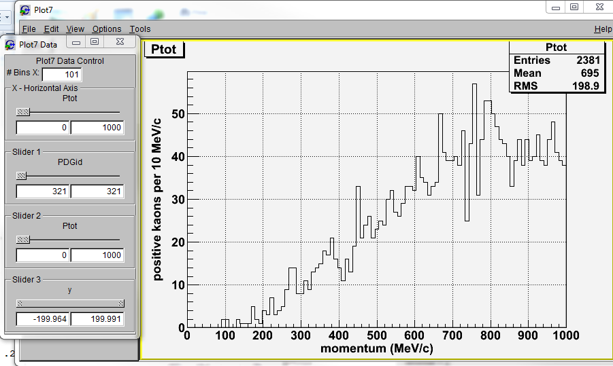
1E6, 24 GeV protons on 5mm wide x 3.8 mm high x 60 mm long carbon target
200 mm radius detector 200 mm d/s tgt center
G4beamline

Slide 29
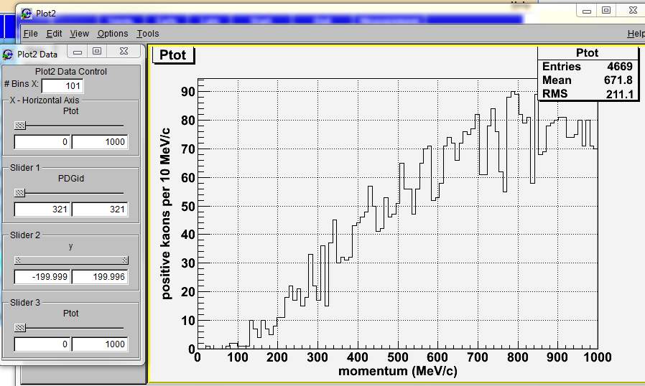
1E5, 95 GeV protons on 5mm wide x 3.8 mm high x 60 mm long platinum target
200 mm radius detector 200 mm d/s tgt center
G4beamline

Slide 30
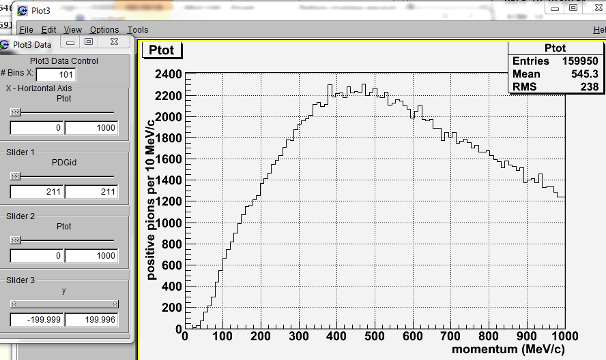
1E5, 95 GeV protons on 5mm wide x 3.8 mm high x 60 mm long platinum target
200 mm radius detector 200 mm d/s tgt center
G4beamline

Slide 31
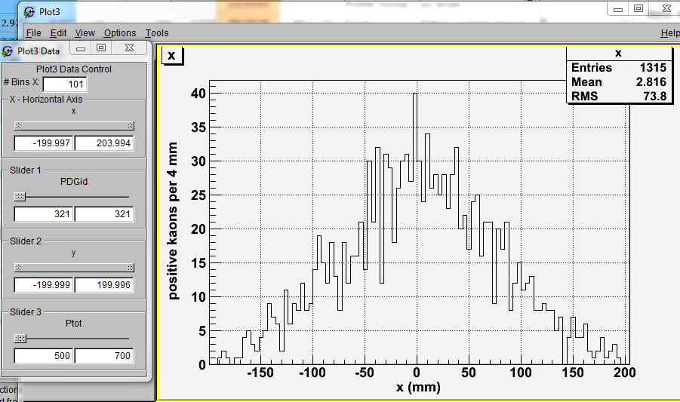
1E5, 95 GeV protons on 5mm wide x 3.8 mm high x 60 mm long platinum target
200 mm radius detector 200 mm d/s tgt center
G4beamline

Slide 32
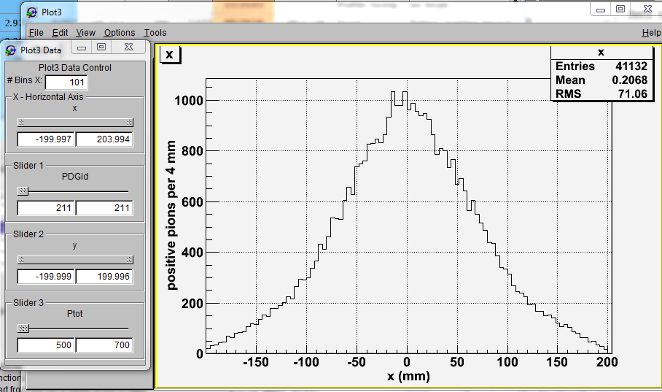
1E5, 95 GeV protons on 5mm wide x 3.8 mm high x 60 mm long platinum target
200 mm radius detector 200 mm d/s tgt center
G4beamline

