Slide 1
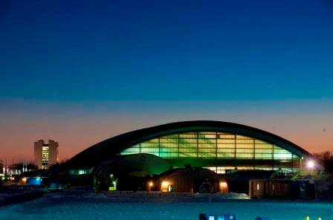
Fermilab Hadron Test Beam and
Irradiation Facilities
Erik Ramberg
10 January, 2013

Slide 2
Test Beam Delivery
MTest
Linac
MCenter
8GeV Line
Booster
Main Injector
SY120
P3 Line
Neutrino Line
P2 Line
Linac loads Booster with a ‘batch’ of up to 80 RF buckets of 19 nsec each
6 of these batches fills the Main Injector
MI accelerates beam to 120 GeV
During the slow spill of the Main Injector, protons are resonantly extracted over a 4 second flattop
One spill is allowed per minute
In the Switchyard (SY120), a septa magnet splits slow spill beam to Meson area or Neutrino area
The majority of the slow spill protons go to SeaQuest (~1E13) in the Neutrino area
The remainder (~ 2E11) can go to Meson
P1 Line
Tevatron
6 second spill per 60 second Main Injector beam cycle for 12 hours a day = 5% impact on neutrino program

Slide 3
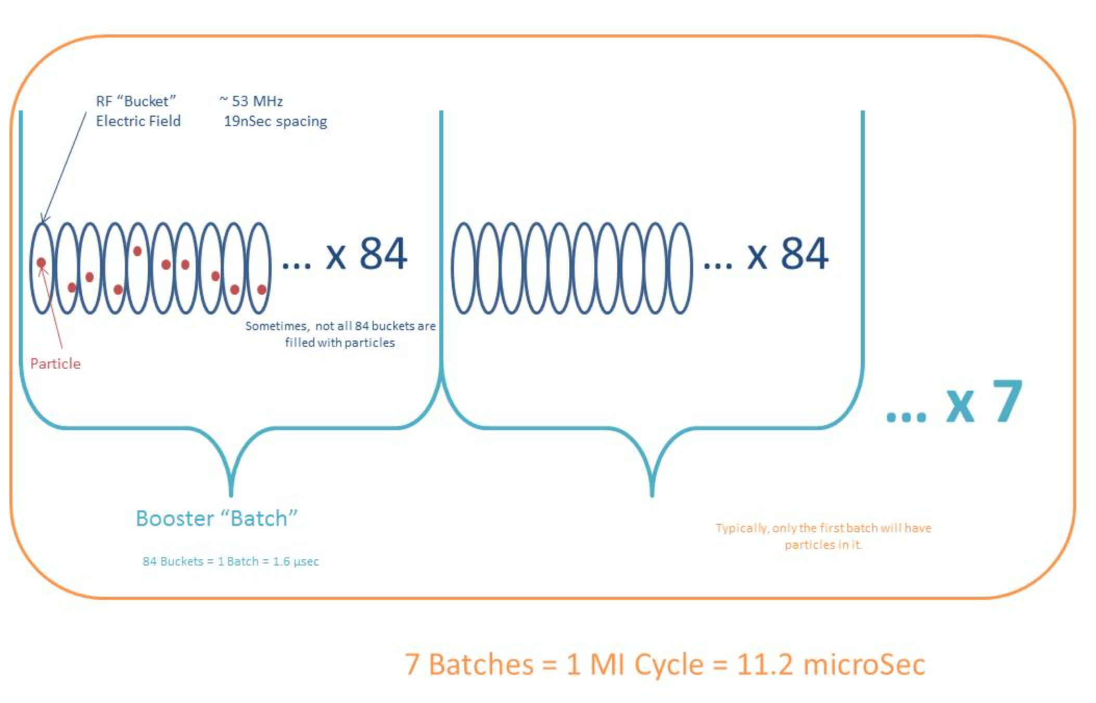
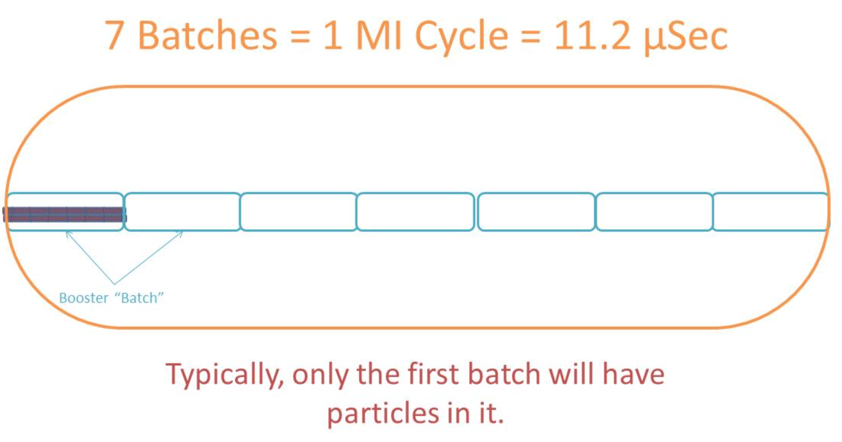
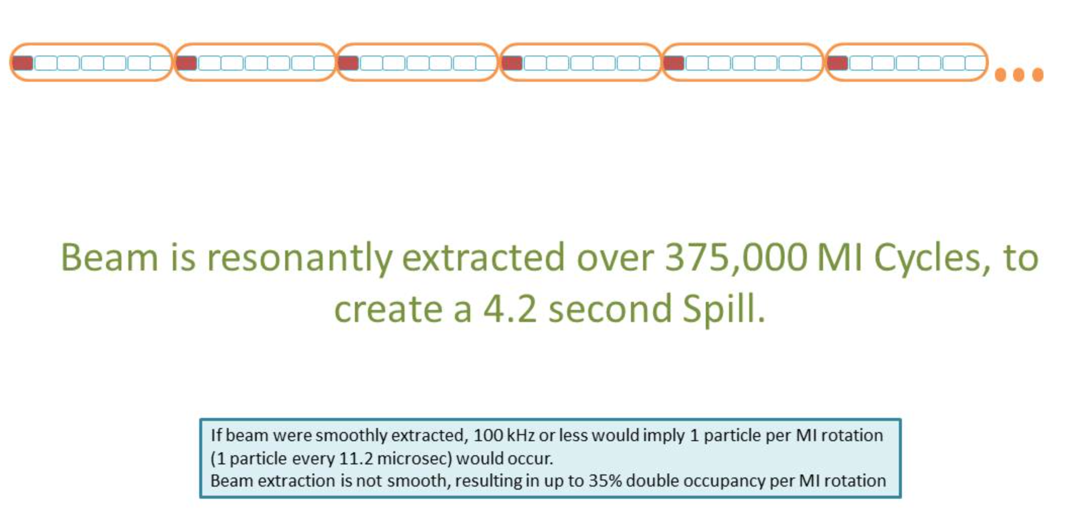
Beam Structure

Slide 4
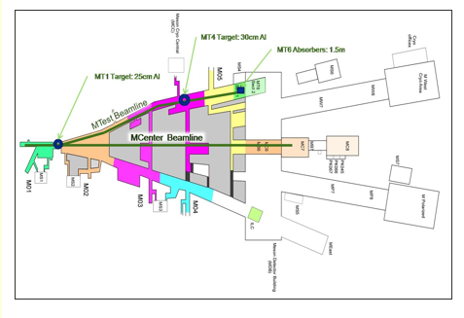
Meson Area Beams
In the Meson area, beam can be delivered simultaneously to the MTest and MCenter beamlines.
Spill structure is the same for both areas.
In MTest, there are 2 targets – one is far upstream and can give higher momentum tunes (>32 GeV)
After the downstream target, the magnets have special low current power supplies that give accurate tunes down to 1-2 GeV
In MCenter, there is a single target located near the beginning of the Meson Detector Building
Mcenter can tune accurately down to about 5 GeV.

Slide 5
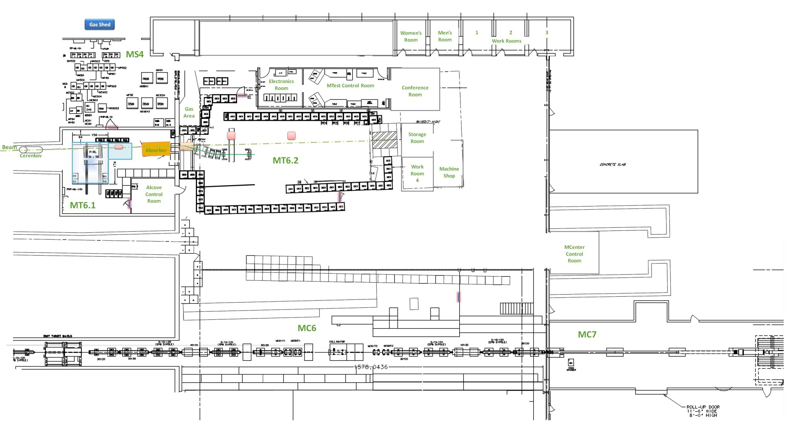
Facility Overview

Slide 6
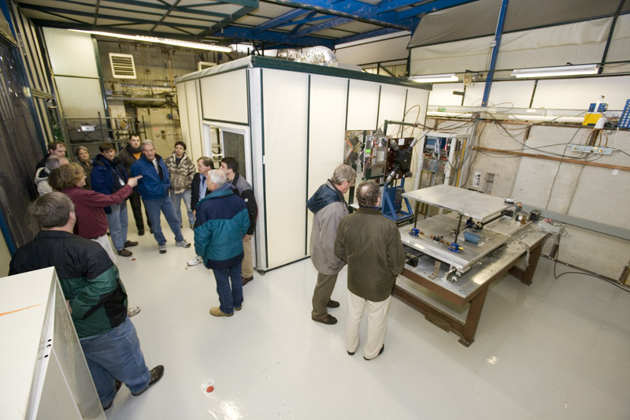
Facility Overview

Slide 7
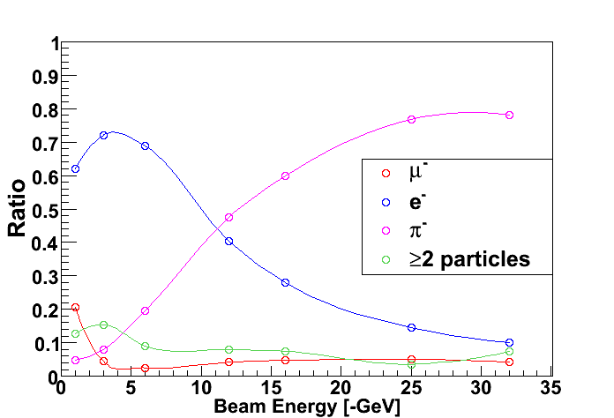
Particle Composition of MTest Beam
Tuning modes:
120 Gev Protons
32-66 GeV Pions
1–32 GeV Mixed Beam
Broadband Muons from Steel absorber/target
Flux can go from about 50-5000 Hz below 8 GeV and up to 100,000 Hz for high energy tunes
Results from CALICE experiment

Slide 8
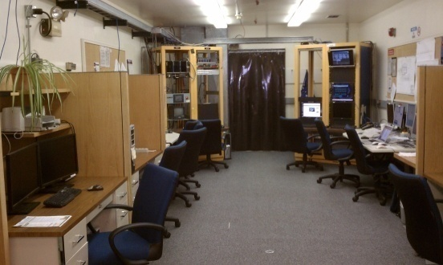
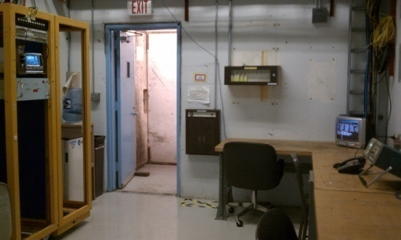
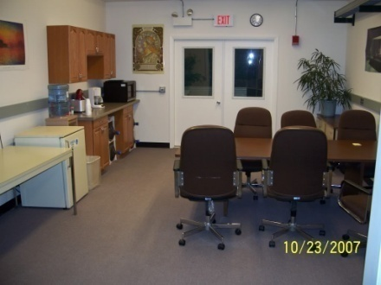
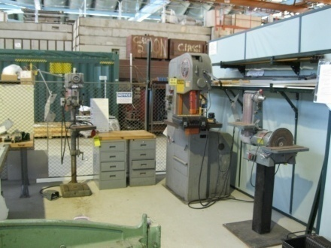
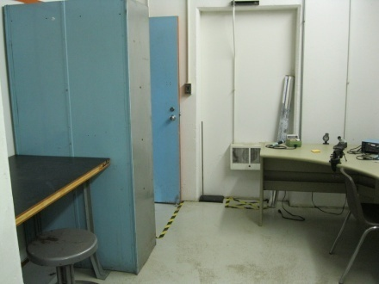
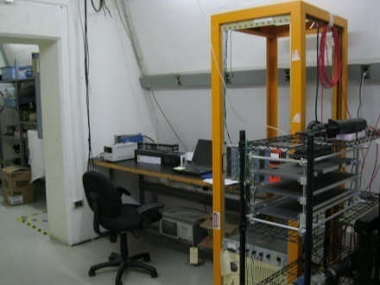
Facility Details - Accommodations
Multiple Control Rooms
Conference Room
Climate-controlled areas for experiments
Machine Shop
Several Work Rooms
Storage Rooms and Cabinets

Slide 9
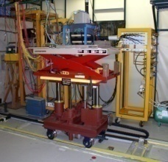
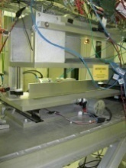
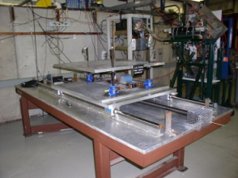
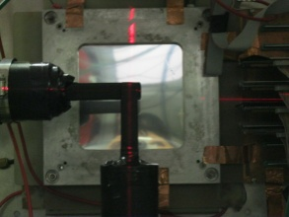
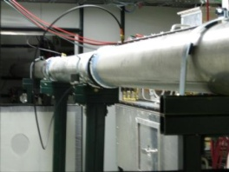
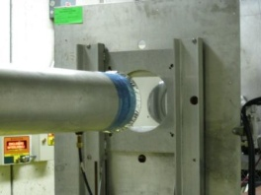
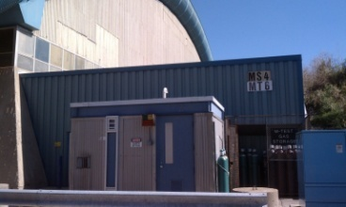
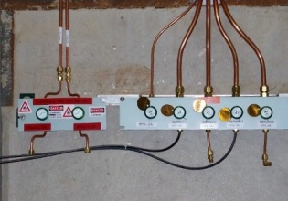
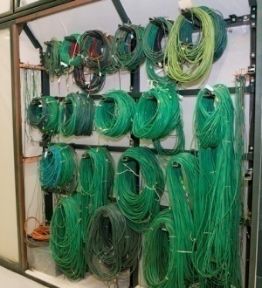
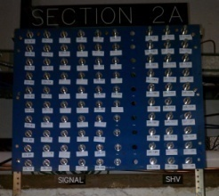
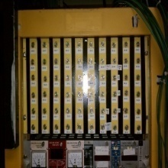
Facility Details - Infrastructure
Remotely controlled Motion Tables
Laser Alignment
Web-based Cameras
Helium Tubes
Gas Delivery
Signal and
High Voltage cable patch panels

Slide 10
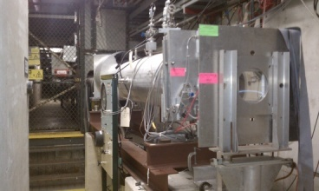
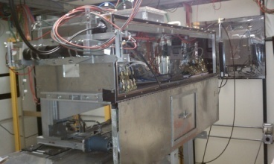
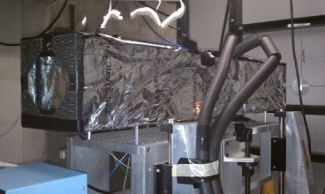
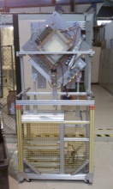
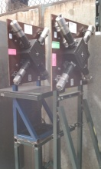
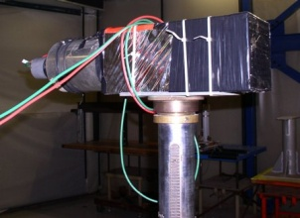
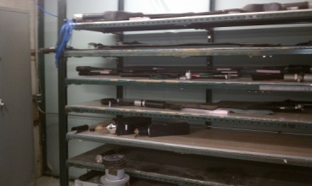
Facility Instrumentation
2 Cerenkov
Detectors (one is differential)
Pixel Telescope with about 10 micron resolution
Silicon strip telescope with similar resolution
Two sets of 4 MWPC Tracking System with about 500 micron resolution
Two Time of Flight Systems with 160 psec or 24 psec resolution
Lead Glass
Calorimeters
Scintillators

Slide 11
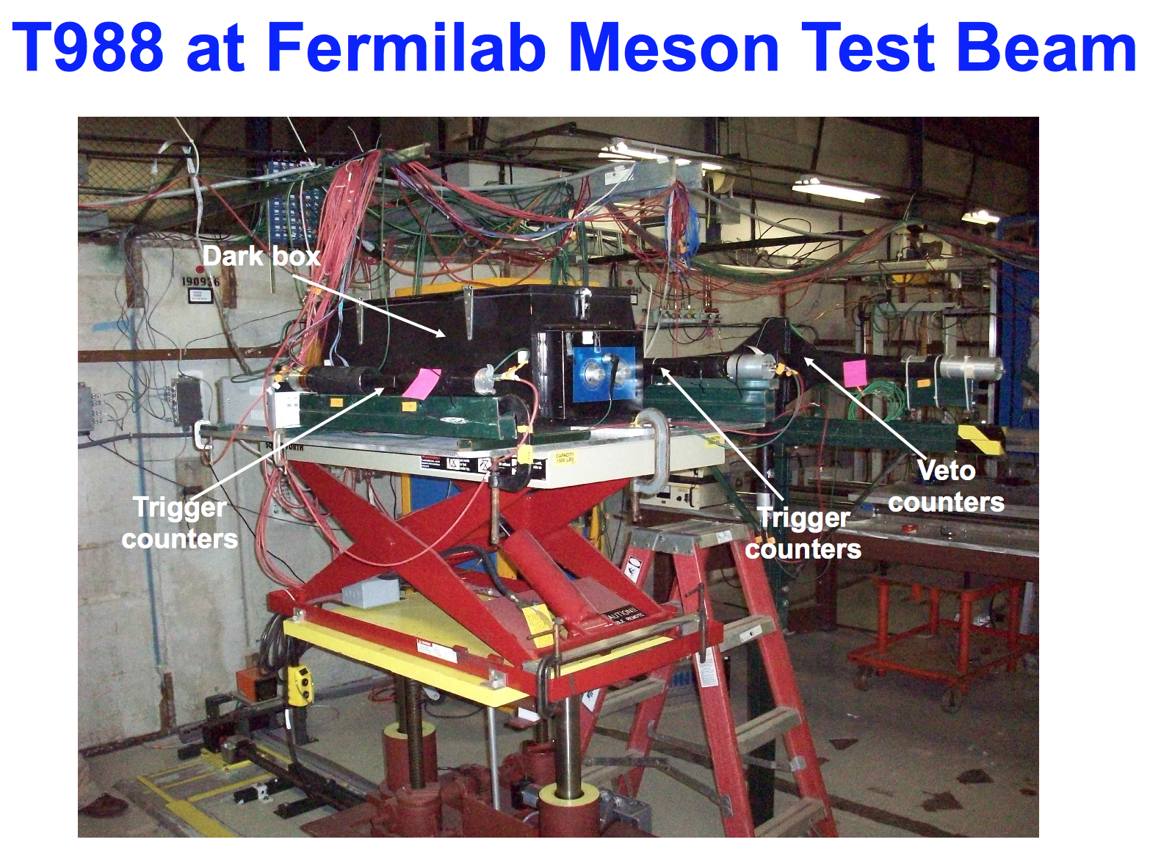
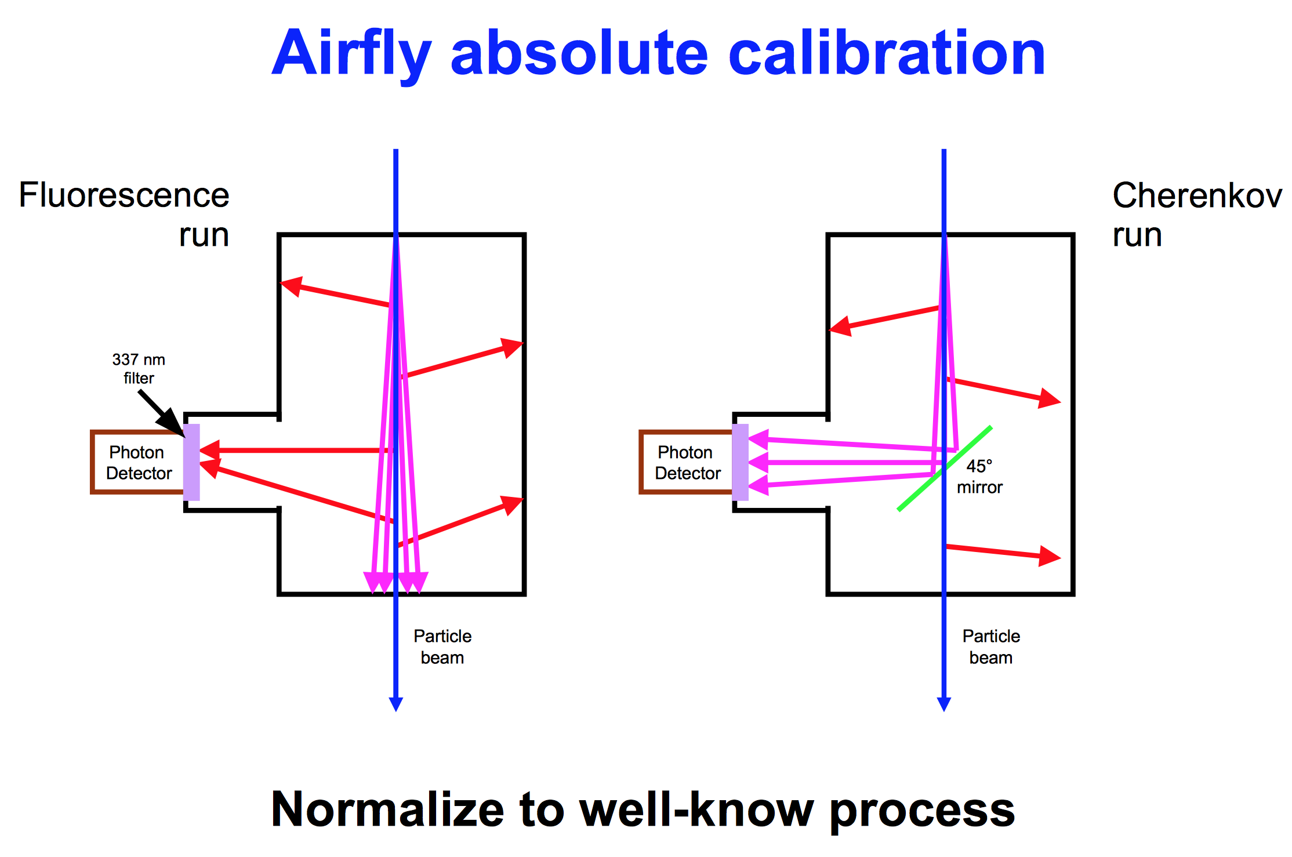
The AIRFLY experiment measured absolute scale of nitrogen fluorescence to the 5% level.

Slide 12
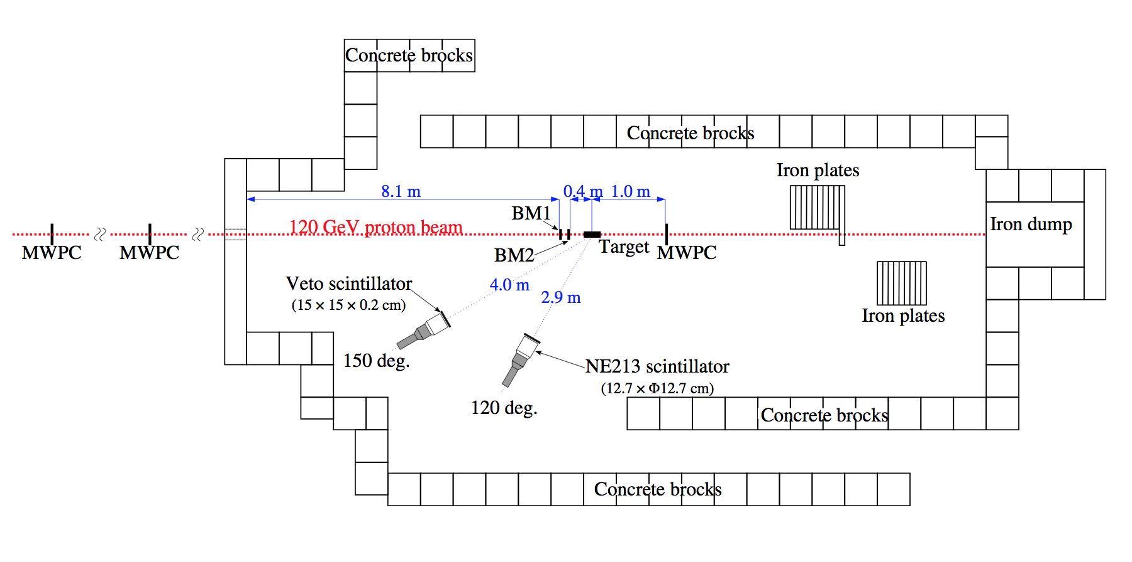
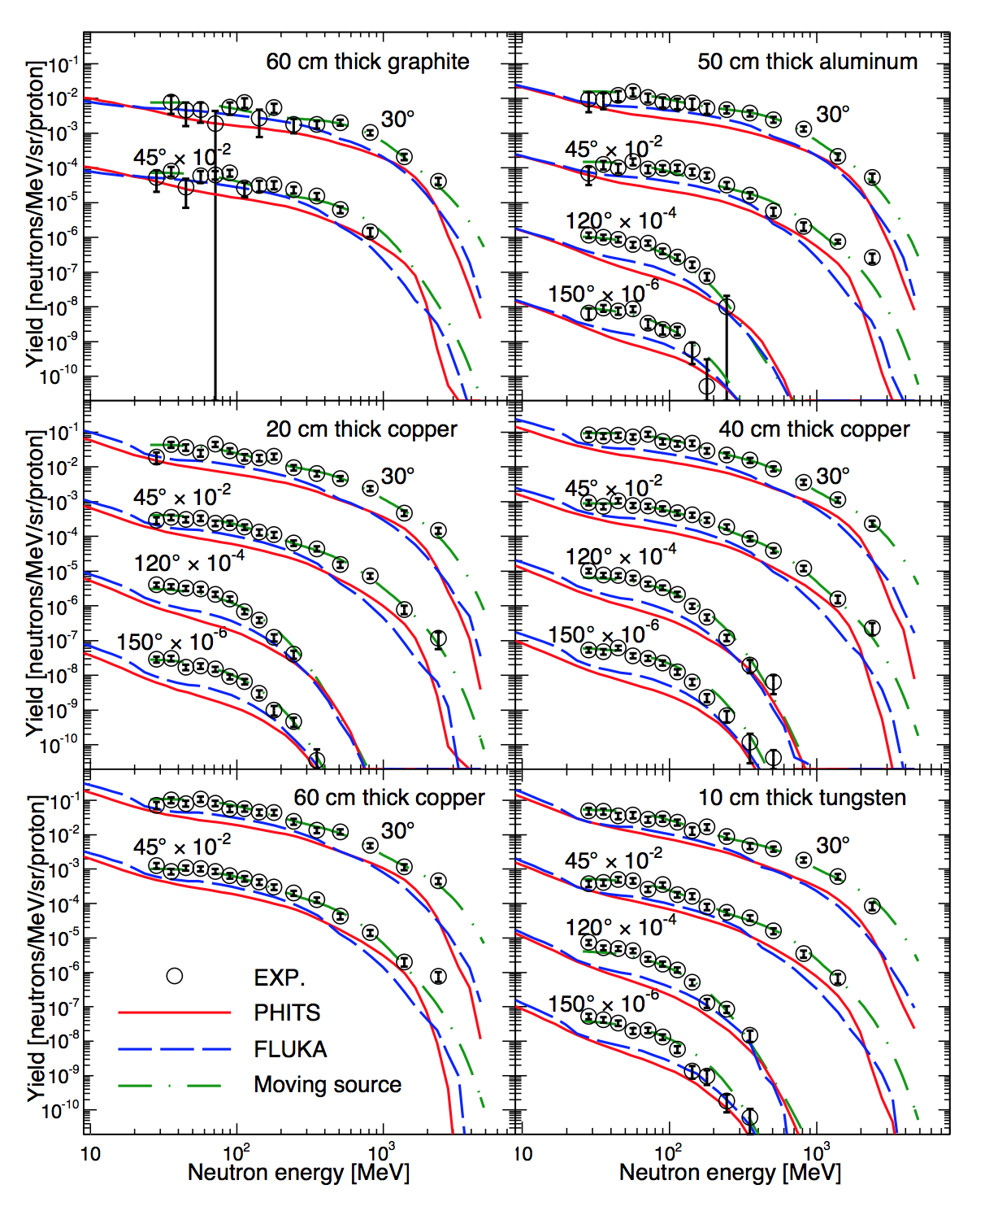
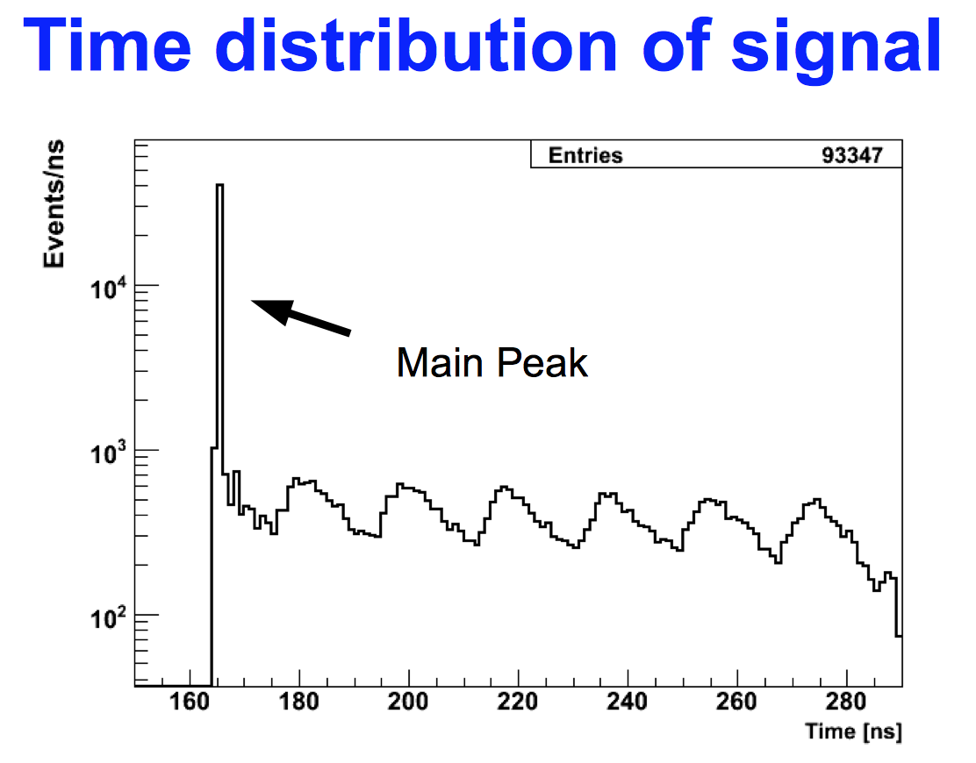
The JASMIN experiment studied neutron production from 120 GeV protons (and other beams on-site) with time-of-flight.

Slide 13
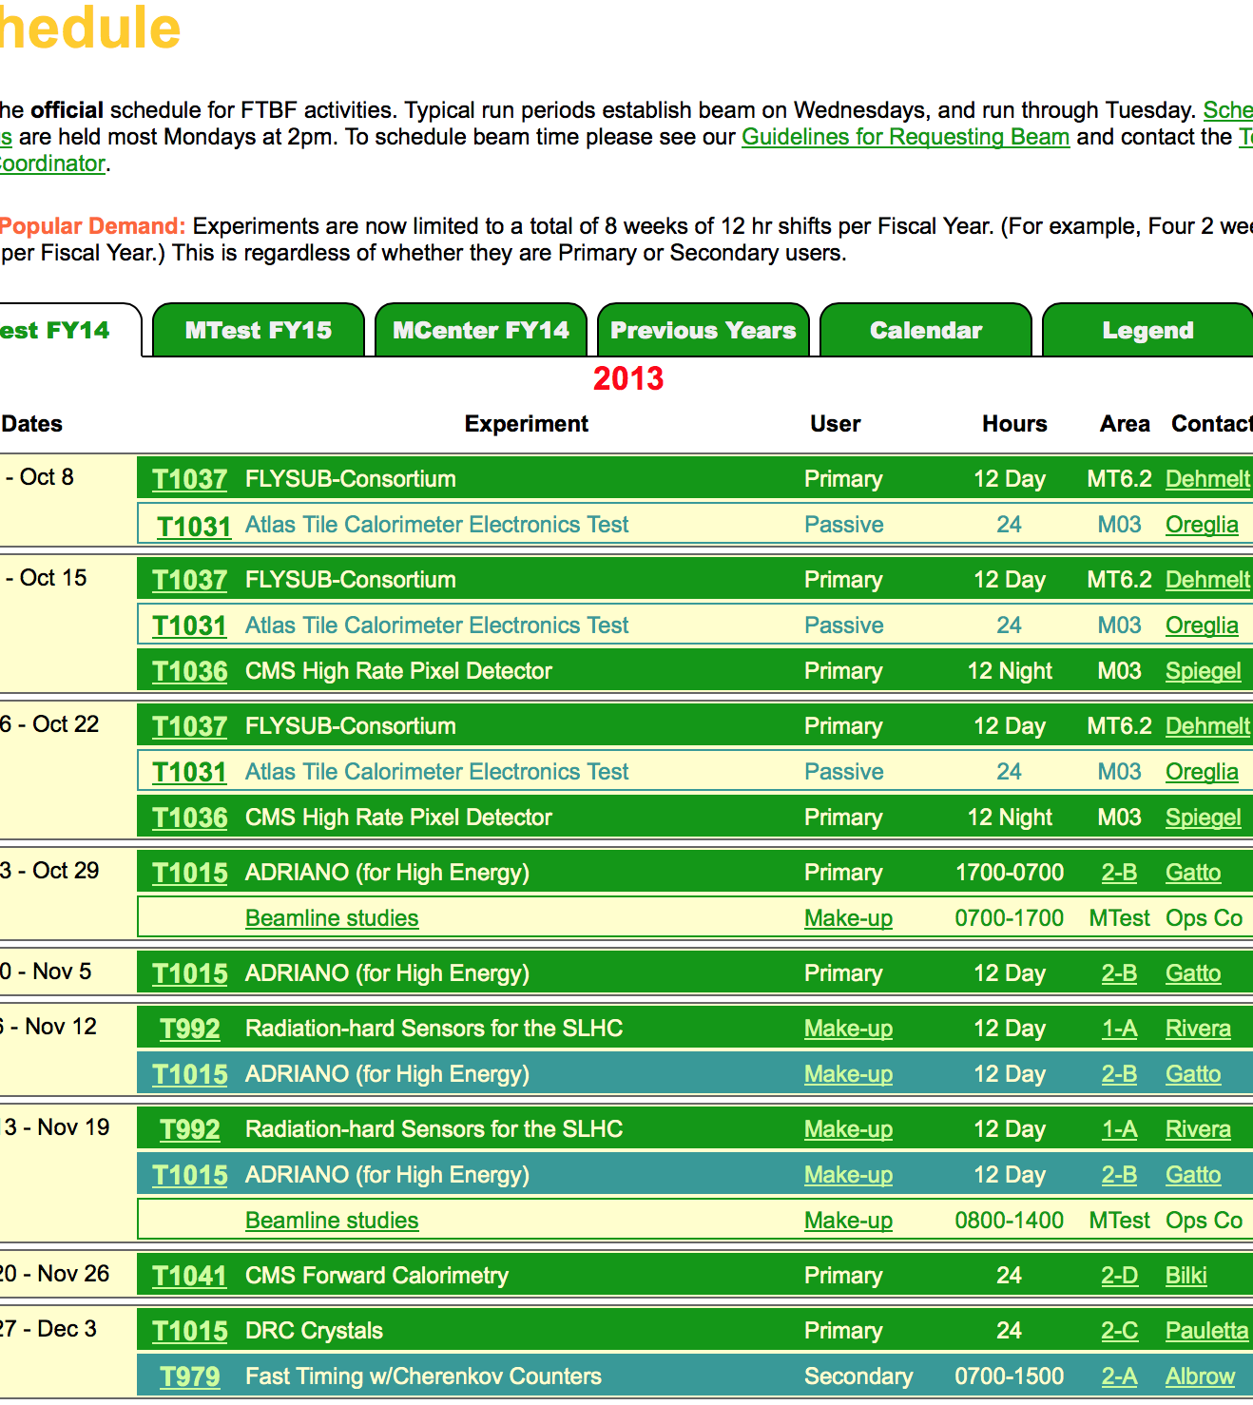
Booking is solid for FTBF
Experiments typically ask for time in 1-3 week chunks.
Often come back for further runs.
Installation on nights and Wednesday day.
Quite often there are multiple users setting up simultaneously.
Safety approval for each experiment takes place on Thursday and often up and running that afternooon.
Make-up time is scheduled at night.

Slide 14
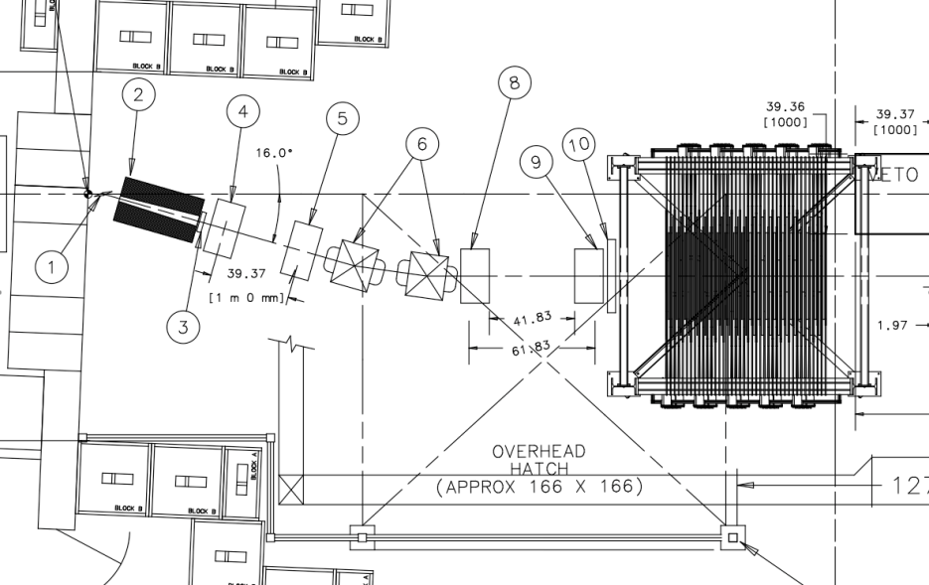
Accommodating Low Energy Users
The lowest energy we can realistically deliver with the secondary beam is ~1 GeV.
In 2008, T-977 MINERvA experiment requested pions with momentum as low as 200 MeV/c
To accommodate this request, Fermilab created a secondary target and tertiary beam spectrometer

Slide 15
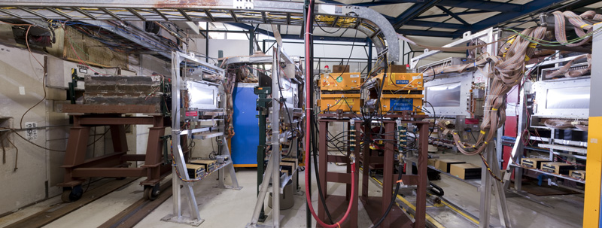
Tertiary Beamline
Target/
Collimator
TOF 1
WC 1
WC 2
Spectrometer Magnets
WC 3
WC 4
TOF 2

Slide 16
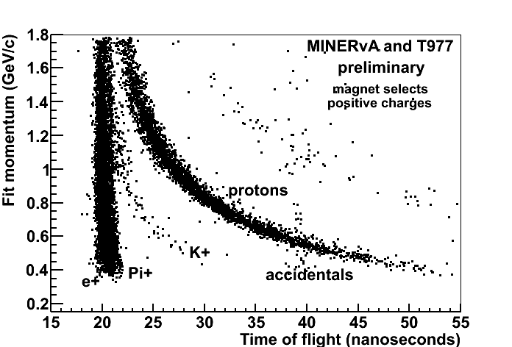
Tertiary Beam Details
Plot of fit momentum vs. TOF shows separation of species
60% pions,
40% protons,
very few electrons, kaons, and deuterons.
Yields will be different at MCenter

Slide 17
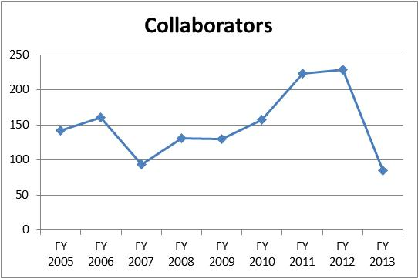
The Need for a New Test Beamline
The Fermilab Test Beam Facility is extremely popular and will remain so for the foreseeable future.
Having multiple users running simultaneously is a common occurrence.
Total number of experimenters rivals large HEP experiment
The need for a second beamline was endorsed and funded by DOE.

Slide 18
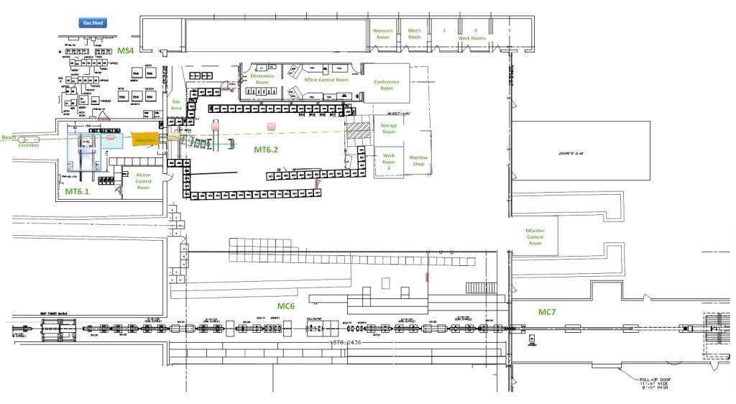
New MCenter Beam as part of the Fermilab Test Beam Facility
Tertiary beam moved to MC7
A control room in the MWest stub
Installed cable
route for users
Walkway to access MC7
This section of pipe has been removed. User area is here.
Can put another user area near magnet

Slide 19
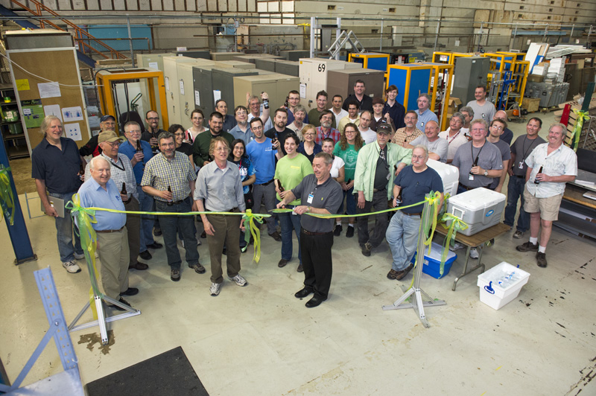
Ribbon Cutting Ceremony at MCenter

Slide 20
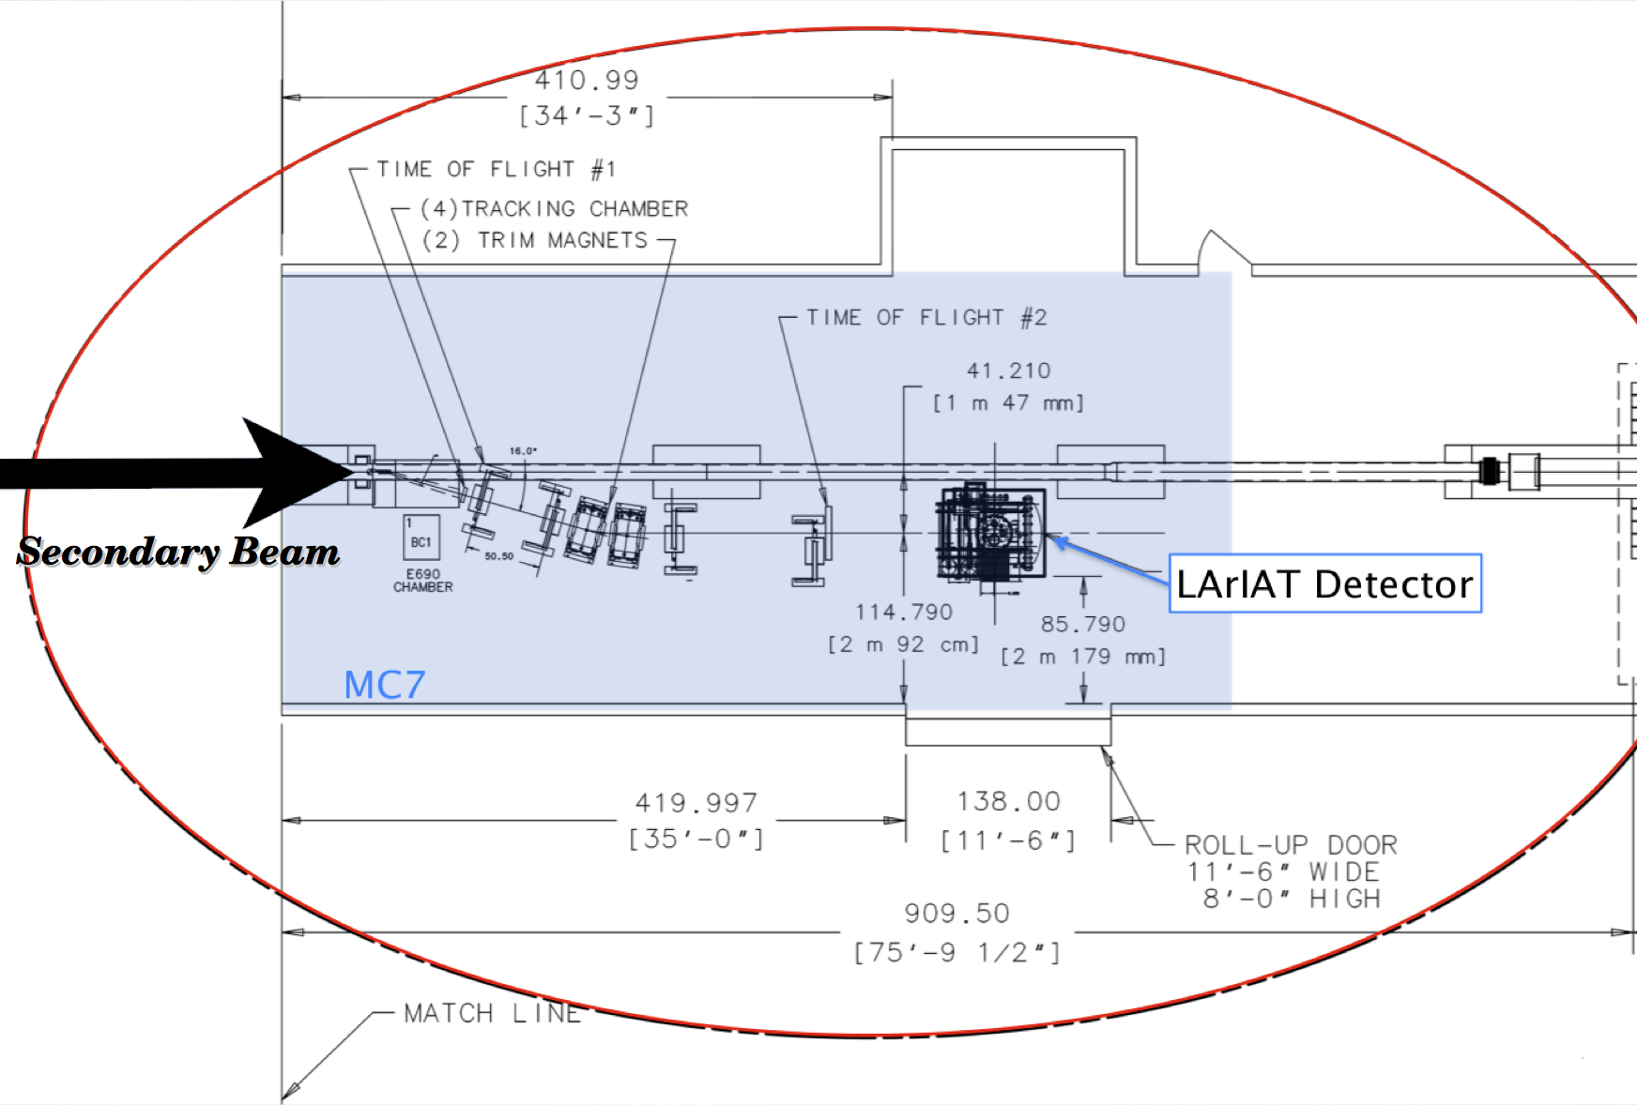
T-1034 LAriaT proposal
‘LAriaT = ‘Liquid Argon in a Testbeam’
Two stage proposal:
  Stage 1: Put ArgoNeut (300 kg) into tertiary beam in Mcenter
  Stage 2: Put as large a new detector as possible (2x2x5 m³) in downstream half of MC7
Imagine being able to study low momentum tagged kaon and proton tracks or photon showers in liquid Argon.
We are creating a cryogenic system large enough for Stage 2, using some parts already purchased.
Still support secondary beam users

Slide 21
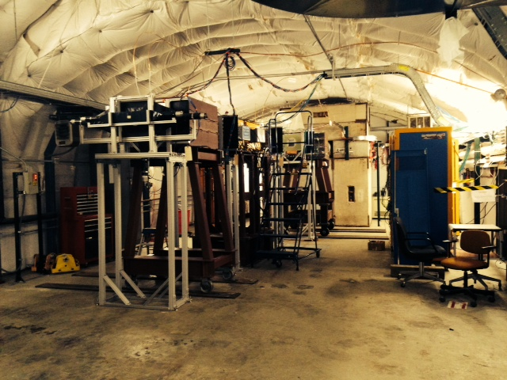
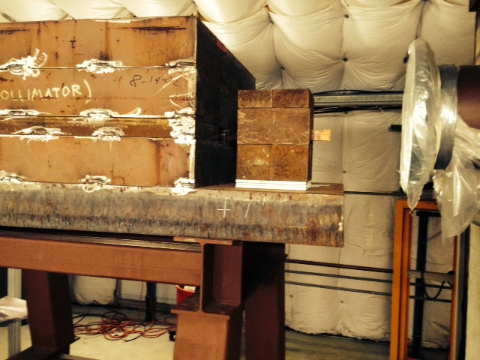
MCenter User Area
Primary target is 300 meters upstream
Copper secondary target and 13º collimator:
Path of secondary beam
Secondary target and collimator can be rolled aside in minutes
Path of tertiary beam

Slide 22
Irradiation Facilities at Fermilab
120 GeV direct proton beam (5E11 protons/spill)
  Located in the Meson beam section MT3, upstream of collimator
  Can only support thin tracking chambers
Radiation fields from high energy proton primary interactions
  Located in MT4, next to primary target
Low Energy protons
  New MTA area has primary LINAC beam at 400 MeV
  Has not supported irradiation yet (probably within next few months
Medium energy Neutrons
  ~5-30 MeV neutrons at the Neutron Therapy Facility
Medium flux gamma irradiation
  At ES&H instrument calibration department

Slide 23
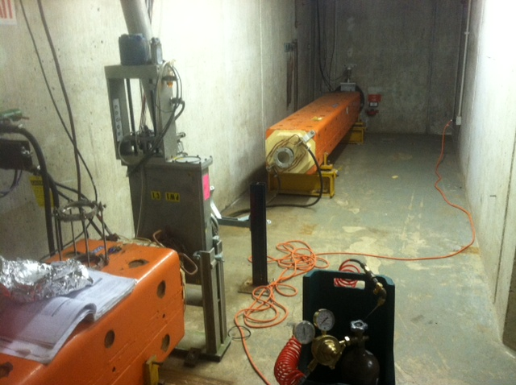
New High Rate Tracking Area
To support R&D on very high rate trackers we have removed a section of beam pipe just upstream of the proton collimator in MT3, and have put a movable table station in this area. Signals are sent to MS3 service building, not Meson Detector Building. Can support rates up to 5E11 Hz.
MT3
MS3 service building

Slide 24
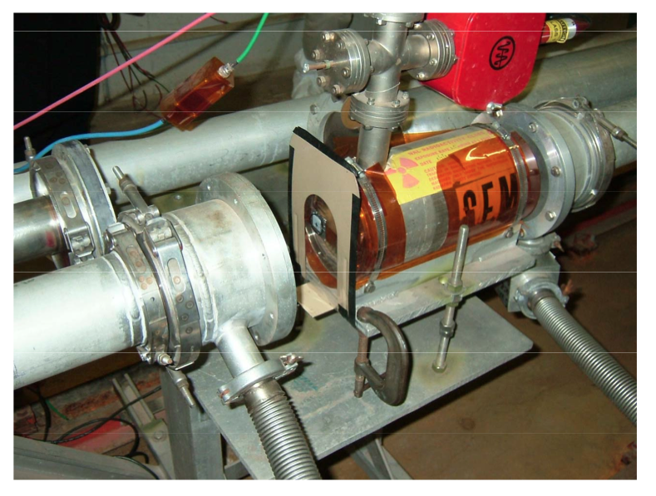
MTest irradiation areas
Have several areas in MT beamline where irradiation studies can take place:
  Near primary target in MT4 you can have a mixed field of radiation that simulates conditions in the LHC halls, for instance.
    (Calculated dose for a Si sample irradiated @ 30 cm away from the aluminum target and pinhole collimator is ≈ 1.2E4 and ≈ 4.5E3 Gy/yr, respectively (very similar to LHC cavern)
Al Target
Beam Dump

Slide 25
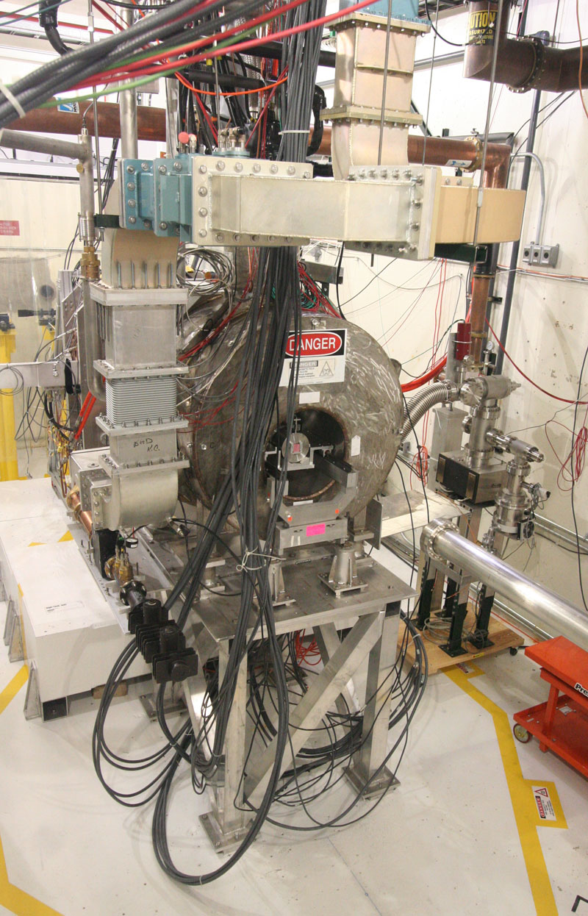

MTA - Muon Test Accelerator
Purpose is to provide an experimental area for the Muon Accelerator Project to test cavities inside high magnetic field, with intense beam.
400 MeV protons from Linac
1 Hz repetition rate with >1E12 beam available
First detector test MOU is up for approval now.

Slide 26
Summary
Fermilab has a very active test beam program, based on the Test Beam Facility in the Meson area.
  It consists of two beamlines (MTest and MCenter), along with a movable tertiary spectrometer for very low energy beam delivery.
  The support infrastructure is extensive and is constantly being improved.
  The schedule is typically full months in advance, but Fall/Winter 2014-15 has many open slots.
Several irradiation facilities exist that can deliver moderately high intensity radiation.

Slide 27
Tips for a Test Beam Manager
It has been my experience that “If you build it, they will come!”.
Incremental improvements to the beamline and user area are important
  Keep looking for ways to improve the facility.
Sharing beam with other programs can actually be beneficial
It’s important to have a service mentality:
  Always encourage customers.
  Don’t say that something is too hard to accomplish

