Slide 1
MUON TARGET PARTICLE PRODUCTION STUDY:
TAPERED FIELD PROFILE
HISHAM KAMAL SAYED
Physics Department
Brookhaven National Lab
July 3, 2012

Slide 2
Ding’s Optimized Parameters
Hg Target
  θ_{Target} = 0.137 rad
  R_{target} = 0.404 cm
Proton Beam
  E = 8 GeV
  θ_{Beam} = 0.117 rad
  σ_{x} = σ_{y} = 0.1212 cm (Gaussian Distribution)
Solenoid Field
  IDS120h → 20 T peak field at target position (Z=0)
  Aperture at Target R = 7.5 cm - End aperture R = 30 cm
  Fixed Field Z = 1862.0 → B_{z} = 1.5 T
Production: Muons within energy KE cut 40-180 MeV
3.27 X 10⁴ (N_{ini} =10⁵)

Slide 3
Target Particle Production with 15 T Peak Solenoid Field
Particle Capture requirement (P_{t} ~ 0.225 GeV/c)
Br = 20 T X 7.5 cm = 150 T cm ----- Br = 15 T X 10 cm = 150 T cm
Fixed flux requirement (Aperture Requirement)
Br² = 20 X 7.5²=1125 T cm² ------ Br² = 15 X 10² =1500 T cm²
MARS simulations with 15 T peak field & new aperture settings (Taper R = 10-30 cm)

Slide 4
Muon Production IDS120h 15 T
Bz=1.85T
Bz=2.12T
Bz=1.7T
Bz=2.5T
Bz=1.667T
Bz=1.667T
Bz_{peak} = 20 T
Z_{end} =1862
Bz_{end} =1.5 T
Bz=1.667T
Bz=1.667T
Bz=1.5T
Bz=1.5T

Slide 5
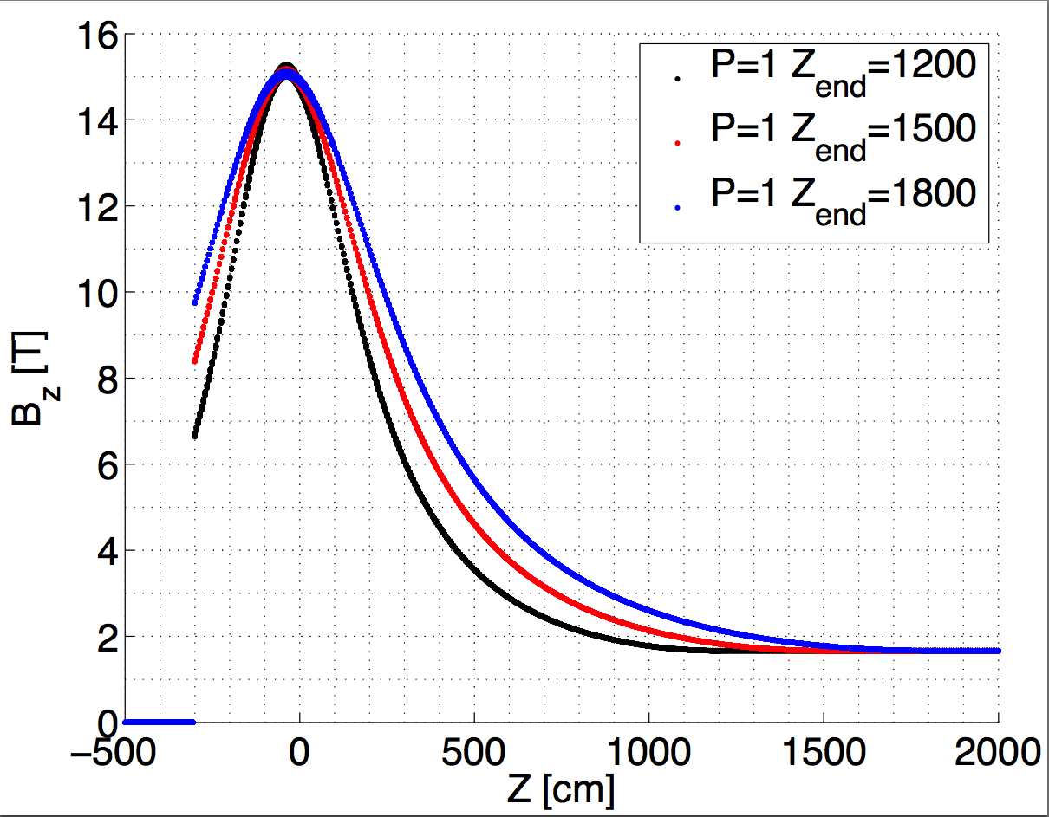
Analytic form for Tapered Solenoid
(K. McDonald)
Inverse-Cubic Taper
Field at R=0
Off-axis field approximation

Slide 6
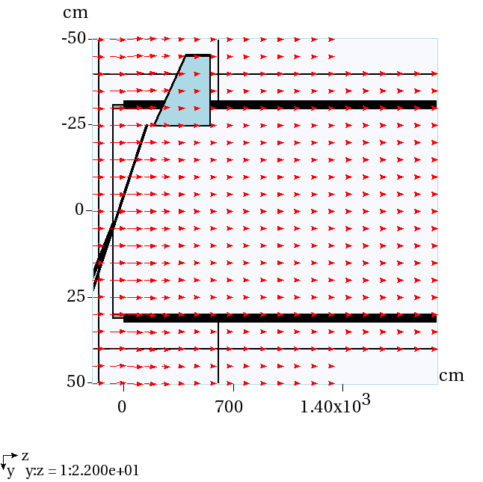
MARS RESULTS
Beam Pipe with constant R = 30 cm
Beam Pipe material changed to blackhole to speed calculations
Added subroutine to m1510.f (FIELD) to calculate the field using inverse cubic equations

Slide 7
Inverse Cubic Field(P = 1)
MARS simulation results:
Counting muons at 50 m with K.E. 80 -140 MeV

