Slide 1
PSI experience with
High Power Target Design and operational considerations for muon production
[with slides from Th.Prokscha, G.Heidenreich]
Mike Seidel
Paul Scherrer Institut
April 19, 2013,
Brookhaven National Laboratory

Slide 2
Outline
overview PSI targets and parameters
thermomechanical target aspects, mechanics and supporting infrastructure
example for μ-beam capture and transport
discussion

Slide 3
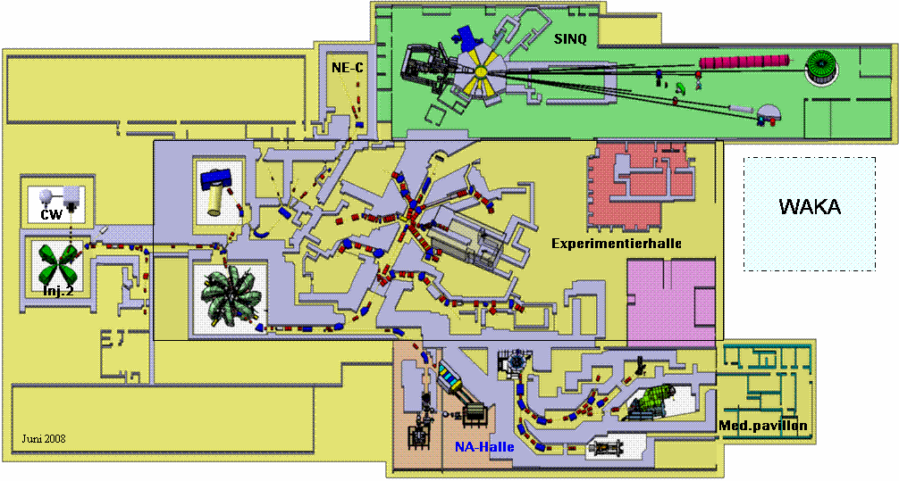
PSI proton accelerator complex
SINQ, neutron spallation source
Dolly
GPD
LEM
High field (9.5T) μSR
MEG
GPS/LTF
UCN
proton therapy, irradiation facility
50 MHz proton cyclotron, 2.2 mA, 590 MeV, 1.3 MW beam power (2.4 mA, 1.4 MW test operation)
Comet cyclotron (superconducting), 250 MeV, 500 nA, 72.8 MHz

Slide 4
Meson production targets used at PSI
Target M Target E
1974-80 < 100 μA Be, Graphite *) Be, Graphite *)
∅ 190 mm ∅ 190 mm
0.9 g/cm² 22 g/cm²
Pyrolitic graphite**)
22 g/cm²
1980-89 250 μA Graphite *) Graphite *)
∅ 320 mm ∅ 280 mm
0.9 g/cm² 18 g/cm²
since 1990 0.5 - 2 mA Graphite *) Graphite *)
∅ 320 mm ∅ 450 mm
0.9 g/cm² 10 g/cm² (60 mm)
or 7 g/cm² (40 mm)
*) rotating wheel target **) static target

Slide 5
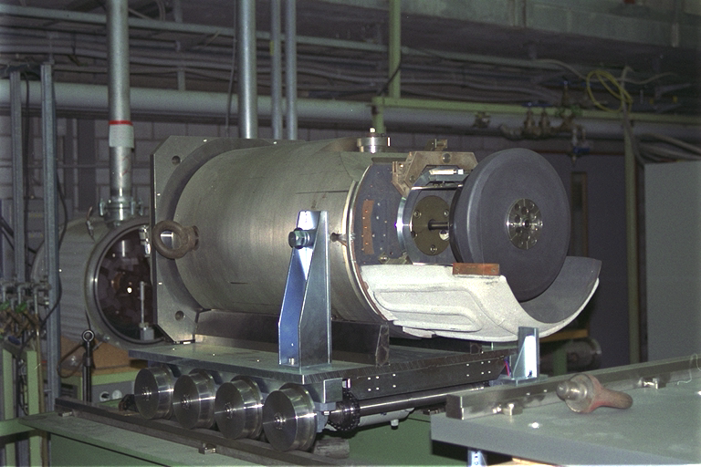
Target-M design
Target M:
Mean diameter: 320 mm
Target thickness: 5.2 mm
Target width: 20 mm
Graphite density: 1.8 g/cm³
Beam loss: 1.6 %
Power deposition: 2.4 kW/mA
Operating Temperature: 1100 K
Irradiation damage rate:0.12 dpa/Ah
Rotational Speed: 1 Turn/s
P-BEAM

Slide 6
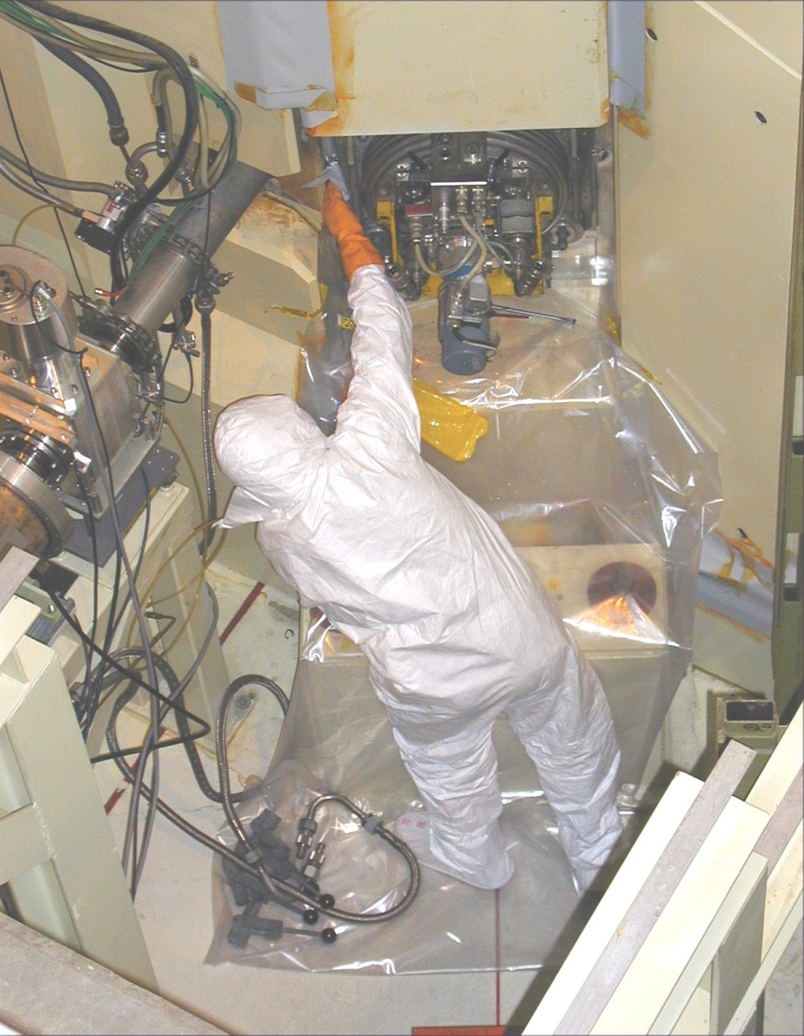
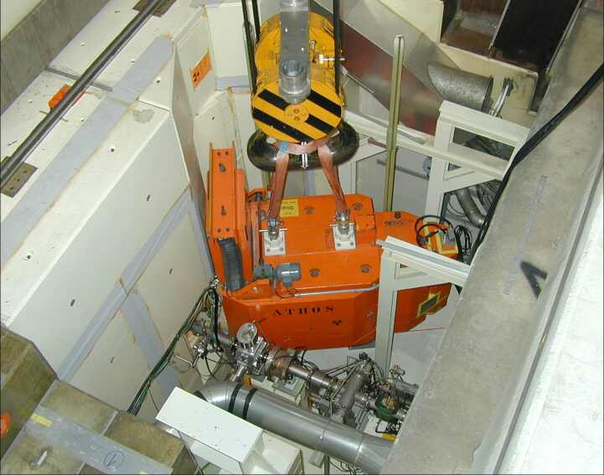
Exchange of Target-M
Operation of the remotely controlled shielded flask
Dose rate ~10 mSv/h

Slide 7
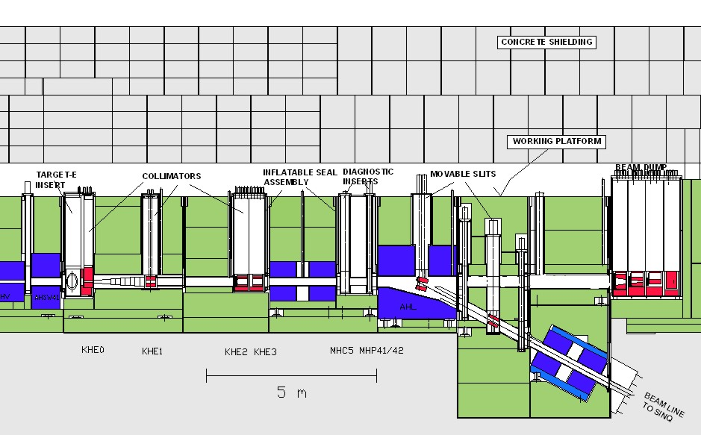
Design of the proton channel between target-E and the beam dump
BEAM DUMP

Slide 8
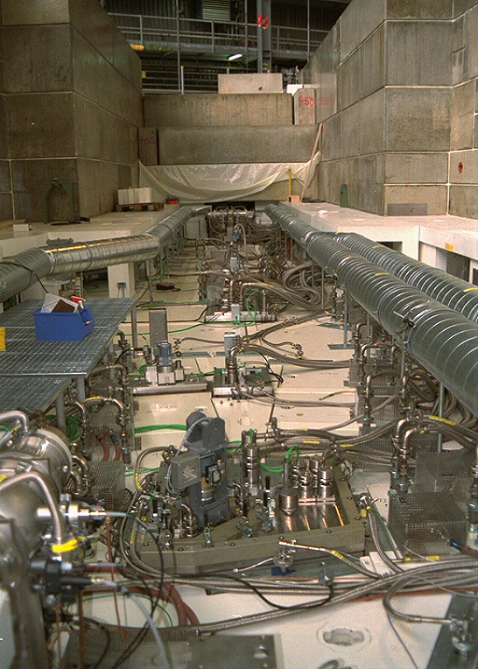
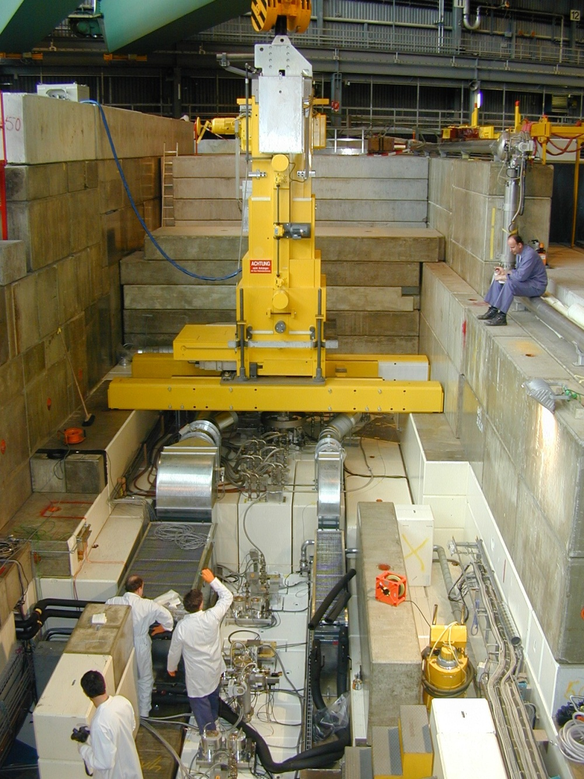
Working platform / Operation of the remotely controlled shielded flask

Slide 9
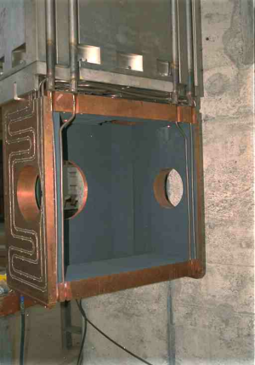
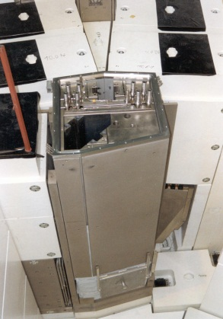
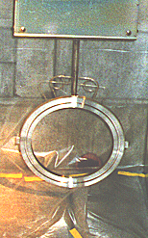
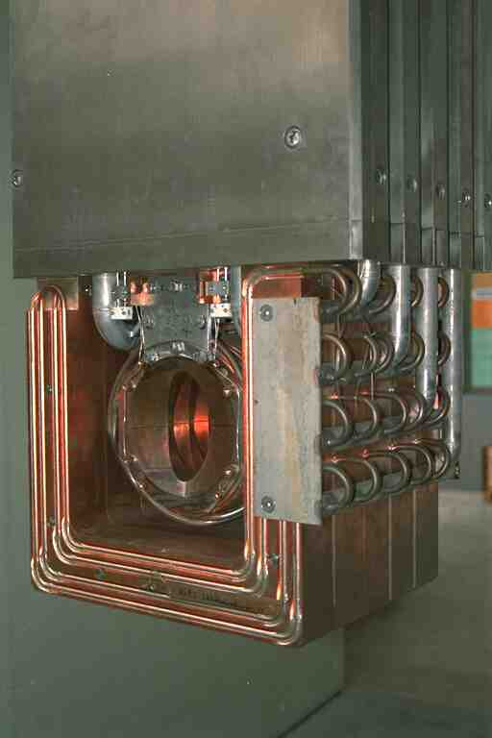
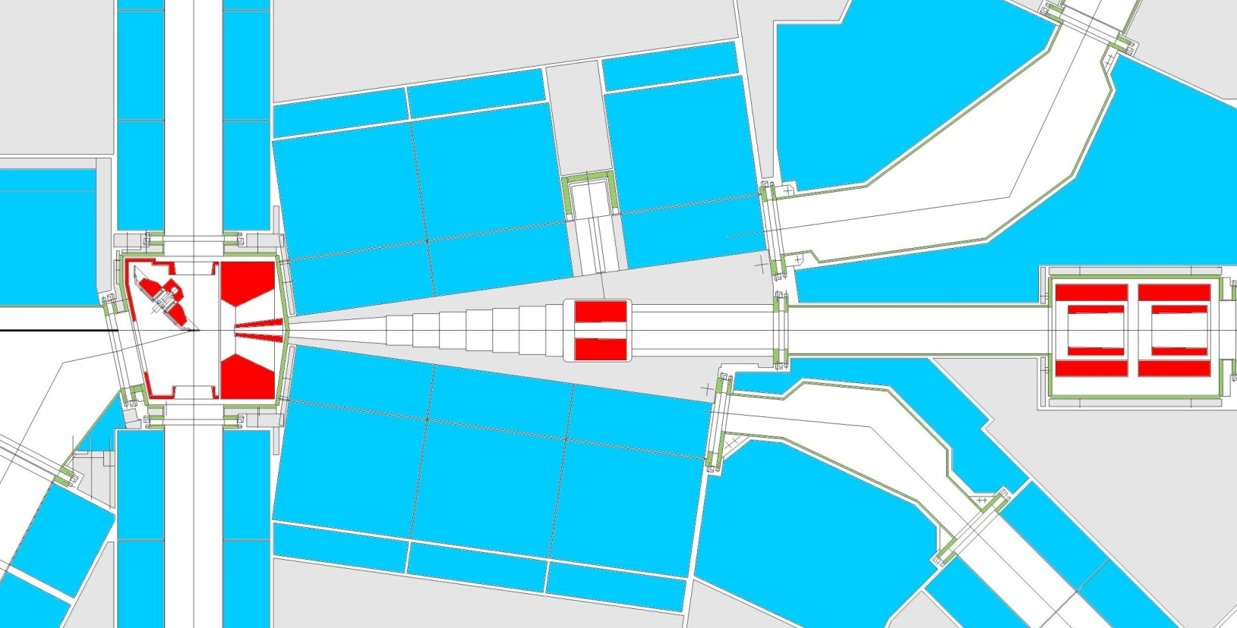
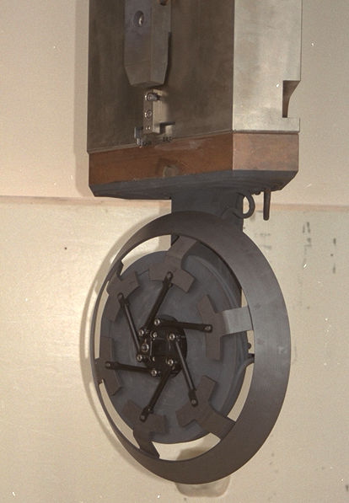
Design of Target station E
BACKWARD SHIELDING
TARGET CHAMBER
INFLATABLE ALL-METAL SEAL
COLLIMATOR 2 & 3
Beam losses: 22/18 %
p
TARGET E: 6/4cm
Beam losses: 18/12 %
FORWARD SHIELDING
SHIELDING COLLIMATOR

Slide 10
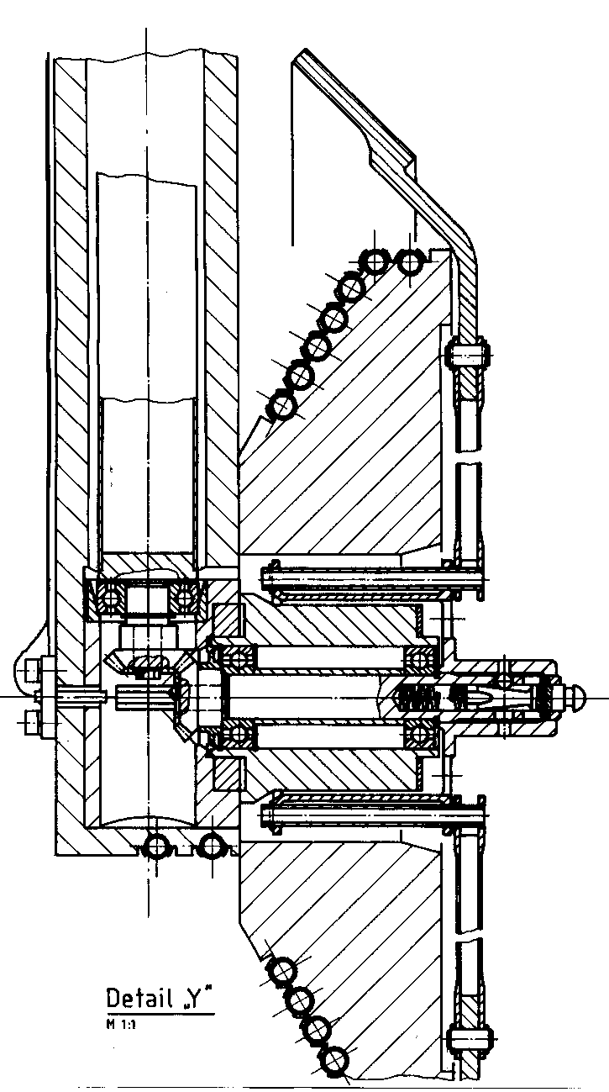
Target-E design
TARGET CONE
Mean diameter: 450 mm
Graphite density: 1.8 g/cm³
Operating Temperature: 1700 K
Irradiation damage rate: 0.1 dpa/Ah
Rotational Speed: 1 Turn/s
Target thickness: 60 / 40 mm
10 / 7 g/cm²
Beam loss: 18 / 12 %
Power deposition: 30 / 20 kW/mA
Drive shaft
SPOKES
To enable the thermal expansion of the target cone
BALL BEARINGS *)
Silicon nitride balls
Rings and cage silver coated
Lifetime 2 y
*) GMN, Nürnberg, Germany
p-beam

Slide 11
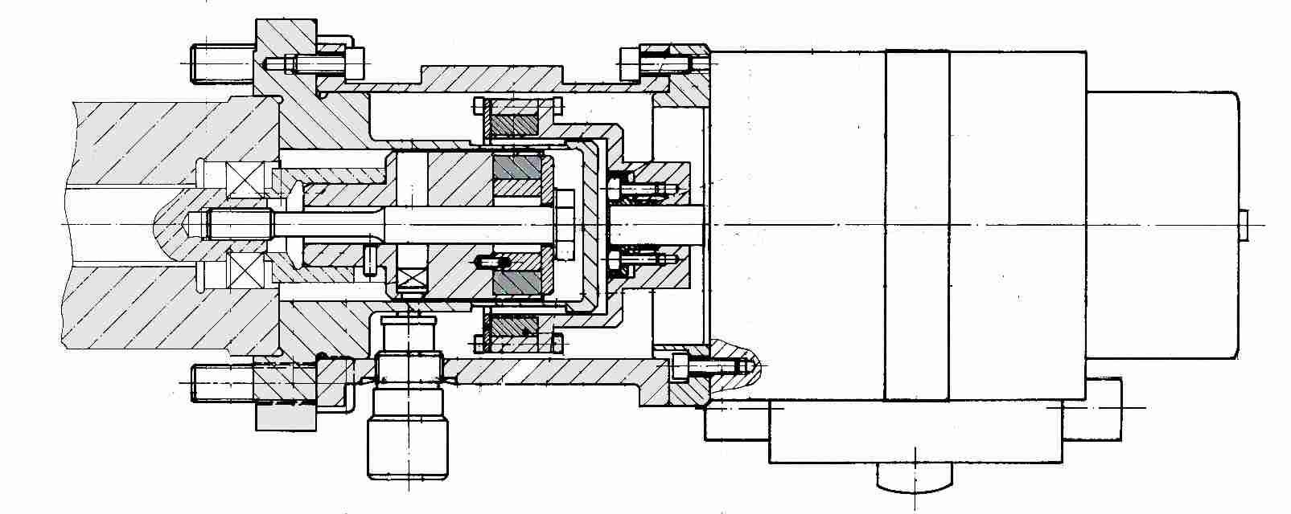
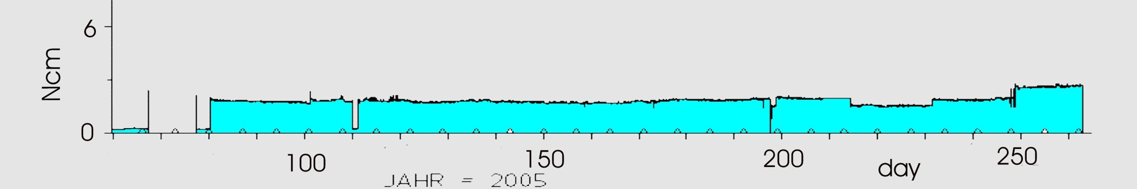
Drive motor & permanent-magnet clutch
vacuum
air pressure
Ball bearing
Permanent-magnet clutch
DC-motor
Record of the drive torque for the rotation

Slide 12
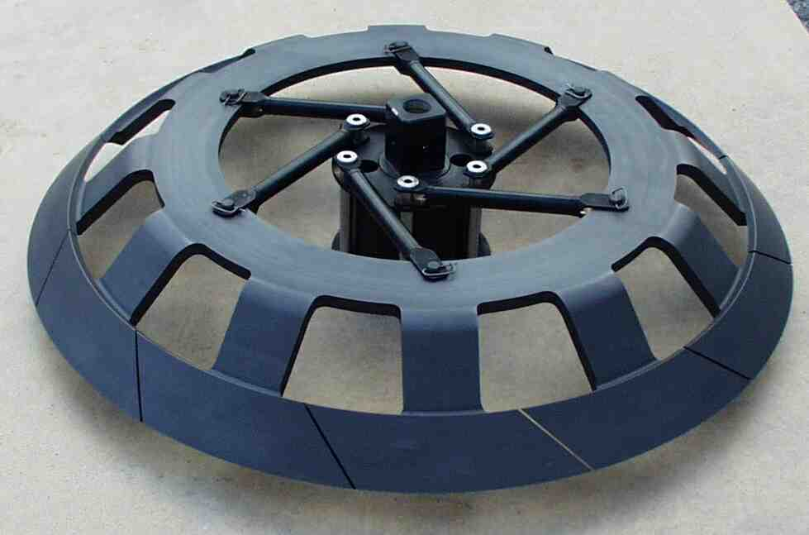
design of graphite wheel
The gaps allow unconstrained dimensional changes of the irradiated part of the graphite.

Slide 13
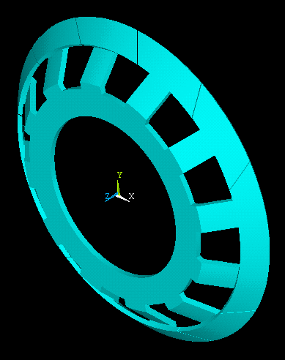
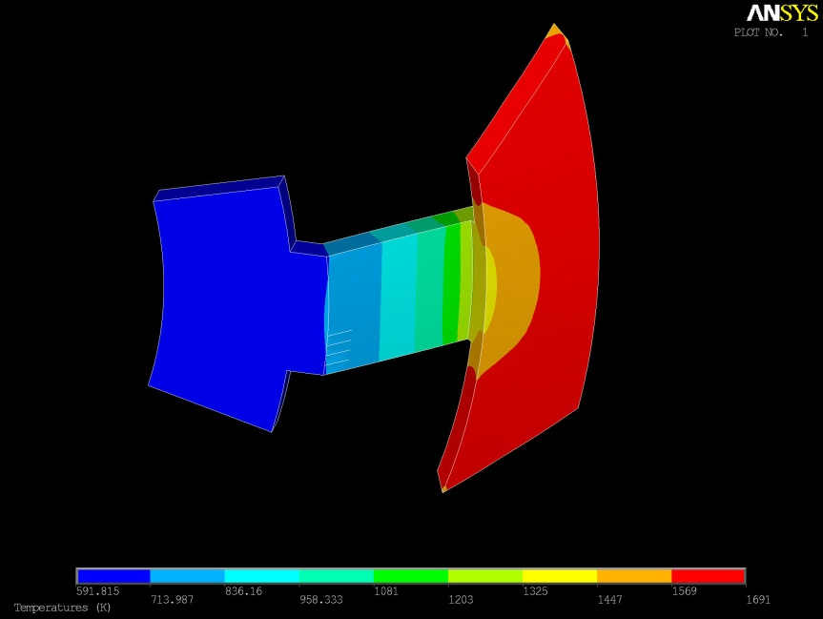
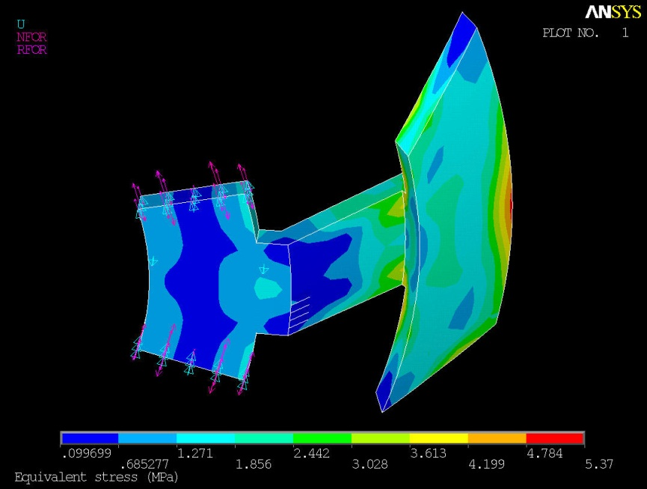
Temperature & stress distribution (2mA, 40 kW)
600 K
1700 K
5 MPa

Slide 14
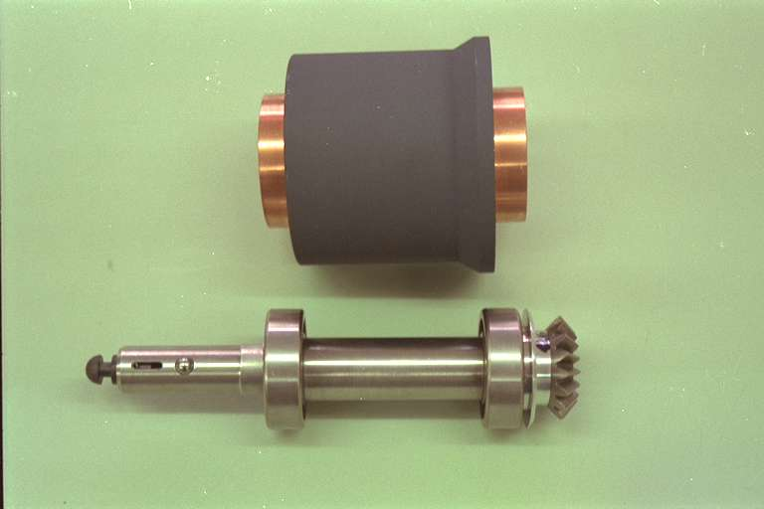
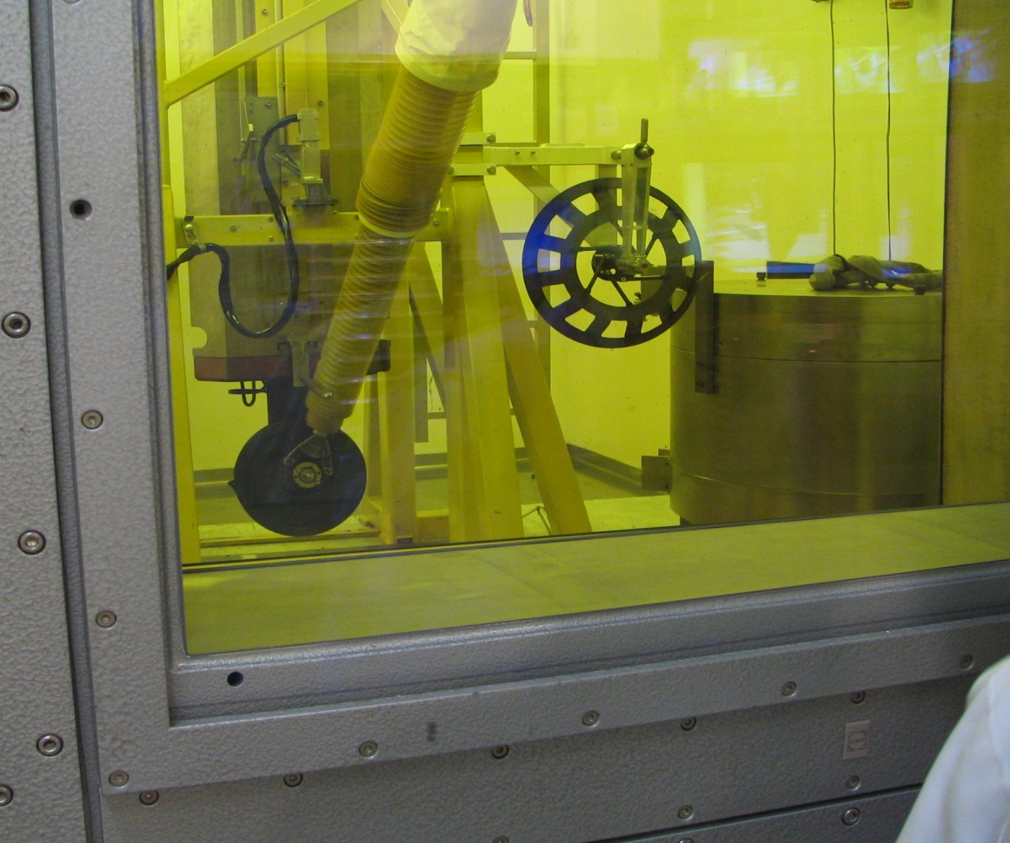
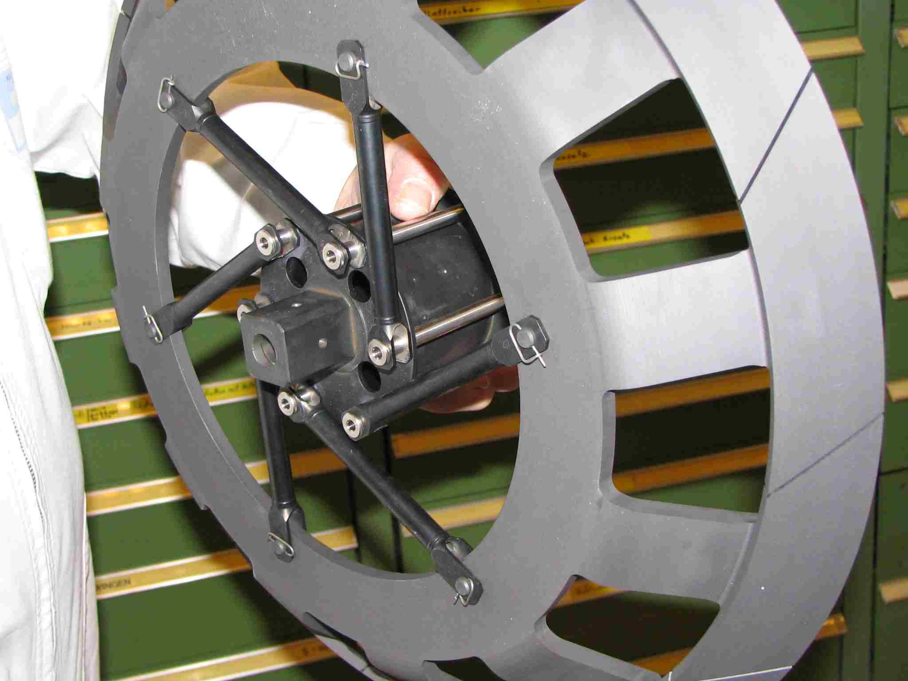
Maintenance of the target-insert in the hot-cell
Exchange parts:
horizontal drive shaft

Slide 15
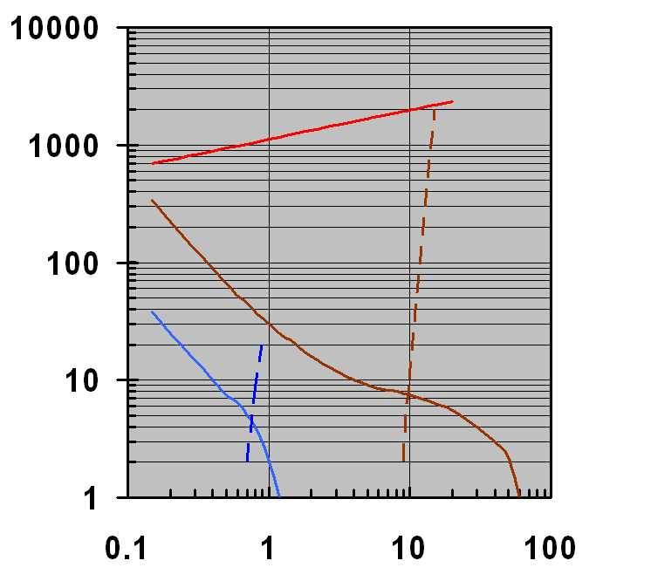
Operational limits of the rotating graphite & beryllium cones for target-E
3mA operation of Target-E
D = 0.45 m
e* = 0.7
Temperature (K)
Safety factor σ_{yp}/σ
I(mA): Proton current
D(m) : Mean target diameter
ε* : effective emissivity
C
Be
Evaporation rate (mg/g/year)
[G.Heidenreich]

Slide 16
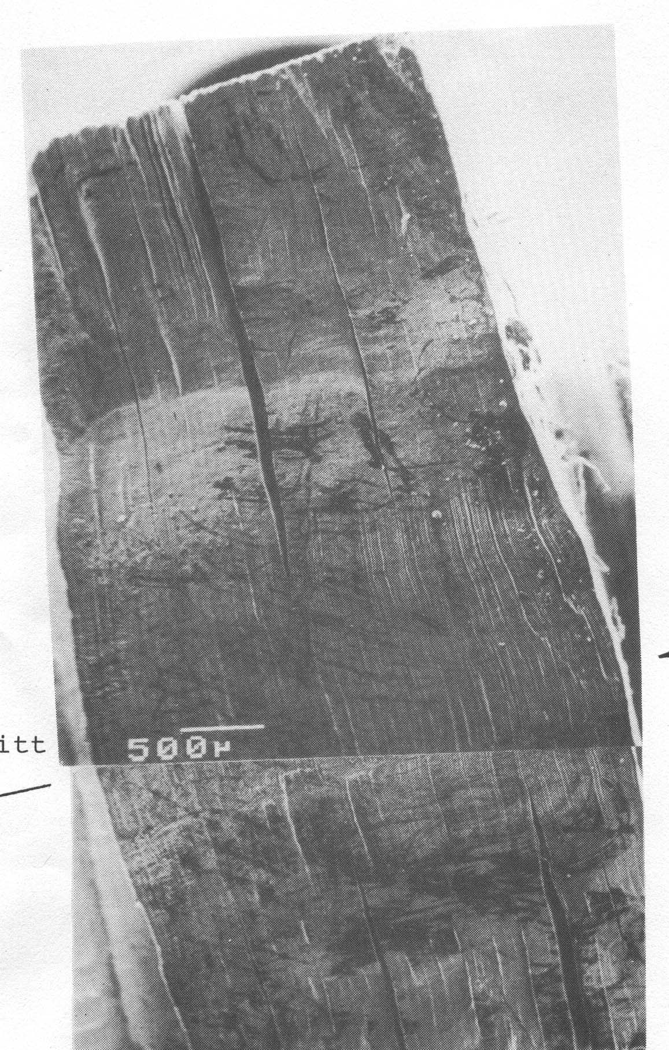
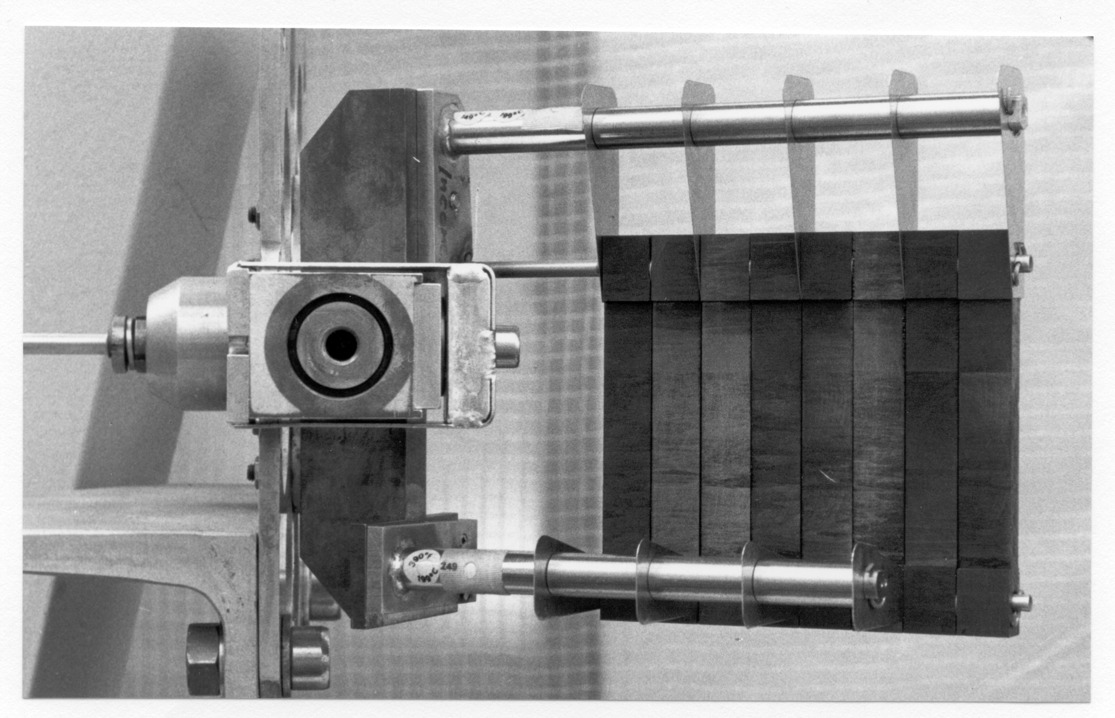
Lifetime of the pyrolitic graphite targets due to irradiation-induced dimensional changes
Operational parameters:
Proton current: 100 μA
Peak current density: 1000 μA/cm²
Peak temperature: 1800 K
Lifetime limits:
Proton fluence: 10²² p/cm²
Integrated beam current: 50 mAh
Irradiation-induced swelling: ~ 10 %
Irradiation damage rate: ~ 1 dpa
Swelling of the target after irradiation
10²² p/cm2
p
70
60
——
1273 - 1423 K
50
——
1473 - 1573 K
40
30
Dimensional change (%)
20
10
0
-10
p
-20
~ 1 dpa
-30
0
2
4
6
8
10
12
* 10²¹ N/cm2
Neutron Fluence
J. Bokros et. al, Carbon 1971,Vol. 9,p. 349

Slide 17
Muon- capture:
Layout of the μE4 high-intensity μ beam [Th:Prokscha]

Slide 18
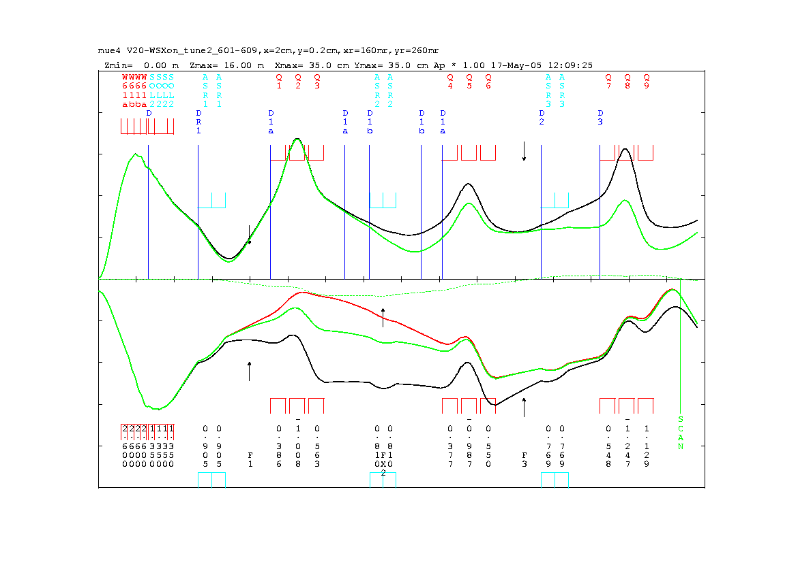
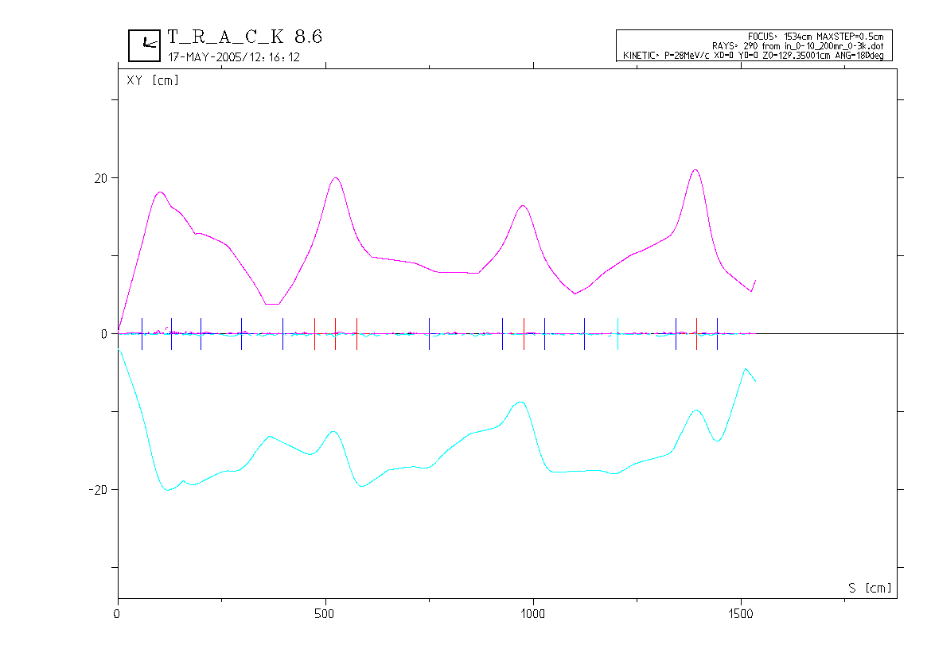
Transport and TRACK calculations
TRANSPORT: PSI Graphic Transport
framework by U. Rohrer, based on a
CERN-SLAC-FermiLab version by
K.L. Brown et al.
y
x
0% Δp/p 1st
Δp/p (FWHM): 5% - 9.5%
3% Δp/p 1st
3% Δp/p 2nd
y
TRACK: Three-dimensional Ray
Tracing Analysis Computational
Kit, developed by PSI magnet
section (V. Vrankovic, D. George)
x

Slide 19
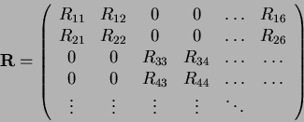

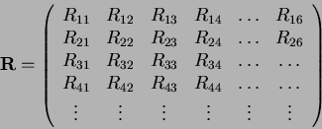



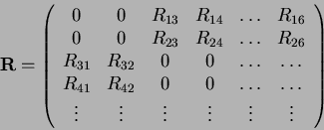

Solenoid versus quadrupole
First order transfer matrix for static magnetic system with midplane symmetry:
➨
First order transfer matrix for a solenoid, mixing of horizontal and vertical phase space:
➨
Mixing of phase space might lead to an increase of beam spot size
Rotation Θ of phase space:
Θ = 90^{ο}: x-y PS exchanged
Focusing powers P_{S,T} of solenoid and triplet at same power dissipation in device:
Azimuthal symmetry of solenoids leads to larger acceptance

Slide 20
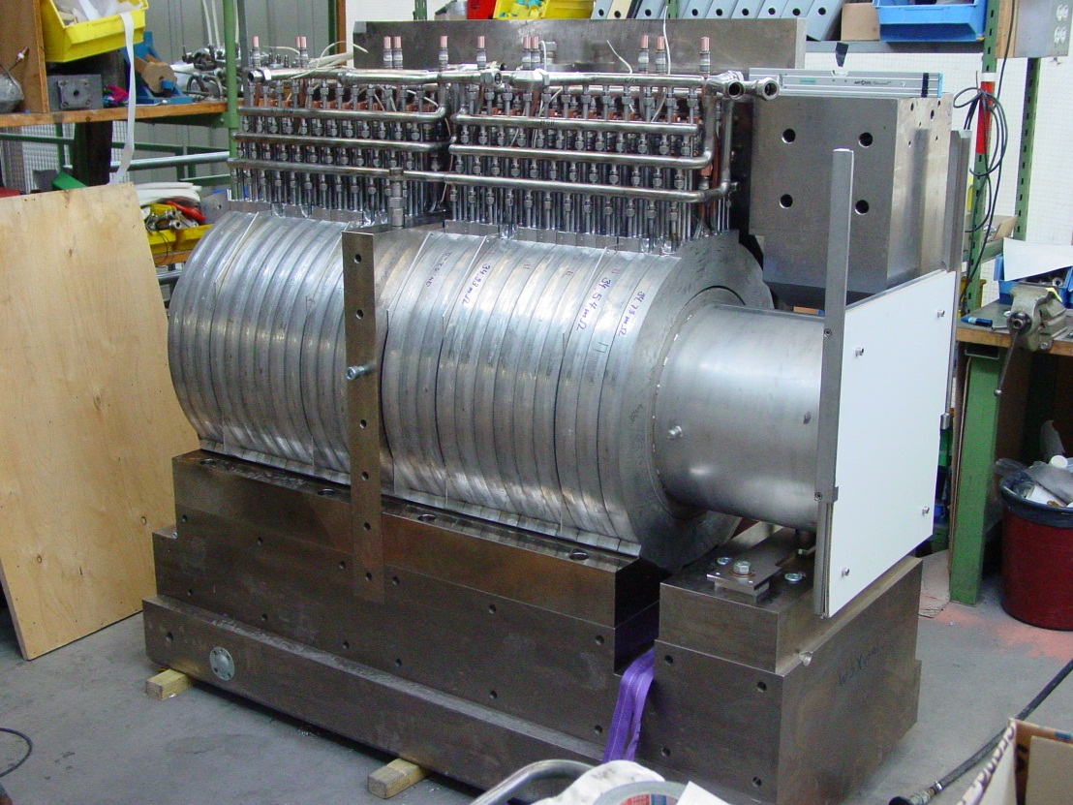
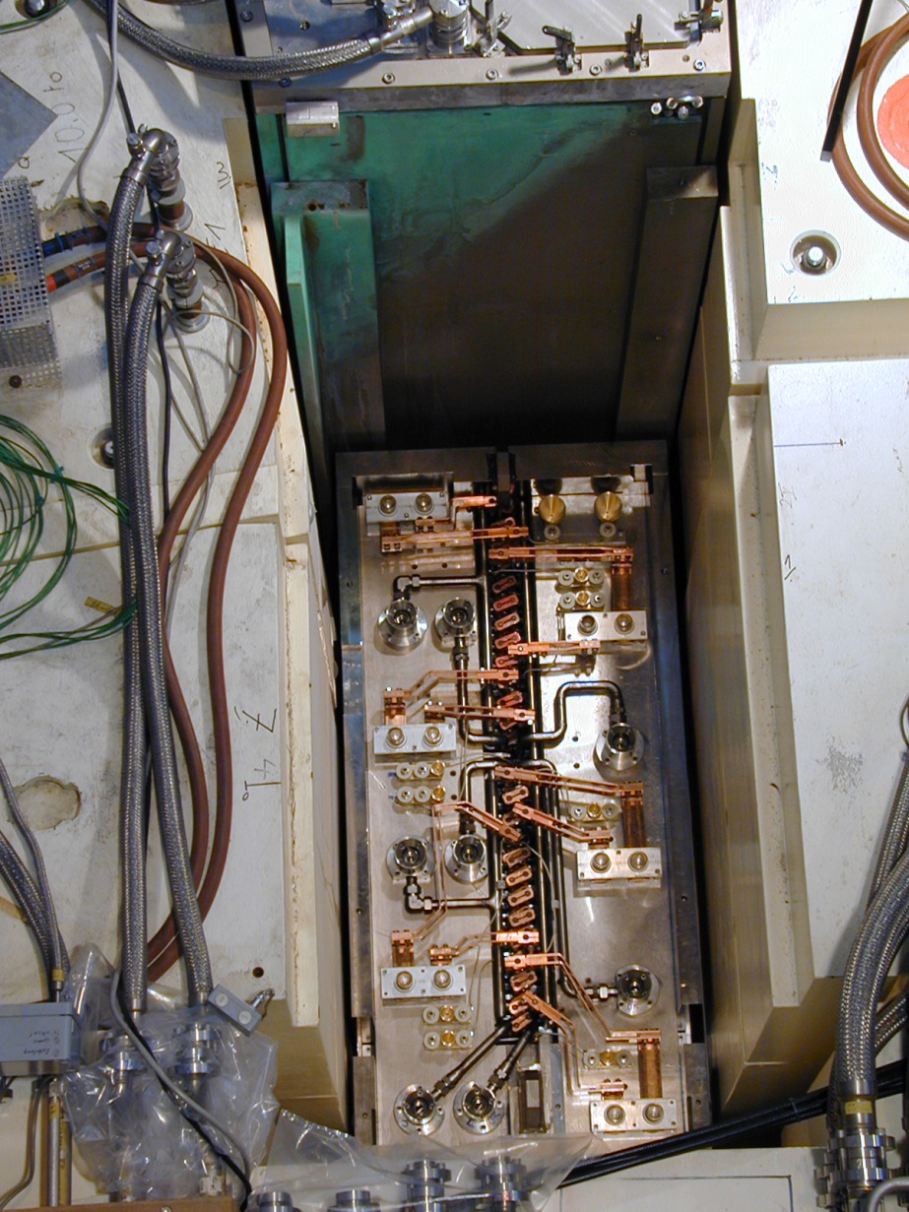
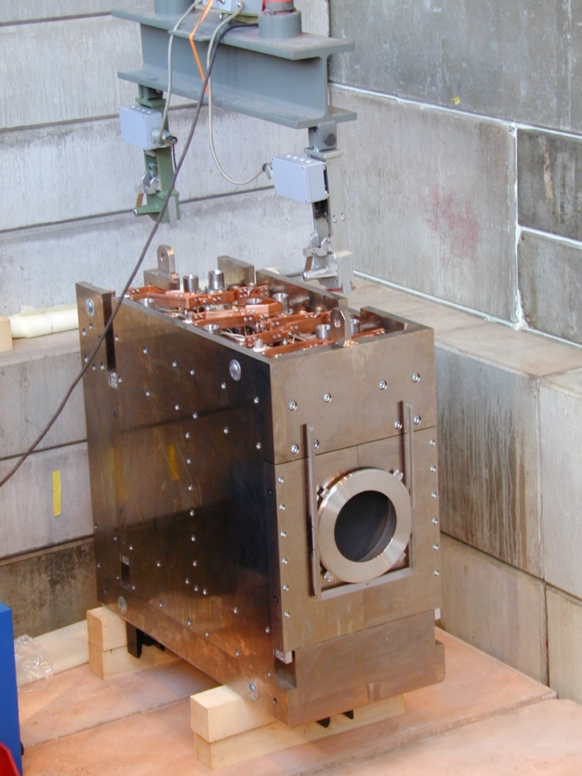
Double-solenoid WSX61/62
B_{max} = 3.5 kG
Ø_{i} = 500 mm

Slide 21
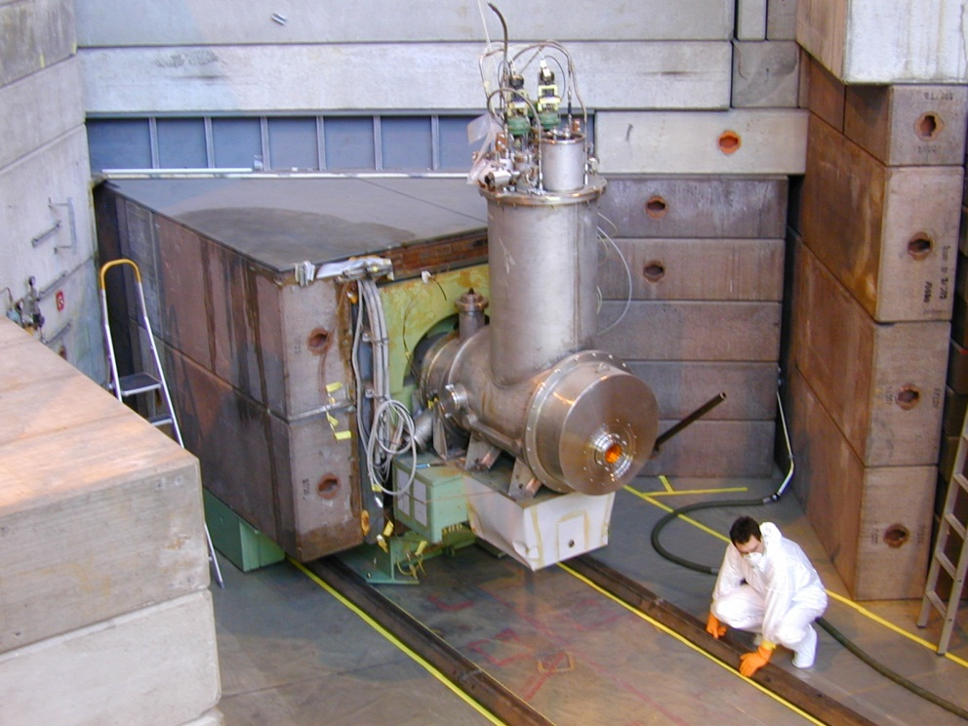
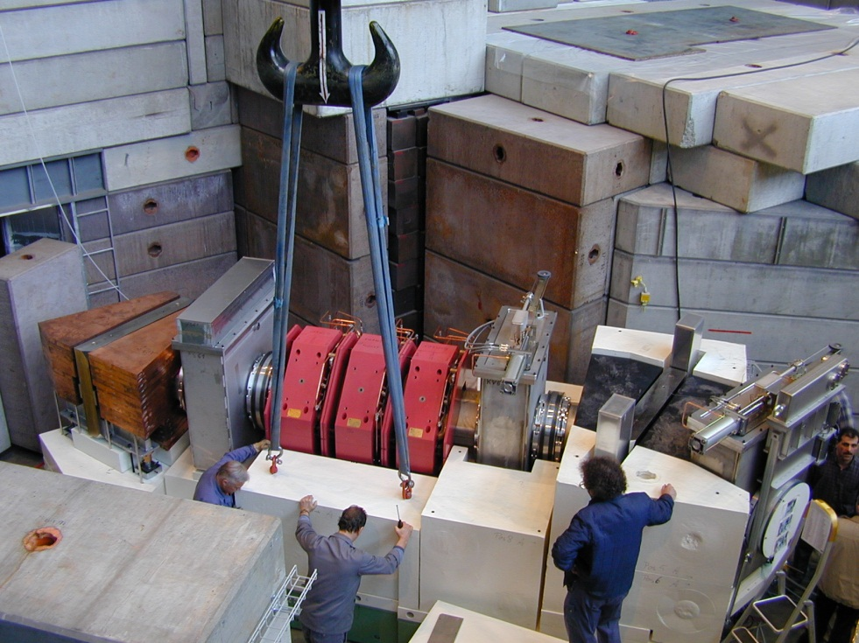
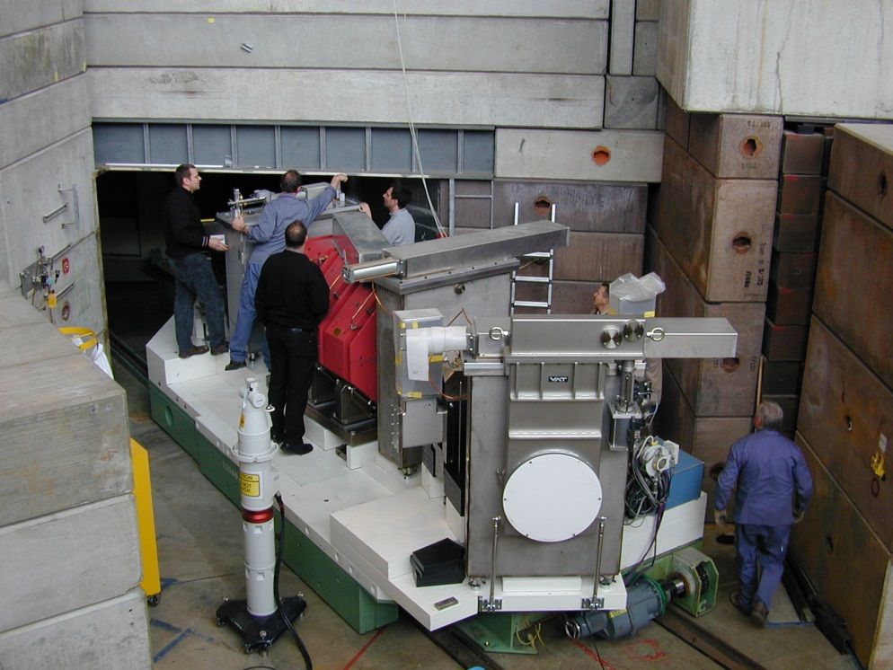
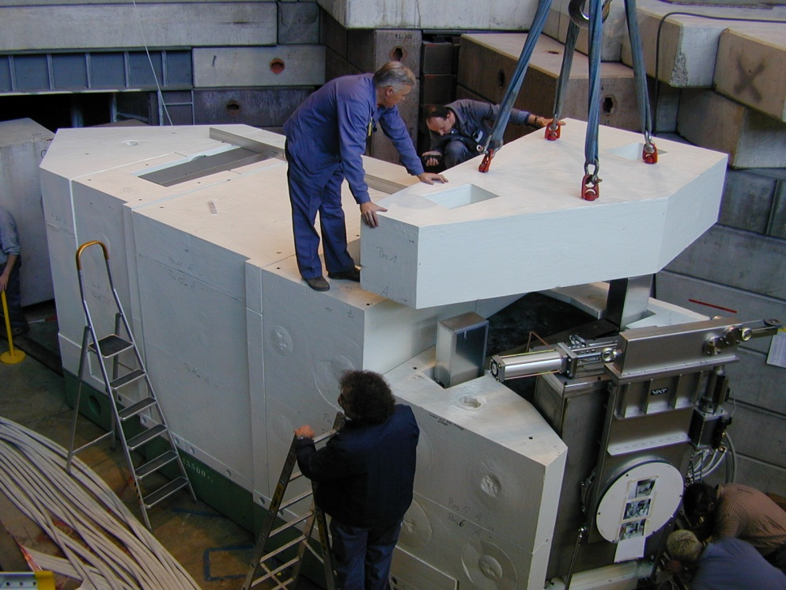
Installation of a section of μE4 in 2004

Slide 22
Discussion
PSI concept is optimized for dual use of beam (Meson and Neutron Production); C = low-z material; strong focus at target: minimize emittance growth
beam loss at 40mm C-target:
  10% inelastic nuclear interactions; 20% collimation of spent beam
rotating graphite target concept with radiation cooling was optimized over many years; lifetime limited by anisotropy of graphite and resulting wobbling from radiation damage; pyrolithic graphite not suited!
service and exchange systems, Hotcell are VERY IMPORTANT for practical operation
Muon figures: ≈5∙10⁸ μ⁺/s possible @p=28MeV/c; Δp/p=9.5%_{FWHM};
ε_{x/y} = 5/10∙10⁻³m∙rad
T. Prokscha, et al., Nucl. Instr. and Meth. A (2008), doi:10.1016
/j.nima.2008.07.081
activation after one year: order of 1…5 Sv/h; thanks to Graphite this is low compared to heavy target materials!
issues: Tritium production in porous material; oxidation of graphite with poor vacuum of 10⁻⁴mbar; carbon sublimation at higher temperatures; wobbling of wheel caused by inhomogeneous radiation damage

