Slide 1
Chicane shielding and energy deposition (IPAC’13 follow-up)
Pavel Snopok
IDS-NF phone meeting
June 4, 2013

Slide 2
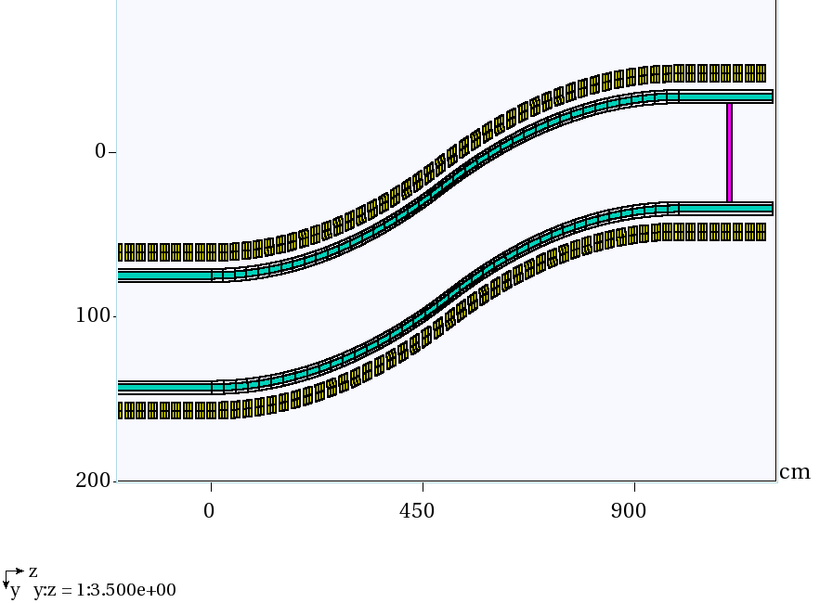
Updates to the chicane
Yellow: coils, subdivided into smaller segments (3 longitudinal, 2 radial, 12 azimuthal) for more precise energy deposition study. Radius = 43-53 cm, length of 18 cm, on-axis field 1.5 T throughout the channel.
Cyan: W shielding (pure W, need to change the density to 60%), 4 cm thickness @ 32-36 cm radii.
Gray around cyan: inner and outer SS pipe, 2 cm thick each @ 30-32 & 36-38 cm radii to enclose W, yet stay 5 cm clear of the coils.
Magenta: proton absorber, 10 cm of Be, outer radius = 30 cm.
Z=0 corresponds to 30 m downstream of the target.

Slide 3
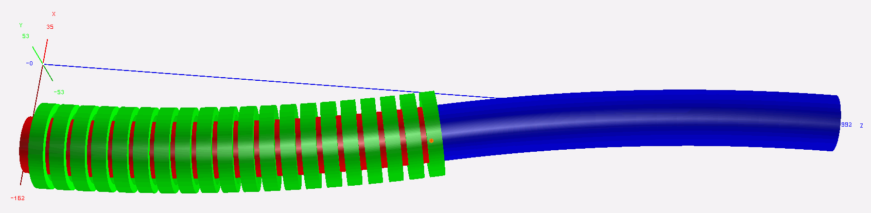
ROOT-based geometry
For irradiation study the chicane is simulated in MARS15. Field maps for MARS simulations are generated by G4beamline.
Complicated geometry of the chicane, => adding shielding is not possible using only MARS extended geometry.
ROOT-based geometry framework for MARS is used with a wide variety of basic volumes provided by the ROOT TGeo module.
The volume of each shielding or coil segment can be calculated precisely in ROOT; removes the uncertainty intrinsic to MARS Monte-Carlo based volume calculation.
Easy to visualize your geometry for debugging (3D visual above is produced by ROOT).
Geometry is straightforward to read/comprehend/modify as needed
Most important for seamless shielding is the TGeoCtub elementary volume (cut tubes with arbitrary entrance/exit angles).

Slide 4
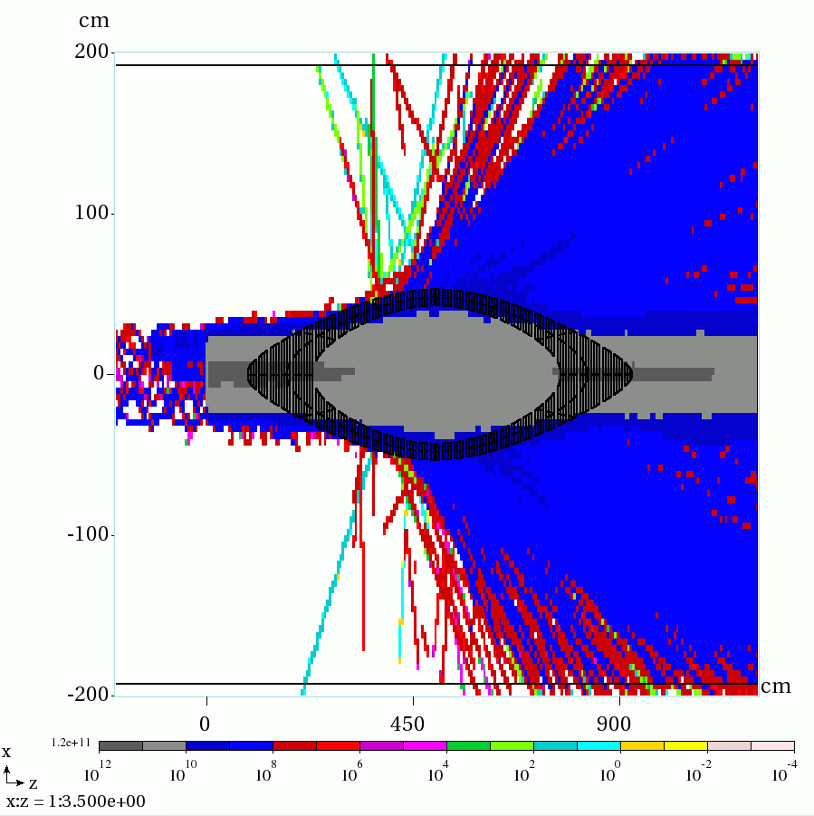
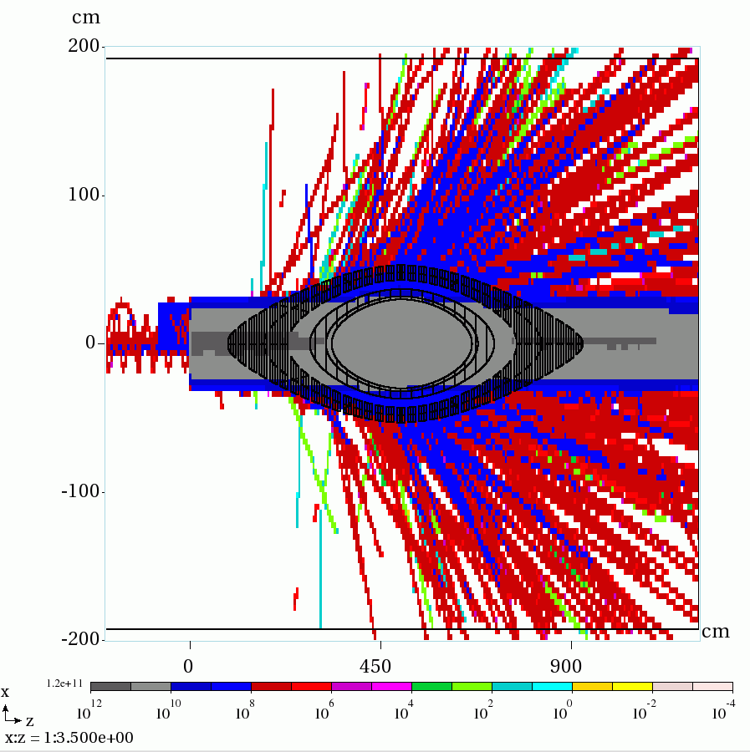
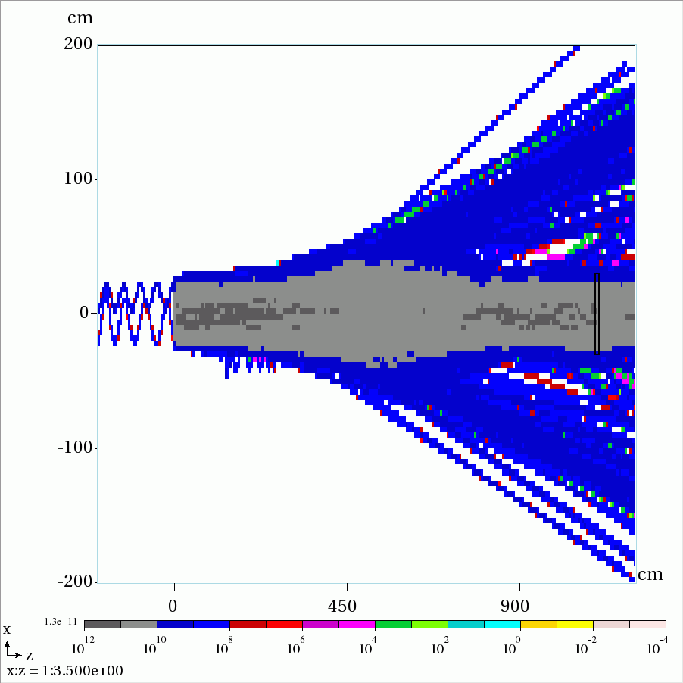
(Vertical) beam size considerations
No shielding, coil inner R = 43 cm, muon flux (main) is not affected
With shielding starting at R = 30 cm, muon flux is clearly affected
No coils, smaller statistics, test that R = 43 cm is indeed a “safe” radius
Beam pipe + shielding shape + coil radii toward the center of the chicane need further modifications.

Slide 5
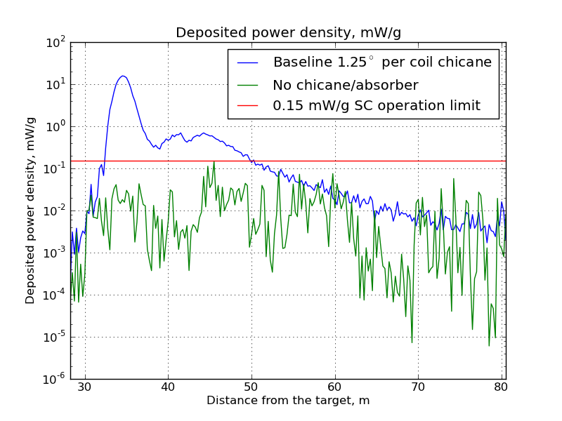
Reference case: no shielding
Average deposited power density (DPD) per coil is shown
The limit of 0.15 mW/g is exceeded in a number of coils; however, it could be reduced to within the limits by providing extra shielding in about half of the coils.
DPD peaks at 15.8 mW/g, that translates into 42.6 kW/m for Cu coils or 33.3 kW/m for SC coils.

Slide 6
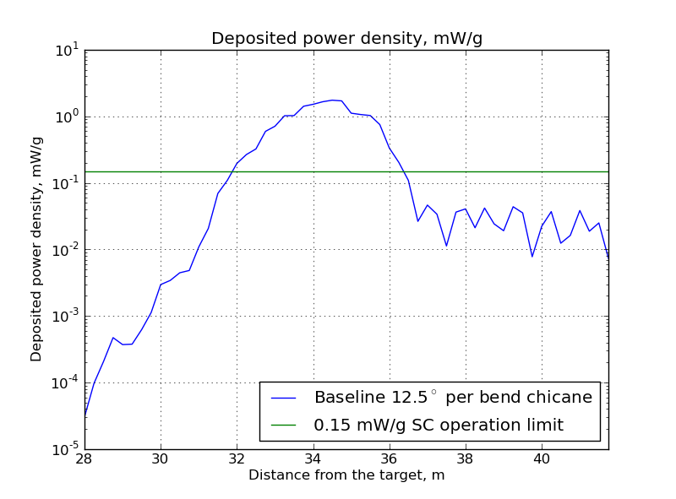
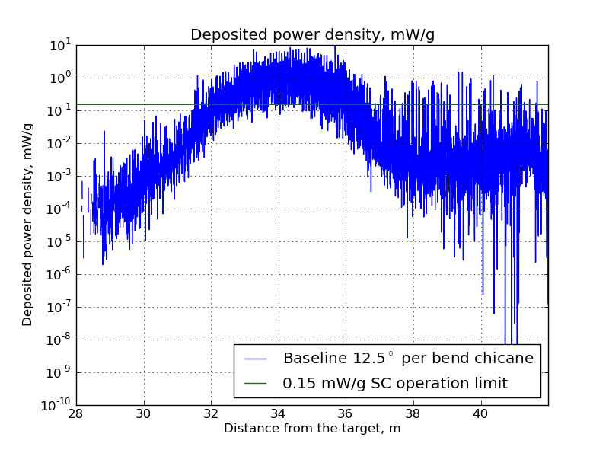
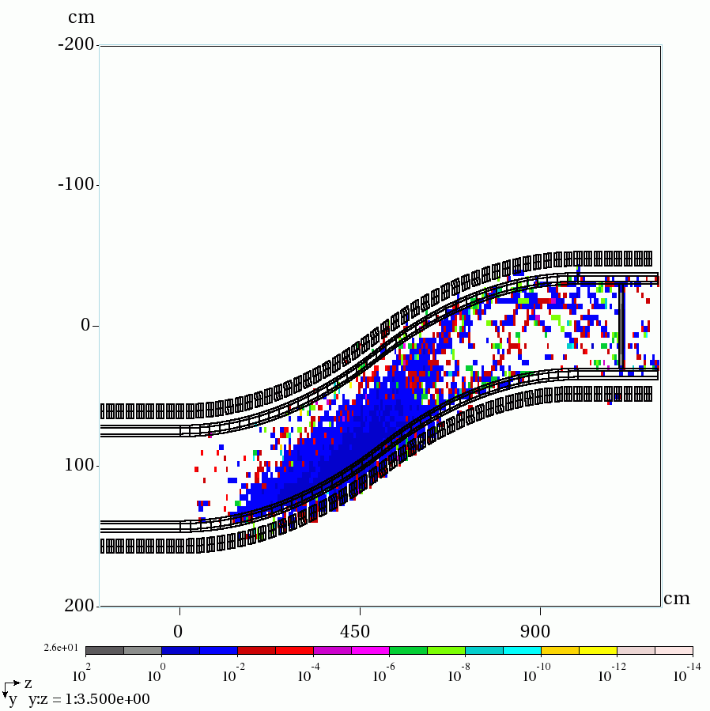
First attempt @ shielding, 4 cm of W
Max average DPD = 1.7 mW/g
Max DPD per segment = 9.1 mW/g
Average deposited power density in the coils is at maximum 1.7 mW/g.
On average: the limit of 0.15 mW/g is exceeded in a smaller number of coils, only those between 32 and 36 m downstream of the target.
Need to change W density to 60%.
At the same time, certain coil segments can get up to 9.1 mW/g (3 longitudinal, 2 radial, 12 azimuthal segments per coil) due to the non-uniformity of energy deposition.

Slide 7
Summary
ROOT-based geometry allows to simulate the complex shape of the chicane + shielding.
Current simulations are based on pure W, should be redone with 60% density (which increases the amount of material considerably, hence, the radius of the coils as well).
Coil and shielding shape need modifications compatible with the beam width at the center of the chicane.
Average DPD with 4 cm of W drops almost an order in magnitude: 15.8 => 1.7 mW/g, although still an order of magnitude larger than the required 0.15 mW/g (even worse if a conservative limit of 0.1 mW/g is used as suggested by Kirk McDonald).
As expected, segmentation of the coils reveals that energy deposition is not uniform, max = 9.1 mW/g.
I would like to continue energy deposition studies, but I will need some help from the Targetry group with their expertise.

