Slide 2
Outline
Introduction
History
Current MARS simulations
  new data files for solid target
Using other codes (ICOOL and G4beamline)
Summary

Slide 3
Introduction
In high-intensity sources muons are produced by firing high energy p onto a target to produce π.
π decay to μ which are captured and accelerated.
Significant background from p and ē, which may result in
  heat deposition on superconducting materials;
  activation of the machine preventing manual handling.

Slide 4
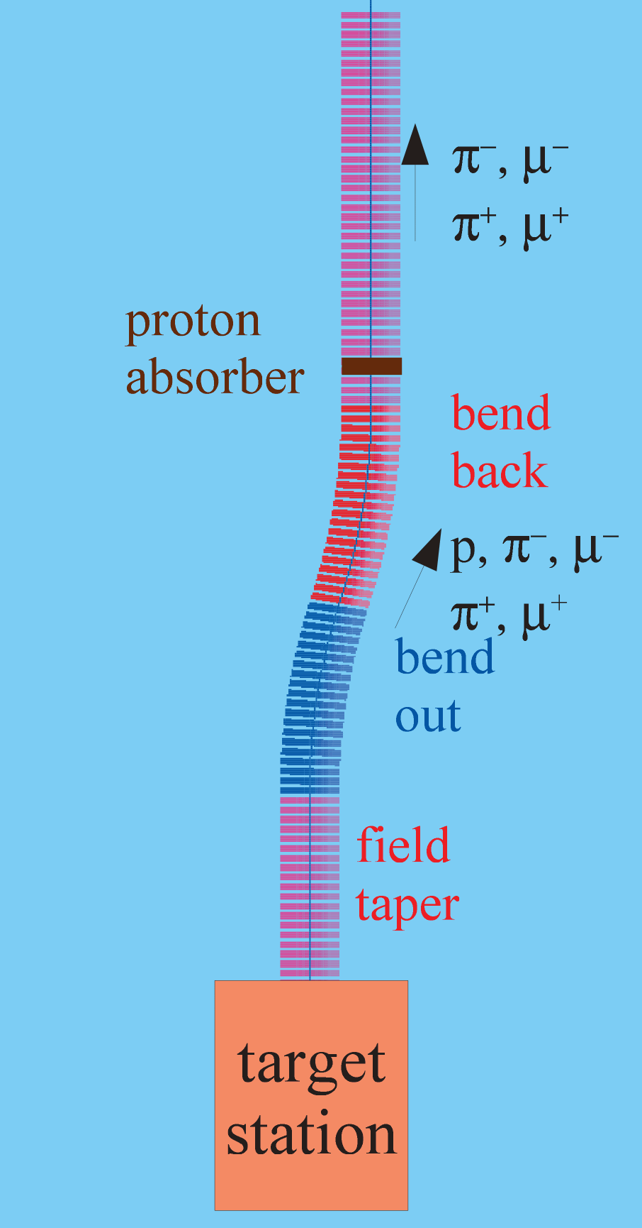
Introduction, contd.
Need a secondary particle handling system for a megawatt class solid C target
  solenoidal chicane
  followed by a proton absorber.
Challenges of optimization and integration of the system with the rest of the muon front end.
Main study tool – MARS, some analysis and validation by using ICOOL and G4beamline.
Start with the chicane, use the same technique downstream to study the the buncher and phase-rotator sections.

Slide 5
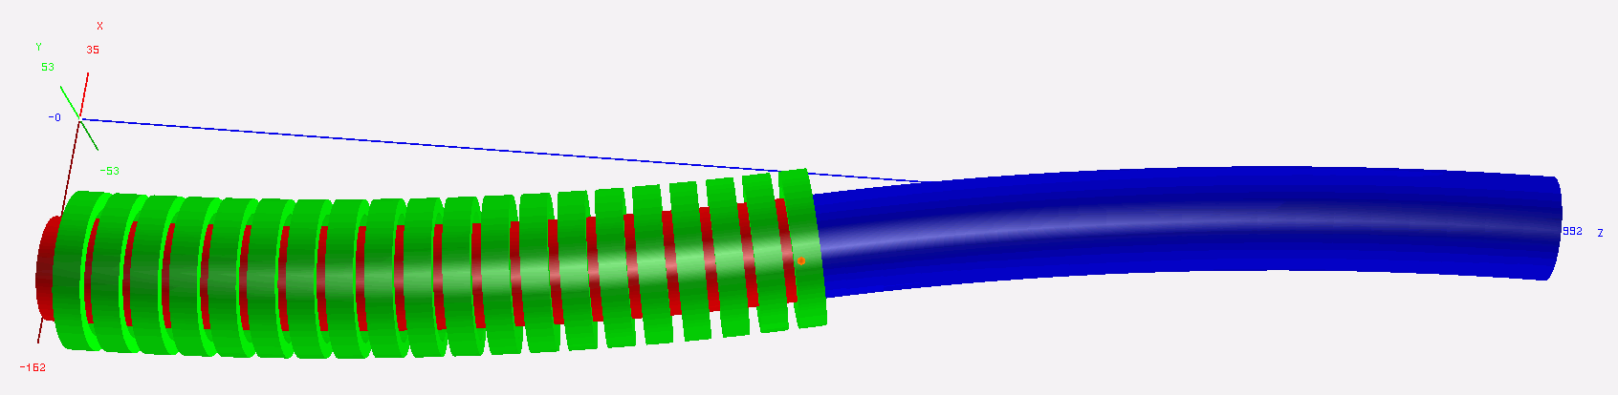
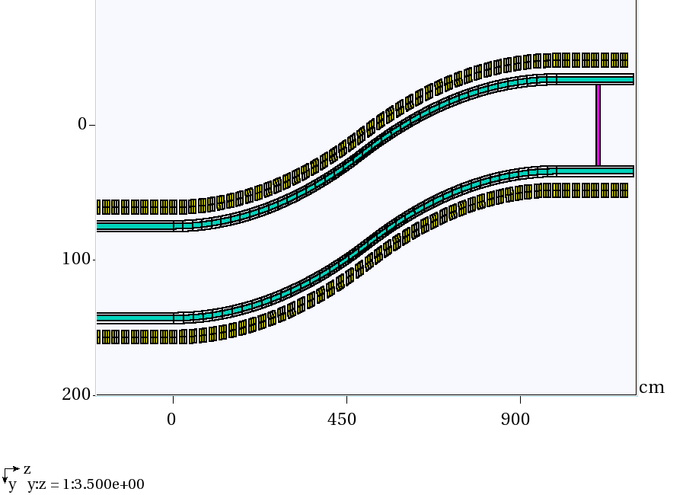
History: MARS simulations
ROOT-based geometry
12.5° single bend, Z=0 corresponds to 19 m downstream of the target
  consistent with RDR (IDS-NF).
W density reduced to 60% to take into account packing fraction for beads.

Slide 6
Reference: no shielding
DPD peaks at 15.8 mW/g, that translates into 42.6 kW/m for Cu coils or 33.3 kW/m for SC coils.

Slide 7
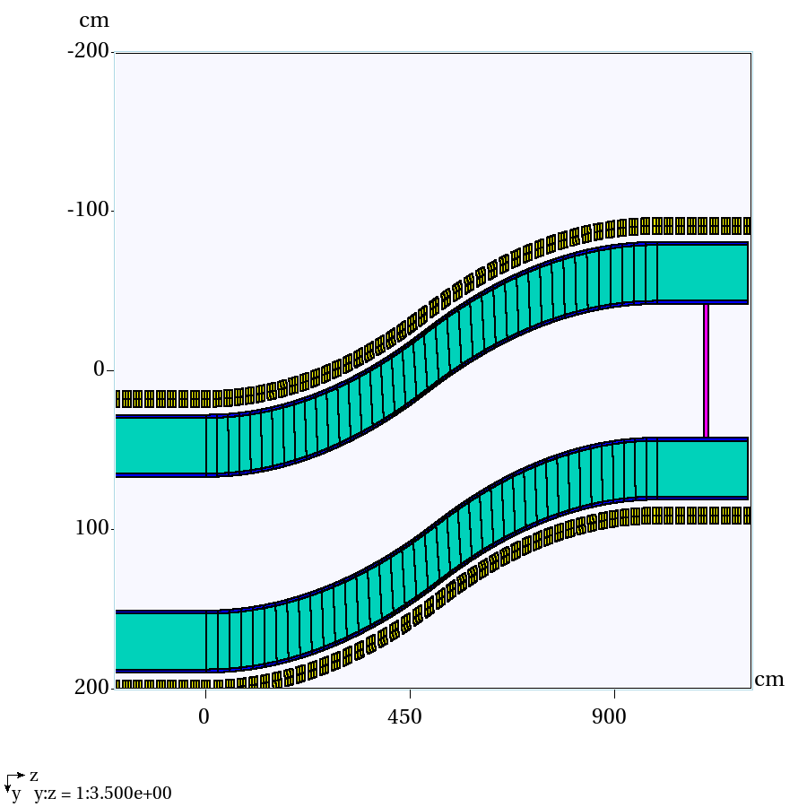
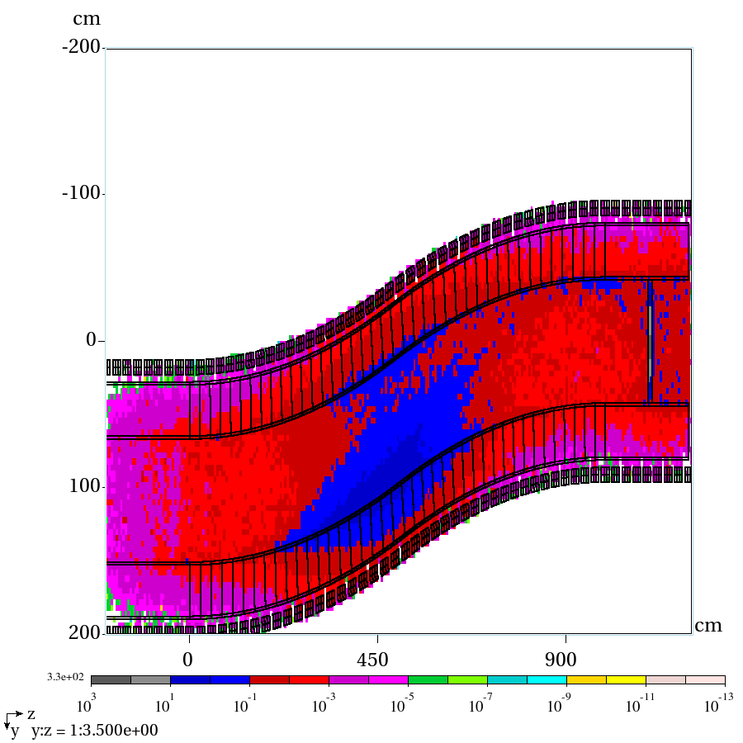
Uniform 35 cm shielding
Empty channel
PD total, mW/g

Slide 8
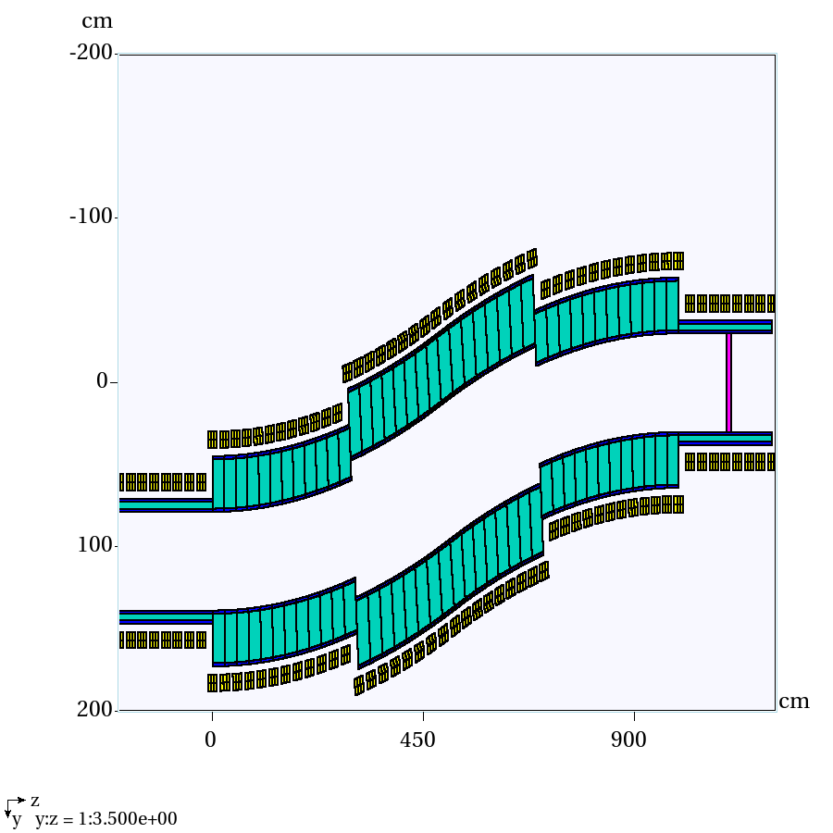
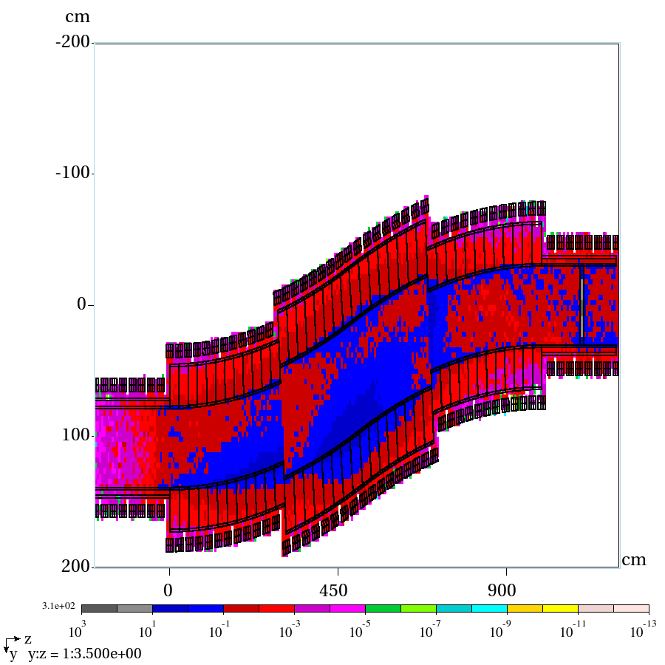
Non-uniform 30 and 40 cm shielding
Empty channel
PD total, mW/g

Slide 9
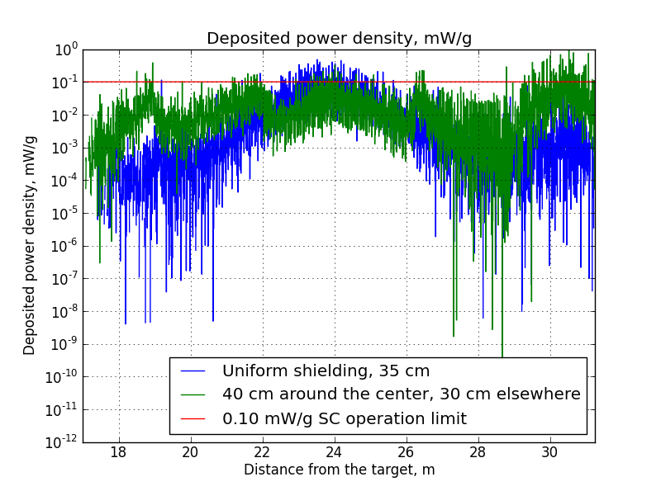
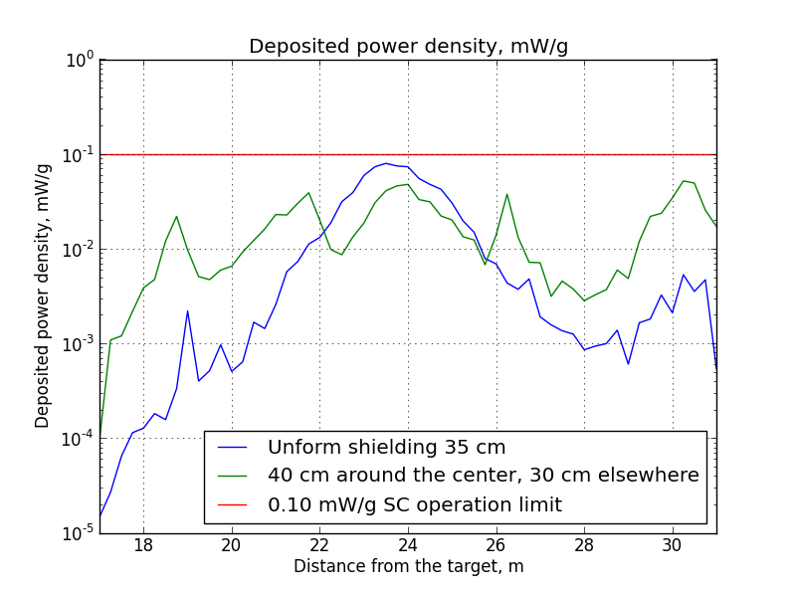
Overall DPD per coil/segment
Segmented coil analysis, total DPD, mW/g
Average DPD per coil, mW/g
In both cases red line corresponds to 0.1 mW/g SC limit

Slide 10
Current MARS simulations
New target parameters:
  8 GeV => 6.75 GeV
  4 MW => 1 MW
  3.125e15 protons/sec => 0.925e15 protons/sec
  new particle distribution
  need to re-run MARS
The hope is that the new parameters help reduce the amount of shielding required

Slide 11
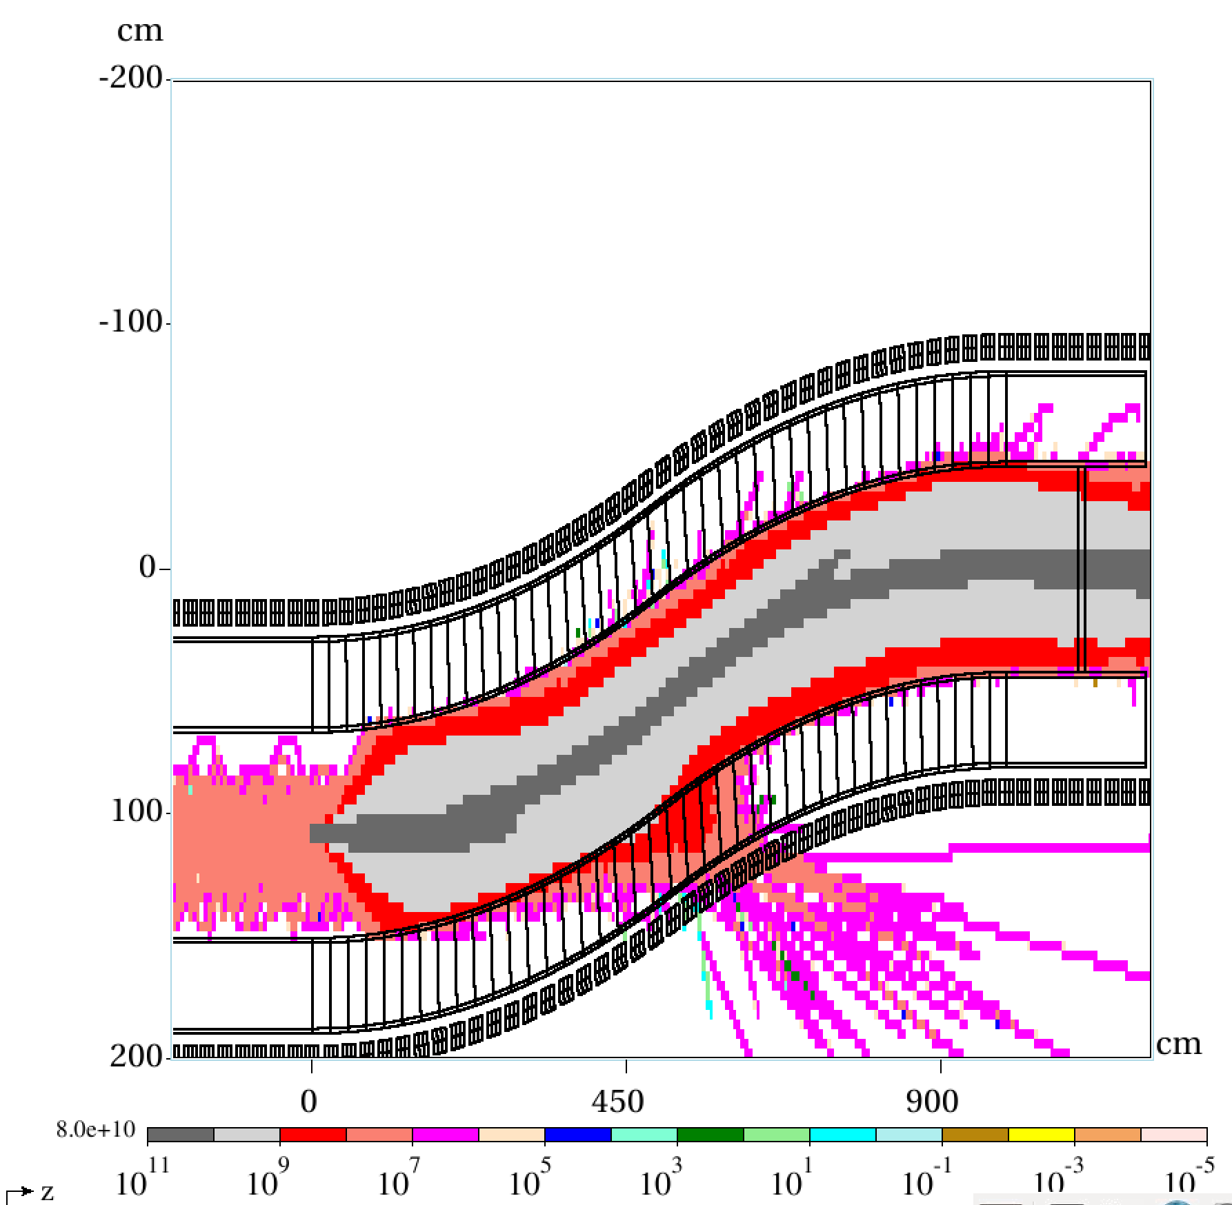
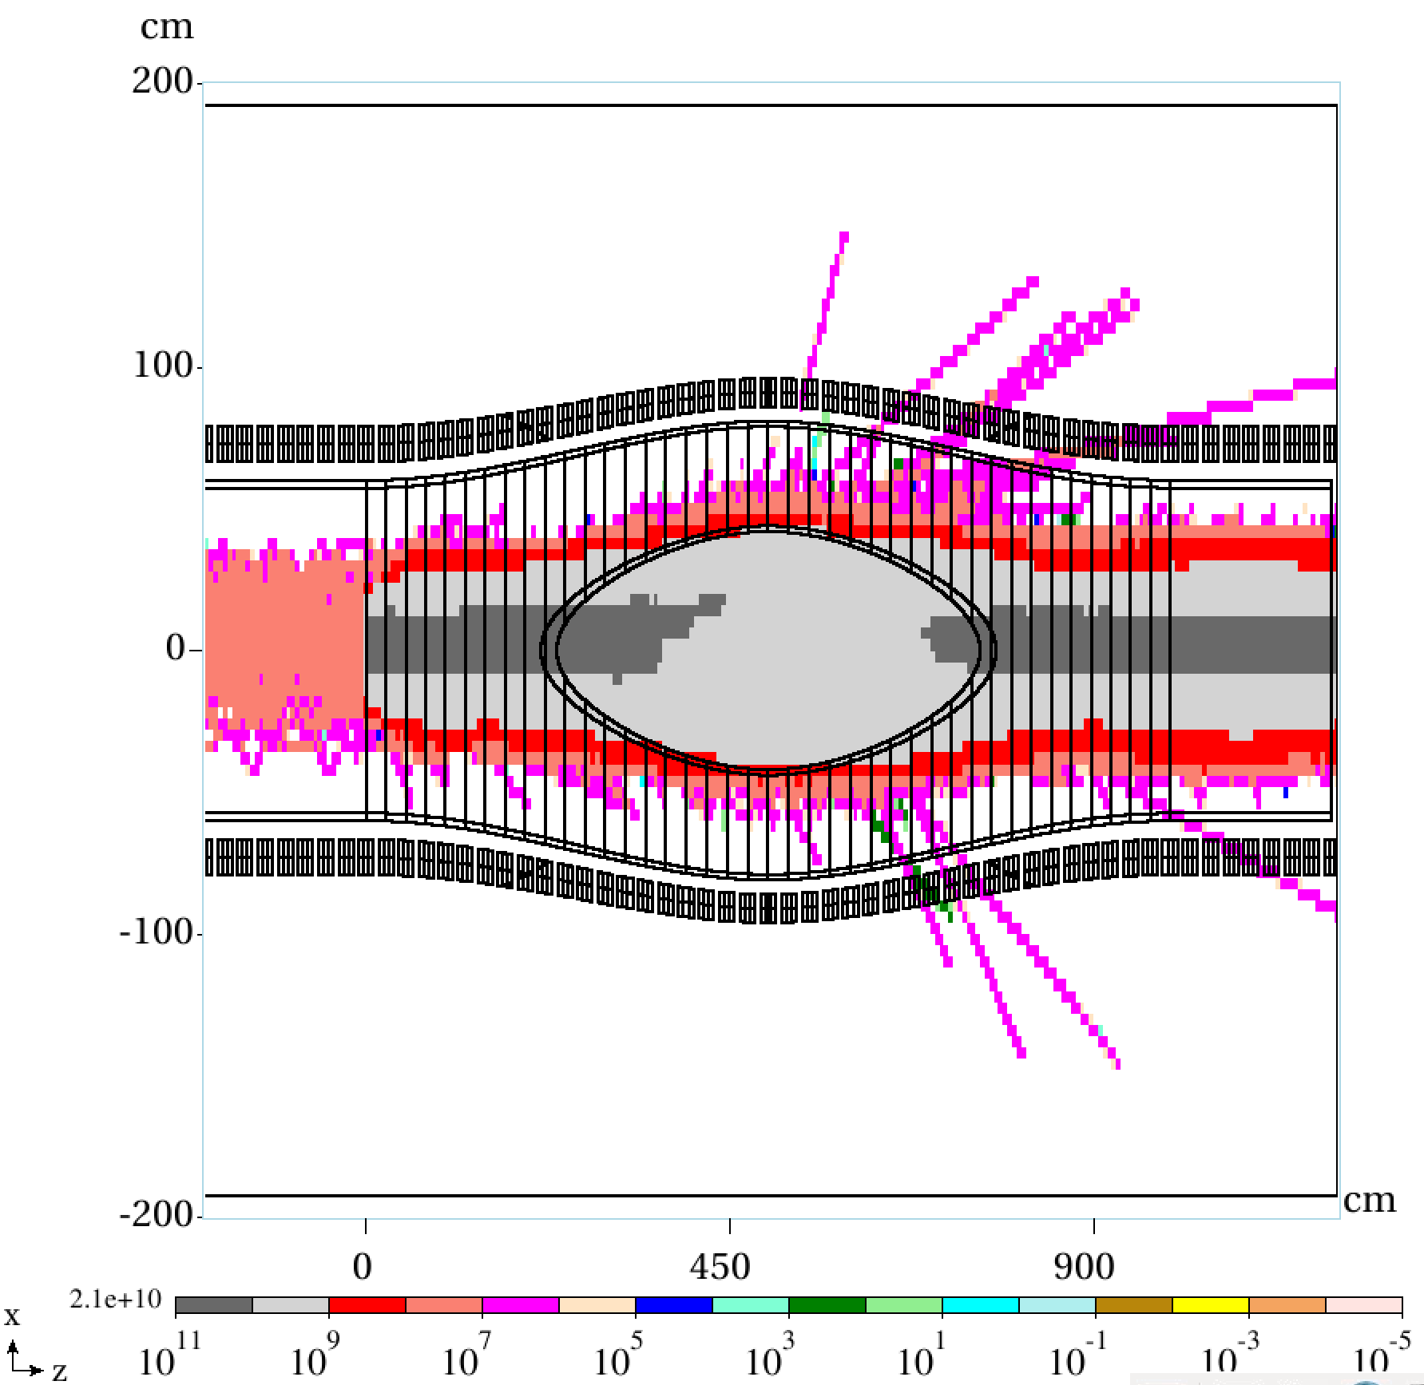
New results
Muon flux, top view
Muon flux, side view

Slide 12
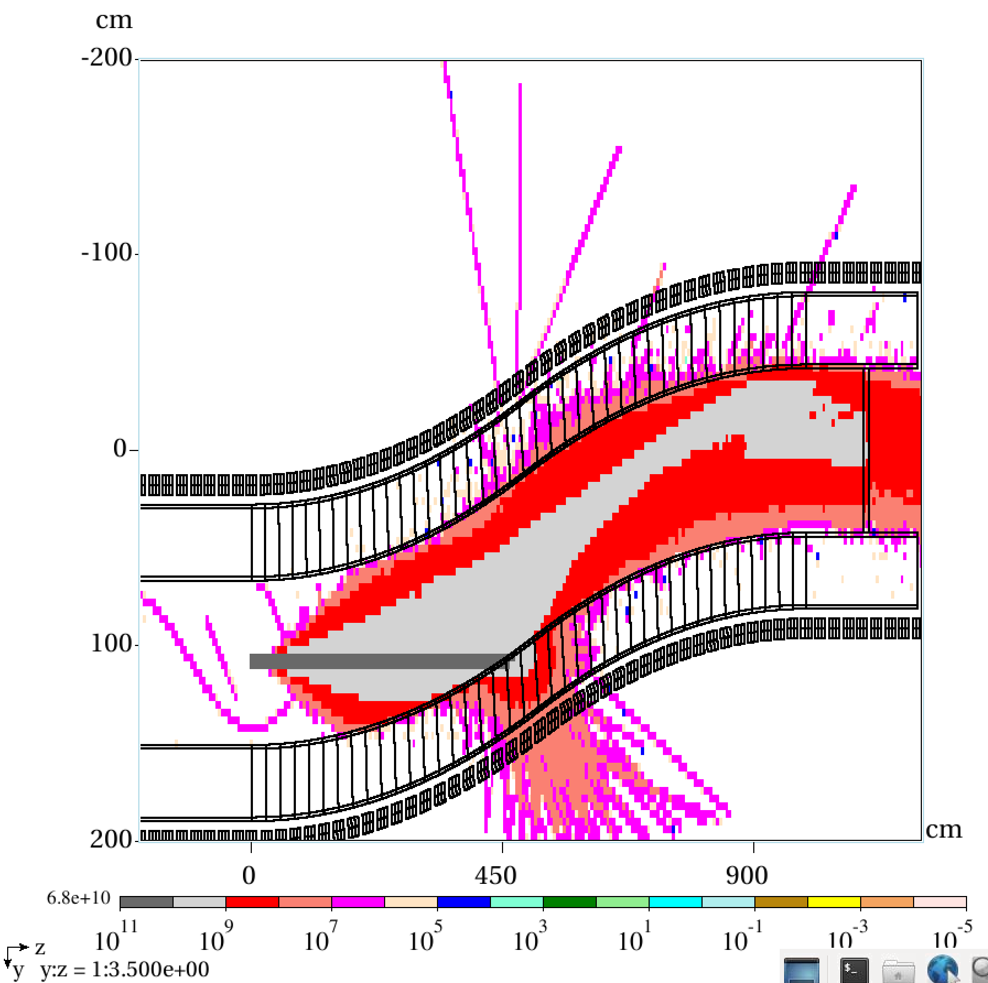
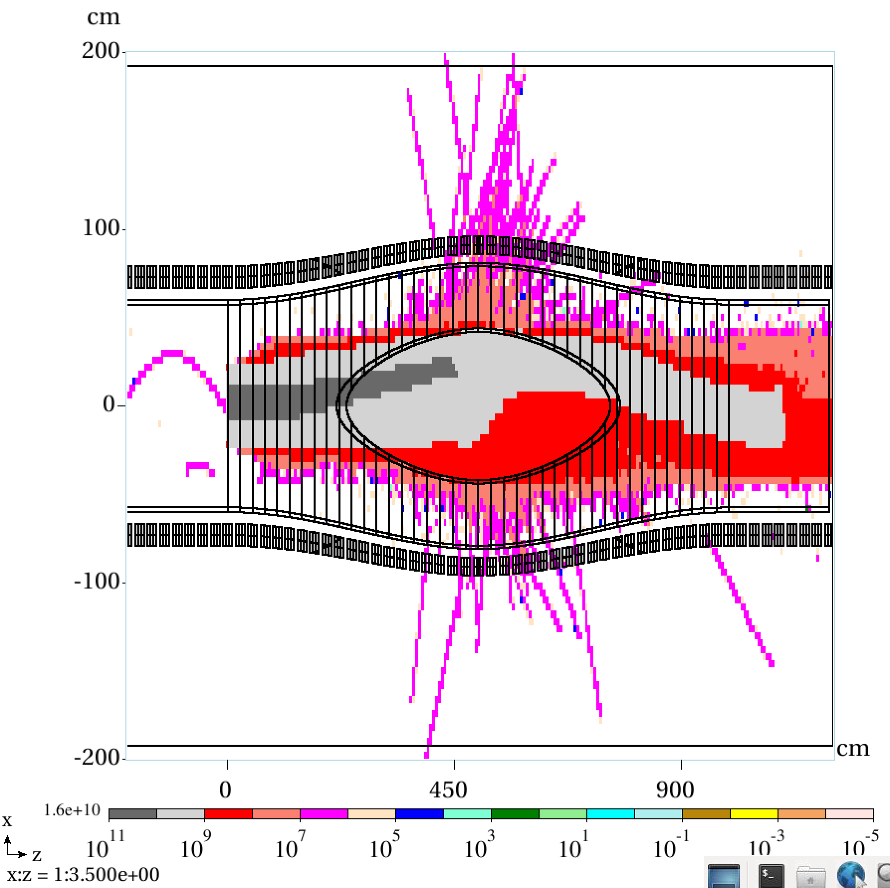
New results 2
Proton flux, top view
Proton flux, side view

Slide 13
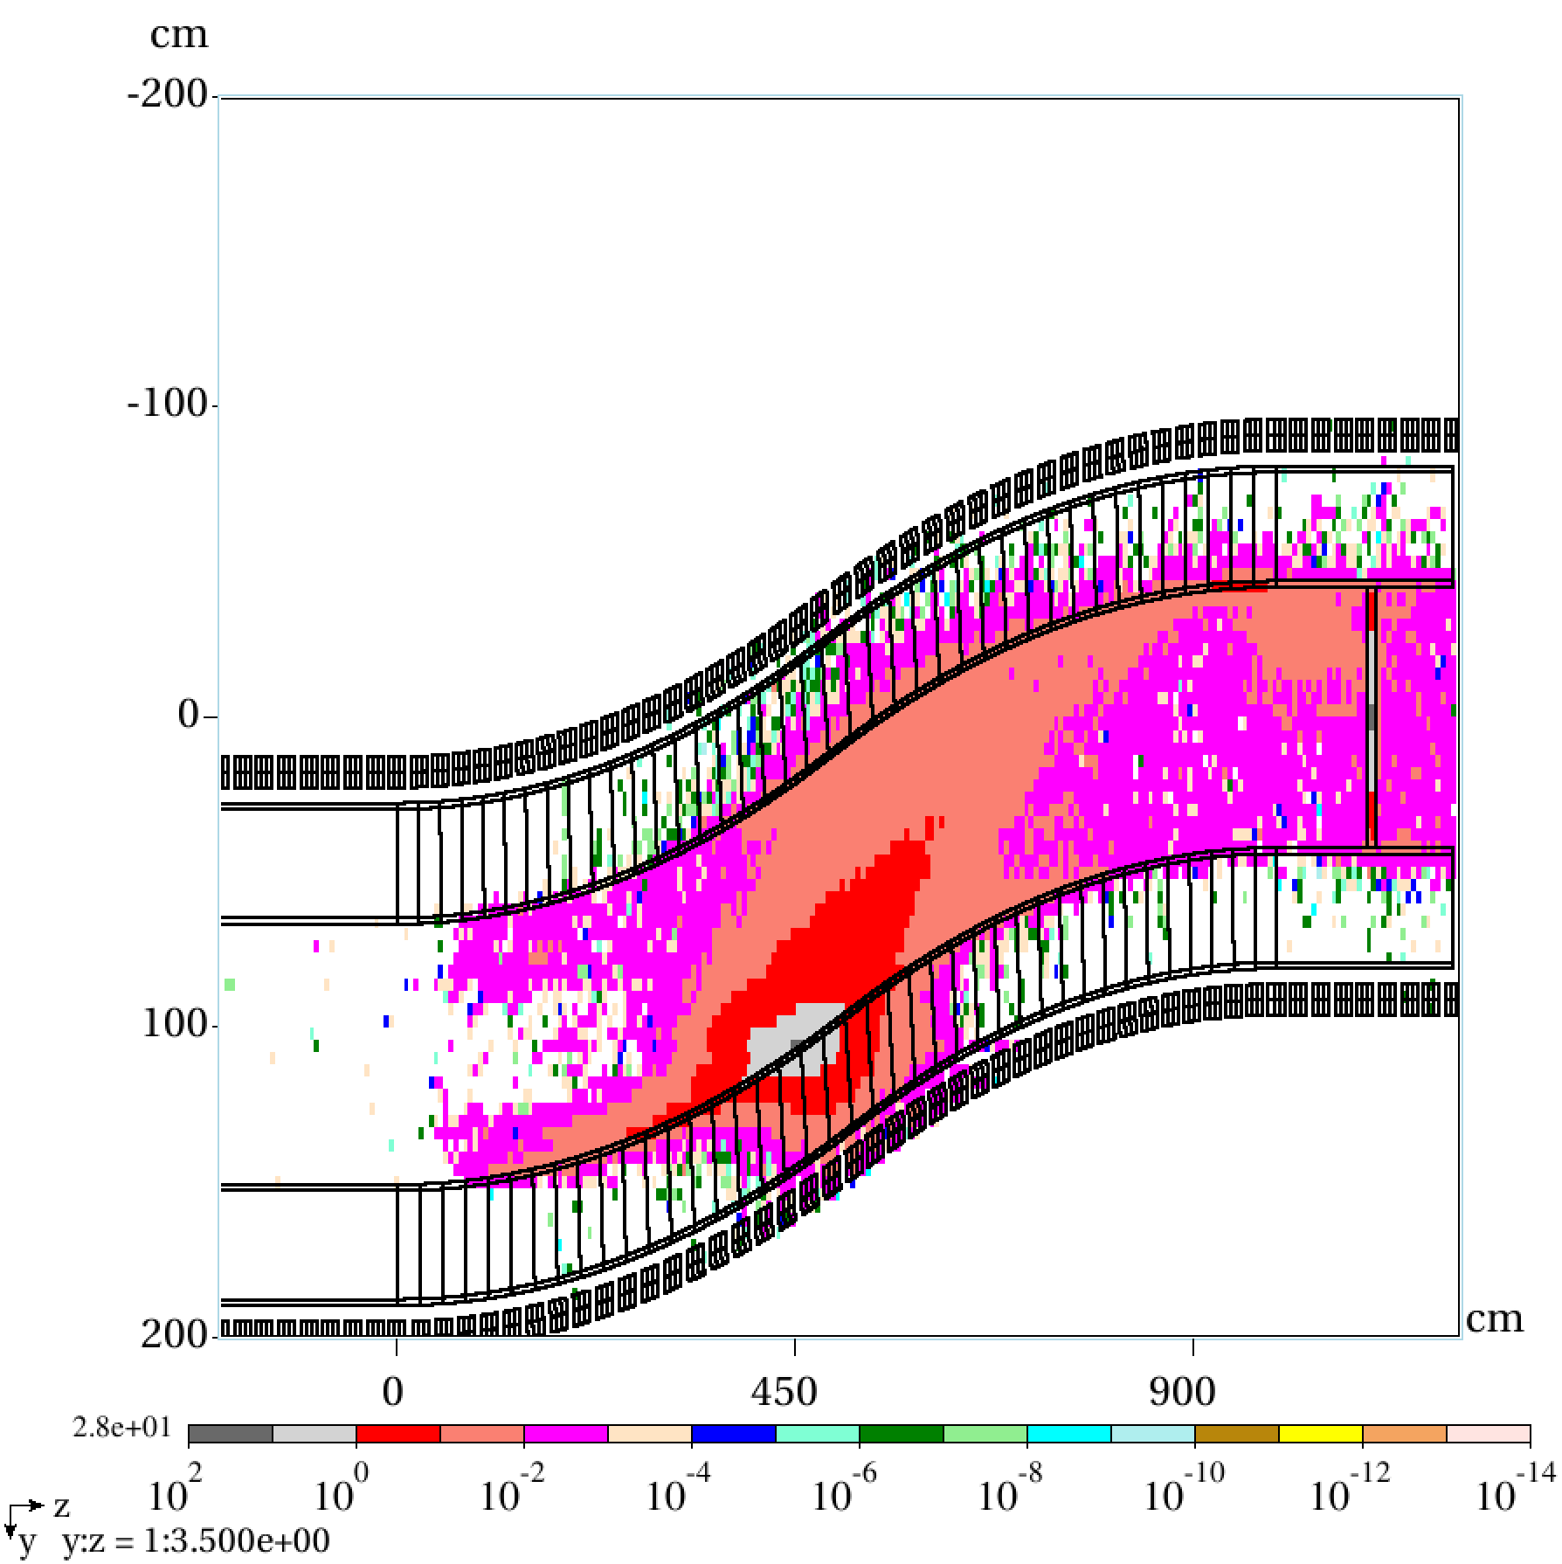
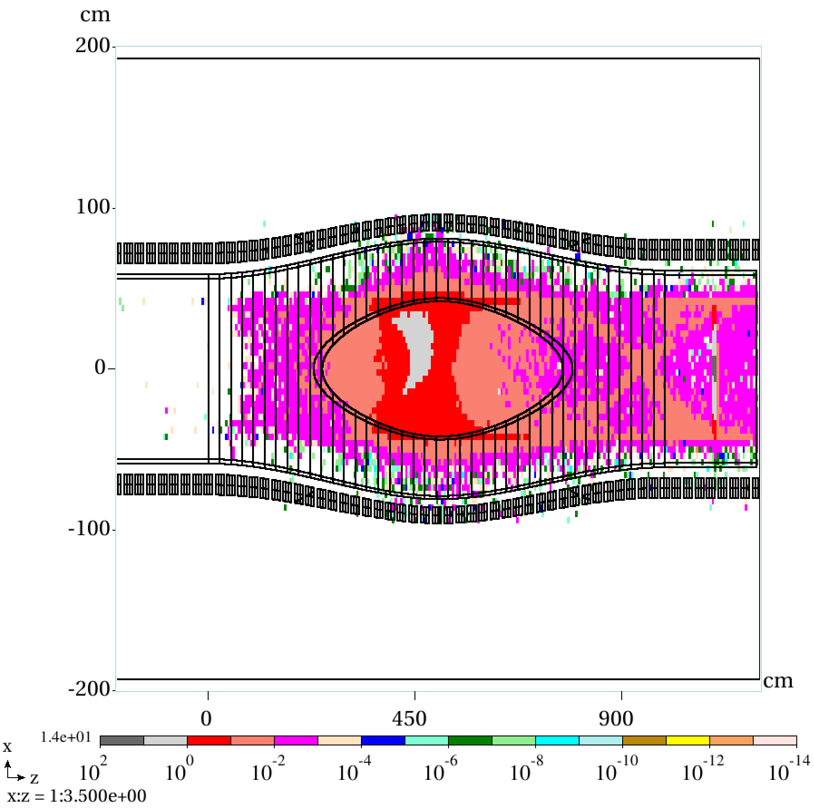
New results 3
Deposited power density, mW/g,
top view
Deposited power density, mW/g,
side view

Slide 14
New results 4
Deposited power density, mW/g
segmented coil analysis
Deposited power density, mW/g
averaged

Slide 15
Other codes
Can G4beamline or ICOOL be used for energy loss/deposition calculations?
Back in 2010 I did a comparison of the two codes for IDR:

Slide 16
Summary
Simulations of the new 1 MW graphite target are underway, first results presented.
  power density > 0.1 mW/g only in a handful of cental coils, very low everywhere else;
  definitely do not need 35 cm of tungsten.
Action item: implement a more sophisticated geometry (elliptical cross-section following the profile of the beam).
  this will allow to significantly reduce the amount of W used for shielding.
MARS is the main tool, although G4beamline and ICOOL can also be used for some analyses.

Slide 17
Thank you!

