Slide 2
Outline
Introduction
History
Current MARS simulations
  based on the hybrid channel ICOOL lattice
Summary

Slide 3
Introduction
In high-intensity sources muons are produced by firing high energy p onto a target to produce π.
π decay to μ which are captured and accelerated.
Significant background from p and ē, which may result in
  heat deposition on superconducting materials;
  activation of the machine preventing manual handling.

Slide 4
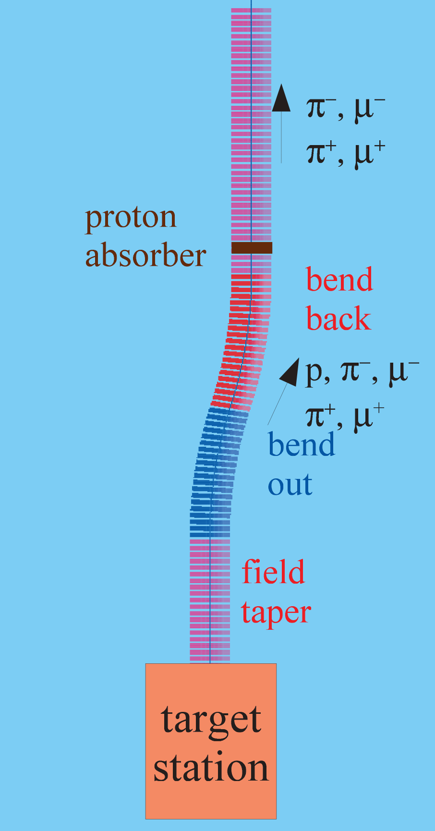
Introduction, contd.
Need a secondary particle handling system for a megawatt class solid C target
  solenoidal chicane
  followed by a proton absorber.
Challenges of optimization and integration of the system with the rest of the muon front end.
Main study tool – MARS, some analysis and validation by using ICOOL and G4beamline.
Use the same technique to study the buncher/phase-rotator/cooler for the hybrid channel.

Slide 5
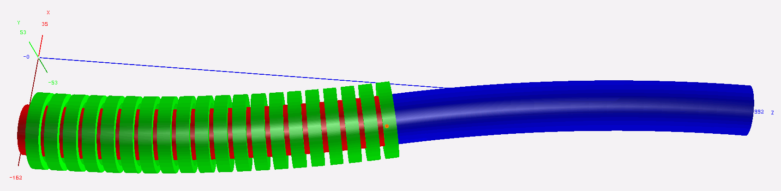
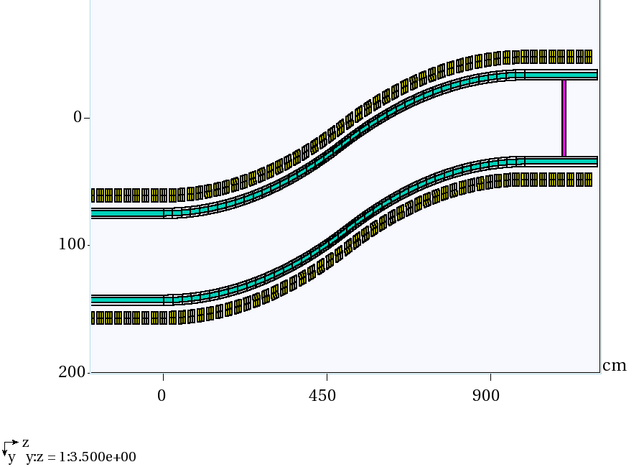
History: MARS simulations
ROOT-based geometry
12.5° single bend, Z=0 corresponds to 19 m downstream of the target
  consistent with RDR (IDS-NF).
W density reduced to 60% to take into account packing fraction for beads.

Slide 6
Reference: no shielding
DPD peaks at 15.8 mW/g, that translates into 42.6 kW/m for Cu coils or 33.3 kW/m for SC coils.

Slide 7
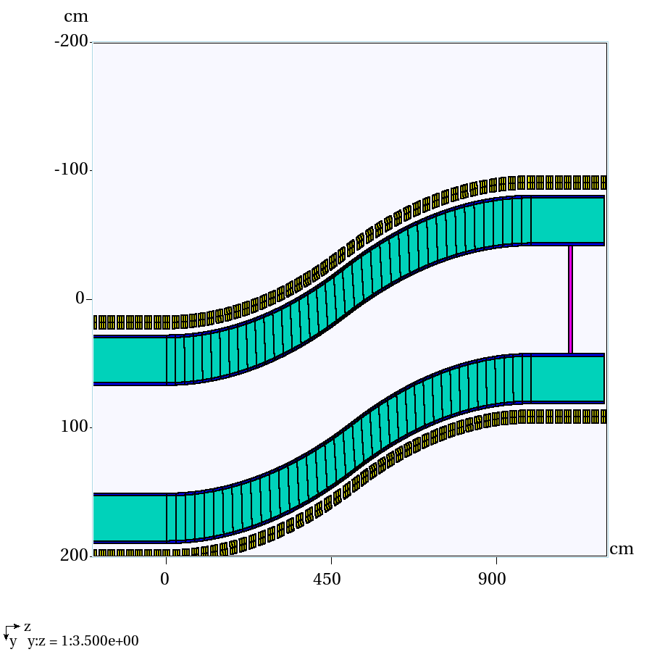
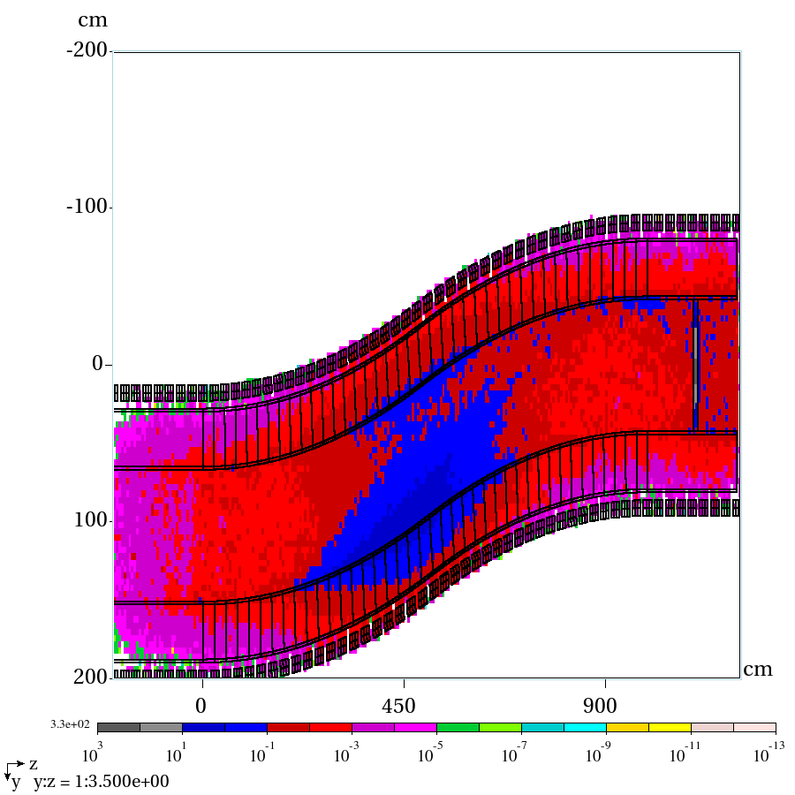
Uniform 35 cm shielding
Empty channel
PD total, mW/g

Slide 8
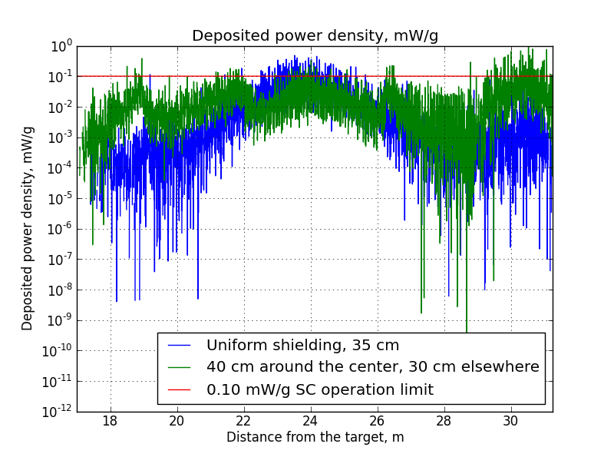
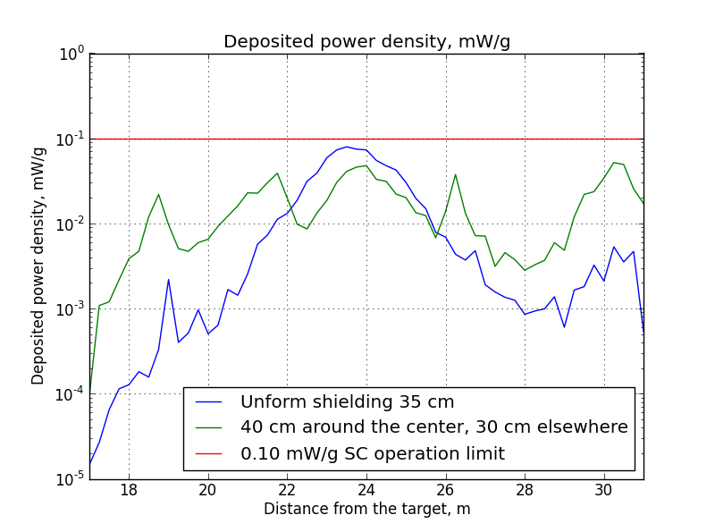
Overall DPD per coil/segment
Segmented coil analysis, total DPD, mW/g
Average DPD per coil, mW/g
In both cases red line corresponds to 0.1 mW/g SC limit

Slide 9
Ongoing MARS simulations
New target parameters:
  8 GeV => 6.75 GeV
  4 MW => 1 MW
  3.125e15 protons/sec => 0.925e15 protons/sec
  new particle distribution
New ICOOL lattice file
  hybrid channel
Looking downstream of the chicane
  buncher
  phase rotator
  matcher/cooler

Slide 10
MARS RF Challenge
Stationary magnetic fields are straightforward…
Time-dependent electric field in the RF cavities is not.
  Ended up using a combination of the two user routines in MARS m1514.f intended for other purposes:
    MFILL = meant for producing data for histograms, knows when a region boundary is crossed.
    KILLPTCL = meant for killing particles under certain conditions, here one can change the energy/momentum of the particle
  RF is a kick approximation (at the center of the cavity).
Use MARS extended geometry, and while it is sufficient, ROOT geometry would be much more convenient given the length and regularity of the structure.

Slide 11
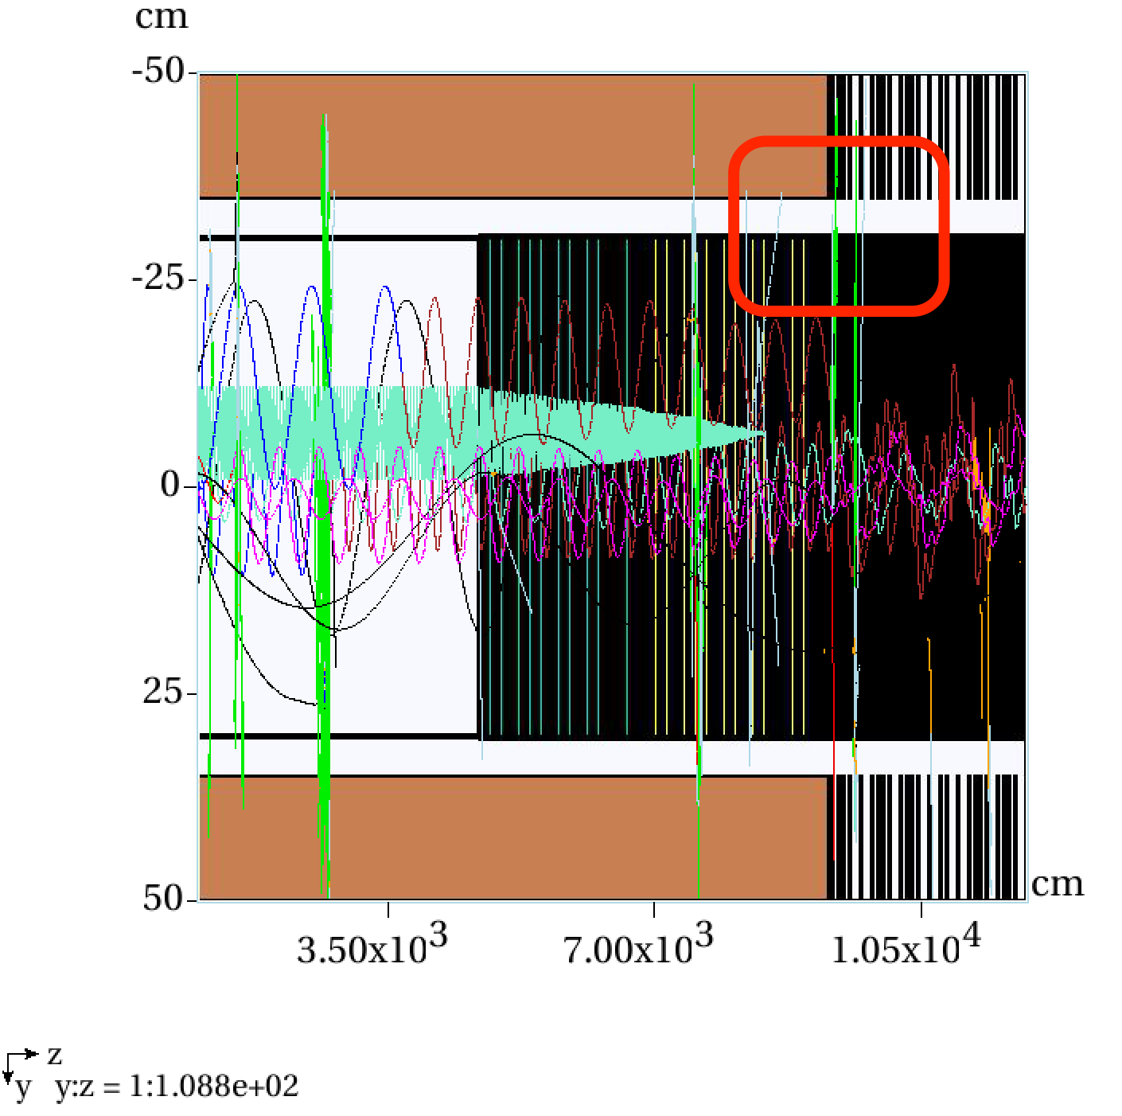
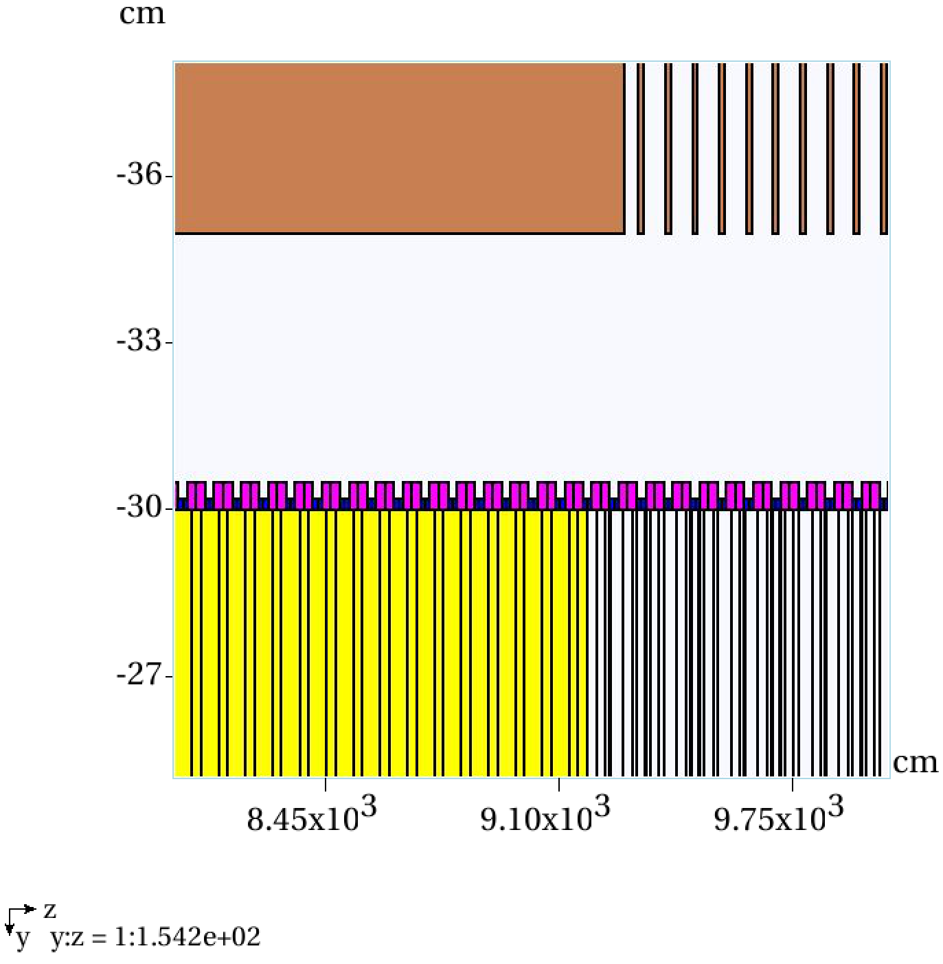
MARS RF, first results
A few tracks running through buncher/rotator/cooler.
Magnetic field is a field map imported from G4beamline.
Tracks lose energy in absorbers and gain energy when they cross the center of a cavity.

Slide 12
Other codes
Once MARS lattice is up and running, the plan is to compare results with G4beamline/ICOOL energy loss calculations
Back in 2010 I did a comparison of the two codes for IDR:

Slide 13
Summary
Buncher/rotator/cooler are in MARS now.
  More input on a more precise geometry for coils and cavities is appreciated.
Kick approximation is used for RF cavities at the moment…
  “workaround” style, something more straightforward and permanent would be good;
  information on phasing is taken directly from ICOOL, no reference particle(s) tracking in MARS.
MARS is the main tool, although G4beamline and ICOOL are also used for some analyses, could be used for validation.

Slide 14
Thank you!

