Slide 1
Modified Moliere’s Screening Parameter and its Impact on Calculation of Radiation Damage
Fermilab
Accelerator Physics Center
Sergei Striganov
5th High Power Targetry Workshop
Fermilab
May 21, 2014

Slide 2
OUTLINE
Models of elastic Coulomb scattering
Screening parameter in Hartree-Fock model
Correction to Born approximation
Comparison with other calculations
Conclusion
2

Slide 3
Models of Elastic Coulomb scattering
At energies below 10 MeV, Coulomb interactions dominate the production of displaced atoms from their lattice sites
For protons classical mechanics approach can be used at energies < Z/10 MeV
Quantum-mechanical description of elastic scattering including a relativistic treatment is also available
Classical and quantum mechanic provide similar results at energies > Z/10 MeV where relativistic and spin effects do not important
3

Slide 4
Models of Elastic Coulomb scattering-II
IOTA code (Konobeyev et al), NASA SEE and SET programs (Jun et al) – energy-transfer differential cross section based on Lindhard, Nielsen, Scharff “Approximation method in classical scattering by screened coulomb field”. This approach was applied to Tomas-Fermi potential. Reduced scattering cross section was obtained as a function of a single scattering parameter.
At large momentum transfer this cross section has same behavior as Rutherford cross section – cross section for scattering on unscreened Coulomb potential
4

Slide 5
Models of Elastic Coulomb scattering-III
G4 code (Boschini et al) – Wentzel-Moliere treatment of single scattering
– Moliere screening parameter. T, Z and M energy, charge and mass of recoil nuclei. z, p and β – charge, momentum and velocity of projectile
5

Slide 6
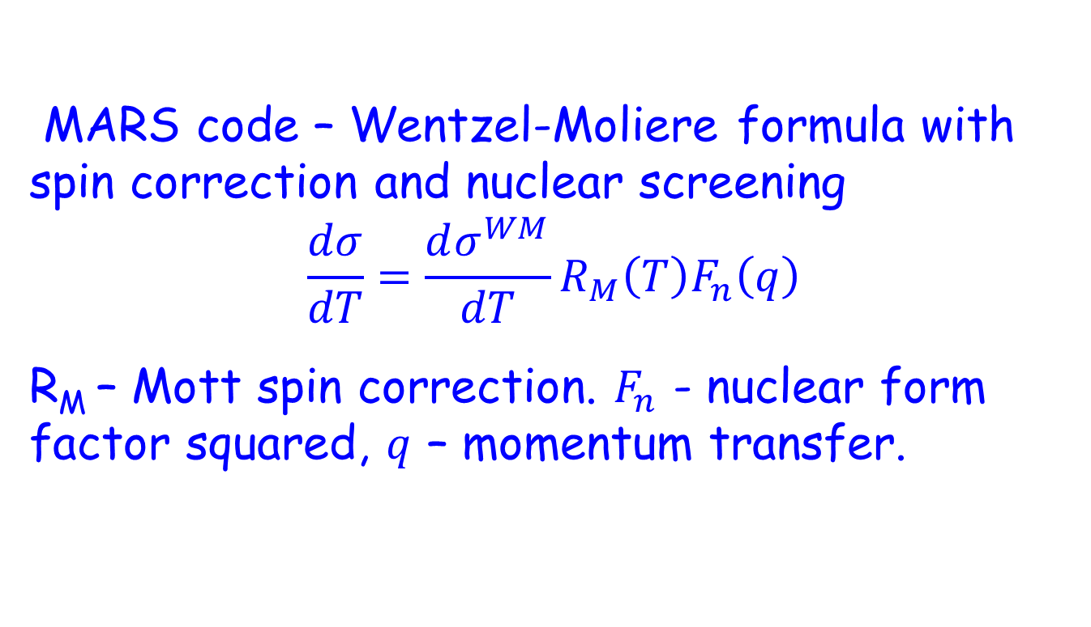
Models of Elastic Coulomb scattering-IV
MARS code – Wentzel-Moliere formula with spin correction and nuclear screening
$$\frac{dσ}{dT}=\frac{dσ^{WM}}{dT}R_{M}\left(T\right)F_{n}\left(q\right)$$
R_{M} – Mott spin correction. $F_{n}$ - nuclear form factor squared, $q$ – momentum transfer.
6

Slide 7
Screening parameter in Hartree-Fock model
Moliere calculated the screening angle using Tomas-Fermi model. Since the Tomas-Fermi model is statistical, for light element it cannot provide a high accuracy of calculation. More precise results can be obtained within the Hartree-Fock approach. It takes into account individual properties of atoms—in particular, their shell structure. Salvat et al propose a simple analytical approximation for atomic screening function depending on five parameters which are determined from the results of Dirac-Hartree-Fock-Slater calculations
7

Slide 8
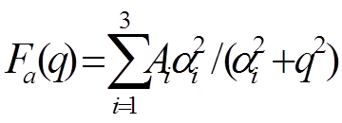
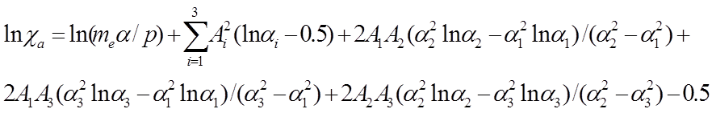
Screening parameter in Hartree-Fock model
Salvat et al has approximated Hartree-Fock atomic from factor as
In Born approximation Moliere “screening angle” reads
8

Slide 9
Screening parameter in Hartree-Fock model
9

Slide 10
Correction to Born approximation
Coulomb correction is the difference between the values of parameters calculated in the eikonal approximation and in Born approximation. An exact formula for the differential cross section in terms of an integral is given in Moliere’s paper, but his final evaluation of integral is numerical and only approximate. Recently, Kuraev et al (JINR, Dubna) have found exact solution in the ultra relativistic limit. Their result reveals significant deviation from Moliere’s approximation for sufficiently heavy elements.
10

Slide 11
Correction to Born approximation - II
Fernandez-Varea et al proposed a precise form for elastic Coulomb scattering cross section based on Hartree-Fock atomic form factor for electron with energy > Z keV correction. They introduced correction parameter to improve agreement with precise partial wave calculation. This cross section is used in popular PENELOPE code for simulation of multiple Coulomb scattering. We can used this parameter as another way of “practical estimate” of Coulomb correction.
For electron energies less than Z keV, accuracy of correction progressively deteriorates. Correction parameter still yields accurate results if kinetic energy E_{c}=0.25Z keV is used, when E < E_{c}
11

Slide 12
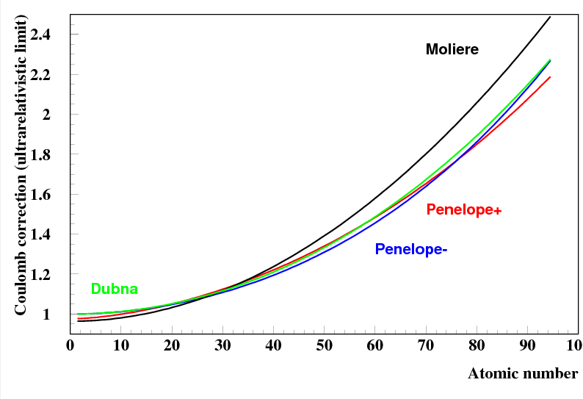
Correction to Born approximation: ultrarelativistic case
12

Slide 13
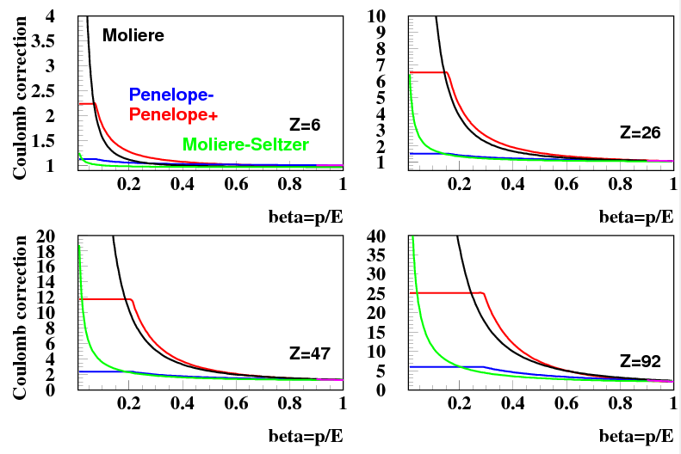
Correction to Born approximation: energy dependence
13

Slide 14
Correction to Born approximation
Recently, Salvat presented computer code for calculation Coulomb elastic scattering of protons with energies 10 keV-10 GeV. Elastic collisions are described in terms of numerical differential cross sections, calculated from eikonal approximation with Dirac-Hartree-Fock-Slater atomic potential (NIM B316 (2013) 144-159).
So, we’ll obtain soon tool to check energy dependence of screening based on rigorous calculation.

Slide 15
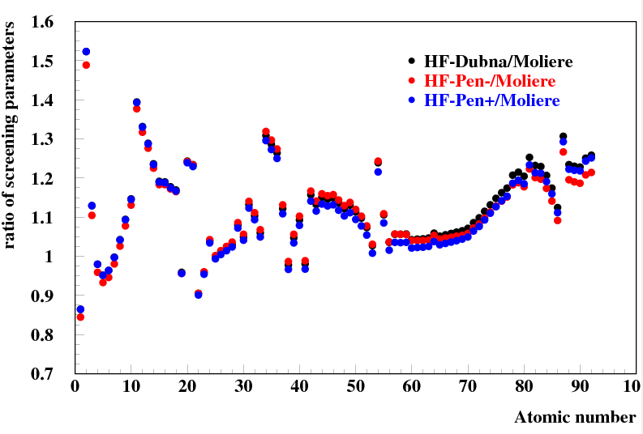
Screening parameters: ultrarelativistic case
15

Slide 16
Comparison with other calculation
We are going to compare calculation Non-Ionizing Energy-Loss (NIEL) and dpa using:
classical approach: NASA team – Jun et al and IOTA code – Konobeyev et al
quantum-mechanics Tomas-Fermi-Moliere approach - G4 team – Boschini et al
With our quantum-mechanics calculation:
Tomas-Fermi-Moliere-Mott + nuclear screening - TFM: Moliere screening parameter
Hartree-Fock-Penelope-Mott + nuclear screening - HFP: Hartree-Fock screening parameter in Born approximation. Penelopa “practical correction” at low energies
Hartree-Fock-Moliere-Dubna-Mott + nuclear screening - HFD: Hartree-Fock screening parameter in Born approximation. Dubna Coulomb correction at ultrarelativistic energies. Moliere Coulomb correction at low energies.

Slide 17
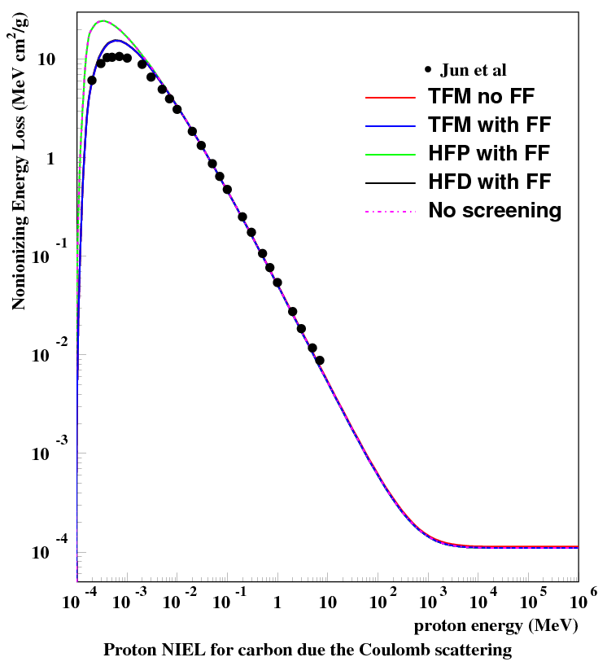
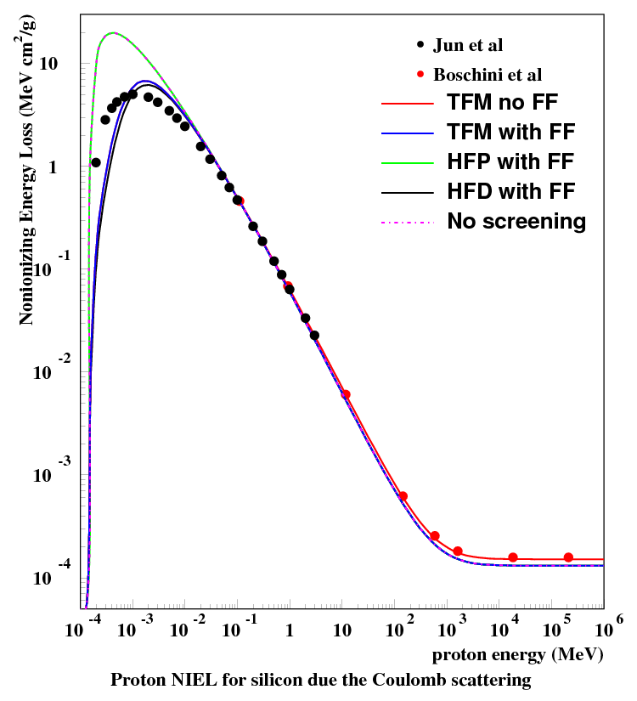
Comparison with other calculation: NIEL

Slide 18
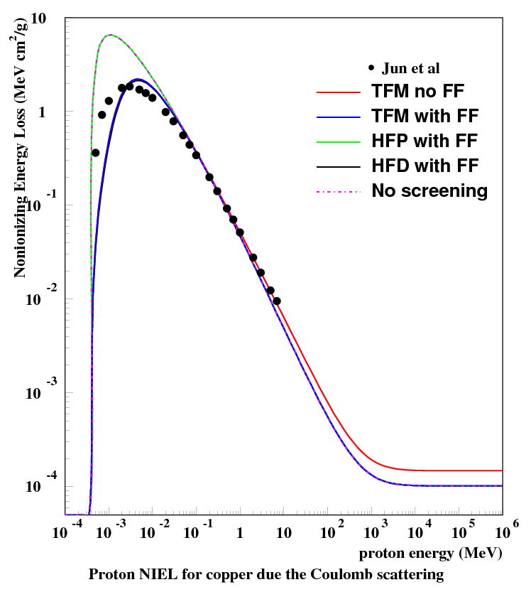
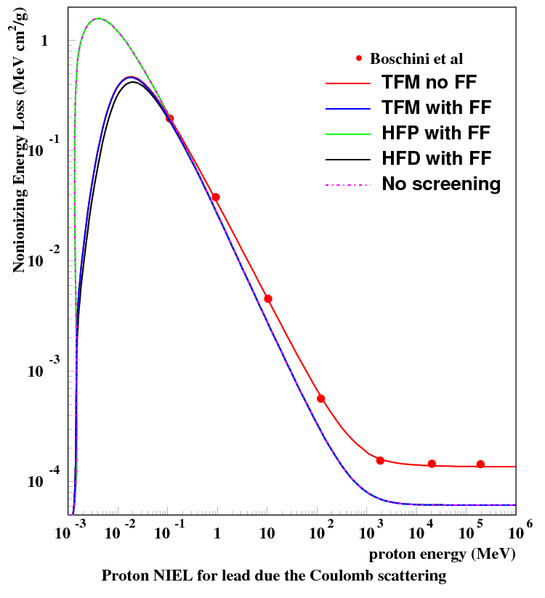
Comparison with other calculation: NIEL

Slide 19
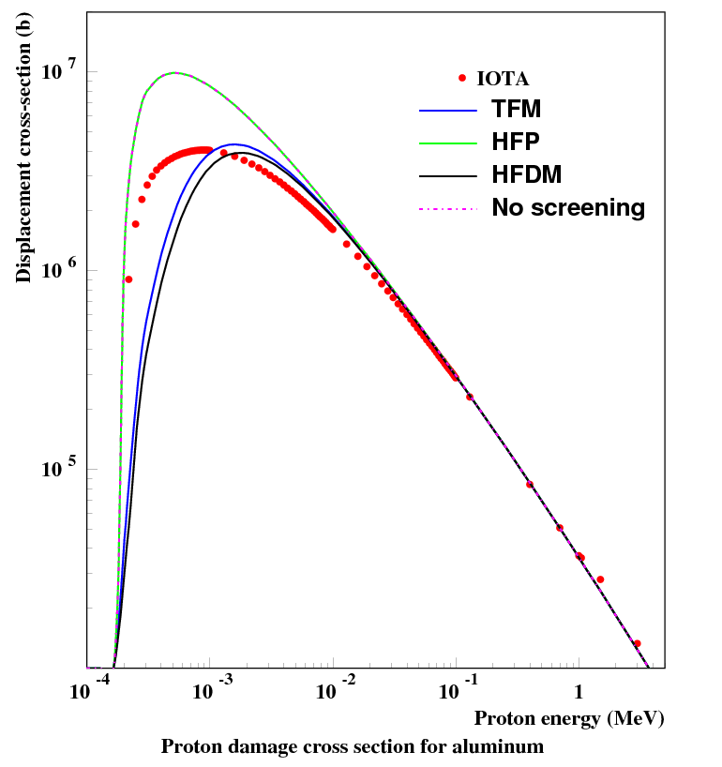
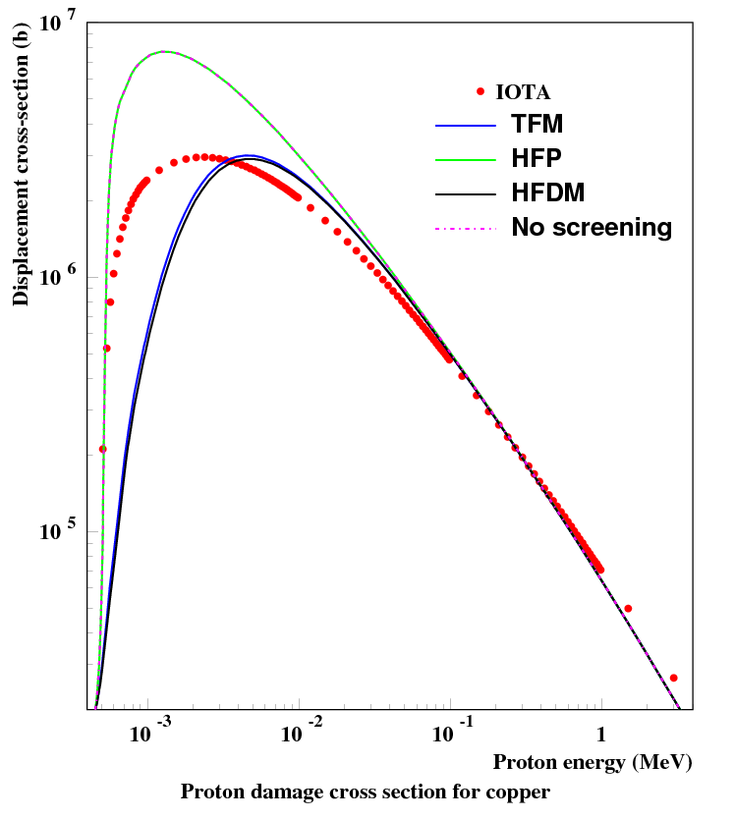
Comparison with other calculation – dpa

Slide 20
Full form factor against Moliere approximation
Moliere approximation – using one dipole term instead full from factor appears to be very useful to obtain analytical approximation of angular distribution due to multiple Coulomb scattering.
In calculation of radiation damage we do not radically simplify procedure by using Moliere’s approximation, but can loose precision.
Let’s compare NIEL and dpa obtained by integration Moliere’s dipole approximation and more precise cross section including all 3 terms in form factor description.

Slide 21
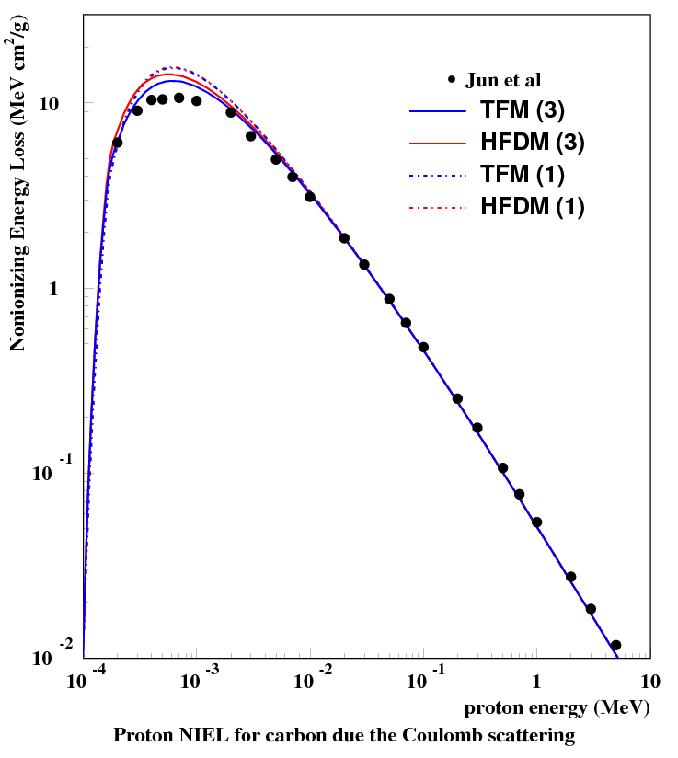
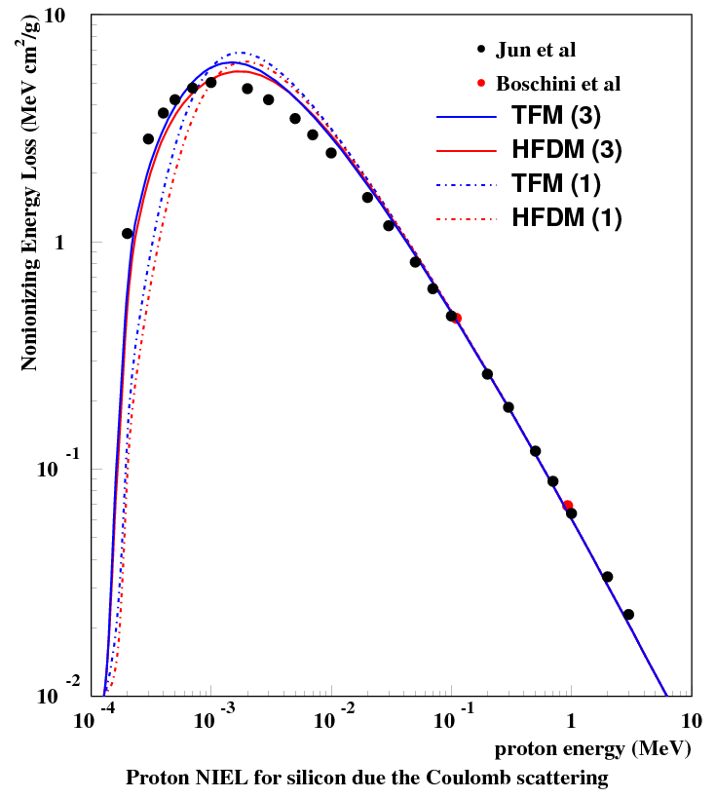
Full form factor against Moliere approximation

Slide 22
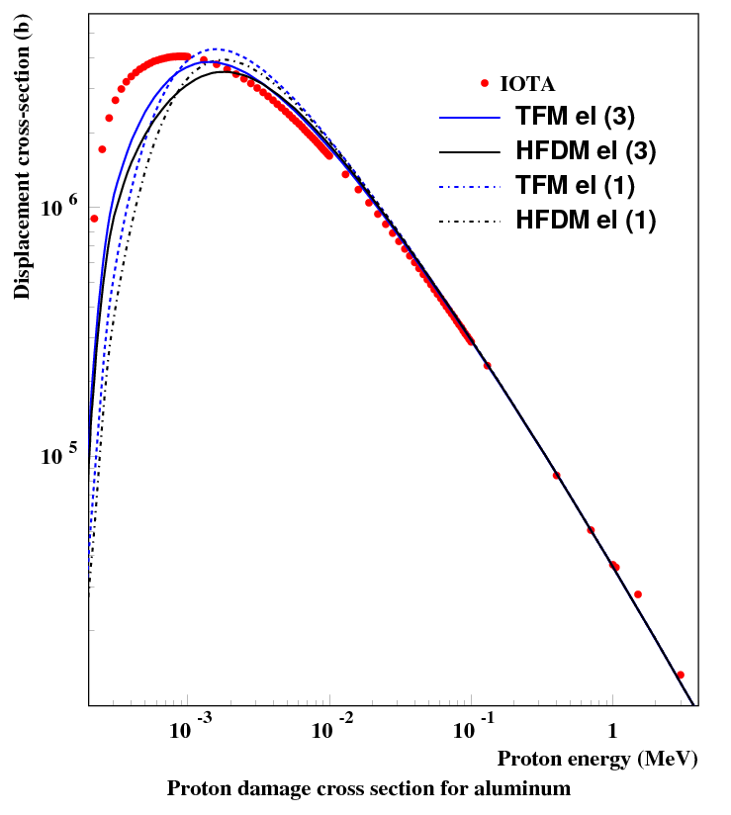
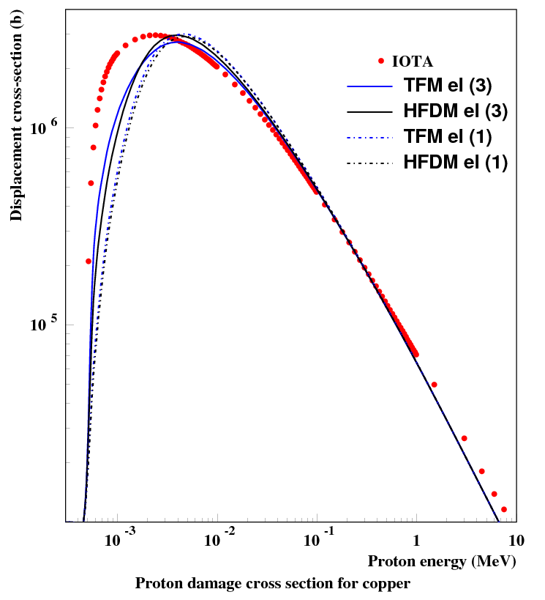
Full form factor against Moliere approximation

Slide 23
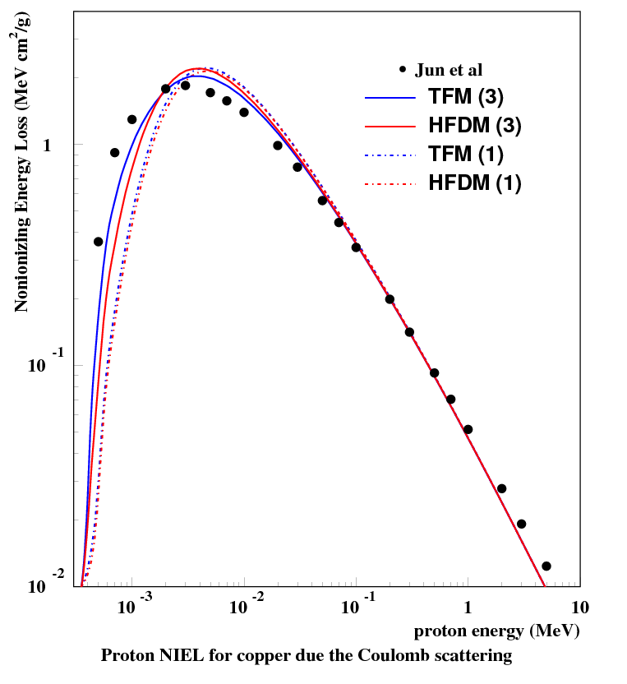
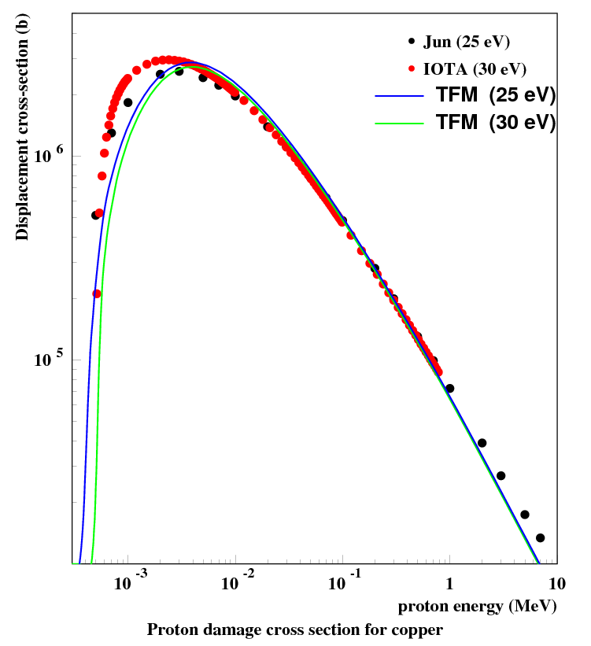
Full form factor against Moliere approximation
Jun(25eV) > IOTA(30eV)?
Different atomic screening?

Slide 24
Conclusions
Calculations of NIEL and dpa based on classical and quantum mechanic approaches are in reasonable agreement for protons with energy larger than few keV
Calculations of NIEL and dpa are not very sensitive to atomic screening model. Energy dependence of screening parameter looks like much more important
Calculation of NIEL and dpa using precise description of atomic form factor improve precision at very low proton energies
Including of nuclear form factor significantly decreases calculated NIEL and dpa, especially for heavy nucleus
Comparison of Moliere’s differential cross section with results of recently developed code (Salvat 2013) at low energies will be interesting

