Slide 1
What do we need?
René Flükiger
Dept. Phys. Cond. Matter (DPMC)
&
TE-MSC-SCD CERN

Slide 2
In the following, analysis will be restricted on Nb₃Sn
(quadrupoles)
MgB₂ for current leads: talk of M. Putti
BI-2212: not yet developed at an industrial level.
Starting point of the present considerations:
Calculations of F. Cerutti (CERN), 2010
(newer calculations in his presentation, today)

Slide 3
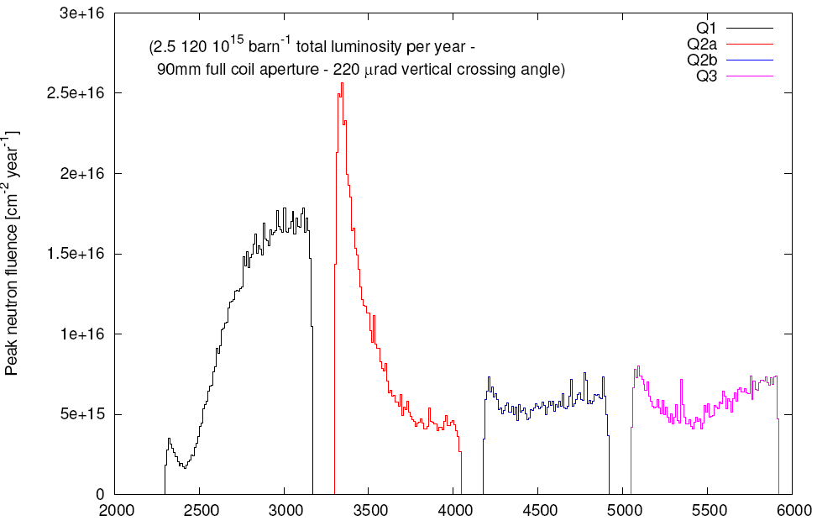
Neutron fluence in the inner winding of Quadrupoles (LHC Upgrade)
« TRIPLET »
Peak: > 5 x 10¹⁷ neutrons/cm²
Fluence in 10 « years » (200 days)
Q1
Q2a
Q2b
Q3
F. Cerutti +
A.Mereghetti
(CERN), 2010
20 25 30 35 40 45 50 55 60
Distance from Collision Point (m)

Slide 4
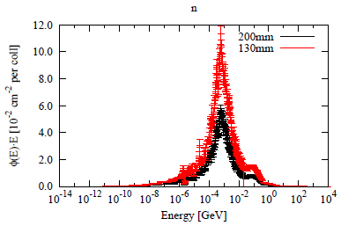
Neutron spectrum in the inner coil of Q2a at peak location
1 MeV
Neutrons

Slide 5
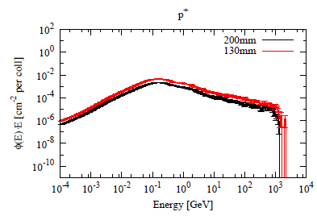
Proton spectrum in the inner coil of Q2a at peak location
1 MeV 100MeV 1GeV
Protons

Slide 6
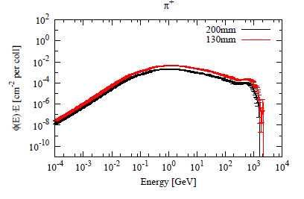
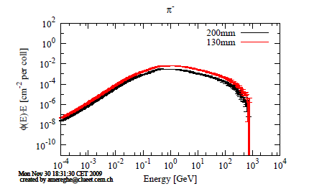
Pions ⁺
1 GeV
Pions ⁻
1 GeV
Pion spectrum in the inner coil of Q2a

Slide 7
Peak Fluence, LHC Upgrade (5 x 10³⁴ cm⁻² s⁻¹)
Radiation spectrum at Q2a: 35m from Collision Point
Aperture 200mm 130mm 130 mm
Photons 88.93 89.00%
Neutrons 4.82 4.04% 4.04%
Protons 0.14 0.13% 0.13%
Pions+ 0.19 0.19% 0.19%
Pions- 0.26 0.25% 0.25%
Electrons 4.31 4.63%
Positrons 2.23 2.45%
0.57%
Protons + Pions(+) + Pions(-) _{≈ 14 %}
Neutrons

Slide 8
Question: How do the magnets (quadrupoles) behave after 10 years of operation?
Study to be carried out for each high energy source:
* the superconductor T_{c}, J_{c}, H_{c2}
* the stabilizing Cu ρ (T)
* the insulator mechanical properties,
electrostatic charges,…
* the magnet combined effects,
quench behavior,
volume changes (expansion of
Nb₃Sn, Cu and insulator )

Slide 9
Keep in mind:
* all high energy sources act simultaneously
* there is no experience on a combined effect of several
high energy sources
* subsequent irradiations with different sources should be
carried out on selected samples
* calculations must be carried out to study combined
irradiations
(taking into account the small values of dpa, this may be
possible

Slide 10
Known effects of radiation on superconductors
Neutrons : Strong source of damage for superconductors
Protons: From known data, even stronger effect (charge)
Pions: Nothing is known yet. Effects expected to be
comparable to those of protons (charges +/-)
Electrons: Very little is known. Much smaller effects expected (in contrast to insulators). More data needed
Photons: Nothing is known. Smaller effects expected.
Data needed

Slide 11
What should be analyzed about irradiation of the superconductor?
Damage Mechanism (atomic ordering); Comparison with heavy ion irradiation
Effect of various energy sources
Number of displacement per atoms
Summation of single irradiations (small dpa numbers)
Irradiation at 4.2K and 300K
Volume expansion of Nb₃Sn; Effect of repeated warming up and cycling on irradiated superconductors
Thermal stabilization: Recovery behavior of Cu?
Mechanical properties of the superconductor after irradiation

Slide 12
Mechanisms of irradiation damage
Due to limited data, results from heavy ion irradiation are also taken into account

Slide 13
Low Fluence
High energy particle
(n, p, p, heavy ions, fission fragments
Collision events (1st, 2nd, 3rd,…)
Frenkel defects, Vacancies, Interstitials
Focused Collision Replacement Sequences
Vacancy mechanism
Vacancy Clusters
Lattice expansion
Disordering
Antisite Defects
Mean Static
Displacements
Depleted zones
Δa > 0
Δ(<u_{s}²>)^{1/2} ≠ 0
Increasing volume fraction
ΔS > 0
Building up of Internal strain (strain misfits)
Amorphous or transformed
High Fluence
13
R. Flükiger, 1986

Slide 14
Effect of neutron irradiation on T_{c}

Slide 15
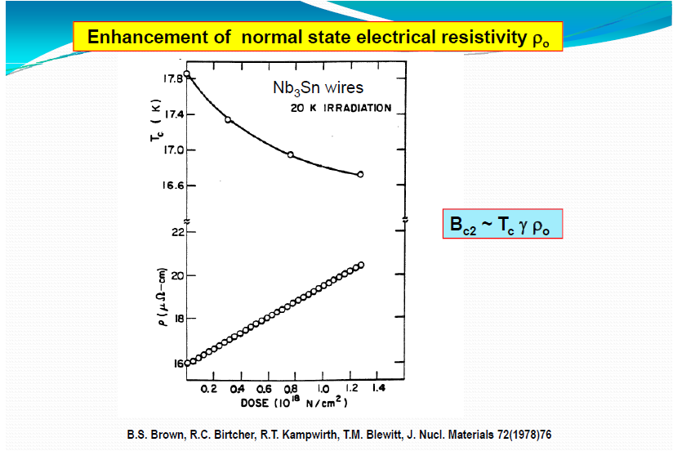

Slide 16
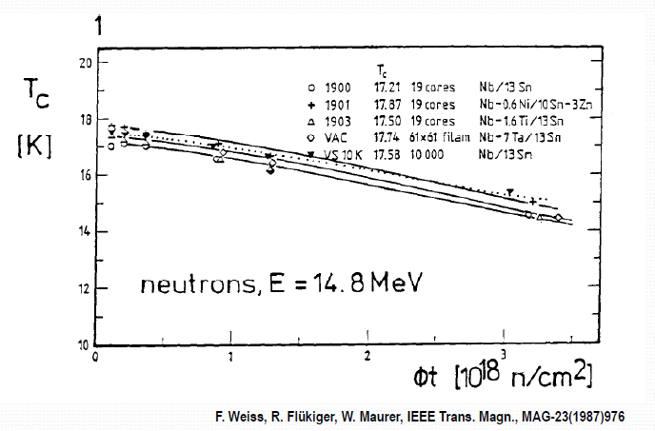

Slide 17
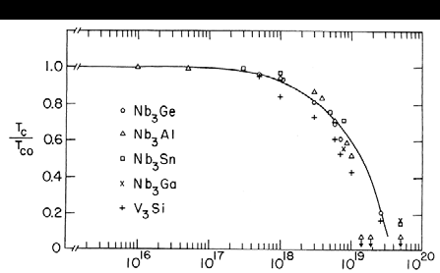
T_{c} of Nb₃Sn after 1 MeV neutron irradiation
A.R. Sweedler, D.G. Schweizer, G.W. Webb, Phys. Rev. Lett. 33 (1974) 168

Slide 18
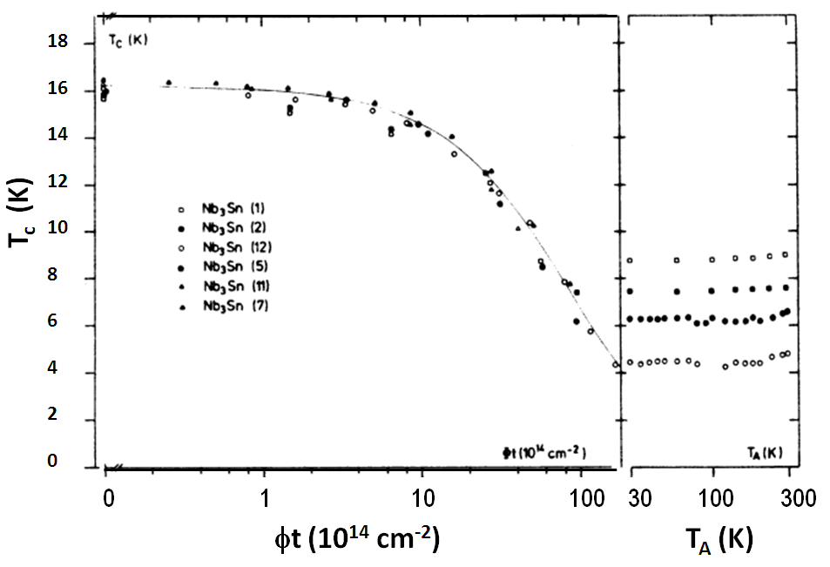
< 1K
Recovery of Nb₃Sn films after irradiation at T < 30K with 25 MeV O-ions (B. Besslein, 1976)

Slide 19
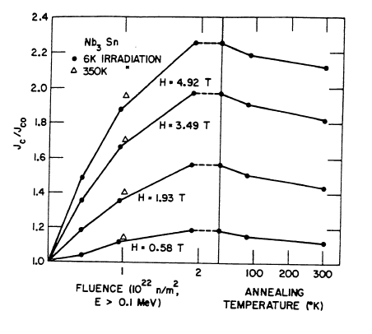
Recovery Effects after warming up
6 %
E > 0.1 MeV
Fluence (x 10¹⁸ n/cm²) T_{ann} (K)
Neutron irradiation of a multifilamentary Nb₃Sn wire,
followed by an anneal of 5 min. at T_{ann}.
B.S. Brown, T.H. Blewitt, T.L. Scott, D.G. Wozniak,, J. Appl. Phys.49(1978) 4144
19

Slide 20
Volume expansion of irradiated Nb₃Sn

Slide 21
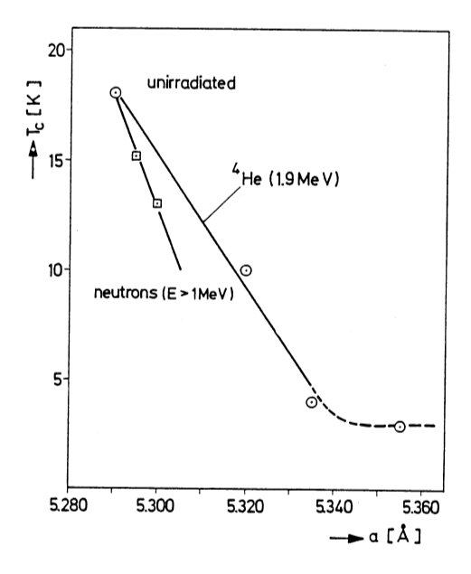
Analogy between neutron and heavy ion irradiation
Scaling law between various sources
not yet investigated
1x 10¹⁸ n/cm²
ΔV ≈ 1%
At 1 x 10¹⁸ n/cm², volume expansion of Nb₃Sn is ≈ 1%: * internal stresses?
* effects on J_{c}?

Slide 22
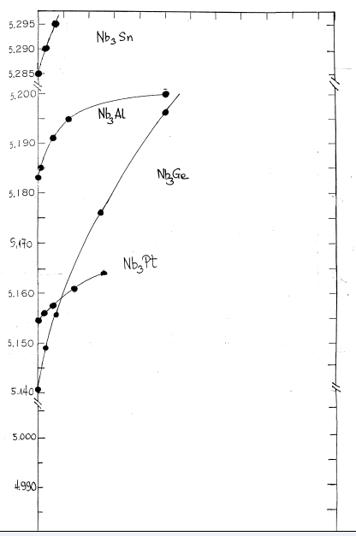
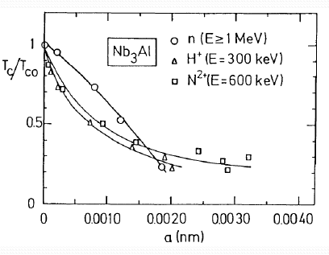
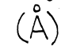
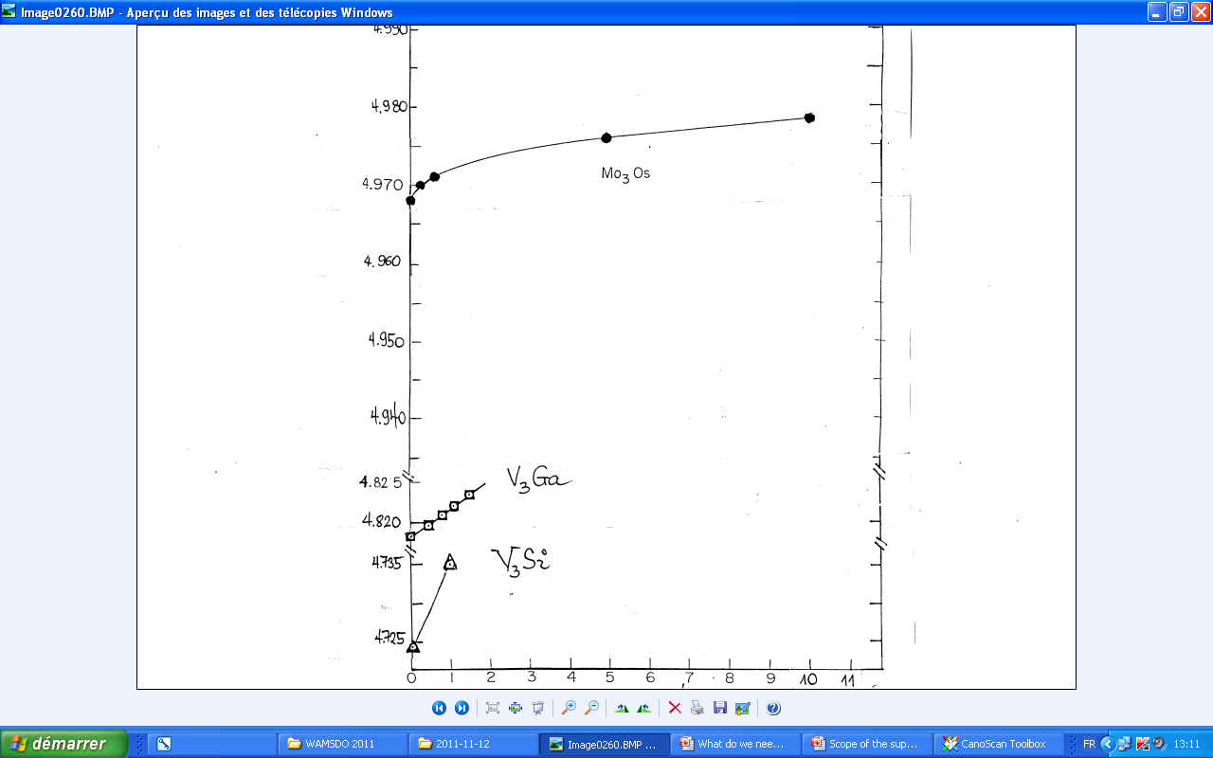
a
Schneider, 1982
A. Sweedler, 1978
Φt (x 10¹⁹ n/cm²)
Volume expansion after irradiation

Slide 23
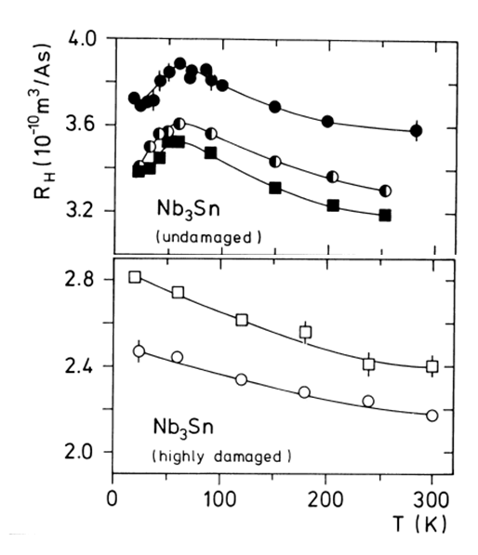
Hall constant
Suppression of martensitic transformation in Nb₃Sn films irradiated with 20 MeV ³²S ions at < 30 K (2 x 10¹⁵ cm⁻²) (C. Nölscher, 1984)

Slide 24
Irradiation of binary and ternary alloyed Nb₃Sn

Slide 25
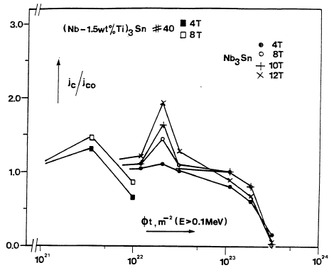
~ 3 x 10¹⁷
1.5 x 10¹⁸
E > 0.1 MeV
J_{c}/J_{co}
(Nb-1.5wt.%Ti)₃Sn wires
12T
Binary Nb₃Sn
wires
10T
8T
4T
8T
4T
E > 0.1 MeV
10¹⁷ 10¹⁸ 10¹⁹ 10²⁰
Fluence (n/cm²)
H.W. Weber et al., 1986, Adv. Cryo. Eng., 32, 853
25

Slide 26
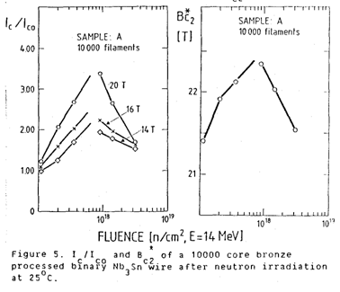
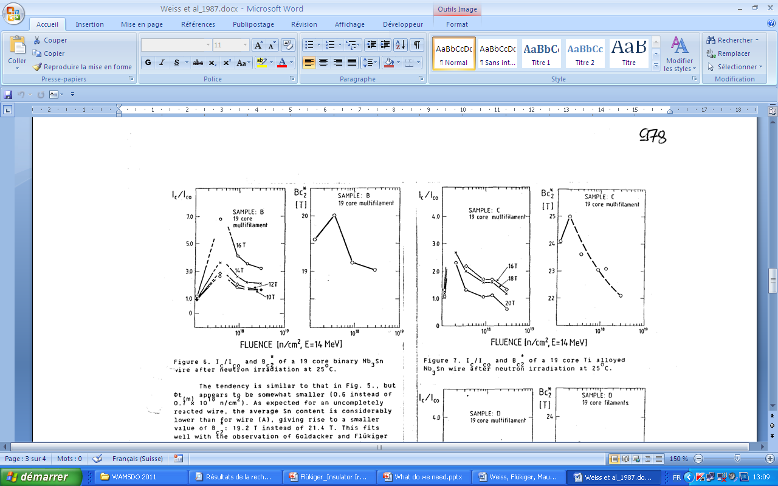
Binary Nb₃Sn
Bronze route
10’000 filaments
Neutron irradiation
E = 14 MeV
Binary Nb₃Sn
Bronze route
19 filaments
F. Weiss, R. Flükiger, W. Maurer, P.A. Hahn, M.W. Guinan,
IEEE Trans. Magn., MAG 23(1987)976
I_{c}(max) varies for
different wire configurations

Slide 27
I_{c}(max) are different for different neutron sources:
When comparing the effect of irradiation for different neutron sources e.g. 1 MeV and 14 MeV, the fluences have to be considered carefully, and the appropriate corrections have to be made

Slide 28
E = 14 MeV
Binary Nb₃Sn wire
(19 filaments)
Ti alloyed Nb₃Sn wire
(19 filaments)
This effect does not depend on the neutron source, but on the Nb₃Sn wire configuration

Slide 29
Behavior of J_{c} under stress after irradiation
29

Slide 30
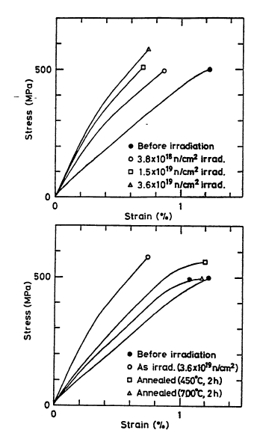
Stress – strain curves before and after irradiation
4.2 K
Bronze Route multifilamentary wire
T_{irr} = 350 K
Hardening with higher fluence
fluence
4.2 K
Recovery after annealing at 450 and 700 °C
T. Okada, M. Fukumoto, K. Katagiri, K. Saito, H. Kodaka, H. Yoshida, IEEE Trans. Magn., MAG-23(1987)972
30

Slide 31
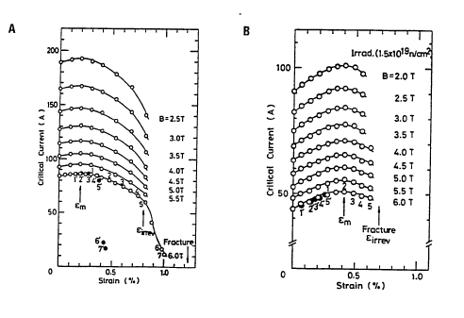
Effect of uniaxial tensile strain after irradiation
Bronze Route
Multifilamentary
Nb₃Sn wire
I_{c}
(A)
I_{c}
(A)
Strain (%)
Strain (%) Strain (%)
Before Irradiation After Irradiation
ε_{m} = 0.2% ε_{m} = 0.4%
T. Okada, M.Fukumoto, K.Katagiri,K.Saito, H.Kodaka, H.Yoshida, IEEE Trans.Magn. MAG-23(1987)972
31

Slide 32
The effect of proton irradiation on Nb₃Sn (thin films)

Slide 33
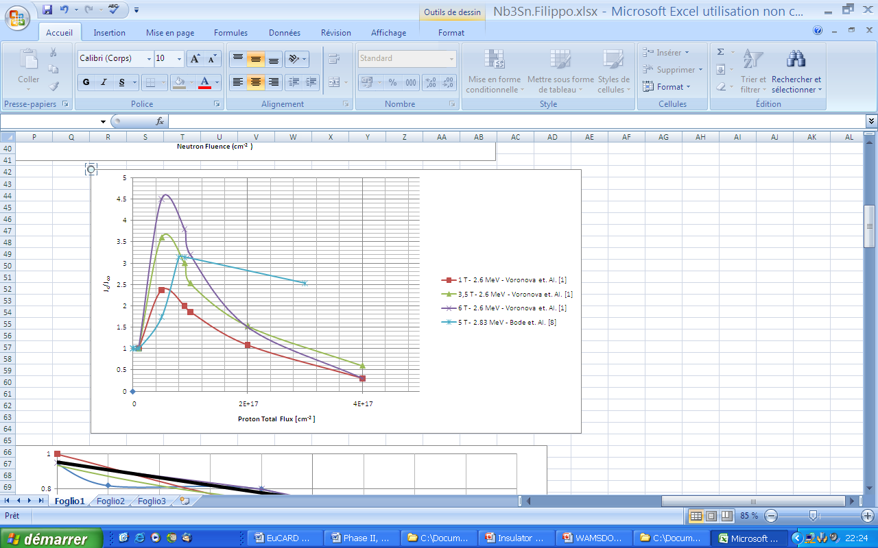
Maximum of I_{c} after proton irradiation
0.6 x 10¹⁷ p/cm²
8 x 10¹⁷ n/cm²
Binary Nb₃Sn
J_{c} max for neutrons
I_{c}/I_{co}
4T – 30 GeV, Snead et al.
0 1 2 3 4
Fluence (x 10¹⁷ p/cm²)

Slide 34
Binary Nb₃Sn wires (and films):
Maximum of I_{c}: neutrons: 8 x 10¹⁷ n/cm²
protons: 6 x 10¹⁶ p/cm ²
Ternary Nb₃Sn wires:
Maximum of I_{c}: neutrons: 2 x 10¹⁷ n/cm²
protons: ?
Still necessary to know behavior after proton irradiation, in spite of 3% fluence with respect to neutrons !
Even more necessary: behavior under pion irradiation. Total damage of protons + pions becomes comparable to that caused by neutrons

Slide 35
Planned operations at CERN
L. Bottura
A. Ballarino
G. De Rijk
C. Scheuerlein
T. Spira PhD, will start January 2012
R. Flükiger
Calculations: Collaboration with F. Cerutti (CERN)
F. Broggi, Milano)

Slide 36
Planned operations at CERN - 1
Neutron irradiation, 1 MeV,
Collaboration with Atominstitut Vienna
Material: Nb₃Sn with additives (Internal Sn, PIT)
Ti
Ta (activation!)
Neutron irradiation of Nb₃Sn wires at 1 MeV and 14 MeV has already been performed 20 years ago
However, new investigation on high J_{c} wires with precisely determined neutron fluence at 300K
(see the presentation of Harald Weber)

Slide 37
Goal of the collaboration with Atominstitut Vienna:
1: Confirm the systematic difference between binary and ternary
alloyed Nb₃Sn wires after neutron irradiation
2: Establish the maximum of J_{c} vs. fluence; find out at which fluence
the values of J_{c} and H_{c2}
2: Comparison between resistive and inductive J_{c} measurements
on Internal Sn and PIT wires
T. Baumgartner et al., MT22 (H. Weber’s talk)
Advantage: once the scaling is established, J_{c} can be determined
on 3 mm wire pieces by magnetization.
This result will be used for measuring J_{c} in proton irradiated wires

Slide 38
Planned operations at CERN - 2
Proton Irradiation at various energies
Material: Nb₃Sn Internal Sn and PIT wires, with Ta and Ti additives
Collaborations with:
* Kurchatov Institute (Russia) 35 MeV 10¹⁸ p/cm²
* Université catholique, 65 MeV 10¹⁷ p/cm²
Louvain la Neuve, Belgique
* CERN:
IRRAD1 24 GeV 10¹⁷ p/cm²
ISOLDE 1.4 GeV 10¹⁸ p/cm²
First magnetization measurements of wires after decay: after mid 2012

Slide 39
Proton irradiations at Kurchatov Institute: Program
Duration : 24 months
Proton energy: 35 MeV
Temperature: 300K (+ heating due to proton impact)
Maximum fluence: 1x 10¹⁸ p/cm²
Tasks on irradiated wires: J_{c} by magnetization measurements*)**)
Electrical resistivity vs. T
T_{c}
TEM
Lattice parameters
Tasks on irradiated bulks: Long range atomic order parameter*)
Calculations: dpa calculations for proton irradiation
*) Measurements will be performed at CERN
**) Transport J_{c} on proton irradiated wires: will be done later

Slide 40
Conclusions (superconductors)
We are still at the beginning of our investigations:
*Need for proton and pion irradiations of Nb₃Sn wires
*Are binary or ternary alloyed Nb₃Sn wires better?
*How has the volume expansion (1% at 10¹⁸ n/cm²) to be taken into
account?
*Irradiations at 4.2K still necessary (very small number, for
comparison)
*Warming up and cooling cycles needed for reliability tests
*New devices for testing at 15 T needed
*New devices for mechanical testing needed
*Calculations needed: dpa, but also combined irradiations

