Slide 1
Thermo-Mechanical Analysis of ISIS TS2 Spallation Target
Dan Wilcox
High Power Targets Group, Rutherford Appleton Laboratory
5th High Power Targetry Workshop, Fermilab
21/05/2014

Slide 2
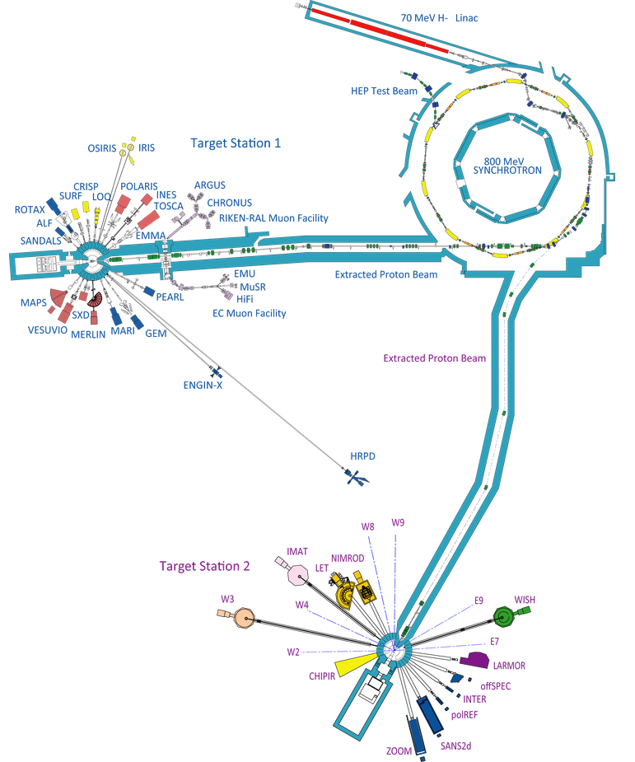
ISIS Overview
Synchrotron
800MeV proton energy
200µA beam current (160kW power)
Pulses at 50Hz
Target Station 1
Receives 4 of every 5 beam pulses (40Hz)
160µA beam current (128kW power)
Target: tungsten plates
Target Station 2
Receives 1 of every 5 beam pulses (10Hz)
40µA beam current (32kW power)
Target: solid tungsten rod

Slide 3
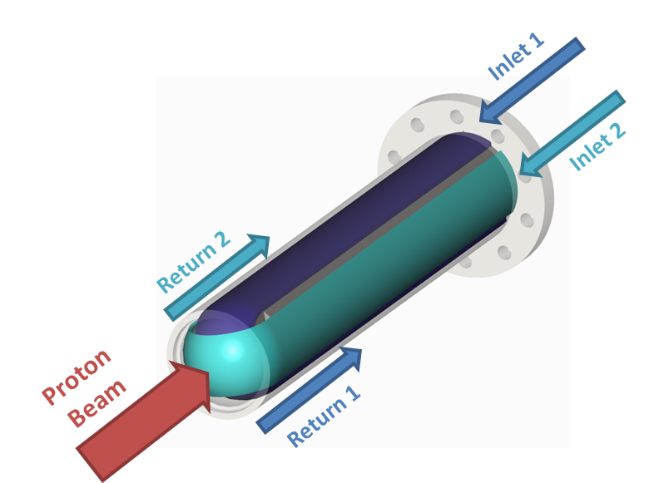
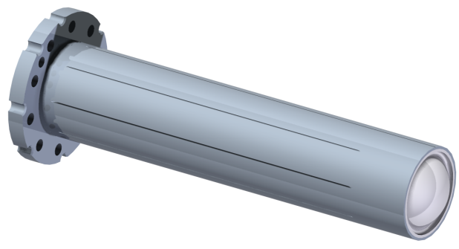
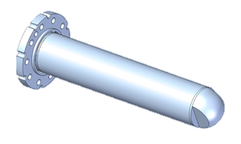
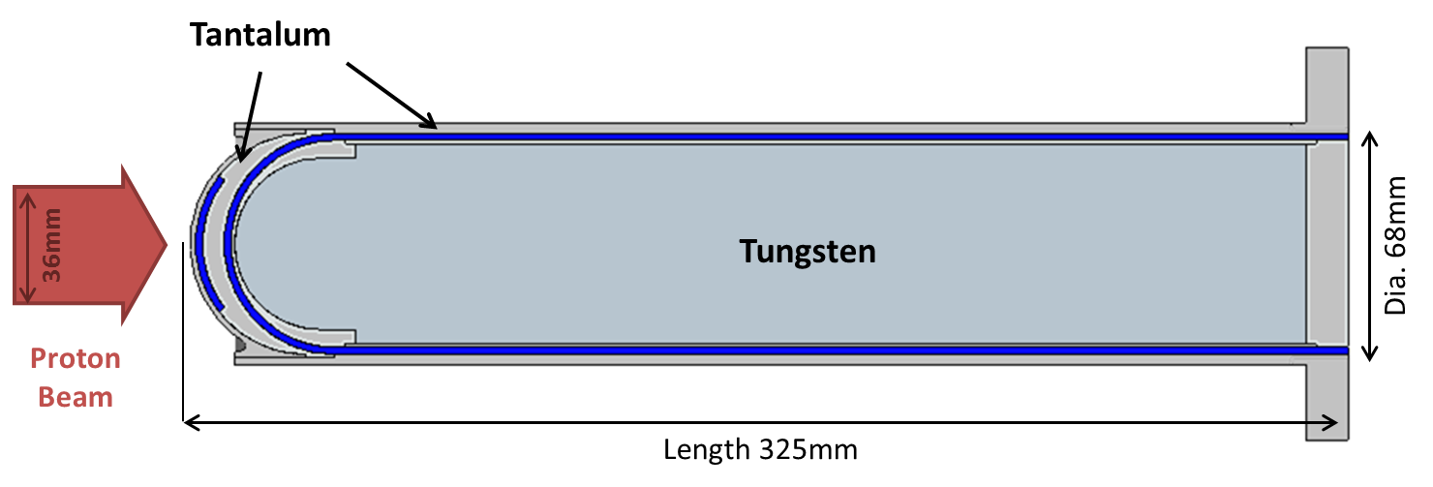
Background
Aim: model the operating condition of the current ISIS TS2 target
Identify factors limiting target lifetime
Mk II target had to be replaced after radioactive material (thought to be tungsten) was detected in the cooling water
Inform design of future targets, e.g. TS1 upgrade

Slide 4
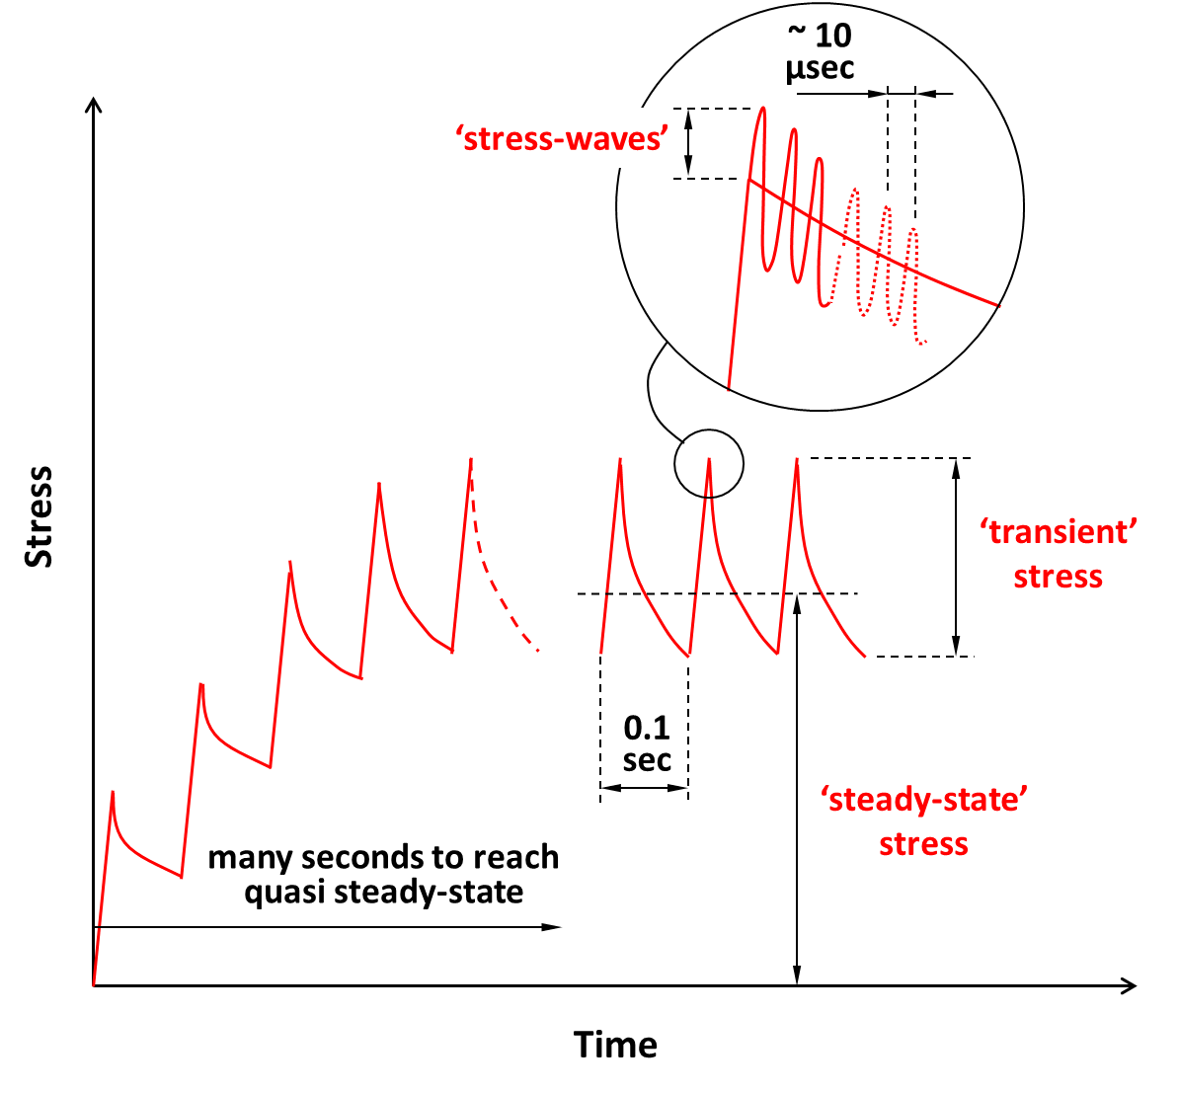
Overview of Beam-Induced Stresses
- Must also consider pre-stress from manufacturing methods
Acoustic waves due to sudden heat load
Periodic stress due to beam pulse
Average stress over time
Image credit: Peter Loveridge, HPTG

Slide 5
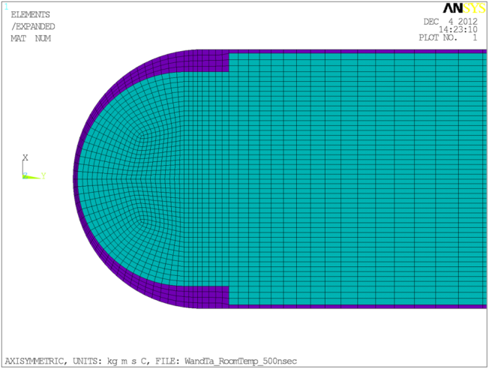
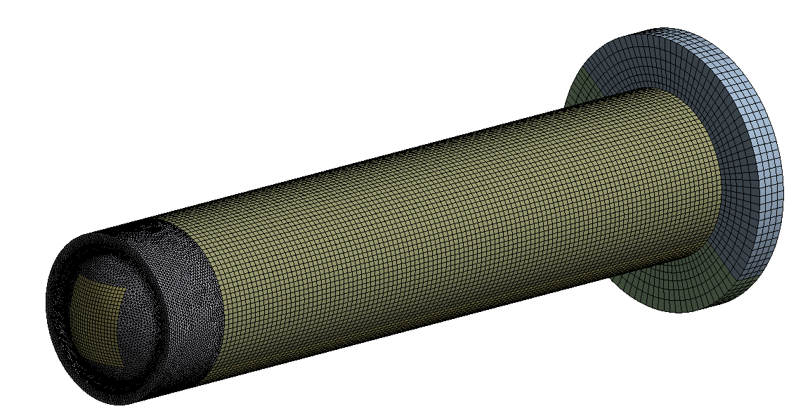
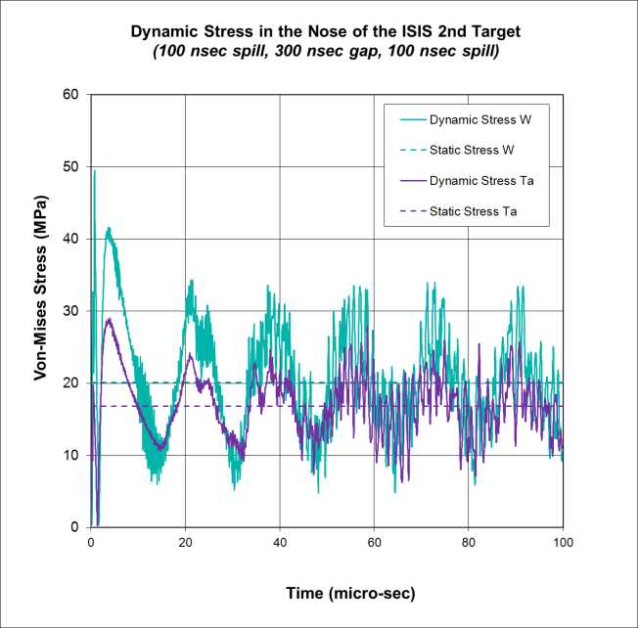
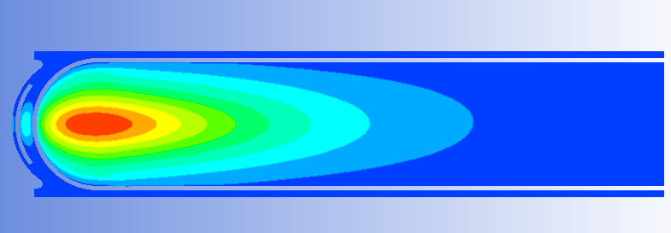
Modelling Beam Stresses
Steady State and Transient
Full 3D geometry
Conjugate heat transfer for steady state
HTC assumed constant during transient model
Thermal results input to structural model
Stress waves
2D model in ANSYS Classic, many time steps required
Inertia effects included (dynamic stress response)

Slide 6
Summary of Stress Results at the Target Nose
Yield Stresses
W Yield ≈ 550 MPa Ta Yield ≈ 160 MPa
W ~ 30 MPa Ta ~ 12 MPa
W ~ 30 + 19 + 157 = 206 MPa Ta ~ 12 + 10 + 90 = 112 MPa
W ~ 19 MPa Ta ~ 10 MPa
W ~ 157 MPa Ta ~ 90 MPa

Slide 7
Pre-Stress: the HIP Process
Hot Isostatic Press (HIP) used to diffusion bond tantalum to tungsten
Tungsten core sealed inside tantalum ‘can’
Assembly heated to ≈1200°C
Pressure of ≈140MPa applied to force parts together until they bond
Gradually returned to room temperature and pressure, then machined to final size
Results in significant pre-stress
High pressure deforms tantalum can, but this occurs above annealing temperature
Cooling causes shrink-fit residual stress (tantalum contracts more than tungsten)
Stresses thought to ‘lock in’ at around 500°C
Heating in an impure environment will affect material properties – getter foils will reduce but not eliminate this
Components of HIP assembly

Slide 8
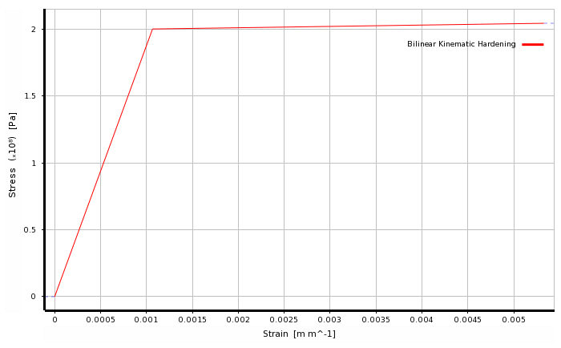
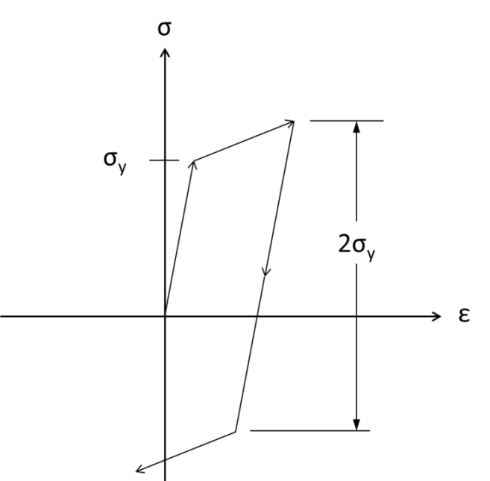
Including Plasticity
Bilinear material model applied for tantalum
‘Kinematic Hardening’ behaviour selected
An increase in yield stress in one direction is compensated for by a decrease in yield strength in the opposite sense (Bauschinger effect)
The total linear stress range is equal to twice the yield stress
Tangent modulus = 1GPa
Yield Stress = 200MPa
ANSYS material property “Bilinear Kinematic Hardening”
Kinematic Hardening Model

Slide 9
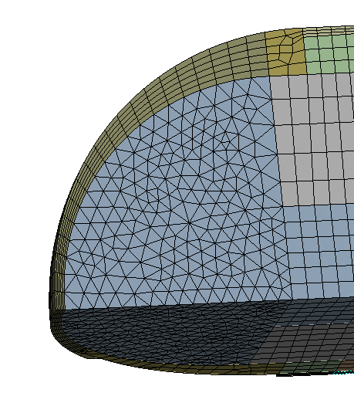
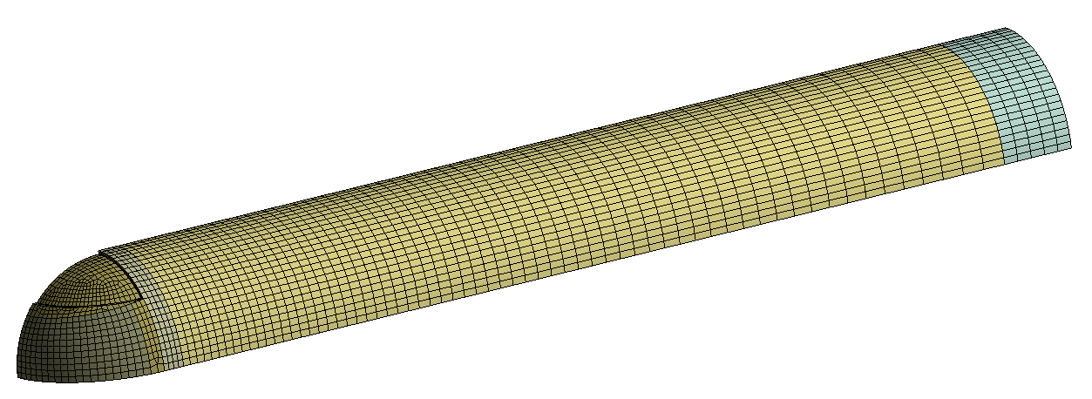
Combined Pre-Stress and Beam Heating
3D geometry in ANSYS Mechanical – target core only
Stress wave effects were not included
Assuming HIP does not affect heat transfer properties, thermal results do not change
Static structural model with multiple load steps:
The model starts in an unstressed state at 500°C
A body temperature of 20°C is applied – resulting in HIP stress
The model is heated to the steady state temperature
Two beam pulses are applied

Slide 10
Combined Pre-Stress and Beam Heating
HIP
Ramp Up to Steady State
Beam Pulses
Elastic/Plastic Transition
Stress and strain components at the target nose

Slide 11
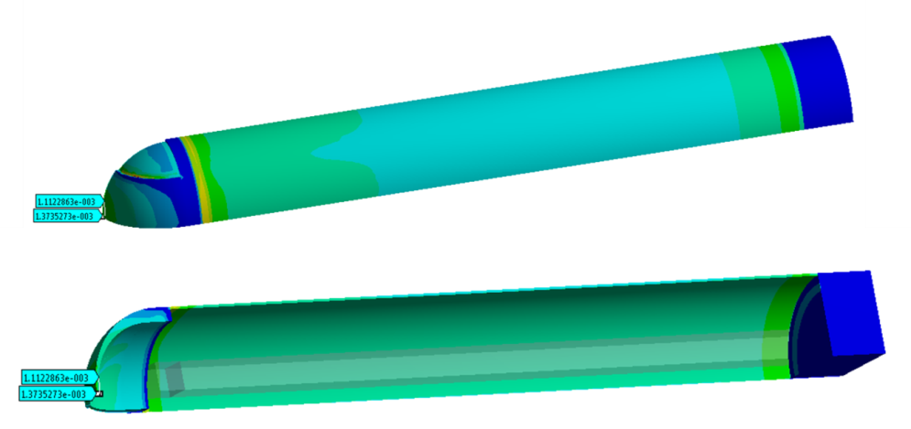
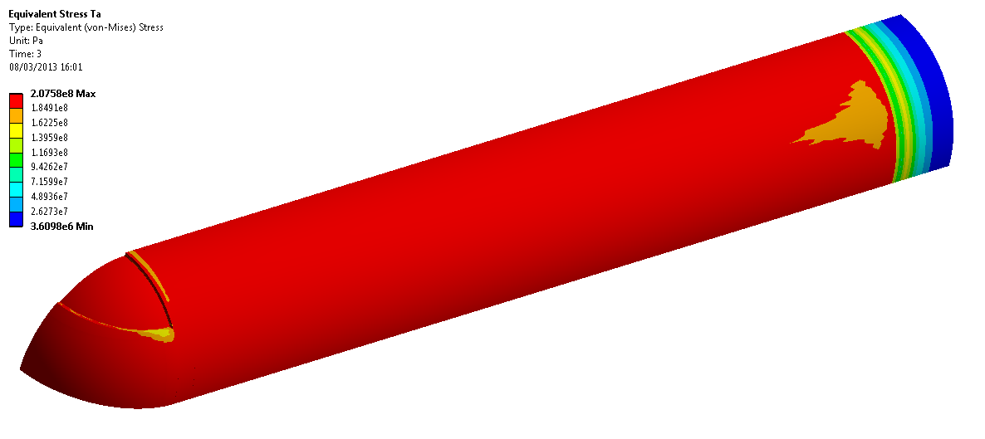
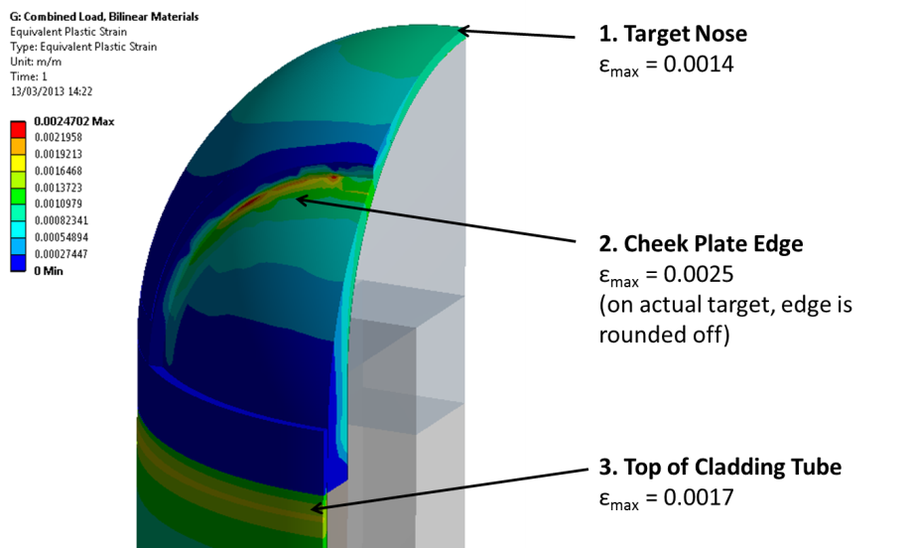
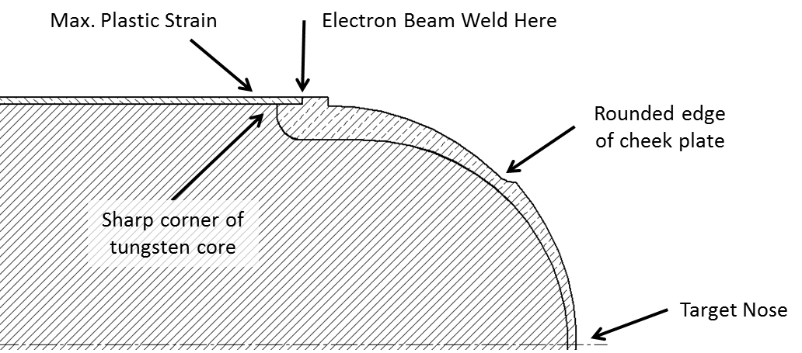
Steady State Results with Pre-Stress
ε_{max} = 0.0025
σ_{max} = 207.6MPa
Von Mises Stress in Tantalum
Equivalent Plastic Strain in Tantalum
Geometry features around cladding front end
Areas of maximum steady state plastic strain

Slide 12
Steady State Plastic Strain
In cladding tube:
Elastic strain = 0.0011
Plastic strain = 0.0017
Total strain = 0.0028 (0.28%)
- Not enough to cause structural failure
Tensile test data for post-HIP Tantalum, carried out by Eamonn Quinn of ISIS

Slide 13
Combined Pre-Stress and Beam Heating
HIP
Ramp Up to Steady State
Beam Pulses
Elastic/Plastic Transition
Stress and strain components at the target nose

Slide 14
Strain Components During Pulsed Operation
ε = 1.0786E-03
ε = 1.0786E-03

Slide 15
Transient Model with Pre-Stress and Bilinear Materials
HIP
Beam On
First Pulse
Beam Pulses
Beam Trips
Stress/strain plot at the target nose

Slide 16
Comparison of Cladding Tube and Target Nose

Slide 17
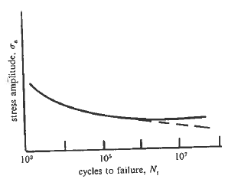
Fatigue Analysis
ISIS beam data suggests there are 0.6 beam trips per hour, or one trip every 60000 pulses
Number per year estimated based on frequency and average facility uptime
Stress waves ignored - material response is different on microsecond timescales
Based on a simple total-life approach
Assumes an initially uncracked surface
Stress-life (high-cycle) fatigue
Stress amplitudes are low, but average stresses are very high
Use a constant life diagram to see if this will be a problem
Load Case | Beam Pulse | Beam Trip
Frequency [Hz] | 10 | 0.00017
Number Per Year | 134,000,000 | 2230

Slide 18
Constant Life Diagram
Endurance Limit
(estimated as 35% of UTS)
Yield Stress
UTS
(values from Eamonn Quinn’s tests on HIPed Ta samples)
Stress amplitude = Δσ/2
Mean stress = yield stress − Δσ/2

Slide 19
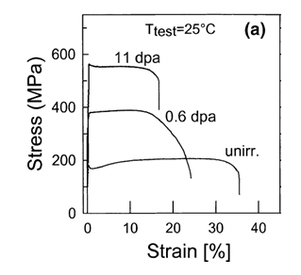
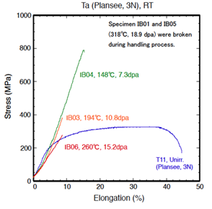
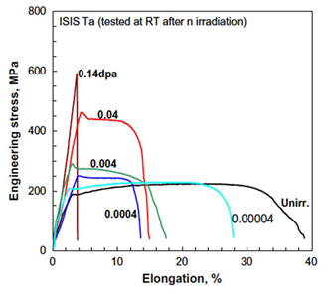
Fatigue Analysis - Limitations
Difficult to draw conclusions due to lack of material property data
No data could be found for tantalum fatigue
Very limited irradiation data
What will happen to HIPed, yielded, irradiated tantalum under periodic loading?
The effect of stress waves is still unknown
Are we including plastic effects in the right way?
Stress concentration on cladding tube
ISIS target cut up at FZ-Juelich
Specimen from STIP-II at PSI
Neutron irradiated specimen from HFIR at ORNL

Slide 20
Conclusions on TS2 Target
HIP pre-stress looks like the most significant stress component
This will be validated against experiments on the ISIS instrument Engin-X, data analysis is currently underway
Current theory is that fatigue failure of tantalum cladding will be the limiting factor of target lifetime
Tensile pre-stress and radiation embrittlement will make the fatigue situation worse
Irradiation creep and stress relaxation may reduce the average stress?
TS1 has much lower periodic loading, and has proven very reliable
Stress concentration on cladding tube will be removed on future targets
Beam accident case is another possible explanation
Current instrumentation will not immediately detect an over-focused beam
Thought to be more of a risk for TS1 than TS2
Understanding is limited by availability of material property data
There are spent ISIS targets available for PIE

Slide 21
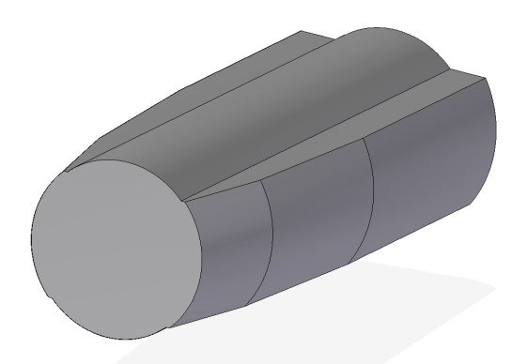
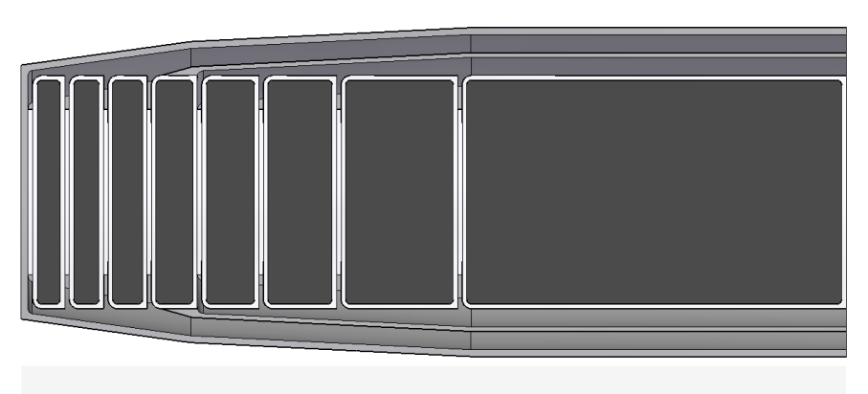
Relevance to TS1 Upgrade
Aim: Design a target which combines the neutronic performance of TS2 and the reliability of TS1
Designed in collaboration with ISIS Neutronics and ISIS Target Engineering
Reliability is the top priority
Neutronic optimisation goals include thinner cladding and fewer plates
Difficult to set material limits without fully understanding the operating condition of current targets
Better understanding of current target issues will ultimately allow for more highly optimised targets in future

