Slide 1
2D Two-Phase Jet Simulations
Yan Zhan
SUNY Stony Brook
Nov. 21, 2013

Slide 2
Outline
2D Turbulent Jet Into Still Air
VOF (Volume Of Fluid Method, FLUENT code)
CLSVOF (Coupled Level Set Volume Of Fluid Method, FLUENT code)
2D Mercury-Air Jet
Movies
Axial Velocity Contour, Volume Fraction Of Water
Snapshots
2D Water-Air Jet
Movies
Axial Velocity Contour, Volume Fraction Of Water
Snapshots

Slide 3
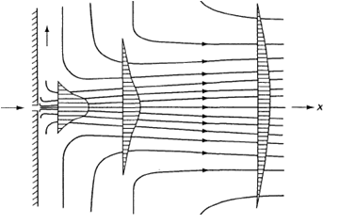
2D Turbulent Jet Into Still Air
r
Wall
Pressure
outlet
Inlet velocity
Axial symmetirc
Interior
Water emerges into a still air from a circular orifice at x=0
Re_{d} = 200000 ( u = 20 m/s）
Temperature = 300 K
ρ = 988.2 kg/m³；ν = 1.002×10⁻⁶ m²/s；
Mercury emerges into a still air from a circular orifice at x=0
Re_{d} = 1812785.017 ( u = 20 m/s）
Temperature = 300 K
ρ = 13456 kg/m³；ν = 1.1147×10⁻⁷ m²/s；

Slide 4
Outline
2D Turbulent Jet Into Still Air
VOF (Volume Of Fluid Method, FLUENT code)
CLSVOF (Coupled Level Set Volume Of Fluid Method, FLUENT code)
2D Mercury-Air Jet
Movies
Axial Velocity Contour, Volume Fraction Of Water
Snapshots
2D Water-Air Jet
Movies
Axial Velocity Contour, Volume Fraction Of Water
Snapshots

Slide 5
Axial Velocity Contour (Mercury- Air ) [click to watch the movie]
VOF
CLSVOF

Slide 6
Volume Fraction Of Water (Mercury - Air ) [click to watch the movie]
VOF
$$α_{Hg}$$
CLSVOF
$$α_{Hg}$$

Slide 7
Snap Shots (Mercury - Air)
CLSVOF( t = 0.0161 s)

Slide 8
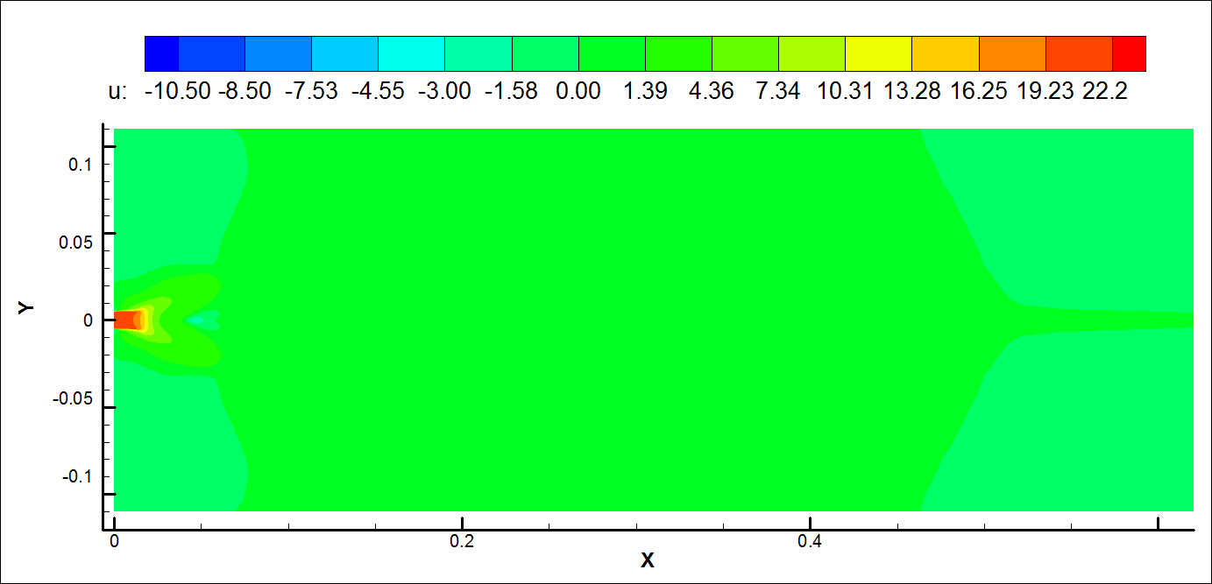
Snap Shots (Mercury - Air)
VOF( t = 0.0161 s)

Slide 9
Snap Shots (Mercury - Air)
CLSVOF( t = 0.0211 s)

Slide 10
Snap Shots (Mercury - Air)
VOF( t = 0.0211 s)

Slide 11
Snap Shots (Mercury - Air)
CLSVOF( t = 0.0611 s)

Slide 12
Snap Shots (Mercury - Air)
VOF( t = 0.0611 s)

Slide 13
Snap Shots (Mercury - Air)
CLSVOF( t = 0.071 s)

Slide 14
Snap Shots (Mercury - Air)
VOF( t = 0.071 s)

Slide 15
Snap Shots (Mercury - Air)
CLSVOF( t = 0.0811 s)

Slide 16
Snap Shots (Mercury - Air)
VOF( t = 0.0811 s)

Slide 17
Snap Shots (Mercury - Air)
CLSVOF( t = 0.331 s)

Slide 18
Snap Shots (Mercury - Air)
VOF( t = 0.331 s)

Slide 19
Snap Shots (Mercury - Air)
CLSVOF( t = 0.411 s)

Slide 20
Snap Shots (Mercury - Air)
VOF( t = 0.411 s)

Slide 21
Snap Shots (Mercury - Air)
CLSVOF( t = 0.461 s)

Slide 22
Snap Shots (Mercury - Air)
VOF( t = 0.461 s)

Slide 23
Snap Shots (Mercury - Air)
CLSVOF( t = 0.511 s)

Slide 24
Snap Shots (Mercury - Air)
CLSVOF( t = 0.511 s)

Slide 25
Snap Shots (Mercury - Air)
CLSVOF( t = 0.0161 s)
$$α_{Hg}$$

Slide 26
Snap Shots (Mercury - Air)
VOF( t = 0.0161 s)
$$α_{Hg}$$

Slide 27
Snap Shots (Mercury - Air)
CLSVOF( t = 0.0611 s)
$$α_{Hg}$$

Slide 28
Snap Shots (Mercury - Air)
VOF( t = 0.0611 s)
$$α_{Hg}$$

Slide 29
Snap Shots (Mercury - Air)
CLSVOF( t = 0.0661 s)
$$α_{Hg}$$

Slide 30
Snap Shots (Mercury - Air)
VOF( t = 0.0661 s)
$$α_{Hg}$$

Slide 31
Snap Shots (Mercury - Air)
CLSVOF( t = 0.0711 s)
$$α_{Hg}$$

Slide 32
Snap Shots (Mercury - Air)
VOF( t = 0.0711 s)
$$α_{Hg}$$

Slide 33
Snap Shots (Mercury - Air)
CLSVOF( t = 0.0811 s)
$$α_{Hg}$$

Slide 34
Snap Shots (Mercury - Air)
VOF( t = 0.0811 s)
$$α_{Hg}$$

Slide 35
Snap Shots (Mercury - Air)
CLSVOF( t = 0.0911 s)
$$α_{Hg}$$

Slide 36
Snap Shots (Mercury - Air)
VOF( t = 0.0911 s)
$$α_{Hg}$$

Slide 37
Snap Shots (Mercury - Air)
CLSVOF( t = 0.0101 s)
$$α_{Hg}$$

Slide 38
Snap Shots (Mercury - Air)
VOF( t = 0.0101 s)
$$α_{Hg}$$

Slide 39
Snap Shots (Mercury - Air)
CLSVOF( t = 0.111 s)
$$α_{Hg}$$

Slide 40
Snap Shots (Mercury - Air)
VOF( t = 0.111 s)
$$α_{Hg}$$

Slide 41
Snap Shots (Mercury - Air)
CLSVOF( t = 0.141 s)
$$α_{Hg}$$

Slide 42
Snap Shots (Mercury - Air)
VOF( t = 0.141 s)
$$α_{Hg}$$

Slide 43
Snap Shots (Mercury - Air)
CLSVOF( t = 0.171 s)
$$α_{Hg}$$

Slide 44
Snap Shots (Mercury - Air)
VOF( t = 0.171 s)
$$α_{Hg}$$

Slide 45
Snap Shots (Mercury - Air)
CLSVOF( t = 0.181 s)
$$α_{Hg}$$

Slide 46
Snap Shots (Mercury - Air)
VOF( t = 0.181 s)
$$α_{Hg}$$

Slide 47
Snap Shots (Mercury - Air)
CLSVOF( t = 0.191 s)
$$α_{Hg}$$

Slide 48
Snap Shots (Mercury - Air)
VOF( t = 0.191 s)
$$α_{Hg}$$

Slide 49
Snap Shots (Mercury - Air)
CLSVOF( t = 0.201 s)
$$α_{Hg}$$

Slide 50
Snap Shots (Mercury - Air)
VOF( t = 0.201 s)
$$α_{Hg}$$

Slide 51
Snap Shots (Mercury - Air)
CLSVOF( t = 0.311 s)
$$α_{Hg}$$

Slide 52
Snap Shots (Mercury - Air)
VOF( t = 0.311 s)
$$α_{Hg}$$

Slide 53
Snap Shots (Mercury - Air)
CLSVOF( t = 0.331 s)
$$α_{Hg}$$

Slide 54
Snap Shots (Mercury - Air)
VOF( t = 0.331 s)
$$α_{Hg}$$

Slide 55
Snap Shots (Mercury - Air)
CLSVOF( t = 0.371 s)
$$α_{Hg}$$

Slide 56
Snap Shots (Mercury - Air)
VOF( t = 0.371 s)
$$α_{Hg}$$

Slide 57
Outline
2D Turbulent Jet Into Still Air
VOF (Volume Of Fluid Method, FLUENT code)
CLSVOF (Coupled Level Set Volume Of Fluid Method, FLUENT code)
2D Mercury-Air Jet
Movies
Axial Velocity Contour, Volume Fraction Of Water,
Snapshots
2D Water-Air Jet
Movies
Axial Velocity Contour, Volume Fraction Of Water,
Snapshots

Slide 58
Axial Velocity Contour (Water - Air ) [click to watch the movie]
VOF
CLSVOF

Slide 59
Volume Fraction Of Water (Water - Air ) [click to watch the movie]
VOF
CLSVOF

Slide 60
Snap Shots (Water - Air)
CLSVOF( t = 0.0161 s)

Slide 61
Snap Shots (Water - Air)
CLSVOF( t = 0.0611 s)

Slide 62
Snap Shots (Water - Air)
CLSVOF( t = 0.0611 s)

Slide 63
Snap Shots (Water - Air)
CLSVOF( t = 0.0711 s)

Slide 64
Snap Shots (Water - Air)
CLSVOF( t = 0.0811 s)

Slide 65
Snap Shots (Water - Air)
CLSVOF( t = 0.0911 s)

Slide 66
Snap Shots (Water - Air)
CLSVOF( t = 0.0101 s)

Slide 67
Snap Shots (Water - Air)
CLSVOF( t = 0.111 s)

