Slide 1
2D Turbulent Mercury Jet
Yan Zhan
SUNY Stony Brook
Dec. 19th 2013

Slide 2
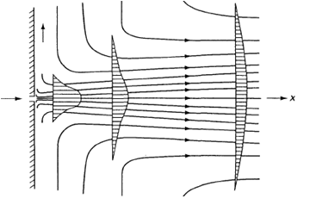
Problem1
r
Wall
Pressure
outlet
Inlet velocity
Axial symmetric
Interior

Slide 3

Problem1 -Jet Characteristics
Physical Characteristics
Numerical Characteristics
  Determination of the mesh size:
Assume only primary breakup, the critical liquid Weber number is less than 10, then Δx < 0.89 μm (mercury)
Diameter (D) | Velocity | Turbulent Intensity | Length Scale
0.0102108 m | 20 m/s | u‘/U = 0.05 | 0.1D
Phase | Density | Viscosity | Surface Tension
Air | 1.225 | 1.460735 m²/s
Mercury | 13456 kg/m³ | 1.1147×10⁻⁷ m²/s | 0.4855 N/m
$$We≡\frac{ρu^{2}l}{σ}$$

Slide 4
Results __ t = 0.15ms

Slide 5
Results __ t = 0.35ms

Slide 6
Results __ t = 0.6ms

Slide 7
Results __ t = 0.8ms

