Slide 1
Results of 2D Hg Jet Simulation and Experimental Data
Yan
April 10th 2014

Slide 2
Problem Description
Viewport 1: 30cm away from
nozzle exit;
Viewport 2: 45cm away from
nozzle exit;
Viewport 3: 60cm away from
nozzle exit;
Viewport 4: 90cm away from
nozzle exit;
Sketch of the mercury free jet with MHD and energy deposition for the MERIT experiment

Slide 3
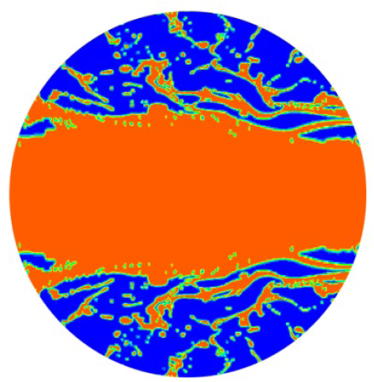
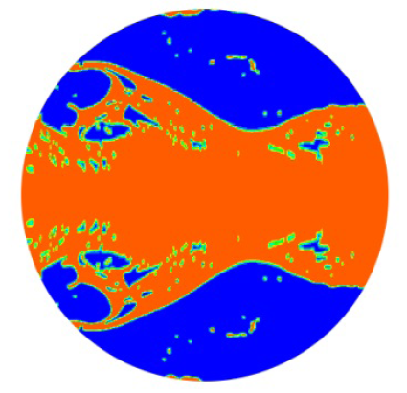
Simulation Results (t = 0.037s)
Simplified Model For Preliminary Simulation
Grid number for halved model is 1,976,968 (width = 172, length = 11,494, Δx ≈ 4.437e-5 m).
One flow-through = 0.0255 s.
Viewport1
z = 30
Viewport2
z = 45
Notes:
http://geolab.larc.nasa.gov/APPS/YPlus/#REN
Operating pressure: (-1.341121, -0.1231579)
x=-0.07112101
y=-0.07367868~ -0.0634679 (center:-0.06857329)
d=0.0102108 m, u=20 m/s:
Re=13546*20*0.0102108/0.001526=1812785.017
X=0
Y=-0.0267208~ -0.01651 (center:-0.0216154)
dX=-0.07112101
dY=-0.04695789

Slide 4
 | yan's simulation | Heejin's experiment
inlet velocity | bulk velocity of 20m/s | bulk velocity of 20m/s
mercury properties | density:13529 kg/m^3 | density:13456 kg/m^3
 | kinematic viscosity:1.12573e-7 m^2/s | kinematic viscosity:1.145e-7 m^2/s
 | surface tension: 0.4855 N/m°C | surface tension: 0.4855 N/m°C
Reynolds number at the jet exit | 1.776625e6 | 1.746725e6
transverse depth of the layer | computation domain with a reduced depth which is 0.02 m | 0.1524 m
location of viewport 1 | 0.3 m away from the nozzle | 0.3 m away from the nozzle
location of viewport 2 | 0.45 m away from the nozzle | 0.45 m away from the nozzle

Slide 5
Experiment Results (20 m/s)
Viewport 1

Slide 6
Experiment Results (20 m/s)
Viewport 1

Slide 7
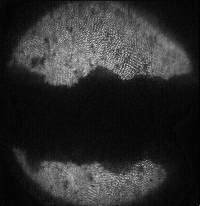
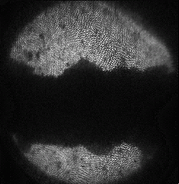
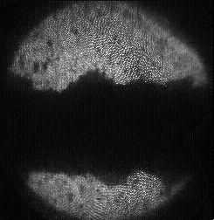
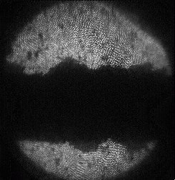
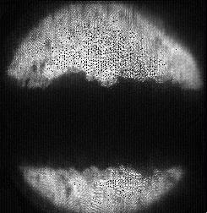
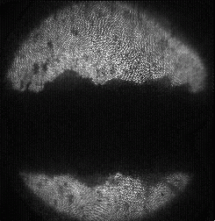
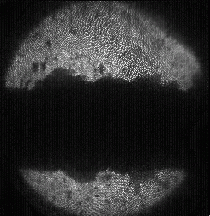
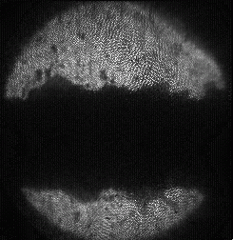
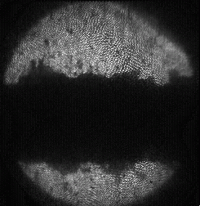
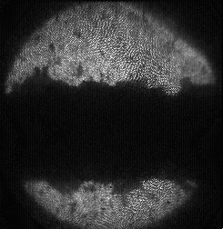
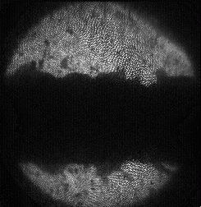
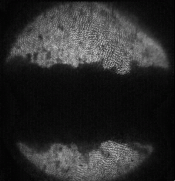
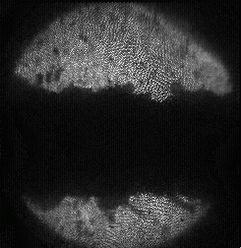
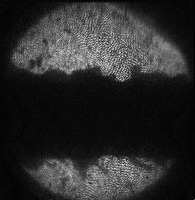
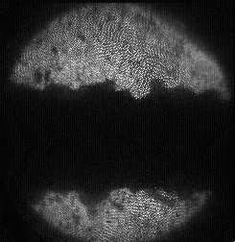
Experiment Results (20 m/s)
Viewport 2

Slide 8
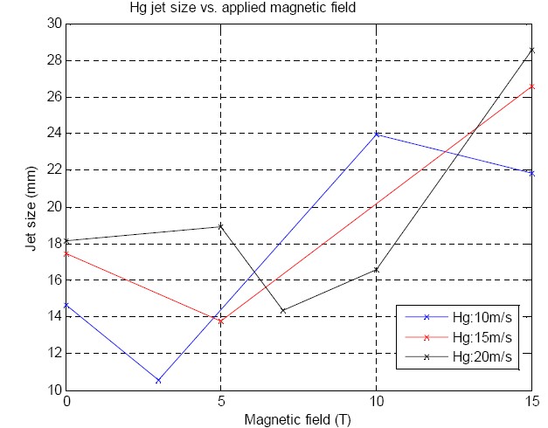
Jet Size At Viewport 2
Heejin Park, Optical Diagnostics, Experiment at MIT, March2~March3,2007
When T = 0, jet size at viewport2 is 18.2mm (Hg:20m/s) and 17.3mm (Hg:15m/s)

Slide 9
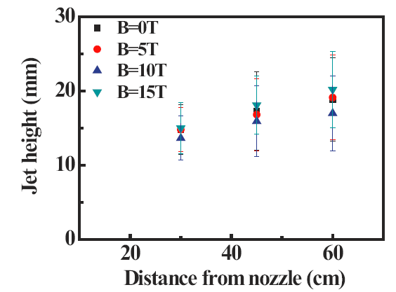
Jet Size For 15 m/s Hg Jet
Hg:15m/s
 | 0T | error | 5T | error | 10T | error | 15T | error
30 (vp 1) | 14.83464 | 3.34655 | 14.79571 | 2.99139 | 13.64166 | 2.9666 | 15.00912 | 3.39786
45 (vp 2) | 17.29619 | 5.29605 | 16.79944 | 4.83743 | 15.90382 | 4.7509 | 18.10419 | 3.91201
60 (vp 3) | 18.83415 | 5.61034 | 19.11242 | 5.68621 | 16.99188 | 5.01408 | 20.18525 | 5.10874

Slide 10
Discussion
Mercury jet reaches the wall
Size of viewport is 5cm according to Heejin
Jet Size is more than 2cm when velocity is 20 m/s
Need larger width for the computational domain

