Slide 1
3 Dimensional Hg Jet Simulation Using Implicit LES Method
Yan Zhan
May 2nd 2014

Slide 2
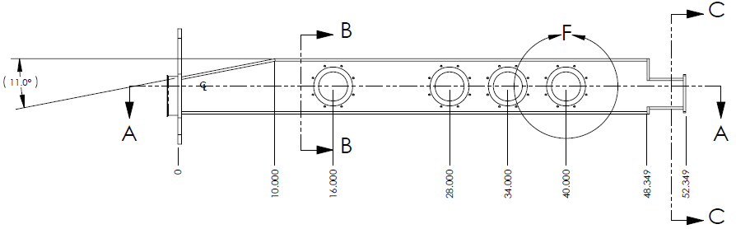
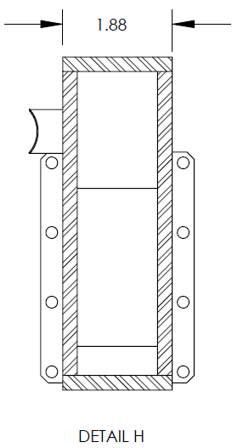
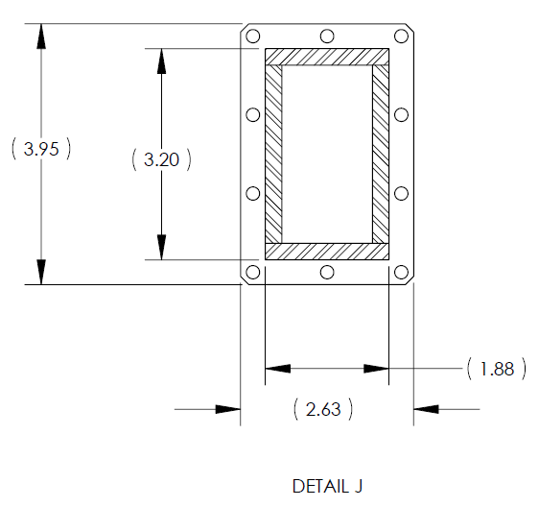
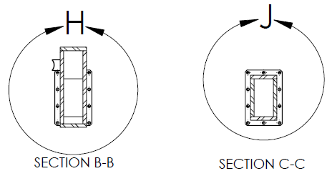
Schematics of Target System_ V GRAVES
(5.2)
Plate thickness: 0.25”

Slide 3
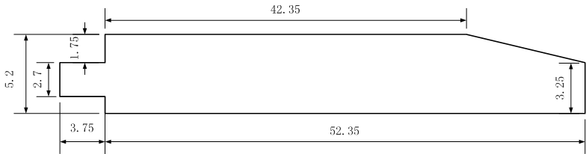
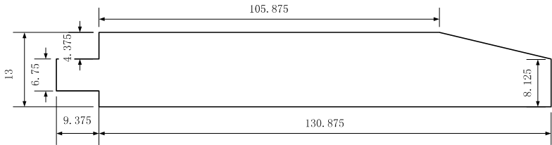
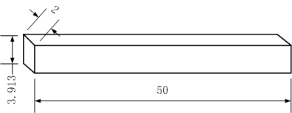
Simplification Of The 3D Hg Jet
dimensional model
(unit: inch)
Thickness normal to page = 1.375”
Nozzle diameter = 1 cm
Non-dimensional model
(normalized by D_{jet exit} )
Simplified model

Slide 4
Boundary Conditions
Wall
Velocity Inlet
Pressure Outlet
symmetry
X axis is in the short (2 unit) direction
Y axis is in the long (3.9 unit) direction
Z axis is in the very long (50 unit direction = direction of jet
No gravity in the model.

Slide 5
Axial Velocity Contour At The Jet Inlet
(without weld bead)
u = U + sqrt(2k/3), where k = ½( (u’)^2+(v’)^2+(w’)^2 )
The x and y axes on this slide are rotated by 90 deg compared to those on slide 4.
pipe simulation

